Slide 1
Welcome to the experiment!
Please see the note in the study information about how to test whether this task will work on your computer. If you have not yet tested this, please return the task and test whether the task will work at this link: foragetask.firebaseapp.com/forage_task_test . If the character moves forward, the task will work. Then return here to complete this study. Otherwise please return the task.
This experiment will require you to press buttons on your keyboard repeatedly, sometimes with your pinky, applying varying amounts of physical effort. If you have any history of any sort of hand injury or pain with typing (e.g. which could make either fast button pressing or stretching your hand uncomfortable) please do not complete this task.
Thank you for participating. For your completion of the task, you will receive at least £3.75 with a potential bonus between 0 and £2.50
Please read the instructions carefully. You will need to pass a quiz before starting the task.
In this experiment, you will play a game in which you will act as a knight that must travel between different trees in order to collect points. You will play 2 rounds of the game in total, each lasting about 9 minutes.
In each round, your goal will be to collect as many points as you can. Your bonus will be based on the average number of points you collect across the two rounds.
Specifically, each 20,000 points in this average will correspond to about 1 GBP of bonus.

Slide 2
We’ll now explain how a round works. In order to travel to a new tree, each round will have a key you must press repeatedly (the ‘TRAVEL key’), as well as a set of other keys you must persistently hold down (the ‘hold-down keys’), in order to move rightward on the screen.
Additionally, there will be a different key (the ‘HARVEST key’) that you must press repeatedly in order to collect points when you are at a tree.
Prior to each round, you will be informed of the travel keys and the harvest key for that round.

Slide 3
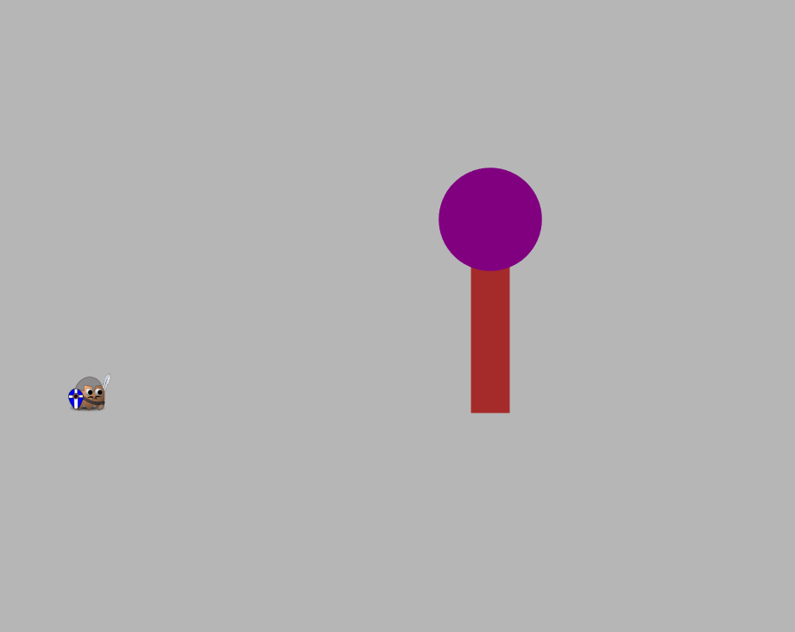
Each round will start with you on the left side of the screen and a tree some distance ahead of you.
In order to travel toward the tree, you will need to repeatedly press the travel key (pressing up and down repeatedly), while steadily holding down the hold-down keys. Which key you must press and which keys you must keep down will be constant through out a round. Additionally, text on the bottom of the screen will always tell you which keys must be pressed and which must held down to travel.
When you successfully are pressing down the hold-down keys, you will see a floor appear below your character in orange.
You will need to press the travel key up and down repeatedly in order to move toward the tree. Pressing the travel key will only move you forward if the hold-down keys are also being pressed down (and the floor is visible). These keys should be pressed down once and then held down for the duration of multiple travel key presses.
The speed with which you travel to the tree will depend on how fast you repeatedly press the travel key while keeping the hold-down keys pressed down. Over the course of a round, pressing faster will get you more points and a higher bonus.
A Tree
You
Repeatedly pressing the travel key while holding down the hold-down keys will move you toward the tree.

Slide 4
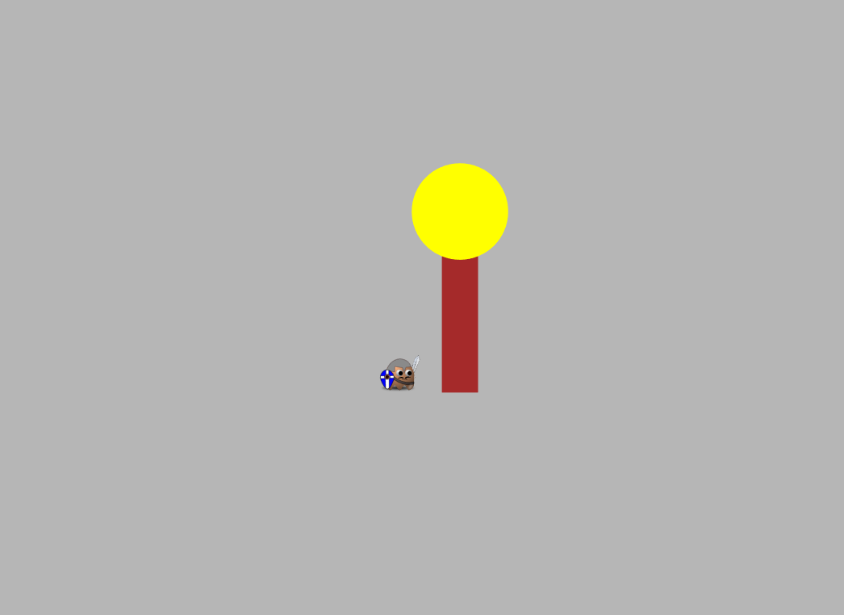
Once you reach the tree, its top will turn yellow.
You can then collect points at the tree by repeatedly pressing the HARVEST key (you will not need to steadily hold down any keys to harvest). This will cause points (represented as red numbers) to fall from the tree and be collected.
At first, the tree will give some number of points. However, as you press more, the tree will run out of points and will give fewer and fewer with each press.
The speed with which points fall from the tree will be determined by how fast you repeatedly press the HARVEST key.
The tree’s top will turn yellow when you reach it.
Repeatedly entering the harvest key when you’re at a tree will cause points to fall.
The number of points will tend to decrease with each press.
85
90
100

Slide 5
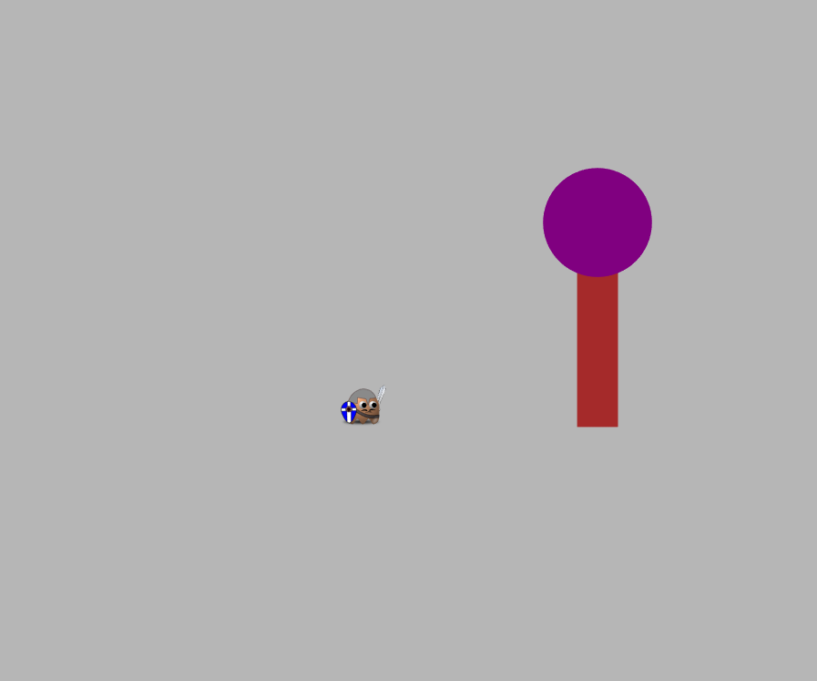
While at a tree, at any point in time, you can choose to leave the tree and head to a new tree by entering the TRAVEL key.
When you do this the current tree will disappear and a new tree will appear, some distance in front of you.
You will then repeat the process of traveling to this new tree by pressing down the hold-down keys and repeatedly pressing up and down the travel-key.
When you harvest from a new tree, its points will at first be high, but will gradually decrease with more presses.
This process of traveling to a tree and then harvesting from it until you leave will continue for the entire round.
After entering the TRAVEL sequence, a new tree will appear, to which you can travel.

Slide 6
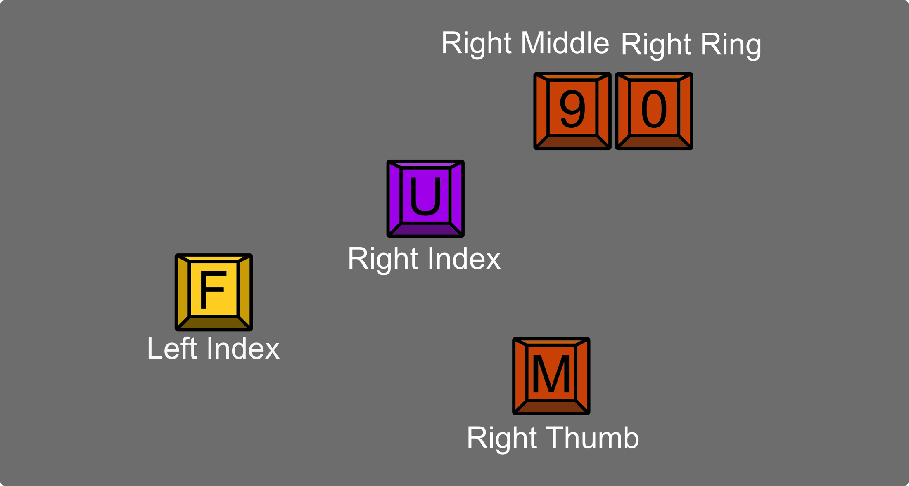
Across the whole task, there are two sets of travel and hold-down keys you might be asked to use to travel.
Prior to each round, you’ll be told which travel keys to use for that round. Additionally, you will be able to see what the travel and hold-down keys are by looking at the bottom of the screen. You will also be instructed which fingers you should use. It is very important that you use those particular fingers to press those particular keys.
Let’s try a short practice round, which will last 1 minute. For this round, in order to travel, you will need to repeatedly press the ‘F’ key (left index), while keeping the following keys held-down (see photo on right): ‘9’ (with right middle) ‘0’ (with right ring), ‘M’ (with right thumb).
To HARVEST you will press ‘U’ (right index). To collect points when you are at a tree, you will need to press this repeatedly. You will not need to hold down any keys while you press this.
When you are ready to begin, press NEXT.
Picture of keys used for this practice round. For traveling, hold down orange keys and repeatedly press yellow key. To harvest, repeatedly press the purple key.

Slide 7
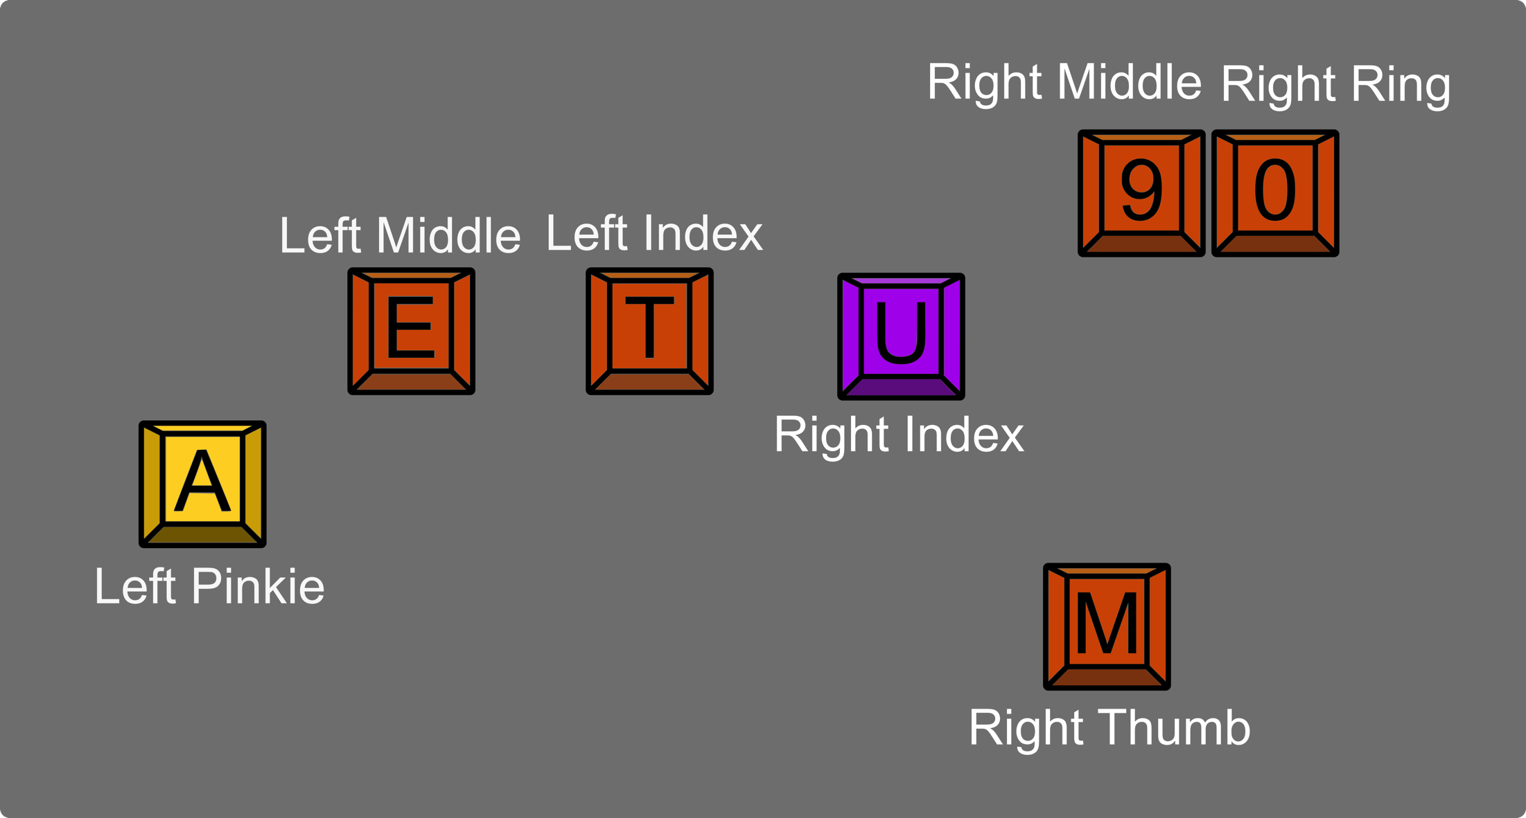
Let’s practice another round now with the other set of travel key and hold-down keys that will be used in the task. Again, as in the task, these will be presented on the bottom of the screen.
For this round, in order to travel, you will need to repeatedly press the ‘A’ key (left pinky), while keeping the following keys held-down: ‘E’ (left middle) ‘T’ (left index), ‘9’ (right middle), ‘0’ (right ring), ‘M’ (right thumb).
To HARVEST you will again press ‘U’ (right index). To collect points when you are at a tree, you will need to press this repeatedly. You will not need to hold down any other keys.
When you are ready to begin, press NEXT.
Picture of keys used for this practice round. For traveling, hold down orange keys and repeatedly press yellow key. To harvest, repeatedly press the purple key.

Slide 8
You will complete 2 rounds of the task. In one round, you will need to use the first set of keys you practiced with (top right). In the other round, you will need to use the second set of keys (bottom right). Take a moment to memorize these key positions. At all times during the task, which keys you need to use will be printed on the bottom of the screen.
During a round, at any given point in time, the environment might change between multiple settings. When settings change, how rewarding the trees are (the number of points that they start with), on average, will change. You will be shown with text on the screen when the environment changes. Depending on environment setting, trees, for a set of time, will start with providing anywhere between 50 points and 130 points.
Remember, your bonus depends on the average number of points you collect across all the rounds. Every round matters for your bonus. You will have more opportunity to affect your bonus (by collecting more points) bonus when the environment is in a high-point setting compared to a low-point setting.
One possible key setting. To travel in this type of environment, hold down the orange keys, and repeatedly tap the yellow key.
Another possible key setting. To travel in this type of environment, hold down the orange keys, and repeatedly tap the yellow key.

Slide 9
Each of the two rounds in the task will last about 9 minutes.
The total number of points that you collect in a round will be affected both by how quickly you decide to press the keys (pressing faster will let you visit more trees and thus will earn you more points), as well as how long you decide to harvest from a tree as its points decrease.
After each round, you will be shown how many points you earned in that round, as an indicator of how you are doing.
Before you begin, you will need to pass a quiz on the instructions.
Either answering a question wrong, or answering ‘I don’t know’, will require you to re-read the instructions. However, you will not need to re-do the practice round.
Press NEXT to begin the quiz.

