Slide 1
Handwritten Digits Recognizer
IT GROUP 2
https://github.com/evans-work/Handwritten-Digit-Recognizer.git

Slide 2
Introduction
The project creates a model that Identifies handwritten digit in 28X28 Images.
The project uses a script written in python.
Dependencies:
TensorFlow - To create the Neural network that detects the digit.
Matplotlib – To plot the image in a window after detection
Numpy – Converting image into Array as required for the model
Python-opencv – To read the images

Slide 3
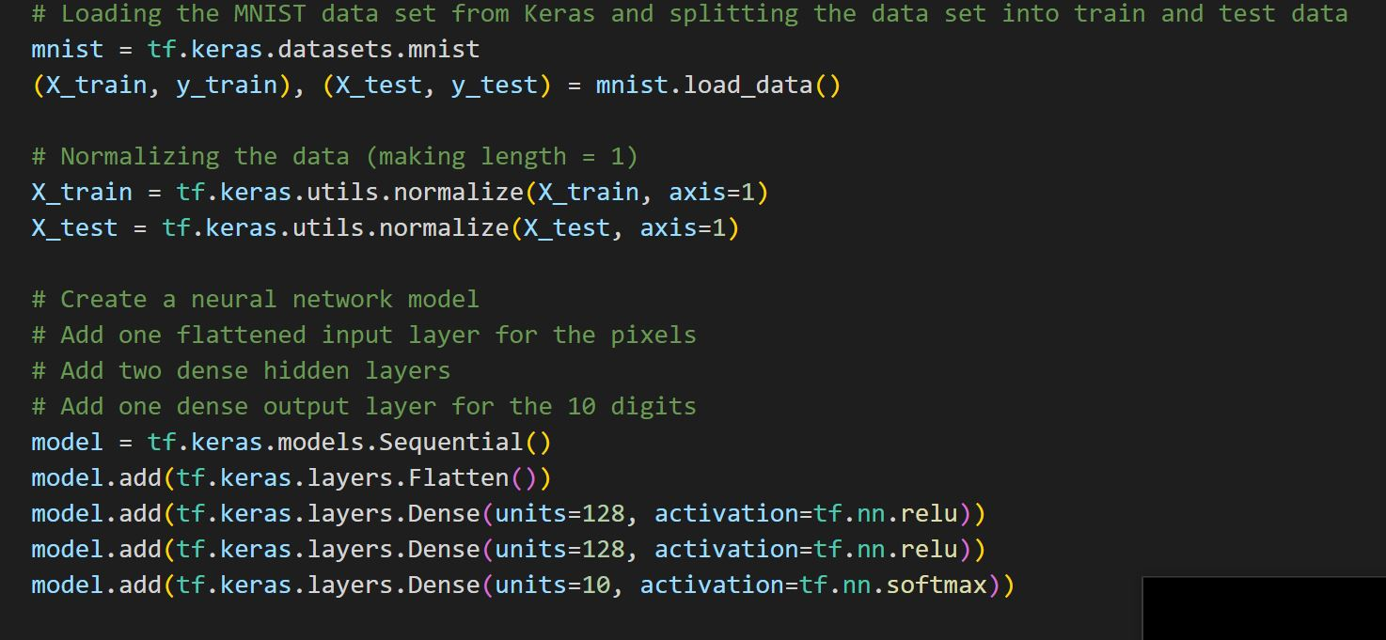
How It Works: Creating and Training a Model
Get Mnist Dataset from tensorflow.keras.
Normalize data or scale it in the range [0,1]
Divide data int train and test data
Create a model
Create layers

Slide 4
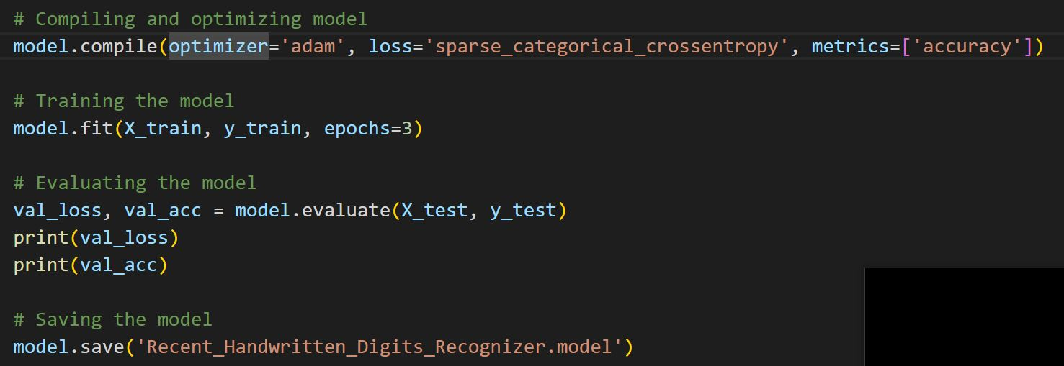
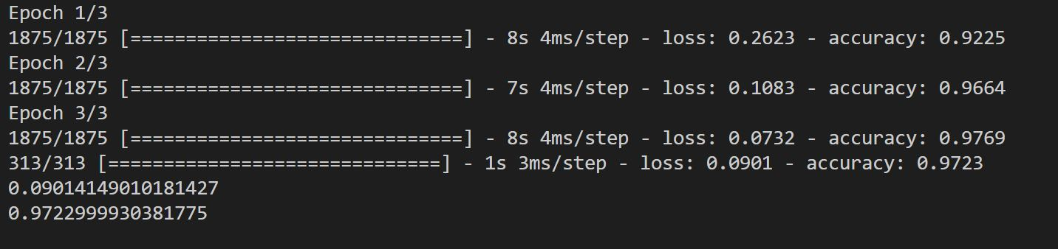
How It Works: Testing and Verifying the model
Compile and optimize the model
Train the model using the training data
Evaluate the model by testing using the test data
Save the model for later use

Slide 5
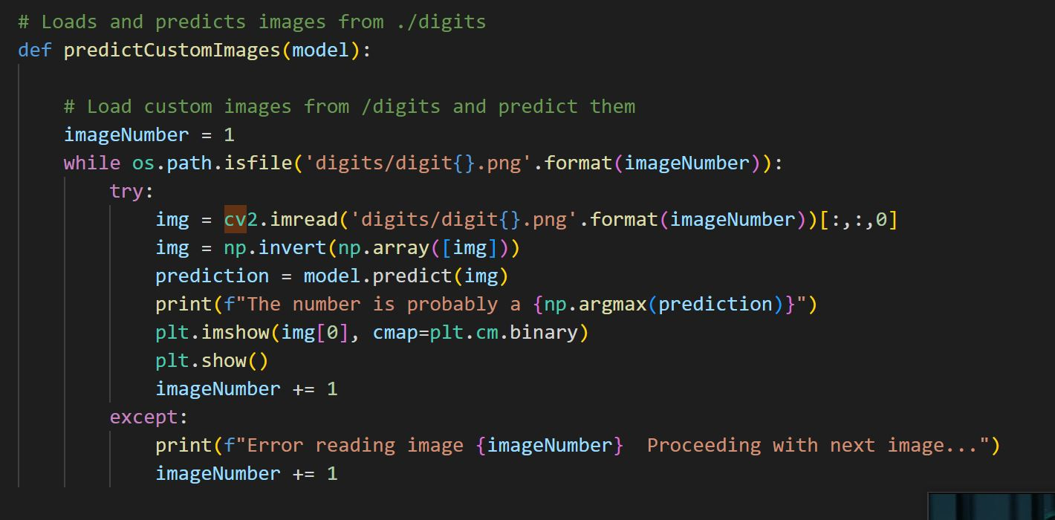
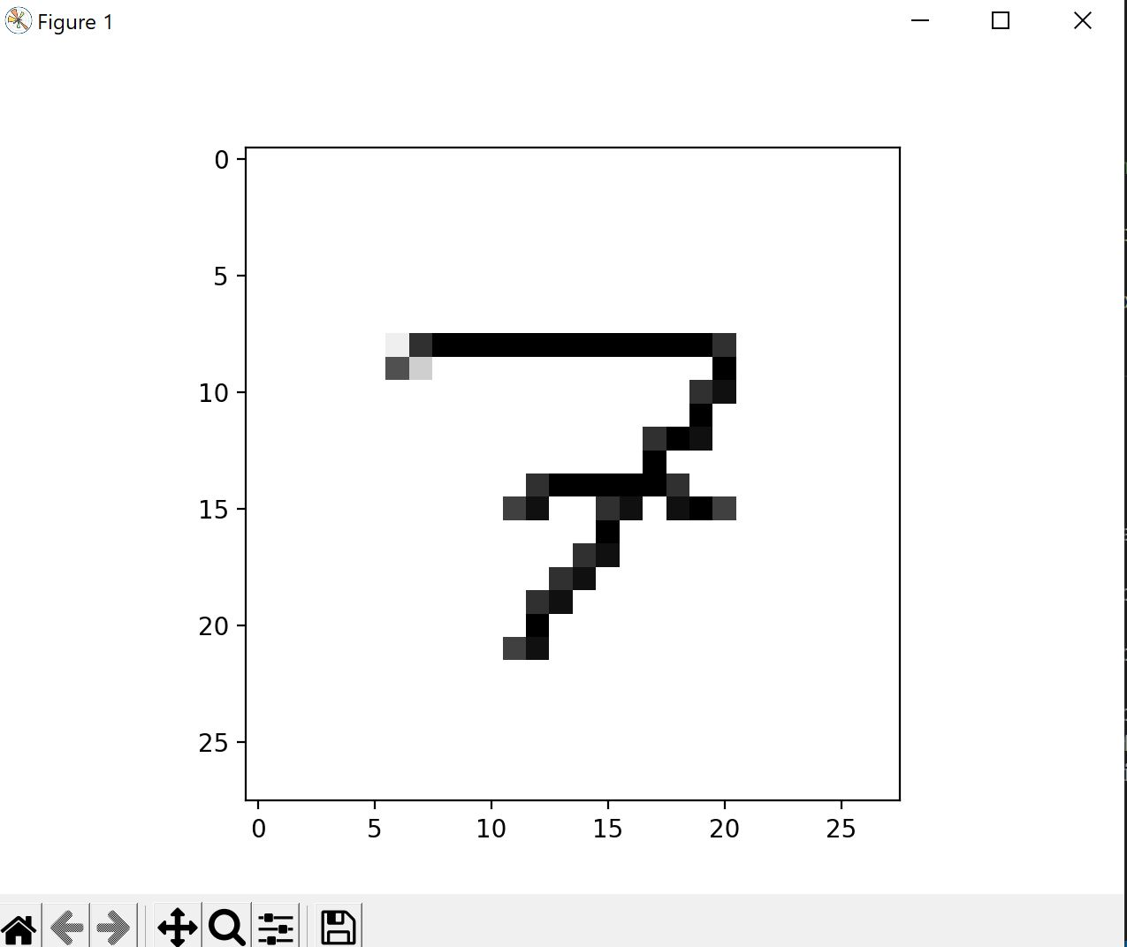
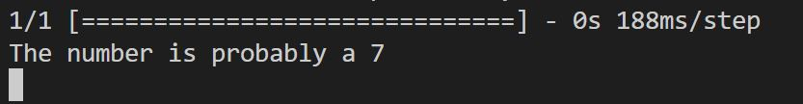
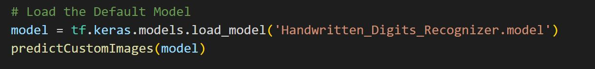
How It Works: Running the Model
Loads a previously created model
Loads images from a folder
Predicts the digits in the images

Slide 6
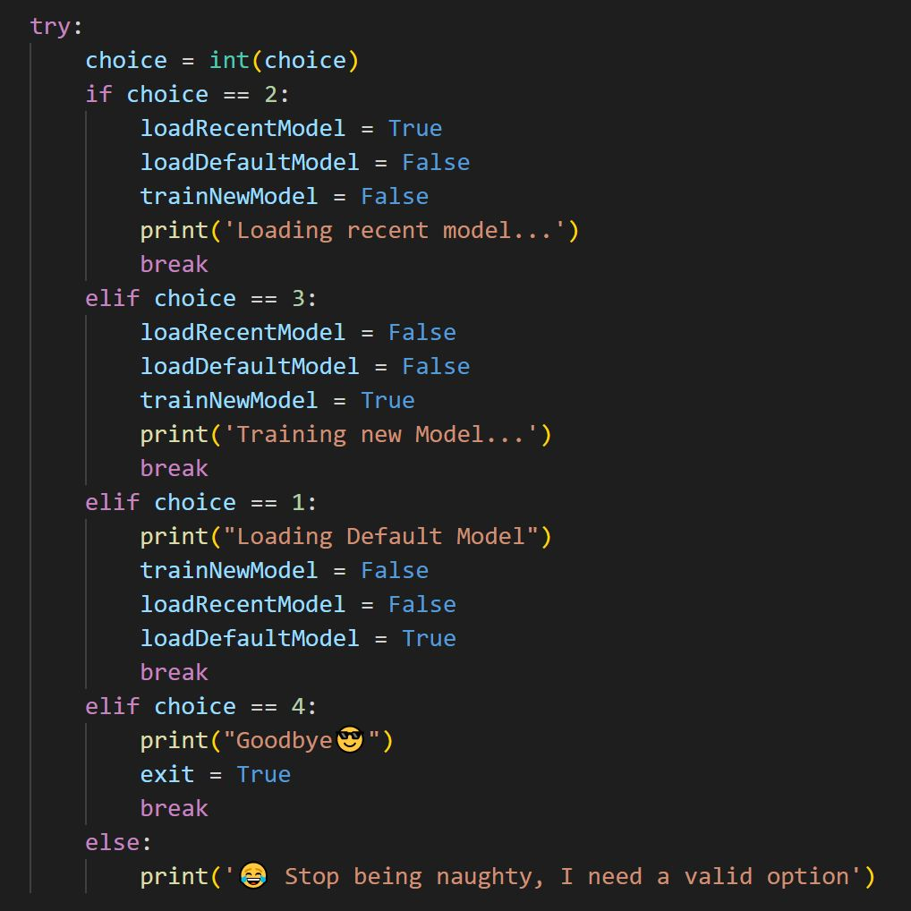
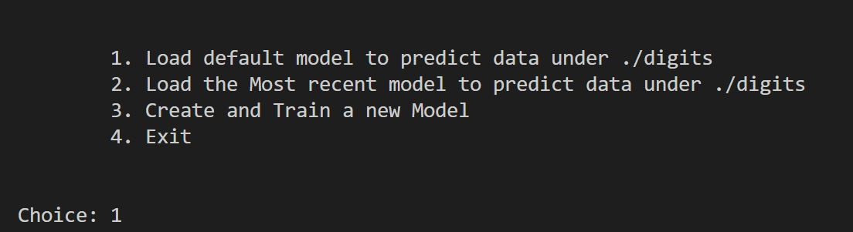
Process
Run the script, which gives 3 options:
Load a default model
Load the most recently created model
Train a new model
Exit the script.

Slide 7
Process
Run the script, which gives 3 options:
Load a default model
Load the most recently created model
Train a new model
Exit the script.

Slide 8
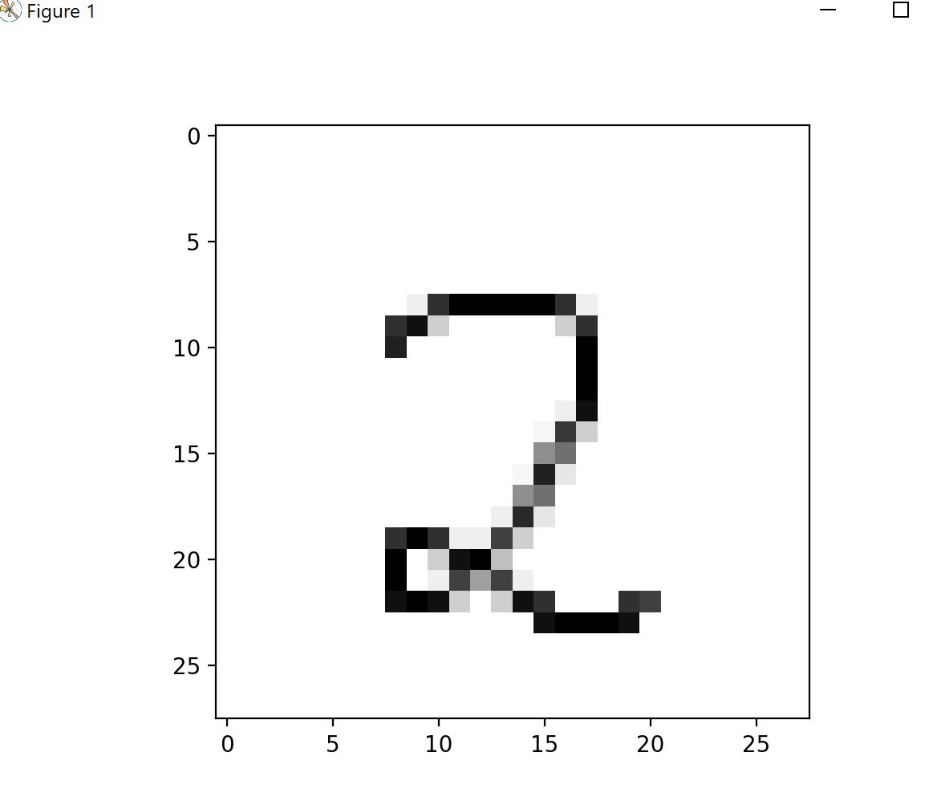
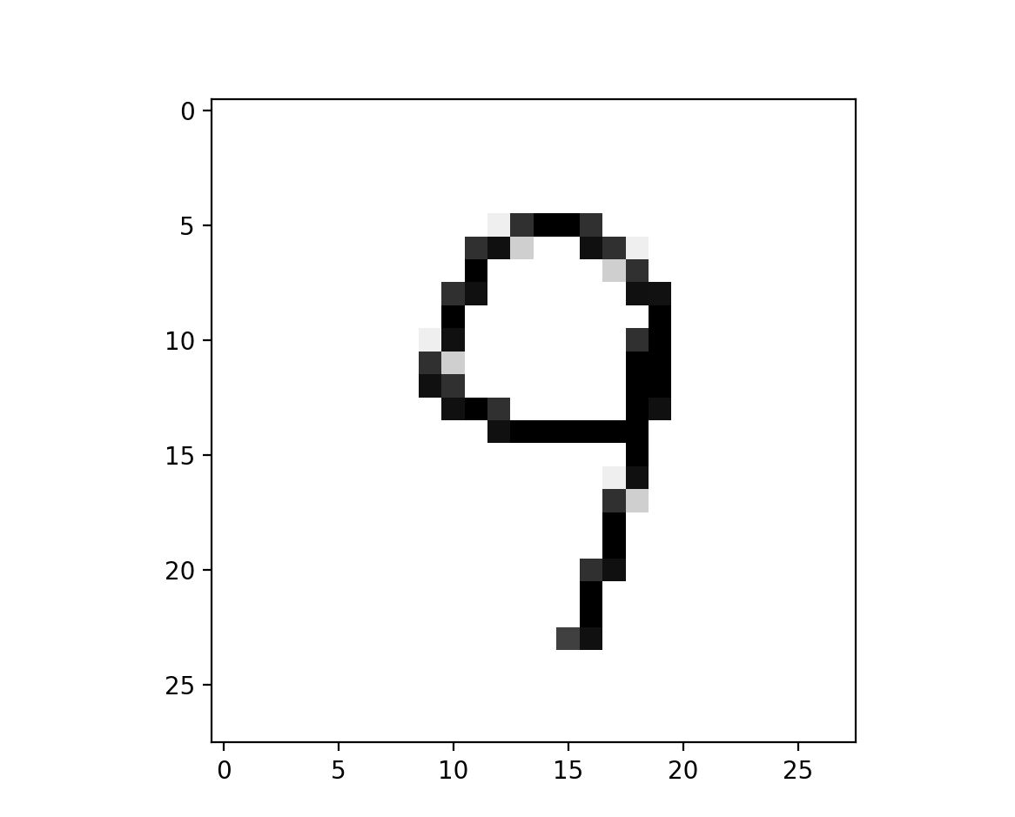
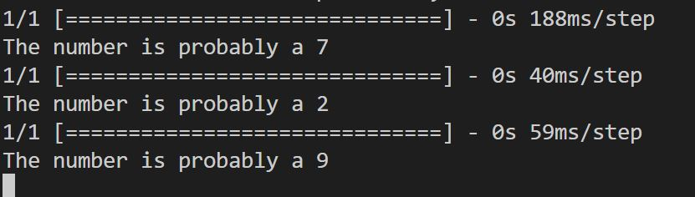
How It Works: Running the Model
Running a Model loads the images to be predicted from the ./digits folder
For each image, it prints the image using matplotlib and prints a prediction on the terminal.

