Slide 1


Kapasa Makasa University
Rural Land Use Planning
Methodology
Integrated Approaches for Sustainable Resource Management
B.Mutale

Slide 2

Part I: Context
Understanding Zambia's Land Landscape

Slide 3


THE ZAMBIAN LAND CONTEXT
Customary Land
State Land
Covers roughly 60-90% of Zambia. Managed by Traditional Authorities (Chiefs and Headmen). Rights are often undocumented but recognized by the 1995 Lands Act.
Managed by the Ministry of Lands. Primarily urban areas and former commercial blocks. Rights held under statutory leaseholds (typically 99 years).
Key Challenge
Integration Need
Overlapping jurisdictions between state laws and traditional norms often lead to land use conflicts and tenure insecurity.
Planning must balanceengagement with customary authorities alongside state administrative boundaries (Wards/Districts).

Slide 4






PRIMARY OBJECTIVES OF LUP
Documentation
Strategic Guide
Conflict Mitigation
Establish current status of land use and management regimes.
Create a roadmap for internal and external investments.
Resolve tensions between competing resource users.

Slide 5

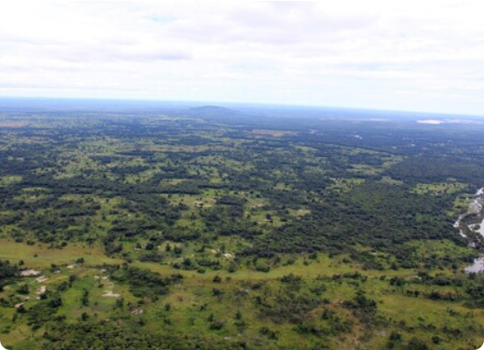
USAID TGCC METHODOLOGY
Since 2014, the TGCC program has supported customary land documentation in Petauke and Chipata Districts.
Over 700 communities documented.
12,000+ land parcels certified.
Focused on Chiefdom-level planning.
This methodology is "bottom-up," starting with village-level information to inform higher-level Chiefdom Development Plans.

Slide 6
Step 1: Legal Framework
Clarifying the Regulatory Environment

Slide 7
LEGAL PILLARS OF PLANNING
Urban and Regional Planning Act (2015): Creates government responsibilities on customary land.
Forest Act (2015): Governance of community forests and protection areas.
Wildlife Act (2015): Management of Game Management Areas (GMAs).
Mines and Minerals Act (2015): Rights that often override customary land claims.
Chiefs Act (1964): Defines roles of traditional authorities in administration.

Slide 8
Step 2: Area & Goals
Defining Boundaries and Vision

Slide 9

DEFINING THE PLANNING AREA
Chiefdom Focus
Digitization
Standard unit of planning. Boundaries are often based on 1958 historical maps, which may require validation.
Collecting village center locations via GPS to draw representative boundaries where official shapefiles are missing.
Neighbor Coordination
Scope Clarification
Essential to inform bordering wards and Chiefdoms to avoid periphery conflicts during planning.
Deciding if planning includes state land enclaves or just the core customary areas.

Slide 10
GOAL SETTING & VISION
Identify Problems: e.g., conflict between pastoralists and cultivators.
Identify Opportunities: e.g., unused irrigation potential or tourism.
Identify Constraints: Legal, financial, or institutional limitations.
Set Planning Period: Typically a 3 to 5-year outlook with phases.

Slide 11
Step 3: Conditions
Resource and Infrastructure Inventory

Slide 12
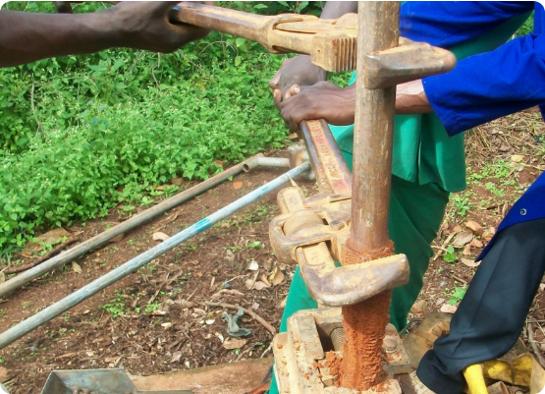
INFRASTRUCTURE MAPPING
Point vs. Shape Data
Information is collected to identify service delivery gaps.
Water: Boreholes and seasonal streams.
Education: School locations and catchments.
Transport: Bridges, culverts, and road status.

Slide 13
STAKEHOLDER ANALYSIS
Category | Interests | Role in Planning
Local Communities | Food security, tenure, resources | Primary beneficiaries and data sources
Traditional Leaders | Governance, land allocation | Decision-makers and enforcers
District Council | Service delivery, statutory law | Regulatory oversight and alignment
Private Sector | Agribusiness, mining, tourism | Potential investors and partners

Slide 14
Step 4: Challenges
Analyzing Barriers and Opportunities

Slide 15
PROBLEM STATEMENTS
Mining Expansion
Settler Pressure
Challenge: Mines entering GMAs or agricultural zones without local consultation.
Challenge: Rapid in-migration (e.g., from Katete to Sandwe) causing land scarcity.
Resource Depletion
Boundary Disputes
Challenge: Unregulated charcoal burning reducing forest cover and soil quality.
Challenge: Overlapping village claims leading to social unrest and stalled investment.

Slide 16
OPPORTUNITIES FOR CHANGE
New Technology: Improved fertilizers, irrigation, or storage methods.
Human Capital: Local labor, skills, and traditional resource knowledge.
Economic Shifts: New markets for crops or carbon credit opportunities.
Policy Reform: Leveraging the Lands Act to secure communal rights.

Slide 17
Step 5: Appraisal
Evaluating and Choosing Alternatives

Slide 18
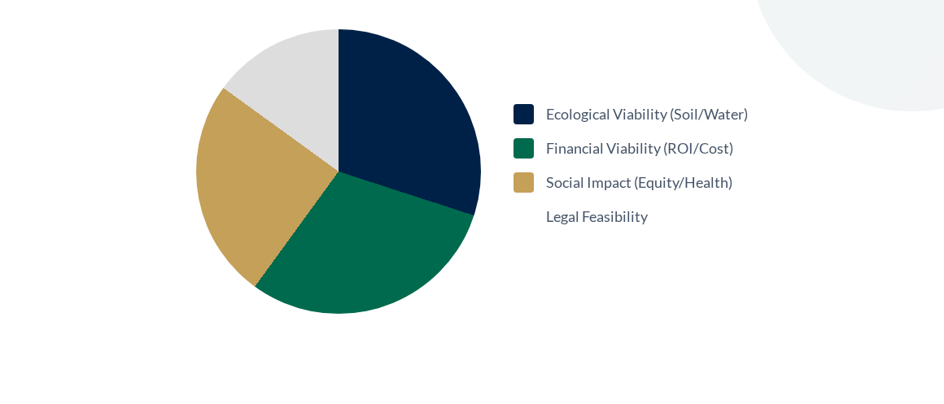
APPRAISAL CRITERIA
Zoning decisions must balance these four pillars to ensure sustainability.

Slide 19
Step 6: Plan Prep
Zoning and Finalizing the Document

Slide 20
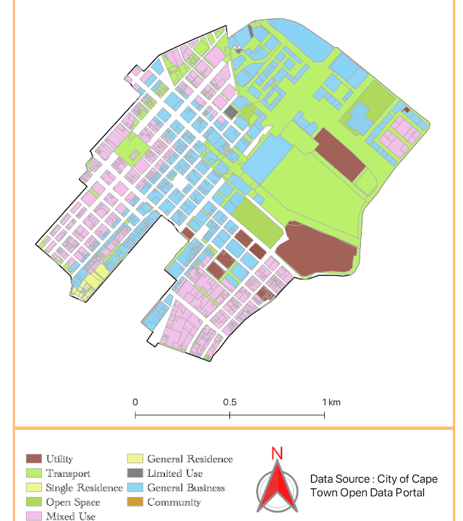
ZONING STRATEGY
Standard Rural Zones
Allocating land based on highest potential and community preference:
Settlement & Public Inst.
Current & Future Cultivation
Community Forests
Game Ranches & Tourism
Mining Concessions

Slide 21
THE PLANNING WORKFLOW
Mobilize
Assess
Consult
Prepare
Finalize
Community consent and introduction.
Data collection and mapping.
Develop options with stakeholders.
Zoning and drafting narratives.
Consensus and approvals.

Slide 22
Step 7: Realization
Implementation, Monitoring, and Revision

Slide 23
GOVERNANCE & ENFORCEMENT
Institutional Support
Public Relations
Formation of independent units to track progress and budget allocation.
Two-way communication: not just "explaining" but "exchanging" ideas with users.
Enforcement
Revision (3-5 Years)
Village-level penalties and social pressure to maintain zoning rules.
Regular updates to ensure the plan remains responsive to new data.

Slide 24
Cross-Cutting Issues
Conflict and Technology

Slide 25
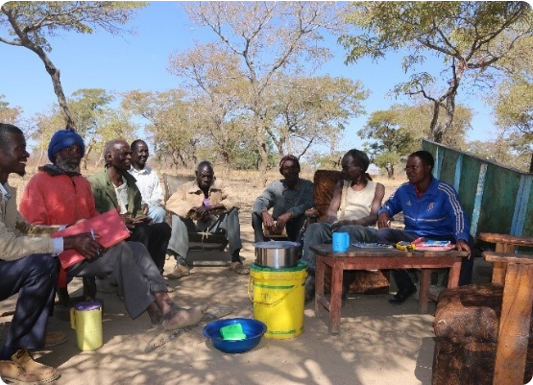
CONFLICT MITIGATION
Common Conflict Drivers
Dry season field prep, cattle damage to crops, and inheritance disputes.
Resolution Strategies
Detailed Investigation of history.
Multi-stakeholder separate/joint meetings.
Training on legal rights (Lands Act).

Slide 26

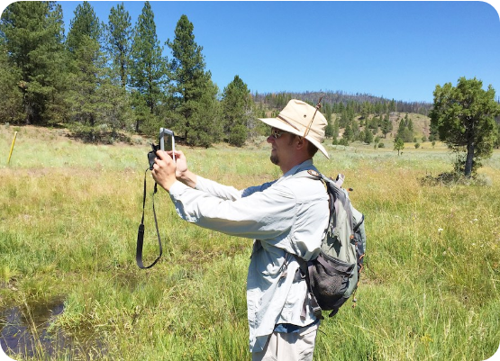
GEOSPATIAL TOOLS (MAST)
Mobile Applications (MAST)
Mobile tools allow for rapid, "crowdsourced" collection of boundary and infrastructure points.
Data is stored in cloud servers for immediate analysis by GIS specialists, ensuring high accuracy (3-5m error margin).

Slide 27
CHALLENGES TO IMPLEMENTATION
Capacity: Limited financial and human resources at the local level.
Ambiguity: Overlapping roles between District Councils and Traditional Chiefs.
Crisis Management: Moving from "emergency" reactions to "proactive" planning.
Control: Limited ability to enforce rules on outside mining/commercial actors.

Slide 28

Thank You!
Time for Questions and Academic Discussion
"Land is our Heritage, Planning is our Future"

