Slide 1
Tools for Land Use Mapping
1.Geographic Information Systems (GIS)
Digital mapping technology used for creating, managing, and analyzing spatial data.
Enables spatial analysis, such as overlaying layers of data to identify patterns and relationships.
Commonly used for urban planning, environmental management, and resource allocation.

Slide 2
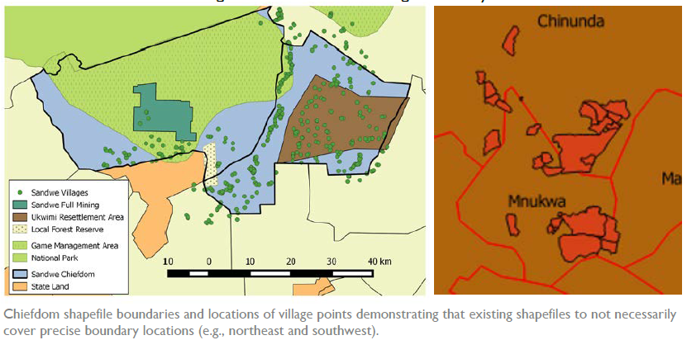

Slide 3
2.Remote Sensing
Utilizes satellite or aerial imagery to classify and monitor land use and land cover.
Provides large-scale, up-to-date information on land changes over time.
Useful for tracking deforestation, urban expansion, and agricultural practices.

Slide 4
3.Field Surveys
Involves collecting ground-level data to validate and supplement remote sensing or GIS data.
Includes measurements, observations, and interviews with local stakeholders.
Ensures accuracy and reliability of land use maps.

Slide 5
4.Participatory Mapping
Engages local communities in the mapping process to incorporate their knowledge and perspectives.
Promotes inclusive land use planning and decision-making.
Often used in community-based resource management and conflict resolution.

Slide 6
Land Use Maps
1.Base Maps
Provide foundational information such as topography, infrastructure (roads, buildings), and administrative boundaries.
Serve as a reference layer for other types of land use maps.

Slide 7
2.Zoning Maps
Show designated land use areas based on urban or regional planning policies.
Categories may include residential, commercial, industrial, agricultural, and conservation zones.
Used to regulate land development and ensure compliance with planning regulations.

Slide 8
3.Thematic Maps
Focus on specific themes or attributes, such as land cover (forests, water bodies), soil types, or environmental factors (biodiversity, climate).
Help in analyzing spatial patterns and making informed decisions about land management.

Slide 9
4.Risk Maps
Identify areas vulnerable to natural disasters (floods, earthquakes), erosion, or pollution.
Used for disaster preparedness, mitigation, and land use planning to reduce risks.
Often incorporate data on historical events, environmental conditions, and human activities.

