Slide 1


Kapasa Makasa University
Agriculture & Forestry Governance in Zambia
B.Mutale
Department of Agriculture and Aquatic Sciences

Slide 2

The Dynamics of Land Regulation
Introduction to Statutory Oversight and Conflict Reduction

Slide 3

Competing Land Uses in Zambia
Key Drivers of Competition
Intensive Agricultural Expansion
"Land use planning is legally governed, not discretionary. It ensures sustainability and conflict reduction through structured frameworks."
Biodiversity and Forest Preservation
Urban and Peri-Urban Settlement Growth
Infrastructure and Resource Extraction

Slide 4





Learning Objectives
Legal Provisions
Governance
GIS Application
Detail the mechanisms of the Agricultural Lands Act and Forests Act.
Identify institutional roles and administrative structures in land oversight.
Analyze how spatial data supports legal compliance in planning.

Slide 5
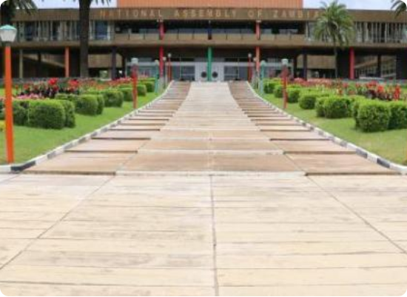
Agricultural Lands Act Cap 187
Enacted in 1960: Part of major land administration reforms.
Post-Colonial Needs: Addressed the transition of land settlement schemes.
Structural Order: Designed to provide a regulated agricultural development path.

Slide 6



Purpose of the Act (Cap 187)
Prevent Speculation
Efficient Production
Tenure Security
Ensuring land is not held for purely financial gain without active production.
Promoting structured agricultural systems for national food security.
Establishing clear rules for leasing, allocation, and land rights.

Slide 7
Tenure Instruments Under the Act
Tenure Type | Nature of Interest | Typical Duration
State Lease | Time-bound land use right subject to conditions. | 30 Years
State Grant | Stronger ownership interest issued by the state. | Indefinite (subject to terms)
Tenancy Scheme | Small-scale or specialized production unit rights. | Variable

Slide 8

Key Legal Definitions
Agricultural Purposes
Holding
Legally includes the cultivation of crops, livestock raising, and dedicated grazing or stock raising activities.
Defined as an allocated unit specifically designated for agricultural production within a planned scheme.

Slide 9

Agricultural Lands Board
Composition
Chairperson: Appointed by the Minister (Non-Public Officer).
Public Sector: Three officials from relevant ministries.
Farmer Stakeholders: Reps from Zambia National Farmers Union (ZNFU).

Slide 10



Functions of the Board
Suitability
Advisory
Compliance
Evaluating land allocation requests based on agricultural potential.
Providing policy guidance to the Minister regarding land distribution.
Monitoring whether lessees meet mandated development targets.

Slide 11
The Land Alienation Process
President
Board Review
Allotment
Lease Issued
Holds ultimate authority over land.
Technical evaluation of the applicant.
Publication of farm boundaries.
Formal legal transfer of rights.

Slide 12
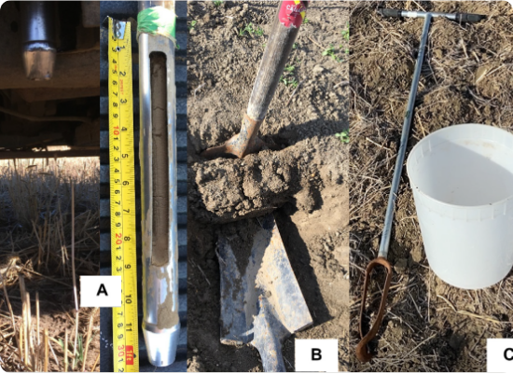
Planning Agricultural Schemes
Suitability Assessment: Analyzing soil, slope, and rainfall.
Economic Units: Designing farm sizes that ensure financial viability.
Infrastructure: Mapping roads, water access, and service centers.

Slide 13


Allotment Plans & Transparency
Boundaries
Conditions
Public Display
Precise mapping of farm parcel layouts and access points.
Specifying required land use and development milestones.
Ensuring transparency through Gazette notices and public inspection.

Slide 14
Key Lease Metrics
30
Standard Lease Duration
The Act provides a 30-year window to encourage long-term capital investment while allowing the state to periodically review land utilization and compliance.
Years of Tenure

Slide 15
Applicant Evaluation Criteria
Metric | Requirement
Financial Capacity | Proof of funds for farm development and operations.
Experience | Technical farming knowledge or prior agricultural success.
Integrity | Clear history of legal and commercial compliance.
Integrity | Evaluation of applicant capability to manage the specific holding.

Slide 16
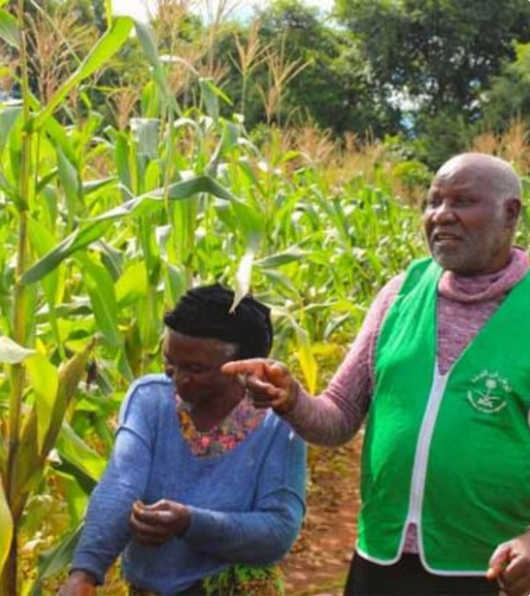
Beneficial Occupation
The "Use it or Lose it" Principle:
Active Use: Mandatory development of crops or livestock.
Infrastructure: Requirement to build dwellings, fences, or storage.
Residency: Often required for scheme-based allocations.

Slide 17
— Section 36, Agricultural Lands Act
"Idle land triggers revocation. The state reserves the right to re-enter any holding that is not productively occupied for the benefit of the nation."
— Section 36, Agricultural Lands Act

Slide 18

Sustainable Forest Management
The Forests Act No. 4 of 2015

Slide 19


Context of the 2015 Act
Degradation
Devolution
Climate
Response to increased charcoal demand and deforestation rates.
Stronger focus on community-led forestry management (CFM).
Integrating global standards for carbon stock management.

Slide 20
Ownership of Trees
100%
State Authority
Trees across all land categories (State, Customary, Private) are vested in the President. Permission is mandatory for felling, regardless of land tenure.
Vested in President

Slide 21
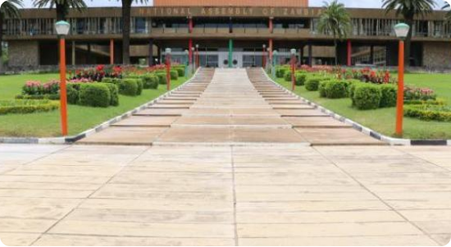

The Forestry Department
Core Responsibilities
Management of Protected Forest Reserves.
Conducting inspections and patrols.
Monitoring biodiversity and conservation.
The lead institution for enforcing protection and issuing harvesting licenses.

Slide 22

Statutory Forest Categories

Slide 23
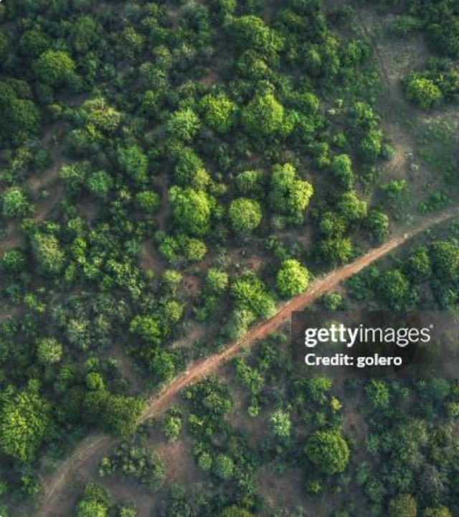
National Forests
Highest status of legal protection:
Conservation: Priority for biodiversity hotspots.
Water Catchments: Protecting vital river sources.
Access: Entry and activities strictly prohibited without permit.

Slide 24
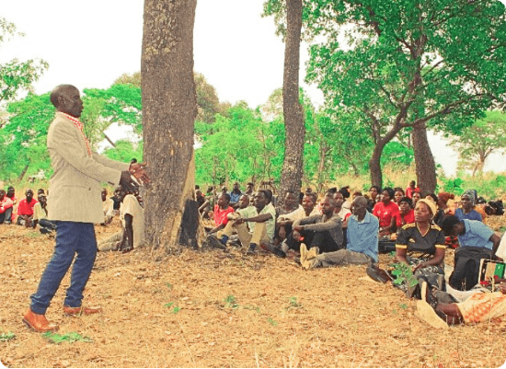
Community Forestry (CFM)
Registered Groups: Managed by recognized community forest groups.
Benefit-Sharing: Allowed use of forest resources for livelihoods.
Co-Management: Shared governance with the Forestry Department.

Slide 25
Other Forest Categories
Botanical Reserves
Private Forests
Local Forests
Strict zones for rare species and scientific research importance.
Registered for commercial timber or carbon credit production.
Protection of local ecosystems and community resource buffers.

Slide 26
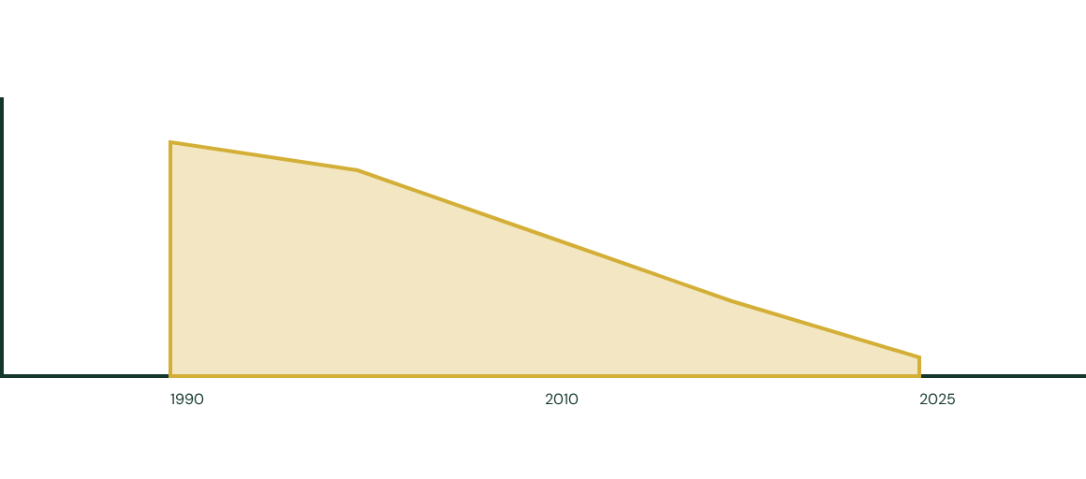
Deforestation Trends in Zambia
Forest Cover Loss Over Time (Illustrative Trend):
Drivers: Agricultural expansion, Charcoal production, and Settlement pressure.

Slide 27
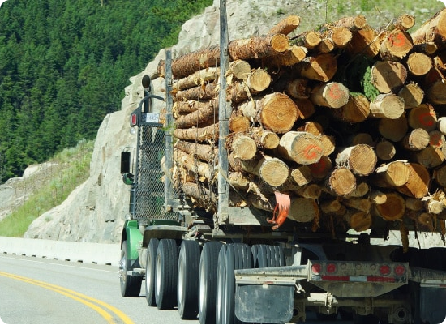
Licensing & Enforcement
Strict Regulation
Timber Harvesting: License required for felling and transport.
Charcoal: Mandatory licenses for production and trade.
Penalties: Fines, imprisonment, and forfeiture of machinery.

Slide 28

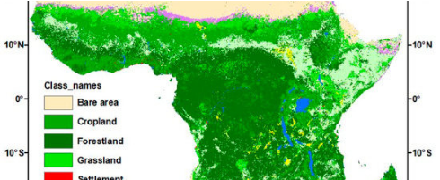
GIS in Compliance Monitoring
Applications
Mapping Forest Reserve Boundaries.
Zoning for Agricultural Schemes.
Analyzing Change in Land Cover.
Spatial Integrity
Using satellite data to detect illegal encroachment and monitor farm development adherence.

Slide 29

Resolving Land Use Conflicts
Common Conflict Zones
Encroachment for subsistence farming.
Resolution Strategies
Illegal logging in protected water towers.
Integration of multi-agency decision making and spatial planning ensures that development does not come at the cost of sustainability.
Charcoal driving landscape degradation.

Slide 30

Thank You
Questions & Discussion
Kapasa Makasa University | Land Use Planning

Slide 31






Image Sources
https://www.parliament.gov.zm/sites/default/files/styles/carousel_image/public/field/image/WhatsApp%20Image%202026-05-06%20at%2014.00.34.jpeg?itok=y8cx9TO5
Source: www.parliament.gov.zm
https://www.finelib.com/images/events/2067_IMAGE.jpg
Source: www.finelib.com
https://saskpulse.com/wp-content/uploads/2023/04/Examples-of-tools-commonly-used-for-soil-sampling.png
Source: saskpulse.com
https://www.global-agriculture.com/wp-content/uploads/2026/04/Untitled-1-copy-296-768x427.jpg
Source: www.global-agriculture.com
https://media.gettyimages.com/id/1269842636/photo/aerial-view-on-the-green-bush-land-in-the-lower-zanbezi-area-in-zambia.jpg?s=612x612&w=gi&k=20&c=b8JLuYY8M0vpIIDWWp4f08HrRyr35qy1_dp7STJ_cR8=
Source: www.gettyimages.fi
https://zambia.unfpa.org/sites/default/files/styles/original/public/news/untitled_1000_x_560_px_24.png?itok=LtX-X_PR
Source: zambia.unfpa.org

Slide 32


Image Sources
https://www.policyalternatives.ca/wp-content/uploads/2025/04/pn_mar2023_logging-trucks.jpg
Source: www.policyalternatives.ca
https://www.mdpi.com/sustainability/sustainability-13-01234/article_deploy/html/images/sustainability-13-01234-g003-550.jpg
Source: www.mdpi.com

