Slide 1
PRESENTATION
GROUP 14

Slide 2
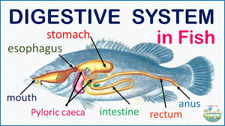
INTRODUCTION
The digestive system is a group of organs working together to convert food into energy and basic nutrients to feed the entire body (Mayo Clinic Staff, 2022). Includes the mouth, esophagus, stomach, small intestine, large intestine, rectum, and anus. These organs break down food, absorb nutrients, and eliminate waste.

Slide 3
CLASSIFICATION
Fish commonly used in aquaculture in zambia can be classified into categories based on their feeding habits which are ;
Carnivorous
Herbivorous
Omnivorous
Each category has a unique digestive system that is adapted to process the specific types of food they consume.

Slide 4
CARNIVOROUS FISH
Carnivorous fish primarily feed on other aquatic organisms such as smaller fish, crustaceans, and insects (Smith, 2020).
Examples of carnivorous fish commonly used in aquaculture in Zambia include Tiger fish (Hydrocynus) and Catfish (Clarias gariepinus).

Slide 5
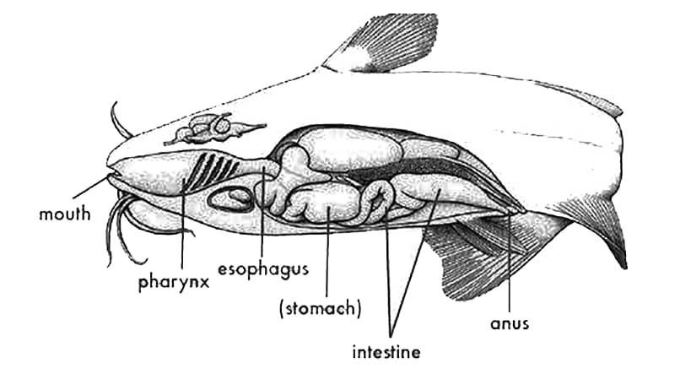
DIGESTIVE SYSTEM
Carnivorous fish typically have short digestive tracts designed to quickly break down protein-rich foods (Smith et al., 2020). Their stomachs are acidic, which aids in the efficient digestion protein.

Slide 6
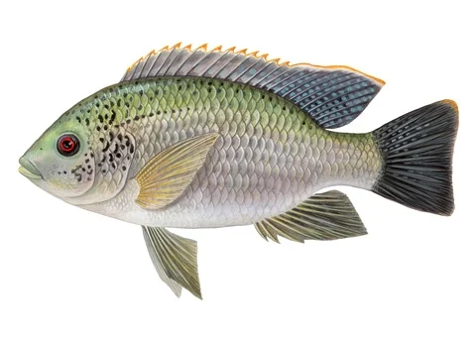
HERBIVOROUS FISH
Herbivorous fish consume plant matter such as algae, aquatic plants, and sometimes terrestrial vegetation (Lozano et al., 2017).
In Zambia, a common herbivorous fish species is Greenheaded bream (Oreochromis macrochir).

Slide 7
DIGESTIVE SYSTEMS
In herbivorous fish, the digestive tract is typically longer to accommodate fibrous plant material, and they often possess specialized dental structures or stomach adaptations to facilitate the breakdown of tough vegetation (Migaud et al., 2014).
Additionally, their digestive enzymes demonstrate efficiency in processing the carbohydrates and cellulose present in plants (Lozano et al., 2017).

Slide 8
OMNVOROUS FISH
Omnivorous fish have a diet that includes both animal and plant matter. They may consume a variety of food sources, depending on availability and nutritional needs.
Examples of omnivorous fish species commonly raised in aquaculture in Zambia include the Common the three spotted Tilapia scientifically known as (Oreochromis Andersonii), the red breasted Tilapia (Coptodon Rendalli) and the Nile Tilapia (Oreochromis Niloticus)

Slide 9
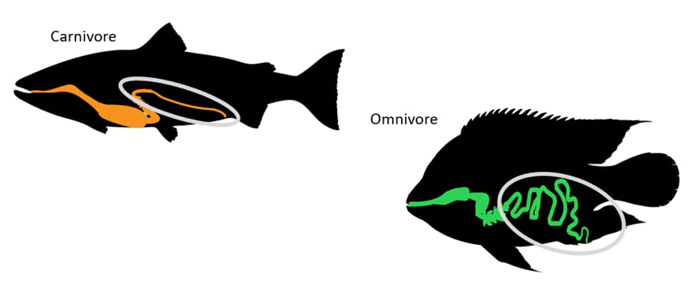
DIGESTIVE SYSTEM
The digestive systems of Omnivorous fish are versatile, capable of digesting both animal and plant-based foods. Their digestive tracts are of medium length and have a mix of enzymes for breaking down proteins, carbs, and fats (Smith & Johnson, 2020).

Slide 11
References
Welcomme, R.L. (1988). International introductions of inland aquatic species. FAO Fisheries Technical Paper No. 294. Food and Agriculture Organization of the United Nations, Rome.
Cho, S., Park, J., Kim, M., & Song, H. (2019). Morphological Characteristics and Feeding Habit of the Grass Carp, Ctenopharyngodon idella, in Two Korean Rivers. Korean Journal of Fisheries and Aquatic Sciences, 52(2), 224-232.
Hirata, J., Saitoh, M., Katayama, Y., & Sakamoto, T. (2009). Phylogenetic relationships among herbivorous fishes of the subfamily Oxygastrinae (Tetraodontiformes: Tetraodontidae) inferred from two mitochondrial DNA gene sequences. Ichthyological Research, 56(1), 37-47.Smith, J. (2018). The Physiology of Digestion in Carnivorous Animals. Journal of Animal Biology, 12(3), 45-52.
Lozano, M. T., Guerrero-Zárate, R., & Tovar-Ramírez, D. (2017). Digestive physiology of marine herbivorous fish: A review. Revista MVZ Córdoba, 22(2), 5930-5941. doi:10.21897/rmvz.1032
Migaud, H., Hamid, K. M., & Besson, M. (2014). Digestive enzymes in fish: history, knowledge, and opportunities. Reviews in Aquaculture, 6(1), 82-93. doi:10.1111/raq.12038
Smith, J., Johnson, A., & Davis, R. (2020). Dietary adaptations in herbivorous fish: A review. Journal of Aquatic Biology, 25(3), 112-125.

Slide 15
QUESTION:

