Slide 1

Care and management of pregnant animals
Dr Alok Kumar
Assistant Professor cum jr. Scientist
Veterinary Gynaecology and Obstetrics
Bihar Veterinary College, BASU. Patna
Notes:
© Copyright PresentationGO.com – The free PowerPoint and Google Slides template library

Slide 2
Overview of topic
Objectives
Conception management
Pregnancy diagnosis
Nutritional management
Calving Management
Overall health management
Notes:
© Copyright PresentationGO.com – The free PowerPoint and Google Slides template library

Slide 3
Objectives
Succesfull complition of gestation period
Birth of healthy calf
Absence/neglisible post partum complication
Optimum lactation
Reduced chances of production diseases
Overall health management
Notes:
© Copyright PresentationGO.com – The free PowerPoint and Google Slides template library

Slide 4
Day 0
Calving
Early
Lactation
Dry period
Conception
Management
Day 80
Late
lactation
Conception
Mid
Lactation
Day 100
Implantation
Day 130
Notes:
© Copyright PresentationGO.com – The free PowerPoint and Google Slides template library

Slide 5
Pregnancy Diagnosis
Why ??????
Farm economy
Pathology of reproductive system
Feeding management accordingly
Methods of PD
PRE
USG
Hormone assay

Slide 6
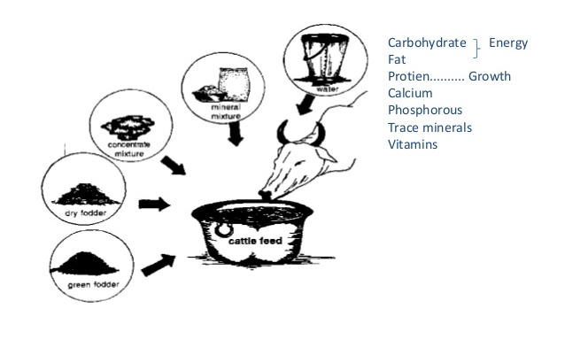
Nutritional management

Slide 7
Feeding a cow
S.n | feed | indigenous | Cross breed
01 | Concentrate feed
1.1 | Maintenance | 1-1.25 kg/100 kg BW | 2kg/100 kg BW
1.2 | Lactation | 1kg/2.5 kg milk (4 % fat) | 1kg/2kg milk (4 % fat)
1.3 | Pregnancy allowance | 1.25 kg/day at last trimester | 1.75 kg/day at last trimester
2 | Roughage | 4kg/100kg BW | 4-5 kg/100kg BW
3 | Green fodder | 20 kg grass/cereal fodder OR 6 kg legume fodder

Slide 8
Ration formulation
Ingredients | Quantity (kg)
Maize | 40
Rice bran | 19
Wheat bran | 20 kg
GNC | 15 kg
Molasses | 03 kg
Mineral sp | 02 kg
Salt | 01 kg
Ingredients | Quantity (kg)
GNC | 15
Gingilly oil cake | 14
Jowar | 20
Maize | 22
Deoiled rice bran | 26
Mineral sp | 02
Salt | 01

Slide 9

Energy requirement
Lactation
Pregnancy
Last trimester
Maintenance
Time

Slide 10
Periods of nutrition requirement
Period – 01 (Challenge period)
Period of early lactation
Rapid increase in milk yield
Amount of concentrate should be increased gradually till cow consumes 800-1000 gm conc./100kg BW
Concentrate allowance 500 gm/day for first two weeks

Slide 11
Periods of nutrition requirement
Period – 02
Period of mid and late lactation
Milk yield remains static
Feeding of balanced ration as per milk yield
Provision of good quality fodder/silage

Slide 12
Periods of nutrition requirement
Period – 03 (Dry period)
Period of advance pregnancy
Withdrawn/halting of milk removal
Remodeling of mammary tissue and preparatory phase for subsequent lactation
Period divided in two phases
Far-off and Close up periods

Slide 13
Far-off period
From beginning of dry period to 03 weeks before calving
Maintaining optimum dietary fiber content
Limiting energy intake
Avoiding an overfeeding of crude protein
Meeting mineral and vitamin requirements.

Slide 14
Close up period
Period starts 03 weeks before calving
Transfer animal to separate housing
Feed intake reduces drastically before 07-10 days prepartum
Less volume of feed but high frequency of feeding
Provide energy dense feed having RUDP
60-76 cm feed bunk space to avoid aggressiveness
Provision of adequate bedding material eg. Paddy/sand layer etc

Slide 15
Nutrient | Units | Far-off Dry Cow | Close-up Dry Cow
Crude protein | % | 12-13 | 14-15
RUDP | % of CP | 28 | 33
NE_{L} | Mcal/lb | 0.57 | 0.68
NDF | % | > 50 | > 40
ADF | % | > 35 | > 25
Ca | % | 0.40-.50 | 0.60
P | % | 0.25 | 0.30
Mg | % | 0.16 | 0.20
K | % | 0.65 | 0.65
S | % | 0.16 | 0.16
Vitamin A | IU/day | 100,000 | 100,000
Vitamin D | IU/day | 30,000 | 30,000
Vitamin E | IU/day | 400 | 600-1,000

Slide 16
Calving Management
Before parturition
Isolate animal from rest of the herd
Provide ample bedding material
Everyday provide Vitamin D supplementation
DO NOT supplement calcium
DO NOT milk animal
During parturition
Primary clinical examination – Rectal\temperature/activity/inspection of vulva
Maintain hygiene around animal

Slide 17
Management just after parturition
If animal is recumbent – Massage of hind quarter
Observe expulsion of placenta
Discourage/avoid placentophagy
Cleaning of body specially hind quarter with moderate-warm water and added KMNO₄
Provide Luke warm drinking water
Carefully observe animal behavior – if sluggish/mostly recumbent/dull – Provide calcium supplementation

Slide 18
Overall health management
Vaccination
Pre-calving vaccination with Calf scours
(Rota, corona viruses, E.coli, Clostridium perfringens C, D)
Before breeding – FMD, IBR-IPVV, BVD, Leptospirosis, Vibriosis
Deworming – pre-partum with pregnancy safe anthelmintics, post partum – benzimidazole gp

Slide 19

“Ease is a greater threat to progress than hardship ”
Thank you for your patience hearing
Any questions ???????
You can find me at
alok9alright@gmail.com

