Slide 1
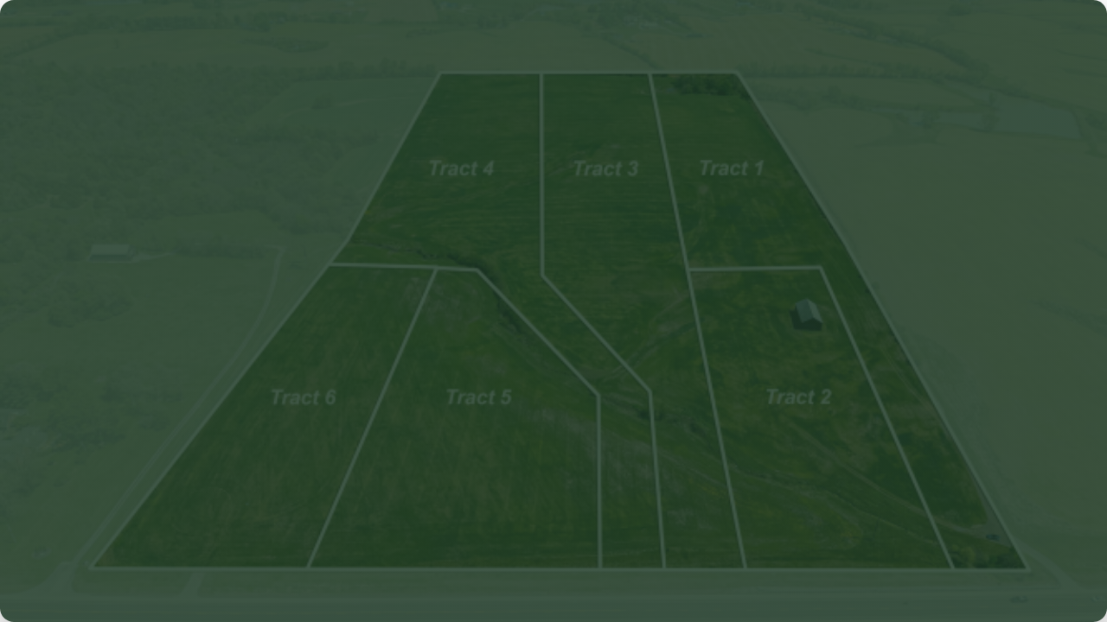

Formulation of Farm-Land Plan
B.Mutale
Department of Agriculture and Aquatic Sciences
LECTURER NOTES:
Slide 1 / 40

Slide 2



Presentation Outline
Part 1 & 2
Part 3 & 4
Part 5 & 6
Foundations of farm-land planning, sustainable principles, and the distinct process of goal setting for both smallholder and commercial models.
Conducting systematic resource inventories (soil, climate, water, labor) and utilizing Land Capability Classifications (LCC) & GIS methods.
Formulating physical farm layouts (conservation design, roadways, irrigation blocks) followed by dynamic implementation timelines.
LECTURER NOTES:
Slide 2 / 40

Slide 3

PART ONE
Introduction to Farm-Land Planning
Defining scales, core terms, and sustainable agricultural principles
LECTURER NOTES:
Slide 3 / 40

Slide 4

What is Farm-Land Planning?
"The systematic spatial evaluation, allocation, and organization of farm resources to maximize sustainable productivity."
The Cost of Non-Planning
Spatial Science: Mapping specific uses to the most suitable soil parcels.
Without a detailed plan, farms commonly suffer from:
•
Cultivation of highly erodible slopes
Integrated Framework: Links agronomic production directly with ecological conservation.
•
Compaction of clayey transit routes
•
Siltation of irrigation channels
Long-term Stewardship: Prevents environmental degradation while securing steady financial yields.
•
Misallocation of high-cost inputs
Slide 4 / 40

Slide 5

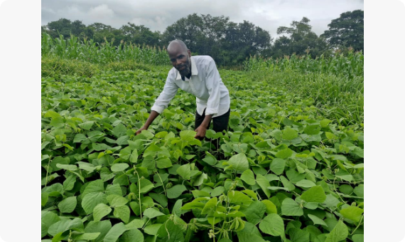
What constitutes a "Farm Plan"?
A completed farm plan is a dynamic document containing both spatial designs and temporal operations:
Zoning Maps: Definitive boundary map separating crop fields, livestock pasture, and forest reserves.
Enterprise Schedules: Detailed crop rotations, grazing timelines, and input application cycles.
Protection Layouts: Engineered soil contour designs, windbreaks, and drainage alignments.
Slide 5 / 40

Slide 6


Why is Farm Planning Vital?
Production Efficiency
Climate Adaptation
Regulatory & Policy
Ensures that premium inputs (like fertilizers, hybrid seeds, water) are matched strictly to highly responsive soils, maximizing return on investment.
Constructs physical features (like water harvesting swales and shade trees) to insulate smallholdings against heat waves and seasonal rainfall anomalies.
Aligns agricultural lands with government water rights, national environmental legislation (e.g., ZEMA in Zambia), and local customary zoning policies.
Slide 6 / 40

Slide 7

Farm LUP vs Macro-Level LUP
Planning Attribute | Farm-Level Planning | Macro-Level (District/Regional) Planning
Scale & Resolution | Highly detailed (1:500 to 1:5,000); covers 1 to 5,000 hectares. | Broad strategic (1:50,000 to 1:250,000); covers entire districts.
Primary Actor | Individual farmer, agricultural manager, or consultant. | Government departments, spatial planners, or district councils.
Primary Objective | Maximized long-term production, crop security, and farm profits. | Balanced socio-economic zoning, public infrastructure, and forests.
Data Requirement | Detailed local soil pits, specific water points, and family labor constraints. | Aggregate census trends, climatic patterns, and major watersheds.
Slide 7 / 40

Slide 8

Sustainable Planning Principles
Ecological Suitability: Never push land beyond its natural carrying capacity.
Cycle of Sustainability
Social Integration: Plans must respect customary rights, communal boundaries, and regional migration corridors.
A truly sustainable farm-land plan treats the agricultural parcel as a self-sustaining cycle where livestock wastes feed the soil, contour barriers hold water table levels, and woodlots block strong wind profiles.
Enterprise Diversity: Multi-crop zoning builds natural systems and breaks monoculture disease cycles.
Slide 8 / 40

Slide 9
PART TWO
Goal Setting in Farm Planning
Divergent objectives across smallholder and commercial models
LECTURER NOTES:
Slide 9 / 40

Slide 10

Identifying Farm Objectives
A farm's goals directly define its physical layout. Objective formulation must be collaborative and cover:
Household Needs: Ensuring baseline nutritional requirements are met in smallholder communities.
Essential Planner Inquiries
1. Is the farm's primary purpose cash generation or household food security?
Financial Viability: Matching cash crop production plans to realistic market demands.
2. What is the access level to capital, storage, and transport infrastructure?
3. What risks (drought, frost, price volatility) is the farm exposed to?
Planning Horizon: Balancing immediate harvest needs with long-term soil conservation.
Slide 10 / 40

Slide 11

Subsistence vs Commercial Goals
Zoning Variable | Subsistence / Smallholder Goals | Commercial Farm Goals
Primary Mandate | Household food security, local dietary diversity, low cash outlay. | Maximized net financial return, market share growth, high capital efficiency.
Risk Tolerance | Very Low: High priority on cropping diversity to guarantee food yield. | Moderate to High: Insured monocultures or specialized dual-crop zones.
Spatial Layout Focus | Irregular, multi-crop fields; integrated crop-livestock; communal access. | Large, standardized rectangular blocks to optimize mechanization.
Conservation Input | Low-cost organic methods, compost, handmade soil contours. | Capital-intensive dams, precision drainage networks, laser-leveled soils.
Slide 11 / 40

Slide 12


Short vs Long-term Goals
Short-Term Focus (1-12 Months)
Long-Term Focus (3-10+ Years)
•
Select crop cultivars for the upcoming rainy season.
•
Build permanent water dams or install solar borehole grids.
•
Apply soil amendments (e.g., lime) to clear nutrient blocks.
•
Plant multi-tier windbreaks and fruit orchard blocks.
•
Prepare basic surface runoff drains prior to intense storms.
•
Transition fields to no-till conservation agriculture.
LECTURER NOTES:
Contrast immediate operational goals with long-term infrastructure planning. Explain that long-term investments require secure land tenure, such as Title Deeds, to justify the upfront capital investment.
Slide 12 / 40

Slide 13



Risk and Uncertainty Mitigation
85%
Risk Management via Crop Zoning
Proper spatial allocation reduces crop exposure to frost, drought-induced water stress, and pathogen outbreaks.
Climatic Risks
Market Risks
Avoid low-lying areas for cold-sensitive crops. Use natural high-ground zones for winter production.
Diversify the farm layout with permanent tree crops and livestock to offset crop price volatility.
LECTURER NOTES:
Slide 13 / 40

Slide 14
PART THREE
The Farm Resource Inventory
Systematic auditing of physical, human, and financial capital baselines
LECTURER NOTES:
Slide 14 / 40

Slide 15

Categorizing Farm Resources
Physical Capital
Human Capital
Financial & Built Capital
Includes land area, soil profile properties, topographic slope, hydrology, agro-ecological climate zone, and native woody vegetation.
Evaluates available family labor, local hired labor markets, technical skill competencies, and managerial experience levels.
Encompasses savings, bank lines of credit, traction tools (oxen/tractors), crop storage facilities, and transport connections.
LECTURER NOTES:
Clearly break down the agricultural asset pillars. A shortfall in human labor at harvest or a lack of transport roads will bottleneck production, regardless of how fertile the soil is.
Slide 15 / 40

Slide 16
Land Size, Shape & Boundaries
A farm's geometry shapes its spatial design options:
Fencing Costs: Irregular boundaries increase perimeter lengths, driving up fencing and border security costs.
Boundary Demarcation
Encroachment Risks: Clearly defined, legal physical boundaries prevent community and leasehold boundary disputes.
Planners must cross-check official registry survey beacons against natural boundary lines on the ground to ensure the farm plan is legally accurate and secure.
Mechanization Flow: Straight fields and square boundaries allow tractors to turn efficiently, reducing fuel waste.
LECTURER NOTES:
Discuss the challenges of irregular farm shapes, which are common in traditional customary land areas.
Slide 16 / 40

Slide 17
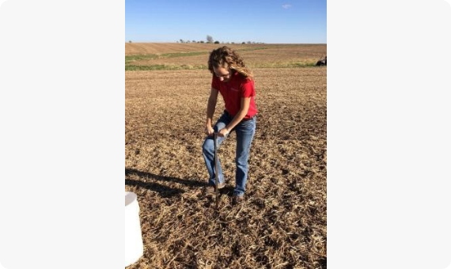
Soil Characteristics and Slope
The soil profile represents the true baseline constraint of any farm design:
Physical Profile: Soil texture (silt/sand/clay), organic matter, and depth control water storage and crop rooting success.
Chemical Status: Base pH, nitrogen, phosphorus, potassium, and micronutrient balances.
Slope Class: Directly dictates water drainage velocity and structural erosion risks.
LECTURER NOTES:
Slide 17 / 40

Slide 18

Climate & Agro-ecological Zones
Macro climate defines regional parameters, but localized topographies create important microclimatic conditions:
Case Study: Zambia AEZ Regions
Region I: Semi-arid valleys (<800mm rain). High drought risk. Requires sorghum, millet, and goats.
Rainfall Profile: Annual rain totals, dry season duration, and single-day downpour trends.
Region II: Fertile plateaus (800-1000mm). Maize, soybeans, tobacco, and cattle commercial hubs.
Temperature Extremes: Frost hazards in low valleys vs intense midday heat peaks on exposed plateaus.
Region III: Wet northern belt (>1000mm). Acidic, highly leached soils. High suitability for tea, coffee, and macadamia.
LECTURER NOTES:
Slide 18 / 40

Slide 19


Water Availability & Hydrology
Surface Water Assets
Groundwater Assets
Audit the reliability of streams, rivers, dams, and seasonal wetlands (dambos).
Map local aquifers, dry-season water table levels, and borehole recharge metrics.
Protect dambos from deep ploughing to preserve natural wetlands and shield downstream systems from sedimentation.
Groundwater security is critical for dry-season high-value vegetable production.
LECTURER NOTES:
Discuss the delicate nature of dambos (grass-covered depressions ).
Slide 19 / 40

Slide 20
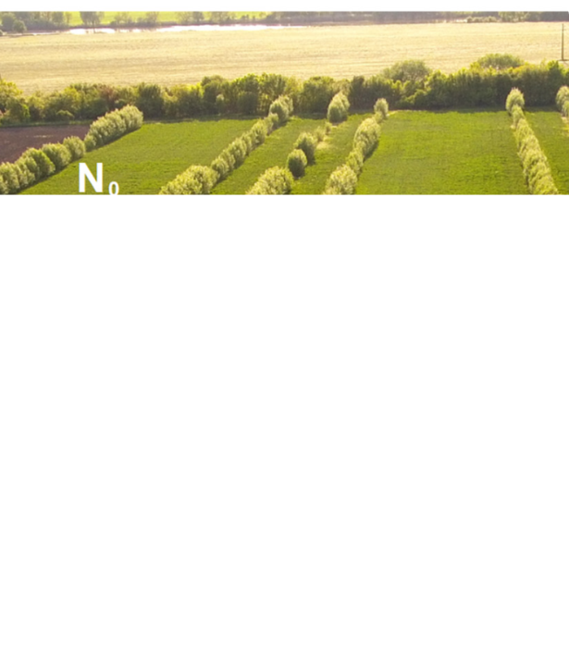
Vegetation & Agroforestry
Native forest stands are valuable spatial assets, not obstacles to be cleared:
Indicator Species: Native trees signal soil quality. For example, Acacia indicates sweet, fertile soils, while certain sedges point to clay-heavy water retention.
Agroforestry Systems: Retain nitrogen-fixing trees (such as Faidherbia albida) in cropping blocks to naturally boost soil fertility.
Slide 20 / 40

Slide 21

Human Labor & Management
A farm plan can only succeed if it fits the household and local labor profiles:
Labor Constraints: Smallholders are heavily restricted by family size, age structure, and domestic duties.
Spreading Labor Demand
Seasonal Peaks: Land preparation, weeding, and harvests create major labor bottlenecks.
Planners must stagger planting dates and diversify crop varieties in the plan to flatten labor spikes and prevent costly crop loss at harvest.
Skills Assessment: Ensure the workforce has the technical training required for precision pesticide use or complex irrigation operations.
LECTURER NOTES:
Slide 21 / 40

Slide 22
Capital, Tools & Machinery
Financial Reserves
Traction Capabilities
Storage Infrastructure
Audit cash resources, seasonal bank loan access, and government input subsidies (like FISP in Zambia) to determine scope and scaling options.
Track access to draft animal power (oxen) or tractors. This directly dictates field length design and turnaround space parameters.
Inspect existing granaries, cold-chain capacity, and tool sheds. This determines the shelf-life and volume potential of high-value yields.
LECTURER NOTES:
Slide 22 / 40

Slide 23
Farm Resource Checklist
Resource Category | Key Parameter to Audit | Field Measurement Method | Strategic Planning Value
Physical Land | Total boundary area, slope %, soil pH. | GPS tracking, clinometer, chemical soil kits. | Shapes field layout and crop matching.
Hydrology | Water point yields, stream flow, wetland extent. | V-notch weir, depth measures, satellite maps. | Defines dry-season irrigation limits.
Human | Active workers, peak labor bottlenecks. | Household surveys, seasonal calendars. | Staggers crop rotations to smooth labor.
Built Assets | Shed capacity, farm roads, tractor power. | Physical audits and machinery checks. | Specifies input staging and yield limits.
LECTURER NOTES:
Slide 23 / 40

Slide 24
PART FOUR
Land Capability & Suitability
Leveraging LCC, the FAO framework, and GIS technology
LECTURER NOTES:
Slide 24 / 40

Slide 25



Land Capability Classification
8
USDA Capability Classes
Classifies land from Class I (ideal for tillage) to Class VIII (extremely fragile and restricted to conservation).
Arable Classes (I - IV)
Non-Arable Classes (V - VIII)
Flat or gentle slopes. Deep soil depth. Suitable for intensive annual crop cultivation with appropriate conservation steps.
Steep slopes, rocky soil, or severe erosion hazards. Use must be restricted to pasture, agroforestry, or wildlife reserves.
LECTURER NOTES:
Slide 25 / 40

Slide 26
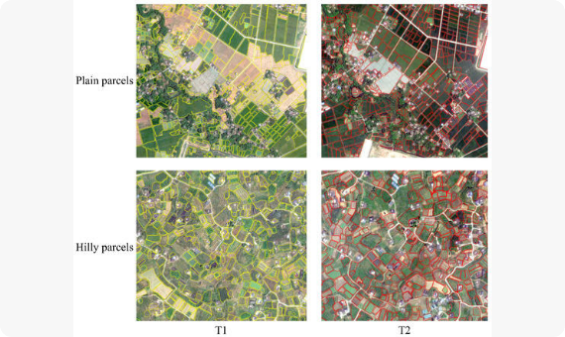
USDA Land Capability Classes
A close look at how the 8 LCC classes guide the placement of farm boundaries:
Classes I & II: Flat, deep, non-erodible soils. Ideal for continuous row crops.
Classes III & IV: Moderate to steep slopes. Requires contouring, strip cropping, or terrace farming.
Classes V - VII: Highly erodible, shallow, or waterlogged soils. Safe only for pastures or tree woodlots.
Class VIII: Restricted to environmental conservation.
LECTURER NOTES:
Slide 26 / 40

Slide 27
The FAO Suitability Framework
Unlike LCC, the FAO framework rates land suitability for specific crop uses:
Order S (Suitable): Land where benefits outweigh inputs. Divided into Highly Suitable (S1), Moderately Suitable (S2), and Marginally Suitable (S3).
Subclass Suffixes
Planners use lowercase letters to flag specific constraints. For example: S2w indicates wetness limitations, while S3s flags shallow soil depth constraints.
Order N (Unsuitable): Land with severe biological or physical barriers. S3 land can be upgraded with soil amendments.
LECTURER NOTES:
Slide 27 / 40

Slide 28
Soil Testing & Decision Support
pH Determination
Textural Analysis
Organic Carbon
Testing soil acidity determines liming needs. This is critical in high-rainfall zones where acidity locks up key plant nutrients.
Sands drain quickly but lose nutrients. Clays store water but compact easily. Loam offers the ideal balance for annual crops.
Acts as an indicator of soil biological health. Plans should include cover crops if organic carbon levels drop below 2%.
LECTURER NOTES:
Slide 28 / 40

Slide 29

Slope & Terrain Constraints
Slope percentage directly limits mechanization options and shapes required conservation features:
0 - 2% Slope: Minimal erosion risk. Ideal for large machinery and center-pivot irrigation.
2 - 8% Slope: Moderate erosion risk. Cultivation must follow contour lines to slow runoff.
Physics of Erosion
When water flows down an slope, doubling the gradient increases the speed of the water, which dramatically multiplies its soil-carrying capacity.
8 - 15% Slope: High erosion risk. Requires engineered terracing or contour grass strips.
> 15% Slope: Severe erosion risk. Planners should preserve these slopes for permanent tree crops or pasture.
LECTURER NOTES:
Slide 29 / 40

Slide 30
GIS & Remote Sensing in Plans
Layer Overlays
Sentinel Imagery
Elevation Models
Stack maps of soils, slope, and water access within QGIS to automatically locate high-suitability production parcels.
Analyze historical Sentinel-2 vegetation indices (NDVI) to track crop health, locate wet spots, and spot nutrient trends.
Use digital elevation models (DEM) to map precise drainage networks, locate contour lines, and plan dam sites.
LECTURER NOTES:
Slide 30 / 40

Slide 31
Agro-Ecological Suitability
Crop Type | Ideal Soil Textures | Min Soil Depth | Rainfall Range | Target Agro-ecological Region
Maize | Sandy Loam to Clay Loam | 90 cm | 600 - 1000 mm | Region II (Plateau, medium rain)
Sorghum | Clay Loam to Sandy clay | 60 cm | 450 - 650 mm | Region I (Low rain, valleys)
Irish Potato | Loose, well-drained Sandy Loam | 45 cm | 500 - 800 mm | Region II (High elevation cooler spots)
Tea / Coffee | Deep Acidic Clay Loam | 150 cm | > 1200 mm | Region III (High rain, leached soils)
LECTURER NOTES:
Slide 31 / 40

Slide 32
PART FIVE
Designing Physical Layouts
Zoning boundaries, roads, and irrigation networks on the ground
LECTURER NOTES:
Slide 32 / 40

Slide 33
Principles of Farm Zoning
Zoning divides the farm into clear management units to simplify logistics and protect fragile zones:
The Farmstead Zone: Place houses, processing sheds, and tool storage in a central, easily accessible spot near primary access roads.
Logistical Optimization
Improper zoning wastes fuel and labor. Moving manure or transporting heavy grain bags over long distances inside the farm is a major source of operational waste.
The Intensive Zone: Keep high-monitoring enterprises (like chicken coops, nurseries, and pig pens) close to the farmstead.
The Extensive Zone: Place pasture blocks and large crop fields on more distant, open acreage.
LECTURER NOTES:
Slide 33 / 40

Slide 34
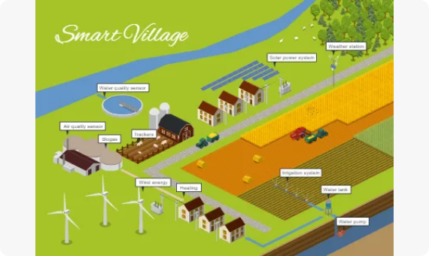
Field Demarcation & Design
Design field shapes and boundaries to match the farm's management scale and equipment:
Field Shape: Use rectangular fields with parallel boundaries to streamline tractor movements and reduce headland turning waste.
Block Alignment: Align long field boundaries across slopes to naturally slow down heavy water runoff.
Rotational Match: Standardize the sizes of crop blocks to simplify rotations and make fertilizer applications uniform.
LECTURER NOTES:
Slide 34 / 40

Slide 35
Soil & Water Conservation
Contour Bunds
Shelterbelts
Buffer Zones
Construct physical earth ridges along topographic contour lines to catch and spread runoff, preventing topsoil erosion.
Plant multi-tier rows of tall native trees perpendicular to dry winds. This protects young crops and reduces evapotranspiration.
Keep a permanent grass buffer strip of at least 30 meters along streams to capture fertilizer runoff and stop river siltation.
LECTURER NOTES:
Slide 35 / 40

Slide 36
Planning Farm Access Networks
Farm roads must be planned carefully; poorly routed roads are a leading cause of soil erosion:
Ridge Alignment: Run main farm access roads along natural ridge lines to ensure good drainage and avoid muddy bogging.
Water Diversion Drains
Avoid Straight Slopes: Never run farm roads straight down a slope. They quickly become pathways for heavy runoff, turning roads into deep gullies.
Build angled miter drains along roadways to divert fast runoff into grassy fields, safely spreading water out before it can carve channels.
Livestock Lanes: Establish dedicated, fenced pathways for cattle to keep animals from trampling valuable crops.
LECTURER NOTES:
Slide 36 / 40

Slide 37
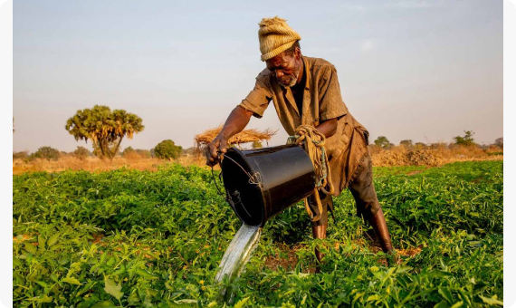
Designing Water Networks
Water delivery plans must balance layout choices with seasonal water supplies:
Micro Drip Systems: Deliver targeted water directly to plant root zones, minimizing evaporation losses on dry plots.
Gravity vs Pump: Place header tanks on the highest ground points to utilize gravity feeding, reducing diesel and electricity pumping bills.
Runoff Planning: Size collection channels to safely route water away from crop fields during heavy storms.
LECTURER NOTES:
Slide 37 / 40

Slide 38
PART SIX
Plan Implementation & Control
Staging operations, budgeting cash flows, and tracking progress
LECTURER NOTES:
Slide 38 / 40

Slide 39




Phased Plan Implementation
Survey & Contour
Water & Fencing
Block Staging
Scale & Audit
Conduct soil profiling, verify boundaries, establish baseline contour barriers, and clear initial access paths.
Install header tanks, sink boreholes, fence outer boundary zones, and construct primary silage pits.
Plant high-value cropping blocks, launch rotation loops, and plant perimeter tree windbreaks.
Maximize production scale, analyze nutrient balances, and adjust field rotations based on initial harvest results.
LECTURER NOTES:
Slide 39 / 40

Slide 40

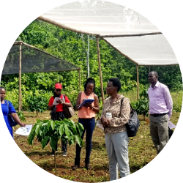
Student Practical Exercise
Task: Formulate a Farm-Land Plan
Baseline Audit: Complete a soil core audit, assess slope %, and record water source volumes.
Spatial Zoning Map: Classify land into capability zones (Classes I - VIII) and draw field layout blocks.
Rotational Schedule: Build a 3-year crop matching matrix to balance seasonal labor peaks.
Slide 40 / 40

