Slide 1

D-walk
Practical Business Analytics
Team Members
Mohamed Ali:
Ranjeet Singh Yadav:
Pavan Siddihally Venugopala Reddy:6644984
Evans Gichuki:
Arun:
Hitesh:

Slide 2
Dataset- Churn Dataset
Dataset
Problem Definition
CRISP-DM
Data Pre-processing
Visualization
Modelling Approaches
Models
Model Assessment
Project Evaluation and Future Deployment

Slide 3
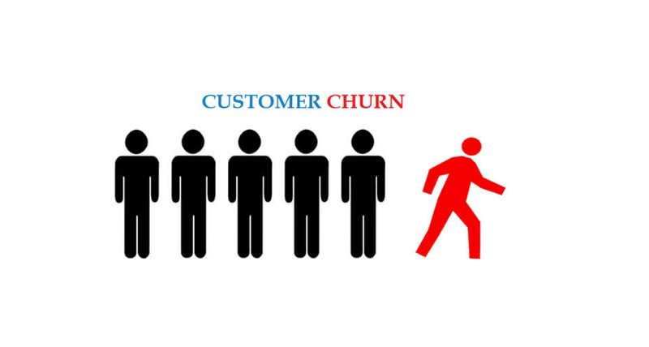
Dataset- Churn Dataset
Each line addresses a client, every section contains client's ascribes depicted on the segment Metadata.
The informational collection incorporates data about:
Clients who left the segment is called Churn
Different Services opted by the customers
Client account data
Segment data about

Slide 4
Problem Definition
With growing competition in many different industries, we find that maintaining customer interest and satisfaction is a matter of great importance. Whether the customer remains interested in the service being provided depends on a number of factors and variables; from which patterns can be analysed in order to provide a future prediction for a business.
The importance of this cannot be understated as the revenue received by the business will be directly proportional to the customers interest and satisfaction.
This presentation therefore aims to explore these factors and variables to determine whether the Telecommunications Industry will be able to maintain the customers interest in the future.
It also aims to determine which factors and variables are the most paramount in ascertaining this. It seems that in previous studies of this nature, it has been found that there is no real consensus with regards to the most efficient classifiers in order to determine voluntary customer churn.
Therefore, in this study we will be employing a number of classification algorithms to weigh up the patterns that we are able to detect through their collective analyses.

Slide 5
CRISP-DM
The Cross Industry Standard Process for Data Mining (CRISP-DM)
An interaction model with six stages
Portrays the information science life cycle.
Helps to plan, put together, and carry out the project.
Business understanding
Data understanding
Data preparation
Modeling
Evaluation
Deployment
The flow of the process can be visualized here

Slide 6
CRISP-DM
Business understanding
Determine business objectives
Assess situation
Determine data mining goals
Produce project plan
Data understanding
Collect initial data
Describe data
Explore data
Verify data quality
Data preparation
Select data
Clean data
Construct data
Integrate data
Format data

Slide 7
CRISP-DM
4.Modeling
Select modeling techniques
Generate test design
Build model
Assess model
5.Evaluation
Evaluate results
Review process
Determine next steps
6.Deployment
Plan deployment
Plan monitoring and maintenance
Produce final report
Review project
The flow of the process can be visualized here

Slide 8
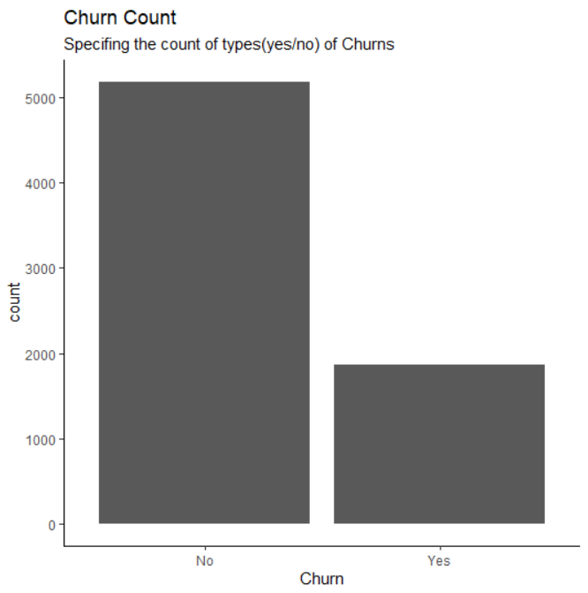
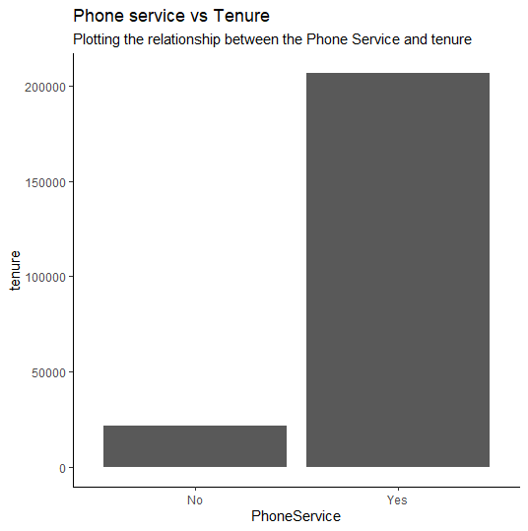
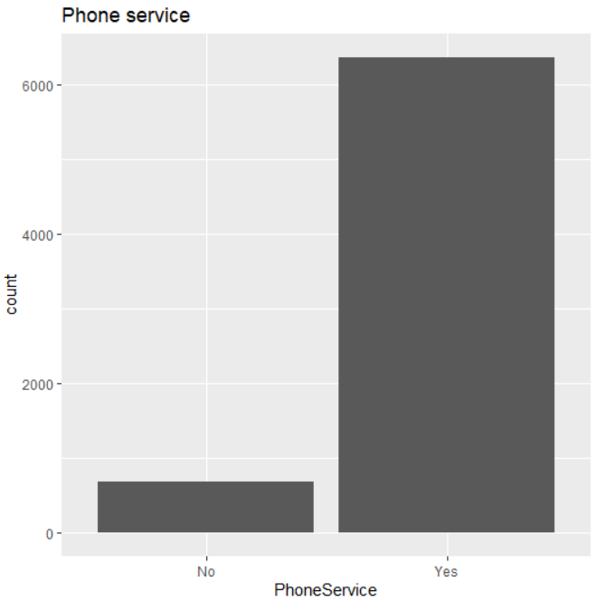
Visualization
The below graph describes
the total churn rate
Phone Service vs Tenure
the count of people opted the phone service and not

Slide 9
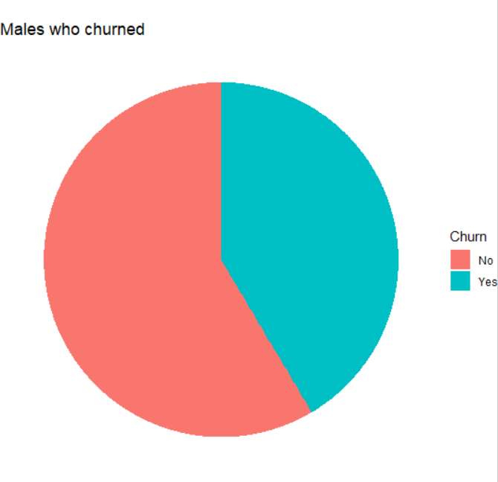
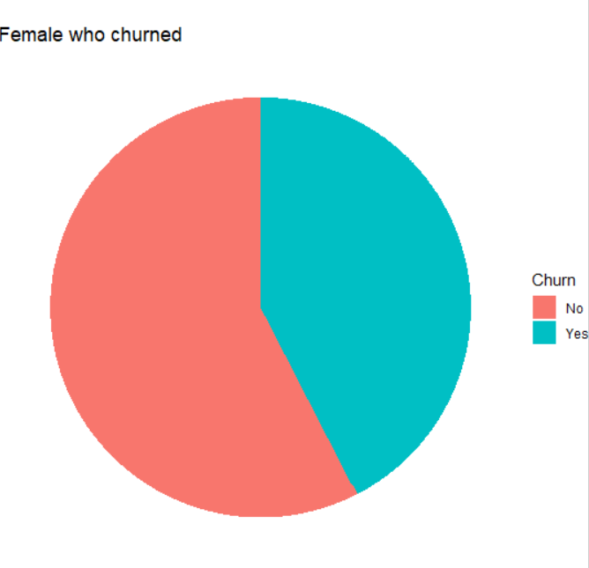
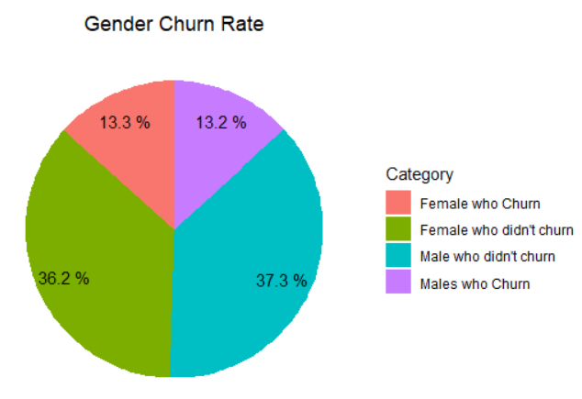
Visualization
The chart below depicts
The male churn rate
the female churn rate
The information of the Gender to churn rate

Slide 10
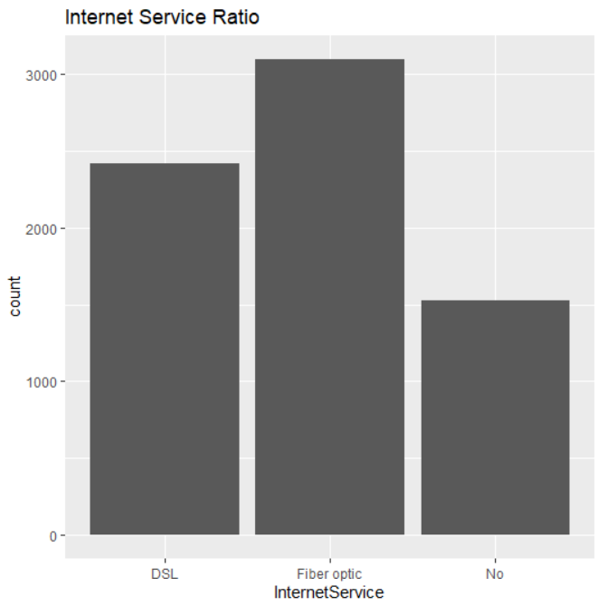
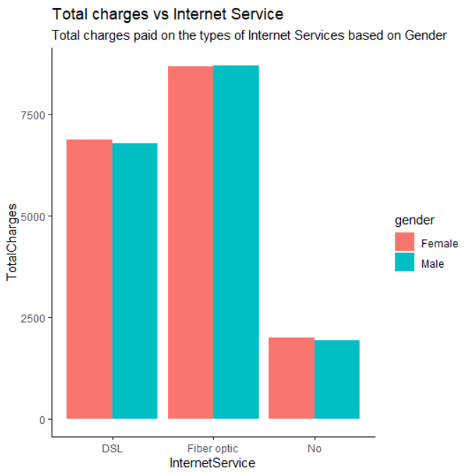
Visualization
The graph below describes number of people who have opted internet service ratio.
The bar graph below describes the total charges vs Internet services with respect to gender.

Slide 11
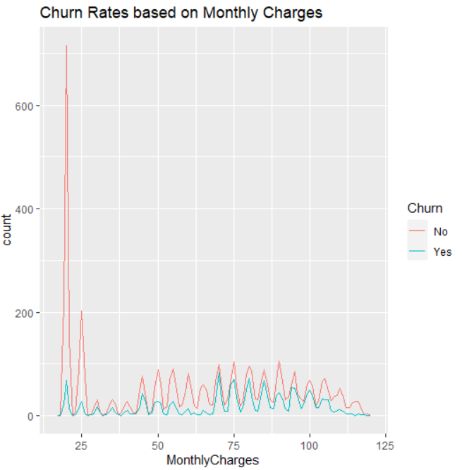
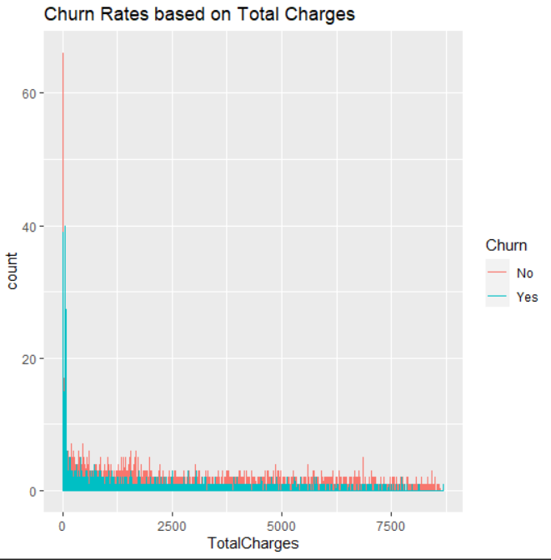
Visualization
The bar graph below describes the count of the Monthly charges with churn rate.
The plot below depicts the count of total charges with the churn rate.

Slide 12
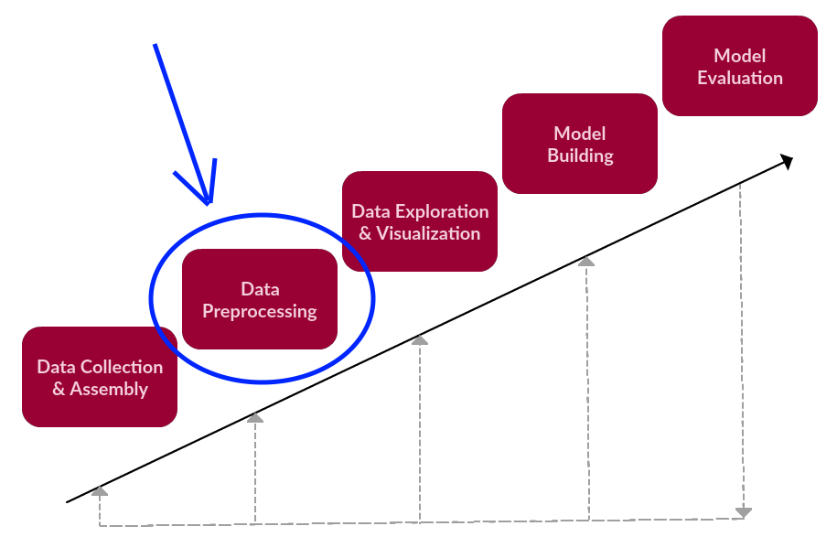
Data Pre-processing
Data Pre-processing is on of the most important step to be performed after loading the data.
To check for the possible issue such as missing values, noisy data and so on.
The pre-processing operations are decided depending on the analysis.
Here are the steps we have performed:
Dropping the unwanted columns
Handling missing values
Dealing with the categorical data
Converting few of the columns into numeric.

Slide 13
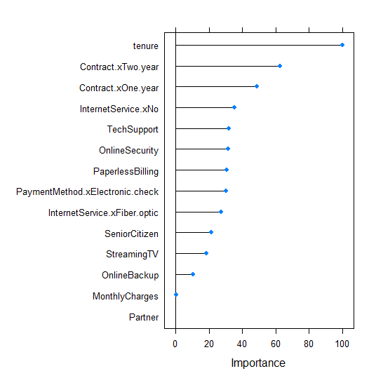
Data Pre-Processing
The chart below depicts the importance
of the columns in the dataset

Slide 14
Modeling Approaches
Mixed data set – binary and discrete data
We have tried different algorithms in modeling to compare and analyze among them.
We have implemented Logistic Regression and SVM with k-cross validation and Naïve Base.
We tried hyper-parameter tuning to find the best possible outcome.
Have obtained the classification report to further asses the models
Predict the churn rate to help the business

Slide 15
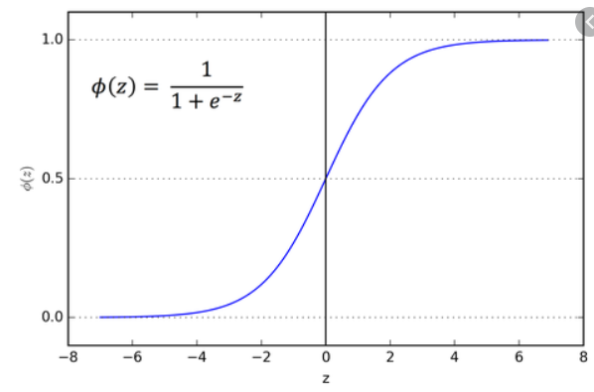
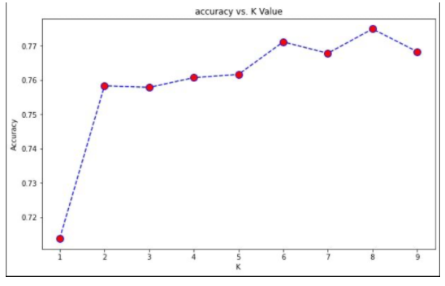
Modeling
The models we have implemented
Logistic Regression
SVN(Support Vector Machine)
KNN(k nearest neighbor)
Naïve Base

Slide 16
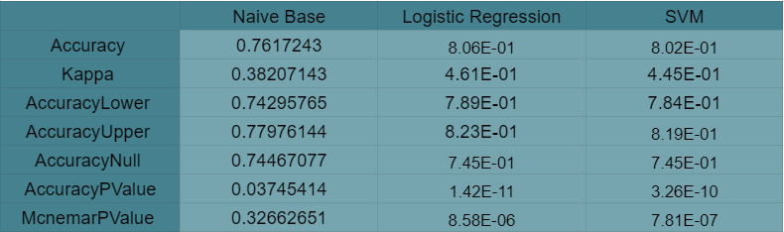
Model Assessment
The table above describes:
Logistic Regression performed the best on most of the measures.
We have tried logistic regression with k-cross validation which gave better results compared to other algorithms
By observing and analyzing all the measures it is clear that there is very negligible differences between the Logistic Regression and SVM.

Slide 17
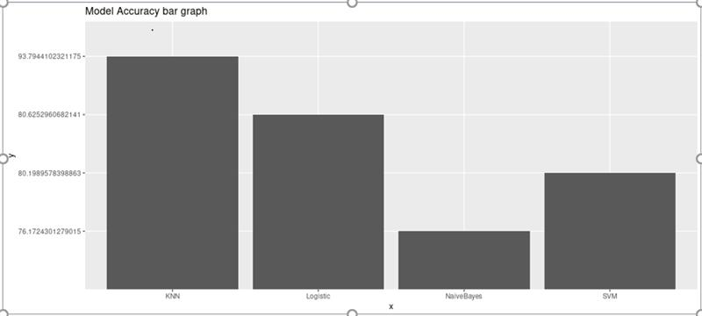

Slide 18
CONCLUSION
TO CONCLUDE THE PROJECT OUR MAIN INTENTION WAS TO IMPROVE THE BUSINESS AND CUSTOMER RETENTION.
WE FIGURE OUT THE VARIABLE OR THE FEATURES WHICH WE HAVE TO CONCENTRATE TO ACHIEVE THE CUSTOMER
RETENTION.
FROM THE MODELS AND VISUALIZATION WE FIGURED OUT THE SERVICES LIKE PHONE SERVICES AND
INTERNET SERVICES WHICH HELPS TO HOLD THE CUSTOMER FOR A LONG DURATION.
WHEN THE TENURE WAS LONGER CUSTOMER TEND TO HAVE LONGER TENURE
WE ALSO TRIED TO OBTAIN SOME INSIGHTS TO TARGET THE CUSTOMERS BASED ON THE GENDER BUT THERE
WAS NEGLIGABLE DIFFERENCES WHERE MALES TEND TO CONTINUE MORE WITH THE COMPANY.

Slide 19
SO WE FOUND MORE SERIOUS AND IMPORTANT INSIGHTS WHEN THE INTERNET AND PHONE SUBSCRIPTIONS WERE THE
CUSTOMERS CONTINUED FOR LONGER DURATION.
THEREFORE WE CAN CONCENTRATE ON TARGETING THE DIFFERENT CUSTOMER GROUPS TO PROVIDE THEM INTERESTING
OFFERS AND SUBSCRIPTION OFFERS TO GAIN THE TRUST OF CUSTOMERS AND RETAIN THEM.

