Slide 1
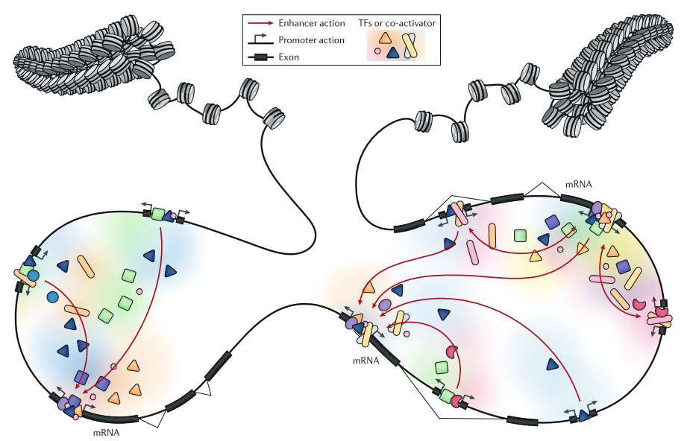

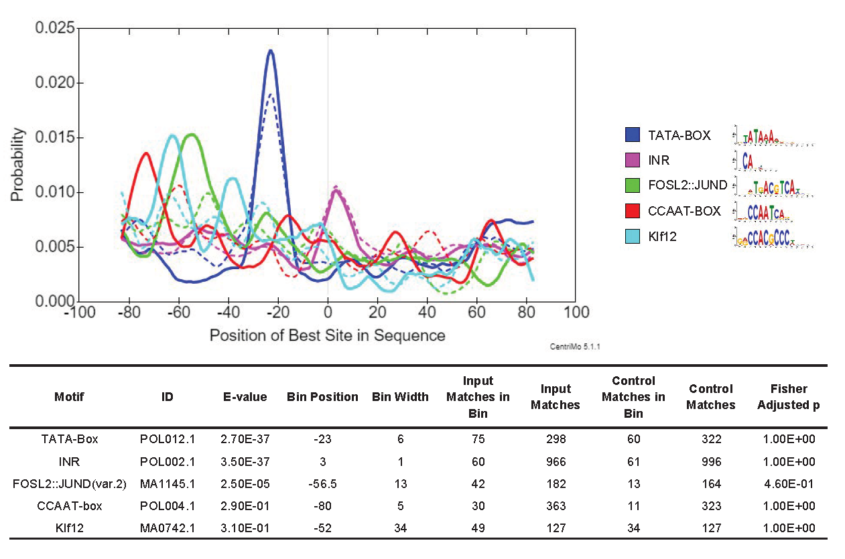
Directionality of eRNA Transcription Burst:
Sequence Features and Transcriptional Context
Less
TSSs
Active Enhancer
Less
TSSs
More
TSSs
Yifan Dai
23/06/2020

Slide 2
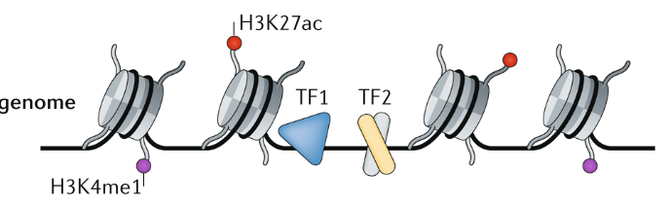
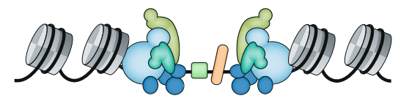

Enhancers can initialize RNA transcription (Kim et al. 2010)
Short (0.5-2kb)
Unspliced
Exosome-sensitive (7.5 min half life)
Non-polyadenylated
1. Andersson, R. & Sandelin, A. Determinants of enhancer and promoter activities of regulatory elements. Nat. Rev. Genet. (2019). doi:10.1038/s41576-019-0173-8
Notes:
Open chromatin ( ATAC-seq peaks, DNAse-seq peaks)
Binding sites with Transcription Factors (TFs)
High H3K4me1-to-H3K4me3 ratio

Slide 3
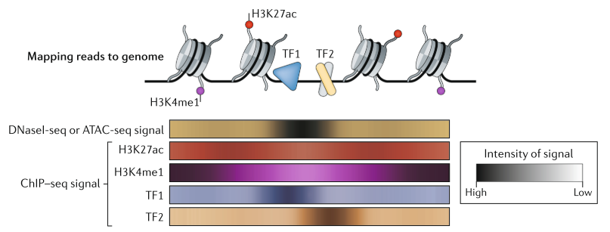
Previous Understanding of Enhancers

Slide 4
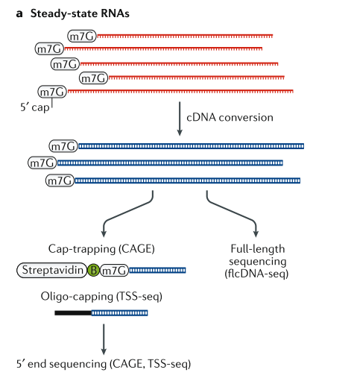
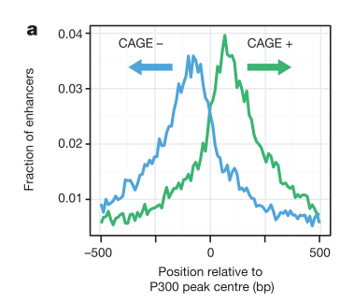
CAGE, a 5’ sequencing technology
1. Andersson, R. et al. An atlas of active enhancers across human cell types and tissues. Nature 507, 455–461 (2014).

Slide 5
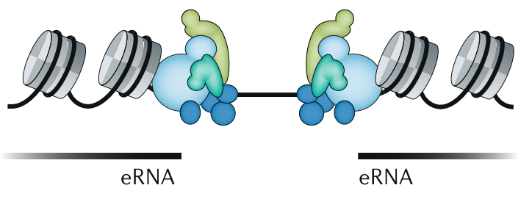
Bidirectional eRNA, a great marker for enhancer activity[1]
CAGE-defined
TSSs
1. Andersson, R. & Sandelin, A. Determinants of enhancer and promoter activities of regulatory elements. Nat. Rev. Genet. (2019). doi:10.1038/s41576-019-0173-8
Notes:
Transcriptional by-product
Transcription of eRNA is important
Initiation or stabilization of enhancer-promoter interaction
Recruitment of Pol II through phase separation
Facilitate elongation by interacting with NELF
eRNAs themselves have specific function
eRNA interacts with specific region on genome
eRNA interacts with specific proteins

Slide 6
Biological function of eRNA remains elusive:
Transcriptional by-product
Transcription of eRNA is important
Initiation or stabilization of enhancer-promoter interaction
Recruitment of Pol II through phase separation
Facilitate elongation by interacting with NELF
eRNAs themselves have specific function
eRNA interacts with specific region on genome
eRNA interacts with specific proteins
…

Slide 7
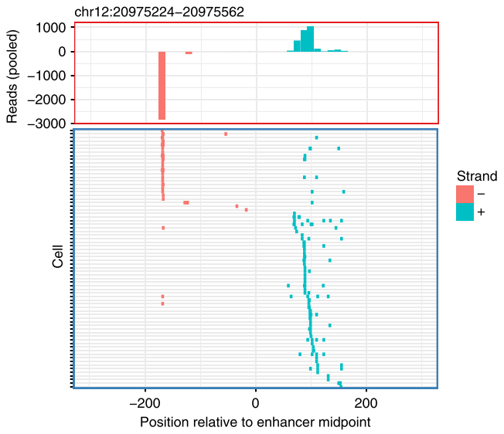
However…
“ eRNAs are transcribed unidirectionally in single cells…in a mutually exclusive manner. ”[2]
Kouno, T. et al. (2019)
2. Kouno, T. et al. C1 CAGE detects transcription start sites and enhancer activity at single-cell resolution. Nat. Commun. 10, (2019).

Slide 8
Are they artifacts? If not, what determines direction in SC?
Randomness,
Sequence,
Chromatin Status?
What does it tell us about eRNA Function?

Slide 9
Raw data
Tumor suppressor TGF-beta treatment on A549 cells
0h, 6h, 24h
3 replicates each
40cells, 41cells, 70cells
C1 CAGE
Remaining cells
Bulk CAGE
(nAnT-iCAGE protocol)
Notes:
no-amplification
non-tagging CAGE libraries

Slide 10
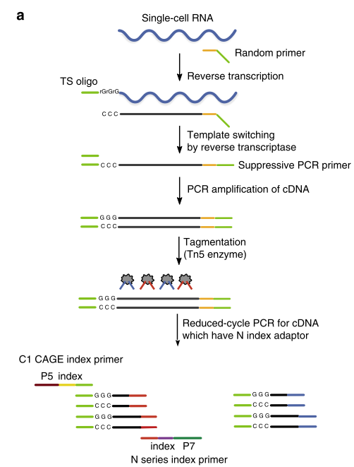
C1 CAGE
Accuracy:
Preference to Capped RNAs
~10% strand invasions
Only 13% reads from rRNA
Sensitivity:
Median 50% detection limit = 22
Notes:
Template switching is the ability of the MMLV reverse transcriptase to introduce a few untemplated nucleotides, predominantly 2-5 cytosines, when it reaches the 5´-end of the RNA template, corresponding to the 3´-end of the newly synthesized cDNA strand. These extra nucleotides work as a docking site for a helper oligonucleotide (“Template Switching Oligonucleotide,” or TSO) that carries 3 riboguanosines at its 3´-end. The reverse transcriptase is then able to “switch template” (from mRNA to the DNA of the TSO) and synthesize a cDNA strand using the helper oligonucleotide as template. Thus, TS makes possible the introduction of an arbitrary sequence at the end of the transcript and, along with the known sequence located at the 5´-end of the oligo-dT primer, allows the efficient amplification of all the transcripts in a cell. Because the sequence on both sides of each cDNA is the same the PCR can be carried out with just one primer, thus exploiting the PCR suppression effect
the 5´- and 3´-terminal fragments recovered by using streptavidin magnetic beads (the TSO and the oligo-dT were both biotinylated),

Slide 11

Identification of bidirectional enhancers on bulk level
A time point specific strategy
Support by 3 replicates
Use threshold Bhattacharyya coefficient (BC) > 0.95 [3]
Intron and intergenic region
Overlapping single-cell signals
$BC=\sqrt{\frac{PD}{2S}}+\sqrt{\frac{MD}{2S}}$
3. Bornholdt J, Saber AT, Lilje B, et al. Identification of Gene Transcription Start Sites and Enhancers Responding to Pulmonary Carbon Nanotube Exposure in Vivo. ACS Nano. 2017;11(4):3597‐3613. doi:10.1021/acsnano.6b07533
Notes:
sqrt((PD/S) * 0.5) + sqrt((MD/S) * 0.5)

Slide 12
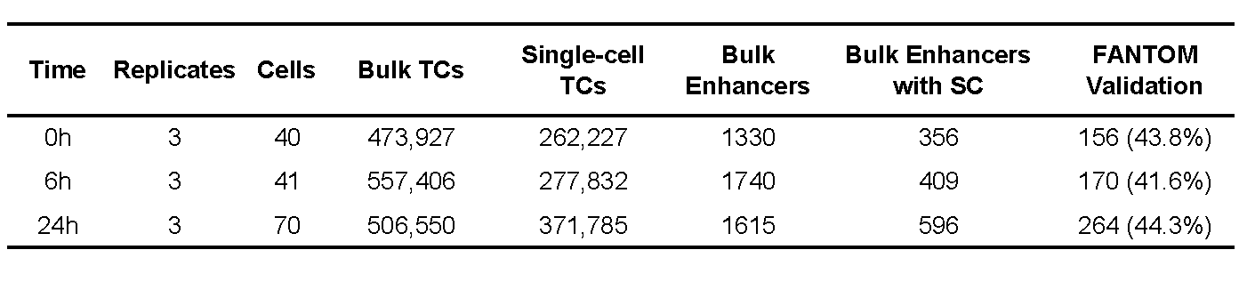
We identified…
Bidirectional, BC > 0.95
Supported by 3 replicates
Intronic or Intergenic
4. SC transcription

Slide 13
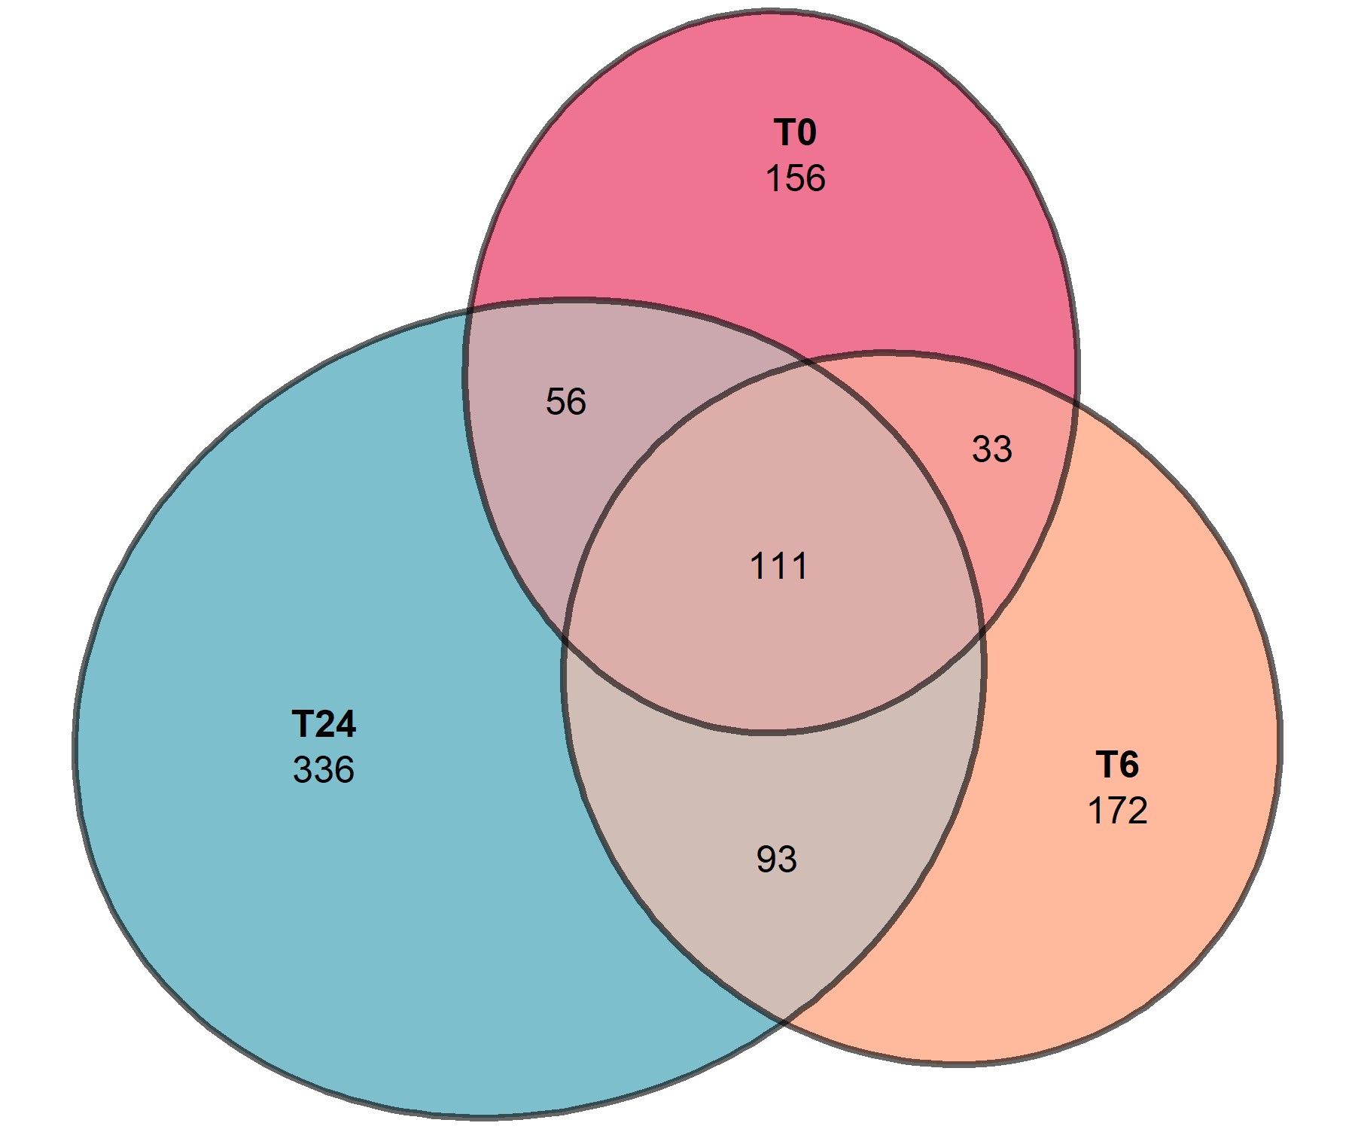
Condition-specific enhancers

Slide 14
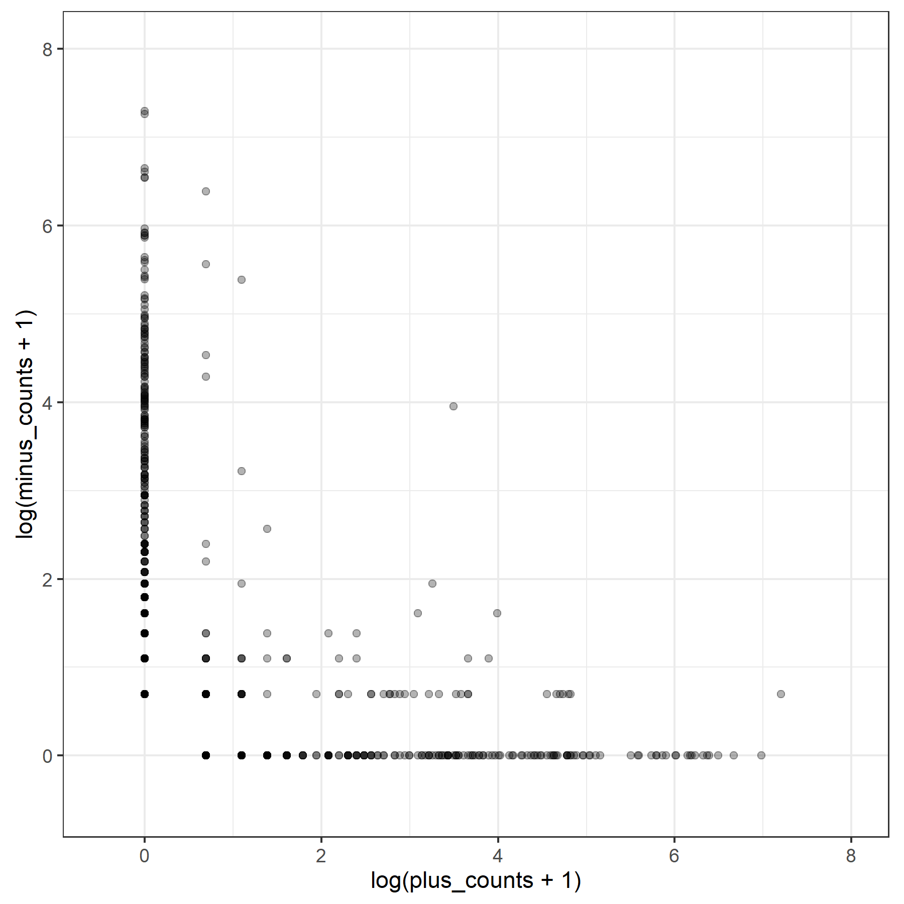
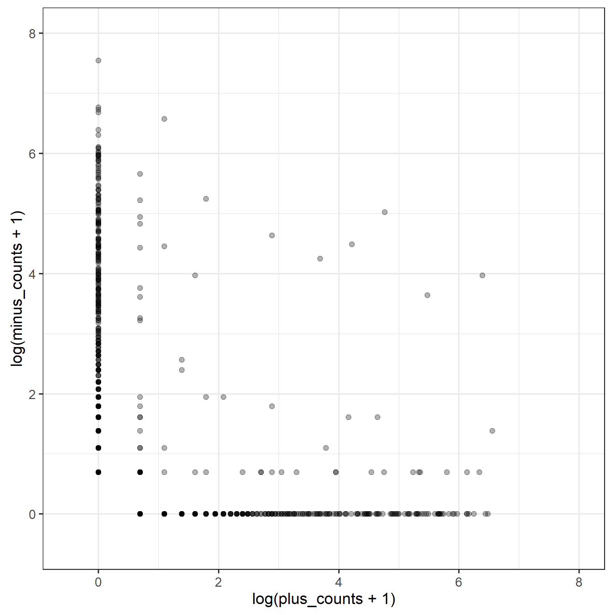
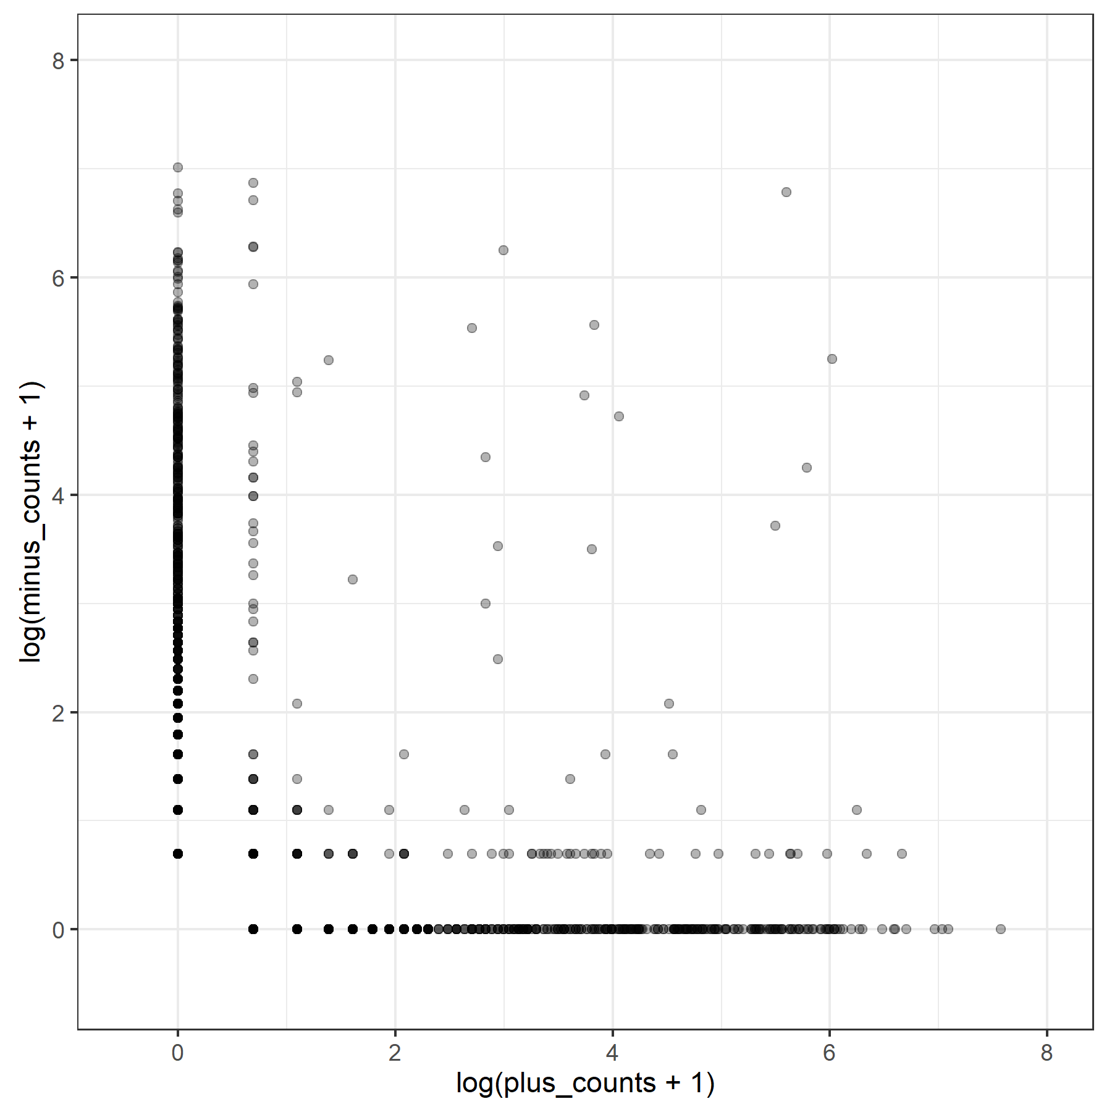
Single cell level transcription: Unidirectional Bursting
SC-Bidirectional
enhancers
T0: 971 enhancer-cell pairs
From 354 enhancers, 40 cells
T6: 1091 enhancer-cell pairs
From 407 enhancers, 41 cells
T24: 1941 enhancer-cell pairs
From 594 enhancers, 70 cells
Notes:
Each point corresponds to an enhancer in a cell

Slide 15
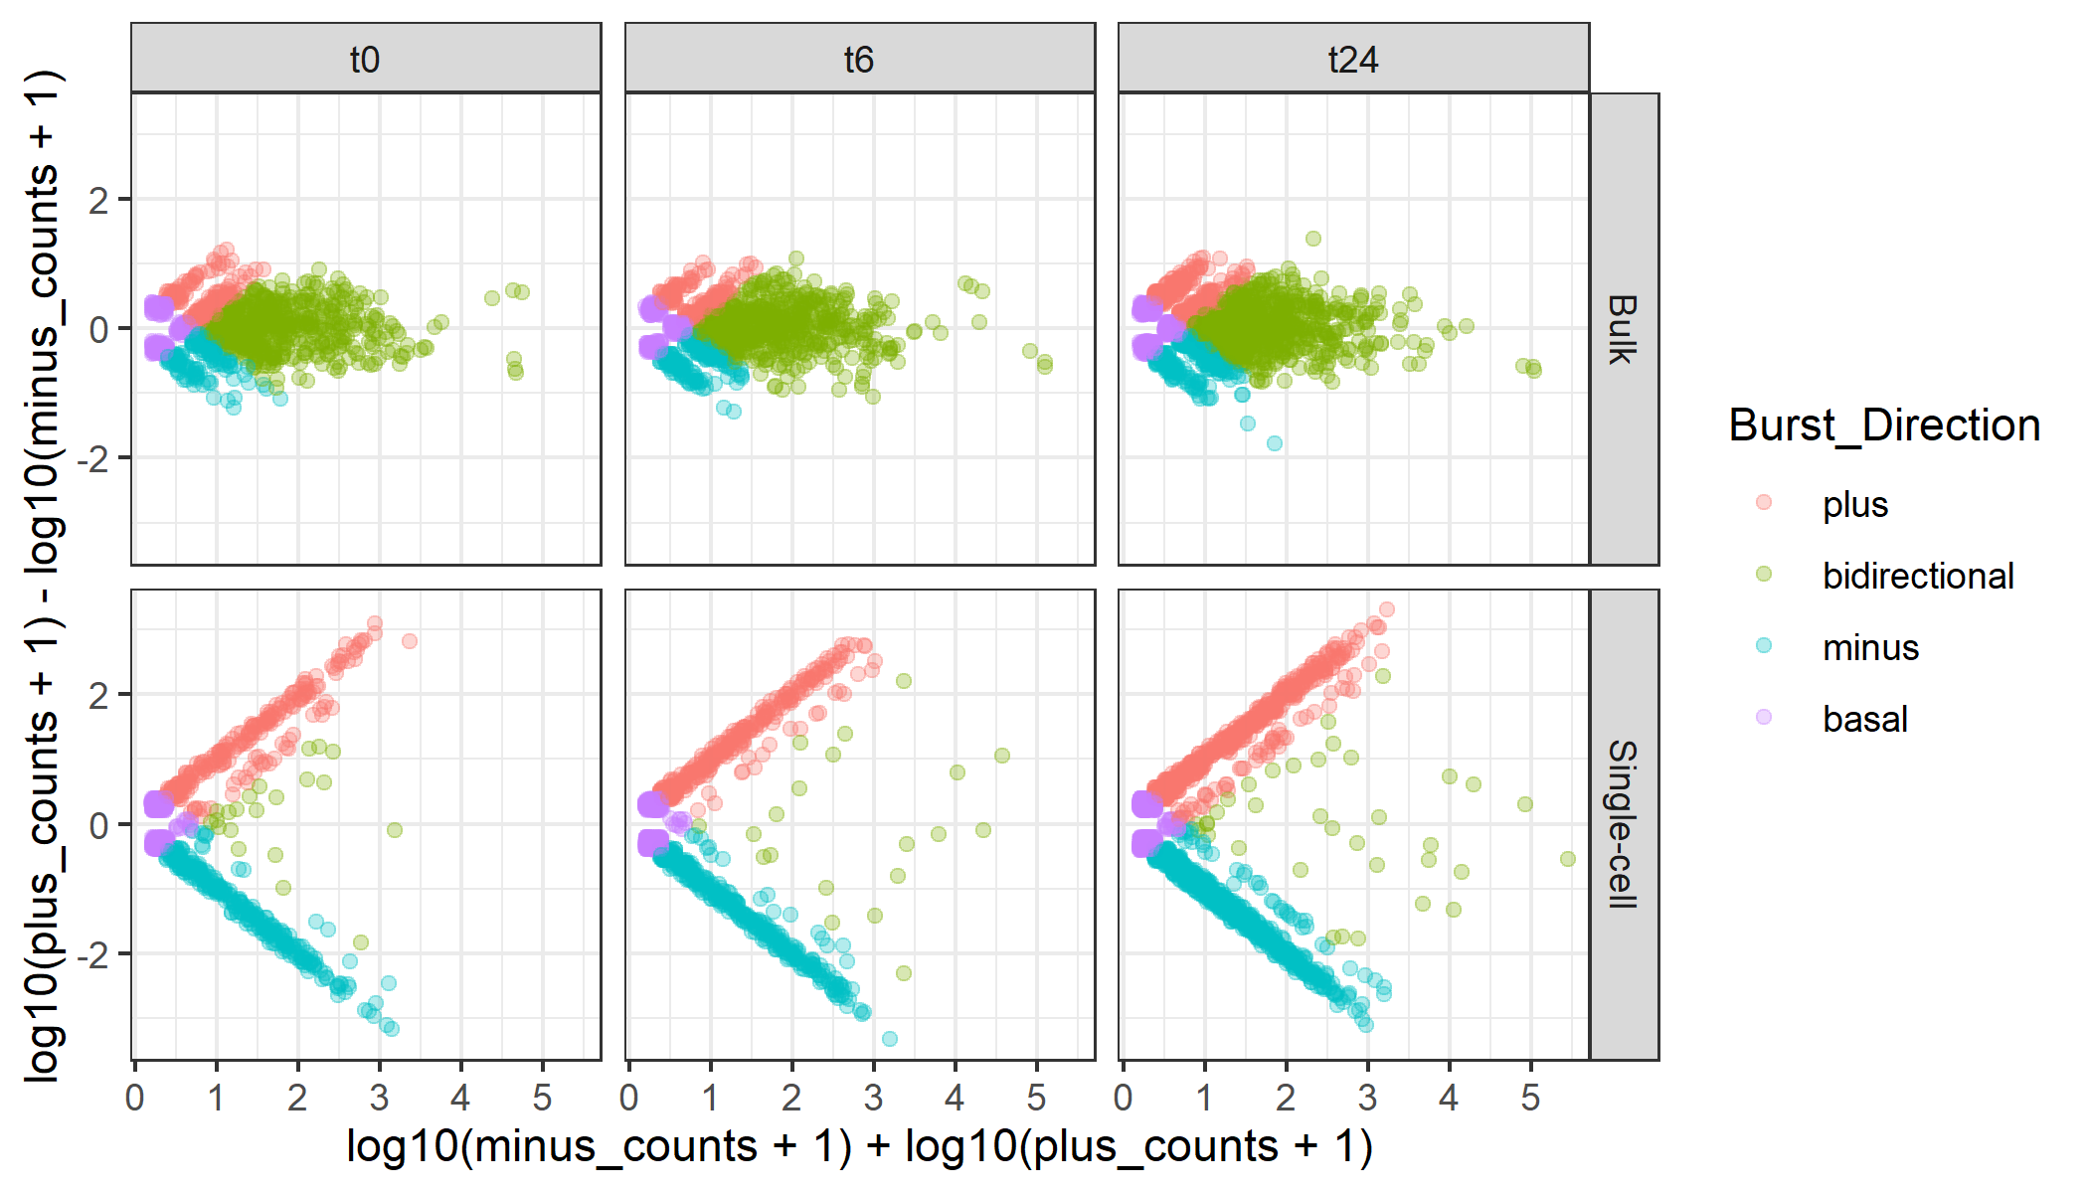
Unidirectional bursting
Plus 164 (15.4%)
Minus 163 (15.4%)
Bidirect 556 (52.6%)
Basal 179 (16.8%)
Plus 171 (14.0%)
Minus 214 (17.5%)
Bidirect 628 (51.4%)
Basal 208 (17.0%)
Plus 321 (18.0%)
Minus 280 (15.7%)
Bidirect 859 (48.2%)
Basal 322 (18.1%)
Plus 237 (26.6%)
Minus 314 (35.2%)
Bidirect 21 ( 2.4% )
Basal 319 (35.8%)
Plus 289 (28.6%)
Minus 367 (36.4%)
Bidirect 20 ( 2.0% )
Basal 333 (33.0%)
Plus 531 (29.5%)
Minus 695 (38.6%)
Bidirect 35 ( 1.9% )
Basal 540 (30.0%)
Notes:
Each point corresponds to an enhancer in a cell

Slide 16
Unidirectionality Supported by
Multiple TSSs
Bulk
SC
SC
Single TSSs
Multiple TSSs
T0: 275‬
T6: 342
T24: 660
T0: 276‬ (50.1%)
T6: 314 (47.9%)
T24: 566 (46.2%)

Slide 17
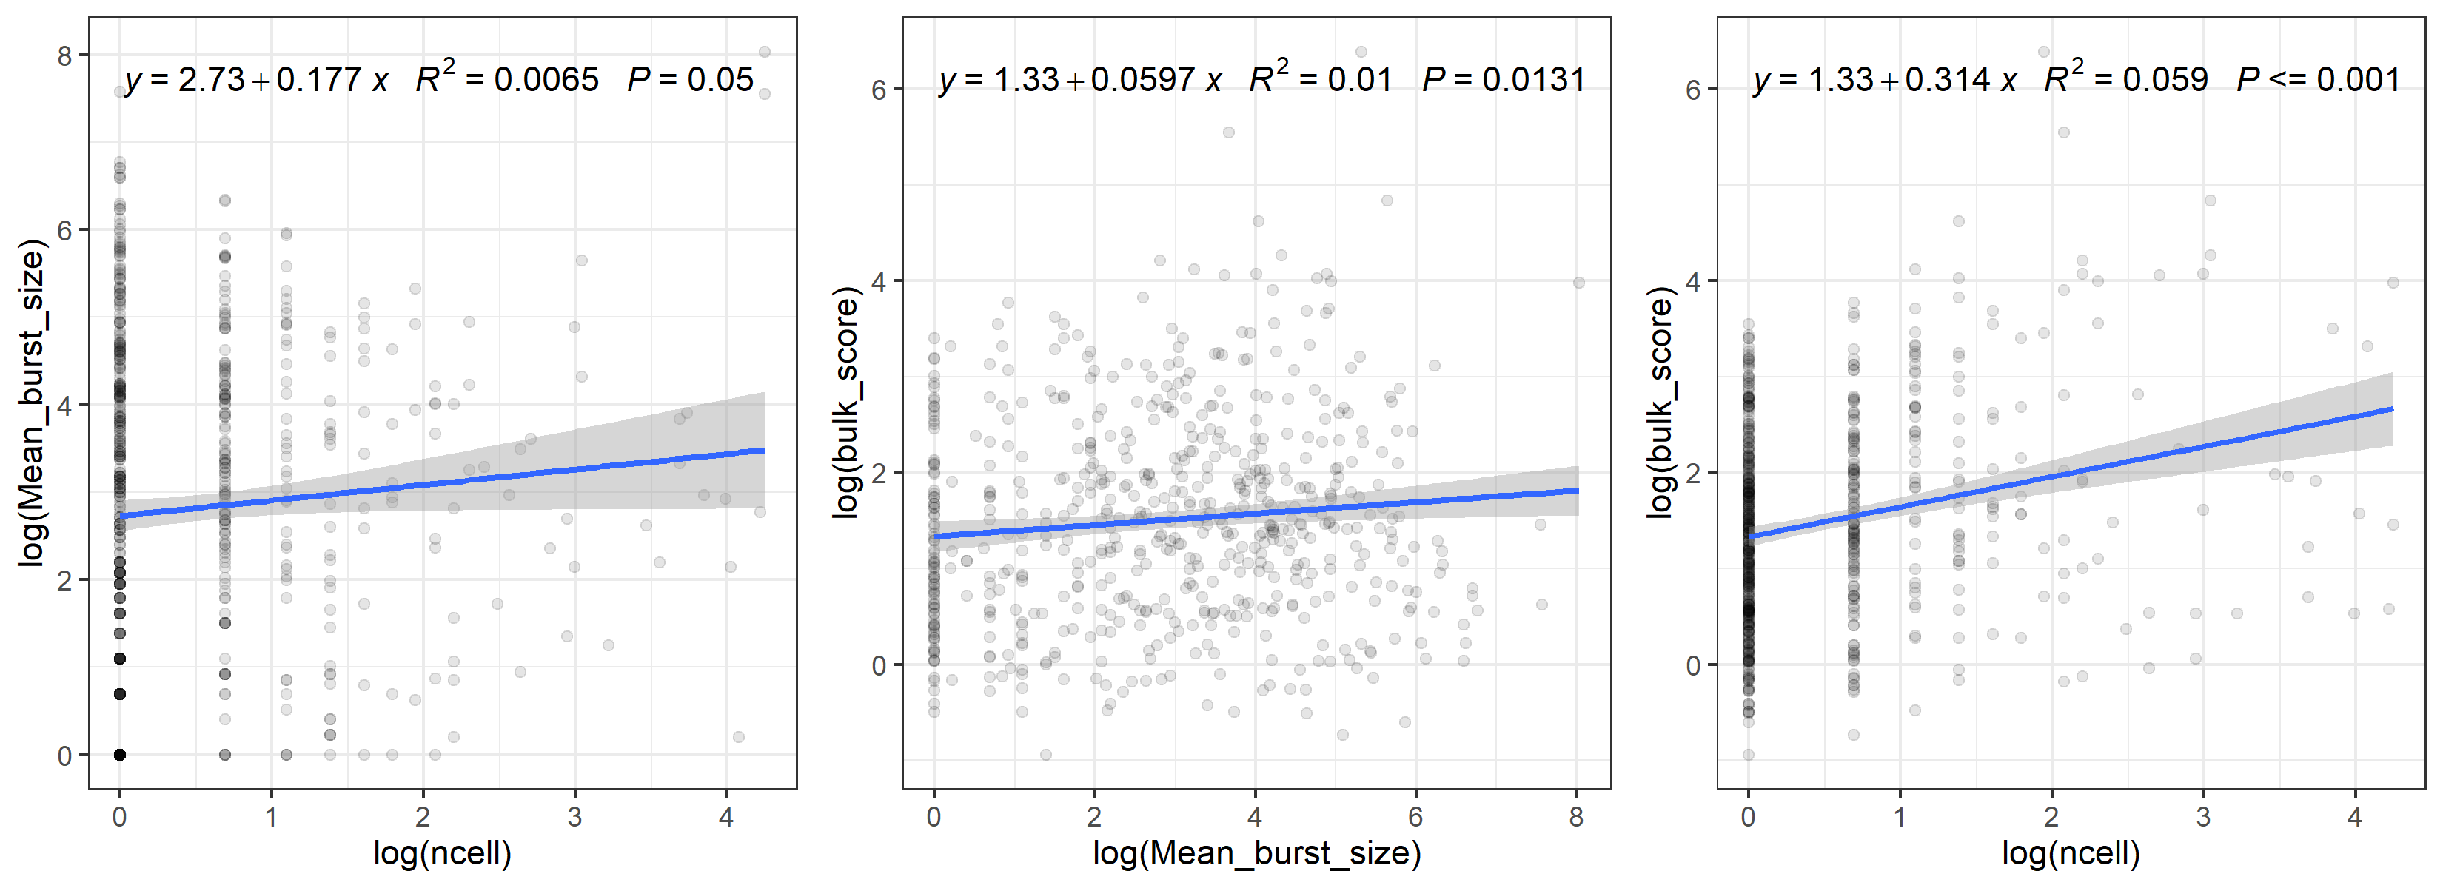
Bulk expression ~ Burst frequency

Slide 18
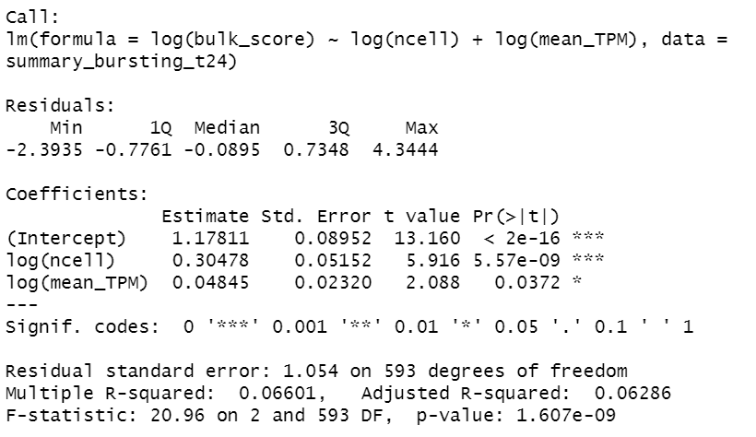
Bulk expression ~ Burst frequency [5]
5. Larsson, A. J. M. et al. Genomic encoding of transcriptional burst kinetics. Nature 565, 251–254 (2019).

Slide 19
Enhancer classified by SC direction
Single Cells
Single Cells
Plus
Minus
Single Cells
Single Cells
Mixed
Bidirectional

Slide 20
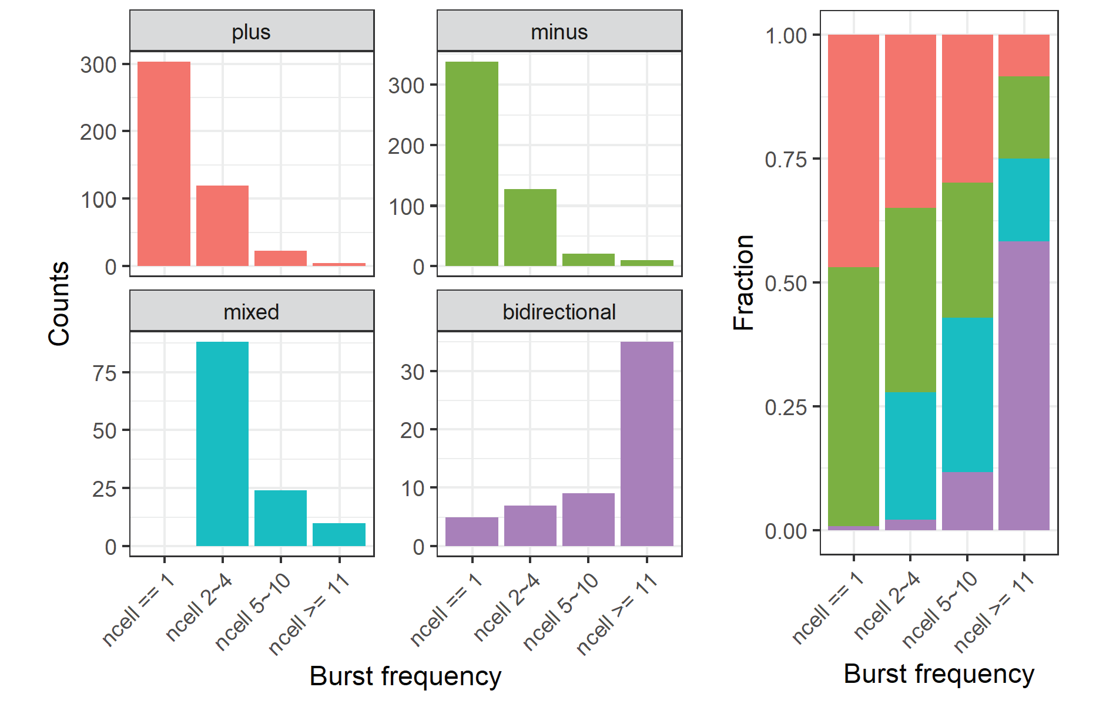
Bidirectionality ~ Burst frequency

Slide 21
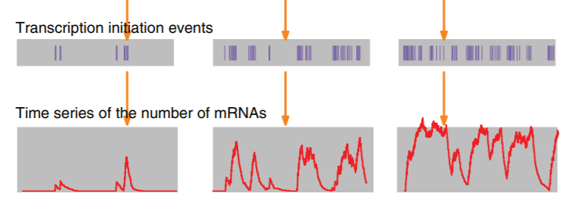
(One possible) Interpretation
Burst Frequency
Probability of coexisting
Opposite Strand eRNAs
1. Wang, Y., Ni, T., Wang, W. & Liu, F. Gene transcription in bursting: a unified mode for realizing accuracy and stochasticity. Biol. Rev. 94, 248–258 (2019).

Slide 22
Determinants of eRNA burst direction?
Random?

Slide 23
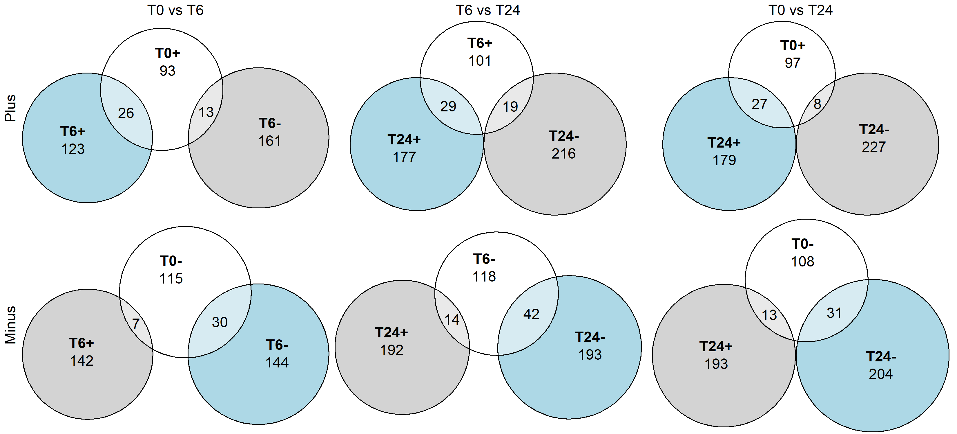
SC Direction are prone to keep over time

Slide 24
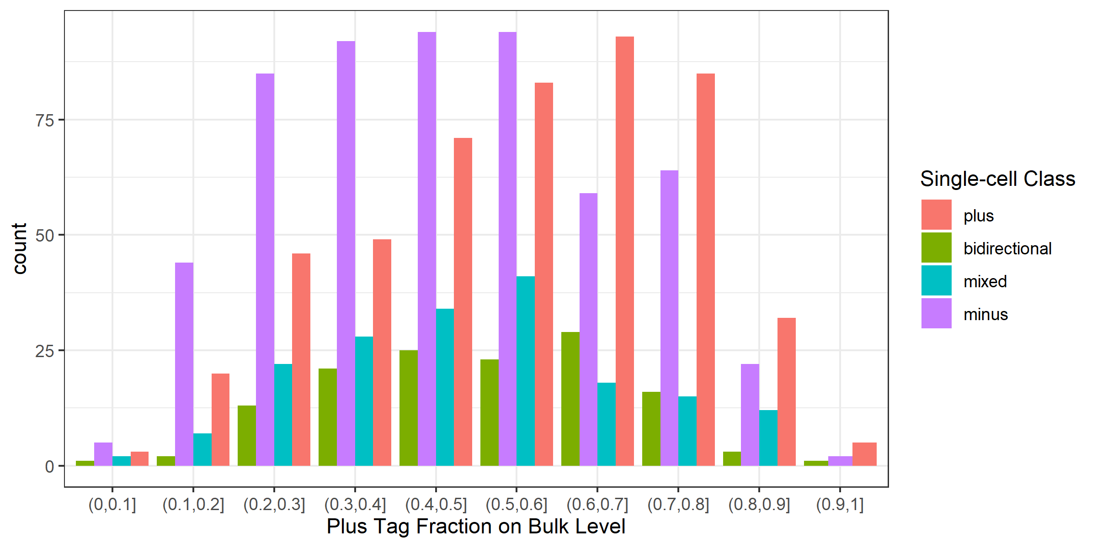
Direction Preference

Slide 25
Preference ~ Sequence features?

Slide 26
Define Main & Minor strand
Main
Minor
Main TSS
Minor TSS

Slide 27
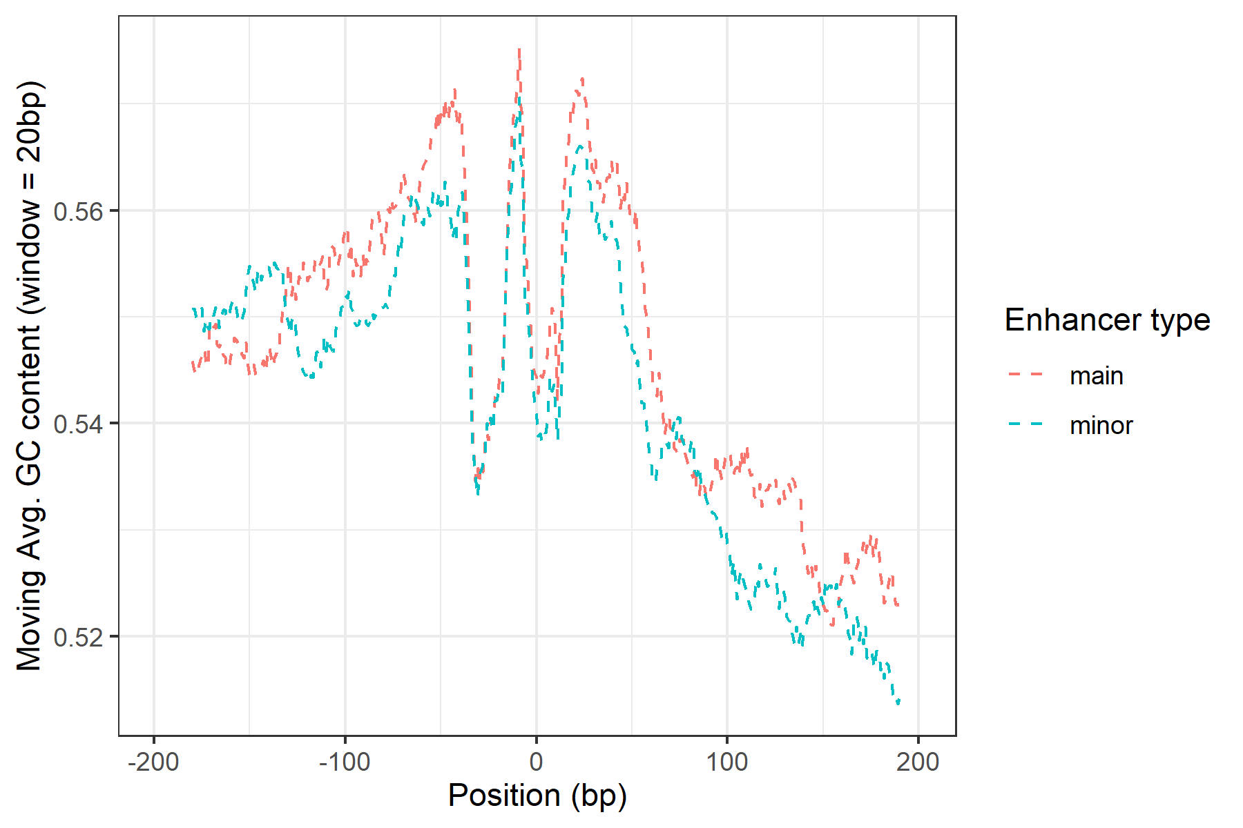
Main ~ Higher CG content
paired t test
t = 2.870
p = 0.0042

Slide 28
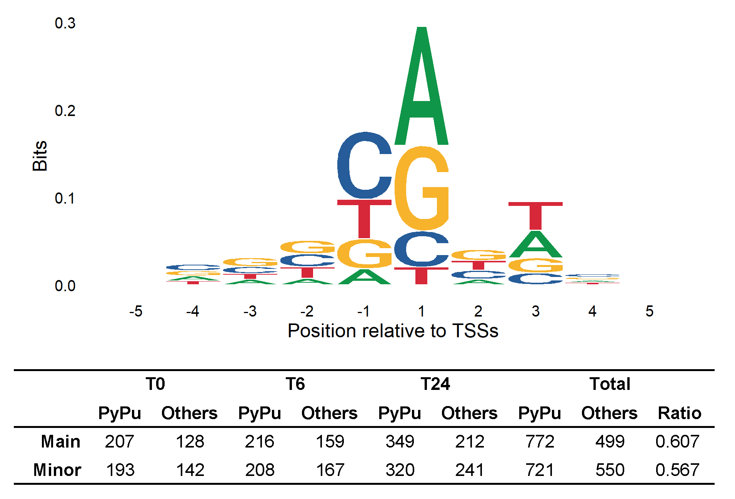
Main ~ More PyPu dinucleotides at TSSs
Fisher’s exact test
p = 0.0439

Slide 29
Enriched Motfis at eRNA TSSs
/
>
/
>
>
>
>
Notes:
1271 total pairs TSSs

Slide 30
Single-cell Context related?

Slide 31
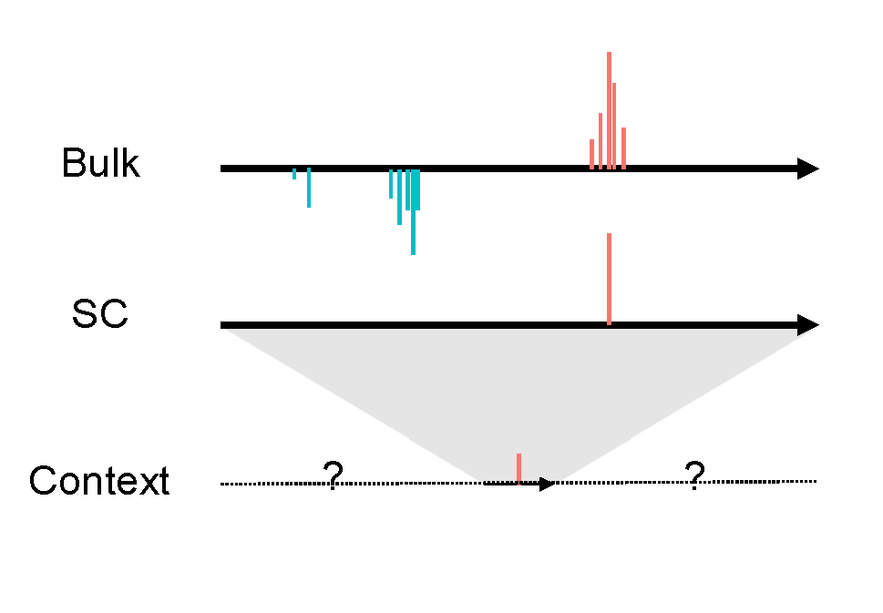
Transcription Contexts

Slide 32
Context Bias Models
Context around a plus enhancer:
Bulk
Bulk
SC
SC
Context
Context
Bias to up/downstream?
Bias to plus/minus strand?

Slide 33
Context Bias Models
Bulk
Bulk
SC
SC
Context
Context
Measured by TPM?
Measured by #of Clusters?

Slide 34










ContextSumBias_dowstream
${TPM}_{a}$
${TPM}_{b}$
Context
$$CSB_downstream= \frac{{TPM}_{b}+{TPM}_{d}}{{TPM}_{a}+{TPM}_{b}+{TPM}_{c}+{TPM}_{d}}$$
${TPM}_{c}$
${TPM}_{d}$
ContextNumBias_dowstream
$N_{a}$
$N_{b}$
$$CNB_downstream= \frac{N_{b}+N_{d}}{N_{a}+N_{b}+N_{c}+N_{d}}$$
Context
$N_{c}$
$N_{d}$

Slide 35
Regression model
For each enhancer i and cell j
Regress out
Other factors
$$log⁡({PlusCounts}_{ij}+1)−log⁡({MinusCounts}_{ij}+1)$$
M_ij ~ Active_ij + txType_i + eid_i + A_ij
+ ContextSumBias_dowstream_ij
+ ContextSumBias_plus_ij
+ ContextNumBias_downstream_ij
+ ContextNumBias_plus_ij
$$\log\left({PlusCounts}_{ij}+1\right)+log⁡({MinusCounts}_{ij}+1)$$
Notes:
where:
ContextSumBias_dowstream_ij = (TPM_dn+TPM_dp)/(TPM_dn+TPM_dp+TPM_un+TPM_up) for each enhancer i, cell j
ContextSumBias_plus_ij = (TPM_up+TPM_dp)/(TPM_dn+TPM_dp+TPM_un+TPM_up) for each enhancer i, cell j
ContextNumBias_downstream_ij = (nPos_dn+nPos_dp)/(nPos_dn+nPos_dp+nPos_un+nPos_up) for each enhancer i, cell j
ContextNumBias_plus_ij = (nPos_up+nPos_dp)/(nPos_dn+nPos_dp+nPos_un+nPos_up) for each enhancer i, cell j
Active_ij = whether enhancer i is active (TPM>0) in cell j
TxType_i = whether enhancer i is located at intron or intergenic region
eid_i = enhancer id
M_ij = log(plus_counts_ij+1)-log(minus_counts_ij+1) for each enhancer i, cell j
A_ij = log(plus_counts_ij+1)+log(minus_counts_ij+1) for each enhancer i, cell j

Slide 36
Regression result
Notes:
blue

Slide 37
Regression result (Cumulative TPM)

Slide 38
Regression result (Cumulative #of TCs)

Slide 39
Suggested Model
Bulk
SC
Context
Availability
(Interpretation)

Slide 40
Interpretation
Less
TSSs
Active Enhancer
Less
TSSs
More
TSSs

Slide 41
Conclusions:
eRNAs are transcribed through unidirectional bursts. Bidirectionality is related with high burst frequency.
Single-cell direction partially accord with bulk direction preference.
Direction preference can be partially attributed to sequence features.
Downstream of eRNA transcription features larger number of TSSs.

Slide 42
In the Future
Model single-cell TSSs density
Integration with chromatin accessibility data (e.g. ATAC)
More tests for generalization
Co-expression map integration with TAD data

Slide 43
Perspectives:
Single-cell resolution → High temporal resolution
High resolution enables detail investigation in mechanism
Feedback about enhancer identification

Slide 44
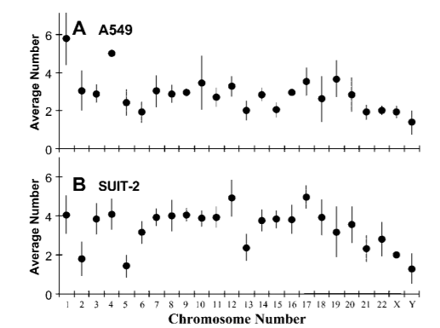
Limitations
1. CAGE unable to distinguish tags from different alleles
1. Isaka, T., Nestor, A. L., Takada, T. & Allison, D. C. Chromosomal variations within aneuploid cancer lines. J. Histochem. Cytochem. 51, 1343–1353 (2003).

Slide 45
Limitations
2. Unique molecular identifiers (UMI) failed in C1 CAGE data
“However, we have not utilized them for molecular counting, because the TSOs carried over from the reverse-transcription could prime the subsequent
PCR reaction while tolerating mismatches on the UMI sequence, thus causing a high level of mutation rate (as evidenced by the fact that most UMIs are seen only once)”
1. Kouno, T. et al. C1 CAGE detects transcription start sites and enhancer activity at single-cell resolution. Nat. Commun. 10, (2019).

Slide 46
Limitations
3. Strand Invasion in template switching
We quantify the level of strand invasion to be ~10% in C1 CAGE
1. Kouno, T. et al. C1 CAGE detects transcription start sites and enhancer activity at single-cell resolution. Nat. Commun. 10, (2019).

Slide 47
Questions
1. Low validation rate?
FANTOM Annotated enhancer database is growing.
Enhancers are treatment specific

Slide 48
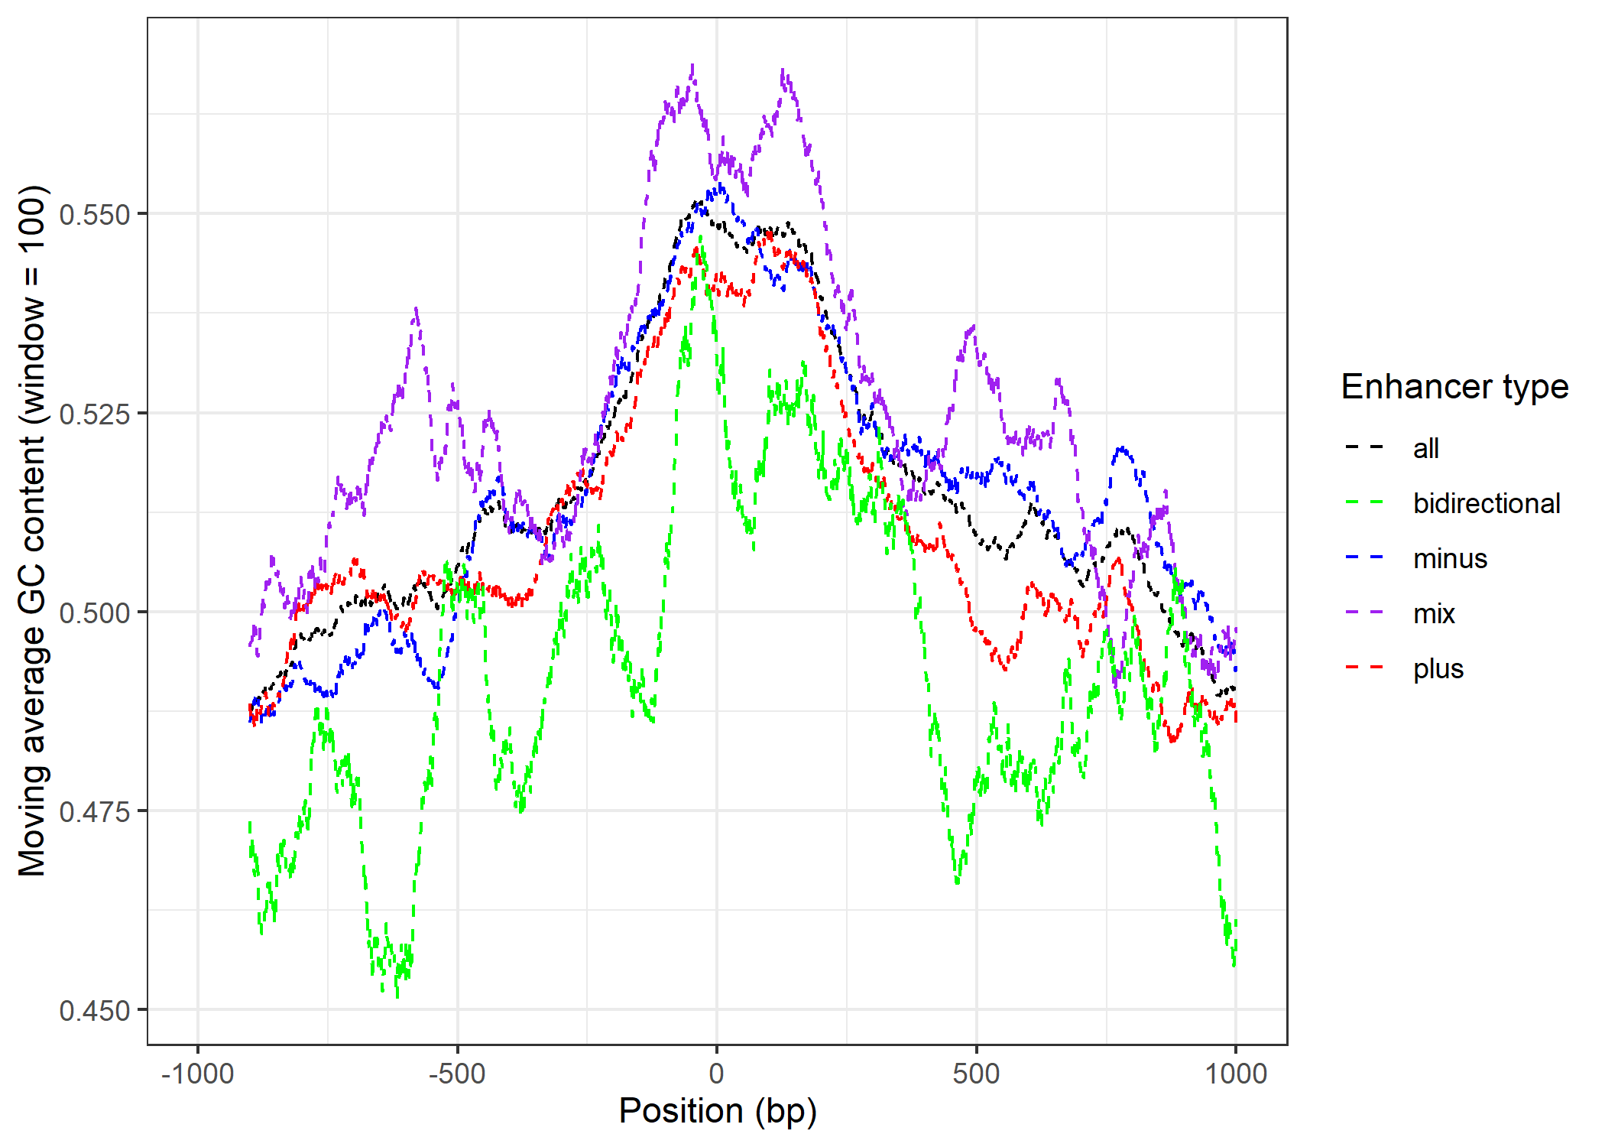
Questions
1. Sequence feature of bidirectional enhancer?

Slide 49
Questions
2. Technical Tricks in C1 CAGE
Suppressive PCR:
Repressing the shortest amplicons by formation of “panhandle” structures
1. Siebert, P. D., Chenchik, A., Kellogg, D. E., Lukyanov, K. A. & Lukyanov, S. A. An improved PCR method for walking in uncloned genomic DNA. Nucleic Acids Res. 23, 1087–1088 (1995).
Notes:
Template switching is the ability of the MMLV reverse transcriptase to introduce a few untemplated nucleotides, predominantly 2-5 cytosines, when it reaches the 5´-end of the RNA template, corresponding to the 3´-end of the newly synthesized cDNA strand. These extra nucleotides work as a docking site for a helper oligonucleotide (“Template Switching Oligonucleotide,” or TSO) that carries 3 riboguanosines at its 3´-end. The reverse transcriptase is then able to “switch template” (from mRNA to the DNA of the TSO) and synthesize a cDNA strand using the helper oligonucleotide as template. Thus, TS makes possible the introduction of an arbitrary sequence at the end of the transcript and, along with the known sequence located at the 5´-end of the oligo-dT primer, allows the efficient amplification of all the transcripts in a cell. Because the sequence on both sides of each cDNA is the same the PCR can be carried out with just one primer, thus exploiting the PCR suppression effect
the 5´- and 3´-terminal fragments recovered by using streptavidin magnetic beads (the TSO and the oligo-dT were both biotinylated),

Slide 50
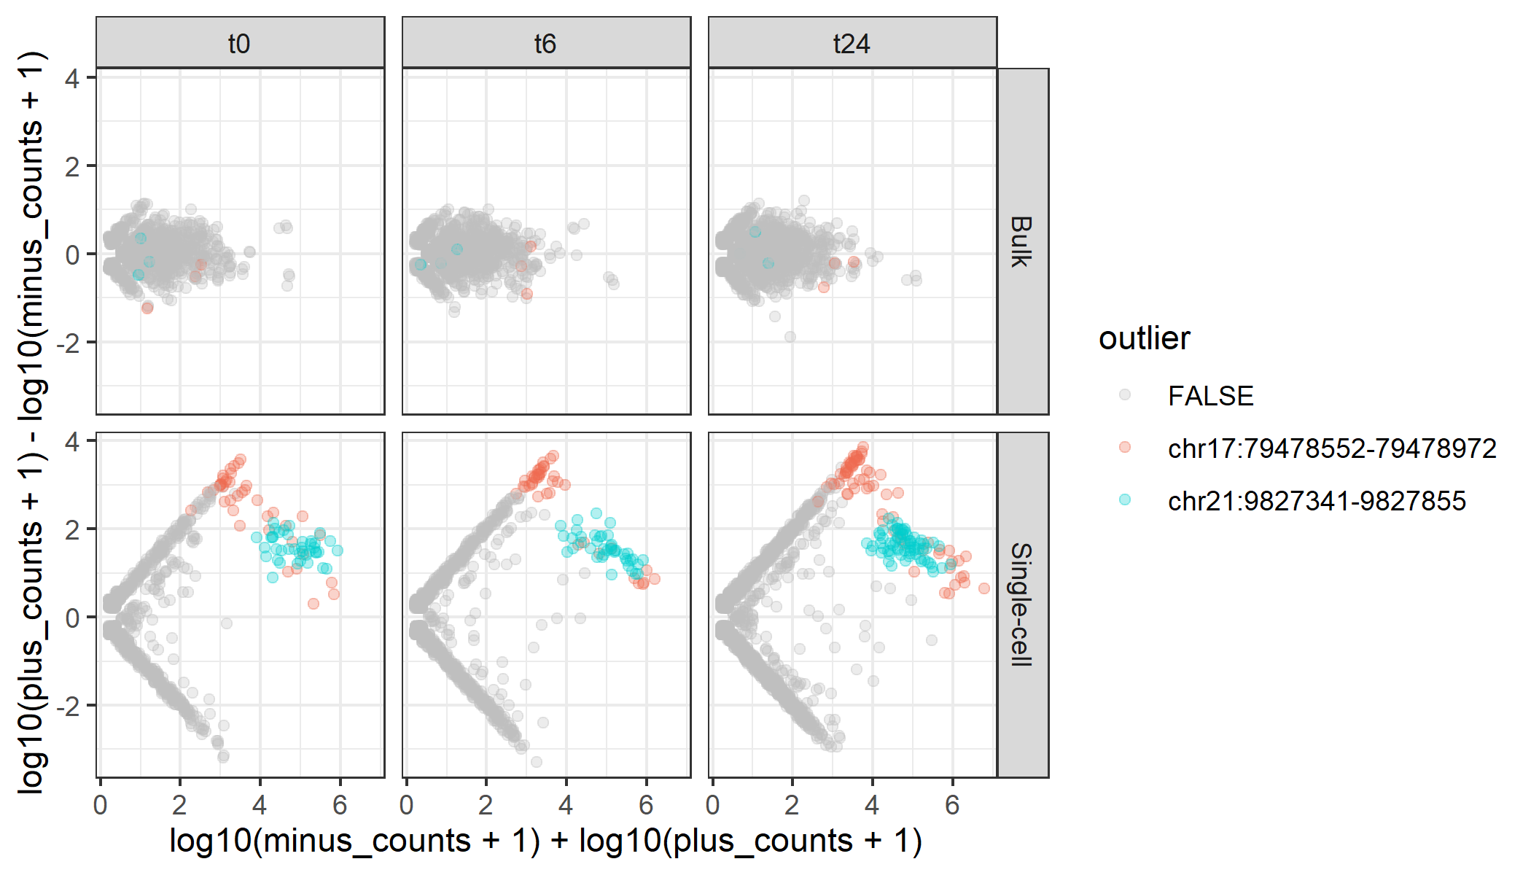
Questions
3. Removed 2 outliers

Slide 51
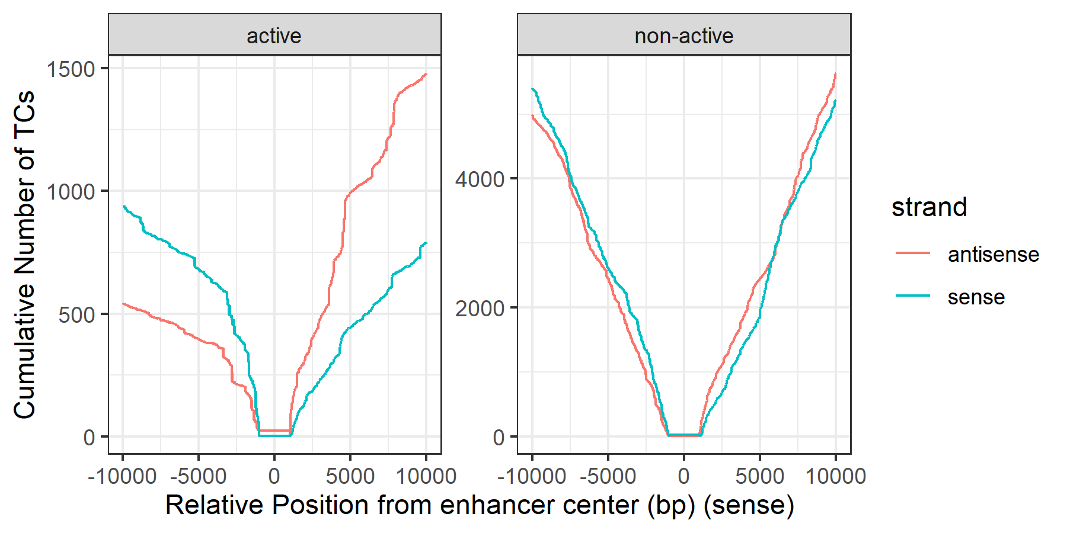
Questions
4. Active enhancers ~ Imbalanced transcription context

Slide 52
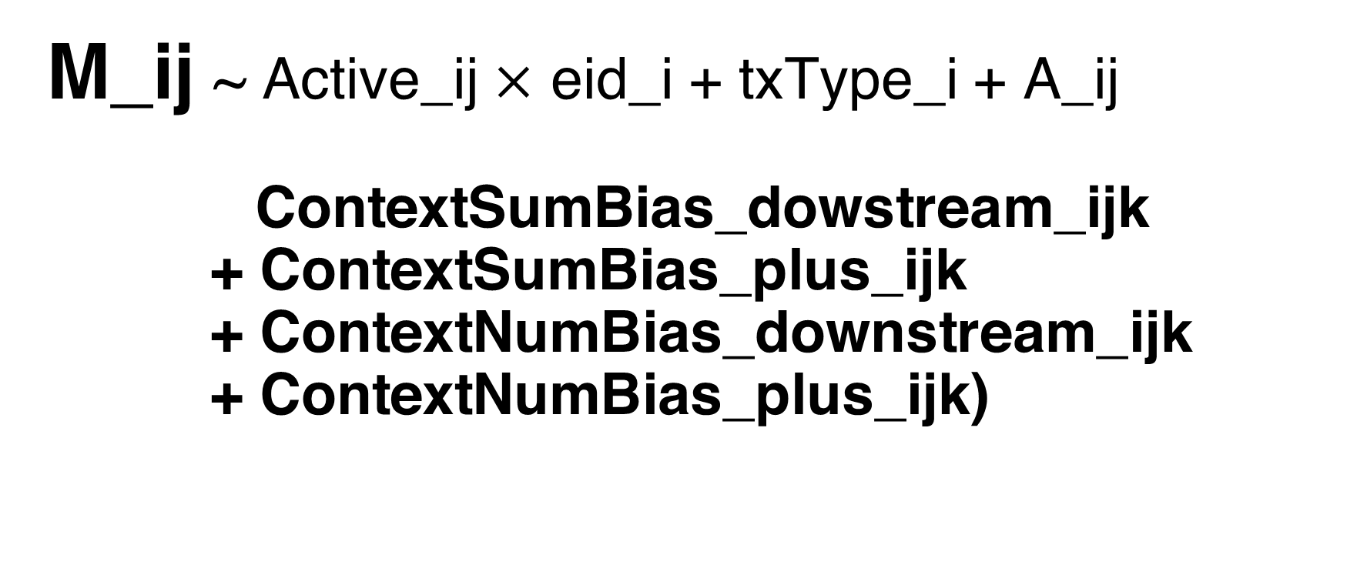

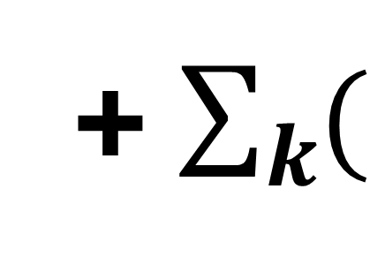
Questions
4. Improvement of Regression Model
For each enhancer i , cell j, context annotated type k
Regress out
Other factors
M_ij ~ Active_ij $×$ eid_i + txType_i + A_ij
ContextSumBias_dowstream_ijk
+ ContextSumBias_plus_ijk
+ ContextNumBias_downstream_ijk
+ ContextNumBias_plus_ijk)
+ $\sum_{k}{(}$
$$)$$
Notes:
where:
ContextSumBias_dowstream_ij = (TPM_dn+TPM_dp)/(TPM_dn+TPM_dp+TPM_un+TPM_up) for each enhancer i, cell j
ContextSumBias_plus_ij = (TPM_up+TPM_dp)/(TPM_dn+TPM_dp+TPM_un+TPM_up) for each enhancer i, cell j
ContextNumBias_downstream_ij = (nPos_dn+nPos_dp)/(nPos_dn+nPos_dp+nPos_un+nPos_up) for each enhancer i, cell j
ContextNumBias_plus_ij = (nPos_up+nPos_dp)/(nPos_dn+nPos_dp+nPos_un+nPos_up) for each enhancer i, cell j
Active_ij = whether enhancer i is active (TPM>0) in cell j
TxType_i = whether enhancer i is located at intron or intergenic region
eid_i = enhancer id
M_ij = log(plus_counts_ij+1)-log(minus_counts_ij+1) for each enhancer i, cell j
A_ij = log(plus_counts_ij+1)+log(minus_counts_ij+1) for each enhancer i, cell j

Slide 53
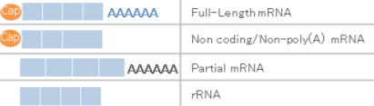
Corrigendum
“The world's first published single-cell 5' sequencing data”
→ The first published single-cell CAGE data
Only C1 CAGE provides strand-specific whole-transcriptome coverage: its detection of 5ʹ-ends is independent from transcript length and polyadenylation owing to the use of random primers.

