Slide 1
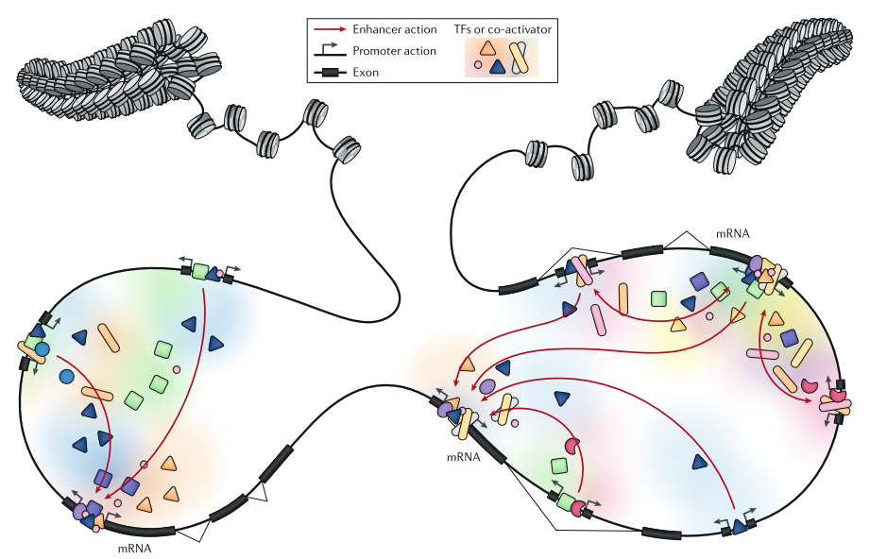

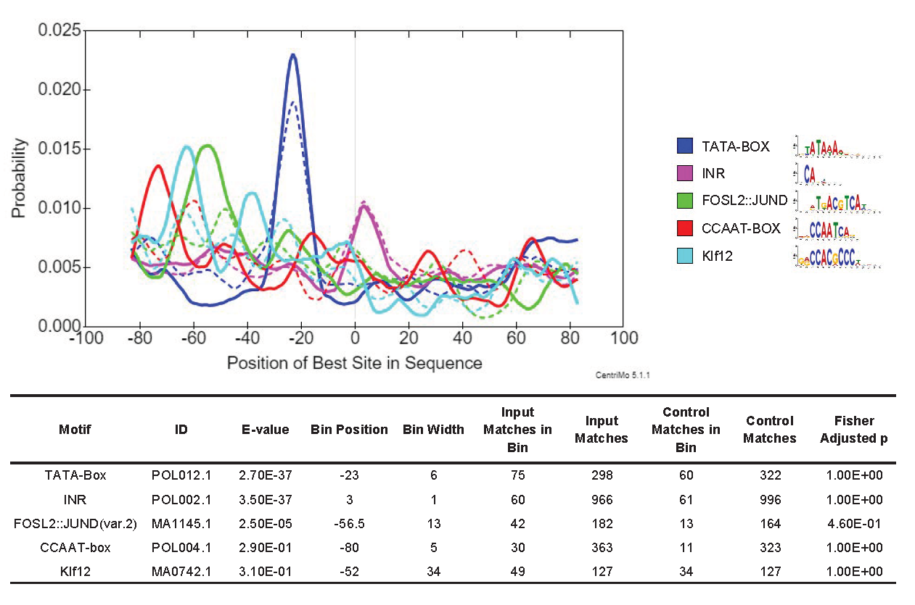
Directionality of eRNA Transcription Burst:
Sequence Features and Transcriptional Context
Less
TSSs
Active Enhancer
Less
TSSs
More
TSSs
Yifan Dai
Supervisor: Albin Sandelin
23/06/2020

Slide 2
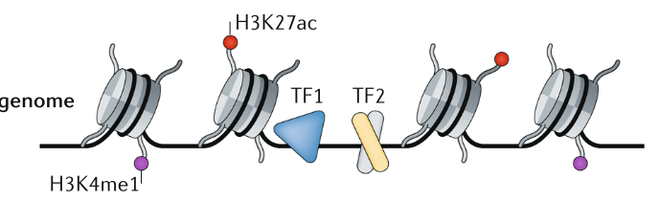
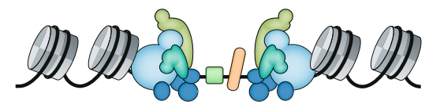

Enhancers can initialize RNA Transcription (Kim et al. 2010)
Short (0.5-2kb)
Unspliced
Exosome-sensitive (7.5 min half life)
Non-polyadenylated
1. Andersson, R. & Sandelin, A. Determinants of enhancer and promoter activities of regulatory elements. Nat. Rev. Genet. (2019). doi:10.1038/s41576-019-0173-8
Notes:
Open chromatin ( ATAC-seq peaks, DNAse-seq peaks)
Binding sites with Transcription Factors (TFs)
High H3K4me1-to-H3K4me3 ratio

Slide 3
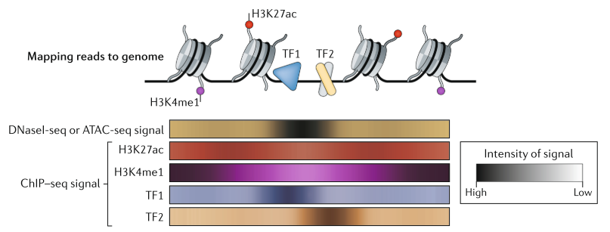
Previous Understanding of Enhancers

Slide 4
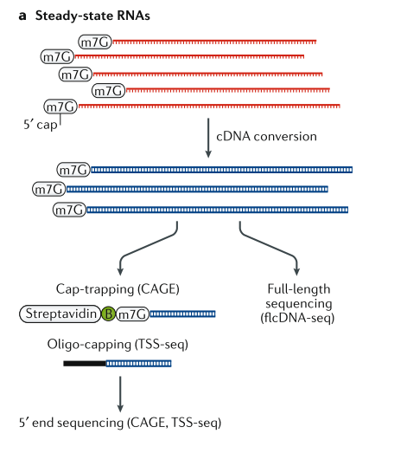
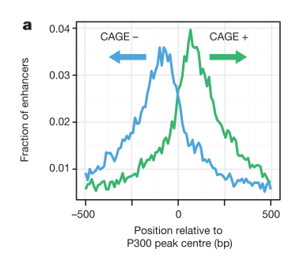

CAGE, a 5’ sequencing technology
1. Andersson, R. et al. An atlas of active enhancers across human cell types and tissues. Nature 507, 455–461 (2014).

Slide 5
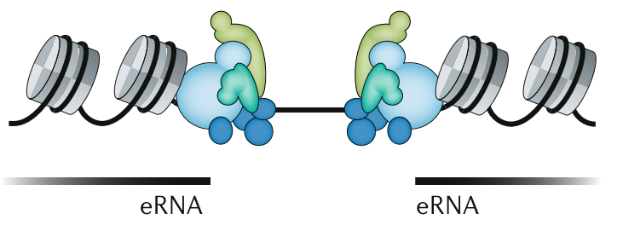
Bidirectional eRNA TSSs, the state-of-art marker for active enhancer[1]
CAGE-defined
Enhancers
1. Andersson, R. & Sandelin, A. Determinants of enhancer and promoter activities of regulatory elements. Nat. Rev. Genet. (2019). doi:10.1038/s41576-019-0173-8
Notes:
Transcriptional by-product
Transcription of eRNA is important
Initiation or stabilization of enhancer-promoter interaction
Recruitment of Pol II through phase separation
Facilitate elongation by interacting with NELF
eRNAs themselves have specific function
eRNA interacts with specific region on genome
eRNA interacts with specific proteins

Slide 6
Biological function of eRNA remains elusive:
Transcriptional noise [1]
Functional eRNAs molecules
Initiation or stabilization of enhancer-promoter interaction[2]
Recruitment of Pol II through phase separation[3]
The Transcription matters
1. Lead to chromatin remodeling[4]
[1] Arnold, P. R., Wells, A. D. & Li, X. C. Diversity and Emerging Roles of Enhancer RNA in Regulation of Gene Expression and Cell Fate. Front. Cell Dev. Biol. 7, 1–14 (2020).
[2] Hsieh, C. L. et al. Enhancer RNAs participate in androgen receptor-driven looping that selectively enhances gene activation. Proc. Natl. Acad. Sci. U. S. A. 111, 7319–7324 (2014).
[3] Nair, S. J. et al. Phase of ligand-activated enhancers licenses cooperative chromosomal enhancer assembly. Nat. Struct. Mol. Biol. 26, 193–203 (2019).
[4] Kaikkonen, M. U. et al. Remodeling of the enhancer landscape during macrophage activation is coupled to enhancer transcription. Mol. Cell 51, 310–325 (2013).

Slide 7
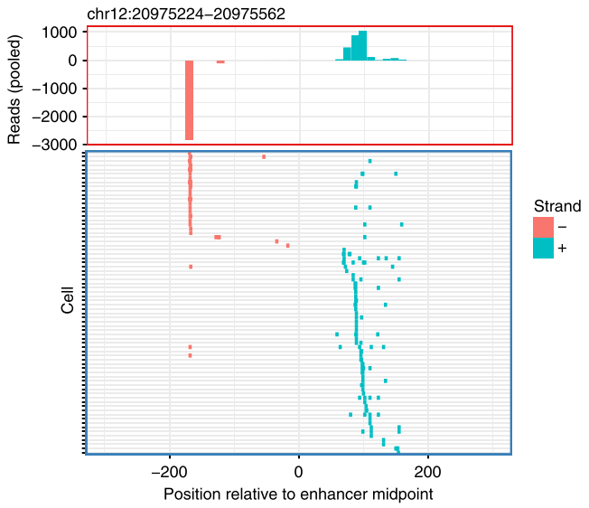
Bidirectional, or Unidirectional mixed
“ eRNAs are transcribed unidirectionally in single cells…in a mutually exclusive manner. ”[2]
Kouno, T. et al. (2019)
… However, they did not extend
much about this
2. Kouno, T. et al. C1 CAGE detects transcription start sites and enhancer activity at single-cell resolution. Nat. Commun. 10, (2019).

Slide 8
Are they artifacts?
If not, what determines direction in SC?
Randomness,
Sequence,
Chromatin Status?
What does it tell us about eRNA Function?

Slide 9
Raw data [1]
Tumor suppressor TGF-beta treatment on A549 human lung cancer cells
0h, 6h, 24h
3 replicates each
40cells, 41cells, 70cells
Single-cell CAGE
(C1 CAGE protocol)
Remaining cells
Bulk CAGE
(nAnT-iCAGE protocol)
1. Kouno, T. et al. C1 CAGE detects transcription start sites and enhancer activity at single-cell resolution. Nat. Commun. 10, (2019).
Notes:
no-amplification
non-tagging CAGE libraries

Slide 10

Identification of bidirectional enhancers on bulk level
A time point specific strategy
Support by 3 replicates
Balance score Bhattacharyya coefficient (BC) > 0.95 [3]
Intron and intergenic region
Overlapping single-cell signals
$BC=\sqrt{\frac{PD}{2S}}+\sqrt{\frac{MD}{2S}}$
3. Bornholdt J, Saber AT, Lilje B, et al. Identification of Gene Transcription Start Sites and Enhancers Responding to Pulmonary Carbon Nanotube Exposure in Vivo. ACS Nano. 2017;11(4):3597‐3613. doi:10.1021/acsnano.6b07533
Notes:
sqrt((PD/S) * 0.5) + sqrt((MD/S) * 0.5)

Slide 11
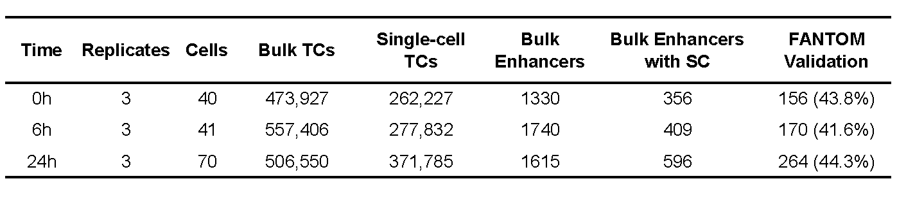
We identified…
1361
Bidirectional, BC > 0.95
Supported by 3 replicates
Intronic or Intergenic
4. SC transcription

Slide 12
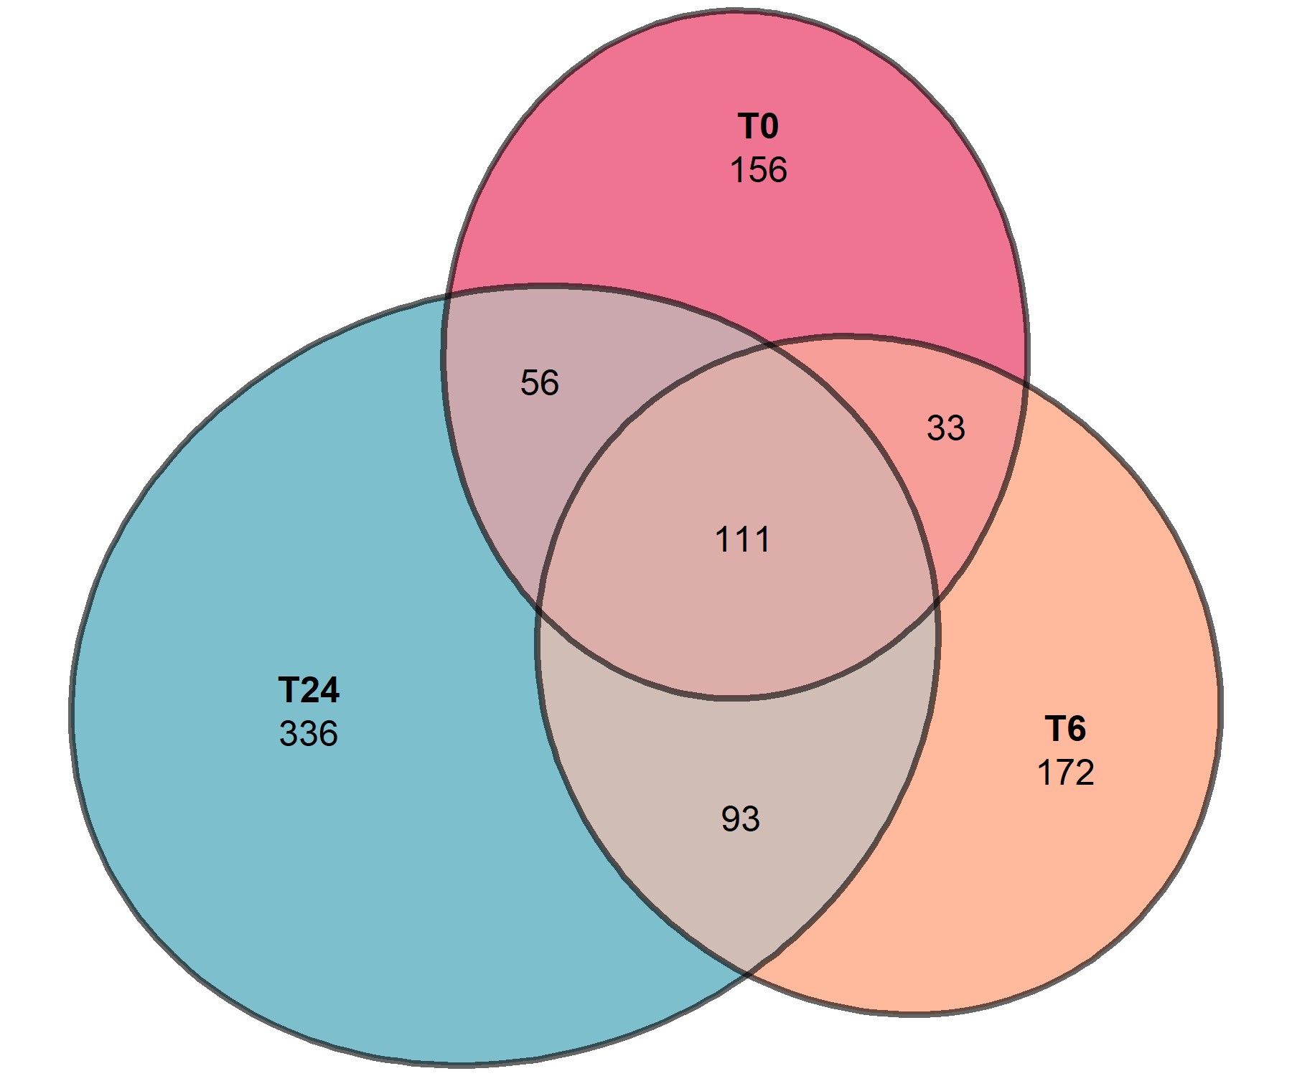
Condition-specific enhancers
Condition specific
664 / 957 (69.4%)

Slide 13
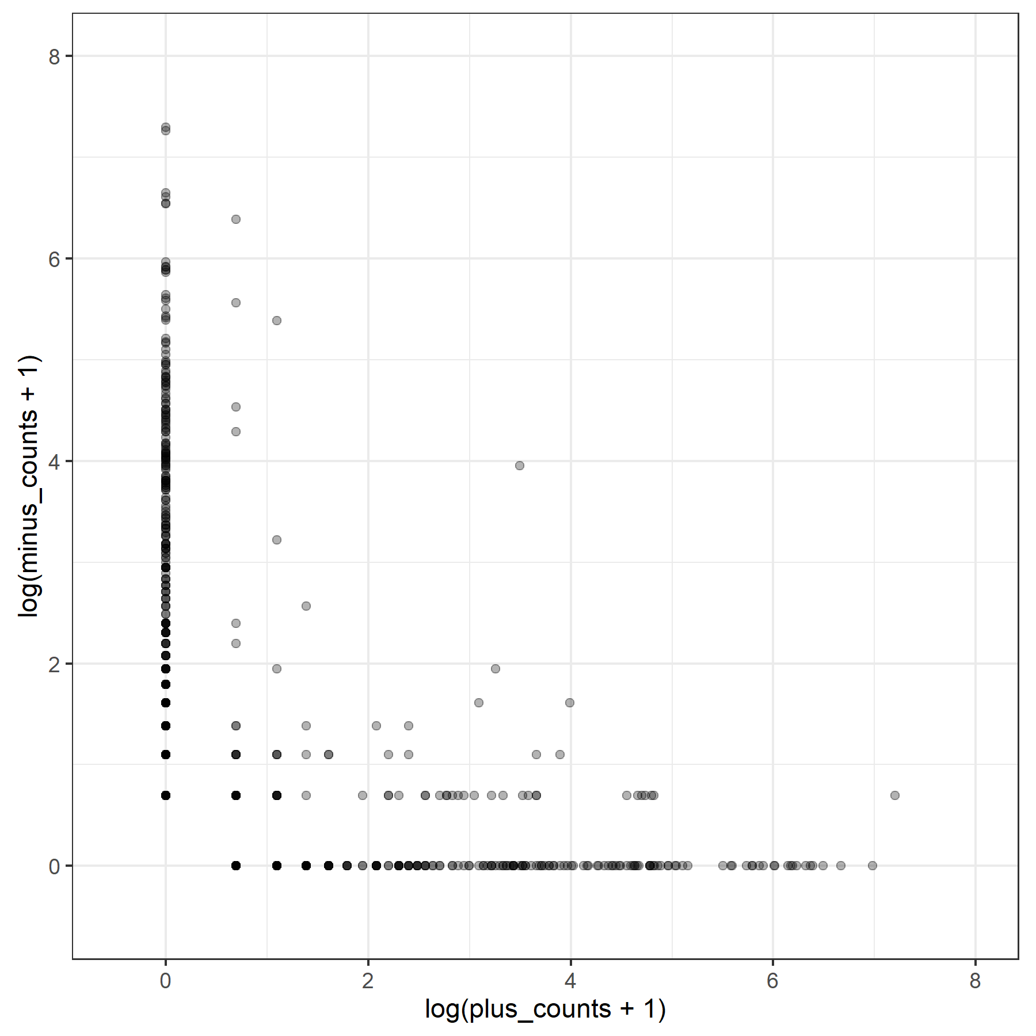
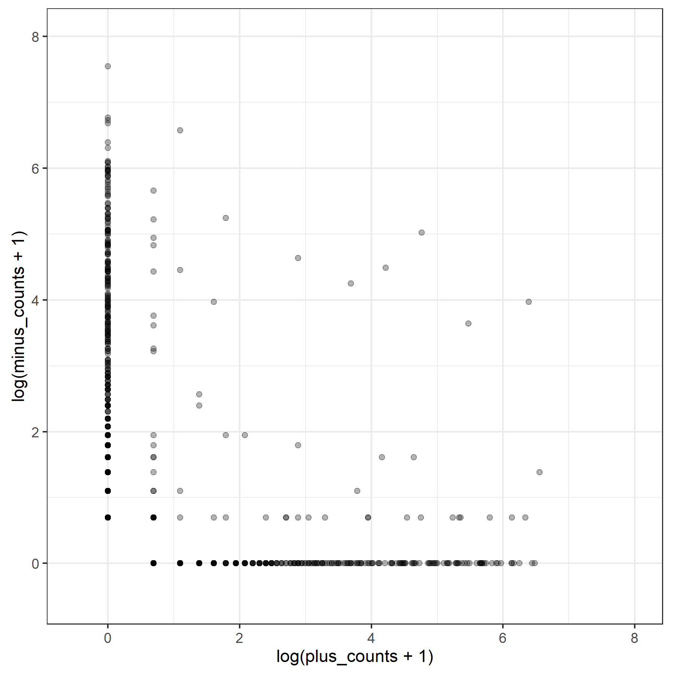
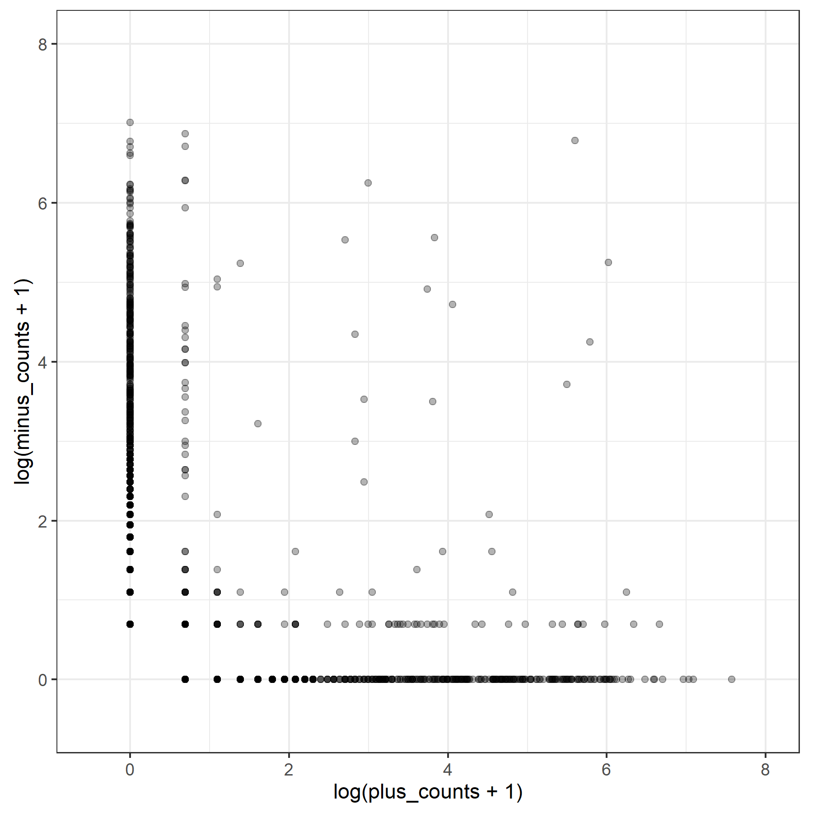
Single-cell eRNA transcription
SC-Bidirectional
enhancers
6.86%
6.54%
4.67%
T0: 971 enhancer-cell pairs
From 354 enhancers, 40 cells
T6: 1091 enhancer-cell pairs
From 407 enhancers, 41 cells
T24: 1941 enhancer-cell pairs
From 594 enhancers, 70 cells
Notes:
Each point corresponds to an enhancer in a cell

Slide 14
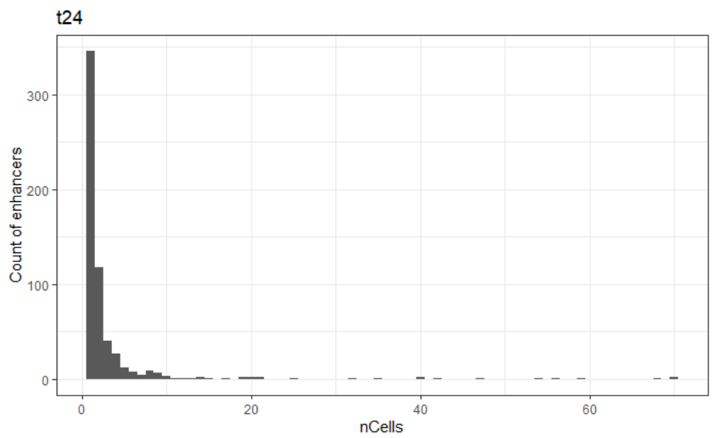
Rarely transcribed

Slide 15
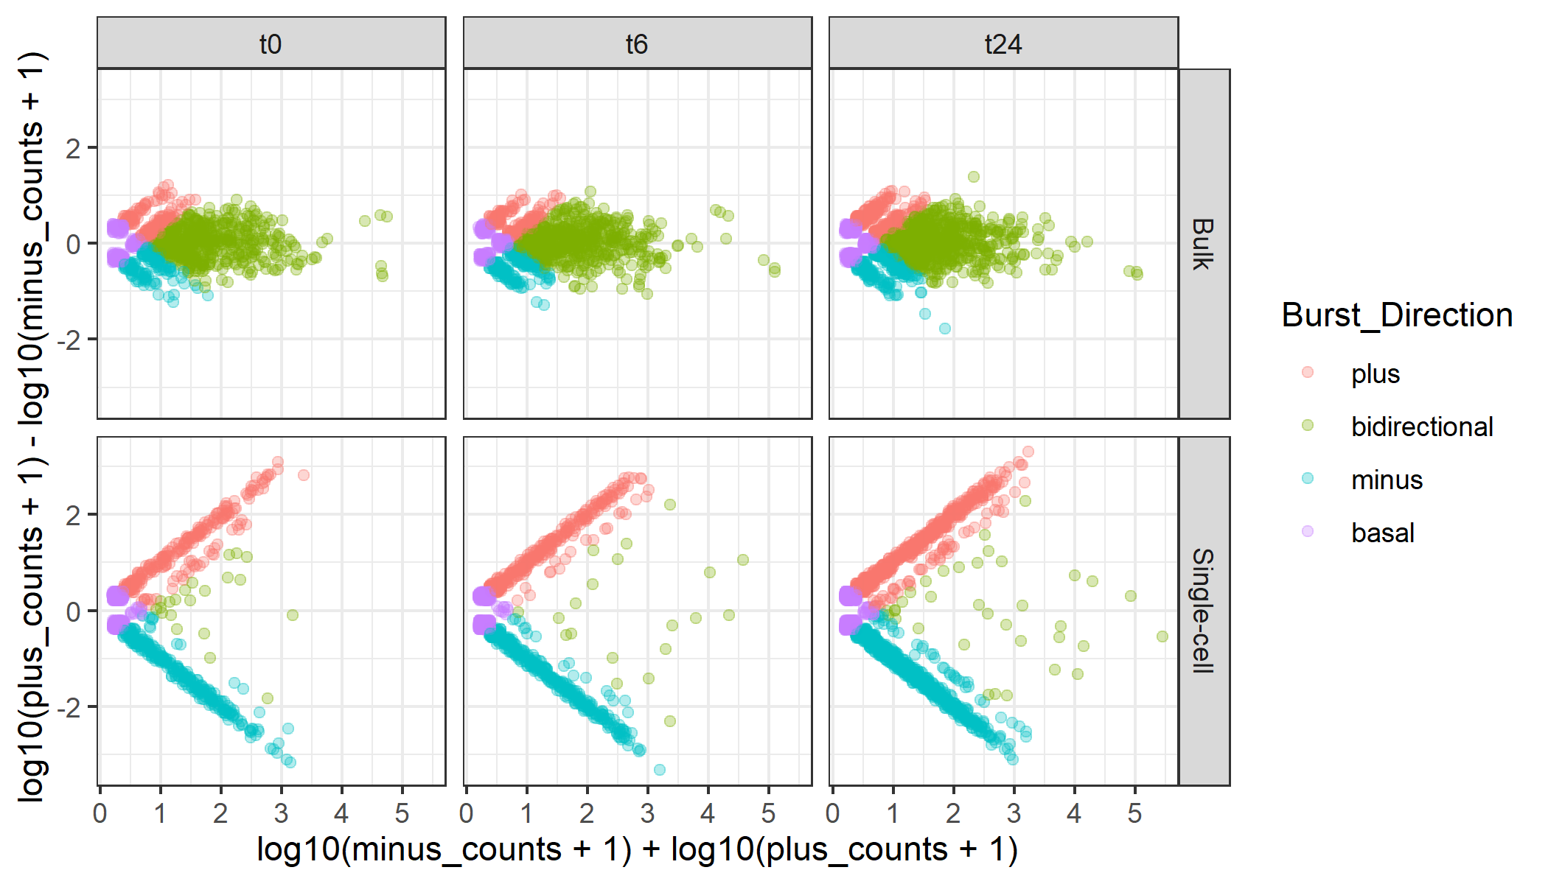
Unidirectional bursting
Plus 164 (15.4%)
Minus 163 (15.4%)
Bidirect 556 (52.6%)
Basal 179 (16.8%)
Plus 171 (14.0%)
Minus 214 (17.5%)
Bidirect 628 (51.4%)
Basal 208 (17.0%)
Plus 321 (18.0%)
Minus 280 (15.7%)
Bidirect 859 (48.2%)
Basal 322 (18.1%)
Plus 237 (26.6%)
Minus 314 (35.2%)
Bidirect 21 ( 2.4% )
Basal 319 (35.8%)
Plus 289 (28.6%)
Minus 367 (36.4%)
Bidirect 20 ( 2.0% )
Basal 333 (33.0%)
Plus 531 (29.5%)
Minus 695 (38.6%)
Bidirect 35 ( 1.9% )
Basal 540 (30.0%)
Notes:
Each point corresponds to an enhancer in a cell

Slide 16
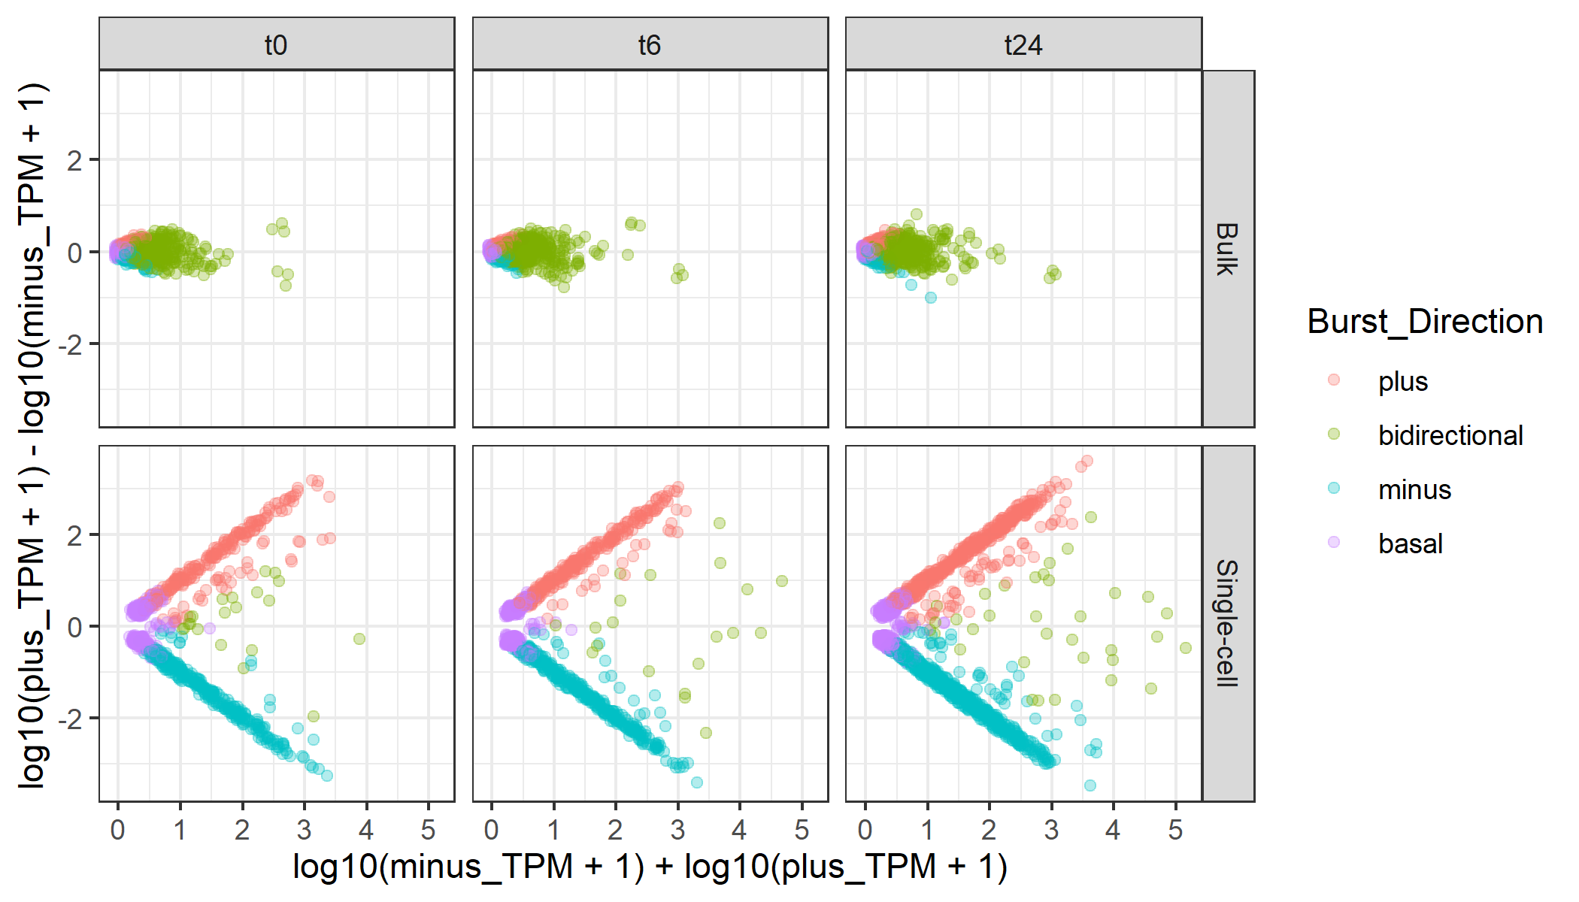
But with high TPM
Plus 164 (15.4%)
Minus 163 (15.4%)
Bidirect 556 (52.6%)
Basal 179 (16.8%)
Plus 171 (14.0%)
Minus 214 (17.5%)
Bidirect 628 (51.4%)
Basal 208 (17.0%)
Plus 321 (18.0%)
Minus 280 (15.7%)
Bidirect 859 (48.2%)
Basal 322 (18.1%)
Plus 237 (26.6%)
Minus 314 (35.2%)
Bidirect 21 ( 2.4% )
Basal 319 (35.8%)
Plus 289 (28.6%)
Minus 367 (36.4%)
Bidirect 20 ( 2.0% )
Basal 333 (33.0%)
Plus 531 (29.5%)
Minus 695 (38.6%)
Bidirect 35 ( 1.9% )
Basal 540 (30.0%)
Notes:
Each point corresponds to an enhancer in a cell

Slide 17
Unidirectionality Supported by
Multiple TSSs
Bulk
SC
SC
Single TSSs
Multiple TSSs
T0: 275‬
T6: 342
T24: 660
T0: 276‬ (50.1%)
T6: 314 (47.9%)
T24: 566 (46.2%)

Slide 18
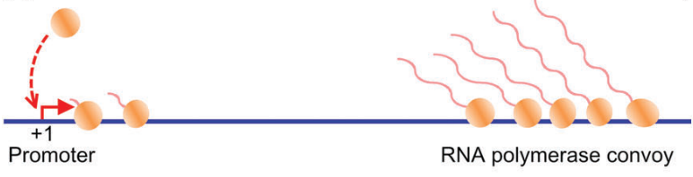
eRNA Rare, unidirectional Transcription Burst
T
TSS
Then, what are the bidirectional events?
1. Wang, Y., Ni, T., Wang, W. & Liu, F. Gene transcription in bursting: a unified mode for realizing accuracy and stochasticity. Biol. Rev. 94, 248–258 (2019).

Slide 19
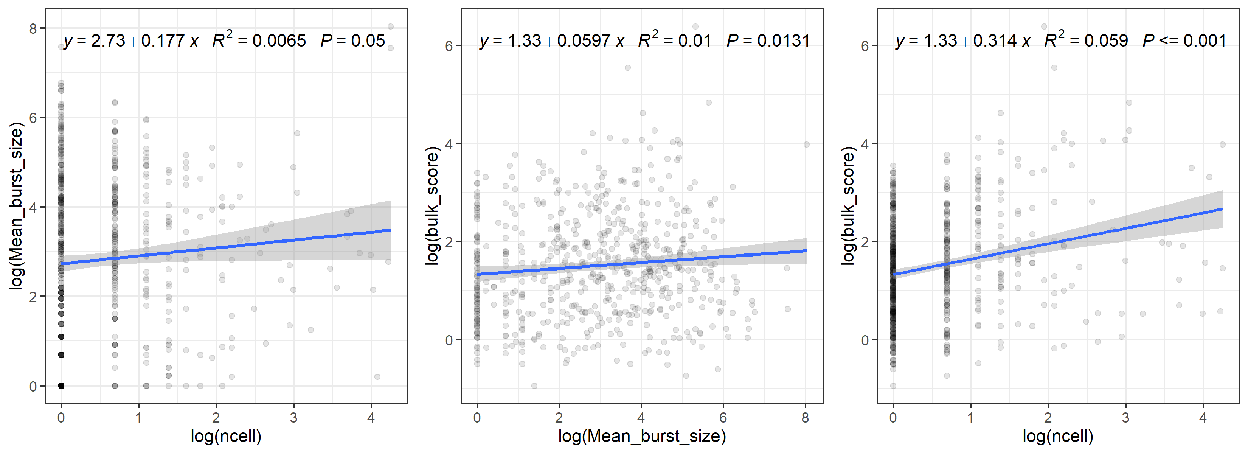
Bulk expression ~ Burst frequency

Slide 20
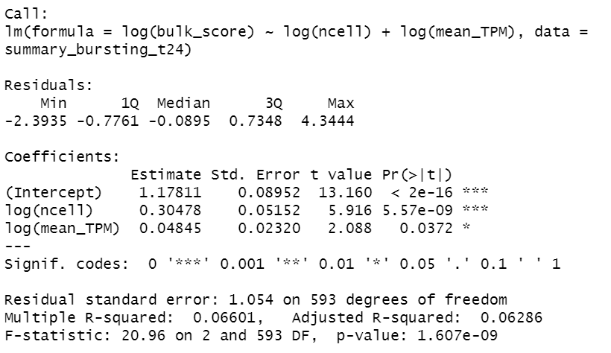
Bulk expression ~ Burst frequency [5]
5. Larsson, A. J. M. et al. Genomic encoding of transcriptional burst kinetics. Nature 565, 251–254 (2019).

Slide 21
Enhancer classified by SC direction
Cell 1
Cell 2
Cell 3
…
Cell 1
Cell 2
Cell 3
…
Plus
Minus
Cell 1
Cell 2
Cell 3
…
Cell 1
Cell 2
Cell 3
…
Mixed
Bidirectional

Slide 22
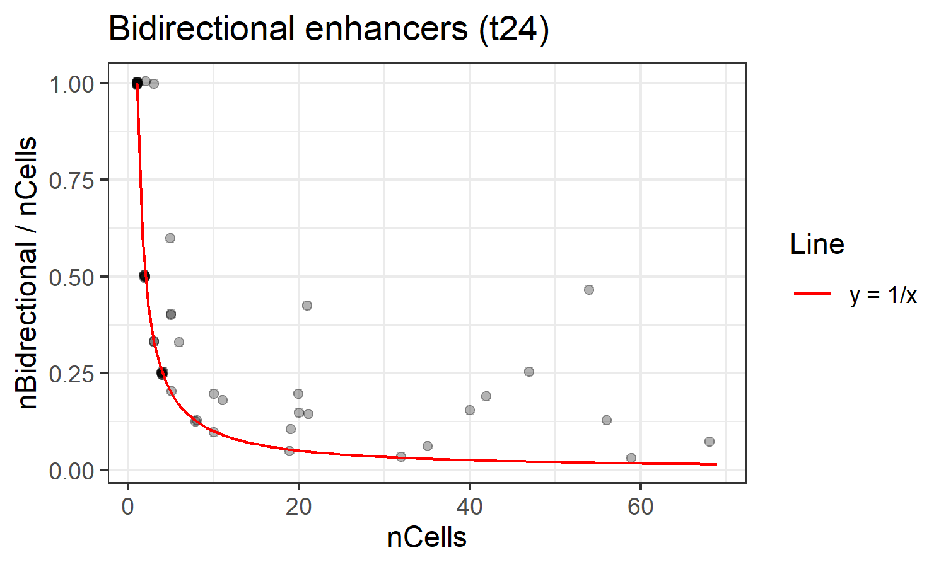
“Bidirectional enhancers”
39/62 (63%)
On the line

Slide 23
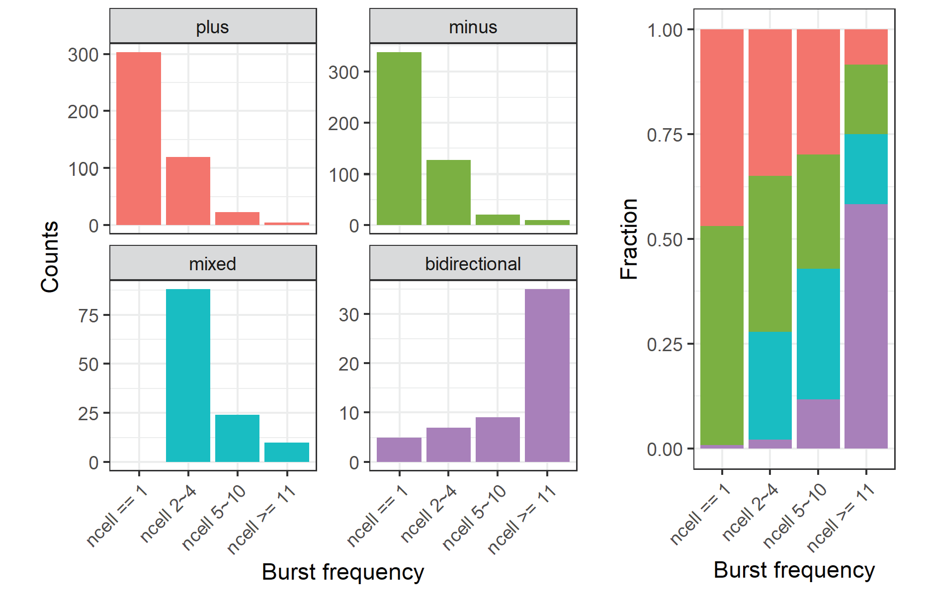
Bidirectionality ~ Burst frequency
Unidirectional ↓
Mixed ↑↓
Bidirectional ↑
Mix of unidirectional
events in single-cell

Slide 24
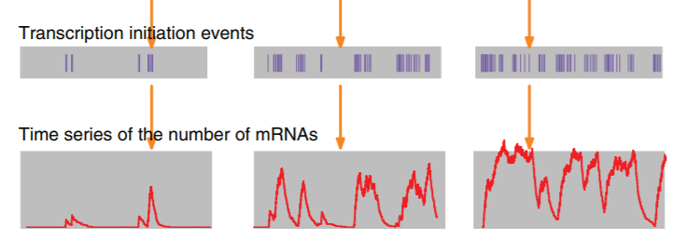
Expected because …
Burst Frequency
Probability of coexisting
Opposite Strand eRNAs
1. Wang, Y., Ni, T., Wang, W. & Liu, F. Gene transcription in bursting: a unified mode for realizing accuracy and stochasticity. Biol. Rev. 94, 248–258 (2019).

Slide 25
Determinants of eRNA burst direction?
Random?

Slide 26
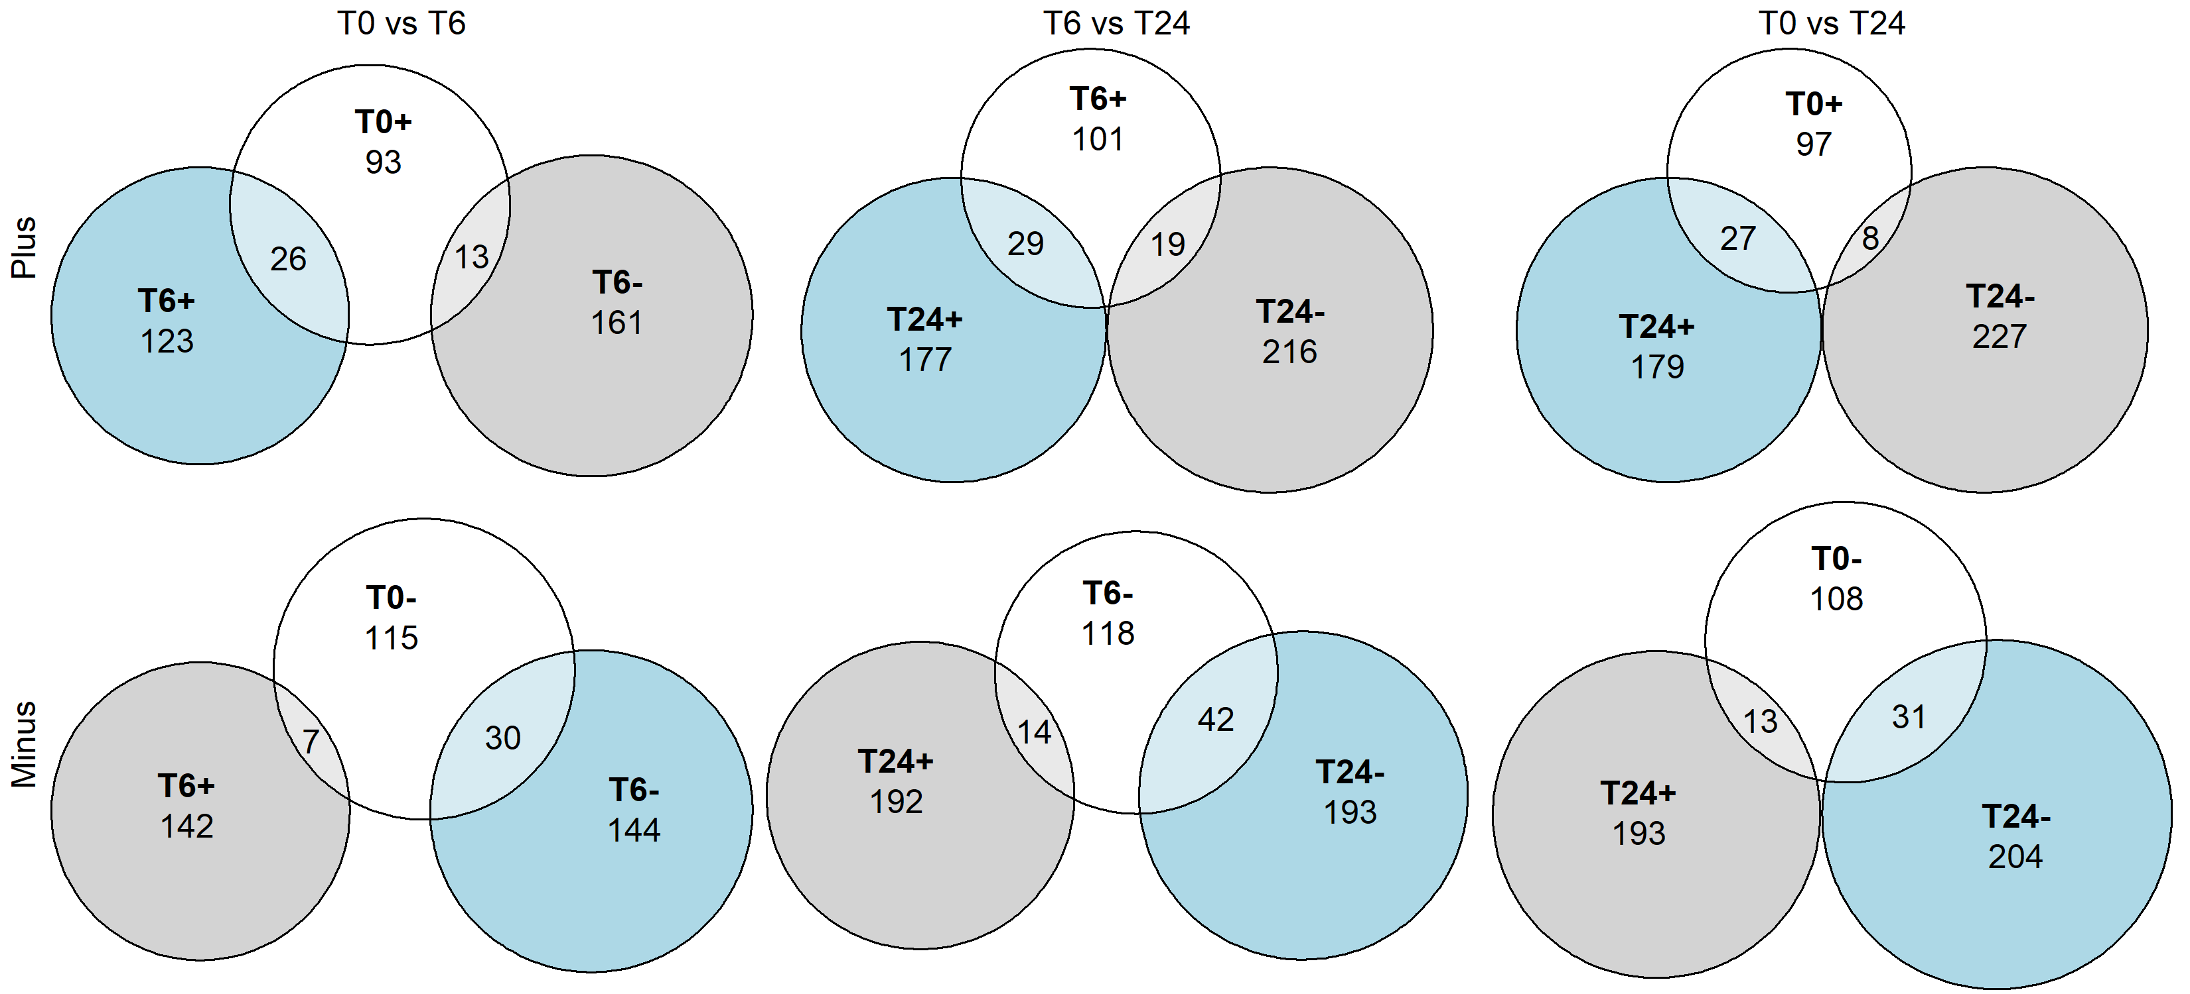
SC Direction are prone to keep over time
Fisher’s exact test, p = 0.009472
Fisher’s exact test, p = 0.04738
Fisher’s exact test, p = 0.0001677
Fisher’s exact test, p = 0.0003742
Fisher’s exact test, p = 0.0005108
Fisher’s exact test, p = 0.01711

Slide 27
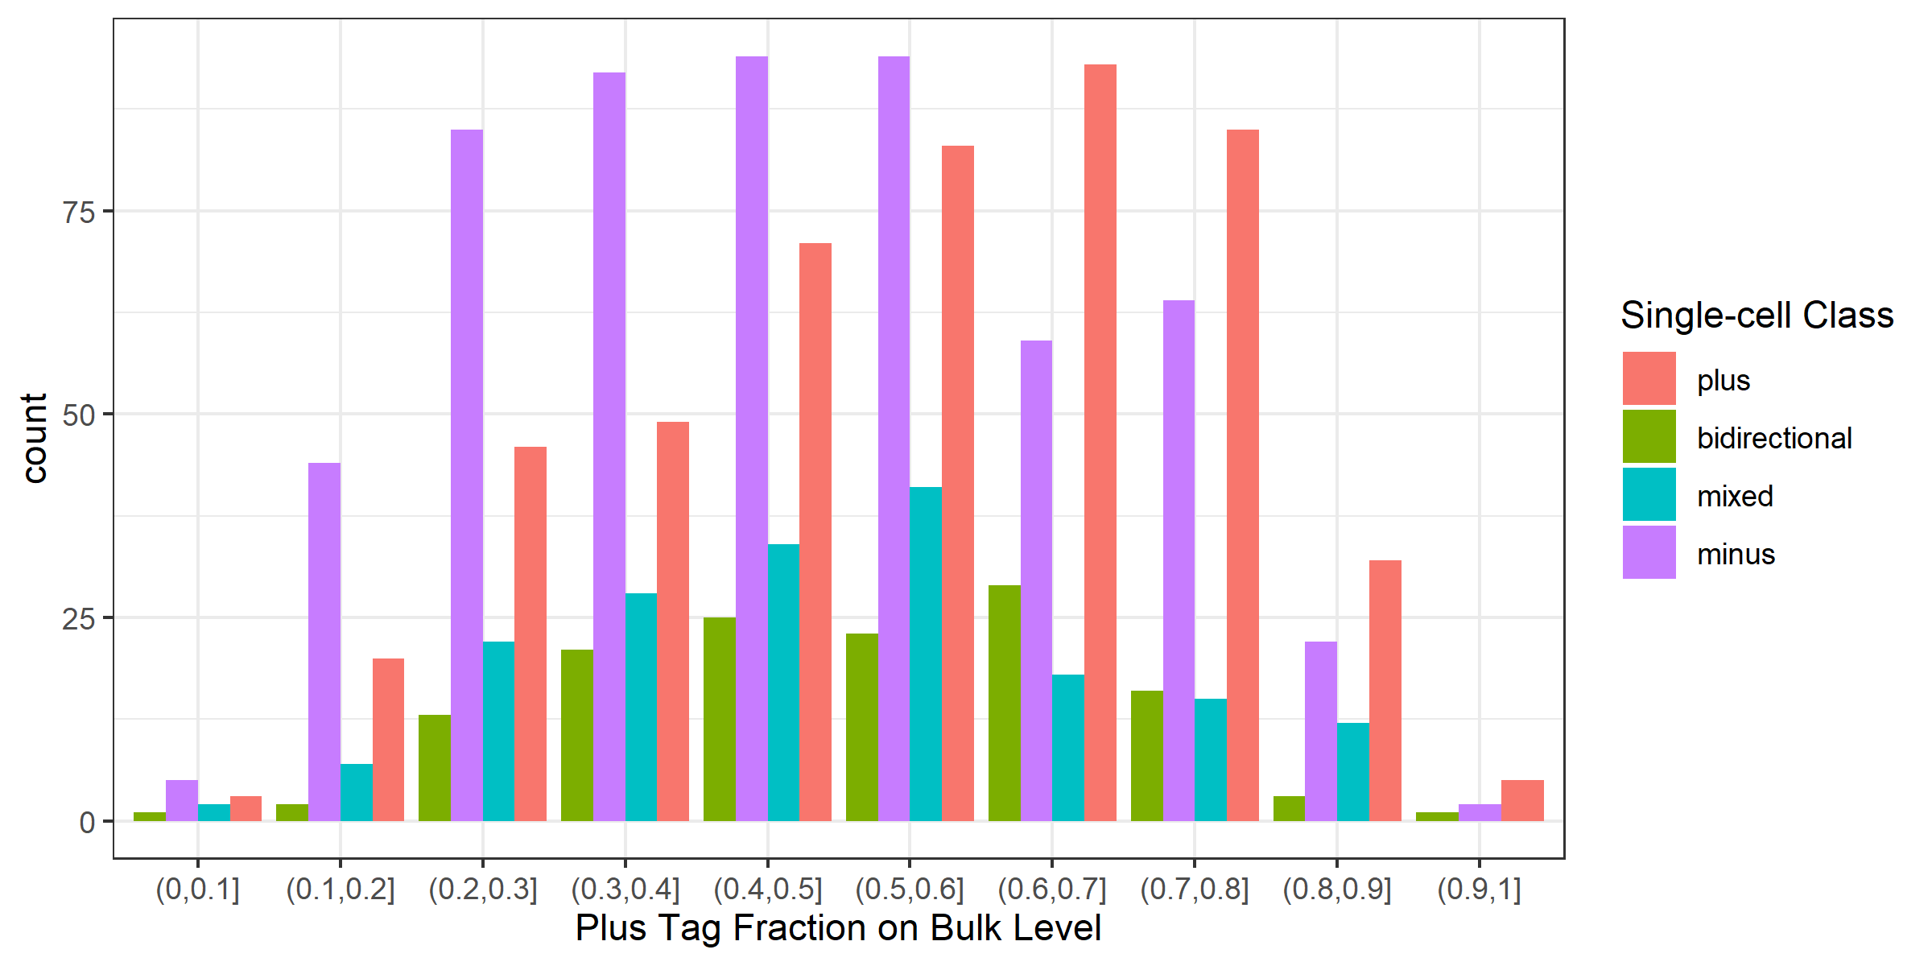
Direction Preference of eRNAs

Slide 28
Preference ~ Sequence features?

Slide 29
Define Main & Minor strand
Main
Minor
Main TSS
Minor TSS

Slide 30
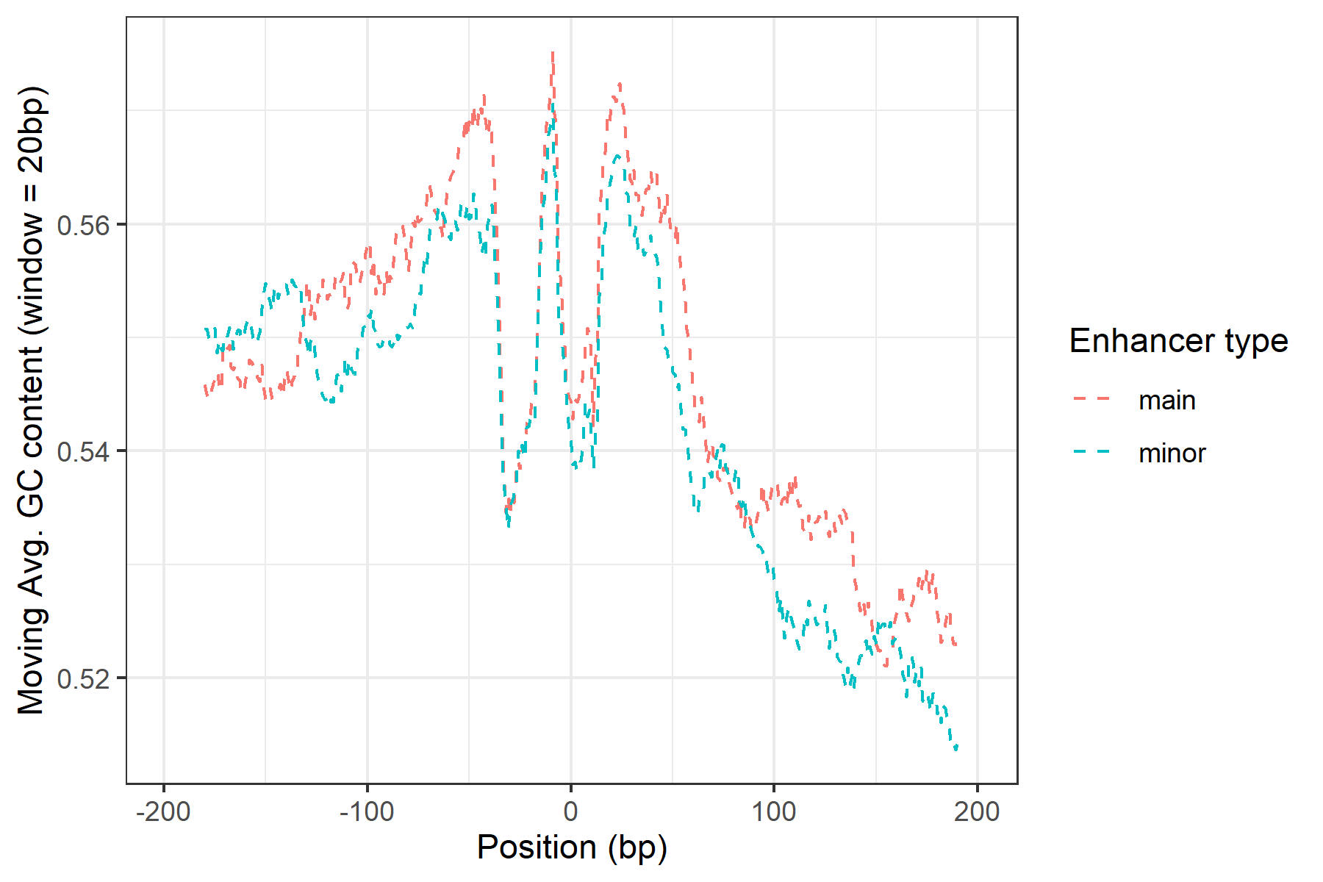
Main ~ Higher CG content
paired t test
t = 2.870
p = 0.0042

Slide 31
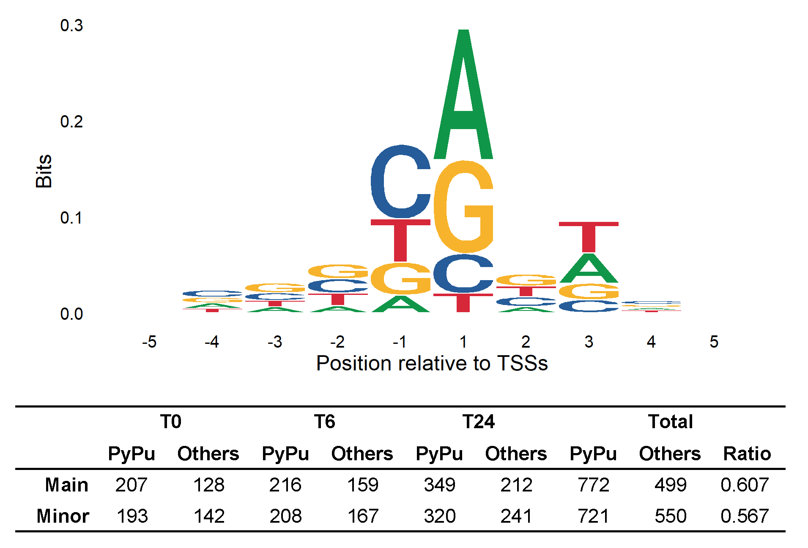
Main ~ More PyPu dinucleotides at TSSs
Fisher’s exact test
p = 0.0439

Slide 32
Enriched Motfis at eRNA TSSs
Main
Minor
AP1 family TF
Over-expressed in A549 cell line
KLF family TF
Regulated by
TGF-beta
/
>
/
>
>
>
>
Notes:
1271 total pairs TSSs

Slide 33
Directional Preference partially explained by Sequence features
What’s more?

Slide 34
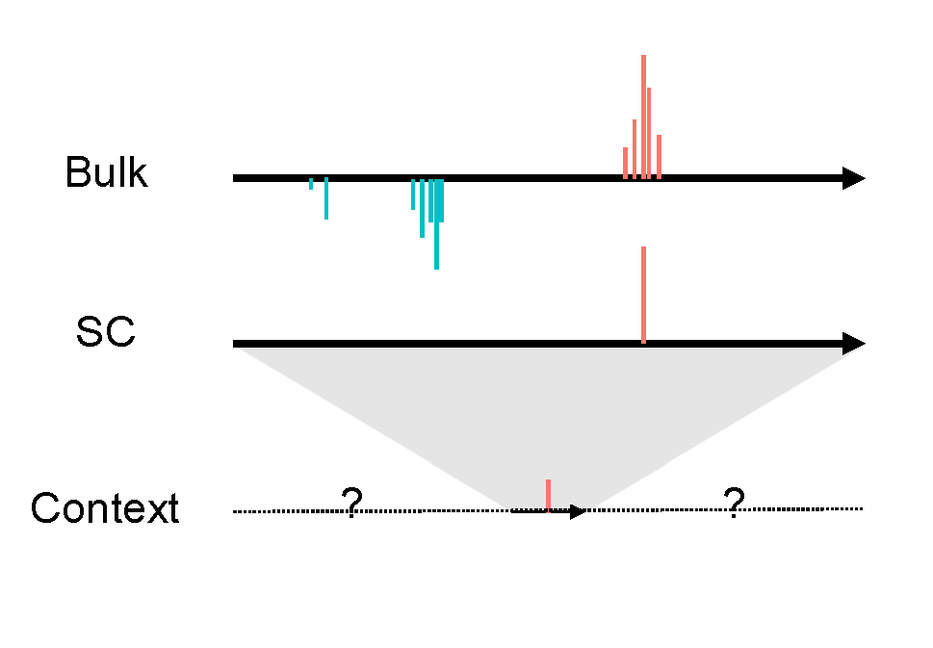
SC direction ~ Context?

Slide 35
Predict eRNA direction using context info
For each enhancer i in cell j, predict
M_ij
$$=log⁡({PlusCounts}_{ij}+1)−log⁡({MinusCounts}_{ij}+1)$$
Using statistics which summarizes the context

Slide 36
Context Bias Models
Context around a plus eRNA transcription
Bulk
Bulk
SC
SC
Context
Context
Bias to up/downstream?
Bias to plus/minus strand?

Slide 37
Measure Context Bias
Bulk
Bulk
SC
SC
Context
Context
Measured by TPM?
Measured by #of Clusters?

Slide 38










Two Measurements for the Bias
${TPM}_{a}$
${TPM}_{b}$
Context
$$CSB_downstream= \frac{{TPM}_{b}+{TPM}_{d}}{{TPM}_{a}+{TPM}_{b}+{TPM}_{c}+{TPM}_{d}}$$
${TPM}_{c}$
${TPM}_{d}$
Range
Emphasize the Total transcription intensity
$N_{a}$
$N_{b}$
$$CNB_downstream= \frac{N_{b}+N_{d}}{N_{a}+N_{b}+N_{c}+N_{d}}$$
Context
$N_{c}$
$N_{d}$
Emphasize the chromatin accessibility

Slide 39
Consider other Factors
A_ij
$$\log\left({PlusCounts}_{ij}+1\right)+log⁡({MinusCounts}_{ij}+1)$$
Active_ij
Whether enhancer i is active in cell j
eid_i
Enhancer id

Slide 40
Regression model
For each enhancer i and cell j
Regress out
Other factors
M_ij ~ Active_ij + eid_i + A_ij + txType_i
+ ContextSumBias_dowstream_ij
+ ContextSumBias_plus_ij
+ ContextNumBias_downstream_ij
+ ContextNumBias_plus_ij
Notes:
where:
ContextSumBias_dowstream_ij = (TPM_dn+TPM_dp)/(TPM_dn+TPM_dp+TPM_un+TPM_up) for each enhancer i, cell j
ContextSumBias_plus_ij = (TPM_up+TPM_dp)/(TPM_dn+TPM_dp+TPM_un+TPM_up) for each enhancer i, cell j
ContextNumBias_downstream_ij = (nPos_dn+nPos_dp)/(nPos_dn+nPos_dp+nPos_un+nPos_up) for each enhancer i, cell j
ContextNumBias_plus_ij = (nPos_up+nPos_dp)/(nPos_dn+nPos_dp+nPos_un+nPos_up) for each enhancer i, cell j
Active_ij = whether enhancer i is active (TPM>0) in cell j
TxType_i = whether enhancer i is located at intron or intergenic region
eid_i = enhancer id
M_ij = log(plus_counts_ij+1)-log(minus_counts_ij+1) for each enhancer i, cell j
A_ij = log(plus_counts_ij+1)+log(minus_counts_ij+1) for each enhancer i, cell j

Slide 41
Bias to Downstream measured by Number TSSs Clusters
Results
Range 10k bp
Notes:
blue

Slide 42
Suggested Model
Bulk
SC
Context
Availability
(Interpretation)

Slide 43
Regression result (Cumulative TPM)

Slide 44
Regression result (Cumulative #of TCs)

Slide 45
Interpretations:
Less
TSSs
Active Enhancer
Less
TSSs
More
TSSs

Slide 46
Conclusions:
eRNAs are transcribed through unidirectional bursts. Bidirectionality is related with high burst frequency.
Single-cell direction partially accord with bulk direction preference.
Direction preference can be partially attributed to sequence features.
Downstream of eRNA transcription features larger number of TSSs.

Slide 47
In the Future
Integration with Chromatin Accessibility data (e.g. ATAC)
Test of Generalization (RIKEN’s unpublished C1 CAGE mouse data)

Slide 48
Perspectives:
Single-cell resolution → Temporal resolution
→ Single burst events & context
→ Mechanism
Insight about Enhancer identification
eRNA transcription balanced?
Yes and No
Thank you

Slide 49
Questions?

Slide 50
Limitations
1. Unique molecular identifiers (UMI) failed in C1 CAGE data
“However, we have not utilized them for molecular counting, because the TSOs carried over from the reverse-transcription could prime the subsequent
PCR reaction while tolerating mismatches on the UMI sequence, thus causing a high level of mutation rate (as evidenced by the fact that most UMIs are seen only once)”
1. Kouno, T. et al. C1 CAGE detects transcription start sites and enhancer activity at single-cell resolution. Nat. Commun. 10, (2019).

Slide 51
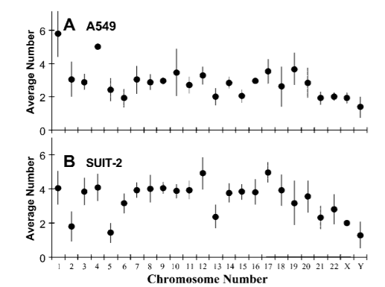
Limitations
2. CAGE unable to distinguish tags from different alleles
1. Isaka, T., Nestor, A. L., Takada, T. & Allison, D. C. Chromosomal variations within aneuploid cancer lines. J. Histochem. Cytochem. 51, 1343–1353 (2003).

Slide 52
Limitations
3. Strand Invasion in template switching
“ We quantify the level of strand invasion to be ~10% in C1 CAGE ”
1. Kouno, T. et al. C1 CAGE detects transcription start sites and enhancer activity at single-cell resolution. Nat. Commun. 10, (2019).

Slide 53
Questions
1. Low validation rate?
FANTOM Annotated enhancer database is growing.
Condition Specific enhancers

Slide 54
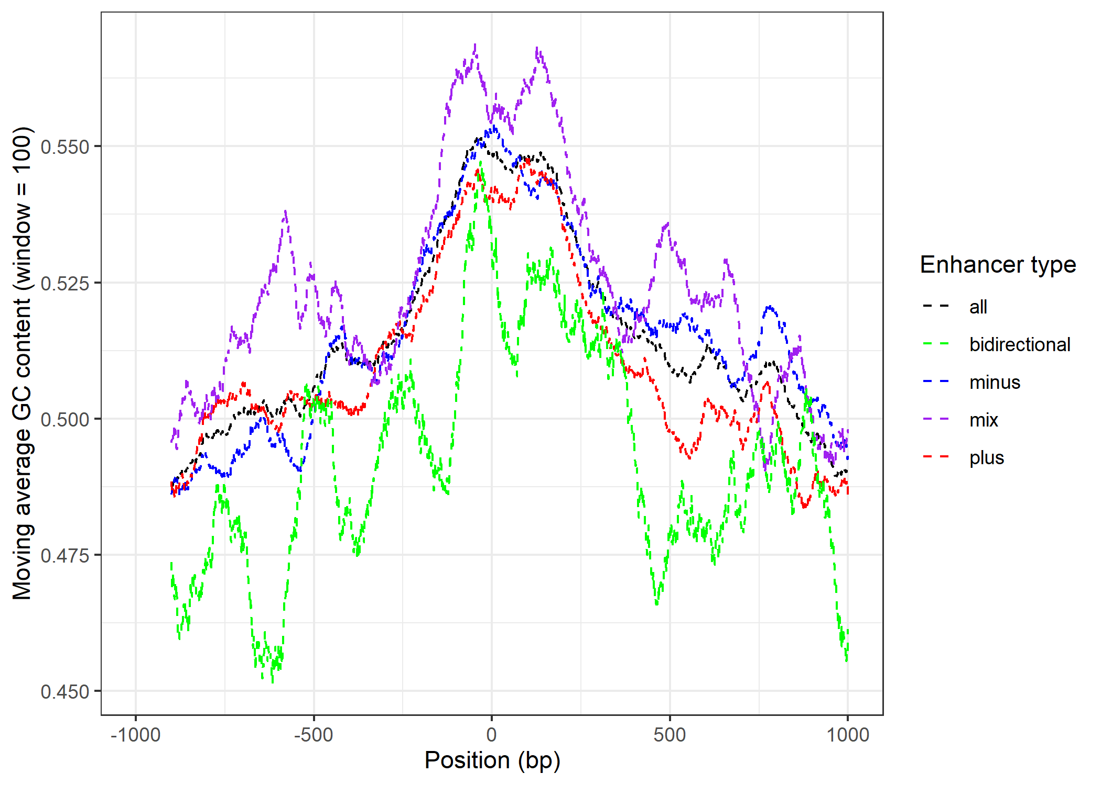
Questions
2. Sequence feature of bidirectional enhancer?

Slide 55
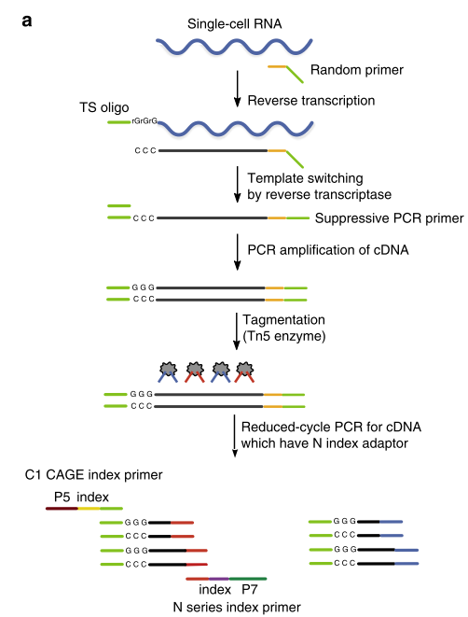
Questions
3. Technical Details about C1 CAGE
Accuracy:
Preference to Capped RNAs
~10% strand invasions
Only 13% reads from rRNA
Sensitivity:
Median 50% detection limit = 22
1. Siebert, P. D., Chenchik, A., Kellogg, D. E., Lukyanov, K. A. & Lukyanov, S. A. An improved PCR method for walking in uncloned genomic DNA. Nucleic Acids Res. 23, 1087–1088 (1995).
Notes:
Template switching is the ability of the MMLV reverse transcriptase to introduce a few untemplated nucleotides, predominantly 2-5 cytosines, when it reaches the 5´-end of the RNA template, corresponding to the 3´-end of the newly synthesized cDNA strand. These extra nucleotides work as a docking site for a helper oligonucleotide (“Template Switching Oligonucleotide,” or TSO) that carries 3 riboguanosines at its 3´-end. The reverse transcriptase is then able to “switch template” (from mRNA to the DNA of the TSO) and synthesize a cDNA strand using the helper oligonucleotide as template. Thus, TS makes possible the introduction of an arbitrary sequence at the end of the transcript and, along with the known sequence located at the 5´-end of the oligo-dT primer, allows the efficient amplification of all the transcripts in a cell. Because the sequence on both sides of each cDNA is the same the PCR can be carried out with just one primer, thus exploiting the PCR suppression effect
the 5´- and 3´-terminal fragments recovered by using streptavidin magnetic beads (the TSO and the oligo-dT were both biotinylated),

Slide 56
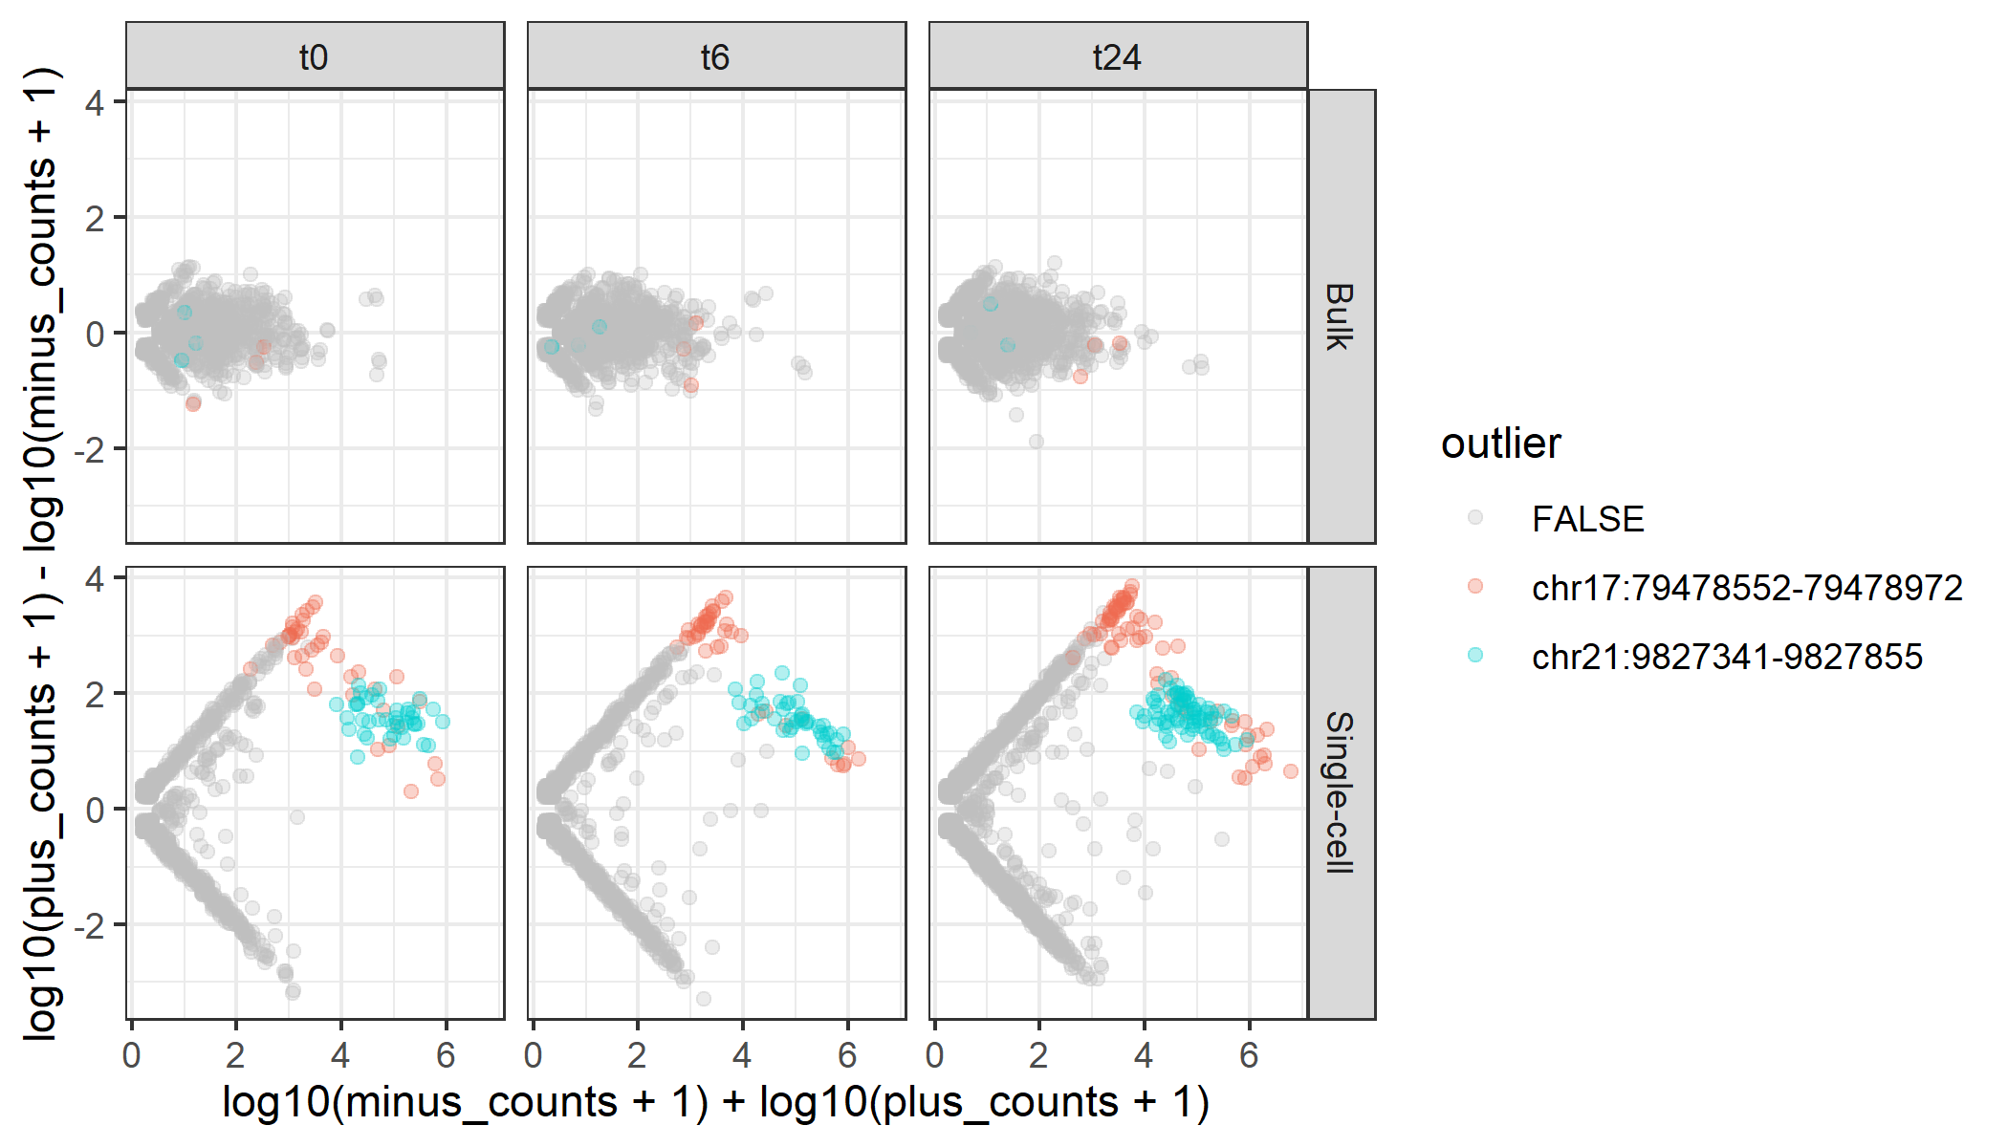
Questions
4. Removed 2 outliers

Slide 57
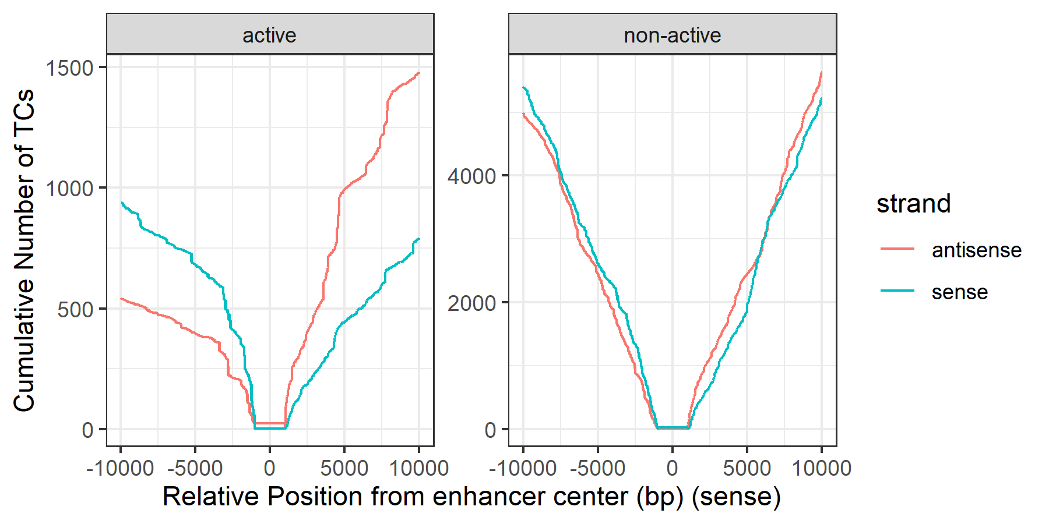
Questions
5. Active enhancers ~ Imbalanced transcription context

Slide 58
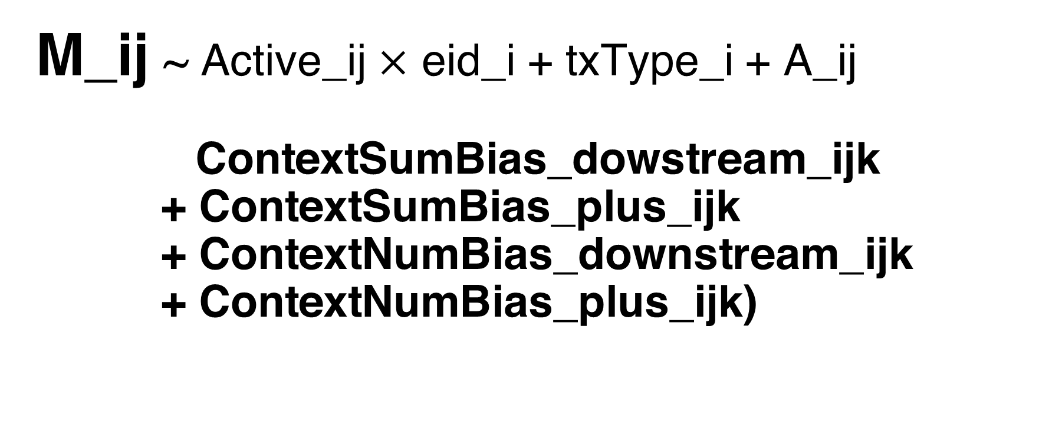

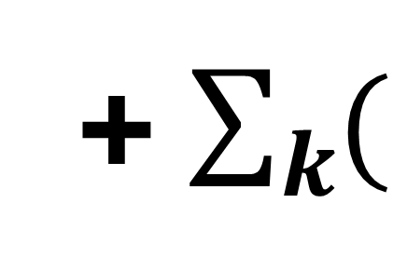
Questions
6. Improvement of Regression Model
For each enhancer i , cell j, context annotated type k
Regress out
Other factors
M_ij ~ Active_ij $×$ eid_i + txType_i + A_ij
ContextSumBias_dowstream_ijk
+ ContextSumBias_plus_ijk
+ ContextNumBias_downstream_ijk
+ ContextNumBias_plus_ijk)
+ $\sum_{k}{(}$
$$)$$
Notes:
where:
ContextSumBias_dowstream_ij = (TPM_dn+TPM_dp)/(TPM_dn+TPM_dp+TPM_un+TPM_up) for each enhancer i, cell j
ContextSumBias_plus_ij = (TPM_up+TPM_dp)/(TPM_dn+TPM_dp+TPM_un+TPM_up) for each enhancer i, cell j
ContextNumBias_downstream_ij = (nPos_dn+nPos_dp)/(nPos_dn+nPos_dp+nPos_un+nPos_up) for each enhancer i, cell j
ContextNumBias_plus_ij = (nPos_up+nPos_dp)/(nPos_dn+nPos_dp+nPos_un+nPos_up) for each enhancer i, cell j
Active_ij = whether enhancer i is active (TPM>0) in cell j
TxType_i = whether enhancer i is located at intron or intergenic region
eid_i = enhancer id
M_ij = log(plus_counts_ij+1)-log(minus_counts_ij+1) for each enhancer i, cell j
A_ij = log(plus_counts_ij+1)+log(minus_counts_ij+1) for each enhancer i, cell j

Slide 59
Questions
7. R-squared (e.g. t0, range = 1e4)
Call:
lm(formula = M ~ active * eid + A + bias_p + bias_d, data = .)
Residual standard error: 0.7409 on 1989 degrees of freedom
Multiple R-squared: 0.675, Adjusted R-squared: 0.6208
F-statistic: 12.44 on 332 and 1989 DF, p-value: < 2.2e-16

Slide 60
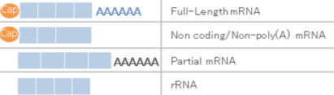
Corrigendum
“The world's first published single-cell 5' sequencing data”
→ The first published single-cell CAGE data
Only C1 CAGE provides strand-specific whole-transcriptome coverage: its detection of 5ʹ-ends is independent from transcript length and polyadenylation owing to the use of random primers.

