Slide 1
BUS-485 Presentation
Team Members
Nazia Nusrat Shamma- 1710576
Amir Hamza-1710095
Labeeba Nisarat Khan- 1820427
Shahria Al Islam- 1731201
Shahriar Hossain-1710819

Slide 2
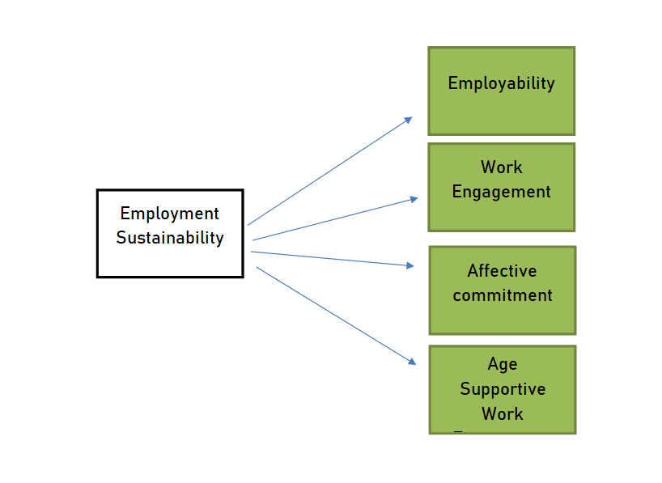

Slide 3
Research Questions
Is Employability positively related to Sustainable Employment?
Does Work Engagement play a vital role in influencing Sustainable Employment?
Does an Age Supportive Work Environment positively contribute to the Sustainability of Employment?
Does Intrinsic Job value positively affect the Sustainable Employability?

Slide 4
Timeline of the research
The following research will be conducted for the next 1 month where employees from different industries will be surveyed and data will be collected through the internet using Google form.
Analysis will be done through Smart PLS software.

Slide 5
Keywords
Sustainable employment,
intrinsic job value,
affective commitment,
age supportive climate,
work engagement,
older employees.

