Slide 1
Java Calculator
In this presentation, these things will be explained:
- Variables
- The use of functions
- About our GUI
- How the program works

Slide 2
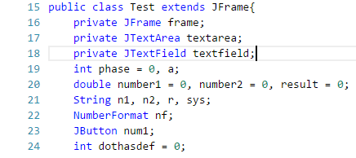
Meanings of ‘a’
Java Calculator - Variables
+ | 1
- | 2
X | 3
/ | 4
phase為階段變數
a則是表示運算子
SQRT 5
三個double為主要進行運算的變數
number1為使用者輸入的第一個變數 number2為使用者輸入的第二個變數 result即為運算結果
這裡的字串都會是經由前面數字轉換顯示到螢幕上
n1, n2, r 分別為上面3個轉換的字串
sys則是要做長度檢查而設立的暫存字串
NumberFormat是要
統一格式而建立的變數
dothasdef是要分開使用
者是在哪些變數加上小數點
而設立的變數

Slide 3
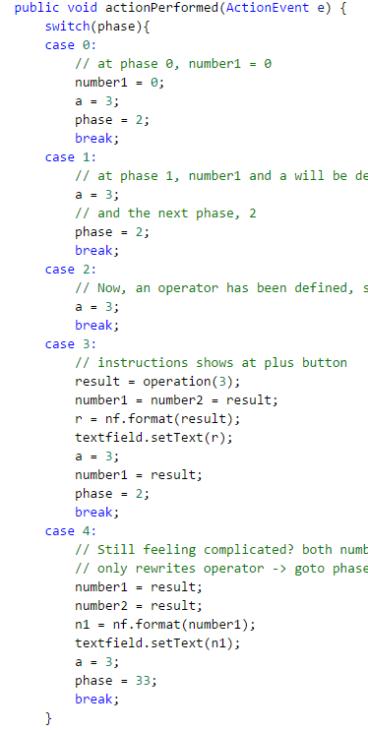
Java Calculator - Variables
DecimalFormat() can dump unnecessary zeros.
Phases (how the program works):
phase 0 : After starting the program, nothing defined.
phase 1 : Only number1 has been defined.
phase 2 : number1 with an operator ‘a’ defined.
phase 3 : Both number1 and number2 with an operator defined.
phase 33 : After phase 4, any operator will rewrite number2.
phase 4 : When equal button was pressed, result defined.

Slide 4
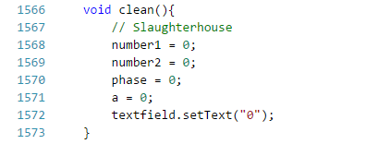
Java Calculator - Functions
clean() is made for clearing all variables
Only number1, number2, phase, dothasdef, and a will be cleared
Other string variables will be cleared every time we enter a number

Slide 5
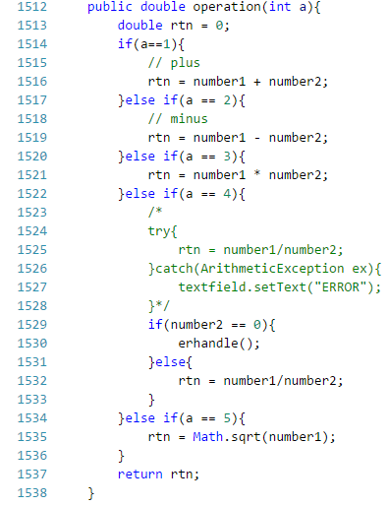
Java Calculator - Functions
+
double number1
double number2
int a
-
a = 1
*
operation(a)
number1 + number2
/
回傳result
√

Slide 6
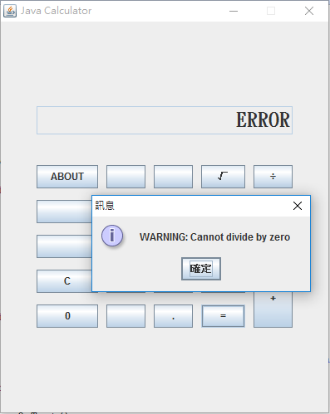

Java Calculator - Functions

Slide 7
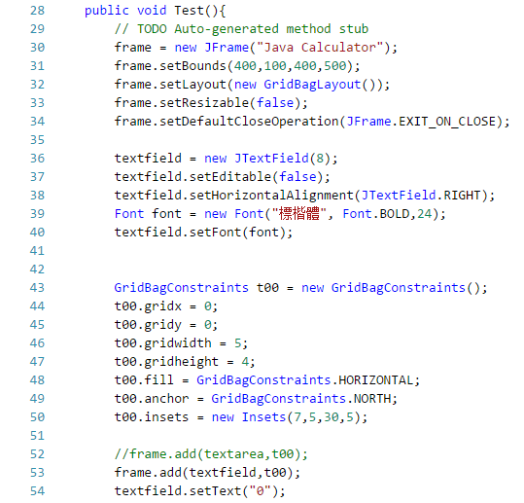
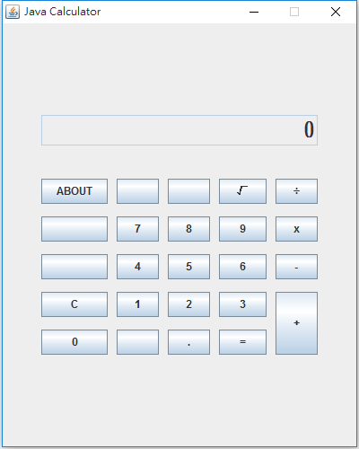
Java Calculator - GUI

Slide 8
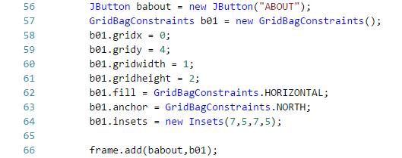
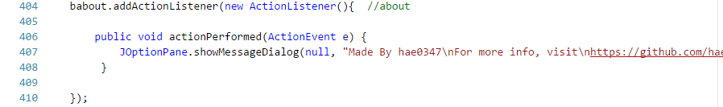
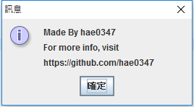
Java Calculator - GUI
2
1
(0,4)
0
2
4
6
8
10
0
1
2
3
4

Slide 9
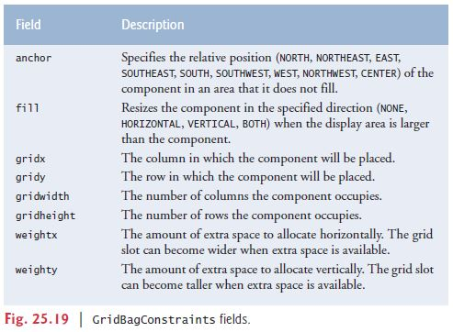
Java Calculator - GUI
2
1
(0,4)
0
2
4
6
8
10
0
1
2
3
4

Slide 10
Java Calculator
check_length
Number
Number
<Phase 1>
StartGUI
<Phase 0>
number1
Operator
Operator
check_length
rewrite a
Operator
<Phase 2>
Number
Number
<Phase 3>
number1
=
<Phase 1>
a
number1
=
Number
number1 a number1
a
number2
<Phase 4>
number1
Operator
Number
a
Operator
number2
result
<Phase 33>

Slide 11





Java Calculator
check_length
Number
Number
<Phase 1>
StartGUI
<Phase 0>
number1
Operator
Operator
check_length
rewrite a
Operator
<Phase 2>
Number
Number
<Phase 3>
number1
=
<Phase 1>
a
number1
=
Number
number1 a number1
a
number2
<Phase 4>
number1
Operator
Number
a
Operator
number2
result
<Phase 33>

