Slide 1
Fake News Challenge
Stage 1: Stance Classification
Xinyu Wang, Junzhuo Chen, Jacob Evans
Computational Data Analysis
Georgia Institute of Technology

Slide 2
Agenda
1
Fake News Challenge
2
Approach
3
Analysis
4
Conclusions

Slide 3
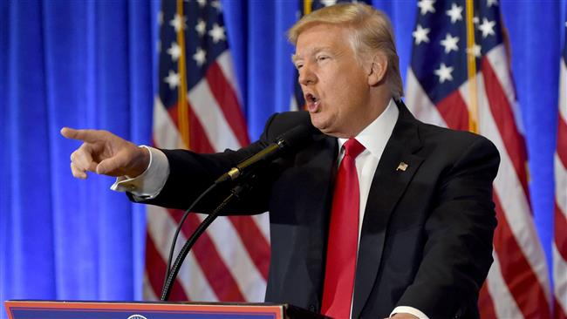
Fake News Challenge: Overview
Goal: automate the fact-checking process for news articles
Digital news consumption continues to rise while other mediums fall
Newspapers down 7% from 2015
Social media is the primary news source for 62% of US adults
Top 20 fake news articles were engaged with 1.33MM more times than the top 20 factual articles in the months leading up to the 2016 election
You’re fake news!
FNC
Approach
Analysis
Conclusions

Slide 4
Fake News Challenge: Stage 1
Stage 1: Stance Classification
Classify the relationship between a headline and an article body as:
Discusses
Agrees
Disagrees
Unrelated
FNC
Approach
Analysis
Conclusions

Slide 5
Fake News Challenge: Stage 1
Task 1: Related/Unrelated Binary Classification
Task 2: Discuss/Agree/Disagree Classification
FNC
Approach
Analysis
Conclusions

Slide 6
Data
Structure:
~1680 unique articles (i.e. 1680 headlines, and 1680 article bodies)
Class distribution:
Headline | Body | Stance
Police find mass graves with... | We arrived to the scene at... | Agree
Hundreds of Palestinians flee... | Everyone at NATO... | Disagree
… | … | …
Rows | Unrelated | Discuss | Agree | Disagree
49972 | 73.13% | 17.83% | 7.36% | 1.68%
FNC
Approach
Analysis
Conclusions

Slide 7




Tools
Python
Deep learning: Keras, TensorFlow, scikit-learn
Topic modeling: gensim
Bayesian Networks: pomegranate
Ensembling & Classification: scikit-learn
Data Management: pandas, numpy, scipy
Visualization: matplotlib
FNC
Approach
Analysis
Conclusions

Slide 8
Proposed Framework
FNC
Approach
Analysis
Conclusions

Slide 9
Current Framework
FNC
Approach
Analysis
Conclusions

Slide 10
Current Framework
FNC
Approach
Analysis
Conclusions

Slide 11
Bag-of-Words
Maps documents to vector space
Dimensions of space = vocabulary of corpus
Mapping functions:
Binary
Frequency
Tf-idf
Motivation:
Widely accepted
Captures topical information, loses context
Simple implementation
FNC
Approach
Analysis
Conclusions

Slide 12
Bag-of-Words
Binary encoding example
ID | Document
1 | I like turtles
2 | You like apples
ID | I | Like | Turtles | You | Apples
1 | 1 | 1 | 1 | 0 | 0
2 | 0 | 1 | 0 | 1 | 1
FNC
Approach
Analysis
Conclusions

Slide 13
Current Framework
FNC
Approach
Analysis
Conclusions

Slide 14

word2vec
Well established deep-learning model that maps words to real-valued vectors while preserving their semantic meaning
Sequential vectors preserve semantic and contextual information
$$\vec{woman}+\vec{royalty}= \vec{queen}$$
FNC
Approach
Analysis
Conclusions

Slide 15
Current Framework
FNC
Approach
Analysis
Conclusions

Slide 16
Approach
“War on drugs”
Vectorize headlines and article bodies
Bag-of-words model
Employ topic modeling
Latent Dirichlet Allocation (LDA)
Model the topic hierarchy
Bayesian Network Structure Learning (BNSL)
Fit Kernel to Class Similarity Densities
Use kernels for classification
ID | on | war | peace | drug | …
1 | 1 | 1 | 0 | 1 | 0
… | … | … | … | … | …
ID | topic0 | topic1 | topic2 | …
1 | 0.25 | 0.05 | 0.0 | 0.0
… | … | … | … | …
FNC
Approach
Analysis
Conclusions

Slide 17
Latent Dirichlet Allocation (LDA)
Documents are a mixture of topics
Topics are distributions over words
Model learns the distribution of words for the given number of topics (N)
Motivation:
The similarity between documents’ topic coverage drives the related vs. unrelated label
Related documents → Cover the same topics
Unrelated documents → Cover different topics
FNC
Approach
Analysis
Conclusions

Slide 18
LDA in Practice
Topic #1:
Topic #2:
Topic #3:
0.031*"airport" + 0.029*"bear" + 0.029*"asbo" + 0.029*"polar" + 0.019*"mechanical" + 0.017*"toy" + 0.017*"letter" + 0.017*"council" + 0.017*"shefford" + 0.017*"gagged" + ...
0.052*"monday" + 0.032*"domestic" + 0.022*"u" + 0.018*"militants" + 0.017*"two" + 0.017*"would" + 0.015*"terror" + 0.015*"forces" + 0.012*"members" + 0.011*"pentagon" + ...
0.073*"hoax" + 0.061*"news" + 0.040*"dead" + 0.035*"set" + 0.020*"whisperer" + 0.020*"website" + 0.020*"story" + 0.019*"russian" + 0.019*"cesar" + 0.019*"twitter" + ...
FNC
Approach
Analysis
Conclusions

Slide 19
LDA Featurization
FNC
Approach
Analysis
Conclusions

Slide 20
LDA: Performance in FNC Context
Easy to distinguish between two articles with different topic distributions
Difficult to distinguish between two articles with similar topic distributions for general, over-arching topics but different “niche” topic distributions
e.g.
V1: “War on drugs”
V2: “Syrian civil war”
Similarity(V1,V2) is large despite being about very different things
Key observation:
General topics add noise
Topic | war | politics | snoopdogg | foreign | military | govt
weight | 0.68 | 0.56 | 0.82 | 0.13 | 0.22 | 0.40
Topic | war | politics | snoopdogg | foreign | military | govt
weight | 0.75 | 0.50 | 0.01 | 0.71 | 0.33 | 0.41
Key motivation:
Emphasize “niche” topics while deemphasizing general topics
FNC
Approach
Analysis
Conclusions

Slide 21




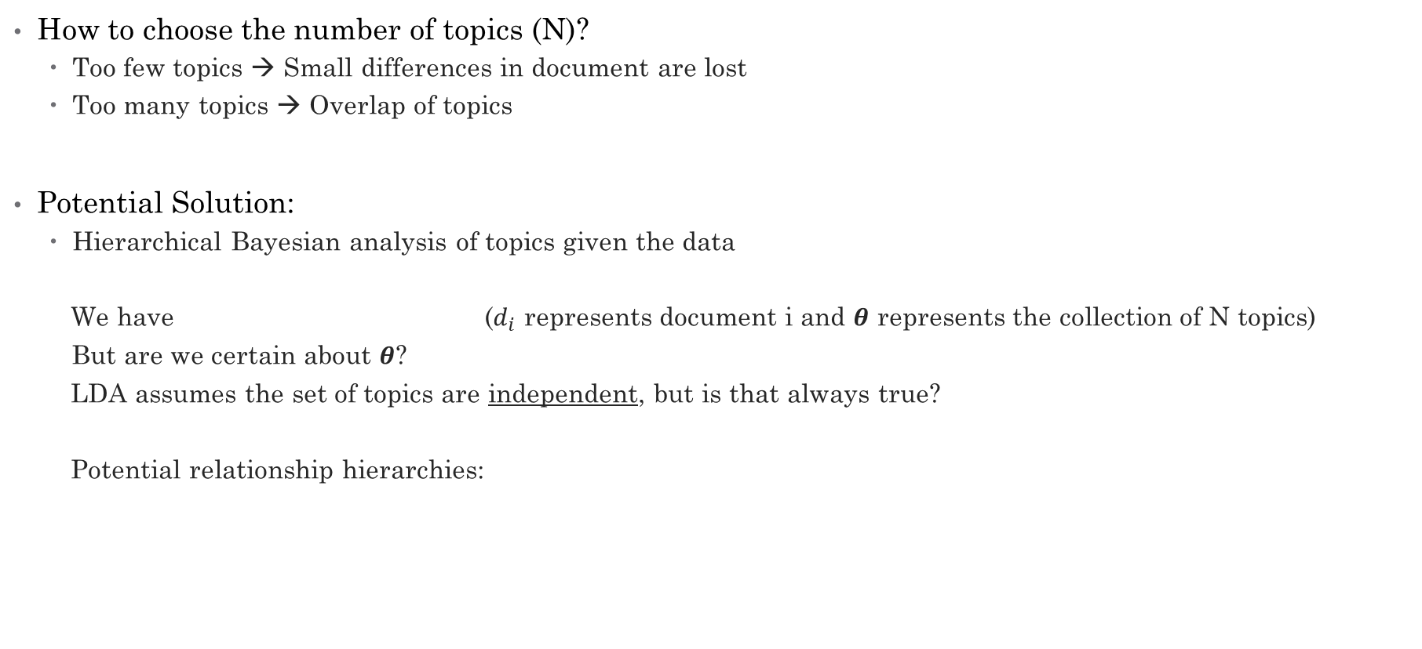






LDA: Can we squeeze out more information?
How to choose the number of topics (N)?
Too few topics → Small differences in document are lost
Too many topics → Overlap of topics
Potential Solution:
Hierarchical Bayesian analysis of topics given the data
We have ($d_{i}$ represents document i and $θ$ represents the collection of N topics)
But are we certain about $θ$?
LDA assumes the set of topics are independent, but is that always true?
Potential relationship hierarchies:
$$d_{i}|θ$$
$$θ_{j}$$
$$θ_{j}$$
$$θ_{j}$$
Which describes the true relationship between topics?
$$θ_{k}$$
$$θ_{k}$$
$$θ_{l}$$
$$θ_{k}$$
$$θ_{l}$$
$$θ_{l}$$
FNC
Approach
Analysis
Conclusions

Slide 22
Bayesian Network Structure Learning (BNSL)
The relationship between the set of topics intuitively represents a Bayesian network (or Bayes net) with an unknown structure
Bayes Nets
Directed acyclic graphs
Nodes represent random variables
Network can be represented by a conditional probability table
BNSL models attempt to learn the optimal, unknown structure of a Bayes net
Application:
Bayes net will inform us of the level of specificity of topics
Bayes net prototypical example:
FNC
Approach
Analysis
Conclusions

Slide 23
BNSL Performance
The universe will end before this finishes
Search and score
Learning time grows exponentially with the number of topics
Guarantees optimality
Constraint learning
Learning time grows quadratically with the number of topics
No probabilistic interpretation
Approximate learning
Learning time grows with the number of topics-squared
Non-optimal solution
Humans will colonize Mars before this finishes
This might be okay
FNC
Approach
Analysis
Conclusions

Slide 24
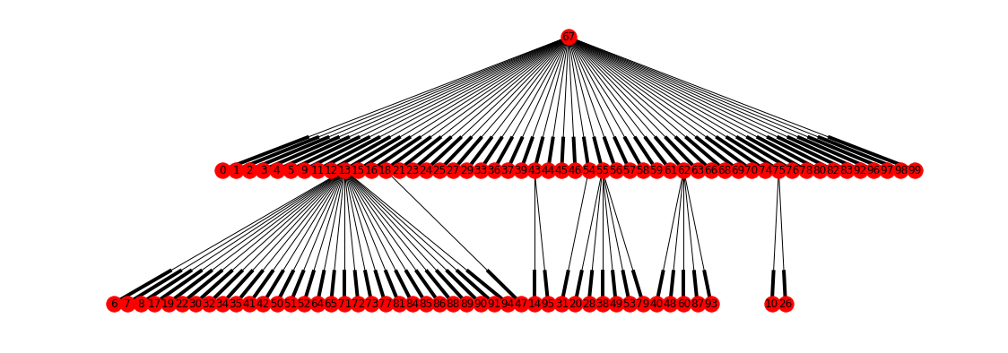
BNSL Results
topic #67: claims, life, rumor, time, hours,
save, still, day, discovered, back
LDA(num_topics=100)
topic #13: death, safe, future, making, rose, important, graffiti, ex, low, include
FNC
Approach
Analysis
Conclusions

Slide 25
Leveraging BNSL
Consider two articles which are each dominated by topic 67 and any other topic:
In order to emphasize their differences, we disregard topic 67
Topic | 67 | 30 | 60 | …
weight | 0.7 | 0.0 | 0.5 | 0.0
Topic | 67 | 30 | 60 | …
weight | 0.7 | 0.5 | 0.0 | 0.0
FNC
Approach
Analysis
Conclusions

Slide 26
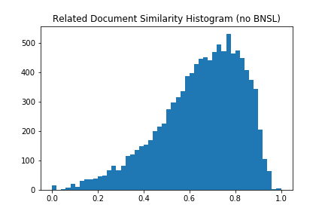
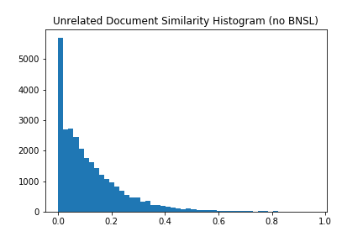
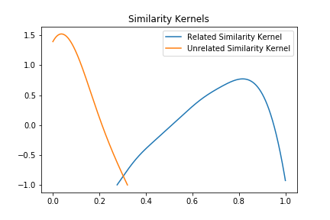
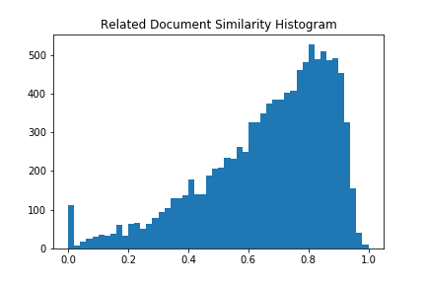
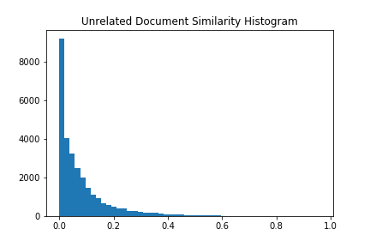
Kernel Density Estimation
Without BNSL:
With BNSL:
Classification Kernels:
Gaussian
bandwidth = 0.06
FNC
Approach
Analysis
Conclusions

Slide 27
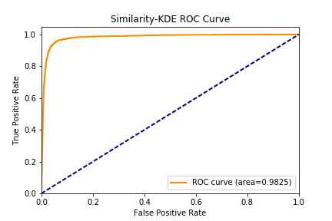
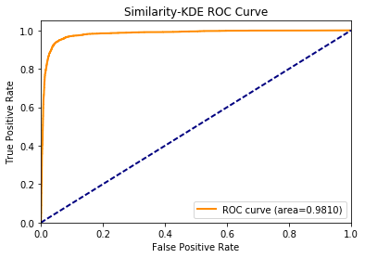
LDA-BNSL-KDE Empirical Results
Without BNSL
With BNSL
 |  | Predicted
 |  | 0 | 1
True | 0 | 6926 | 438
 | 1 | 135 | 2568
 |  | Predicted
 |  | 0 | 1
True | 0 | 6988 | 376
 | 1 | 136 | 2567
Accuracy: 94.31%
Accuracy: 94.91%
(+0.6% lift!)
FNC
Approach
Analysis
Conclusions

Slide 28
Current Framework
FNC
Approach
Analysis
Conclusions

Slide 29
Multilayer Perceptron
Essentially a deep neural network with only feed-forward learning
Motivation:
Mapping a bag-of-words to related/unrelated is a complex procedure
Deep neural networks excel at capturing complicated non-linear relationships between input and output
FNC
Approach
Analysis
Conclusions

Slide 30
Multilayer Perceptron Empirical Results
20 layers
Dropout
Accuracy: ~63.13%
Future Considerations:
Hyperparameter tuning
word2vec training data
 |  | Predicted
 |  | 0 | 1
True | 0 | 5553 | 1789
 | 1 | 1906 | 739
Confusion Matrix
FNC
Approach
Analysis
Conclusions

Slide 31
Current Framework
FNC
Approach
Analysis
Conclusions

Slide 32
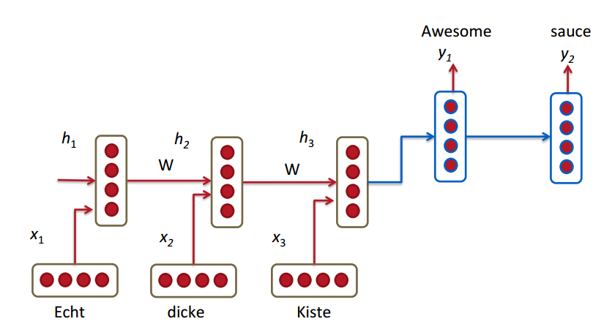
Deep learning
Recurrent Neural Network:
Particularly good at modeling sequence data
‘Speech recognition’, ‘Natural language processing’
Neural networks with “loops”
RNN
RNN Translation Model
FNC
Approach
Analysis
Conclusions

Slide 33
Big Picture
Embedding
Layer
RNN
Prediction Layer
Pretrained Word2Vec Model:
GloVe 6B
Trained on Wikipedia 2014 + Gigaword 5
400K vocabulary
Dimension = 50
Gated Recurrent Units (GRU)
Enable Memories
Capture long distance dependencies
A single layer Neural network
# of hidden units = 100
Unrelated
Raw Texts:
45000 Pairs of Headline and Body Texts
A 45000 x (200 + 50) x 50 Tensor
Features for prediction
Agree
Bi-directional RNN
Forward: left to right
Backward: right to left
Fix Headline length = 50
Body Text length = 200
Pad with 0
Concatenate Headline and Body Text
Out-of-Vocab: initialize by 0
Disagree
Discuss
# of hidden units = 200
FNC
Approach
Analysis
Conclusions

Slide 34
Deep Learning
Our options (Hyperparameters):
Experimental results:
Achieve (overall) score 78%
Training the model
Developed on Tensorflow
ISyE Lab
CPU - i7
RAM - 16G
GPU – Null
Training time
around 7 hours under the current setting
Future work:
Explore more settings for further improvement
Hyperparameter | current
Len( Headline) | 50
Len(Body) | 200
Type of Unit | GRU/LSTM
# of Hidden Units in RNN | 200
# of Hidden Units in Prediction Layer | 100
# of layers in Prediction layer | 1
# of epochs to train | 10
Batch size (SGD) | 32
FNC
Approach
Analysis
Conclusions

Slide 35
Initial Conclusions
Text-classification is difficult!
Context of text (i.e. sequence of words) holds information vital for correct classification
There’s probably a ceiling on how well bag-of-words models perform
Future Considerations:
Bigger and more complex deep-learning models
Intensive hyperparameter tuning
Use only leaf-node topics for LDA-BNSL-KDE stack
Ensembling
FNC
Approach
Analysis
Conclusions

Slide 36
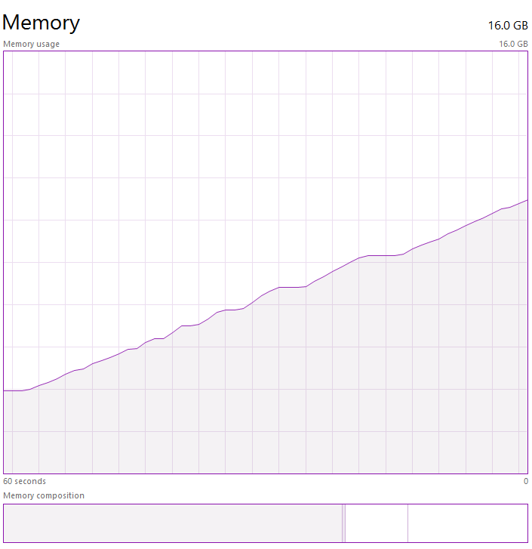
Problems and Pitfalls
LDA-BNSL-KDE stack
Hierarchical LDA already exists
Reportedly generates less comprehensible topics
BNSL models don’t scale well with the number of topics
Multilayer perceptron
Long training time → difficulty tuning hyperparameters
Bi-directional RNN with GRU cell
Very long training time
Many hyperparameters to tune
FNC
Approach
Analysis
Conclusions

Slide 37
Questions?

