Slide 1

A study of NYC’s transit data
Evan Spiller

Slide 2
Sprint 1: overview and EDA

Slide 3
Non-technical overview
NYC has public data on every rideshare and taxi ride from 2009-2023
This data contains a huge amount of data on New York’s transportation patterns
There are really endless questions that this dataset can answer. Even looking at the file sizes gives you a rough view of pandemic decline and recovery in movement!

Slide 4
Non-technical overview: problem
Context: A huge amount of for-pay rides are < 2 miles. Just in January: New Yorkers spent $54M on rides < 2 miles. This represents a failure of public transit to serve New Yorker’s basic transit needs, increasing traffic and costing New Yorkers money and experiences.
Problem: Increase bus ridership by designing routes with high demand. Furthermore, study the speed by which these patterns change in order to understand the utility of MTA’s multi-year planning process.
Opportunity: create an application that finds the a potential bus route from one location to another that would make the most number of for-pay rides unnecessary. Furthermore, predict how these routes will change over time.

Slide 5
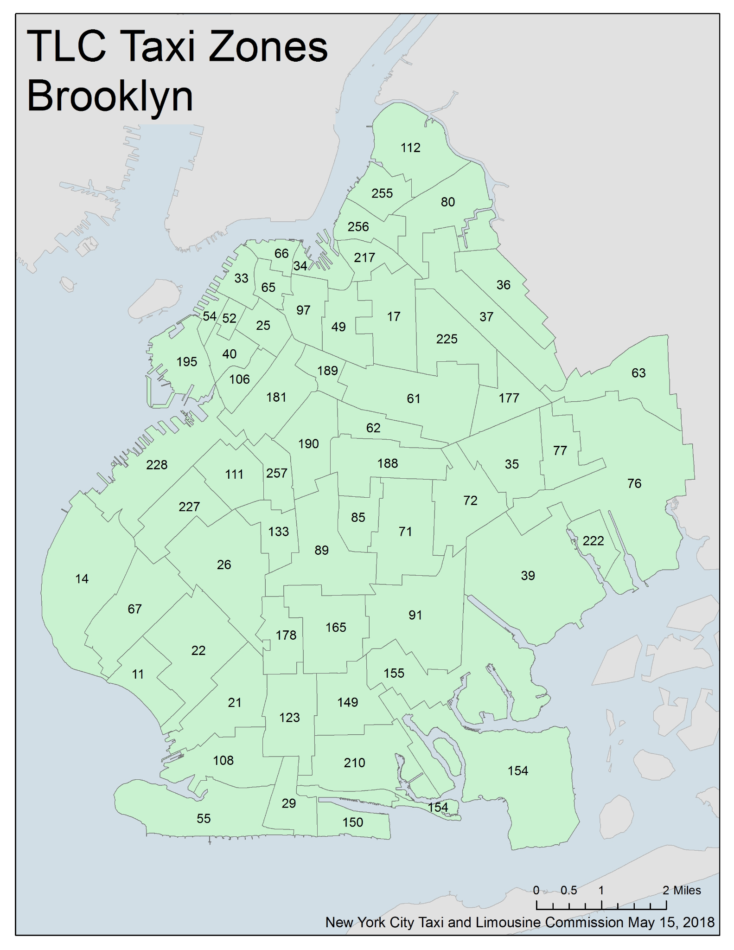
How to tackle this problem with data science
Pick a start and end point by taxi zone.
Using graph algorithms, create an application that lists potential routes where:
The ‘bus’ only travels through adjacent routes
The bus never travels through the same route twice
The bus is limited to a set number of taxi zones
Weight routes by ridership to find ‘best route’
Generalize application so that you can discover ‘best route’ by inputting starting point, end point, time, and number of taxi zones.
Use a moving time window to to predict movement of an optimal route e.g., how will the optimal route for 2013-5 from Astoria to Williamsburg change by 2016.
This will also give a sense of the pace of change of transportation needs

Slide 6
Potential impact
Two potential impacts:
Create a rudimentary tool for deciding and predicting the best bus routes. While there are myriad other considerations such as logistics, specific community needs, and budget that are not being accounted for in my algorithm, this is potentially a valuable tool for policymakers to discover routes that fit transit needs and have the potential to increase ridership.
Examine the pace of change of transportation needs, providing datapoints for citizens and policymakers who wish to examine the utility of MTA’s multi-year planning process.

Slide 7
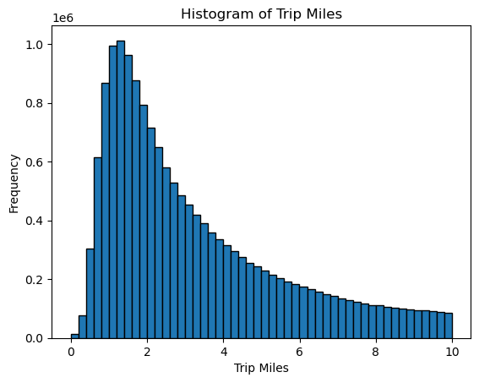
Introduction to the dataset: key findings
Ride length peaks at about one mile then declines exponentially.
(Jan 2023 data)

Slide 8
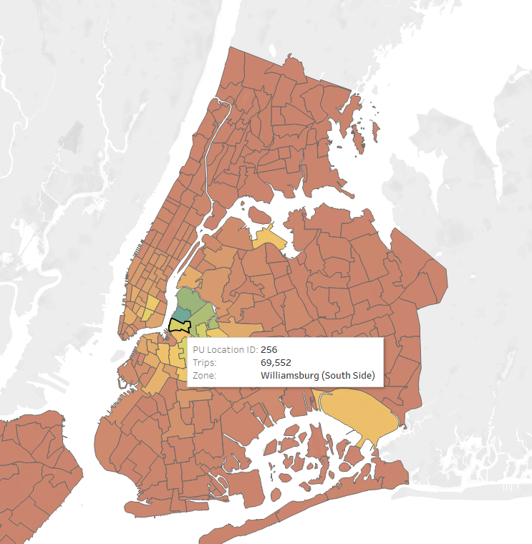
Introduction to the dataset: key findings
Data is split by pickup and dropoff location to taxi districts.
Most taxi districts behave like this: the bulk of rides come from that district and nearby districts as well as JFK and LGA airports.

Slide 9
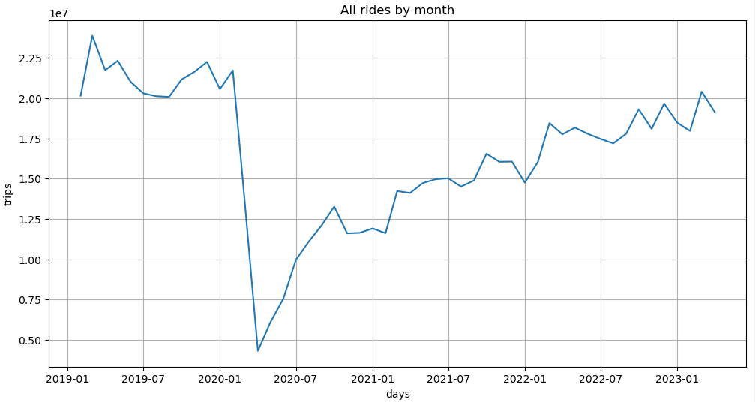
Introduction to the dataset: key findings
Overall, rideshare trips track pandemic behavior, movement and economic recovery.

Slide 10
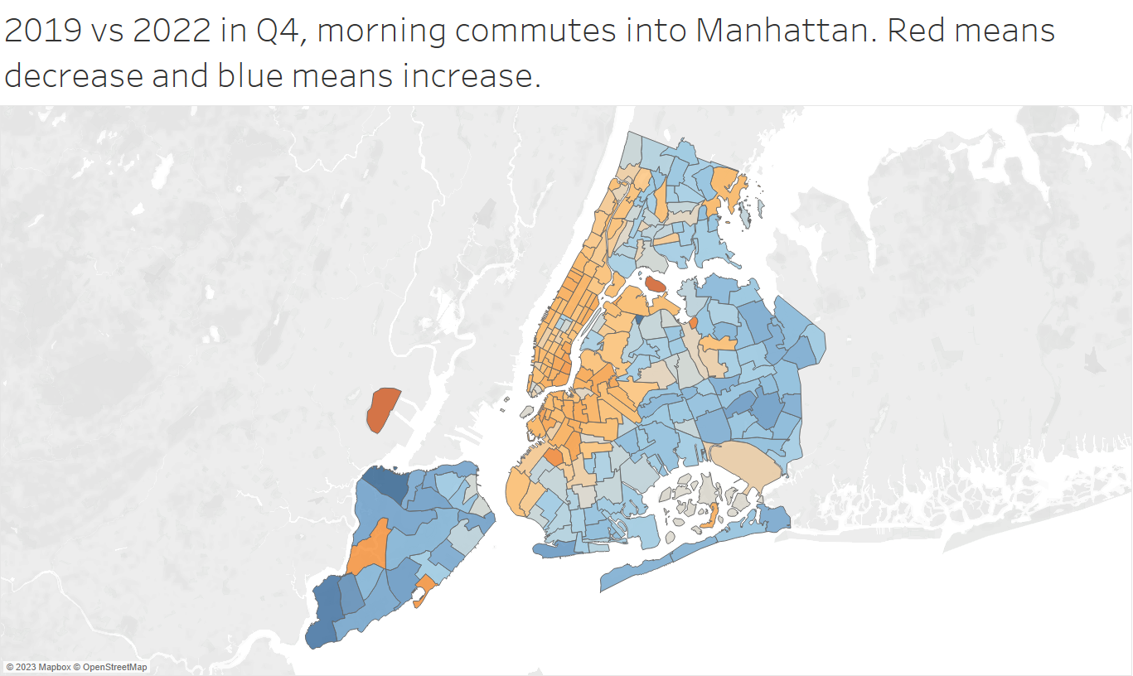
Introduction to the dataset: key findings
This is also a remarkable dataset for studying changes to behavior by neighborhood in NYC, especially pre and post-pandemic.

Slide 11
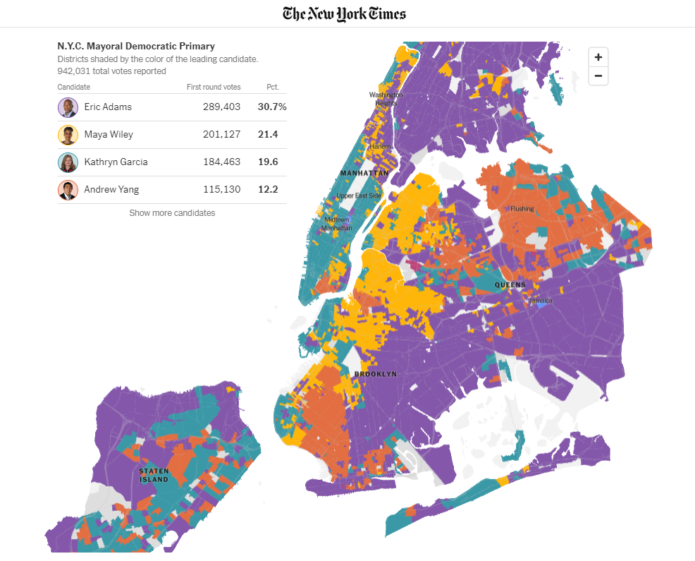
Introduction to the dataset: key findings
Commuter differences are very similar to voting patterns and other maps that demonstrate the difference in lifestyles between inner and outer-borough residents.

Slide 12
Sprint 2: modeling

Slide 13
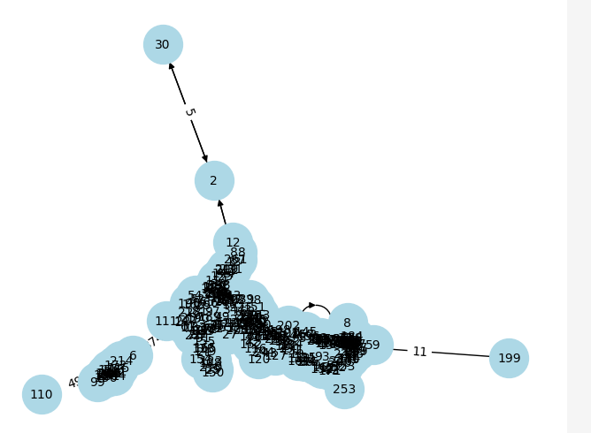
Turning data into a network
Using Geopandas, I wrote code to find the adjacent zones for each taxi district and flatten the dataset so I could fit it into a graphing library, NetworkX.
Merged with 2022 data and used # of trips as weight.
Finally, I used NetworkX to turn the taxi districts into a graph as you see on the right.
After working with it, I identified issues e.g., missing bridges and tunnels and fixed them.

Slide 14
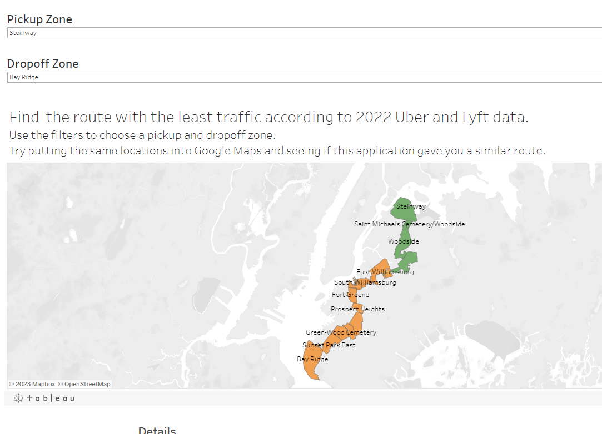
Shortest path application
As a first dive into graphing algorithms, I used the ‘shortest path’ function to find the least trafficked – in terms of adjacent districts – path from point A to point B.
I started with a few districts, then ran the function for every district.
Finally, I used the comprehensive dataset to create an application in Tableau that can show you the least-trafficked path from any taxi zone to any other taxi zone.
Play with the application here

Slide 15
Best bus route algorithm
I wanted to find the route from location a to b, which made the most number of rides redundant as this could potentially find you the most valuable bus route.
Since there’s no natural algorithm for this, I spent considerable time looking for a way to do this.
Ultimately, I used “all_simple_paths”, which gives you all routes from point a to b, given a cutoff of number of zones traversed where no zone is traversed more than once.
Then, I added a formula to split paths into ordered 2-zone tuples (so [A,B,C,D] -(A,B),(A,C),(A,D),(B,C),(B,D),(C,D)).
Created dictionary of 2-zone weights, and added weights together for each path.
Took the highest-weighted path for the route, given the cutoff.

Slide 16
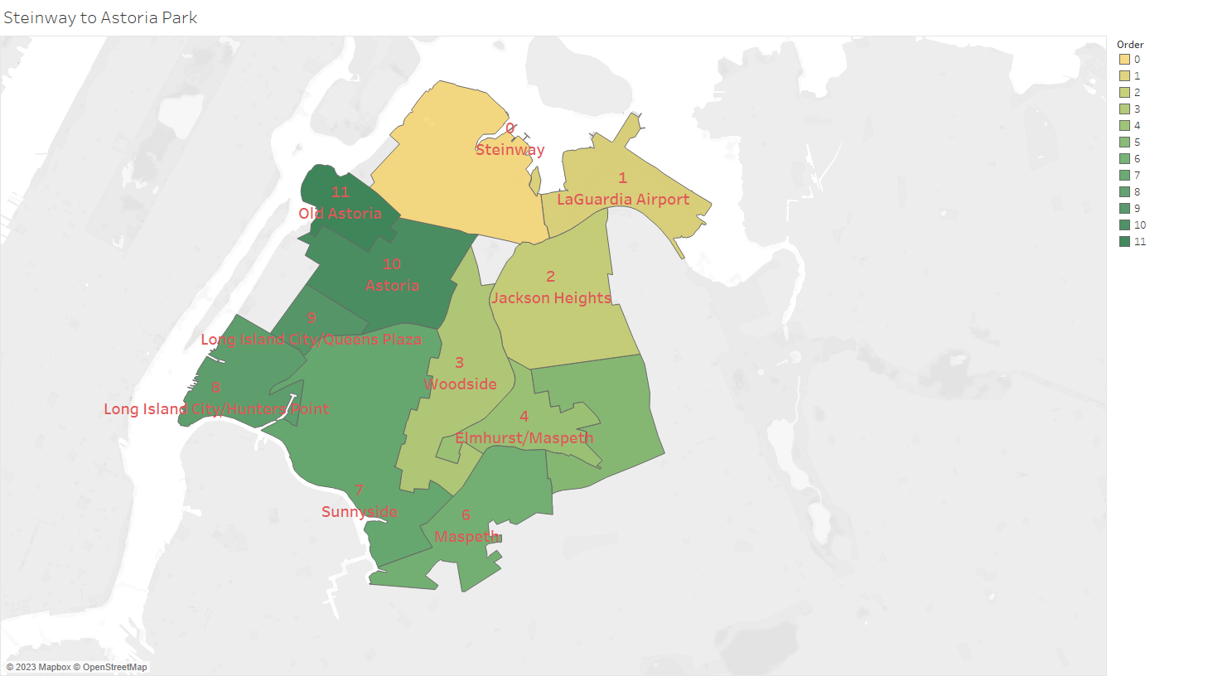
Best bus route: creates circulators through high-traffic areas

Slide 17
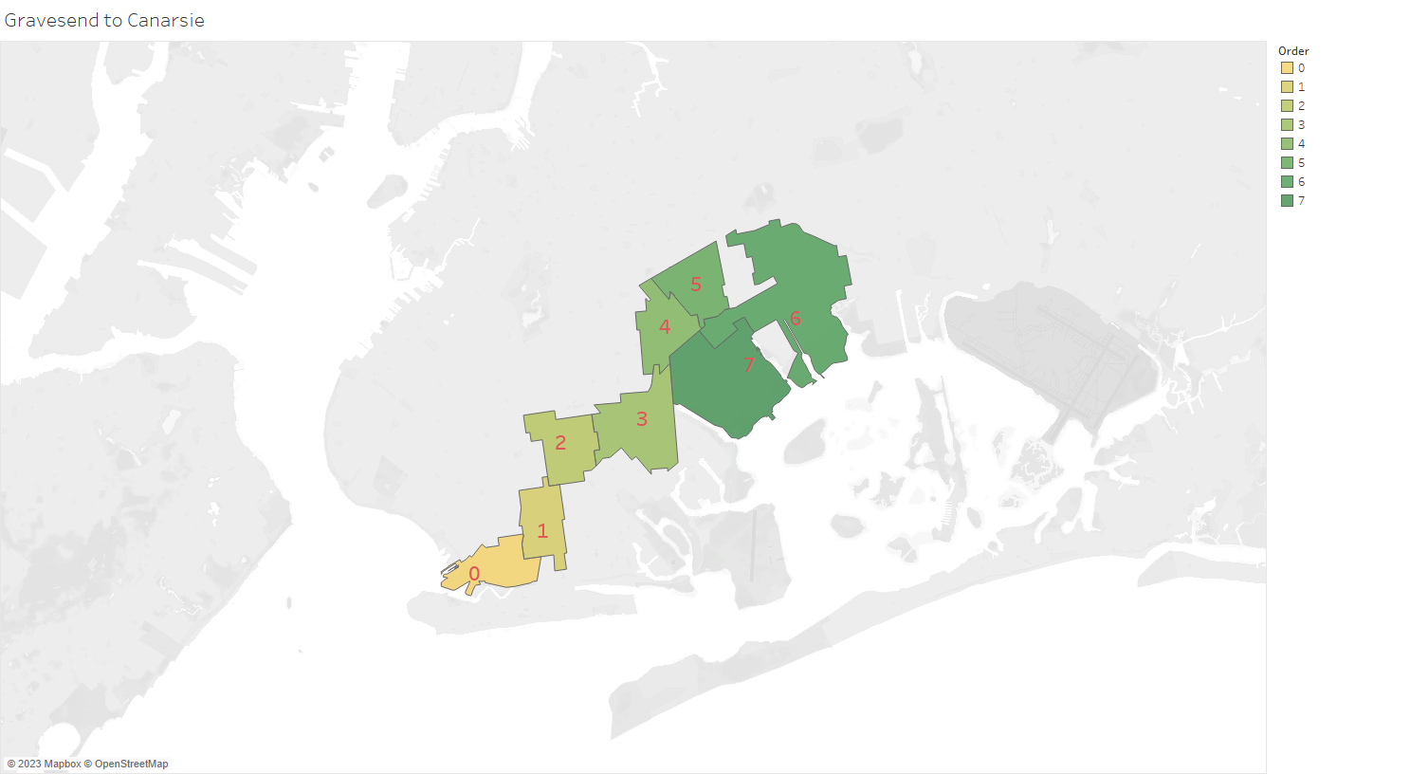
Or finds a route with a lot of traffic.

Slide 18
Next steps
Complete aggregation of parquet files for yellow cabs and rideshare rides pre-2019.
Switch weighting from ‘most trips’ to ‘trip cost’ – this will account for the greater value of longer rides while preventing the model from simply zigzagging through major population centers.
Formalize ‘cutoff number’ – I’m thinking unweighted shortest path * 1.5.
Run model for proposed bus routes for last ten years.
Use Jaccard distance or something similar to measure change over time.
Create final presentation.

