Slide 1
Weather Vs Crime
CRANG

Slide 2
Core message
Hypothesis- If weather can influence mood, mood can influence actions, and actions can be criminal, then weather should sometimes influence criminal activity. We suspect that we will find trends in crime data as it relates to weather data.
Null Hypothesis- If weather has no effect on crime then crime rates will be unaffected by variable weather conditions.

Slide 3

Motivation
Crime data can be found in abundance
There have been many studies based on crime and socioeconomic status
Weather is a good variable to compare against crime rates because it adjusts to region specificity.
Correlating those day-by-day crime records with changes in average daily temperature might show some types of crime are more likely to increase when the weather is hotter and decrease when cooler.

Slide 4

Data Source
Crime - Data World
Weather - Open Weather API
2 Years of data - 2014 and 2015
Thee Large U.S. Cities

Slide 5

Data Exploration and Cleanup
Data frame is imported from data world using: df = pd.read_csv
Data frame is then filtered to only display 2 years using pd.loc functions
The data frames for the 2 years are then merged with a concat
Import 3 APIs from Open Weather and merge data with crime data
Analyze data for trends between crime and weather

Slide 6
The data analysis process
Examining types of weather (rain, snow, clouds, clear, etc.)
Examining trends of crime levels and wind
Sorting crime levels by temperature

Slide 7
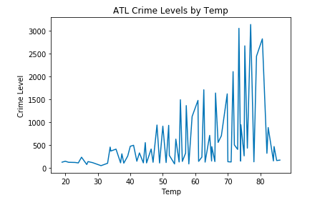
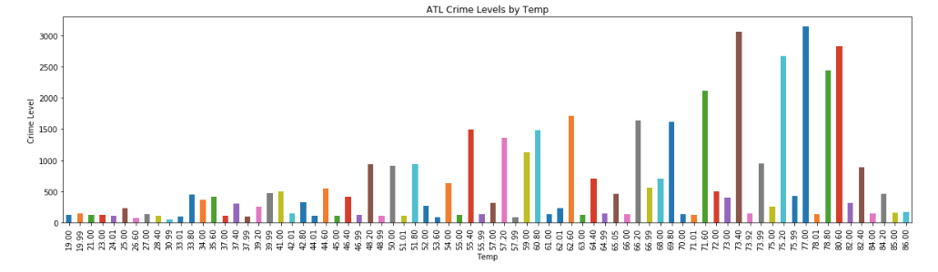
Atlanta
As the temperature rose, the crime rate increased
The highest crime level was during the summer.

Slide 8
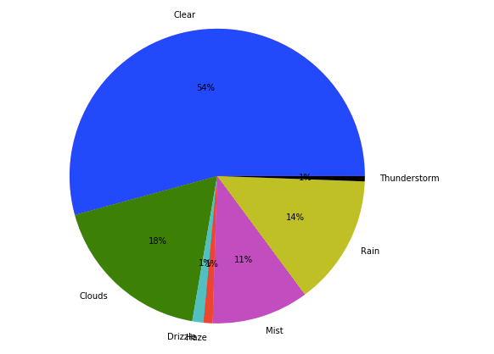
Atlanta
The highest crime level was during the clear weather.
Atlanta Crime Rates by Weather Status

Slide 9
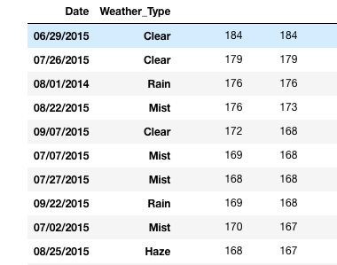
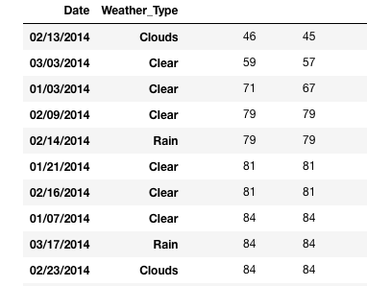
Atlanta
Top and lowest 10 crime days of the year

Slide 10
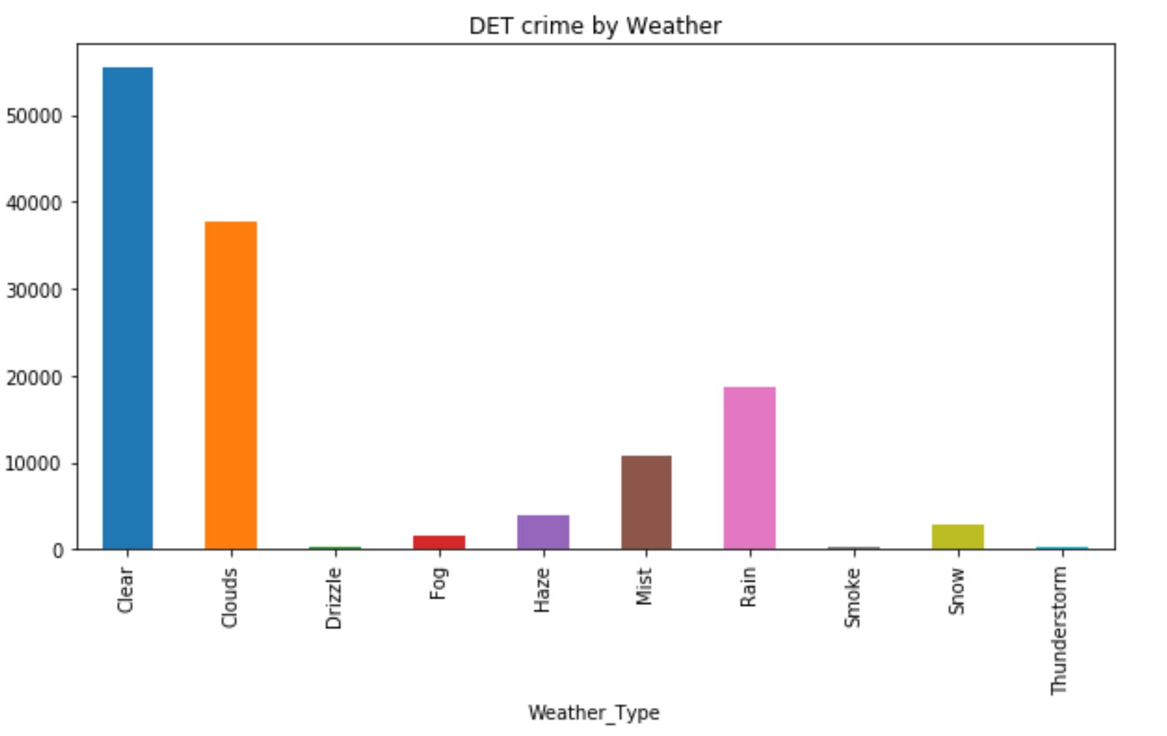
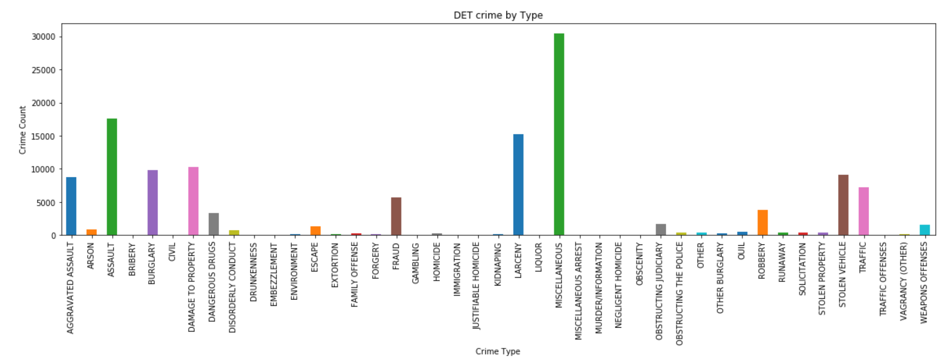
Detroit
Highest crime count is miscellaneous, assault, and larceny
Most crime occurred during clear, cloudy ,and rainy weather

Slide 11
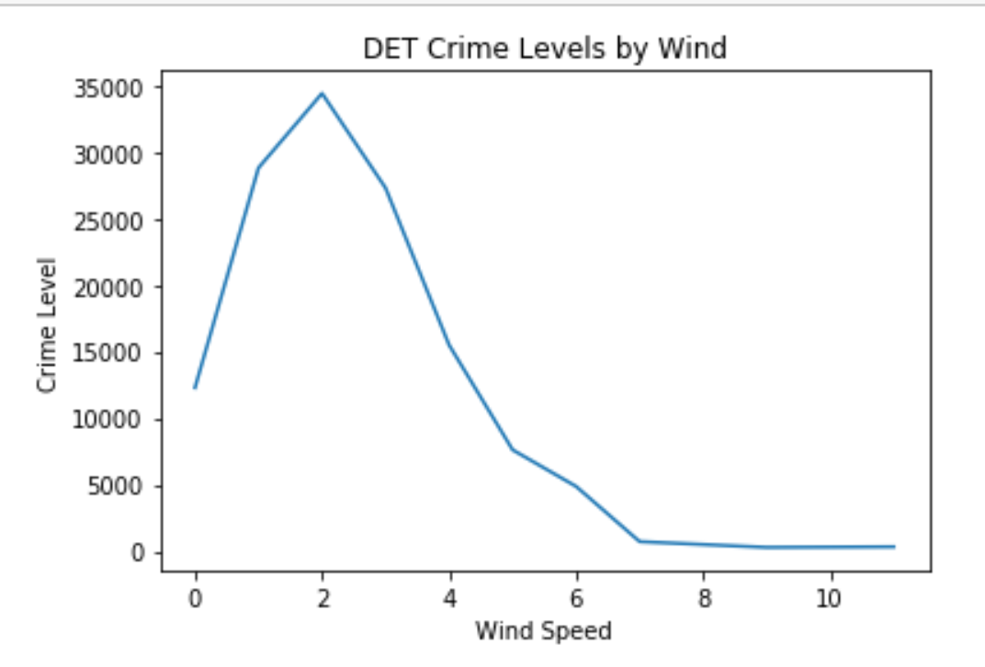
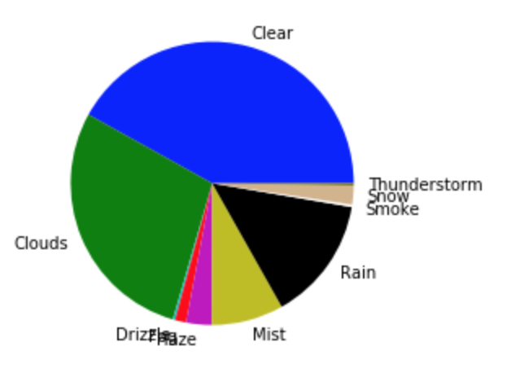
Detroit
As the wind speed increases, crime levels trend downward
The most crime occurs in clear conditions, followed by clouds, and then rain
Detroit Crime by Weather Conditions

Slide 12
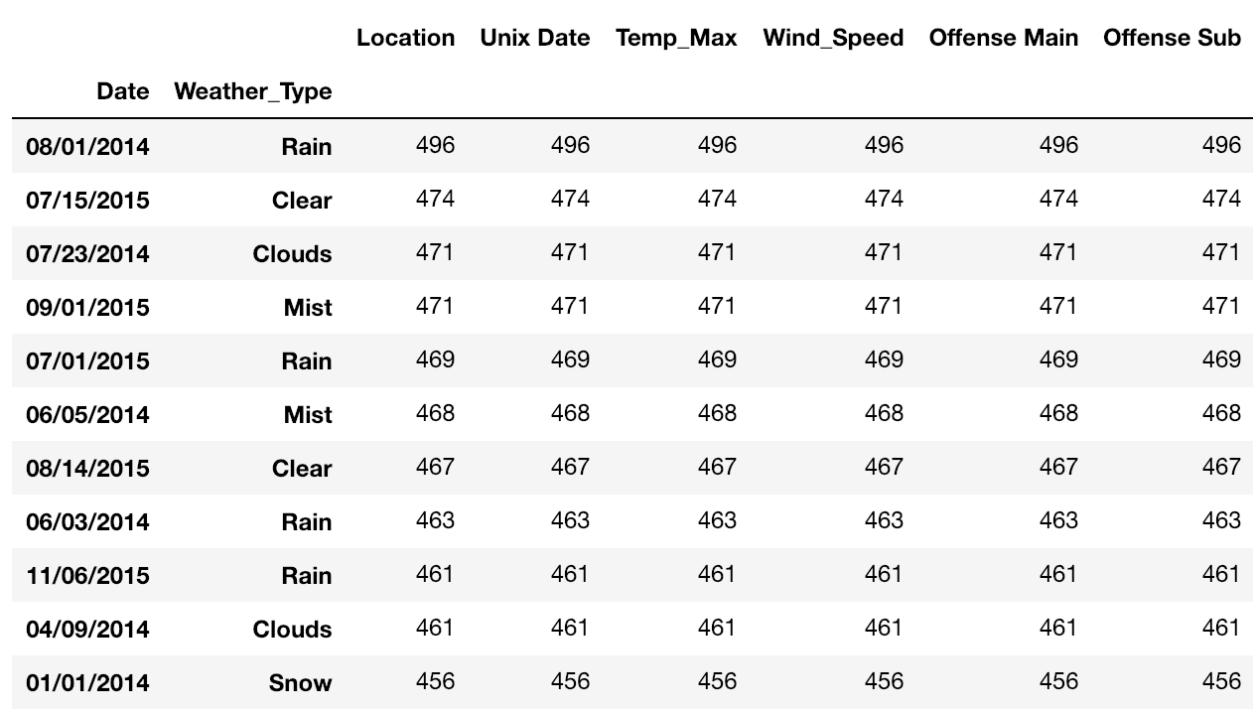
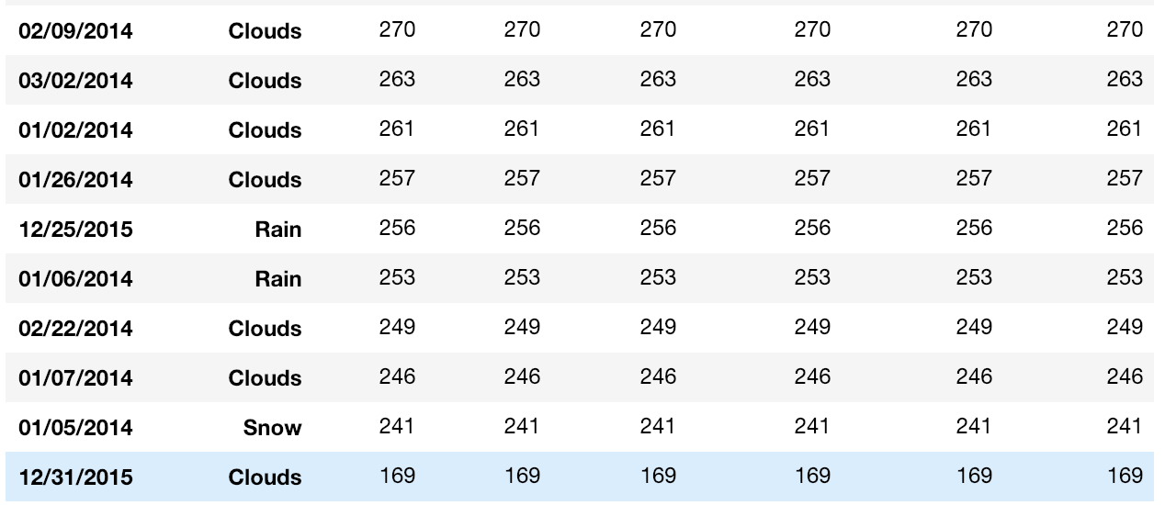
Detroit
Top Ten Days of Crime 2014-2015 by Date and Weather Type
Bottom Ten Days of Crime 2014-2015 by Date and Weather Type

Slide 13
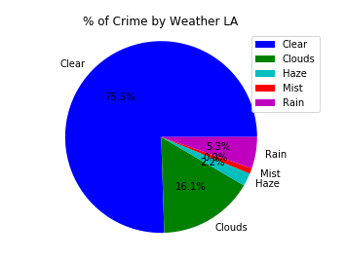
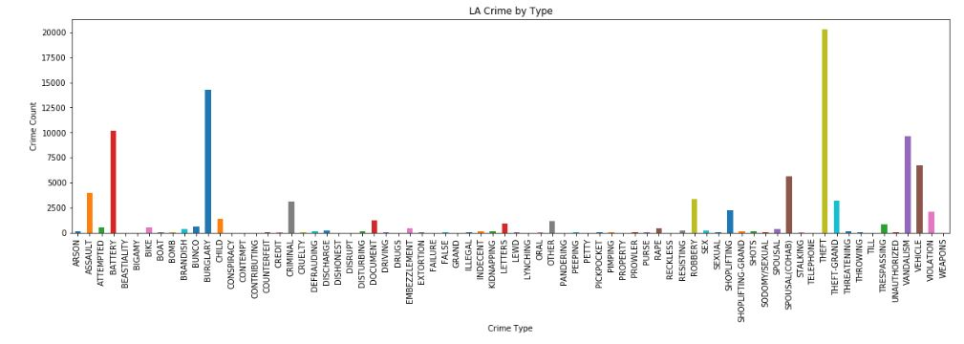
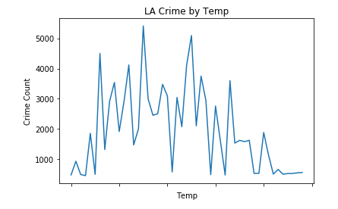
LA
Highest crime count is theft, burglary, and battery
Most occurred weather condition was clear.

Slide 14
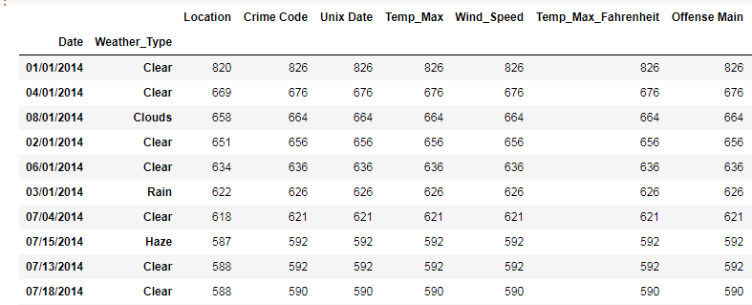
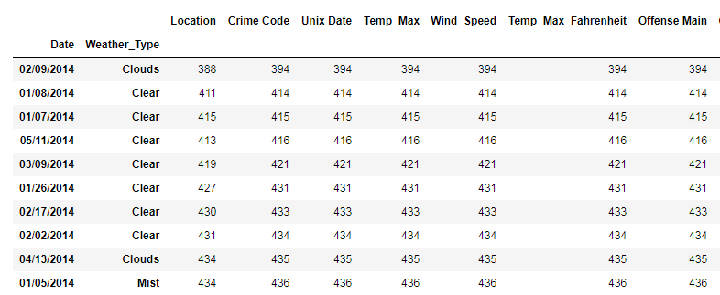
LA
LA Highest Rates of Crime
LA Lowest Rates of Crime

Slide 15
Conclusions
Crime peaks during summer months, but not all types of crime are equally susceptible to changes in temperature according to the observations.
Further testing is necessary to corroborate trends seen
Most crime occurs during clear weather, increased wind speed conditions reduce crime rate looking at the graphs.

Slide 16
Challenges
Weather API for historical data is not free
Working through merge conflicts
The size of the data we are using is very large
The date types between the weather and crime data not being in the same format
Having to convert traditional dates to unix dates
Merging the weather data into the crime data by unix date
converting Kelvin Temp to Farenheit
The number of crime types was very high - had to group them smaller

Slide 17
Additional Questions
Visual trends and the top/lowest 10 trends lead to more questions about the correlation between weather and crime
We would like to expand upon the data analysis done to identify if there is actually a correlation
Would like to examine specific types of crime (white color, ect) and weather trends
Do more crimes take place during the night or day? Are crime rates different during daytime and nighttime hours?

Slide 18

Crang lived happily ever after

