Slide 1
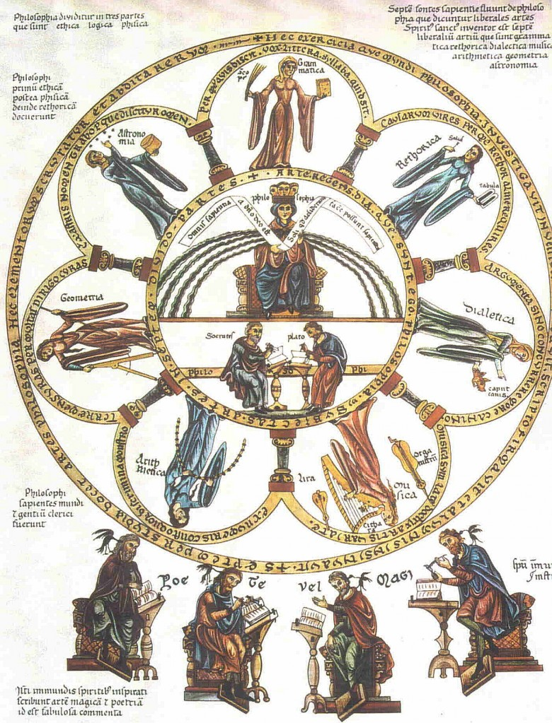
The Seven Liberal Arts
Herrad von Landsberg

