Slide 1
0110110110110110110110110110110110110110110110110110110110110110110110110110110110110110
1000001110111011110011101111110111011001010100000111011111010001101111010000011000111101
1001000111010101000111000100011011101101011011010000100000101111100001011011110110011101
0011001101100100100110110101100100100101001001100101011001001101011001101010110011010010
Quiz: Which sequence is most random?

Slide 2
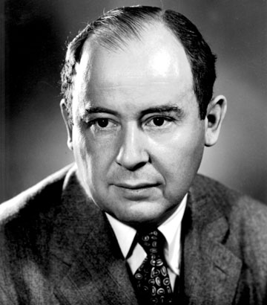
Anyone who considers arithmetical methods of producing random digits is, of course, in a state of sin.
John von Neumann

Slide 3
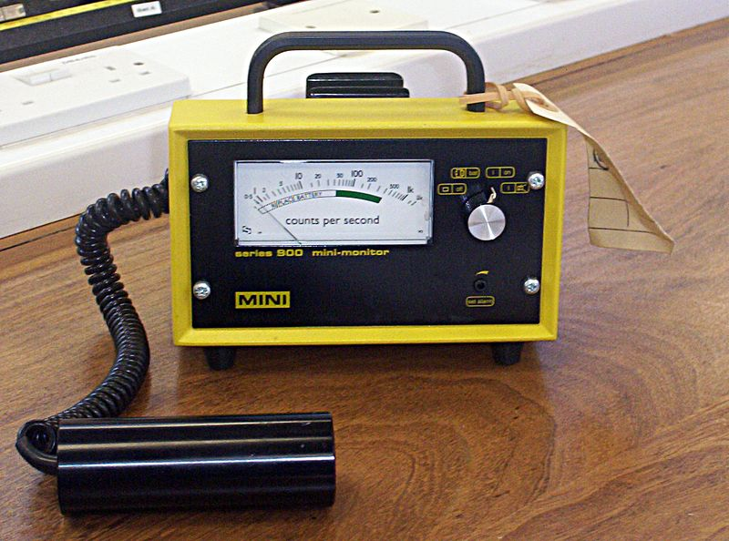

Slide 4
Quiz: Which sequence is most random?
0110110110110110110110110110110110110110110110110110110110110110110110110110110110110110
1000001110111011110011101111110111011001010100000111011111010001101111010000011000111101
1001000111010101000111000100011011101101011011010000100000101111100001011011110110011101
✓
0011001101100100100110110101100100100101001001100101011001001101011001101010110011010010

