Slide 1

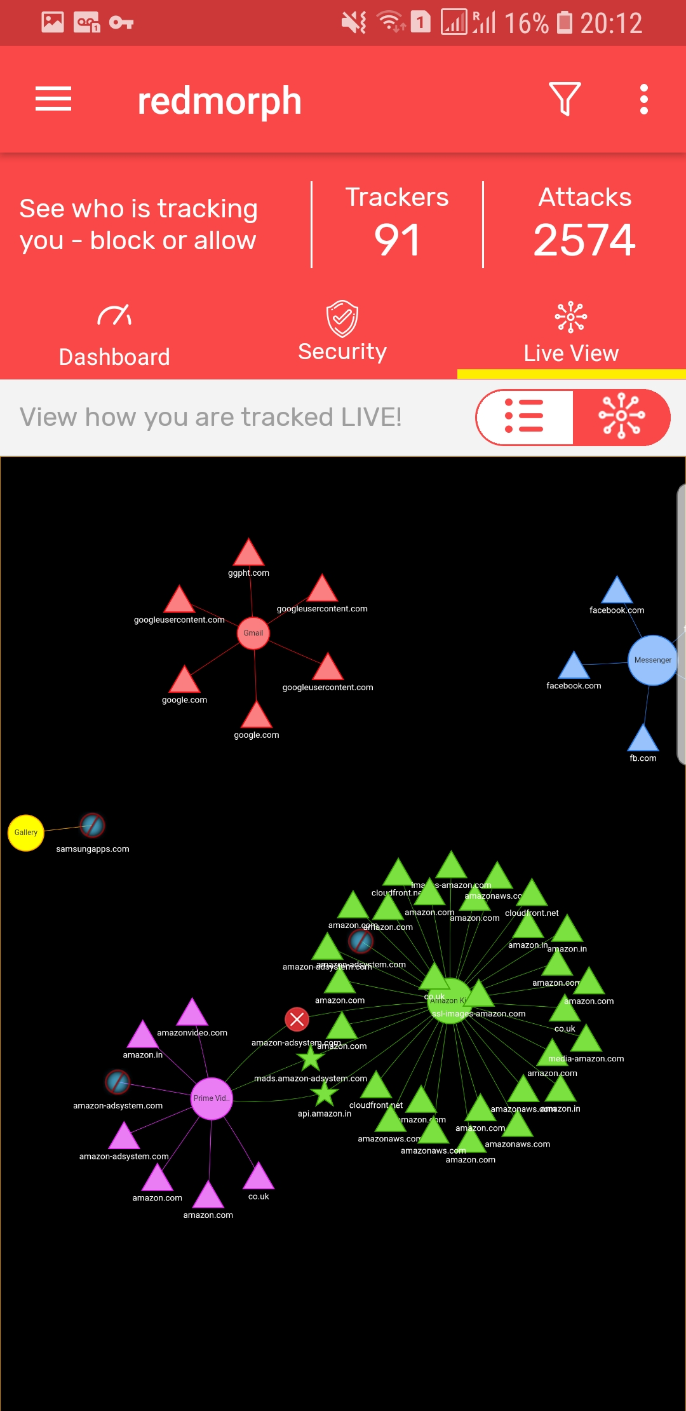
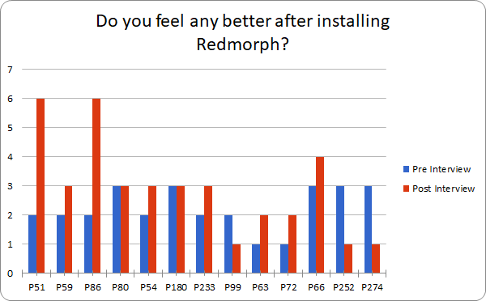
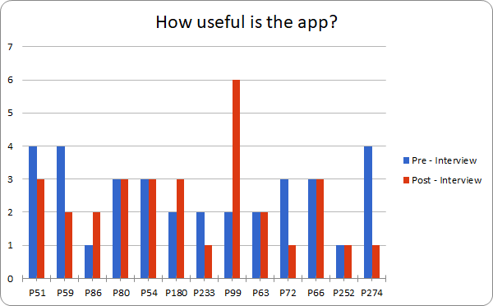
Recommendation
for Improvements
Recruit Participants
User Study
Evaluation

Slide 2
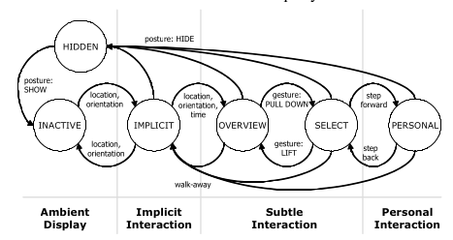
Default
Hide Scene
Default
Default
Default
Default

Slide 3
Photo: Liwei Chan

