Slide 1


Spotting “Fake” News and Images
on the WEB

Slide 2
Learning Goals
Understand why it’s important to question the truthfulness of articles and images found on the web
Define confirmation bias and recognize how it impacts a person’s decision-making
Develop strategies for identifying “fake” news and images

Slide 3
Class discussion
What are the different ways we experience the news?

Slide 4
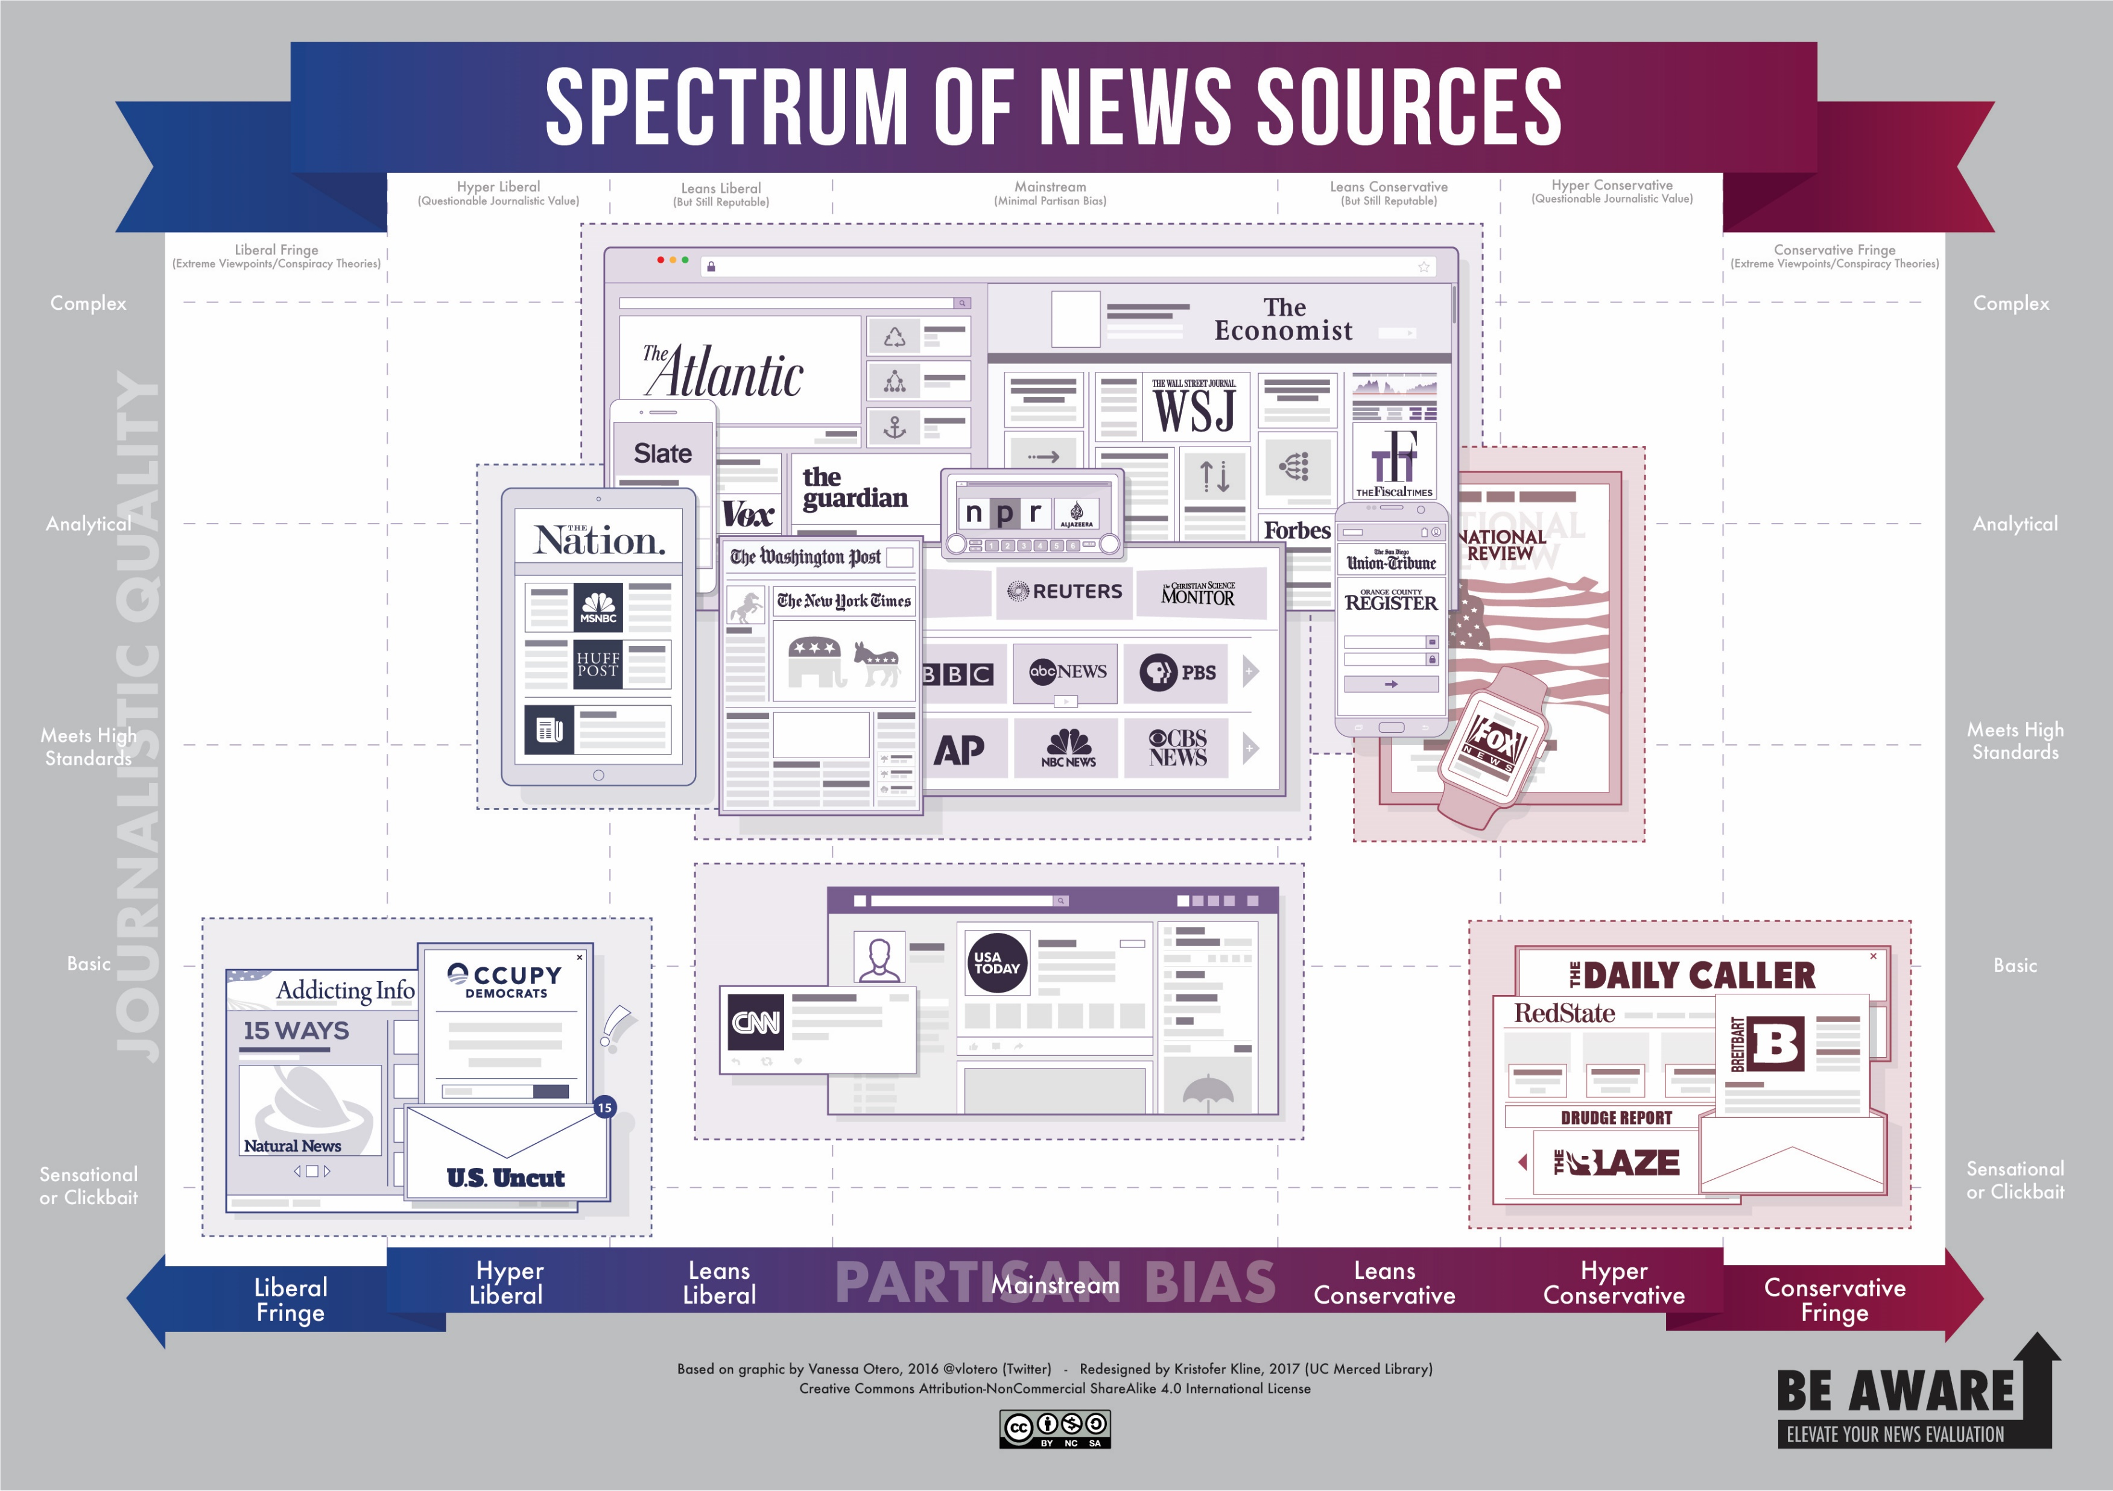

Slide 5

Small group discussion:
How can the spread of misinformation have negative consequences?
Scenario #1: “News” reports tell of alleged gas shortage in the wake of Hurricane Harvey.

Slide 6
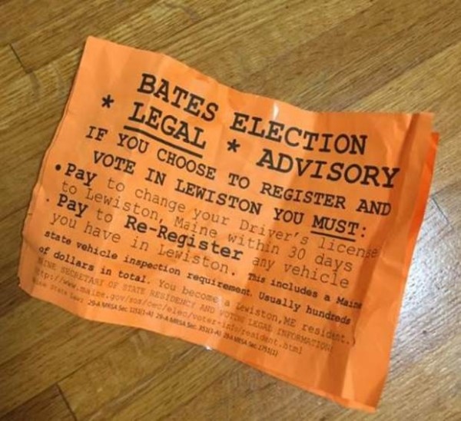
Small group discussion:
How can the spread of misinformation have negative consequences?
Scenario #2: Orange “legal advisory” fliers distributed on the Bates College campus in Maine only days prior to 2016 election telling students that if they wanted to vote in Lewiston, they would have to pay to change their driver’s licenses and to re-register any vehicle in the city.

Slide 7
Small group discussion:
How can the spread of misinformation have negative consequences?
Scenario #3: You hear a rumor about a classmate at school and tell it to several others. You later learn the rumor is not true, but you had a hand in spreading it around school.

Slide 8
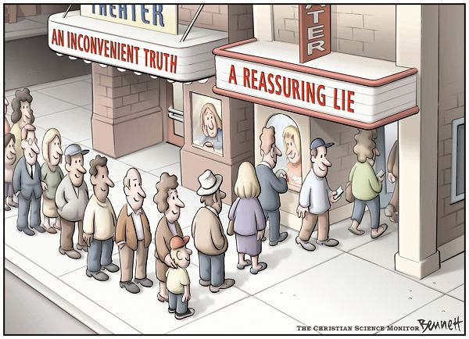
Confirmation bias The natural tendency to seek out or favor information that confirms what you already believe to be true while at the same time ignoring evidence that contradicts your beliefs.

Slide 9
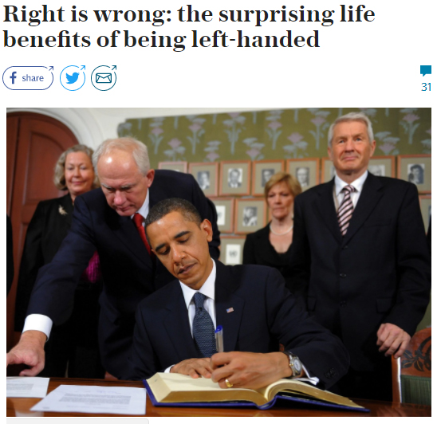
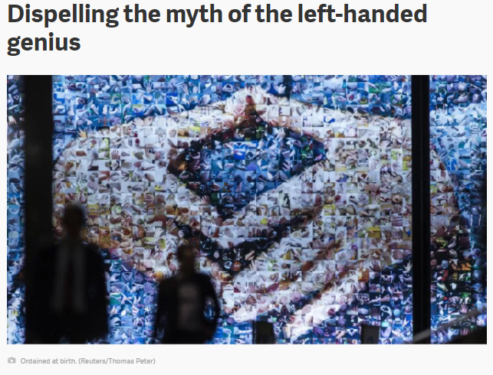
Confirmation bias
Which article would you share on social media if you believed left-handed people are more creative than right-handed people?
ARTICLE B
ARTICLE A

Slide 10
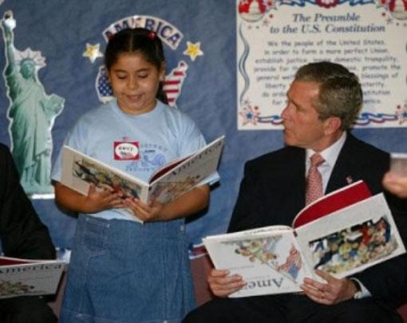
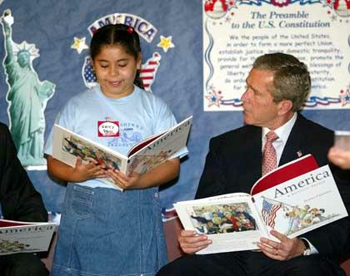
Evaluating the credibility of images

Slide 11
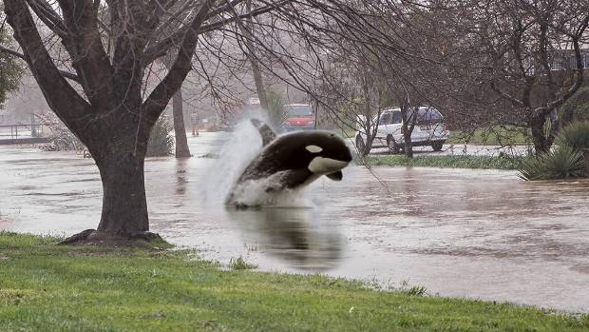
Evaluating the credibility of images
Photoshopped image of orca swimming in flood waters near Christchurch, New Zealand

Slide 12
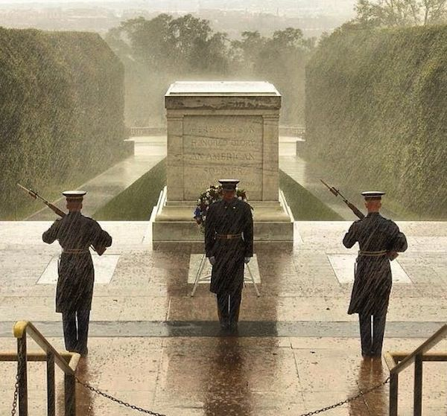
Evaluating the credibility of images
This image was circulated on social media and in news stories as being taken during Hurricane Sandy, but the photo was actually taken during a different rain storm.
Tomb of the Unknown Soldier

Slide 13
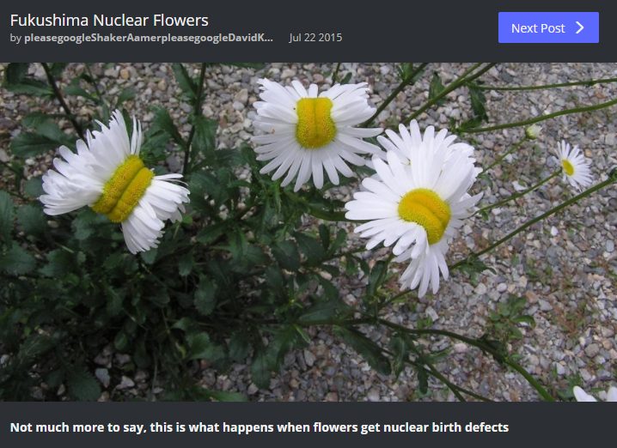
Evaluating the credibility of images
You are doing a research paper on the effects of nuclear radiation, and you stumble upon this picture posted on a photo sharing site (Imgur).
How could you find out whether this image is making a true or false claim?

Slide 14
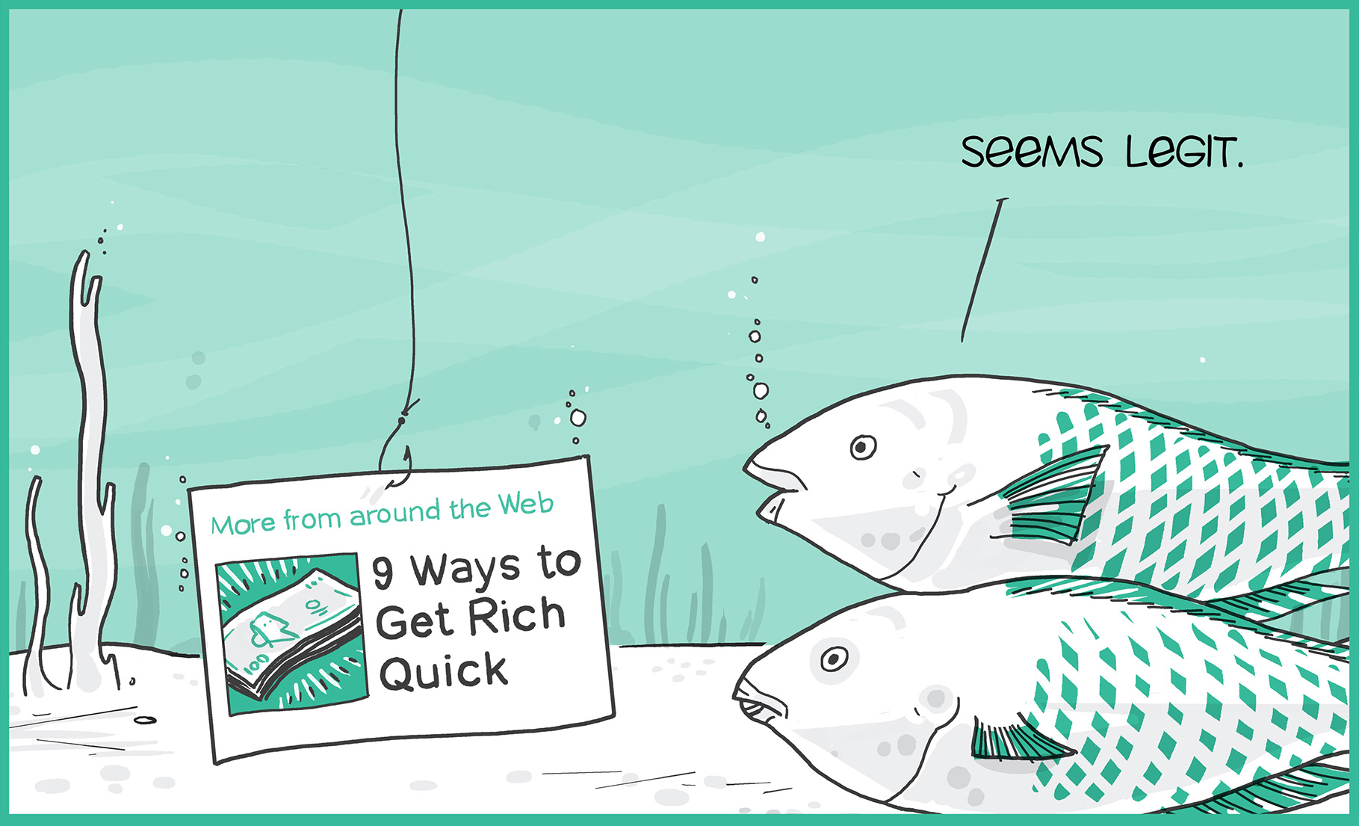
Clickbait
Catchy headlines and/or images designed to grab your attention and encourage you to click through to an article or website that may contain questionable content.
Sometimes clickbait is ad content disguised to look like a legitimate news article.

Slide 15
Legitimate News or Clickbait? Using the SMART Board, draw a line from the headline to News or Clickbait.
12 Unusual Ways Celebrities Hydrate Their Skin
News
Avoid a Holiday Health Crisis
The Economy Is Humming, but Businesses Aren't Borrowing
Clickbait
World’s Oldest Woman Reveals the One Food She Eats Every Day

Slide 16

Tips for Recognizing “Fake” News and Images Before you cite or share:
Read beyond the headline
Consider the source
Check the author/photographer
Check the date
Check the links

Slide 17
Tips for Recognizing “Fake” News and Images Before you cite or share:
Check the comments
Evaluate supporting quotes
Ask: “Is this a joke?” (satire)
The Onion, The Daily Current, Empire News
Ask: “Do my own beliefs affect my judgement?” (confirmation bias)
Conduct a reverse image search

Slide 18

Resources
Handout:
Fact or Fiction? 10 Tips for “Ferreting Out” Fake News (also available in 11x17 poster)
Fact-checking websites:
FactCheck.org
Politifact.com
Snopes.com
Test your news sense: http://factitious .augamestudio .com/#/

Slide 19
Discussion Post
Due tomorrow:
How does the spread of misinformation and “fake news” relate to research? Write a well-developed paragraph of 6-8 sentences and post to the class blog. Respond to at least two of your classmates’ posts by Friday.
Up Next:
Evaluating Web Sources Using the CRAAP Test
Introduction to Library Databases (Yay!)

Slide 20
Sources
Bennett, C. (2006, May 30). An inconvenient truth [Photo]. The Association of American Editorial Cartoonists. http://editorialcartoonists.com/cartoon/display.cfm/24088/
Fukushima nuclear flowers [Photo]. (2015). Retrieved from https://imgur.com/gallery/BZWWx
IFLA. (2016). How to spot fake news [Infographic]. Retrieved from https://www.ifla.org/publications/node/11174
Kline, K. (2017). Spectrum of news sources [Infographic]. UC Merced Library. Retrieved from http://libguides.ucmerced.edu/elevate-news-evaluation/spectrum
Sharethrough. The true cost of clickbait [Photo]. (2015, August 12). Retrieved from http://nativeadvertising.com/the-true-cost-of-clickbait/
US Army. (2012). Despite Sandy, Soldiers Stand Guard at Tomb of the Unknown Soldier [Photo]. NPR. Retrieved from https://www.npr.org/sections/thetwo-way/2012/10/29/163875922/photo-despite-sandy-soldiers-stand-guard-at-tomb-of-the-unknown-soldier
Webber, S. (2017, July 25). Christchurch photographer Sarah Webber's photoshopped flood pictures [Photo]. Stuff. Retrieved from https://www.stuff.co.nz/national/95074888/Christchurch-photographer-Sarah-Webbers-photoshopped-flood-pictures

