Slide 1


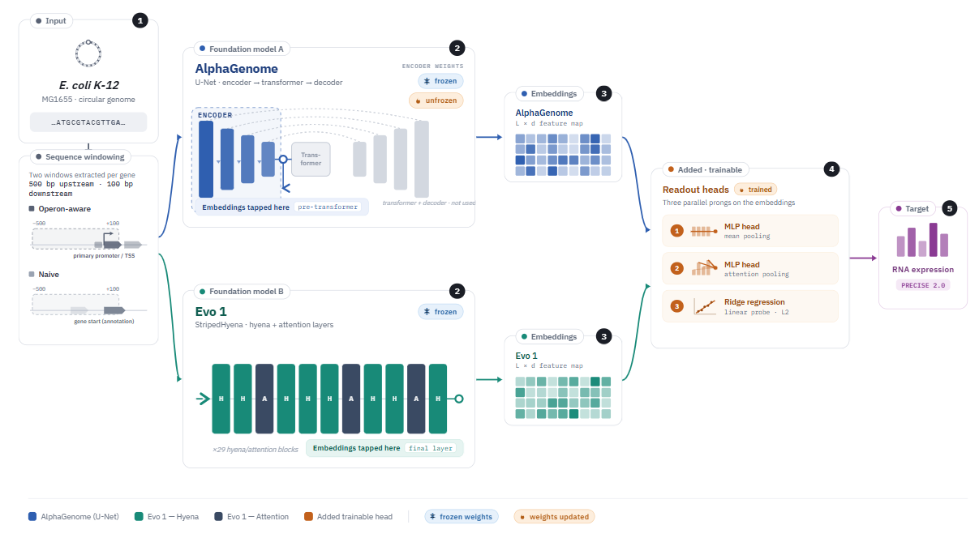
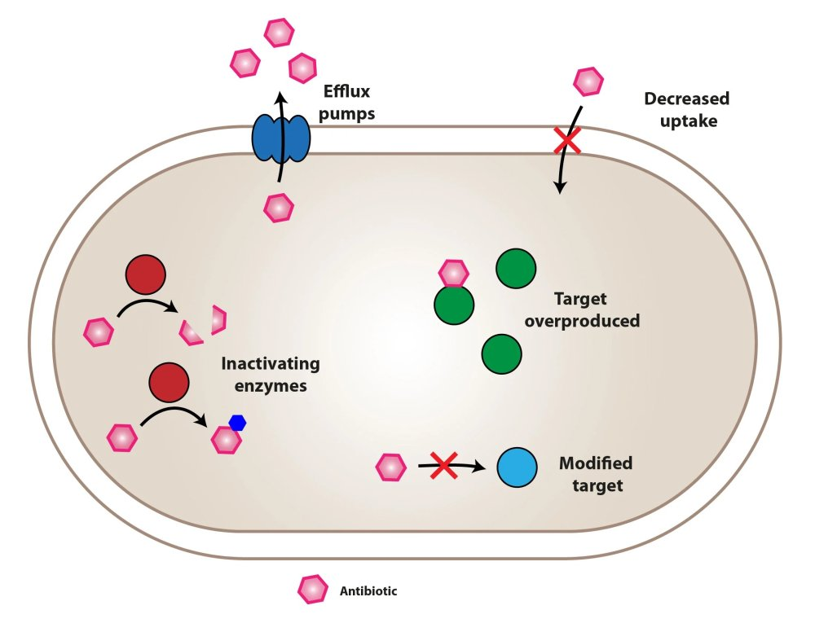
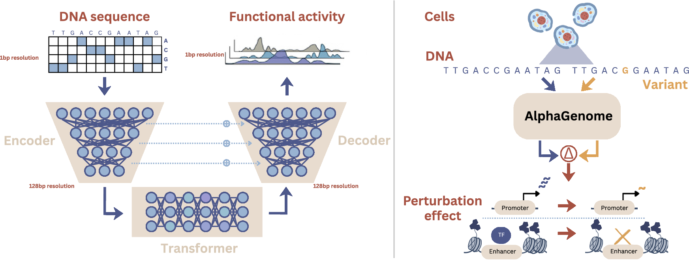
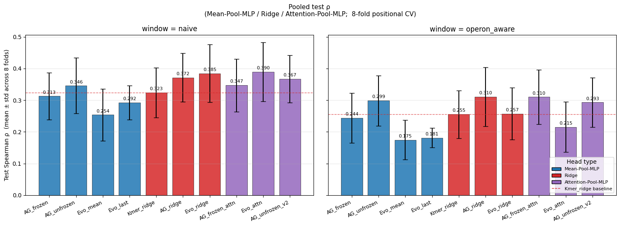
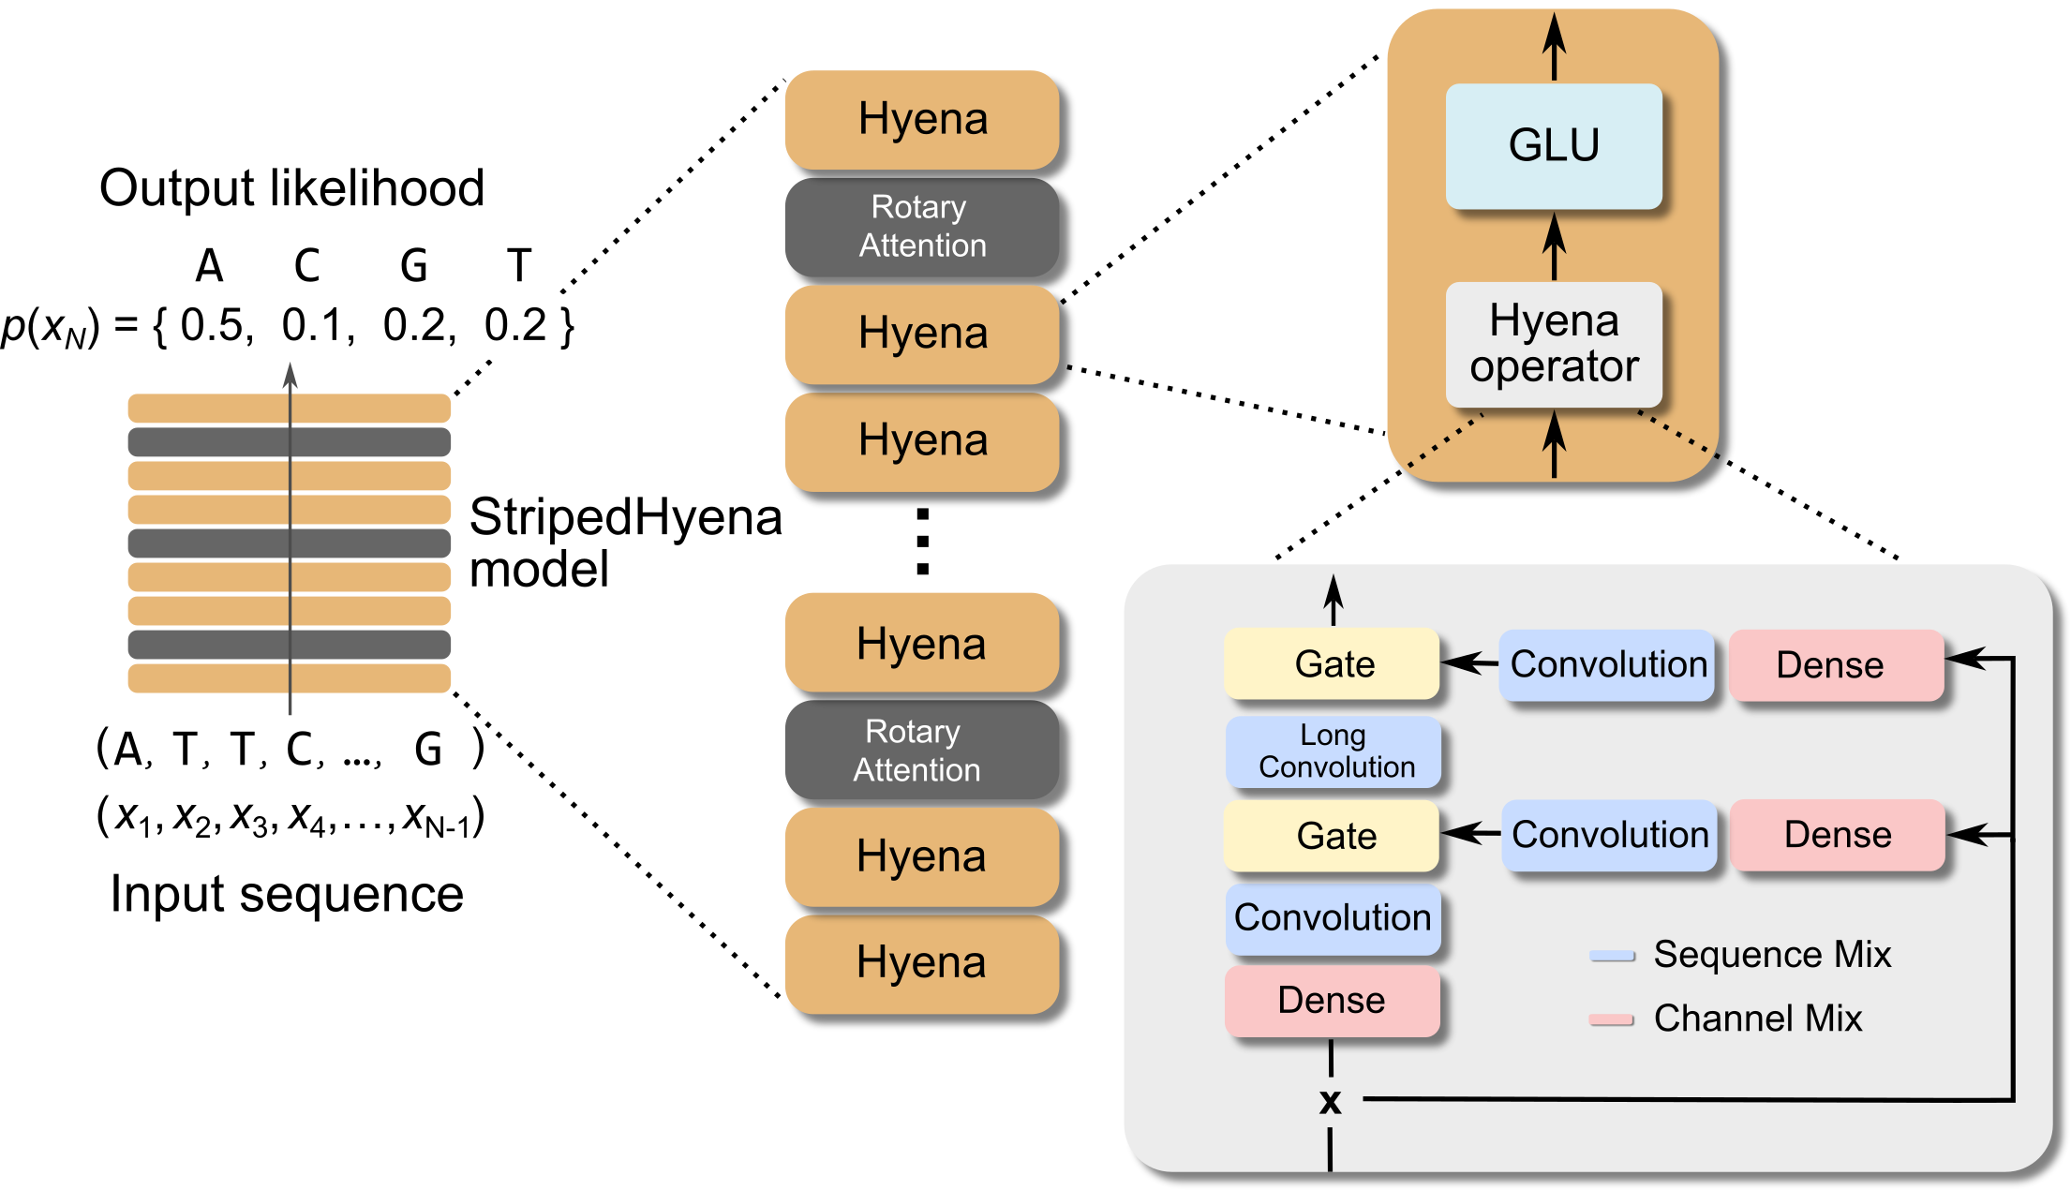
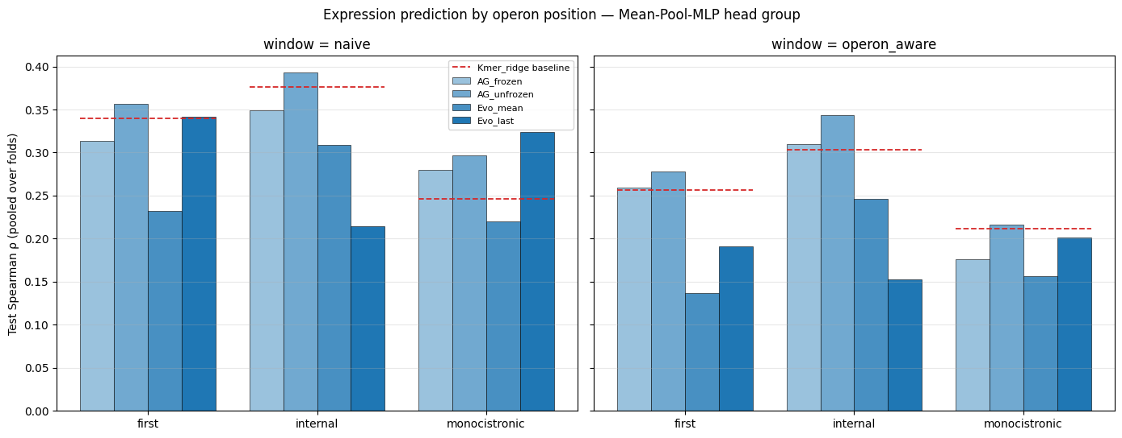
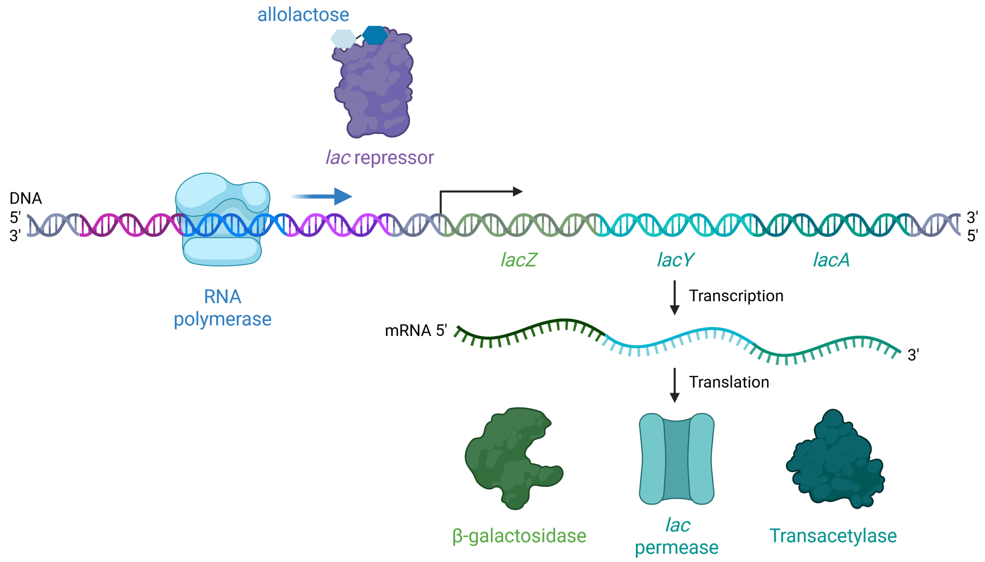
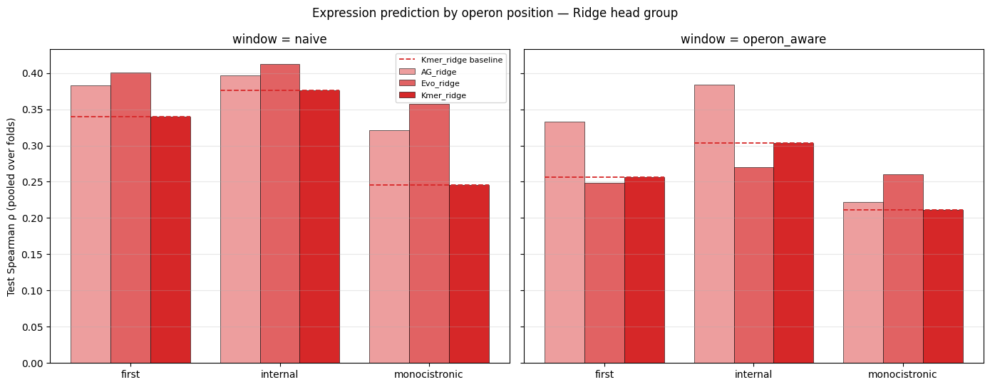
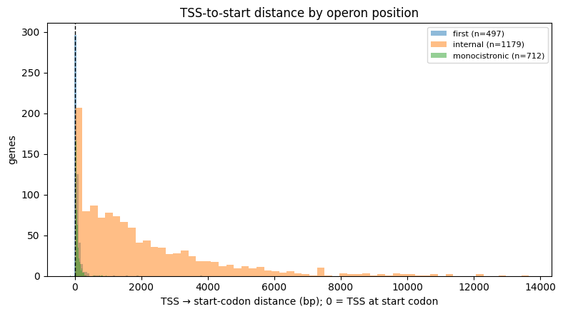
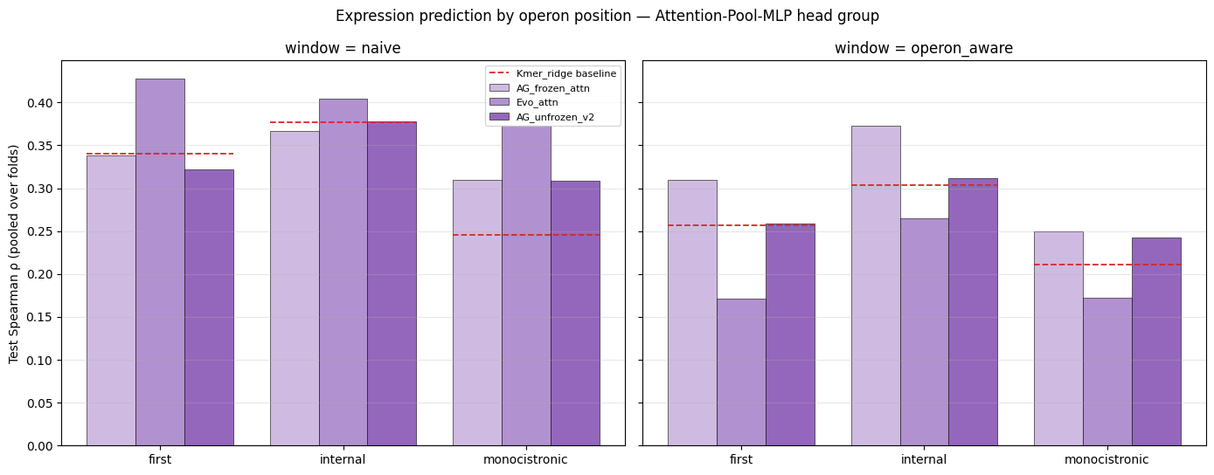
n
Benchmarking AlphaGenome On Bacteria
Evan Yang^{1,2,3}, Tengfei Ma², Peter Koo³
MSTP Program, Stony Brook University, NY, USA
Department of Bioinformatics, Stony Brook University, NY, USA
Simons Center for Quantitative Biology, Cold Spring Harbor Laboratory, NY, USA
1
3
5
Bacterial genetic mutations drive antibiotic resistance
Experimental Set Up
Bacterial foundational models need improvement
Bacterial infections are a major cause of hospitalizations and deaths globally
In the United States, more than 3 million bacterial infections and 48 thousand infection-related deaths occur each year [1].
Despite dedicated prevention and infection control efforts, antibiotic resistance is a major rising concern.
Genetic mutations in bacteria is one of the primary methods antibiotic resistance is developed [2].
8- fold Cross-Validation Positional Split Data Leakage Quantification
1/1451 groups with shared transcription start site (TSS) was split across folds
7/1179 internal genes were separated from transcription start site across folds
Even with data leakage, ρ < 0.45
Results
Baseline K-mer Ridge regression achieves moderate performance (ρ=0.323)
With Ridge Regression heads, Evo 1 embeddings (ρ=0.385) slightly improves model performance over AlphaGenome embeddings (ρ=0.385)
Strongest performing model was Evo 1 embeddings with attention-pooling MLP (ρ=0.390)
Naïve-windowing achieves better performance than operon-aware windowing
Attention-pooling MLPs and Ridge regression linear probe outperformed the K-mer Ridge Regression baseline, whereas mean-pooling MLPs performed worse compared to the baseline
Stratification by gene cluster revealed worse performance on monocistronic genes and better performance on operon-first or operon-internal genes
Discussion
This preliminary study highlights a need for improved bacterial seq2func models due to low ρ of RNA-expression predictions.
Understanding bacterial genetic cis-regulatory grammar remain a challenge due to different regulatory mechanisms from eukaryotes.
AlphaGenome demonstrated minimal generalizability to bacteria; unfreezing the encoder can potentially enable better generalizability.
2
Genomic seq2func models predict biological activity
Genomic sequence-to-function (seq2func) models predict biological activity (RNA expression, chromatin accessibility, transcription factor binding, etc) from genomic DNA sequences
AlphaGenome is a state of the art seq2func model [3].
4
Results show minimal generalizability to bacteria
Evo 1 is a prokaryotic genomic foundation model [4]
6
Future directions
Gene Clustering based on RegulonDB into:
Monocistronic genes
Polycistronic genes
First: first gene within an operon
Internal: Non-first genes within an operon
Systematic testing and benchmarking of seq2func models on bacteria
Testing different bacterial species and organisms
Different biological activity targets
RNA expression
Splicing
TF-binding
Improved bacterial seq2func models
Bacterial genomic aware context windows
Environmental embeddings
Bacterial specific biological activity prediction
Operon-aware predictions
Application of seq2func models towards antibiotic resistant bacteria
Monitoring of emergent strains
Antibiotic design and selection
AlphaGenome | Evo 1
Trained on mouse and human genomes Seq2func model 1 million bp context U-net architecture Primary application: variant effect prediction | Trained on bacteria, archaea, phage and plasmid genomes Both a generative model and a seq2func model 131,072 bp context Striped Hyena architecture Primary application: sequence generation, variant effect prediction
7
Citations
Center for Disease Control and Prevention. Antimicrobial Resistance Fact and Stats. Feb 4, 2025. https://www.cdc.gov/antimicrobial-resistance/data-research/facts-stats/index.html
Coculescu BI. Antimicrobial resistance induced by genetic changes. J Med Life. 2009 Apr-Jun;2(2):114-23. PMID: 20108530; PMCID: PMC3018982.
Avsec Ž, Latysheva N, Cheng J, et al. Advancing regulatory variant effect prediction with AlphaGenome. Nature. 2026;649:1206–18. https://doi.org/10.1038/s41586-025-10014-0.
Eric Nguyen et al., Sequence modeling and design from molecular to genome scale with Evo.Science386,eado9336(2024).DOI:10.1126/science.ado9336
A multi-scale transcriptional regulatory network knowledge base for Escherichia coli. Cameron R. Lamoureux, Katherine T. Decker, Anand V. Sastry, Kevin Rychel, Ye Gao, John Luke McConn, Daniel C. Zielinski, Bernhard O. Palsson bioRxiv 2021.04.08.439047; doi: https://doi.org/10.1101/2021.04.08.439047
Although AlphaGenome has been exclusively trained on mammalian genomes, it has demonstrated state-of-the-art generalizability to plants, beating plant-specific models.
koolab.cshl.edu
koo@cshl.edu
Notes:
1

