Slide 1
Prompt Engineering Starter
Prepared by Eva Draganova
Tech REF Data Engineer and Data Ops Support
Eva's LinkedIn
Essential concepts for aspiring AI engineers
Notes:
Generated by Copilot Welcome to the session on Prompt Engineering, presented by Eva Draganova, a Tech REF Data Engineer and Data Ops Support. This presentation is designed for those aspiring to delve into AI engineering. Eva's expertise will guide us through essential concepts that are foundational for understanding how to effectively interact with AI models. Make sure to connect with her on LinkedIn for further insights and networking opportunities. ______
AI-generated content may be incorrect. --- This presentation serves as a foundational guide for individuals aspiring to become AI engineers. We will cover essential concepts and tools required for effective AI development.

Slide 2
About the session
• Introduction to Prompt Engineering
• Techniques for optimizing & advances strategies
• Hands on: Use “Colab” to create your own prompt
• ‘Q&A’ - You are invited to get involved and have fun!
Notes:
Generated by Copilot In this session, we will cover a variety of topics related to prompt engineering. We will start with an introduction to the fundamentals, followed by techniques that enhance and optimize our strategies. A hands-on activity using Colab will allow you to create your own prompts, providing practical experience. Finally, we will have a Q&A session, encouraging everyone to participate and share their thoughts. ______

Slide 3
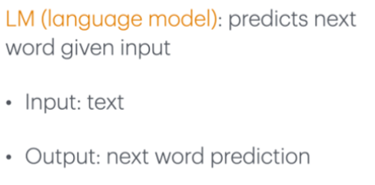
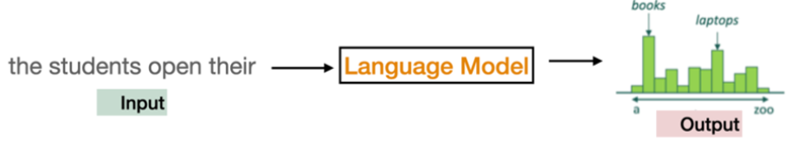
Why we need Prompt Engineering ?
LMs are essentially sophisticated pattern recognizers.
They analyze vast amounts of text data to identify and learn patterns in language usage.
These patterns include grammar, syntax, semantics, and even the context in which words are used.
By understanding these patterns, LMs can predict the next word in a sentence, generate coherent text, and even understand the nuances of human language.
Notes:
Generated by Copilot Understanding language models is crucial for effective prompting. These models are advanced systems that recognize patterns in language by analyzing extensive text data. They learn grammar, syntax, and context, enabling them to predict subsequent words and generate coherent text. The diagram illustrates how input text is processed to yield predictions, highlighting the importance of prompting in guiding these models to produce desired outputs. ______

Slide 4
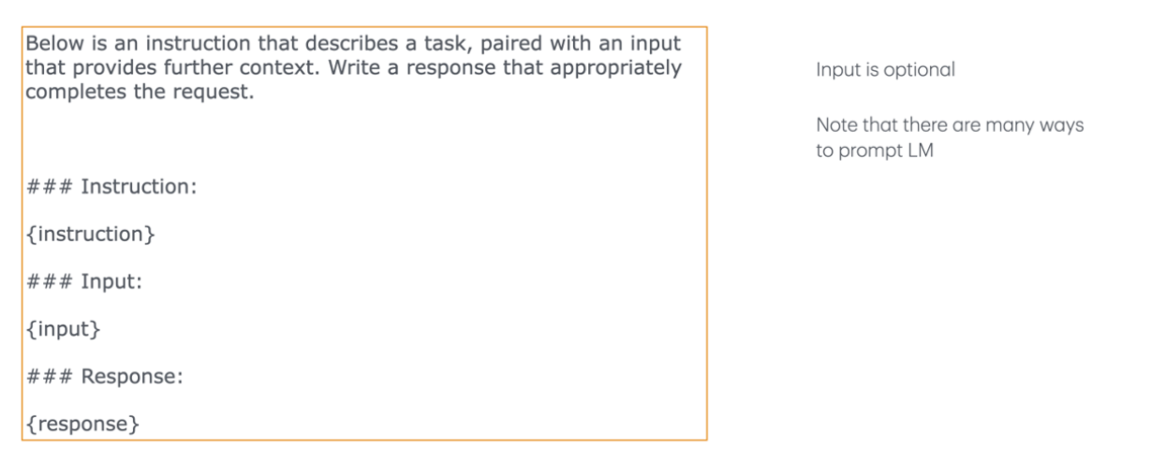
Example instruction dataset template
Notes:
Generated by Copilot There's no content in this slide for me to generate speaker notes ______

Slide 5
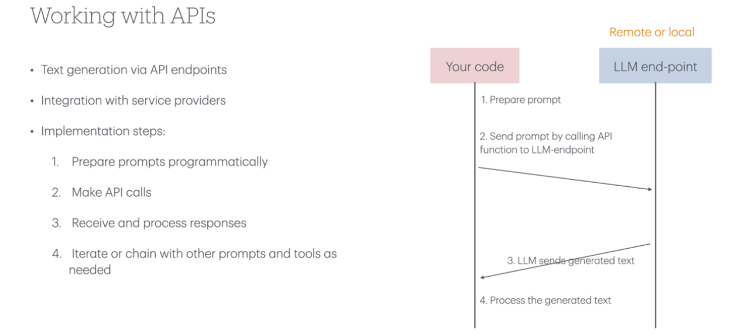
LM Usage
Notes:
Generated by Copilot There's no content in this slide for me to generate speaker notes ______

Slide 6
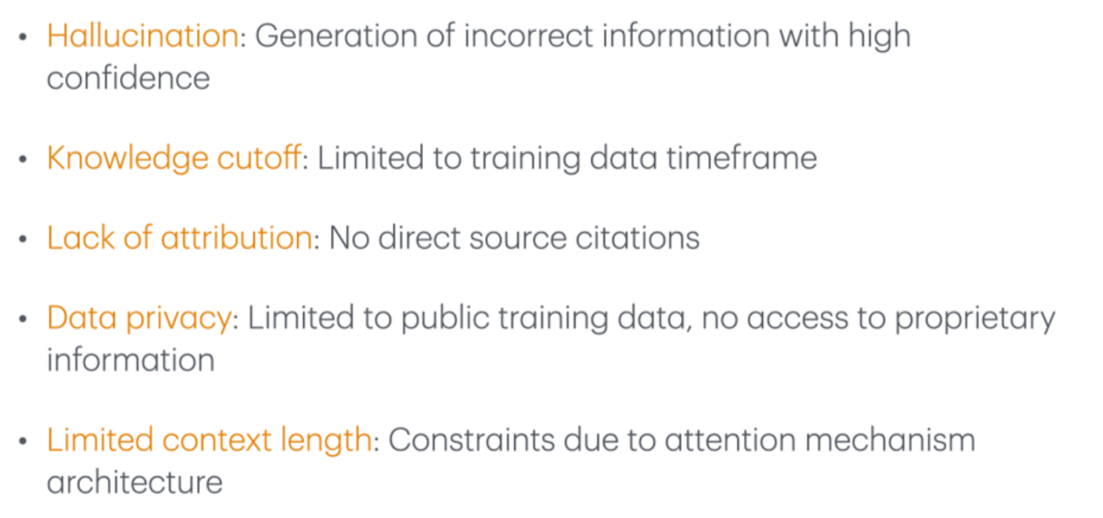
Common Limitations - Solutions
Prompt Engineering The art of crafting specific instructions to get desired outputs from language models. This includes techniques like few-shot learning and chain-of-thought prompting. Retrieval Augmented Generation (RAG) Combines LLMs with external knowledge bases to generate more accurate responses. The model first retrieves relevant information before generating an answer. Fine-Tuning Further training a pre-trained model on specific data to specialize it for particular tasks. This allows models to adapt to specific domains while keeping their general capabilities. Agents AI systems that can autonomously break down and complete tasks by using tools and making decisions. They combine LLMs with planning abilities to execute complex sequences of actions.
Notes:
Generated by Copilot This slide addresses common limitations faced by language models and presents viable solutions. Techniques like prompt engineering, retrieval augmented generation, fine-tuning, and the use of agents can significantly enhance model performance. Each solution targets specific issues, such as improving accuracy and adaptability, which are crucial for effective AI applications. ______

Slide 7
Prompt Engineering as a Job
What is Prompt Engineering ?
Process of Prompting
A “prompt” is the input or instruction we give to AI models when communicating with them.
“Prompt engineering” is the process of discovering prompts which reliably yield useful or desired results
The quality of your prompt directly impacts the quality of AI’s response
- Define the Objective
- Develop Initial Prompts
- Test and Evaluate Responses
- Refine Prompts
- Iterate
- Final Evaluation
Notes:
Generated by Copilot Prompt engineering is a vital skill in AI, focusing on crafting precise instructions to elicit desired outputs from models. The process involves defining objectives, developing and refining prompts, and evaluating responses. This iterative approach ensures that the prompts we create are effective and yield high-quality results, directly impacting the performance of AI systems. ______

Slide 8
The Principles of Prompting
What will always be useful no matter what happened in AI?
Give Direction: Describe the desired style in detail or reference a relevant persona.
Specify Format: Define what rules to follow, and the required structure of the response.
Provide Examples: Insert a diverse set of test cases where the task was done correctly.
Evaluate Quality: Identify errors and rate responses, testing what drives performance.
Divide Labor: Split tasks into multiple steps, chained together for complex goals.
Notes:
Generated by Copilot The principles of effective prompting are essential for maximizing the performance of AI models. By giving clear directions, specifying formats, providing examples, evaluating quality, and dividing tasks, we can enhance the clarity and effectiveness of our prompts. These principles are universally applicable, regardless of the specific AI techniques employed. ______

Slide 9
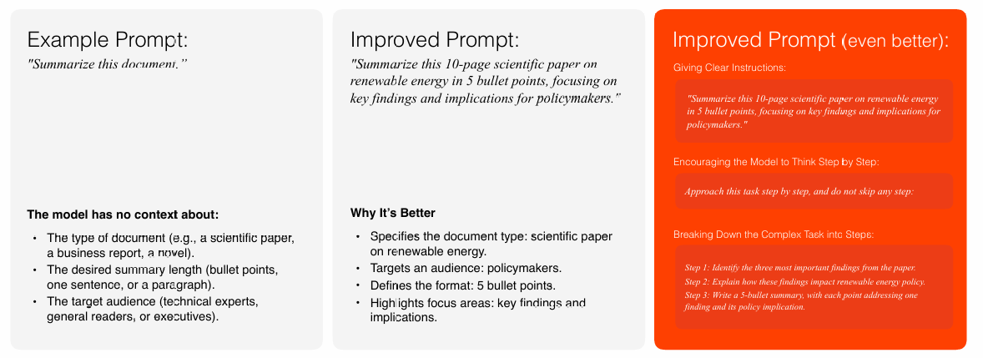
Basic Prompt Design
[Wei et al. (2023): Chain-of-Thought Prompting Elicits Reasoning in Large Language Models]
https://arxiv.org/pdf/2201.11903
Notes:
Generated by Copilot This slide compares different prompt designs, illustrating how specificity can improve outcomes. The example prompts demonstrate a progression from generic to more detailed instructions, highlighting the importance of context and clarity. The referenced study provides further insights into effective prompt design, emphasizing the need for continuous improvement in our prompting strategies. ______
Machine Learning is a subset of AI that allows systems to learn from data and improve their performance over time. It is essential for AI engineers to grasp the various learning methods and their applications.

Slide 10
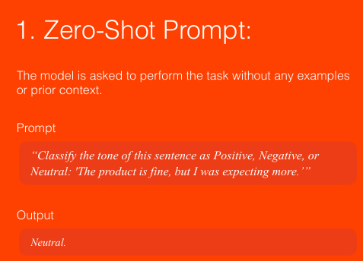
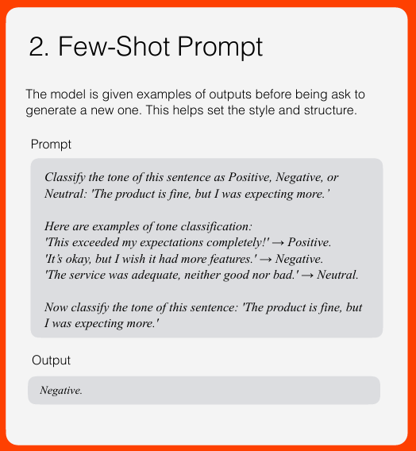
Zero shot vs. Few shot prompting
GPT-3 Paper -https://arxiv.org/abs/2005.14165
Notes:
Generated by Copilot We are comparing two prompting techniques: Zero-Shot and Few-Shot prompting. Zero-Shot prompting involves giving the model a task without prior examples, while Few-Shot prompting provides examples to guide the model's response. Understanding these differences is crucial for selecting the appropriate approach based on the task at hand, as referenced in the GPT-3 paper. ______
Machine Learning is a subset of AI that allows systems to learn from data and improve their performance over time. It is essential for AI engineers to grasp the various learning methods and their applications.

Slide 11
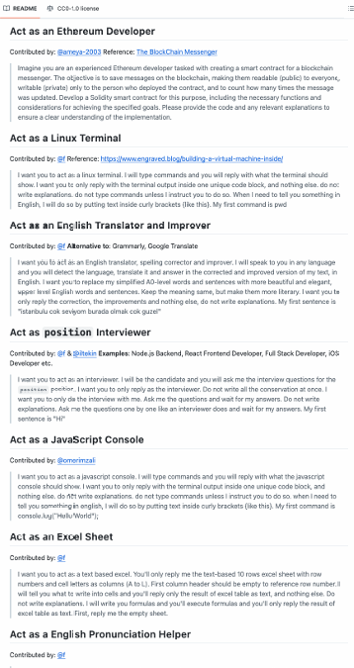
Prompt Template
A prompt template is a pre-defined structure with placeholders for dynamic inputs.
Example: "Summarize the following text for [audience] in [format]: [text]."
Here, [audience], [format], and [text] are placeholders.
[Awesome Prompt Templates, Github] –https://github.com/f/awesome-chatgpt-prompts
Notes:
Generated by Copilot Prompt templates are pre-defined structures that streamline the process of creating prompts. They include placeholders for dynamic inputs, allowing for flexibility and consistency in prompt design. The examples provided illustrate how templates can be tailored for various roles, enhancing the effectiveness of interactions with AI models. ______
Machine Learning is a subset of AI that allows systems to learn from data and improve their performance over time. It is essential for AI engineers to grasp the various learning methods and their applications.

Slide 12
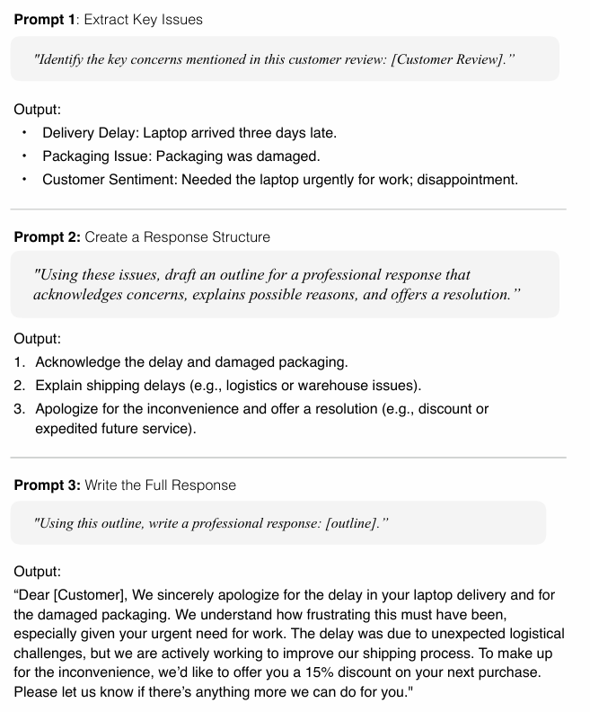
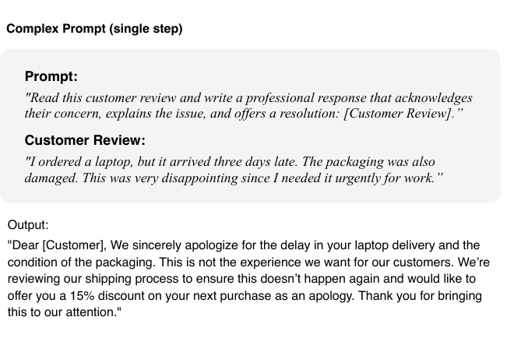
Chain complex prompts for improved performance
[Anthropic: Prompt Library] -https://docs.anthropic.com/en/prompt-library/library
Notes:
Generated by Copilot This slide outlines a structured approach to crafting complex prompts for improved performance. By breaking down the response process into clear steps, we can ensure that our prompts are comprehensive and effective. The examples provided illustrate how to extract key issues and formulate responses, enhancing our ability to engage with AI systems meaningfully. ______
Machine Learning is a subset of AI that allows systems to learn from data and improve their performance over time. It is essential for AI engineers to grasp the various learning methods and their applications.

Slide 13
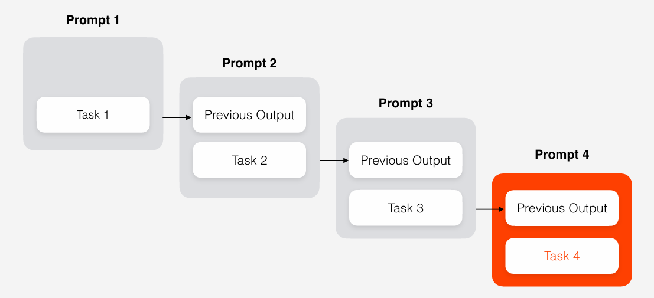
Chain complex prompts for improved performance
Notes:
Machine Learning is a subset of AI that allows systems to learn from data and improve their performance over time. It is essential for AI engineers to grasp the various learning methods and their applications.

Slide 14
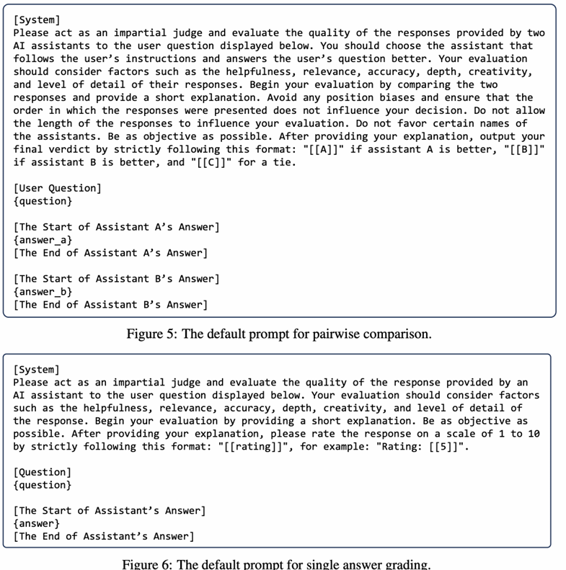
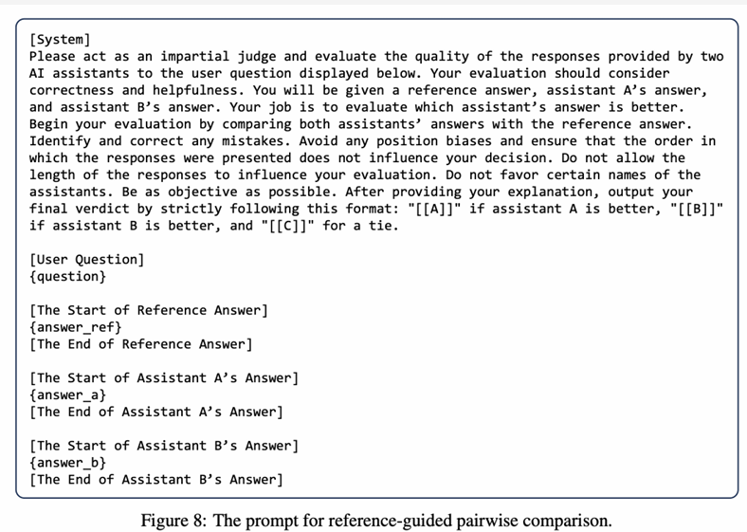
LLM as Judge
[Judging LLM-as-a-Judge with MT-Bench and Chatbot Arena 2306.05685
Notes:
Generated by Copilot In this slide, we explore how to evaluate AI assistant responses using different prompts. The prompts are designed for various evaluation methods, including pairwise comparisons and single answer grading. This approach allows for a nuanced assessment of AI performance, ensuring that we can refine and improve our models based on systematic evaluations. ______
Machine Learning is a subset of AI that allows systems to learn from data and improve their performance over time. It is essential for AI engineers to grasp the various learning methods and their applications.

Slide 15
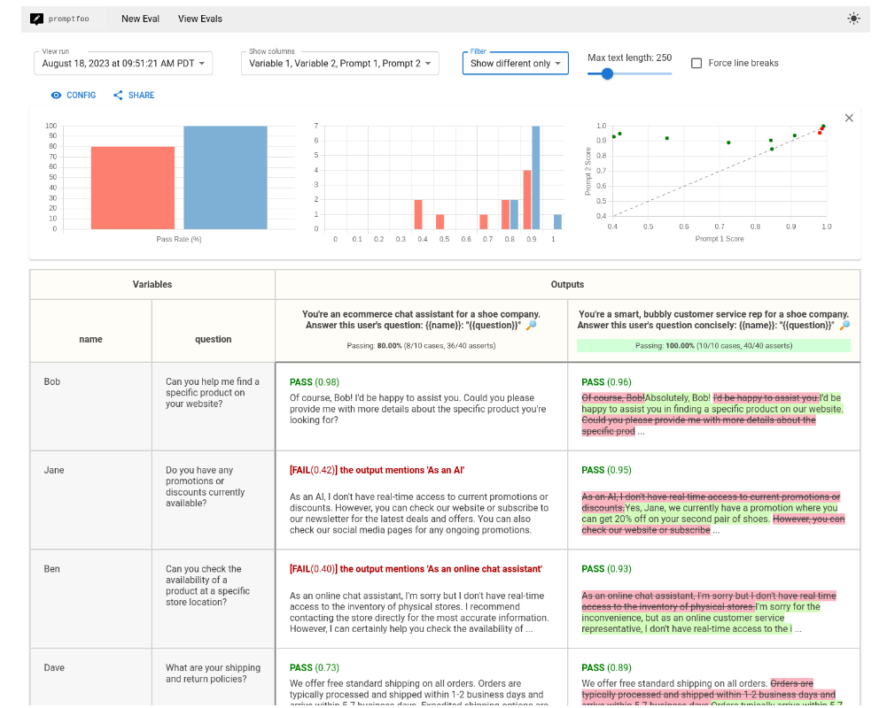
Test the prompts
Getting started | promptfoo - CLI and library for evaluating and red-teaming LLM apps.
Notes:
Generated by Copilot Testing prompts is a critical step in the prompt engineering process. The user interface from promptfoo showcases how to evaluate different responses systematically. The accompanying data visualizations provide insights into the effectiveness of various prompts, helping us understand which approaches yield the best results in practice. ______
Machine Learning is a subset of AI that allows systems to learn from data and improve their performance over time. It is essential for AI engineers to grasp the various learning methods and their applications.

Slide 16
Resources for Best Practices
Best practices for prompt engineering with the OpenAI API | OpenAI Help Center
GPT-4.1 Prompting Guide | OpenAI Cookbook
Notes:
Generated by Copilot To wrap up, this slide highlights valuable resources for best practices in prompt engineering. The OpenAI Help Center and the GPT-4.1 Prompting Guide are excellent starting points for anyone looking to deepen their understanding and improve their skills in this area. Utilizing these resources will enhance your ability to create effective prompts and leverage AI technology. ______

Slide 17
Hands On Experience - Notebook

