Slide 1


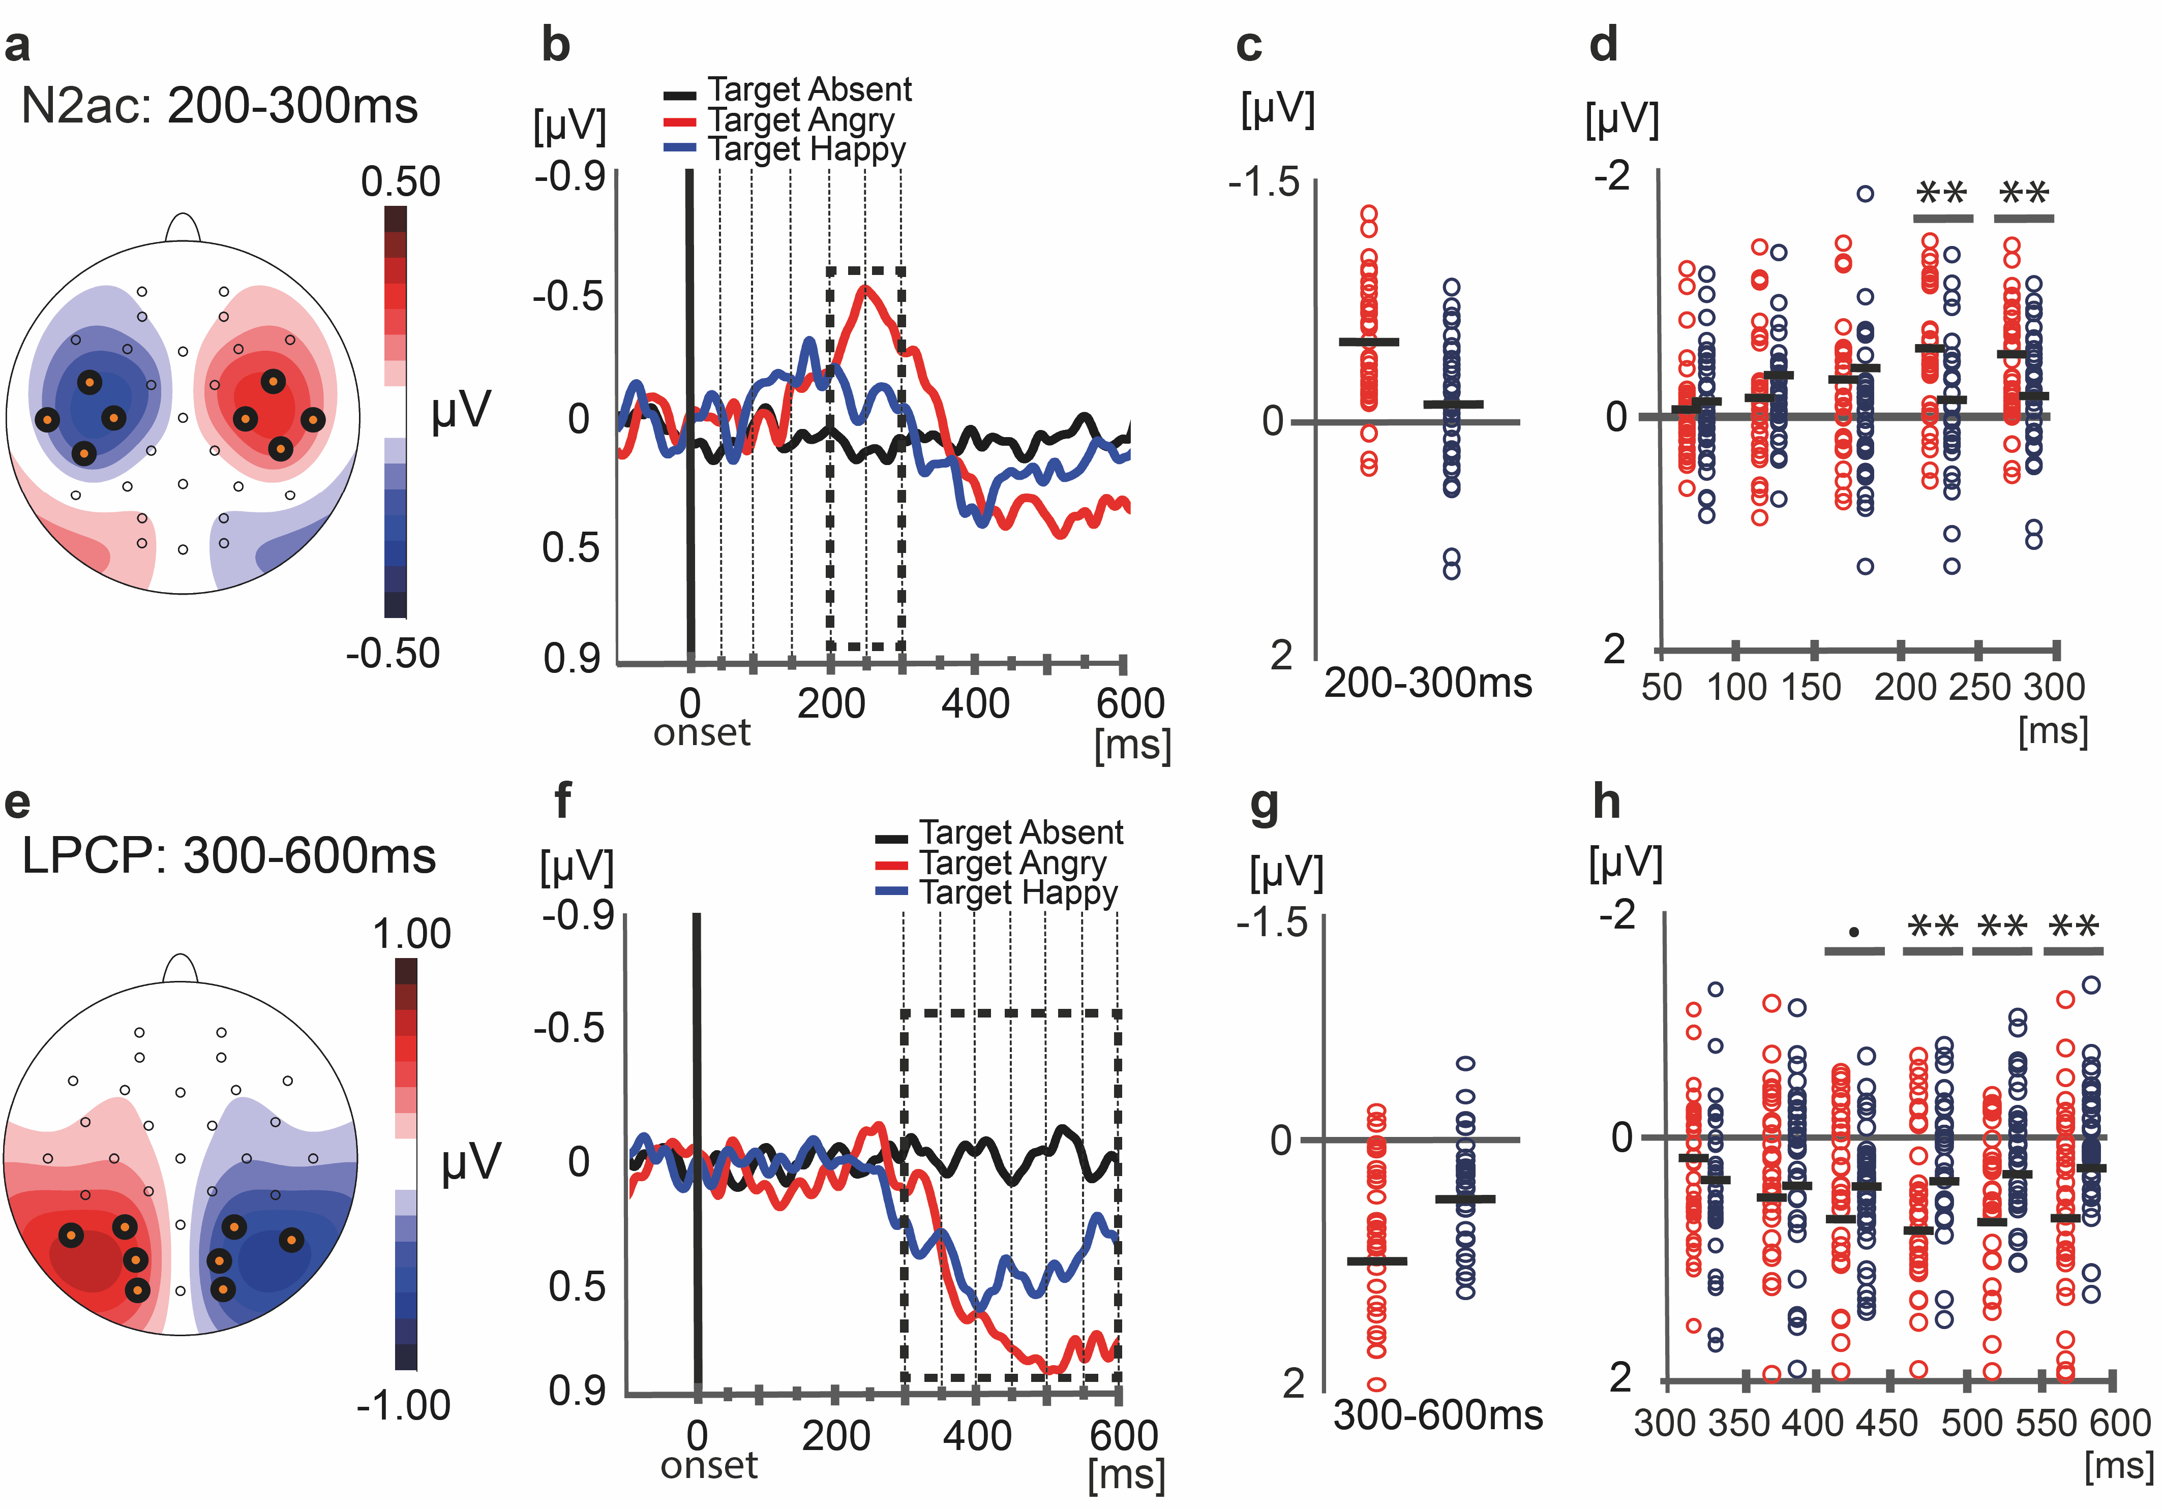
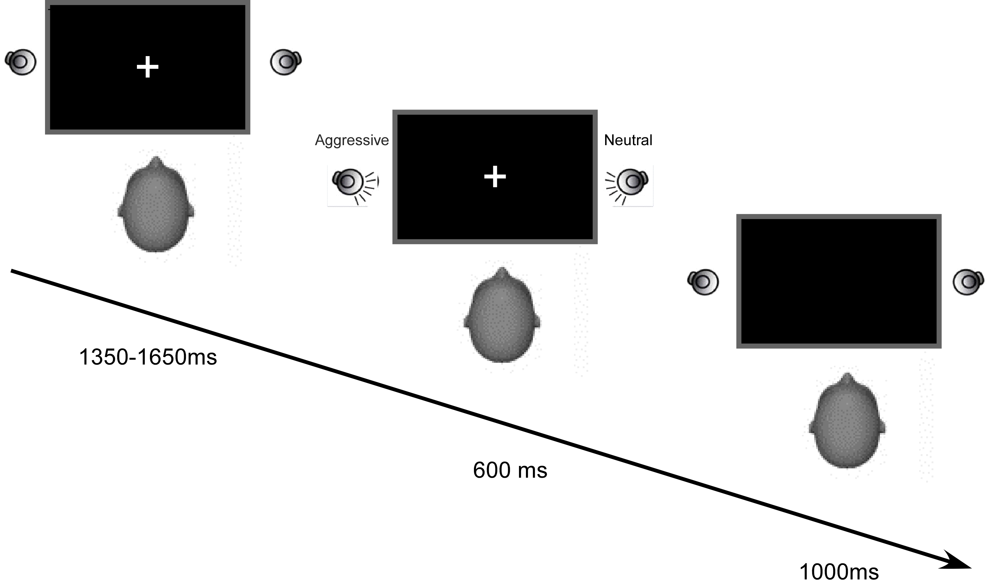
Early spatial attention deployment
toward and away from aggressive voices
Burra, N ¹., Kerzel, D ¹., Munoz, D ¹., Grandjean, D.^{1,2,3}, & Ceravolo, L. ^{1,2,3}
1) Université de Genève, Faculté de psychologie et des sciences de l’éducation, 2) University of Geneva, Neuroscience of Emotion and Affective Dynamics Lab 3) University of Geneva, Swiss Center for Affective Sciences
INTRODUCTION
EEG: METHOD
Salient vocalizations, especially aggressive voices, are considered to preferentially attract attention due to an automatic threat detection system that would enable rapid shifts of attention.
Facilitated attentional orienting to threat has been mainly measured in vision using angry faces, an effect called the “anger superiority effect”. Previous electrophysiological studies have revealed evidence of an early correlate of the anger superiority effect ª , as a reliably enlarged N2pc, a lateralized event-related potential (lERP) used as an index of spatial attention deployment in the visual domain for angry target faces as compared to happy target faces.
Despite reports of an enhanced sensory processing of a visual probe by an enhanced P1 amplitude to the probe following the location of an aggressive vocal signal, 500ms after the vocal signal ^{b}, studies assessing the actual temporal dynamics of auditory spatial attention to aggressive voices are missing.
Recently, it has been observed that spatial attention deployment in an auditory scene might be measured using with an auditory component analogous to the N2pc, i.e. the N2ac ^{c}. The N2ac, an anterior-central component, was followed by a posterior-contralateral positive subcomponent, i.e. the LPCpc, a marker of spatial attention reorienting to the center after target localization.
We hypothesized that if attentional priority is overall enhanced by threatening stimuli, this enhancement should occur at an early stage of attentional processing, even in auditory domain.
EEG : Biosemi ActiveTwo system with electrode positions based on the International 10-10 system. We recorded from 32 Ag/AgCl scalp sites (Fp1/2, Fz, F3/4, F7/8, Cz, C3/4, T7/8, Pz, P1/2, P3/4, P5/6, P7/8, P9/10, POz, PO3/4, PO7/8, Oz, O1/2, Iz). Reference: Mastoids. Filtering: 0.1-40 Hz. Baseline: 100ms. Epochs containing saccades (HEOG > 30 µV), blinks (VEOG > 60 µV), abnormal signals (overall signal > 80 µV) or wrong answers were discarded from the analysis (12%).
Analysis:
lERPs (difference contra-ipsilateral to the target):
N2ac : 200-300ms measured in a cluster of eight anterior electrode sites (C3/4, CP5/CP6, FC5/FC6, T7/8).
LPCpc : 300-600ms, measured in a cluster of eight parietal electrodes (O1/O2, P7/P8, PO3/P04, P3/P4).
ERPs:
N1 : 110-160ms at Cz.
P300 : 300-500ms at Pz.
lERPs + ERPs: RESULTS
N2ac:
**
HEOG
METHOD
Subjects: 34 healthy volunteers (13 male, mean age: 20.7 ± 2.54 year: min-max 18–32). Seventeen participants were assigned to a blocked version of the task while 17 participants were assigned to the event-related task.
Stimuli:
Task and procedure: Our experiment took place in a soundproof cabin (Diatec AG, Switzerland). Participants sat 85 cm from a computer screen with loudspeakers (Logitech, LS11, Dick Smith Electronics) located at approximately ±15° of azimuth and 5° of elevation relative to the participants’ head.
rANOVA failed to reveal any beahvioural difference between our target conditions (RT or Accuracy).
Meaningless utterances taken from the large and validated Geneva Multimodal Expression Portrayals (GEMEP) database (Bänziger T and KR Scherer 2007), produced by eight professional actors (4 male and 4 female) who pronounced “Aah's” in either an aggressive, happy, or neutral voice, resulting in 24 different stimuli.
Pitch, duration and intensity of each stimulus were measured using Praat software (Boersma & Weenink, 2016) and equalized using a shareware version of GoldWave digital audio editor. These parameters did not reveal any differences (all p > .05) with respect to the voice emotional content. Following the experiment, participants rated the valence and intensity of each vocal signal, which confirmed the accurate evaluation of the material.
 | Pitch (Hz) |  | Duration (ms) | Intensity (dB)
Neutral (n = 8) | 246 ± 69 |  | 548 ± 97 | 81.3 ± 2.62
Aggressive (n = 8) | 288 ± 94 |  | 597 ± 11 | 79.6 ± 9.6
Happy (n = 8) | 300 ± 58 |  | 596 ± 59 | 80.59 ± 1.6
F (2,21) |  | 1.12 | 1.41 | .18
p |  | .34 | .26 | .83
LPCpc:
**
Acoustic analysis results of our stimuli. Average means and standard deviation errors of acoustical parameters for neutral, aggressive and happy vocal signals. N.B. Hz = Hertz, ms = milliseconds and dB = decibels.
The presentation of the stimuli and the collection of the responses were controlled by a computer running MATLAB 2009b (The Math Works, Natick, USA), the Psychtoolbox v.3 and a high-definition audio card (Realtek Inc., Hsinchu, Taiwan).
Participants were required to detect the presence/absence of a specific target among neutral stimuli (50% present, 50% absent). The target could be an aggressive or a happy vocal signal in different blocks (blocked version) or aggressive and happy inside one block (event-related version), positioned on the left or the right location. The experiment consisted of 896 trials.
N.S.
***
= Electrode(s) of interest n.s. = not significant, ** = p <.01, *** = p < .001
CONCLUSIONS
Consistent with previous studies on visual attention and threat, the current study provides evidence that attentional orienting is enhanced as early as 200ms in response to threatening vocal signals. Subsequently, around 400ms, auditory attention allocated to the center of the screen is enhanced, consistent with the need to maximize the information intake when threatened during a phase of reorienting. Our data extend knowledge to the auditory domain, specifically that a vocal aggressive signal is processed preferentially early in spatial attentional processing.
1350-1650 ms
REFERENCES
700 ms
Feldmann‐Wüstefeld, T., Schmidt‐Daffy, M., & Schubö, A. (2011). Neural evidence for the threat detection advantage: differential attention allocation to angry and happy faces. Psychophysiology, 48(5), 697-707.
Brosch, T., Grandjean, D., Sander, D., & Scherer, K. R. (2009). Cross-modal emotional attention: emotional voices modulate early stages of visual processing. Journal of cognitive neuroscience, 21(9), 1670-1679.
Gamble, M. L., & Luck, S. J. (2011). N2ac: An ERP component associated with the focusing of attention within an auditory scene. Psychophysiology, 48(8), 1057-1068.
1000 ms
Contact: Nicolas.Burra@unige.ch

