Slide 1


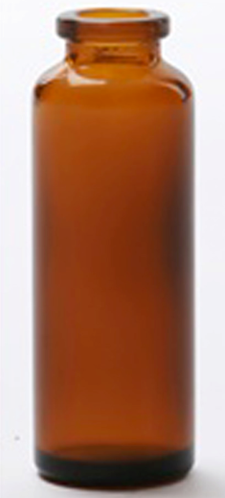
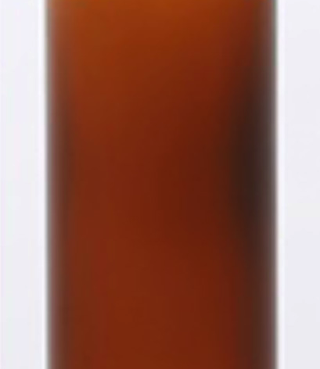
Sweet reward increases implicit discrimination of similar odors
Eva Pool ^{1,2} Sylvain Delplanque ^{1,2} Christelle Porcherot³ Tatiana Jenkins², Isabelle Cayeux³ David Sander ^{1,2}
1 Laboratory for the Study of Emotion Elicitation and Expression, Department of Psychology, University of Geneva
2 Swiss Center for Affective Sciences, University of Geneva
3 Firmenich, SA, Geneva, Switzerland
INTRODUCTION
FRAMEWORK
HYPOTHESIS
Perceptual processing is facilitated for emotional stimuli^{[1,2]}
If specific, perceptual discrimination of odor pairs:
Is this facilitation specific to the emotional stimulus or does it generalize to neutral stimuli with similar perceptual characteristics ?
Reward-associated
Similar Neutral
Neutral
Similar Neutral
Studies conducted on odors associated with negative and threatening stimuli showed a specific facilitation^{[3]}: emotional stimuli are better discriminated from their similar versions compared to neutral stimuli
EXPLICIT
IMPLICIT
Sweet reward increases the behavioral performances during a triangular test
Sweet reward increases the inspiration volume during a triangular test
Do positive and rewarding stimuli function the same way?
METHOD
RESULTS
Pavlovian Conditioning^{[4,5]} :
Pavlovian Conditioning:
EXPLICIT
IMPLICIT
*
*
Figure 1. Participants (N = 16) were exposed to two pairs of odors, each composed of one odor and its similar version which was created by blending it with Hedion (CS+; similar CS+ and CS-; similar CS-). They smelled the odor and pressed on a keyboard to remove the gray patch and discovered whether the odor was associated with the rewarding chocolate or not. The CS+ was associated with the reward whereas the similar CS+, the CS- and the similar CS- were not.
Figure 3. Means (± 1 SEM^{[7]}) of the likeability ratings for the four odors used as conditioned stimuli (CSs) at the end of the Pavlovian conditioning.
Planned contrast: t(15) = 2.45, p = .026, d = .47
Figure 4. Means (± 1 SEM^{[7]}) of the amplitude of the skin conductance responses (SCR) during the perception of the four odors used as CSs at the end of the Pavlovian conditioning during the rating phase.
Planned contrast: t(12) = 2.41, p = .032, d = .21
Triangular test^{[6]} :
Triangular test:
EXPLICIT
IMPLICIT
*
Figure 2. Participants smelled three different odors (2 identical and 1 odd) and were asked to indicate the bottle containing the odd odor by clicking on the corresponding picture of bottle. Separate triangular tests were administered for each pair of odors (CS+ and similar CS+; CS- and similar CS-) used in the conditioning. For each test, all possible combinations of apparition of the three bottles (and odors; i.e., 6 in total) were presented to each and randomly across participants
PRE
POST
Figure 5. Means (± 1 SEM^{[7]}) of the accuracy of the behavioral choice during the triangular test.
Figure 6. Means (± 1 SEM^{[7]}) of the integral of the volume of the inspiration during the triangular tests.
ANOVA 2 (Odor: CS+ or similar CS+)  2 (Session: pre- or post- conditioning) interaction: F(15,1) = 5.41, p = .034, η2 = .26
DISCUSSION
MAIN FINDING
CONCLUSIONS
IMPLICIT
Positive and rewarding stimuli increase implicit discrimination of odors that would otherwise be indistinguishable.
Reward-associated
Similar Neutral
Neutral
Similar Neutral
?
Similarly to negative and threatening stimuli, the perception processing of positive rewarding stimuli is specifically facilitated
EXPLICIT
Reward-associated stimuli can elicit affective responses, even though they cannot be consciously identified
Reward-associated
Similar Neutral
Neutral
Similar Neutral
[1] Vuilleumier, P. (2005). How brains beware: Neuronal mechanisms of emotional attention. Trends in Cognitive Sciences, 9, 585-594.
[2] Yiend, J., & Mathews, A. (2001). Anxiety and attention to threatening pictures. Quarterly Journal of Experimental Psychology Section a-Human Experimental Psychology, 54(3), 665-681. .
[3] Li, W., Howard, J. D., Parrish, T. B., & Gottfried, J. A. (2008). Aversive learning enhances perceptual and cortical discrimination of indiscriminable odor cues. Science, 319(5871), 1842-1845
[4] Talmi, D., Seymour, B., Dayan, P., & Dolan, R. J. (2008). Human pavlovian-instrumental transfer. Journal of Neuroscience, 28(2), 360-368.
[5] Prevost, C., Liljeholm, M., Tyszka, J. M., & O'Doherty, J. P. (2012). Neural Correlates of Specific and General Pavlovian-to-Instrumental Transfer within Human Amygdalar Subregions: A High-Resolution fMRI Study. Journal of Neuroscience, 32(24), 8383-8390
[6] Laska, M., & Teubner, P. (1999). Olfactory discrimination ability of human subjects for ten pairs of enantiomers. Chemical Senses, 24(2), 161-170.
[7] Cousineau, D. (2005). Confidence intervals in within-subject designs: A simpler solution to Loftus and Masson’s method. Tutorial in Quantitative Methods for Psychology,1, 42–45

