Slide 1


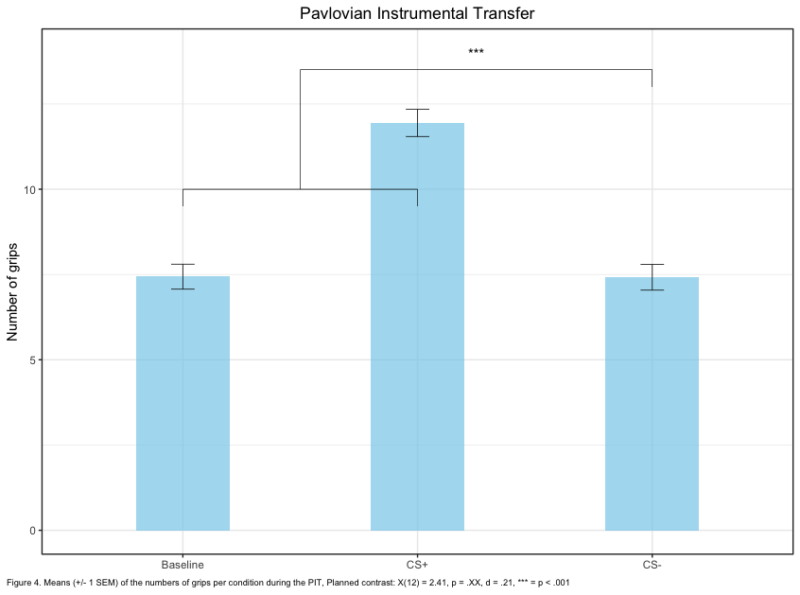
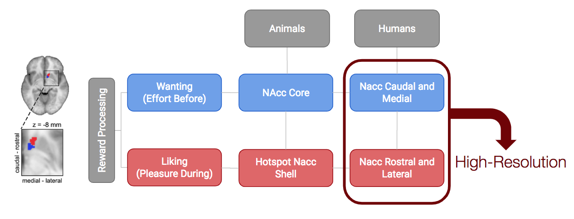

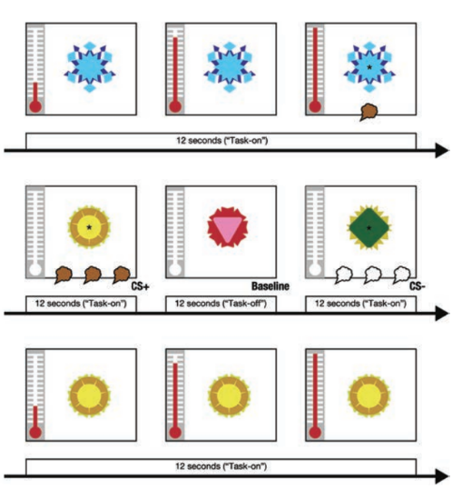
Wanting and Liking within the Human Ventral Striatum: a “high-resolution” fMRI study
Pool, E.¹; Prévost, C.³; Delplanque, S.¹; Brosch, T.²; Vuilleumier, P.³; Sander, D.¹
¹ University of Geneva, Emotion Elicitation and Expression Laboratory; ²University of Geneva, Consumer Decision and Sustainable
Behavior Laboratory; ³University of Geneva, Laboratory for Neurology and Imaging of Cognition
INTRODUCTION
The aim of the study is to disentangle motivation (how much the person invests energy to obtain a reward) and hedonic pleasure (how much a reward is liked).
Despite that animal studies have succeed to dissociate the two some authors have theoretically conceptualized those differences (e.g. Robinson & Berridge, 1993) this dissociation has still never been demonstrated in humans.
Recently, it has been observed that spatial attention deployment in an auditory scene might be measured using with an auditory component analogous to the N2pc, i.e. the N2ac ^{c}. The N2ac, an anterior-central component, was followed by a posterior-contralateral positive subcomponent, i.e. the LPCpc, a marker of spatial attention reorienting to the center after target localization.
We hypothesized that if attentional priority is overall enhanced by threatening stimuli, this enhancement should occur at an early stage of attentional processing, even in auditory domain.
lERPs + ERPs: RESULTS
METHOD
Subjects: 34 healthy volunteers (13 male, mean age: 20.7 ± 2.54 year: min-max 18–32). Seventeen participants were assigned to a blocked version of the task while 17 participants were assigned to the event-related task.
Stimuli:
Meaningless utterances taken from the large and validated Geneva Multimodal Expression Portrayals (GEMEP) database (Bänziger T and KR Scherer 2007), produced by eight professional actors (4 male and 4 female) who pronounced “Aah's” in either an aggressive, happy, or neutral voice, resulting in 24 different stimuli.
Task and procedure: Our experiment took place in a soundproof cabin (Diatec AG, Switzerland). Participants sat 85 cm from a computer screen with rANOVA failed to reveal any beahvioural difference between our target conditions (RT or Accuracy).
CONCLUSIONS
Consistent with previous studies on visual attention and threat, the current study provides evidence that attentional orienting is enhanced as early as 200ms in response to threatening vocal signals. Subsequently, around 400ms,
REFERENCES
Feldmann‐Wüstefeld, T., Schmidt‐Daffy, M., & Schubö, A. (2011). Neural evidence for the threat detection advantage: differential attention allocation to angry and happy faces. Psychophysiology, 48(5), 697-707.
Brosch, T., Grandjean, D., Sander, D., & Scherer, K. R. (2009). Cross-modal emotional attention: emotional voices modulate early stages of visual processing. Journal of cognitive neuroscience, 21(9), 1670-1679.
Gamble, M. L., & Luck, S. J. (2011). N2ac: An ERP component associated with the focusing of attention within an auditory scene. Psychophysiology, 48(8), 1057-1068.
Contact:David.Munoz@etu.unige.ch
Notes:
<number>

