Slide 1
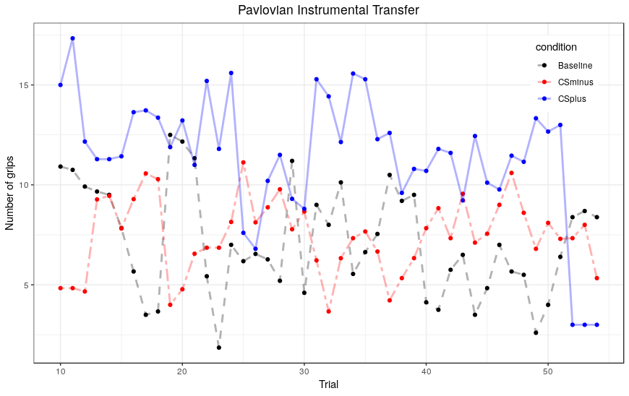
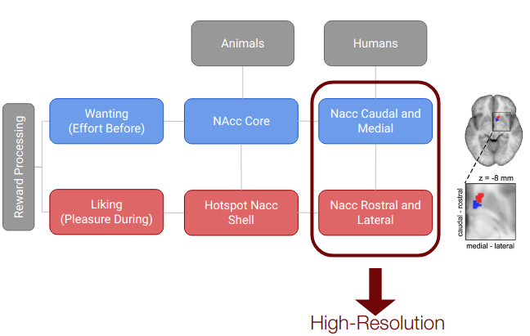
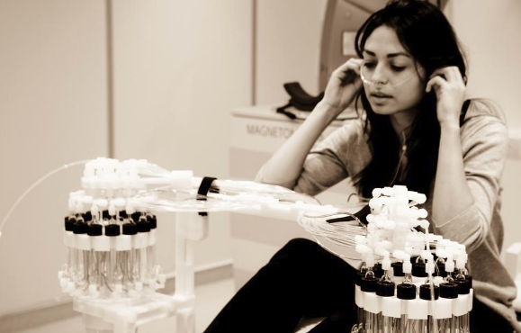
Wanting and Liking within the Human Ventral Striatum: a “high-resolution” fMRI study
Pool, E.¹; Prévost, C.²; Delplanque, S.¹; Brosch, T.³; Vuilleumier, P.⁴; Sander, D.¹
Aims of the study
Click here to insert your Abstract text. Type it in or copy and paste from your Word document or other source.
This text box will automatically re-size to your text. To turn off that feature, right click inside this box and go to Format Shape, Text Box, Autofit, and select the “Do Not Autofit” radio button.
Introduction
Method
Figure X. Label in 24pt Calibri.
Analysis
Background and previous studies:
Berridge & Robinson (2003). Trends in Neuroscience
Order your poster from Genigraphics and we will perform a free design review and advise you if we see anything that may be a concern for printing. We’ll even help tidy things up.
We have more history with PowerPoint® than any other printing company. In fact, we helped Microsoft® design the software and we created all of the original color themes, templates, and clip art galleries. We know how to make your printed poster look just like it does on screen. Other printing companies and copy centers will blindly convert your file to another format prior to printing. This can result in text shifting, symbols changing, and altered colors. We know the secrets to avoid those issues. So choose Genigraphics for the most accurate reproduction available.
Population: We selected 24 right-handed adults from 18-36 year old, from the undergraduate student population in Geneva with a high personality trait of reward seeking and who liked chocolate.
Experimental Procedure:
Day 1: Manipulation Check + Select neutral odor (Lasted 1h45??)
Day 2 (in the scanner):
-Learning reminders (5min)
-PIT(15*item, 20 min) CS+, CS-, Baseline
-Pleasure (hedonic, 15*odor), choco-empty-control
cf. Figure X
Material and Technical Parameters:
Seqeunce (Prévost et al., (2012)) 26 Partial EPI
TR 2400 TE 41, 1.8 voxel isometric, + T1; Gradient field maps; Whole Brain
Olfactometer
Biopac (PPU; Belt; Handgrip) ??
MRI operator (Bruno Bonet)
Click here to insert your Discussion text. Type it in or copy and paste from your Word document or other source.
This text box will automatically re-size to your text. To turn off that feature, right click inside this box and go to Format Shape, Text Box, Autofit, and select the “Do Not Autofit” radio button.
To change the font style of this text box: Click on the border once to highlight the entire text box, then select a different font or font size that suits you. This text is Calibri 30pt and is easily read up to 4 feet away on an A0 poster.
Zoom out to 100% to preview what this will look like on your printed poster.
Table 1. Label in 24pt Calibri.
 | Heading | Heading | Heading
Item | 800 | 790 | 4001
Item | 356 | 856 | 290
Item | 228 | 134 | 238
Item | 954 | 875 | 976
Item | 324 | 325 | 301
Item | 199 | 137 | 186
Predictions
NAcc caudal and medial
(core) will correlate more with the behavioral index of the PIT than with the behavioral index of hedonic pleasure
AND
NAcc rostral and lateral (shell) will correlate more with the behavioral index of hedonic pleasure than with the behavioral index of the PIT
Figure 1. Label in 24pt Calibri.
Figure 2. Label in 24pt Calibri.
¹Department of Psychology, Emotion Elicitation and Expression Laboratory
²Department of Neurosciences and Clinical Neurology, Laboratory of Neurology and Imaging of Cognition
³Department of Psychology, Consumer Decision and Sustainable Behavior Laboratory
⁴Department of Fundamental Neurosciences, Laboratory for Neurology and Imaging of Cognition
References
David Munoz Tord
Email: david.munoz@etu.unige.ch

