Slide 1
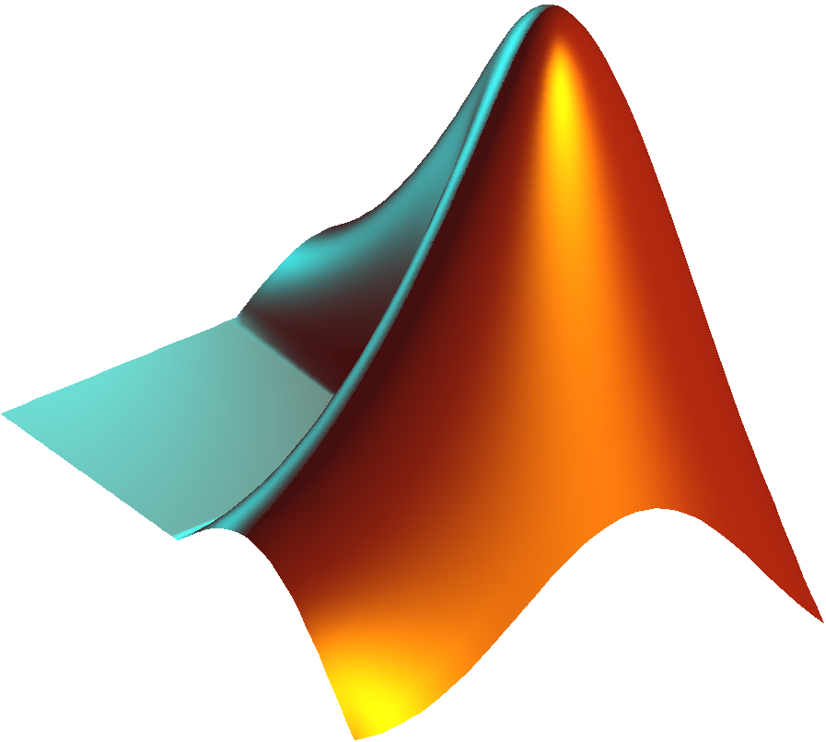
Introduction to PsychToolbox in MATLAB
Psych 599, Summer 2016
Jonas Kaplan, Ph.D.
University of Southern California

Slide 2
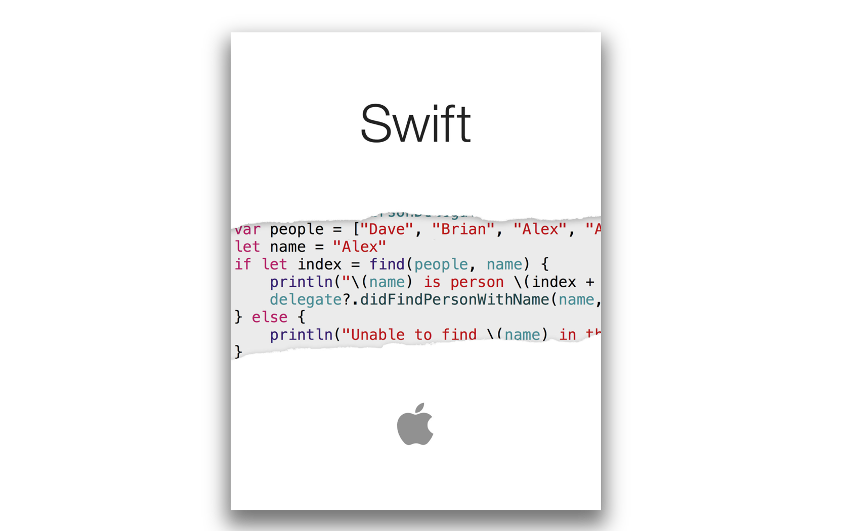

Slide 3
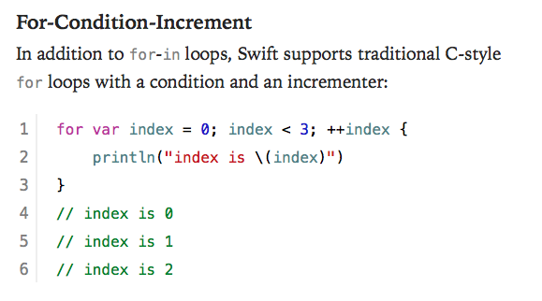

Slide 4
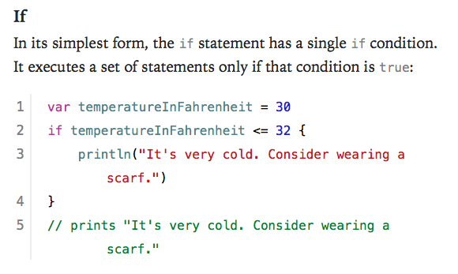

Slide 5
Final Exam
Full Experiment. Must:
Write the entire thing from scratch yourself
Take subject code and any relevant conditions as inputs
Present repetitive trials that involve at least 2 different conditions
Must present either visual or auditory stimuli (or both)
Must collect some kind of behavioral response where timing is recorded
Must write responses out to a log file
Please run your experiment plan by me as soon as possible. If you don't have something you are working on now, I will make something up for you.

Slide 6
Week 3 Recap

Slide 7
Debugging
proximal cause of error
>> debugDemo('SB02')
Error using fprintf
Function is not defined for 'cell' inputs.
Error in debugDemo>printSomething (line 19)
fprintf('This is your string: %s\n',stringToPrint);
Error in debugDemo (line 11)
printSomething(myConditions);
distal cause of error
Links to the help file for that function
Links to the line in the script where the problem occurred

Slide 8
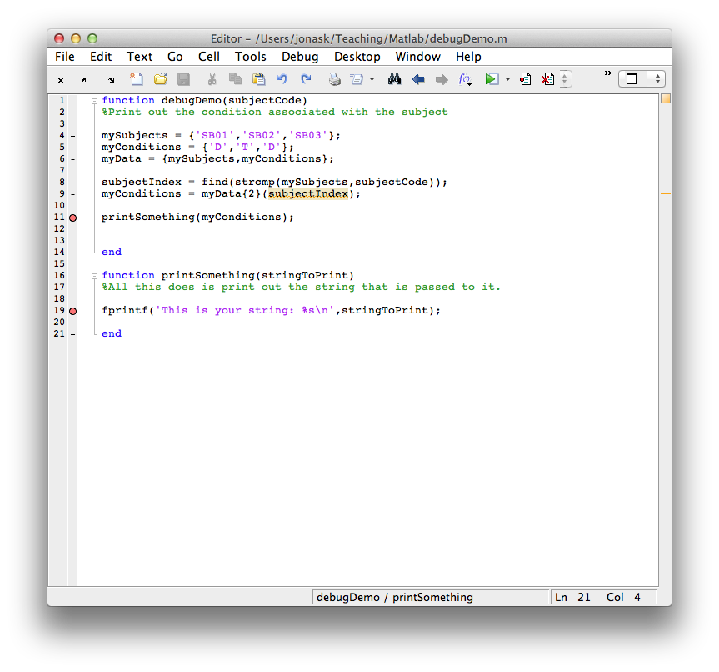
BREAKPOINTS

Slide 9
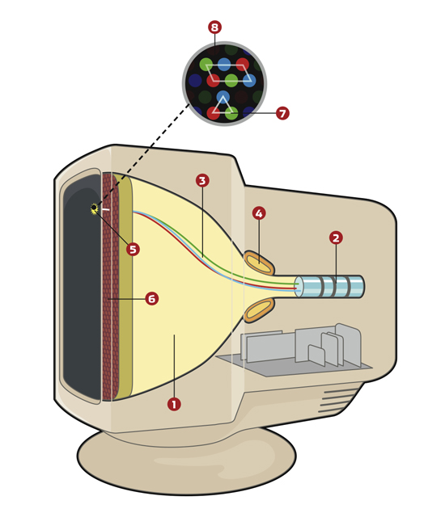
How monitors work
1 – cathode ray tube
2 – electron gun
3 – electron beam
4 – deflection yoke
The deflection yoke manipulates the electron beam, sweeping it across the screen, one horizontal line ("scanline") at a time

Slide 10
TIME
Frame 1
Frame 2
Frame 3
Frame 4
VBL
VBL
VBL
PTB tries to swap the front and back buffers during the VBL, so that content is not being updated in the middle of a frame draw.
This is called VBL Synchronization. If synchronization between buffer-swapping and VBL fails:
- Visual artifacts like flicker and tearing may occur
- Timing measurement will be less precise

Slide 11
Flip timing
VBLtime = Screen('Flip',windowPtr [, when] [,dontclear])
Default is to flip now, i.e. at the next VBL interval. However, you can specify a time in the future for the flip to take place. Flip will wait until that time and then flip at the next VBL interval after the specified time.
Default is to clear the back buffer. However in some cases you may want to leave the back buffer as is. Default is 0, set to 1 if you don't want it to clear.

Slide 12
Using the Screen command
Opening the screen
[windowPtr,rect]=Screen('OpenWindow',ScreenNumber)
returns a number that we will use to refer to this screen in future commands
which screen you want to open (you may have multiple monitors)
returns a rectangle (a vector of four numbers) that describe the dimensions of the screen

Slide 13
Using the screen
Before you can do anything with the screen (drawing on it, checking its frame rate, flipping its buffers, etc.) you must open the screen with OpenWindow
OpenWindow returns a windowPointer, a number we can use to refer to the screen
When you run "clear Screen" you are closing the screen and your windowPointer is now useless
NEW

Slide 14
Using the screen
Screen('OpenWindow')
do stuff with the screen
clear Screen (or Screen('Close',wPtr))
NEW

Slide 15
KbWait
[secs, keyCode, deltaSecs] = KbWait()
Will wait until the user presses a key, and return the time and keypress.
KbWait IS NOT FOR MEASURING
REACTION TIMES!!

Slide 16
KbWait
[secs, keyCode, deltaSecs] = KbWait()
keyCode is a vector of all the keys, with a 1 for any key that was pressed.
find(keyCode) will return the index of the button(s) pressed.
That code can then be turned into a character using KbName()

Slide 17
Working with color
Specify colors using a vector of 3 integers
myColor = [ x, y, z]
Examples:
red= [ 255,0,0]
aqua = [0,200,255]

Slide 18
Drawing functions
Screen('DrawLine', windowPtr [,color], fromH, fromV, toH, toV [,penWidth]);
Screen('DrawArc',windowPtr,[color],[rect],startAngle,arcAngle)
Screen('FrameArc',windowPtr,[color],[rect],startAngle,arcAngle[,penWidth] [,penHeight] [,penMode])
Screen('FillArc',windowPtr,[color],[rect],startAngle,arcAngle)
Screen('FillRect', windowPtr [,color] [,rect] );
Screen('FrameRect', windowPtr [,color] [,rect] [,penWidth]);
Screen('FillOval', windowPtr [,color] [,rect] [,perfectUpToMaxDiameter]);
Screen('FrameOval', windowPtr [,color] [,rect] [,penWidth] [,penHeight] [,penMode]);
Screen('FramePoly', windowPtr [,color], pointList [,penWidth]);
Screen('FillPoly', windowPtr [,color], pointList [, isConvex]);
Screen('DrawDots', windowPtr, xy [,size] [,color] [,center] [,dot_type]);
Screen('DrawLines', windowPtr, xy [,width] [,colors] [,center] [,smooth]);

Slide 19
Screen coordinate system
(0,0)
y
(xMax,yMax)

Slide 20
Drawing simple shapes
Screen('FillRect', wPtr, color, rect);
Define the rectangle(s) to fill in. If you leave this blank, the whole screen will be filled, and the background color will be set to that color (when you Flip the screen, the buffer will clear to this color)

Slide 21
Centering
(screenCenterX – rectWidth/2, screenCenterY – rectHeight/2)
(screenCenterX,screenCenterY)
(rectLeft + rectWidth, rectTop + rectHeight)

Slide 22
Drawing circles
Screen('FillOval', wPtr, color, rect);

Slide 23
Alpha blending
>> Screen BlendFunction?
>> Screen('BlendFunction',wPtr,GL_SRC_ALPHA,GL_ONE_MINUS_SRC_ALPHA);
>> Screen('BlendFunction',wPtr,GL_ONE,GL_ZERO);
ENABLE BLENDING
DISABLE BLENDING

Slide 24
Using DrawDots
Alternate method for drawing several shapes at once. Even though it is called DrawDots, it will draw squares as well as circles.
Screen('DrawDots', windowPtr, xy [,size] [,color] [,center] [,dot_type]);
Matrix containing coordinates of dot centers. Two rows, x and y. Each column is another dot.
Define center coordinates
0 (default) = squares
1 = circles
2 = circles with high quality anti-aliasing
Can either be a single value, or a vector of values, one per dot
Single color vector, or matrix with three rows (r,g,b)

Slide 25
Using DrawLines
Screen('DrawLines', windowPtr, xy [,width] [,colors] [,center] [,smooth]);
Matrix containing coordinates. Two rows (x and y). Each pair of columns (start and end) specifies a line.
0 (default) = no smoothing
1 = smoothing
2 = high quality smoothing
NOTE: smoothing requires blending to be on
Either a single color, or one color per point in xy. Three rows (r,g,b).

Slide 26
Animation
Create a loop where something changes each time through the loop

Slide 27
Drawing text
Two steps to drawing text:
1. Set up all the properties of the text we want to draw (font, size, style) using separate commands
2. Draw the text using DrawText

Slide 29
Assignment Week 3
Write a function called yourInitials_week3()
The function should take two inputs:
- An integer called speed
- An integer called radius
The function should:
- Draw a circle in the center of the screen with radius equal to radius. Wait for the user to press a key. The circle will then start moving diagonally towards the lower right hand corner of the screen. The speed at which it moves will be determined by speed: speed is actually the number of pixels that the circle will move each frame. In other words, increment both the x and y position of the circle by speed every frame.
- If the circle should "bounce" off the edge of the screen. That means that once it hits the bottom of the screen, it will start to move up instead of down, and when it hits the right side of the screen it will start to move left instead of right, etc.
- The color of the circle should randomly change whenever it hits a wall
- The circle will continue to bounce around the screen indefinitely

Slide 30
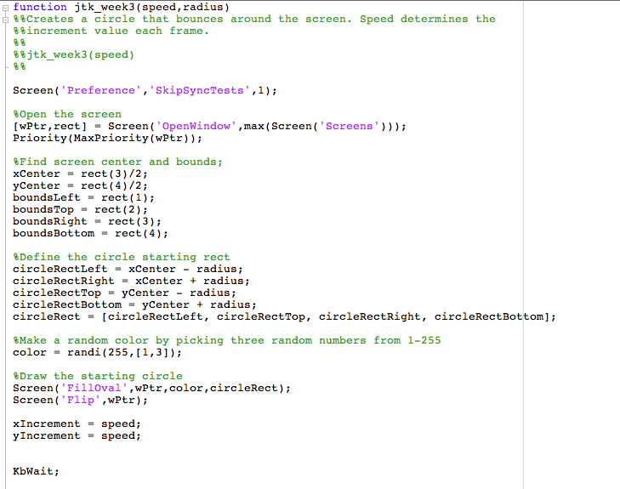

Slide 31
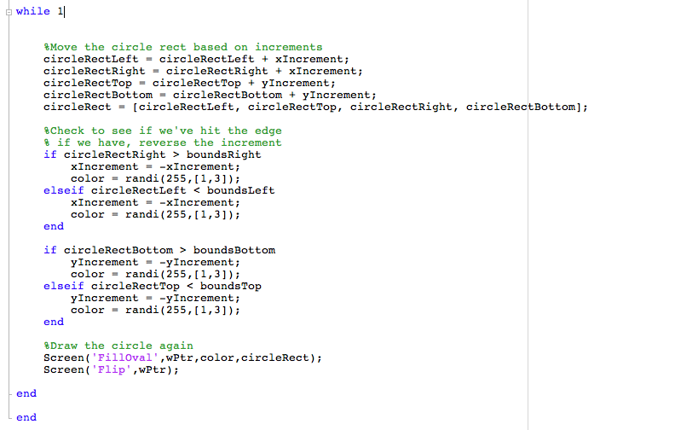

Slide 33
Week 4
Drawing Text
Animation
Presenting images
Playing movies

Slide 34
Drawing text
Two steps to drawing text:
1. Set up all the properties of the text we want to draw (font, size, style) using separate commands
2. Draw the text using DrawText

Slide 35
Drawing Text
Screen('TextSize',wPtr,size);
Screen('TextFont',wPtr,fontString);
Screen('TextStyle',wPtr,style);
0 = normal
1 = bold
2 = italic
4 = underline
8 = outline
32 = condense
64 = extend

Slide 36
Drawing Text
Screen('DrawText',wPtr,text,x,y,color)

Slide 37
Drawing Text
>> [wPtr, rect] = Screen('OpenWindow',1);
>> Screen('TextFont',wPtr,'Helvetica');
>> Screen('TextSize',wPtr,48);
>> Screen('DrawText','Hello there',100,100,[200 0 0]);

Slide 38
Drawing Text
Sometimes, to position text, we need to know its size in pixels:
rect = Screen('TextBounds',wPtr,textString);

Slide 39
Centering text, the hard way
>> [wPtr, rect] = Screen('OpenWindow',1);
>> screenCenterX = rect(3)/2;
>> screenCenterY = rect(4)/2;
>> myText = 'Hello World!';
>> textRect = Screen('TextBounds',wPtr,myText);
>> textWidth = textRect(3);
>> textHeight = textRect(4);
>> textX = screenCenterX – textWidth/2;
>> textY = screenCenterY – textHeight/2;
>> Screen('DrawText',wPtr,myText,textX,textY,0);
>> Screen('Flip',wPtr);

Slide 40
Drawing Formatted Text
DrawFormattedText(wPtr,textString,sx,sy,color,wrapat,flipHorizontal,flipVertical, vSpacing, rightoleft, winRect)
Advantages over DrawText:
Helpful for splitting text into multiple lines. Can include newline characters in the text string (\n).
Can do automatic centering if you set sx to "center" or right justify if you set to "right"

Slide 41
Centering text, the easy way
>> [wPtr, rect] = Screen('OpenWindow',1);
>> myText = 'Hello World!';
>> DrawFormattedText(wPtr,myText,'center','center',0);

Slide 42
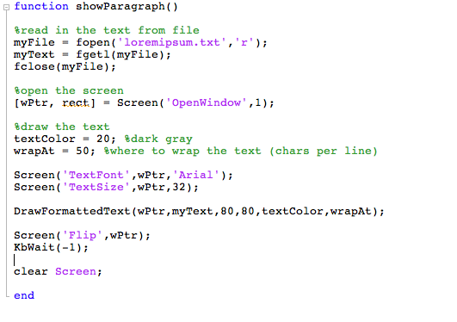
Paragraphs
<play with options>

Slide 43
Displaying pictures
Steps to displaying a picture:
1. Use imread() to read the image into a matrix of numbers
2. Use MakeTexture to create an OpenGL texture using that matrix
3. Use DrawTexture to draw the texture to the screen

Slide 44
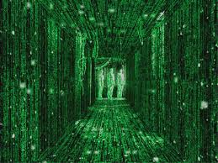
Images

Slide 45
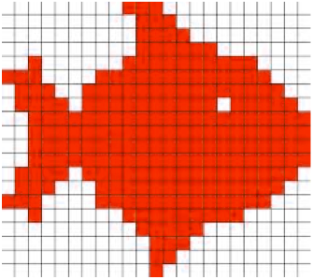
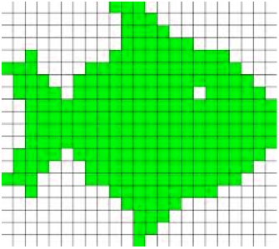
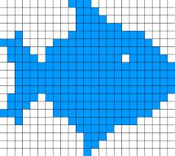
Images

Slide 46
Images
Step 1: Read in the image data using imread()
Supported image formats:
BMP, GIF, JPEG, PNG, TIFF, etc.

Slide 47
Images
A = imread('mypicture.jpg');
[A, map] = imread('mypicture.jpg');
[A, map, alpha] = imread('mypicture.jpg');

Slide 48
Displaying images
>> faceData = imread('sadface.jpg');
>> size(faceData);
ans =
650 506 3

Slide 49
Images
Step 1: Read in the image data using imread()
Step 2: Make a texture

Slide 50
Images
myTextureIndex = Screen('MakeTexture',wPtr, imageMatrix)

Slide 51
Displaying images
>> faceData = imread('sadface.jpg');
>> size(faceData);
ans =
650 506 3
>> faceTexture = Screen('MakeTexture',wPtr,faceData);
>> Screen('DrawTexture',wPtr,faceTexture);
>> Screen('Flip',wPtr);

Slide 52
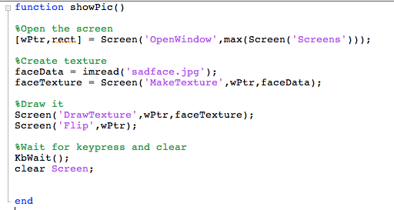

Slide 53
Drawing Images
Screen('DrawTexture', windowPointer, texturePointer [,sourceRect] [,destinationRect] [,rotationAngle] [, filterMode] [, globalAlpha]
[, modulateColor] [, textureShader] [, specialFlags] [, auxParameters]);
rect defining subpart of picture to present, default is whole picture
rect defining subpart of screen to present picture in (defaults to center of screen)

Slide 54
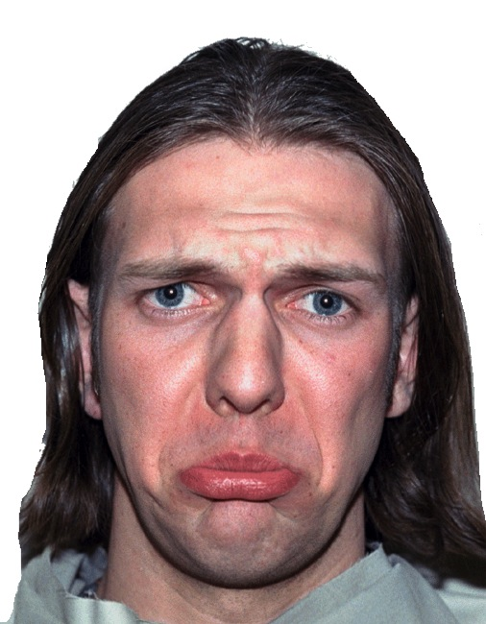
Moving images
0,0
xOffset, yOffset
xOffset + imageWidth, yOffset + imageHeight

Slide 55
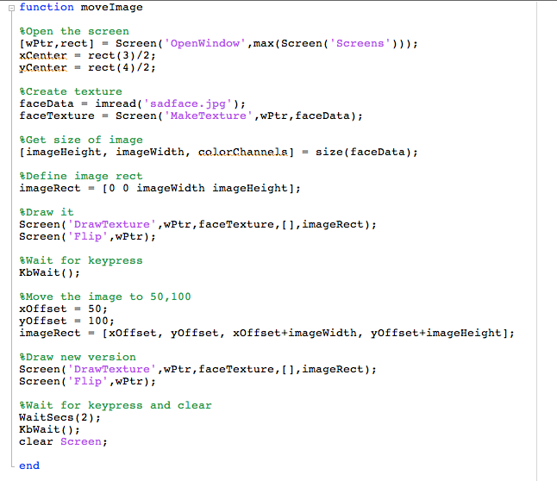

Slide 56
Scaling images
To scale an image, change the size of the destination rectangle

Slide 57
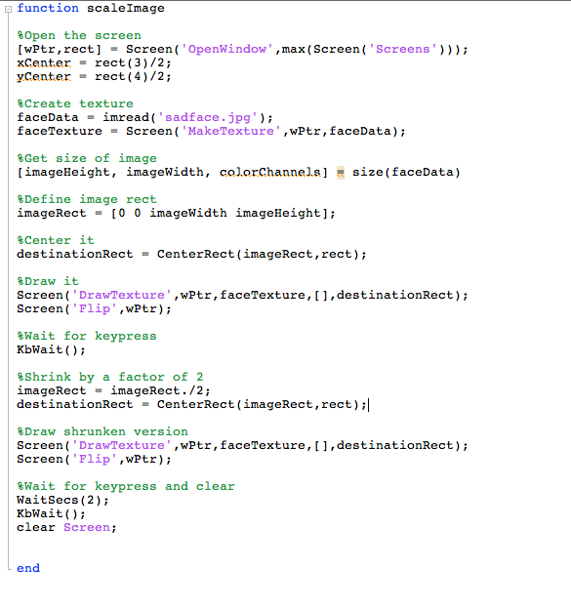

Slide 58
Rotating images
Screen('DrawTexture', windowPointer, texturePointer [,sourceRect] [,destinationRect] [,rotationAngle] [, filterMode] [, globalAlpha]
[, modulateColor] [, textureShader] [, specialFlags] [, auxParameters]);
set rotation angle. upright image is 0 degrees

Slide 59
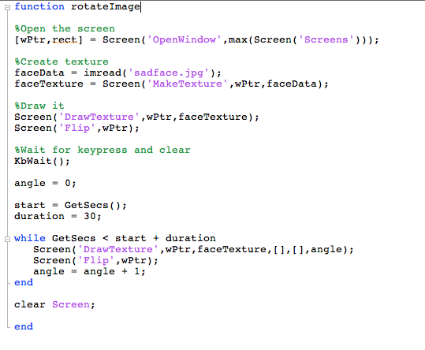

Slide 60
Multiple images
You can draw multiple image textures to the back buffer, and then flip to show them at the same time

Slide 61
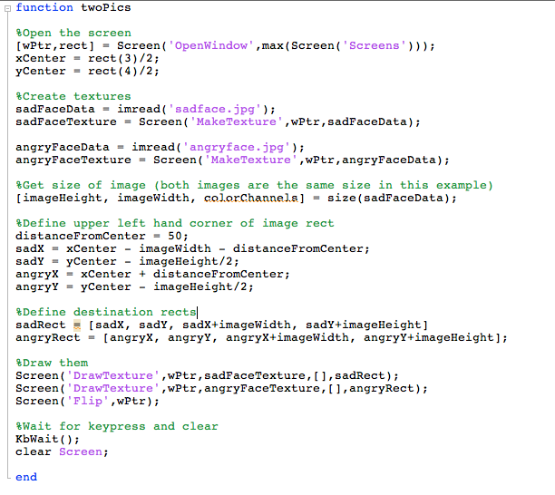

Slide 62
Transparency
Screen('DrawTexture', windowPointer, texturePointer [,sourceRect] [,destinationRect] [,rotationAngle] [, filterMode] [, globalAlpha]
[, modulateColor] [, textureShader] [, specialFlags] [, auxParameters]);
set alpha for image, alpha blending must be on
0 = fully transparent
1 = fully solid

Slide 63
Alpha blending
>> Screen BlendFunction?
>> Screen('BlendFunction',wPtr,GL_SRC_ALPHA,GL_ONE_MINUS_SRC_ALPHA);
>> Screen('BlendFunction',wPtr,GL_ONE,GL_ZERO);
ENABLE BLENDING
DISABLE BLENDING

Slide 64
Displaying images
Loading images in and making textures can take time
Don't wait until you want to present the images to load them in
Make your textures at the beginning of your script, then present them on time

Slide 65

Movies
http://www.gstreamer.com

Slide 66

Movies
OSX: Must have XCode installed
Make sure to press "customize" and check all the boxes in the installer to install all the parts

Slide 67
Movies
1. OpenMovie to open the movie file
2. PlayMovie to start playing
3. Loop:
GetMovieImage to create frame texture
Draw texture and flip screen
4. PlayMovie to stop playing
5. CloseMovie to close movie file

Slide 68
Movies
[ moviePtr [duration] [fps] [width] [height] [count [aspectRatio]]=Screen('OpenMovie', windowPtr, moviefile [, async=0] [, preloadSecs=1] [, specialFlags1=0][, pixelFormat=4]
[, maxNumberThreads=-1]);

Slide 69
Movies
Screen('PlayMovie', moviePtr, rate, [loop], [soundvolume]);
0 = stop playback
1 = play, normal speed
-1 = play, normal speed backwards
0 = mute
1 = max volume

Slide 70
Movies
[ texturePtr [timeindex]]=Screen('GetMovieImage', windowPtr, moviePtr, [waitForImage=1], [fortimeindex], [specialFlags = 0] [, specialFlags2 = 0]);

Slide 71
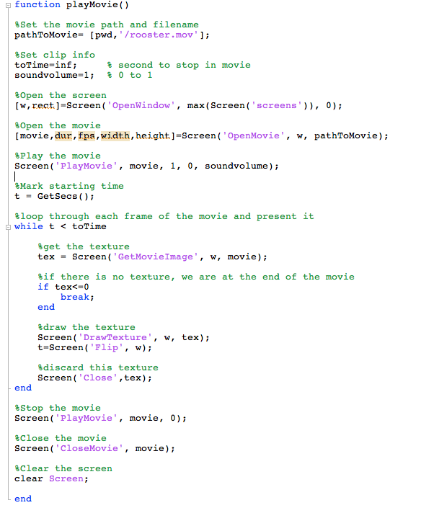

Slide 73
Assignment # 4
Create a function called yourInitials_week4()
The function should take one input:
subjectCode, a string identifying the subject
The function should do the following:
Using a loop, present 20 trials of the following emotion categorization experiment. On each trial, a picture will appear. The picture will randomly be chosen between sad.jpg and angry.jpg. The location of the picture will also be randomly chosen between the left and right side of the screen. The edge of the picture should always be 100 pixels from the center of the screen, horizontally.
Once the picture appears, wait for the user to press a key. The subject should press S for sad and A for angry.
On each trial, write out the following information to the next line of a log file. The log file should be named subjectCode_log.txt where subjectCode is the code that they entered from the command line. Each line should contain: the trial number, which picture was presented, where it was presented, which key was pressed, the reaction time, and whether or not the keypress was correct.
When the experiment is over, print out the subject's overall accuracy to the command window.

