Slide 1
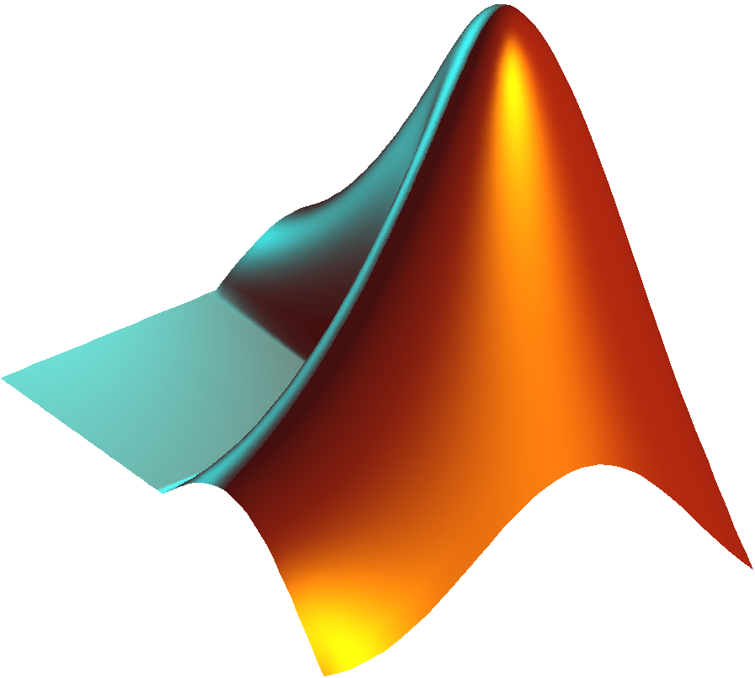
Introduction to PsychToolbox in MATLAB
Psych 599, Summer 2016
Jonas Kaplan, Ph.D.
University of Southern California

Slide 2
Week 4 Recap

Slide 3
Drawing text
Two steps to drawing text:
1. Set up all the properties of the text we want to draw (font, size, style) using separate commands
2. Draw the text using DrawText

Slide 4
Drawing Text
Screen('DrawText',wPtr,text,x,y,color)

Slide 5
Drawing Formatted Text
DrawFormattedText(wPtr,textString,sx,sy,color,wrapat,flipHorizontal,flipVertical, vSpacing, rightoleft, winRect)
Advantages over DrawText:
Helpful for splitting text into multiple lines. Can include newline characters in the text string (\n).
Can do automatic centering if you set sx to "center" or right justify if you set to "right"

Slide 6
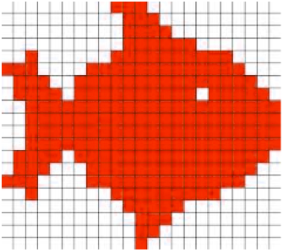
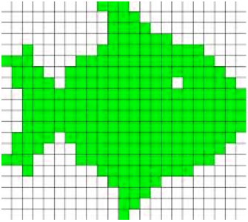
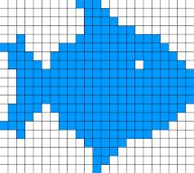
Images

Slide 7
Displaying pictures
Steps to displaying a picture:
1. Use imread() to read the image into a matrix of numbers
2. Use MakeTexture to create an OpenGL texture using that matrix
3. Use DrawTexture to draw the texture to the screen

Slide 8
Images
A = imread('mypicture.jpg');
[A, map] = imread('mypicture.jpg');
[A, map, alpha] = imread('mypicture.jpg');

Slide 9
Images
myTextureIndex = Screen('MakeTexture',wPtr, imageMatrix)

Slide 10
Drawing Images
Screen('DrawTexture', windowPointer, texturePointer [,sourceRect] [,destinationRect] [,rotationAngle] [, filterMode] [, globalAlpha]
[, modulateColor] [, textureShader] [, specialFlags] [, auxParameters]);
rect defining subpart of picture to present, default is whole picture
rect defining subpart of screen to present picture in (defaults to center of screen)

Slide 11
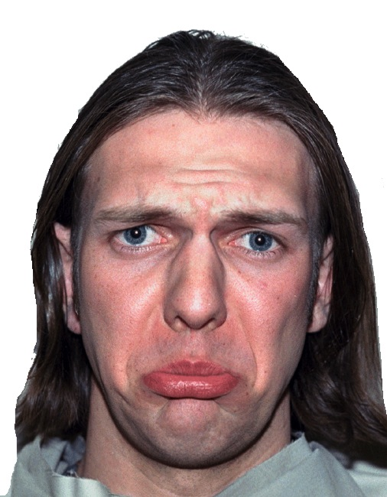
Positioning images
0,0
xOffset, yOffset
xOffset + imageWidth, yOffset + imageHeight

Slide 12
Scaling images
To scale an image, change the size of the destination rectangle

Slide 13
Rotating images
Screen('DrawTexture', windowPointer, texturePointer [,sourceRect] [,destinationRect] [,rotationAngle] [, filterMode] [, globalAlpha]
[, modulateColor] [, textureShader] [, specialFlags] [, auxParameters]);
set rotation angle. upright image is 0 degrees

Slide 14
Multiple images
You can draw multiple image textures to the back buffer, and then flip to show them at the same time

Slide 15
Movies
1. OpenMovie to open the movie file
2. PlayMovie to start playing
3. Loop:
GetMovieImage to create frame texture
Draw texture and flip screen
4. PlayMovie to stop playing
5. CloseMovie to close movie file

Slide 16

Movies
http://www.gstreamer.com

Slide 17
Assignment # 4
Create a function called yourInitials_week4()
The function should take one input:
subjectCode, a string identifying the subject
The function should do the following:
Using a loop, present 20 trials of the following emotion categorization experiment. On each trial, a picture will appear. The picture will randomly be chosen between sad.jpg and angry.jpg. The location of the picture will also be randomly chosen between the left and right side of the screen. The edge of the picture should always be 100 pixels from the center of the screen, horizontally.
Once the picture appears, wait for the user to press a key. The subject should press S for sad and A for angry.
On each trial, write out the following information to the next line of a log file. The log file should be named subjectCode_log.txt where subjectCode is the code that they entered from the command line. Each line should contain: the trial number, which picture was presented, where it was presented, which key was pressed, the reaction time, and whether or not the keypress was correct.
When the experiment is over, print out the subject's overall accuracy to the command window.

Slide 18
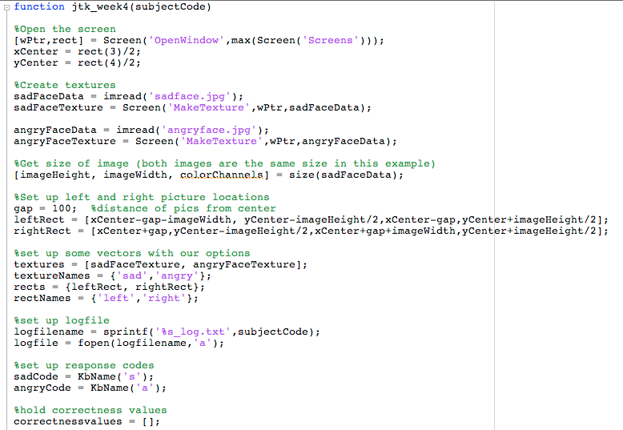

Slide 19
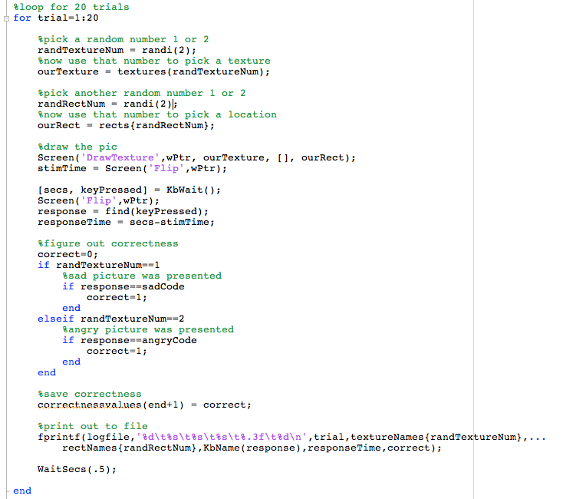

Slide 20
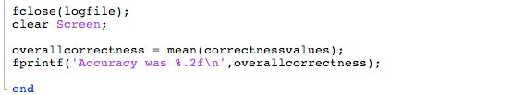

Slide 22
Week 5
Sound
Collecting input: keyboard, mouse, joystick, etc.
Sending output: external devices

Slide 23
Sound
Creating sounds to play
Playing existing sound files

Slide 24
Sound
PsychPortAudio is the sound driver for PTB-3
Type PsychPortAudio in the command window to see all of the subcommands, just like Screen
Get help on a subcommand just like Screen: PsychPortAudio Start?
Test your audio setup with BasicSoundOutputDemo

Slide 25
Sound data
Sound data should be in the form of a matrix where each row is one sound channel
Samples in the vector should range from -1 to 1, where 0 is silent.
You can create a sound by generating data for a matrix on your own, or you can read in from a wav file

Slide 26
Reading from wav files
Y = wavread(FILE)
[ Y, freq ] = wavread(FILE)

Slide 27
Reading from .au files
Y = auread(AUFILE)
[Y, freq ] = auread(AUFILE)

Slide 28
Reading from audiofiles
New Matlab command available in versions 2012b and later, will read many audio formats including WAV, FLAC, MP3, MPEG-4, OGG
[Y, freq ] = audioread()

Slide 29
Reading in sounds
>> PsychtoolboxRoot
ans =
/Applications/Psychtoolbox/
>> cd /Applications/Psychtoolbox/PsychDemos/SoundFiles
>> ls
COPYING motor_a8.wav phaser.wav
funk.wav motor_b8.wav radar.wav
>> [funkData, funkFreq ] = wavread('funk.wav');
>> funkFreq
funkFreq =
48000
>> whos funkData
Name Size Bytes Class Attributes
funkData 624000x1 4992000 double
>> plot(funkData)

Slide 30
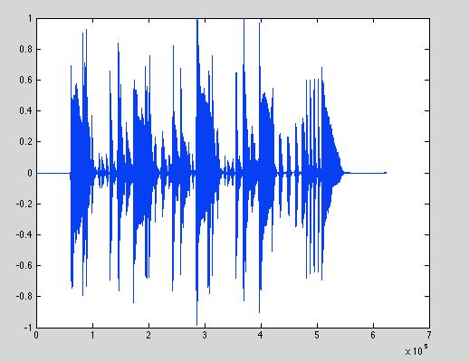
Reading in sounds

Slide 31
Preparing sound data for playing
>> whos funkData
Name Size Bytes Class Attributes
funkData 624000x1 4992000 double
>> funkData = funkData'
>> funkData = [funkData; funkData];
>> whos funkData
Name Size Bytes Class Attributes
funkData 2x624000 9984000 double
change column to row
duplicate to make two rows for stereo

Slide 32
Creating sound stimuli
Length of vector is sampling frequency * duration (we want sfreq samples per second for X seconds )

Slide 33
Creating sounds
>> samplingFreq = 48000;
>> duration = 5;
>> whitenoise = rand(1,(samplingFreq * duration));
>> whos whitenoise
Name Size Bytes Class Attributes
whitenoise 1x240000 1920000 double

Slide 34
Creating sounds
MakeBeep() will create a pure tone
Y = MakeBeep( freq, duration, samplingrate )

Slide 35
Creating sounds
>> beep1000 = MakeBeep(1000,5,48000);
>> sound(beep1000,48000);
>> beep500 = MakeBeep(500,5,48000);
>> sound(beep500,48000);
matlab's built-in sound function, not PTB's

Slide 36
Steps to playing a sound
InitializePsychSound
open audio channel with PsychPortAudio('Open')
fill audio buffer with PsychPortAudio('FillBuffer')
start playing a sound with PsychPortAudio('Start')
stop playing a sound with PsychPortAurio('Stop')
close the audio channel with PsychPortAudio('Close')

Slide 37
Step 1: Intialize
InitializePsychSound
Loads the sound driver. Place this at the beginning of your script.
on Windows, things may not work with high precision timing without an ASIO sound card (read help InitializePsychSound if you are on Windows)

Slide 38
Step 2: Open audio channel
pahandle = PsychPortAudio('Open' [, deviceid][, mode] [, reqlatencyclass][, freq][, channels] [, buffersize] [, suggestedLatency][, selectchannels][, specialFlags=0]);
playback channels:
1 = mono
2 = stereo
etc.
default is 2
how aggressively to take over the sound device in order to assure latency
default is 1. Higher numbers give better latency
but have consequences.
Which audio device
to use for playback.
PsychPortAudio('GetDevices') to list all available devices
requested playback rate in Hz

Slide 39
Step 3: Fill the audio buffer
PsychPortAudio('FillBuffer', pahandle, bufferdata);
This is analogous to drawing on the back buffer with the Screen command. We fill the buffer now, but it will not be heard until we play it.

Slide 40
Step 4: Start playback
startTime = PsychPortAudio('Start', pahandle [, repetitions=1] [, when=0] [, waitForStart=0] [, stopTime=inf] [, resume=0]);
Wait until this time to start playing (default is play now)
Set to 0 to repeat indefinitely
set a time to stop playing
0: Ask playback to start and move on
1: wait for playback to actually begin.
A 1 here is necessary if you want to get timing info back

Slide 41
Remaining steps
Stop playback if necessary: PsychPortAudio('Stop',pahandle);
Close the audio driver: PsychPortAudio('Close',pahandle);

Slide 42
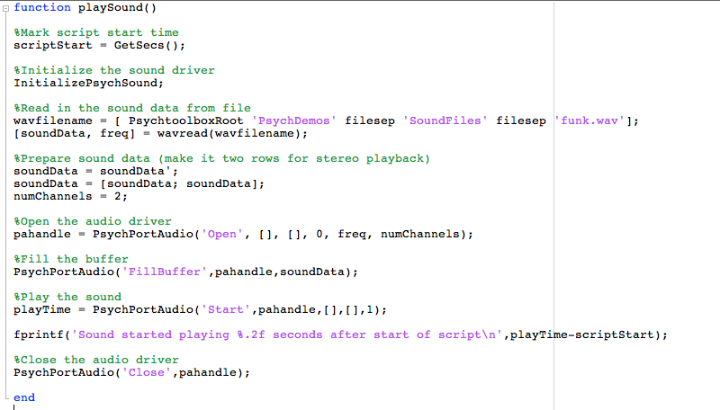

Slide 43
Sound recording
Also done through PsychPortAudio
See BasicSoundInputDemo.m

Slide 44
Sound recording steps
Initialize sound driver: InitializePsychAudio
Open audio channel for recording with PsychPortAudio('Open') setting mode to 2
Clear a buffer using PsychPortAudio('GetAudioData')
Start recording with PsychPortAudio('Start')
Stop recording with PsychPortAudio('Stop')
Get audio data using PsychPortAudio('GetAudioData')

Slide 45
Step 2: Open audio channel
pahandle = PsychPortAudio('Open' [, deviceid][, mode] [, reqlatencyclass][, freq][, channels] [, buffersize] [, suggestedLatency][, selectchannels][, specialFlags=0]);
1: sound playback only (default)
2: audio capture
3: simultaneous capture and playback (may not work on all hardware)

Slide 46
GetAudioData
Call before you start recording to setup an empty buffer, then after recording to retrieve recorded data
[audiodata absrecposition overflow cstarttime] = PsychPortAudio('GetAudioData', pahandle [, amountToAllocateSecs] [, minimumAmountToReturnSecs][, maximumAmountToReturnSecs] [, singleType=0]);

Slide 47
Writing data to file
wavwrite(audiodata, freq, nbits, filename)
audiowrite(filename, audiodata, freq)

Slide 48
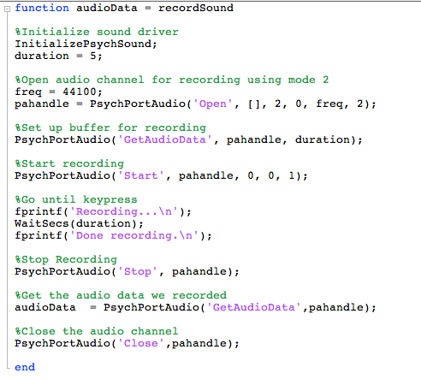

Slide 50
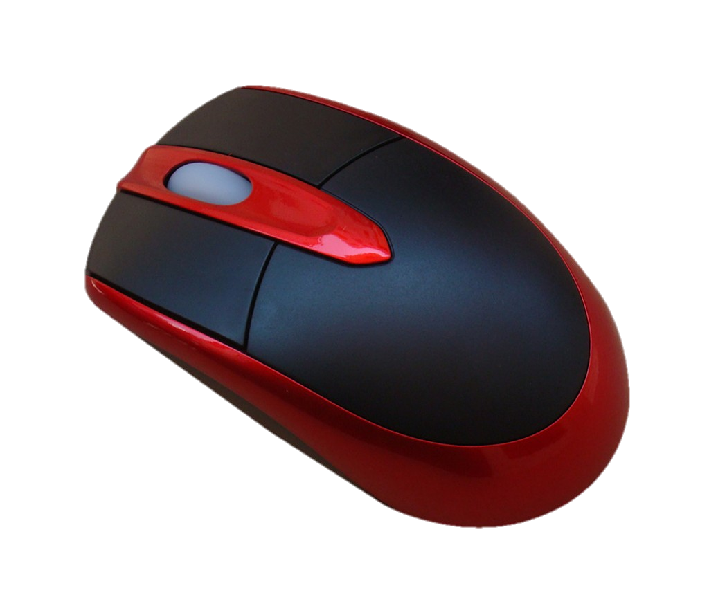
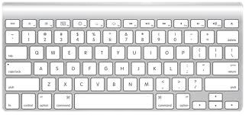
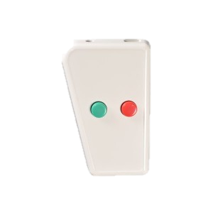
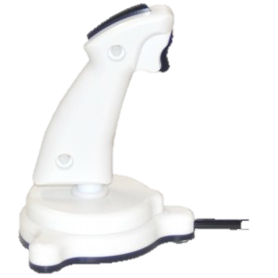
Collecting responses

Slide 51
PsychHID
Interaction with USB devices is accomplished through PsychHID (Human Interface Device)
Even internal keyboards are accessed this way

Slide 52
Listing devices
devices = PsychHID('Devices');
Returns a structure array where each element describes a single device
PsychHID only checks for USB devices on startup. If you plug in a device after starting matlab it wont be recognized by PsychHID, even if you can see its input on the screen. You need to either restart Matlab or issue clear PsychHID to renumerate the connected devices.

Slide 53
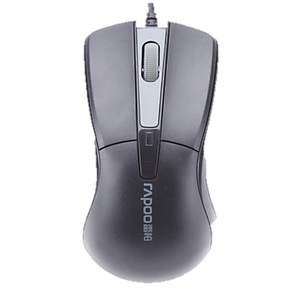
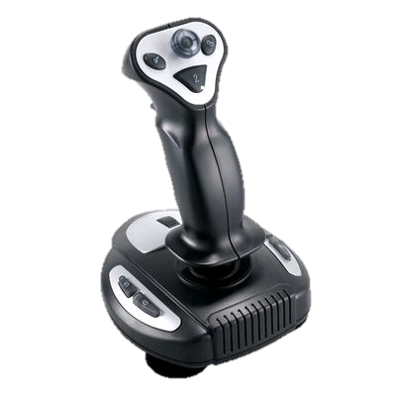
Psychtoolbox Response Monitoring
GetChar()
KbWait()
KbCheck()
KbQueueCheck()
GetMouse()
GetClicks()
GetMouseWheel()
SetMouse()
ShowCursor()
HideCursor()
GamePad()

Slide 54
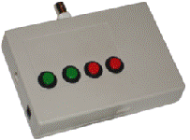
Psychtoolbox Response Monitoring
PsychRTBox()
http://lobes.usc.edu/RTbox/

Slide 55
Other response input methods
Ask()
GetEchoNumber()
GetEchoString()
GetNumber
GetString

Slide 56
Keyboard responses
GetChar()
KbWait()
KbCheck()
KbQueueCheck()

Slide 57
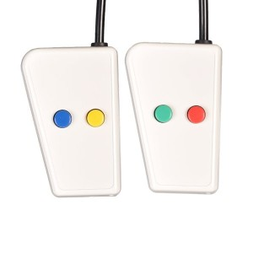

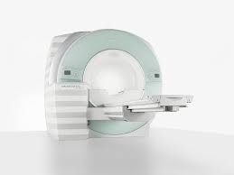
Keyboard responses
MRI response interface that delivers the keypresses from the button box and the triggers from the scanner is a keyboard device.

Slide 58
GetChar
[ch, when] = GetChar()
GetChar can return characters that were type before you called it!
As long as listening is turned on, GetChar will be listening. It will then return all the keys pressed since it started listening, in order. If there are none left in the queue, it will wait for a new one.
Use FlushEvents() to clear the queue and to start listening. You can also call ListenChar() to turn listening on and off directly.

Slide 59
GetChar
>> FlushEvents()
>> pressed = GetChar()
pressed =
p
>> pressed = GetChar()
pressed =
r
>> pressed = GetChar()
pressed =
e
>> FlushEvents;GetChar()
ans =
x

Slide 60
GetChar
Don't use GetChar() for timing!
No, really, don't use GetChar for response times!

Slide 61
KbWait
[secs, keyCode, deltaSecs] = KbWait([devicenumber] [, forWhat = 0][, untilTime=inf)
which device are we listening to?
use PsychHID('Devices') to list all devices
GetKeyboardIndices() will return the device numbers of all keyboard devices
Use -1 to listen to all keyboards
Use -2 to listen to all keypad devices
Use -3 to listen to all keyboards and keypads

Slide 62
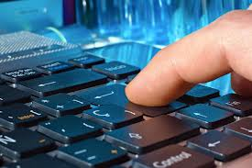
KbWait
When you press a key, you press it and then release it

Slide 63
KbWait
[secs, keyCode, deltaSecs] = KbWait([devicenumber] [, forWhat = 0][, untilTime=inf)
0: Default. Listen for key down
1: Listen for key release
2: Wait until all keys are released, THEN wait for key down
3: Wait until all keys are released, then wait for a full key press and release
Stop waiting when we get to this time

Slide 64
KbCheck
[keyIsDown, secs, keyCode, deltaSecs] = KbCheck([deviceNumber])
Has a key been pressed?
1 if any key has been pressed,
0 otherwise
interval between this check and the last one
Time key was pressed
256-element logical vector indicating which key(s) were pressed

Slide 65
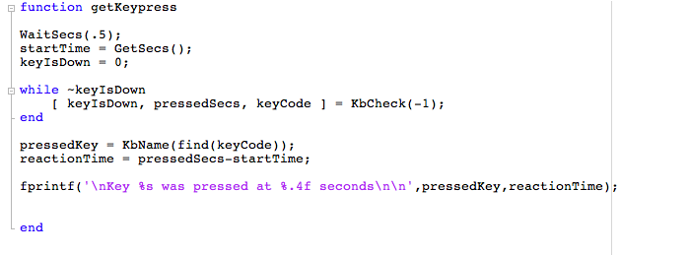

Slide 66
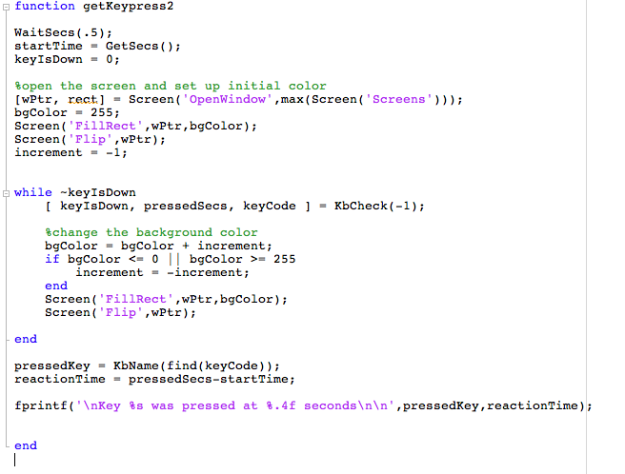
Use KbCheck to break out of an animation loop

Slide 67
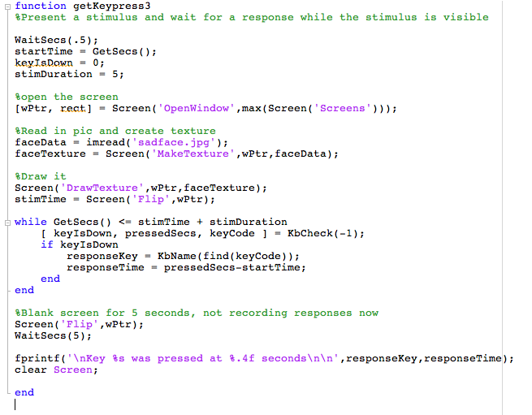
Collect a response only while the stimulus is visible

Slide 68
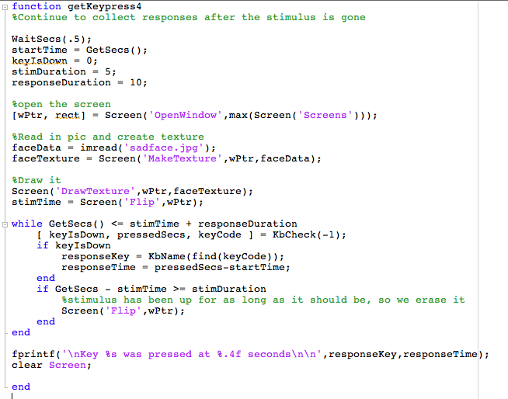
Continue collecting responses after the stimulus goes away

Slide 69
Ignoring responses
DisableKeysForKbCheck([disablekeys])
vector of key codes to ignore
RestrictKeysForKbCheck([enablekeys])

Slide 70
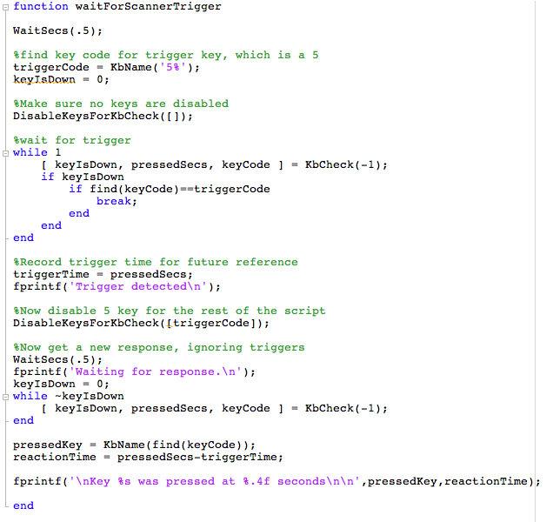
waiting for a specific response
waiting for any response EXCEPT certain keys

Slide 71
Keyboard responses
GetChar()
KbWait()
KbCheck()
KbQueueCheck()

Slide 72
KbQueueCheck
An alternative set of commands for collecting keypresses:
KbQueueCreate
KbQueueStart
KbQueueStop
KbQueueCheck
KbQueueWait
KbQueueFlush
KbQueueRelease

Slide 73
KbQueueCheck
Advantages of KbQueueCheck:
Sometimes detects really brief responses that KbCheck can miss
Very accurate time recording
Records presses and releases both
Disadvantages:
Difficulty in recording multiple presses of the same key
May not deal well with many rapid keypresses

Slide 74
Steps to using KbQueue
KbQueueCreate([deviceNumber]) to create the queue.
KbQueueStart() to start listening
KbQueueStop() to stop listening (does not clear the queue)
KbQueueCheck() to check the values recorded while the queue was active
KbQueueFlush() to empty the queue
KbQueueRelease() to destroy the queue object

Slide 75
KbQueueCheck
[pressed, firstPress, firstRelease, lastPress, lastRelease] = KbQueueCheck()
has a key been
pressed?
array indicating when each key was first pressed
array indicating when each key was first released

Slide 77
Other keyboard response functions
GetNumber()
GetString()
GetEchoString(wPtr,message,x,y)
Ask(wPtr, message)

Slide 78
Mouse responses
GetMouse()
GetClicks()
GetMouseWheel()
SetMouse()
ShowCursor()
HideCursor()

Slide 79
Mouse responses
[x,y,buttons] = GetMouse([windowPtrOrScreenNumber][, mouseDev])
vector of three numbers, one for each mouse button
0 = not pressed
1 = pressed
which mouse device

Slide 80
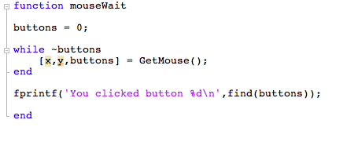

Slide 81
Mouse responses
[clicks,x,y,whichButton] = GetClicks([windowPtrOrScreenNumber] [, interclickSecs][, mouseDev])
Use this to wait for a click and record where the user clicked, and how many clicks they made (e.g. double-click).
wheelDelta = GetMouseWheel([mouseIndex])
Use this to get the position of the mouse scroll wheel

Slide 82
Controlling the mouse
SetMouse(x,y) to move the mouse to a location
HideCursor() to hide the mouse pointer
ShowCursor() to show the mouse pointer

Slide 83
Other input devices
GamePad()
Type Gamepad in the command window for help, or Gamepad Subcommand? for help with a subcommand

Slide 84
Gamepad
Gamepad('GetButton',gamepadIndex, buttonIndex) to get status of buttons
Gamepad('GetAxis',gamepadIndex,axisIndex) to get joystick position
Gamepad('GetBall',gamepadIndex,ballIndex) to get trackball info

Slide 86
Assignment #5
Create a function called yourinitials_week5()
The function will take one input, radius, which will determine the radius of a circle
Draw a black circle in the center of the screen. Using KbCheck, wait for the user to press a key. If the user presses R, the ball will turn red; if they press G the ball should turn green; B will turn the ball blue.
The ball will begin moving towards the mouse position. Only move the ball 2 pixels each frame, do not jump right to the location of the mouse. The ball will follow the mouse around the screen until the user clicks the mouse, when the program will end and the screen will clear.
While the ball is moving, the user may press R, G, or B to change the color of the circle accordingly.

Slide 88
Week 6
Output to USB devices
Randomization, permutation, condition order
Priority handling
Handling complex code: Subfunctions

