Slide 1
A practical introduction to random effects models for non-independent data
Part I
Ben Meuleman
Swiss Center for Affective Sciences
January 29, 2016, Geneva

Slide 2
Contents
Theory seminar
Standard linear model
Non-independent data
Classic repeated measures analysis
Marginal mixed model
Challenges to classic approaches
Hierarchical mixed model – Basics
Hierarchical mixed model – Extensions
Hierarchical mixed model – FAQ
Practical workshop

Slide 3
Personal background
2003 – 2007 Bachelor in Psychology
2007 – 2009 Master in Psychology
2009 – 2010 Master in Statistical Data Analysis
2011 – 2015 Ph.D. in Psychology
Experience with repeated measures data in multiple formats (e.g., longitudinal, multilevel) and settings (e.g., clinical, psychological).
Part-time statistical assistant at CISA (2011–2013, 2015) and occasional contributor of teaching materials.

Slide 4
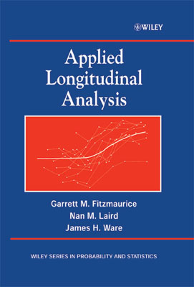
Background literature
Fitzmaurice, Laird & Ware (2004). Applied Longitudinal Analysis. John Wiley and Sons.
Clear and accessible treatment of repeated measures data. Detailed examples and calculations in each chapter.
Extensions include discussions on missing data, growth curve modelling, and generalized linear mixed models
Highly recommended!

Slide 5
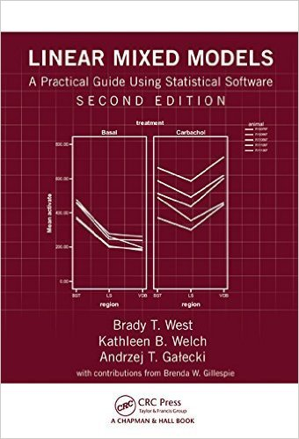
Background literature
West, Welch & Galecki (2014). Linear Mixed Models: A Practical Guide Using Statistical Software. Chapman and Hall.
Practical treatment of numerous datasets, with extensive discussion of modelling and potential complications
Full code in SPSS, SAS, and R for all data problems in the book!

Slide 6
R statistical software
For this workshop I will use the R statistical software. The software and all its packages are free to download: https://www.r-project.org/
Workshop requires the packages "lme4", "lmerTest", "nlme", and "blme"
Benefits of using R:
Very fast and flexible. If you like syntax in SPSS, consider the jump to R!
Superior graphics and plotting facilities
You will acquire a better understanding of statistical methods and what you are doing
You will accidentally learn basic programming along the way
I usually don’t recommend user guides. Simply start by copying the code that you need from other people/google and learn by imitation first. Later

Slide 7
1. Standard Linear Model

Slide 8
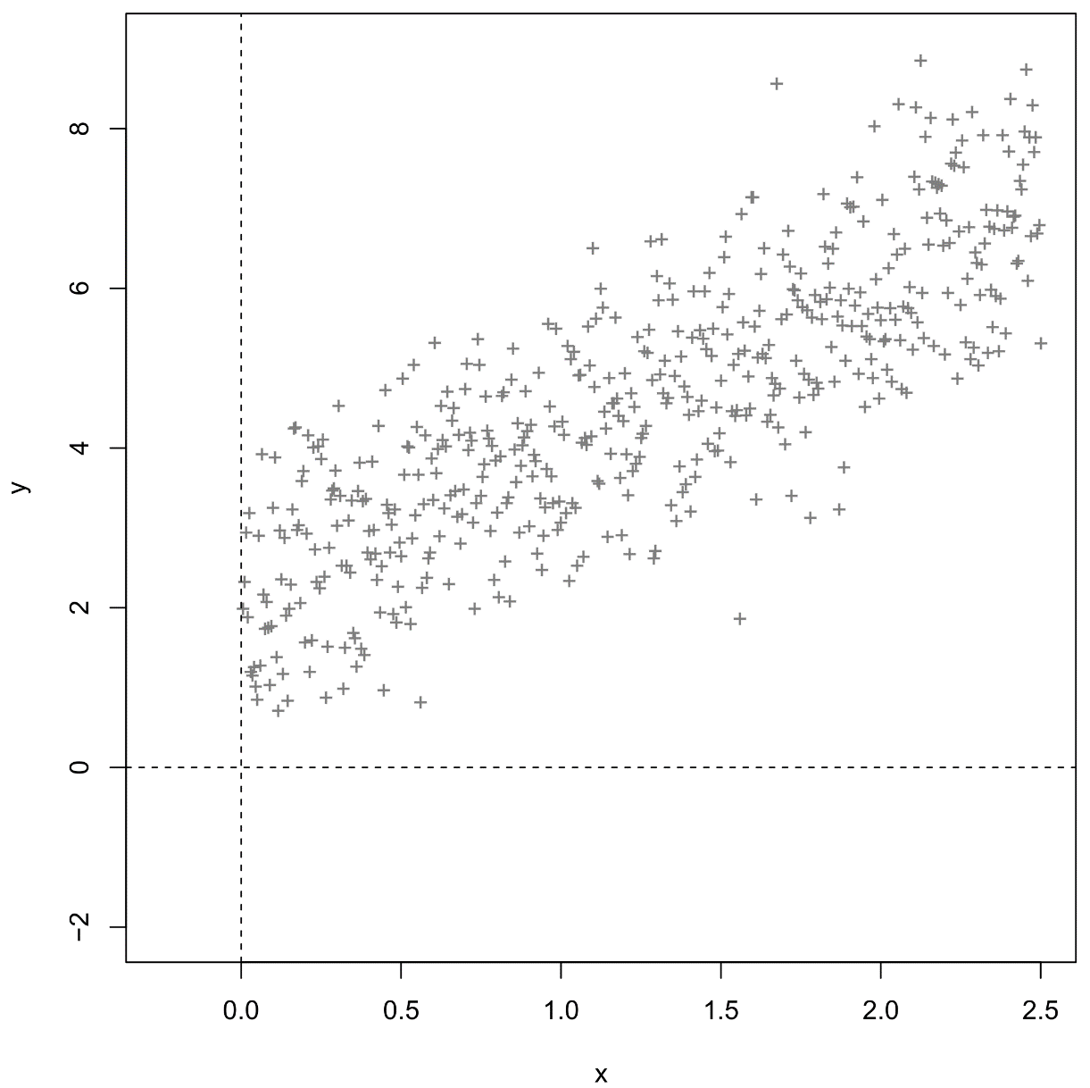
1.1 One-way regression
Continuous dependent Y
Continuous independent X

Slide 9
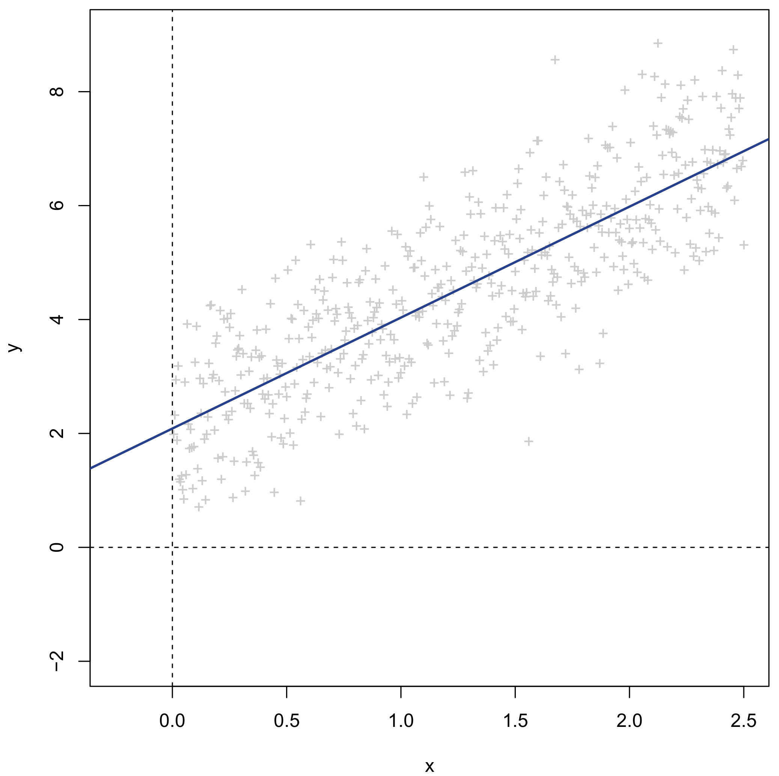
1.1 One-way regression
Linear regression of Y on X
= Linear approximation of Y using X

Slide 10
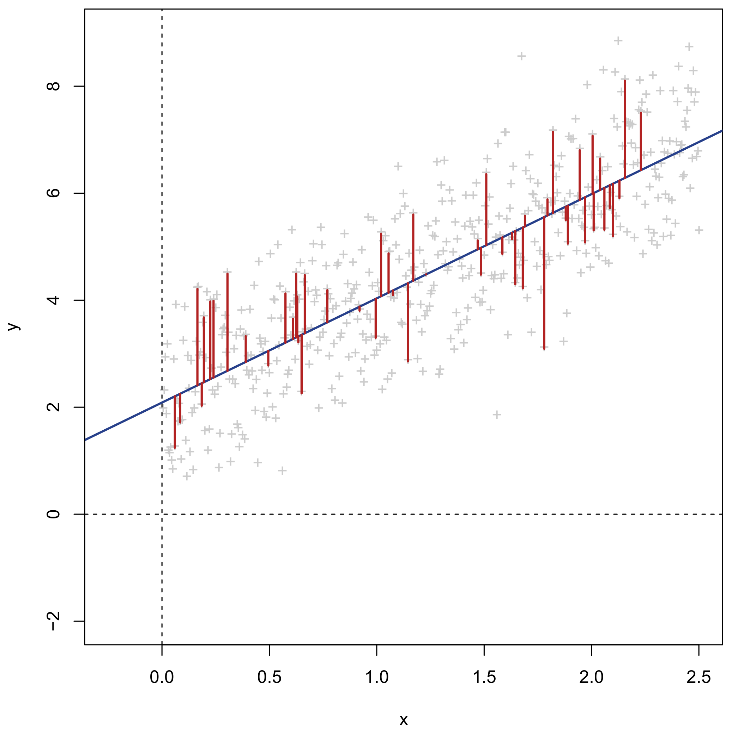
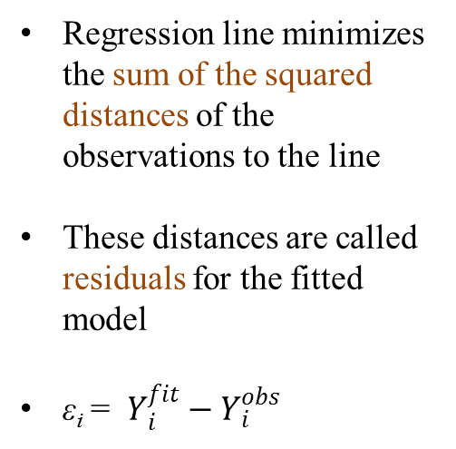
1.1 One-way regression

Slide 11
1.1 One-way regression
Y_{i} = β₀ + β₁X_{i} + ε_{i}
ε_{i} ~ N(0,σ²)
cor(ε_{i},ε_{j}) = 0
Residuals are assumed to be independently and normally distributed with constant variance σ² = Gauss-Markov assumptions
β₁ slope
β₀ intercept

Slide 12
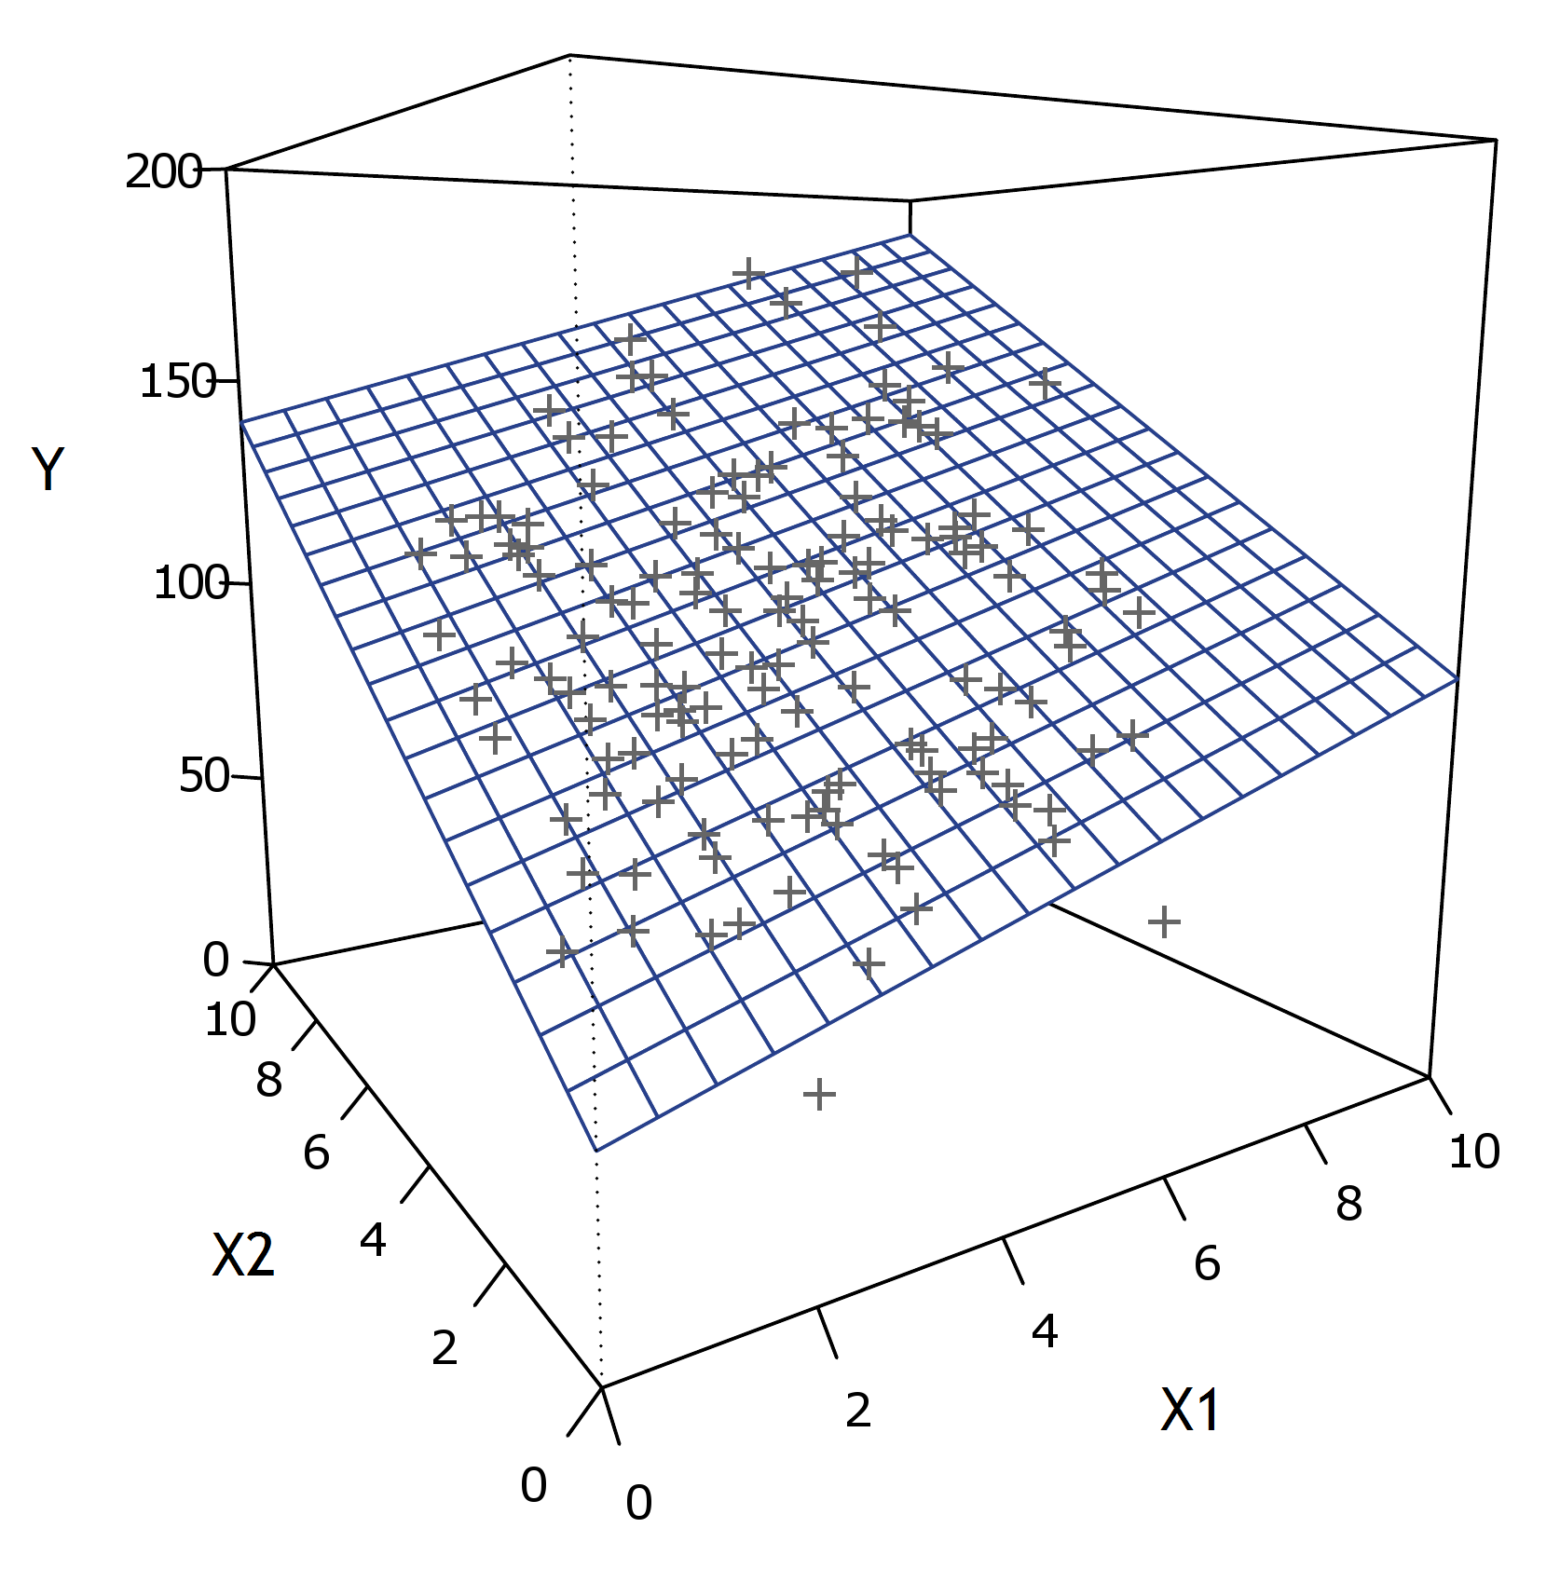
1.2 Multiple regression
Y_{i} = β₀ + β₁X_{i1} + … + β_{p}X_{ip} + ε_{i} ε_{i} ~ N(0,σ²), cor(ε_{i},ε_{j}) = 0

Slide 13
1.2 Multiple regression
Y_{i} = β₀ + β₁X_{i1} + … + β_{p}X_{ip} + ε ε_{i} ~ N(0,σ²), cor(ε_{i},ε_{j}) = 0

Slide 14
And remember…
The following analyses are merely special cases of the standard linear regression model:
One-way regression | One continuous independent
Multiple regression | Multiple continuous independent
T-test | One categorical independent (2 levels)
One-way ANOVA | One categorical independent (>2 levels)
Multi-way ANOVA | Multiple categorical independents
ANCOVA | Both categorical and continues independents
Correlation | One continuous independent. Dependent and independent standardized.

Slide 15

1.2 Multiple regression
lm(formula = Santa_Claus ~ Age + Gender + Siblings + Rank + Easter_bunny, data=santa)
Coefficients:
Estimate Std. Error t value Pr(>|t|)
(Intercept) 5.487031 0.312914 17.535 < 2e-16 ***
Age -0.769430 0.029532 -26.054 < 2e-16 ***
Gendergirl 0.022870 0.145955 0.157 0.876
Siblings 0.002239 0.073478 0.030 0.976
Rank 0.069784 0.130941 0.533 0.594
Easter_bunny 0.152862 0.030902 4.947 1.27e-06 ***
---
Signif. codes: 0 ‘***’ 0.001 ‘**’ 0.01 ‘*’ 0.05 ‘.’ 0.1 ‘ ’ 1
Residual standard error: 1.253 on 294 degrees of freedom
Multiple R-squared: 0.7667, Adjusted R-squared: 0.7627
F-statistic: 193.2 on 5 and 294 DF, p-value: < 2.2e-16
Degree of belief in Santa Claus (-4 to 4) for 300 children (ages 3–12) regressed on age, family characteristics, and belief in the Easter bunny.

Slide 16
1.3 Gauss-Markov assumptions
Variance-covariance matrix of residuals ε_{i} through ε_{N}
 | 1 | 2 | 3 | 4 | 5 | 6 | 7 | 8 | 9 | ... | N
1 | σ² | 0 | 0 | 0 | 0 | 0 | 0 | 0 | 0 | ... | 0
2 | 0 | σ² | 0 | 0 | 0 | 0 | 0 | 0 | 0 | ... | 0
3 | 0 | 0 | σ² | 0 | 0 | 0 | 0 | 0 | 0 | ... | 0
4 | 0 | 0 | 0 | σ² | 0 | 0 | 0 | 0 | 0 | ... | 0
5 | 0 | 0 | 0 | 0 | σ² | 0 | 0 | 0 | 0 | ... | 0
6 | 0 | 0 | 0 | 0 | 0 | σ² | 0 | 0 | 0 | ... | 0
7 | 0 | 0 | 0 | 0 | 0 | 0 | σ² | 0 | 0 | ... | 0
8 | 0 | 0 | 0 | 0 | 0 | 0 | 0 | σ² | 0 | ... | 0
9 | 0 | 0 | 0 | 0 | 0 | 0 | 0 | 0 | σ² | ... | 0
... | ... | ... | ... | ... | ... | ... | ... | ... | ... |  | 0
N | 0 | 0 | 0 | 0 | 0 | 0 | 0 | 0 | 0 | 0 | σ²

Slide 17
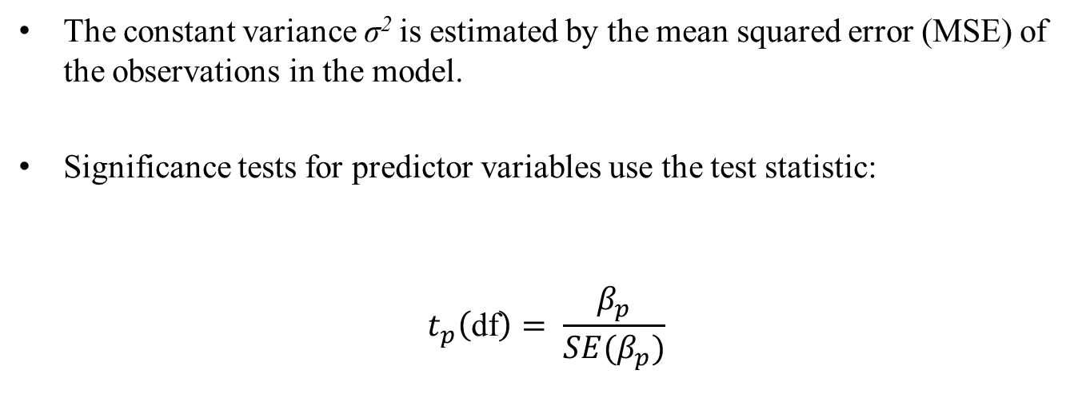
1.4 Implications of assumptions

Slide 18

1.4 Implications of assumptions
lm(formula = Santa_Claus ~ Age + Gender + Siblings + Rank + Easter_bunny, data=santa)
Coefficients:
Estimate Std.Error t value Pr(>|t|)
(Intercept) 5.487031 0.312914 17.535 < 2e-16 ***
Age -0.769430 0.029532 -26.054 < 2e-16 ***
Gendergirl 0.022870 0.145955 0.157 0.876
Siblings 0.002239 0.073478 0.030 0.976
Rank 0.069784 0.130941 0.533 0.594
Easter_bunny 0.152862 0.030902 4.947 1.27e-06 ***
---
Signif. codes: 0 ‘***’ 0.001 ‘**’ 0.01 ‘*’ 0.05 ‘.’ 0.1 ‘ ’ 1
Residual standard error: 1.253 on 294 degrees of freedom
Multiple R-squared: 0.7667, Adjusted R-squared: 0.7627
F-statistic: 193.2 on 5 and 294 DF, p-value: < 2.2e-16

Slide 19
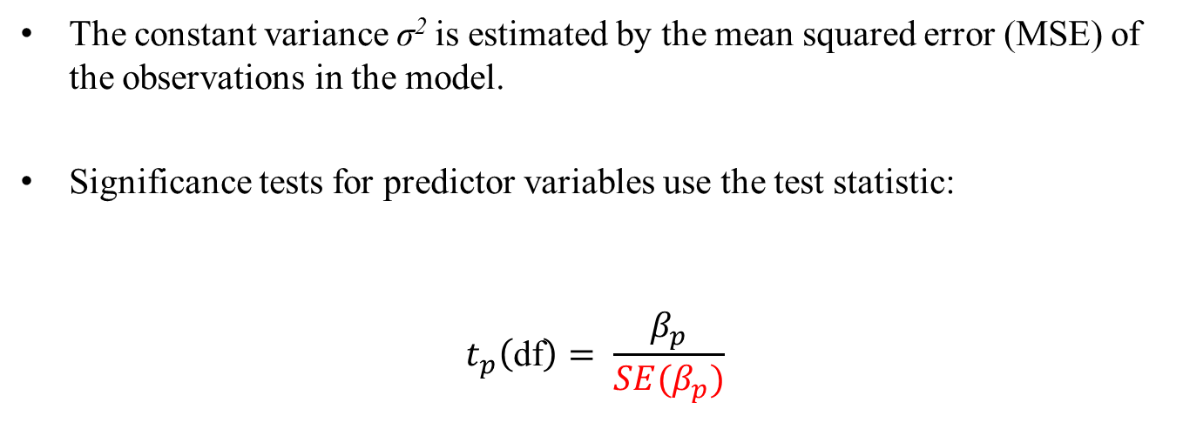
1.4 Implications of assumptions
The formula for SE(β_{p}) contains MSE. Therefore if the estimate for MSE is incorrect, the effects tests will be incorrect!

Slide 20
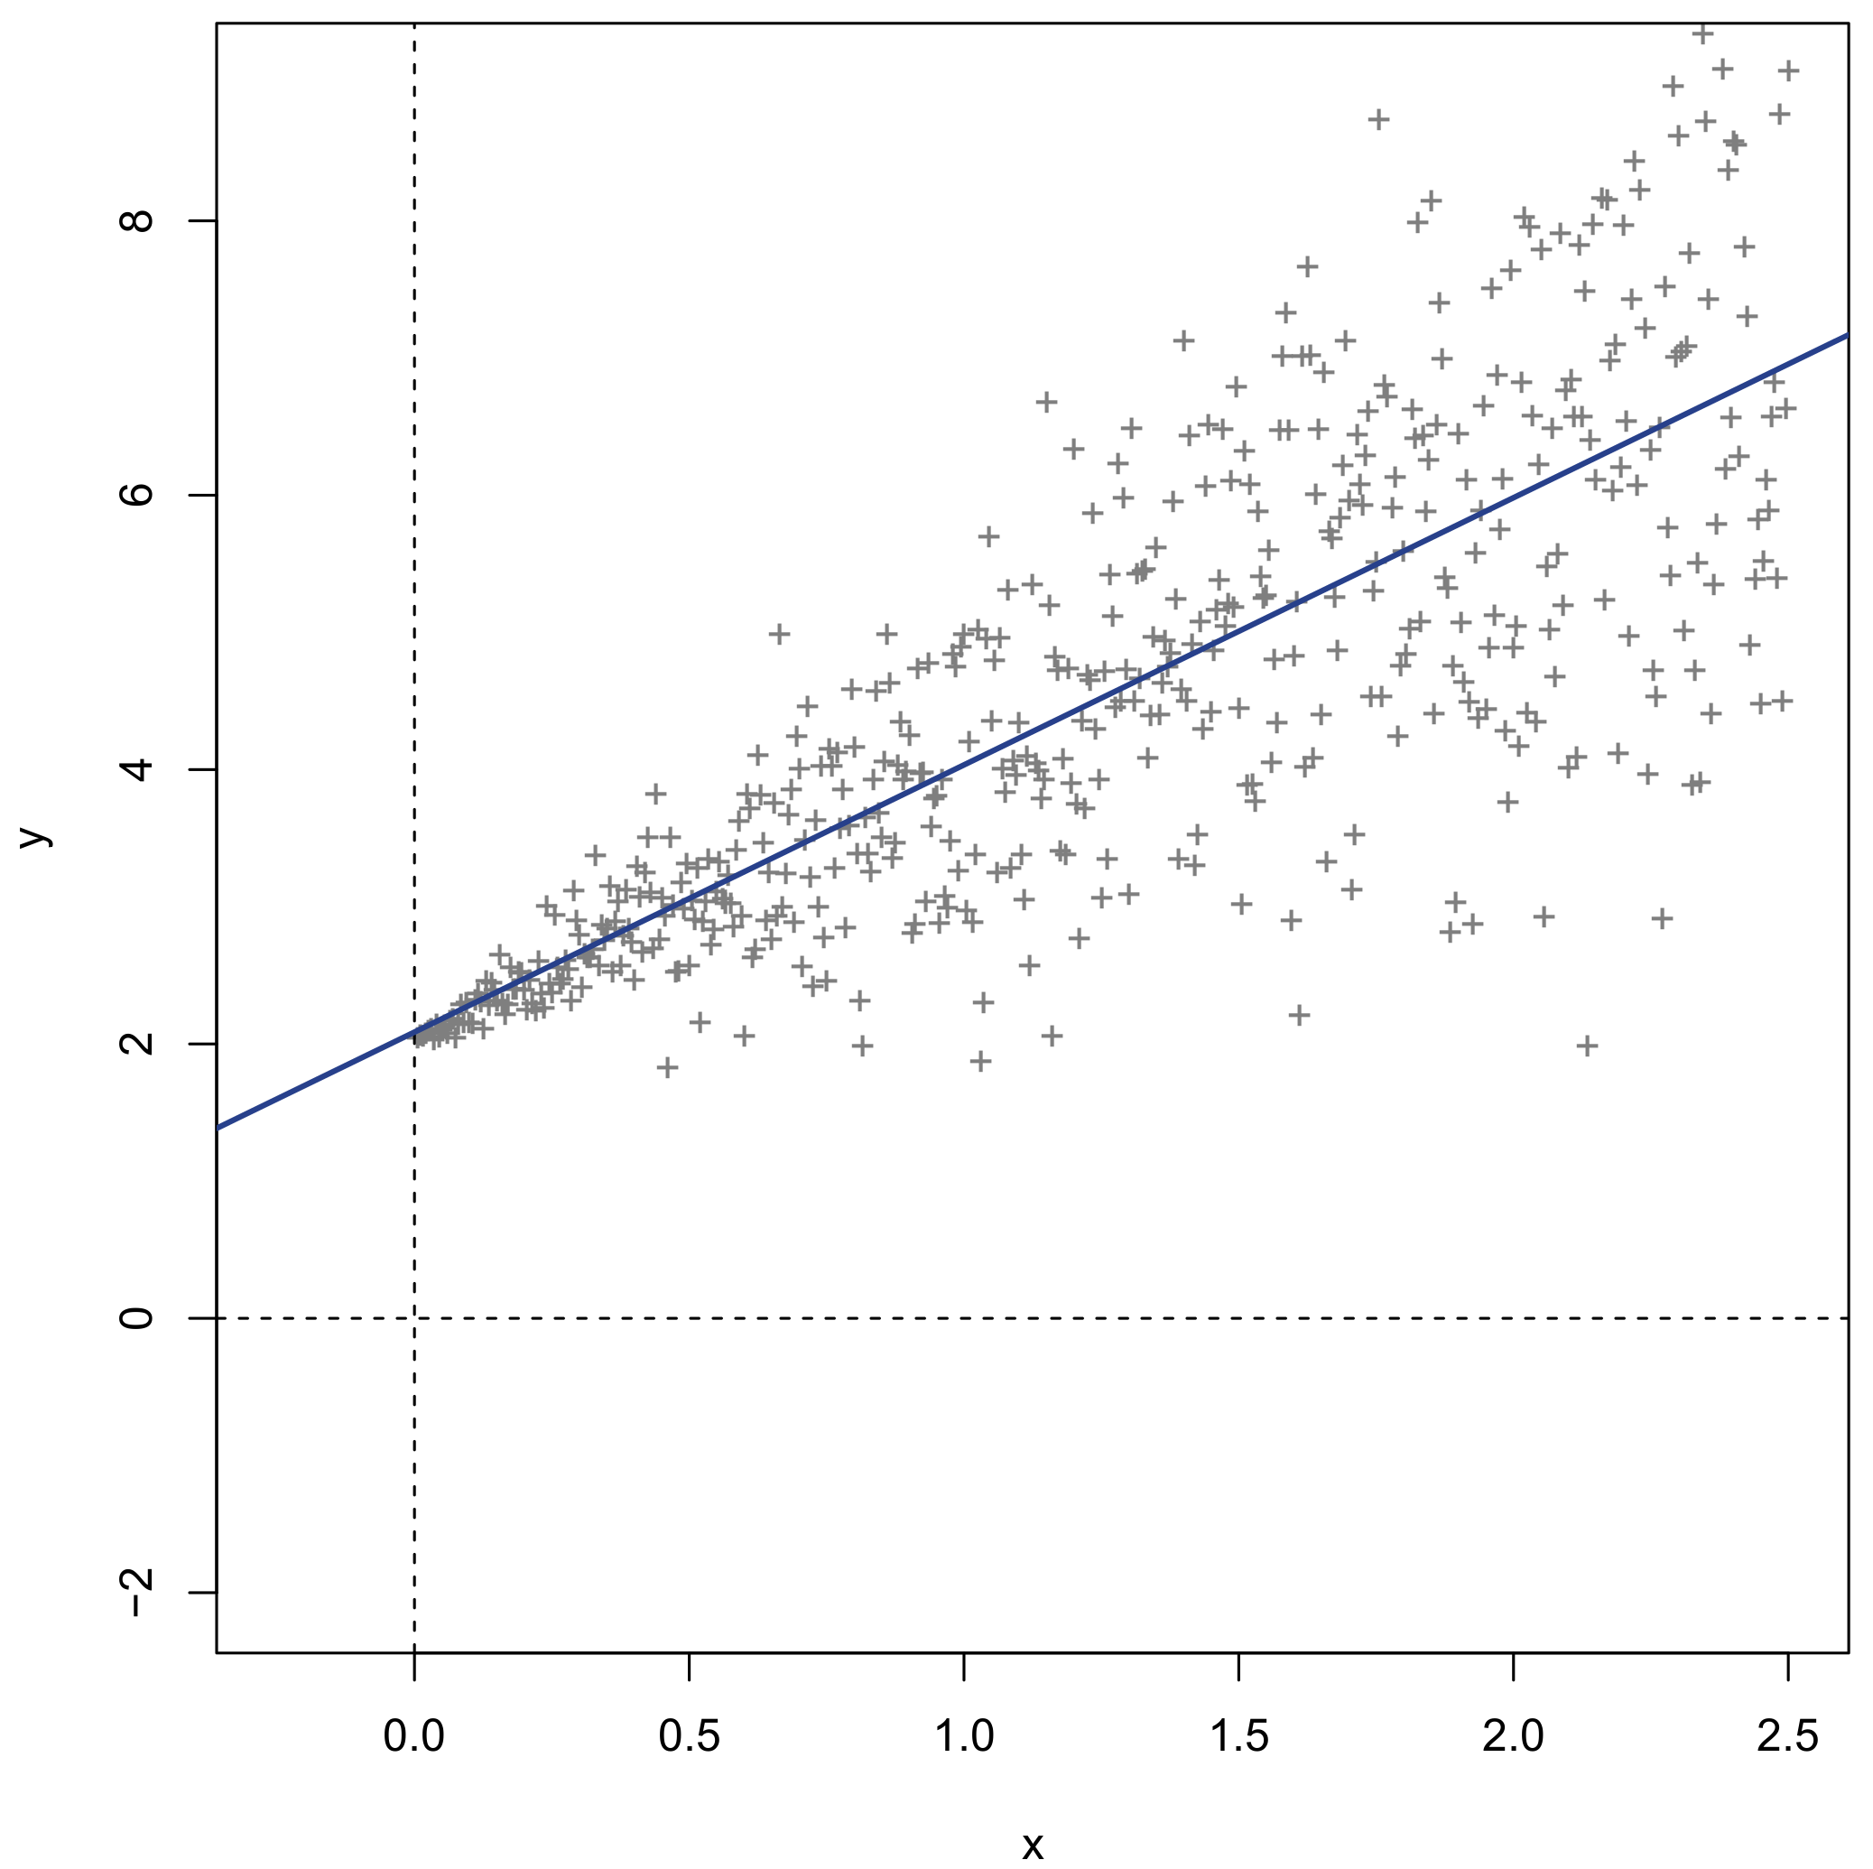
1.5 Violations of assumptions
Heteroscedasticity
Tests: Breusch-Pagan, White, Brown-Forsythe, Levene’s test, F-ratio test
Corrections: Welch correction, weighted least squares

Slide 21
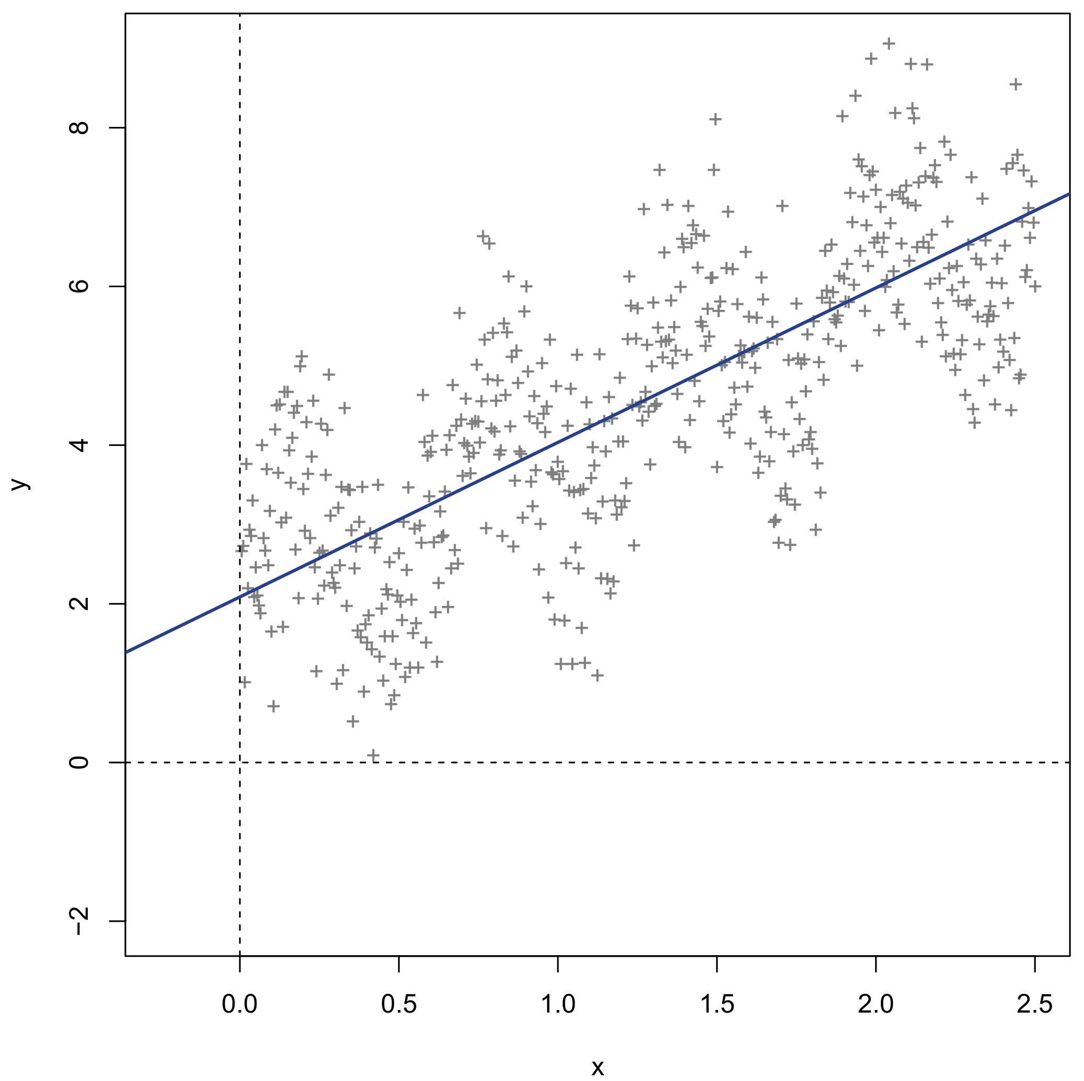
1.5 Violations of assumptions
Auto-correlation
Test: Durbin-Watson, Breusch-Godfrey
Corrections: weighted least squares

Slide 22
2. Non-independent Data

Slide 23
2.1 Non-independent data
In general, violation of variance-covariance assumptions in linear regression is brought about by non-independence of observations.
Non-independence is often a consequence of clustered data, either by design or incidental:
Repeated measurements taken from the same subject
Multiple subjects measured in the same family/region/country
Experimental subjects assigned to the same dyad
Measurements taken at consecutive time points / adjacent regions
Combinations of all of the above
…

Slide 24
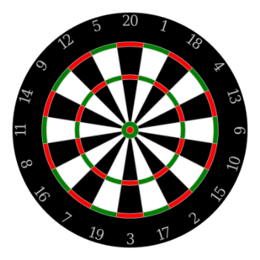
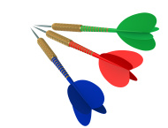
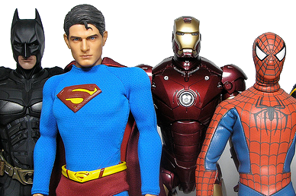
2.2 Repeated measures example
Obs. | Subject | Throw | Points
1 | Batman | T1 | 60
2 | Batman | T2 | 40
3 | Batman | T3 | 50
4 | Hulk | T1 | 1
5 | Hulk | T2 | 10
6 | Hulk | T3 | 25
7 | Spider-Man | T1 | 50
8 | Spider-Man | T2 | 15
9 | Spider-Man | T3 | 11
... | ... | ... | ...
60 | Iron Man | T3 | 19
20 super heroes play darts. Each hero gets 3 throws. 60 observations total.

Slide 25
2.3 Residuals for repeated measures
Standard variance-covariance assumptions for these residuals are not tenable:
 | 1 | 2 | 3 | 4 | 5 | 6 | 7 | 8 | 9 | ... | N
1 | σ² | 0 | 0 | 0 | 0 | 0 | 0 | 0 | 0 | ... | 0
2 | 0 | σ² | 0 | 0 | 0 | 0 | 0 | 0 | 0 | ... | 0
3 | 0 | 0 | σ² | 0 | 0 | 0 | 0 | 0 | 0 | ... | 0
4 | 0 | 0 | 0 | σ² | 0 | 0 | 0 | 0 | 0 | ... | 0
5 | 0 | 0 | 0 | 0 | σ² | 0 | 0 | 0 | 0 | ... | 0
6 | 0 | 0 | 0 | 0 | 0 | σ² | 0 | 0 | 0 | ... | 0
7 | 0 | 0 | 0 | 0 | 0 | 0 | σ² | 0 | 0 | ... | 0
8 | 0 | 0 | 0 | 0 | 0 | 0 | 0 | σ² | 0 | ... | 0
9 | 0 | 0 | 0 | 0 | 0 | 0 | 0 | 0 | σ² | ... | 0
... | ... | ... | ... | ... | ... | ... | ... | ... | ... |  | 0
N | 0 | 0 | 0 | 0 | 0 | 0 | 0 | 0 | 0 | 0 | σ²

Slide 26
2.3 Residuals for repeated measures
Every three observations belong to the same subject:
 | 1 | 2 | 3 | 4 | 5 | 6 | 7 | 8 | 9 | ... | N
1 | σ² | ? | ? | 0 | 0 | 0 | 0 | 0 | 0 | ... | 0
2 | ? | σ² | ? | 0 | 0 | 0 | 0 | 0 | 0 | ... | 0
3 | ? | ? | σ² | 0 | 0 | 0 | 0 | 0 | 0 | ... | 0
4 | 0 | 0 | 0 | σ² | ? | ? | 0 | 0 | 0 | ... | 0
5 | 0 | 0 | 0 | ? | σ² | ? | 0 | 0 | 0 | ... | 0
6 | 0 | 0 | 0 | ? | ? | σ² | 0 | 0 | 0 | ... | 0
7 | 0 | 0 | 0 | 0 | 0 | 0 | σ² | ? | ? | ... | 0
8 | 0 | 0 | 0 | 0 | 0 | 0 | ? | σ² | ? | ... | 0
9 | 0 | 0 | 0 | 0 | 0 | 0 | ? | ? | σ² | ... | ?
... | ... | ... | ... | ... | ... | ... | ... | ... | ... |  | ?
N | 0 | 0 | 0 | 0 | 0 | 0 | 0 | 0 | ? | ? | σ²

Slide 27
2.4 Repeated measures covariance
For repeated measures designs in psychology, the covariance matrix of the repeated measurements is often called the within-subjects covariance matrix.
Basic challenge of repeated measures models is to find a parametric structure for the within-subjects covariance matrix, e.g.:
 | T1 | T2 | T3
T1 | σ₁² | σ₁₂ | σ₁₃
T2 | σ₁₂ | σ₂² | σ₂₃
T3 | σ₁₃ | σ₂₃ | σ₃²
Variances
Covariances

Slide 28
3. Classic Repeated Measures Analyses
Let’s make a short detour…

Slide 29
3.1 Classic repeated measures analyses
Two classical methods for analyzing repeated measures data are repeated measures ANOVA and repeated measures MANOVA.
A special case of these methods is the paired t-test (one within-factor, 2 levels), which is the most basic type of repeated measures analysis.
The ANOVA and MANOVA each make a different assumption about the within-subjects covariance matrix. However, these details are largely obscured by the software routines (e.g., SPSS) and not familiar to users.
Let’s take a closer look at our darts-playing super heroes again…

Slide 30
3.2 Long and wide format data
Obs. | Subject | Throw | Points
1 | Batman | T1 | 60
2 | Batman | T2 | 40
3 | Batman | T3 | 50
4 | Hulk | T1 | 1
5 | Hulk | T2 | 10
6 | Hulk | T3 | 25
7 | Spider-Man | T1 | 50
8 | Spider-Man | T2 | 15
9 | Spider-Man | T3 | 11
... | ... | ... | ...
60 | Iron Man | T3 | 19
Obs. | Subject | T1 | T2 | T3
1 | Batman | 60 | 40 | 50
2 | The Hulk | 1 | 10 | 25
3 | Spider-Man | 50 | 15 | 11
... | ... | ... | ...
20 | Iron Man | 5 | 12 | 19
Wide format data
Long format data

Slide 31
3.2 Long and wide format data
Long format data:
Each row of the data matrix corresponds to only one repeated measurement for one subject of the dependent variable
One column corresponds to all measurements of the dependent
The independent variable is listed explicitly as a leveled factor
Format is analogous to that for univariate regression
Wide format data:
Each row of the data matrix corresponds to all repeated measurements for one subject of the dependent variable
Multiple columns correspond to the measurements of the dependent
The independent variable is not listed explicitly
Format is analogous to that for multivariate regression
Wide format data are the default format for conducting repeated measures (M)ANOVA. As part of the analysis the user must manually specify the independent and its properties.

Slide 32
3.2 Wide format data
Obs. | Subject | T1 | T2 | T3
1 | Batman | 60 | 40 | 50
2 | Hulk | 1 | 10 | 25
3 | Spider-Man | 50 | 15 | 11
4 | Superman | 60 | 60 | 60
5 | Hawkeye | 50 | 36 | 25
6 | Ant-Man | 17 | 6 | 18
7 | Wonder Woman | 36 | 3 | 8
8 | Black Widow | 12 | 24 | 15
9 | Captain America | 11 | 5 | 13
10 | Thor | 9 | 45 | 15
11 | Wolverine | 25 | 50 | 18
12 | Storm | 20 | 14 | 25
13 | Rogue | 8 | 7 | 30
14 | Professor X | 0 | 3 | 0
15 | Punisher | 8 | 40 | 36
16 | Dr Manhattan | 50 | 50 | 50
17 | Rorschach | 3 | 2 | 17
18 | Flash | 9 | 26 | 4
19 | Daredevil | 10 | 50 | 18
20 | Iron Man | 5 | 12 | 19
Covariance matrix of the repeated measures within subjects
 | T1 | T2 | T3
T1 | σ₁² | σ₁₂ | σ₁₃
T2 | σ₁₂ | σ₂² | σ₂₃
T3 | σ₁₃ | σ₂₃ | σ₃²

Slide 33
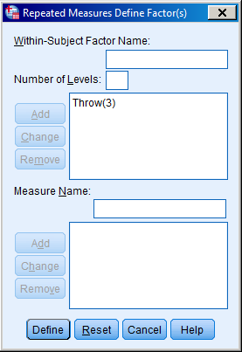
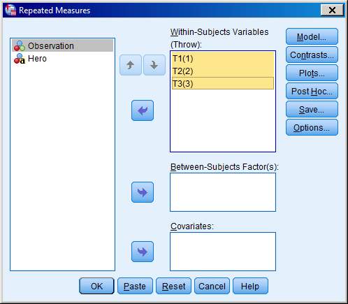
3.3 Repeated measures (M)ANOVA
Specifying the within-variable in SPSS.

Slide 34
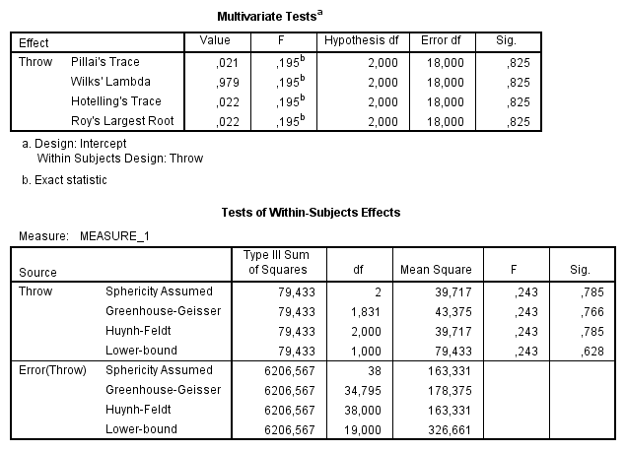
3.3 Repeated measures (M)ANOVA
rm-MANOVA
rm-ANOVA
No significant differences in scored points between darts throws.

Slide 35
3.4 Covariance assumptions
rm-MANOVA
rm-ANOVA
σ₁² | σ₁₂ | σ₁₃
σ₁₂ | σ₂² | σ₂₃
σ₁₃ | σ₂₃ | σ₃²
σ² | σ₁ | σ₁
σ₁ | σ² | σ₁
σ₁ | σ₁ | σ²
Unstructured
sum(K:1) parameters
Sphericity / Compound symmetry
2 parameters
No constraints on individual variances and covariances (≈ sample covariance estimates)
Never incorrect
Parameter number increases exponentially
Overparametrized for many covariance matrices
Weakens power of statistical tests
Variances constrained to be equal
Covariances constrained to be equal
Very sparse
More powerful effects tests if it holds
Needs to be validated with a test (sphericity)
Rarely holds for large covariance matrices

Slide 36
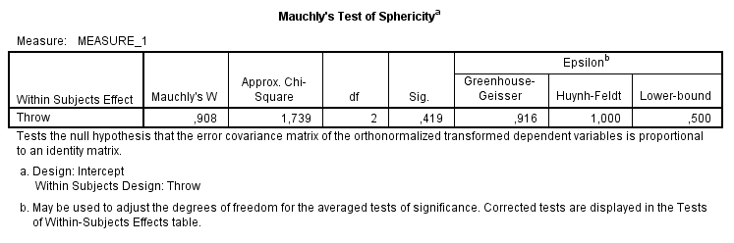
3.5 Sphericity / Compound symmetry
Mauchly’s test of sphericity tests whether the within-subject covariance matrix has a sphericity structure. Since sphericity = the null hypothesis, we want this test to be non-significant.
The degree of departure from sphericity is measured by epsilon. The closer epsilon to its lower bound, the more severe the departure from sphericity.

Slide 37
3.5 Sphericity / Compound symmetry
If Mauchly’s test of sphericity test is:
Non-significant: This means sphericity holds for the within-subjects covariance (or at least cannot be rejected). In this case, uncorrected repeated measures ANOVA tests can be reported. These tests can have a lot more power than repeated measures MANOVA.
Significant: This means sphericity has to be rejected for the within-subjects covariance. In this case, you should never report uncorrected tests for the repeated measures ANOVA! Either you report the repeated measures MANOVA results, or you report Greenhouse-Geisser corrected ANOVA tests.
In practice, the utility of Mauchly’s test of sphericity is somewhat dubious. The test tends to be unreliable for small samples and overpowered for large samples…
Note that, for within-subjects variables with only 2 levels, sphericity holds by definition! Mauchly’s test is redundant in this case. Repeated measures ANOVA and MANOVA will return identical effects tests for 2-level within-variables.

Slide 38
3.6 Problems with classic covariance structures
Repeated measures ANOVA and MANOVA each make different assumptions on the within-subjects covariance matrix. For many data, neither approach is satisfactory:
The rm-ANOVA structure is often overly simplistic: 2 parameters no matter the size of the covariance matrix! Most repeated data tend to have more complex correlation patterns than this.
The rm-MANOVA structure is often overly parametrized: exponential growth of parameters with covariance matrix size. Most repeated data tend to be more structured than this.
Can we not find an optimal structure in between these two extremes…?

Slide 39
4. Marginal linear mixed model
Our short detour continues…

Slide 40
4.1 Marginal linear mixed model
A marginal linear mixed model is contrasted to a hierarchical linear mixed model. Both of these models attempt to model the covariance pattern of the repeated measurements (e.g., within subjects).
The marginal model directly specifies a parametric structure for the covariance pattern (e.g., spherical, unstructured, auto-regressive).
The hierarchical model implicitly models the covariance pattern, with the introduction of random effects (see later).¹
¹Additional covariance patterns can still be specified explicitly (if need be) but this is typically optional.

Slide 41
4.2 Repeated measures covariance structures
σ² | 0 | 0
0 | σ² | 0
0 | 0 | σ²
σ² | σ₁ | σ₁
σ₁ | σ² | σ₁
σ₁ | σ₁ | σ²
ρσ² | ρ | ρ²
ρ | ρσ² | ρ
ρ² | ρ | ρσ²
Independence 1 parameter
Compound symmetry 2 parameters
First-order auto-regressive 2 parameters
σ² | σ₁ | σ₂
σ₁ | σ² | σ₁
σ₂ | σ₁ | σ²
λ₁² + d₁ | λ₁λ₂ | λ₁λ₃
λ₁λ₂ | λ₂² + d₂ | λ₂λ₃
λ₁λ₃ | λ₂λ₃ | λ₃²+ d₃
σ₁² | σ₁₂ | σ₁₃
σ₁₂ | σ₂² | σ₂₃
σ₁₃ | σ₂₃ | σ₃²
Banded K parameters
Factor-analytic
K*d parameters
Unstructured sum(K:1) parameters

Slide 42
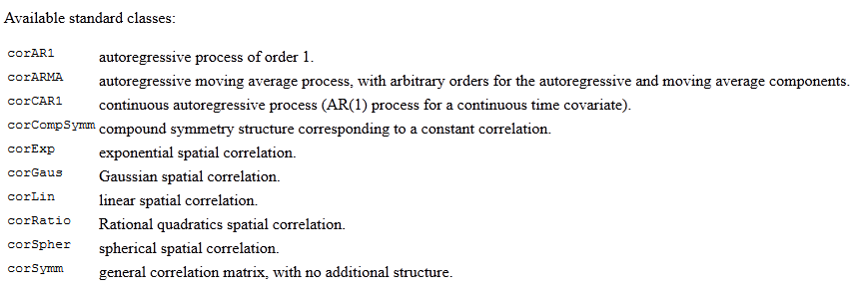
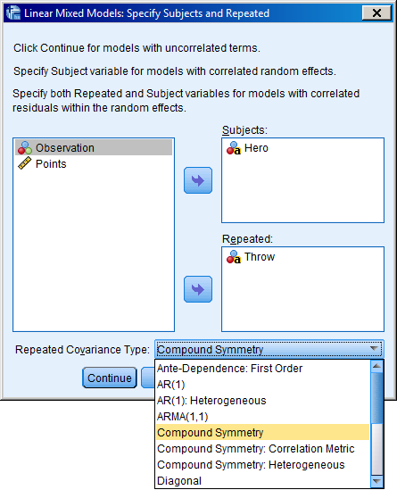
4.3 Selecting a structure
"nlme" package in R
Linear mixed models in SPSS

Slide 43
4.3 Selecting a structure
A large number of structures is available for the repeated measures covariance. Some are tailored to specific data types (e.g., time series, spatial data).
Major software packages have options for specifying the structure directly (SPSS, SAS, R) and for comparing their goodness-of-fit. Some software even allow complete freedom in which covariance parameters to constrain and which ones not (e.g., SAS).
Identifying an optimal the structure directly provides much insight into the correlation/covariance between your repeated measurements, especially if it is highly patterned.
But is it worth the trouble…?

Slide 44

4.4 The magic epsilon…
When sphericity is violated in repeated measures ANOVA, corrections can be applied to the degrees of freedom:
The less spherical the within-subjects covariance, the more the Greenhouse-Geisser correction will pull the degrees of freedom to those of the rm-MANOVA tests (unstructured model). These df can be fractional, cfr. Welch corrected t-test.

Slide 45
4.4 The magic epsilon…
Violation of sphericity can be compensated with Greenhouse-Geisser correction, without the need to specify an alternative within-subjects covariance explicitly. In that sense, GG-corrected tests offer a good black box correction that requires no further interpretation.
However, GG correction cannot compensate everything! Specific data problems may still require specific covariance pattern structures (e.g., autoregressive structures for serially correlated data).
The alternative solution is the unstructured covariance matrix supplied by rm-MANOVA. Since this structure makes no assumptions on covariance patterns (all parameters are unconstrained) it is very robust. Unfortunately, for moderate to large within-subject covariance matrices, large sample sizes may be required to ensure reliable estimation/inference.

Slide 46
5. Challenges to classic approaches
The detour ends

Slide 47
5.1 Introduction
Classic approaches such as rm-ANOVA and rm-MANOVA are well-suited to traditional within-subjects designs (factorial, balanced).
For these designs, the marginal linear mixed model affords even more detailed modeling of the within-subjects covariance.
However, detailed modelling of within-subjects covariance may not always be necessary. For large datasets the rm-MANOVA is very robust. In many other cases Greenhouse-Geisser corrected rm-ANOVA can be applied.
SPSS is very good at this type of modeling! In R this is surprisingly tricky/cumbersome to do.
Despite these advantages, classic approaches also have important limitations…

Slide 48
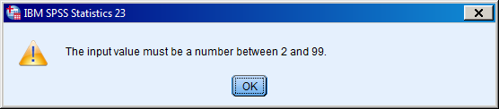
Problem case 1: More repeats than subjects
40 subjects participate in an EEG experiment. They view pleasant or unpleasant pictures (valence factor), 50 of each. EEG recordings are isolated to 2000 milliseconds after stimulus onset: 2000 recorded time points (1000 Hz sampling).
Average time series are calculated across trials, per subject per valence condition, yielding a data matrix with 40 rows and 2 × 2000 columns.
The design for a rm-(M)ANOVA suggests a valence (2) × time (2000) analysis…

Slide 49
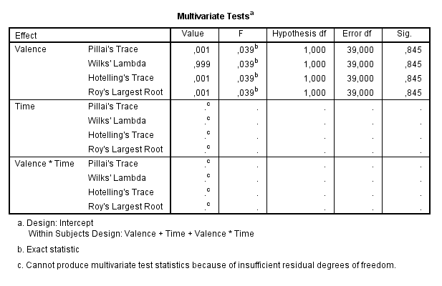
Problem case 1: More repeats than subjects
No multivariate tests for effects where the number of levels > N
No results for Mauchly’s test of sphericity
SPSS does print rm-ANOVA output (whereas R returns nothing at all)

Slide 50
Problem case 2: Partial within-designs
30 subjects participate in a clinical trial study, contrasting a new drug (A), to an existing drug (B) and to a placebo treatment (P). Each subject participates in two sessions, one placebo, and one drug (A or B) session, in random order. Effects of the treatment are measured on a physiological response (e.g., blood pressure).
Subject | Order | A_resp | B_resp | P_resp
ID02 | 0 | 1.01 | ? | 0.82
ID10 | 1 | 0.99 | ? | 0.76
ID04 | 0 | ? | 1.23 | 0.91
ID27 | 0 | 0.86 | ? | 0.83
… | … | … | … | …
ID74 | 1 | ? | 1.15 | 0.77

Slide 51
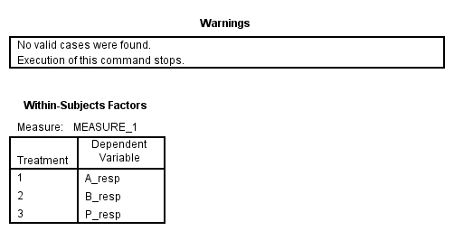
Problem case 2: Partial within-designs
Most software conducts a complete case analysis for repeated measures analyses. Every subject that has at least one missing value will be deleted entirely from the analysis model. For partial-within designs, this means everyone will end up deleted!

Slide 52
Problem case 3: Continuous within-variables
100 patients are tracked for 1 year following lung surgery. Each patient has 12 visits scheduled per year for follow-up (one per month). Respiratory capacity is measured upon visit.
Researchers attempt to schedule visits evenly spaced throughout the year, but this is not always possible. Moreover, not all patients visit the hospital on the same day, and some patients miss appointments (or drop out of the study altogether).
Notes:
<number>

Slide 53
Problem case 3: Continuous within-variables
Patients have no respiratory data for the days that other patients visited. Again, we deal with systematic missingness.
 | Day of visit
Patient | 2 | 6 | 12 | 14 | 41 | 44 | 47 | 49 | 67 | 68 | 72 | 80 | … | 366
AH | ? | ? | 0.12 | ? | ? | ? | ? | 0.14 | ? | ? | ? | 0.09 | … | ?
BM | ? | ? | ? | 0.05 | ? | 0.09 | ? | ? | 0.04 | ? | ? | ? | … | ?
KG | 0.13 | ? | ? | ? | ? | ? | 0.21 | ? | ? | ? | 0.20 | ? | … | ?
VS | ? | 0.01 | ? | ? | 0.10 | ? | ? | ? | ? | 0.11 | ? | ? | … | ?
… | … | … | … | … | … | … | … | … | … | … | … | … | … | …
EP | ? | ? | ? | ? | ? | ? | ? | ? | ? | ? | ? | ? | … | 0.02

Slide 54
Problem case 3: Continuous within-variables
We could ignore the exact timing/day of the visits and simply focus on their order. This is still not satisfying…
 | Visit number
Patient | 1 | 2 | 3 | 4 | 5 | 6 | 7 | 8 | 9 | 10 | 11 | 12
AH | 0.12 | 0.14 | 0.09 | 0.10 | 0.11 | 0.11 | 0.19 | 0.20 | 0.18 | 0.22 | 0.15 | 0.12
BM | 0.05 | 0.09 | 0.04 | 0.04 | ? | 0.01 | 0.06 | 0.10 | 0.09 | ? | 0.11 | 0.10
KG | 0.13 | 0.21 | 0.20 | 0.25 | 0.28 | ? | ? | ? | ? | ? | ? | ?
VS | 0.01 | 0.07 | 0.08 | 0.14 | 0.18 | 0.26 | 0.23 | 0.23 | 0.27 | 0.28 | 0.28 | 0.31
… | … | … | … | … | … | … | … | … | … | … | … | …
EP | ? | 0.01 | 0.10 | 0.04 | 0.11 | 0.07 | 0.08 | 0.11 | 0.11 | 0.11 | 0.19 | 0.20

Slide 55
Problem case 3: Continuous within-variables
The underlying problem is that wide format data requires/treats within-variables as categorical, with different columns corresponding to different levels of the within-variable. Implicitly, it is assumed that levels are equally spaced apart.
For the lung example, even if we observed all patients on all days, repeated measures (M)ANOVA would test whether any pair of two time points differs significantly in their observed response. This is clearly not of interest.
Time should be treated as a continuous variable. Ideally, we would like to estimate a trend over time, e.g., a regression slope that captures the improvement/decline of lung function after surgery.
Continuous within-variables cannot be integrated into classic repeated measures (M)ANOVA.

Slide 56
Problem case 4: Paired correlations
40 high school students are trained to think about mathematical problems visually. Before and after training, they submit to a visual/spatial ability test and a numerical ability test. Researchers would like to find out whether the correlation between visual and numerical ability increases due to the training.
Student | Vis_Pre | Num_Pre | Vis_Post | Num_Post
ID1 | 64 | 59 | 67 | 60
ID2 | 78 | 57 | 80 | 63
ID3 | 53 | 45 | 54 | 53
ID4 | 66 | 66 | 68 | 69
ID5 | 64 | 70 | 62 | 70
… | … | … | … | …
ID40 | 83 | 91 | 86 | 92

Slide 57
Problem case 4: Paired correlations
No obvious way to compare cor^{T1}(vis,num) with cor^{T2}(vis,num) within the classic repeated measures approach.
Paired correlation problem is actually a variation on the continuous within-variable problem. Both visual and numerical ability vary continuously within subjects.
Note that the paired correlation problem can also be analyzed with several specific tests that have been developed for this case (see "cocor" package in R).
Student | Time | Visual | Numerical
ID1 | Pre | 64 | 69
ID1 | Post | 67 | 60
ID2 | Pre | 78 | 57
ID2 | Post | 80 | 63
… | … | … | …
ID40 | Post | 86 | 92
Long format data

Slide 58
Problem case 5: Complex non-independence
Researchers conduct a longitudinal study on life-satisfaction. In 20 countries, they track 300 families each, containing between 2 to 8 people each (thousands of subjects). Data have a complex multilevel structure:
Country | Family | Subject | Time | Gender | Age | … | LS
Belgium | FBE_101 | SFBE101_02 | 02/03/1990 | M | 6.2 | … | 4.2
Belgium | FBE_101 | SFBE101_02 | 11/06/1990 | M | 6.5 | … | 3.0
Belgium | FBE_101 | SFBE101_02 | 12/10/1991 | M | 7.8 | … | 2.9
Belgium | FBE_101 | SFBE101_02 | 01/02/1992 | M | 8.1 | … | 3.1
Belgium | FBE_101 | SFBE101_02 | 22/07/1992 | M | 8.6 | … | 4.6
Iceland | FIS_009 | SFIS009_01 | 04/04/1994 | F | 25.1 | … | 0.3
Iceland | FIS_009 | SFIS009_01 | 15/06/1995 | F | 26.3 |  | 0.7
Iceland | FIS_009 | SFIS009_01 | 19/10/1998 | F | 29.8 |  | 0.5
… | … | … | … | … | … | … | …
Canada | FCA_078 | SFCA078_04 | 14/08/2001 | F | 32.4 | … | 4.5

Slide 59
Problem case 5: Complex non-independence
Multiple sources of non-independence simultaneously: time points < subjects < families < countries (4 levels!).
Hierarchical nesting of subjects within families and countries. These levels cannot be treated like a factorial design (e.g., a person cannot be observed in multiple families/countries).
Independent variables that vary at different levels of the hierarchy: time-varying (e.g., age), subject-varying (e.g., gender), family-varying (e.g., socio-economic status), and country-varying (e.g., GDP). Many of these are continuous and not categorical.
Missing values due to non-overlapping measurement times (see problem case 3), and possibly due to dropout/attrition.

Slide 60
5.3 Solution to problems?
All these problems cannot be handled by classic repeated measures approaches:
More repeates than subjects
Partial within-designs
Continuous within-variables
Paired correlation problem
Multilevel structures
…
Missing values for within-variables
Unequally spaced levels for within-variables
…
Enter the hierarchical linear model…!
A.k.a., linear mixed model, multilevel model, variance components model, random effects regression. These are all synonyms for the same conceptual model.

