Slide 1
A practical introduction to random effects models for non-independent data
Part II
Ben Meuleman
Swiss Center for Affective Sciences
January 29, 2016, Geneva

Slide 2
Contents
Theory seminar
Standard linear model
Non-independent data
Classic repeated measures analysis
Marginal mixed model
Challenges to classic approaches
Hierarchical mixed model – Basics
Hierarchical mixed model – Extensions
Hierarchical mixed model – FAQ
Practical workshop

Slide 3
6. Hierarchical linear model – Basics

Slide 4
Let us backtrack for a moment
Obs. | Subject | Throw | Points
1 | Batman | T1 | 60
2 | Batman | T2 | 40
3 | Batman | T3 | 50
4 | Hulk | T1 | 1
5 | Hulk | T2 | 10
6 | Hulk | T3 | 25
7 | Spider-Man | T1 | 50
8 | Spider-Man | T2 | 15
9 | Spider-Man | T3 | 11
... | ... | ... | ...
60 | Iron Man | T3 | 19
Obs. | Subject | T1 | T2 | T3
1 | Batman | 60 | 40 | 50
2 | Hulk | 1 | 10 | 25
3 | Spider-Man | 50 | 15 | 11
... | ... | ... | ...
20 | Iron Man | 5 | 12 | 19
Wide format data
Long format data

Slide 5
Let us backtrack for a moment
Variance-covariance matrix of residuals ε_{i} through ε_{N}
 | 1 | 2 | 3 | 4 | 5 | 6 | 7 | 8 | 9 | ... | N
1 | σ² | ? | ? | 0 | 0 | 0 | 0 | 0 | 0 | ... | 0
2 | ? | σ² | ? | 0 | 0 | 0 | 0 | 0 | 0 | ... | 0
3 | ? | ? | σ² | 0 | 0 | 0 | 0 | 0 | 0 | ... | 0
4 | 0 | 0 | 0 | σ² | ? | ? | 0 | 0 | 0 | ... | 0
5 | 0 | 0 | 0 | ? | σ² | ? | 0 | 0 | 0 | ... | 0
6 | 0 | 0 | 0 | ? | ? | σ² | 0 | 0 | 0 | ... | 0
7 | 0 | 0 | 0 | 0 | 0 | 0 | σ² | ? | ? | ... | 0
8 | 0 | 0 | 0 | 0 | 0 | 0 | ? | σ² | ? | ... | 0
9 | 0 | 0 | 0 | 0 | 0 | 0 | ? | ? | σ² | ... | ?
... | ... | ... | ... | ... | ... | ... | ... | ... | ... |  | ?
N | 0 | 0 | 0 | 0 | 0 | 0 | 0 | 0 | ? | ? | σ²

Slide 6
6.1 A different approach
So far we have discussed approaches that try to model explicitly the covariance structure of the repeated measurements. This approach is naturally compatible with the multivariate-type wide format data.
Now we return to long format data, with repeated measurements in multiple rows (stacked below each other) and only one column for the dependent. This format is analogous to that of conventional between-subjects regression.
Refocus Question
Why are repeated measurements correlated within subjects, or families, countries, etc.?

Slide 7
6.1 Covariates for modeling non-independence
20 subjects complete a lexical decision task (word or non-word?) with affective priming. The prime word can be positive or negative, and the target word can be positive or negative. Researchers measure the reaction time (RT) to make the lexical decision on each trial.
It is expected that subjects react faster if the valence of the prime and the target words match (on word trials).
However, subjects differ individually in their decision speed. Slow subjects tend to respond slowly in all conditions of the lexical task. Fast subjects tend to respond quickly in all conditions of the lexical task.
This potentially explains why repeated measurements within a subject are correlated…

Slide 8
6.1 Covariates for modeling non-independence
Subject | Speed | Prime | Target | RT
ID1 | 1.21 | Positive | Positive | 502
ID1 | 1.21 | Positive | Negative | 553
ID1 | 1.21 | Negative | Positive | 549
ID1 | 1.21 | Negative | Negative | 511
ID2 | 0.94 | Positive | Positive | 555
ID2 | 0.94 | Positive | Negative | 560
ID2 | 0.94 | Negative | Positive | 592
ID2 | 0.94 | Negative | Negative | 549
… | … | … | … | …
ID20 | 1.06 | Positive | Positive | 510
ID20 | 1.06 | Positive | Negative | 571
ID20 | 1.06 | Negative | Positive | 582
ID20 | 1.06 | Negative | Negative | 546

Slide 9
6.2 Covariates for modeling non-independence
If we had a measure of subject speed/agility available, we could add it to our regression model, as a covariate, to account for the dependence among the repeated measures, e.g.:
RT = β₀ + β₁ prime + β₂ target + β₃ (prime×target) + β₄ speed + ε
This approach is no different from how we handle the regular fixed effects in a regression model. For example, within-gender correlation of measurements can be accounted for by adding a gender effect to the model
Unfortunately, (1) we rarely have available the right individual difference measure that explains within-subject correlation, and (2) within-subjects correlation often reflects a combination of many individual difference factors.
Can we not make a black box guess…?

Slide 10
6.3 Fixed intercept – naive approach
What about simply adding "subject" as a fixed effect?
RT ~ Prime*Target + Subject
Anova Table (Type III tests)
Response: RT
Sum Sq Df F value Pr(>F)
(Intercept) 1147546 1 564.8275 < 2.2e-16 ***
Prime 48191 1 23.7196 9.233e-06 ***
Target 7928 1 3.9021 0.05307 .
Subject 225781 19 5.8490 9.987e-08 ***
Prime:Target 36680 1 18.0541 8.034e-05 ***
Residuals 115806 57
---
Signif. codes: 0 ‘***’ 0.001 ‘**’ 0.01 ‘*’ 0.05 ‘.’ 0.1 ‘ ’ 1

Slide 11
Quick recap – Categorical variables in regression
In a regression model, categorical independents are recoded into binary dummy variables, e.g., a gender factor becomes a 0/1 variable, with 0=male and 1=female.
In general, for categorical variables with K levels, K–1 dummy variables will be created. The model’s intercept codes for the remaining K^{th} level, and for that reason it is often called the reference level, e.g.:
E(Y) = β₀ + β₁ gender
Expected length for males (gender=0): β₀
Expected length for females (gender=1): β₀ + β₁
The gender coefficient β₁ therefore codes for the difference in expected length between males and females (=gender effect).

Slide 12
6.3 Fixed intercept – naive approach
Adding a subject factor to our model with, e.g., 20 subjects, will add 19 dummy variables:
E(RT) = β₀ + β₁ subject₂ + … + β₁₉subject₂₀
Each dummy coefficient codes the deviation in RT for that subject from the reference subject (here subject 1).
When we also add the prime × target effects to the model, the subject effect codes an overall RT deviation in the prime × target RT profile, from the reference subject.
In other words, the subject effect allows each subject to have their own fixed intercept.

Slide 13
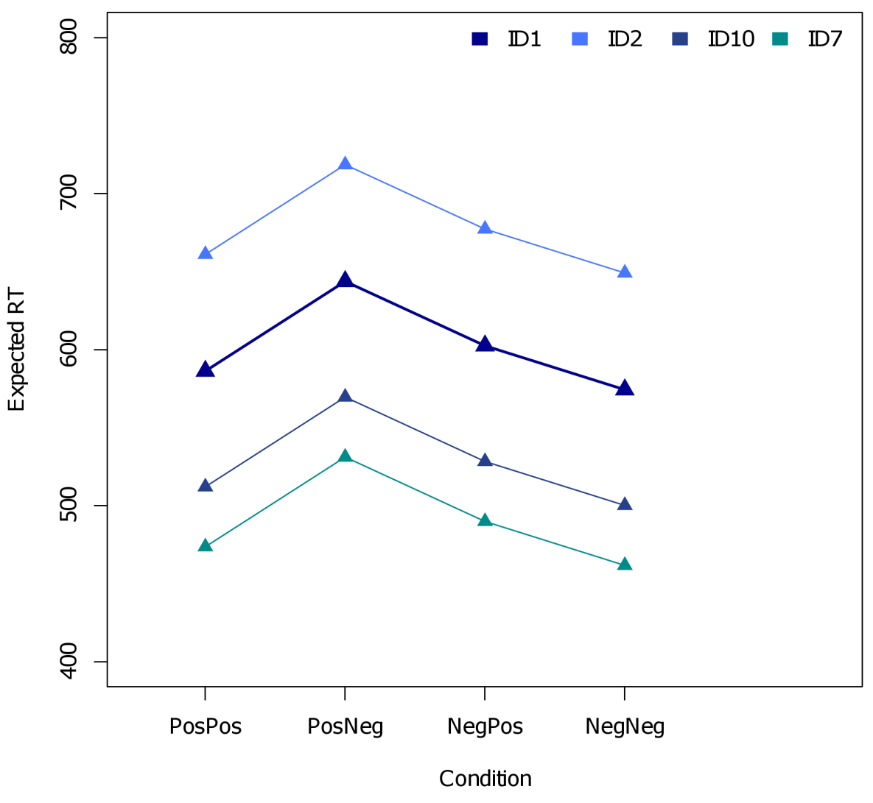
6.3 Fixed intercept – naive approach
The plot shows predicted RT profiles for a model that includes a fixed subject effect.
Subject 1 is the reference subject for the subject effect.
Subject coefficients encode the global deviation in expected RT from one subject versus subject 1.
A population profile for the expected RT in each condition is not readily available from the model
β₁
β₆

Slide 14
6.3 Fixed intercept – naive approach
Technically speaking, there is nothing wrong with the fixed intercept approach. However, there are two good reasons why this approach is actually undesirable:
Power: including a fixed subject effect to the model adds N–1 dummy variables (for N subjects). As a consequence, the degrees of freedom for any individual effects test will be greatly reduced as compared to a model without the subject dummies.
Generalization: subjects are typically a random sample from a larger population. Treating subjects as fixed, however, pretends that the sampled subjects are the population. Any statistical inference will be valid only for this particular sample of subjects. This drawback is the primary motivation for hierarchical regression with random effects…

Slide 15
6.4 Random sources of variation
Many variables influence the outcome of a study without necessarily being part of the design:
A particular group of subjects that was sampled for the study
A particular set of stimuli that was sampled for the study
Time of the day when the study took place
Day of the week when the study took place
Country, city, or even the building in which the study took place
…
The observed values/levels for such variables typically represent a random sample from a population of values/levels, e.g., there is a population of subjects, or a population of stimuli, etc.

Slide 16
6.4 Random sources of variation
All these variables contribute random variation to the outcome of the experiment, as opposed to manipulations, or background covariates, whose levels are typically fixed and therefore contribute fixed variation to the outcome.
Just as we want the results of our analysis to generalize to the population of subjects, we want to generalize to the population of stimuli, times, days, or countries.
Hierarchical regression achieves this by modelling multiple sources of random variation simultaneously, and by keeping fixed and random sources of variation separate.

Slide 17
6.5 Random intercept model^{[for subjects]}
The simplest type of hierarchical regression is the so-called random intercept model. Here, I illustrate the model for simple one-way regression:
Y_{ij} = β₀ + β₁X_{ij} + b_{i} + ε_{ij}
Y_{ij} A measured response/dependent for the i^{th} subject for the j^{th} repeat
X_{ij} A fixed predictor/independent with values for the i^{th} subject for the j^{th} repeat
β₀ The population intercept. The baseline response, across subjects, when X_{ij} = 0
β₁ The population slope. The rate of change between X and Y, across subjects
b_{i} A between-subject intercept. A constant deviation of the population intercept
for the i^{th} subject
ε_{ij} A within-subject error. A constant deviation of the population response
for the i^{th} subject for the j^{th} repeat

Slide 18
6.5 Random intercept model
Both the subject intercept and the measurement error are assumed to be random variables with mean 0 and variance, , for subjects and, , for errors. Subjects and errors are assumed to be uncorrelated, and errors are assumed to be uncorrelated.
Y_{ij} = β₀ + β₁X_{ij} + b_{i} + ε_{ij}
The expected response model for the population:
E(Y_{ij}) = β₀ + β₁X_{ij}
The expected response model for the i^{th} subject:
E(Y_{ij}|b_{i}) = (β₀ + b_{i}) + β₁X_{ij}
β₁ The population slope. The rate of change between X and Y, across subjects

Slide 19
6.6 Sleep deprivation example
50 students participate in a sleep deprivation study. The students are deprived of sleep for 10 hours, starting at 22:00. At 20 randomly selected sampling points during these 10 hours, each of the students performs an attentional task. Researchers are interested to see how attention (standardized) declines as a function of hours of sleep deprivation.
Subject | Deprivation | Attention
ID1 | 0.4 | 0.367
ID1 | 1.3 | 0.594
ID1 | 3.9 | -0.513
ID1 | 4.4 | -0.465
ID1 | 6.4 | -1.282
ID1 | 9.9 | -2.389
… | … | …
ID50 | 9.0 | -1.536

Slide 20
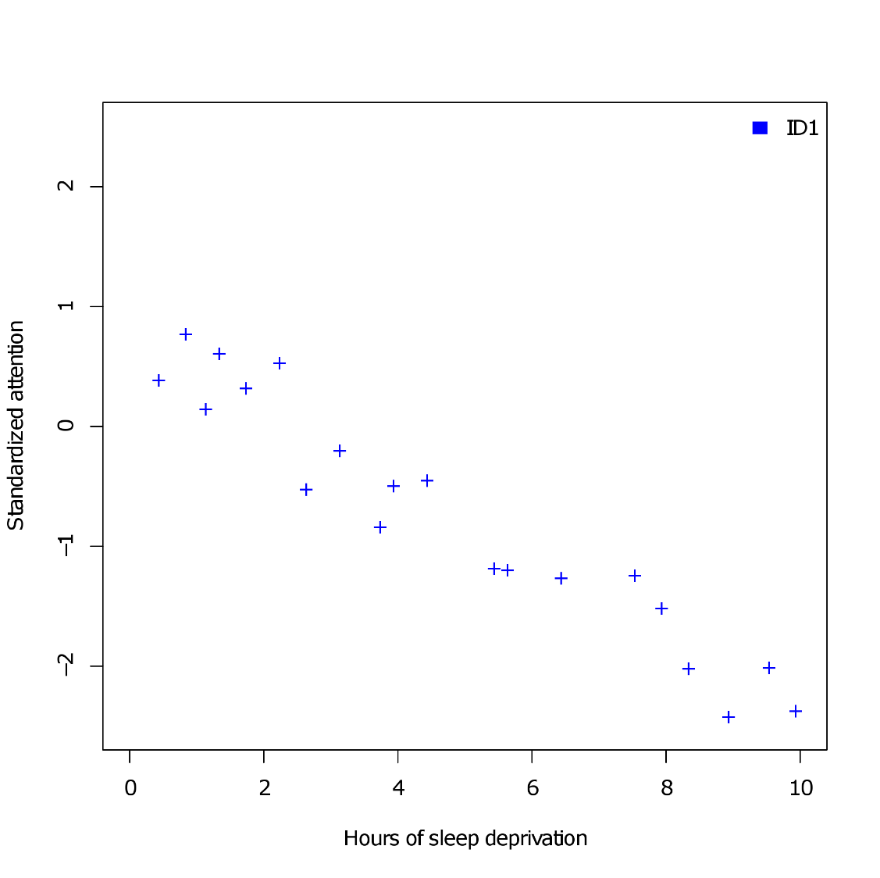
6.6 Sleep deprivation example
Observations for subject 1

Slide 21
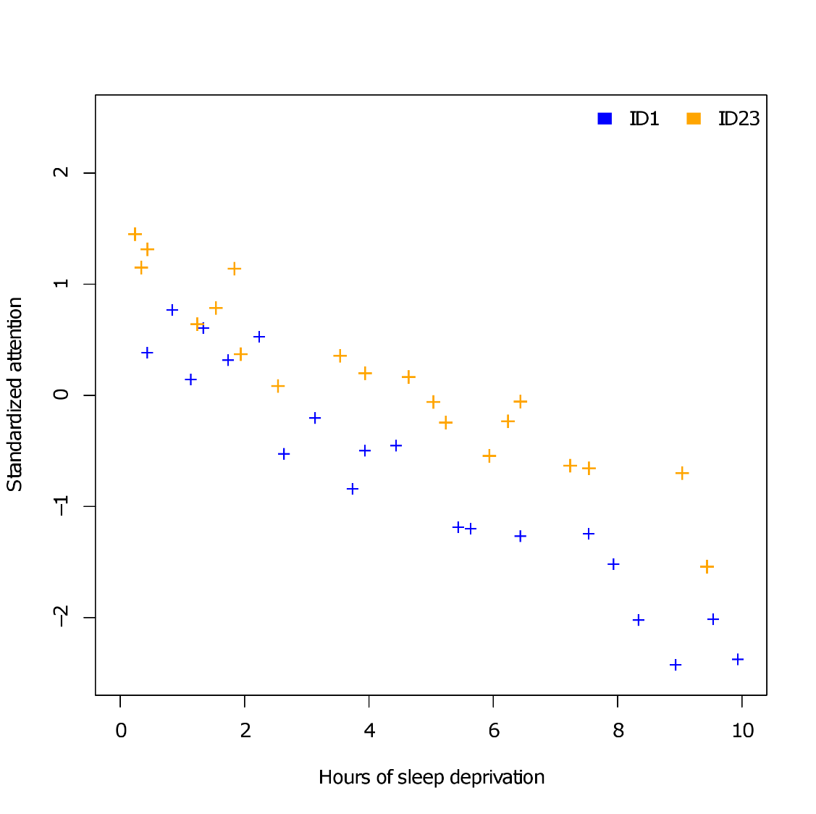
6.6 Sleep deprivation example
Observations for subject 1, and 23

Slide 22
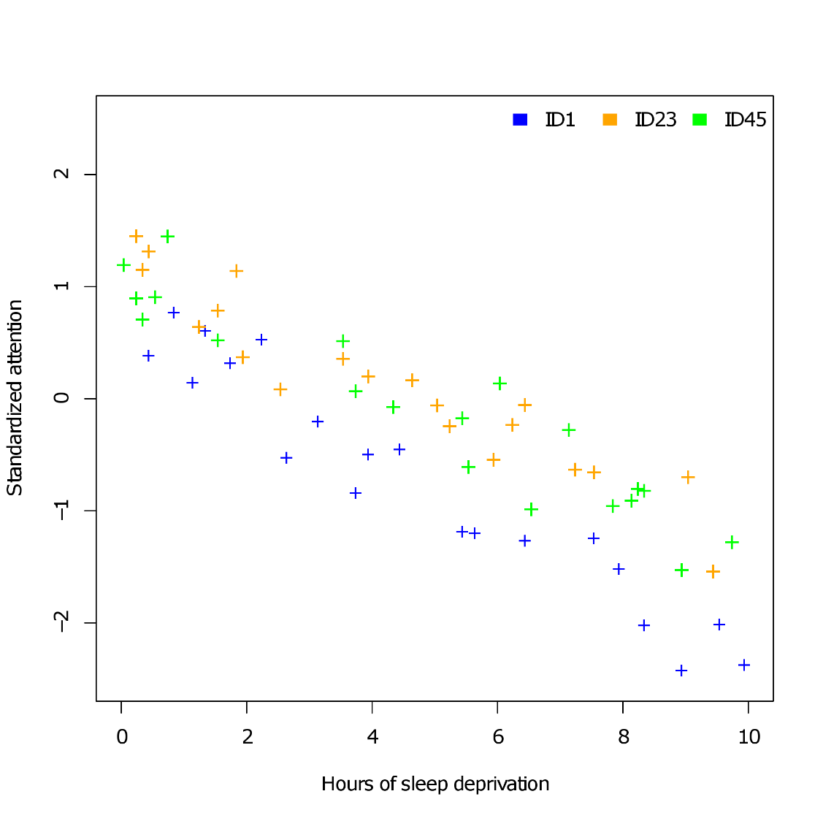
6.6 Sleep deprivation example
Observations for subject 1, 23, and 45

Slide 23
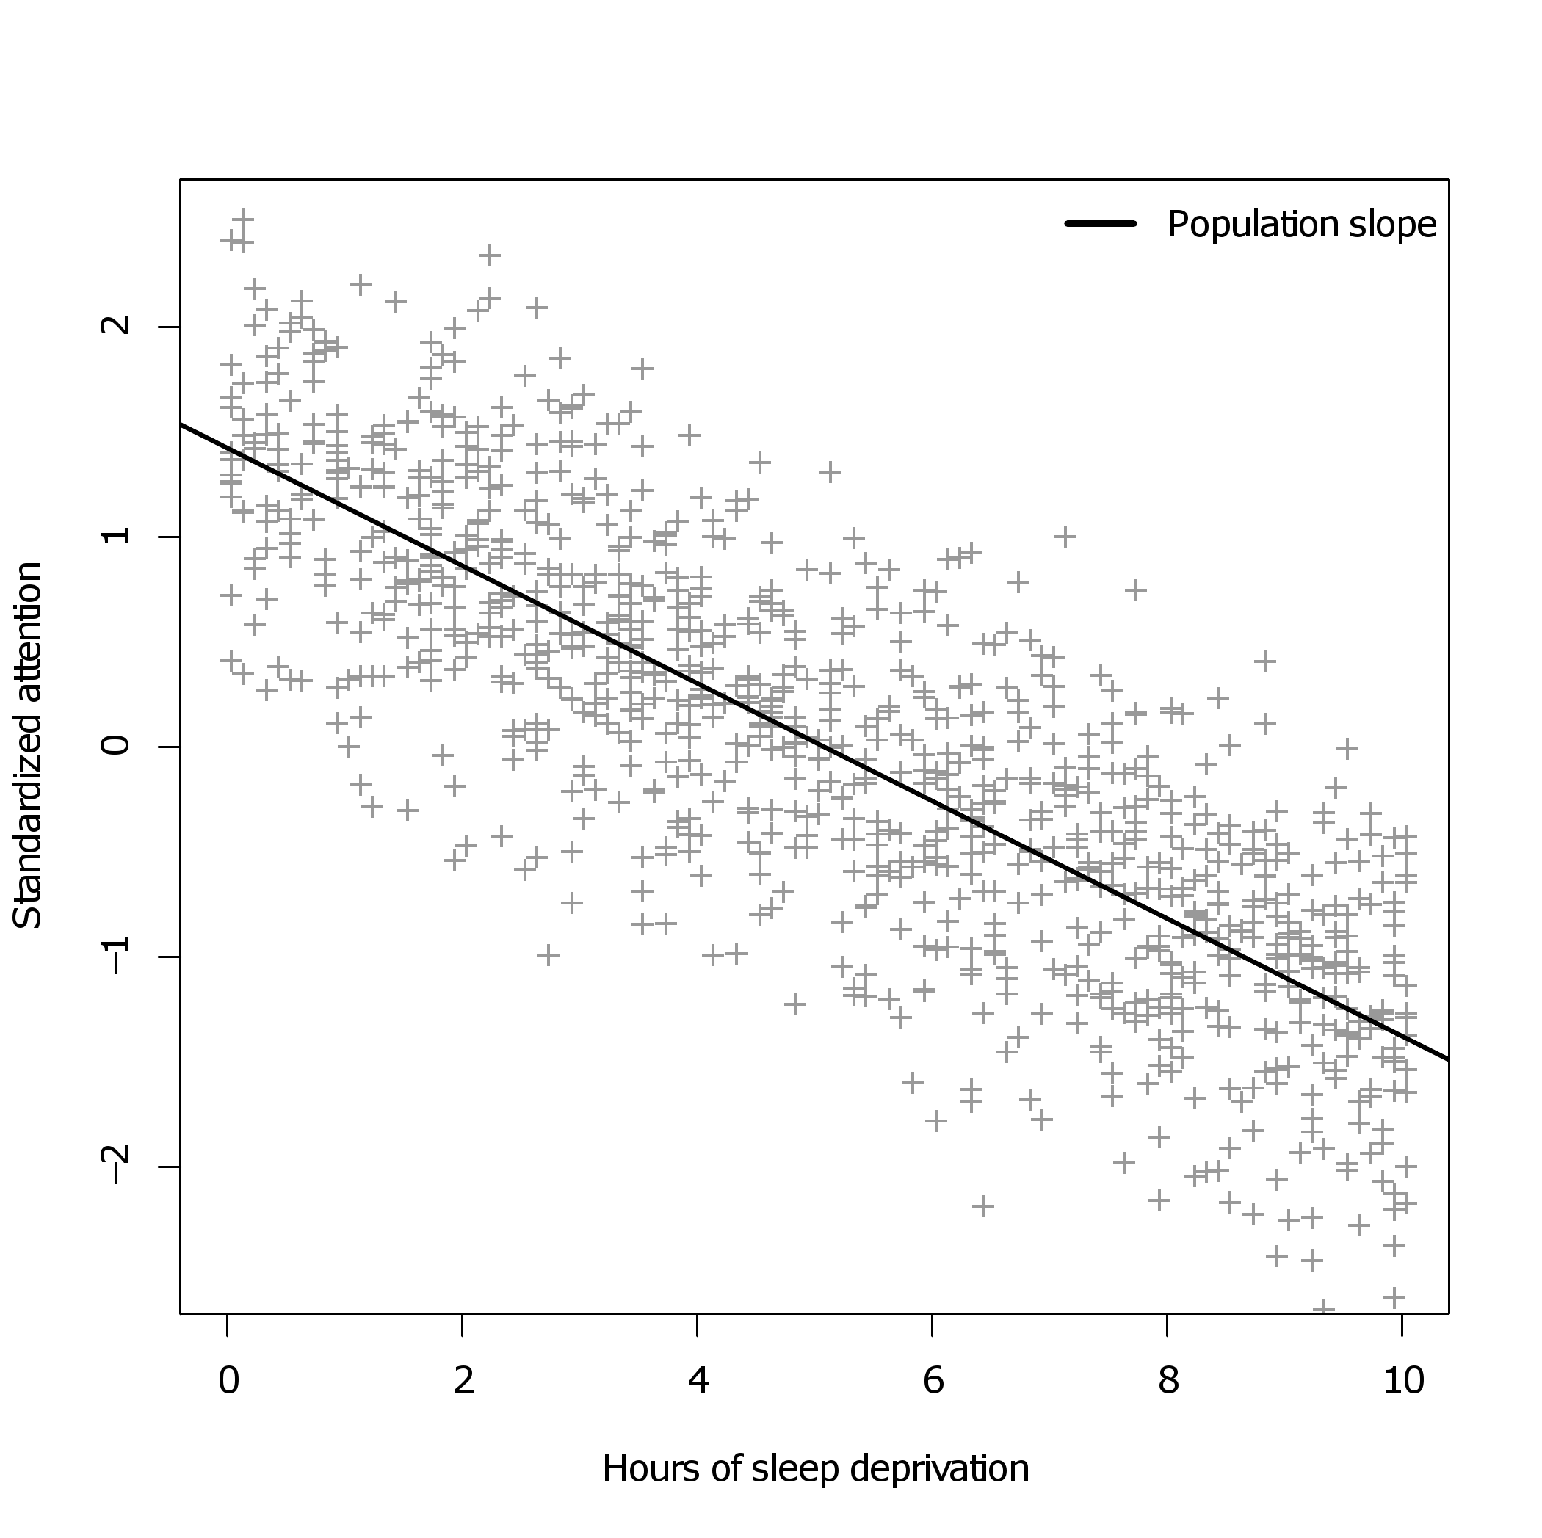
6.6 Sleep deprivation example
The population slope (across subjects):

Slide 24
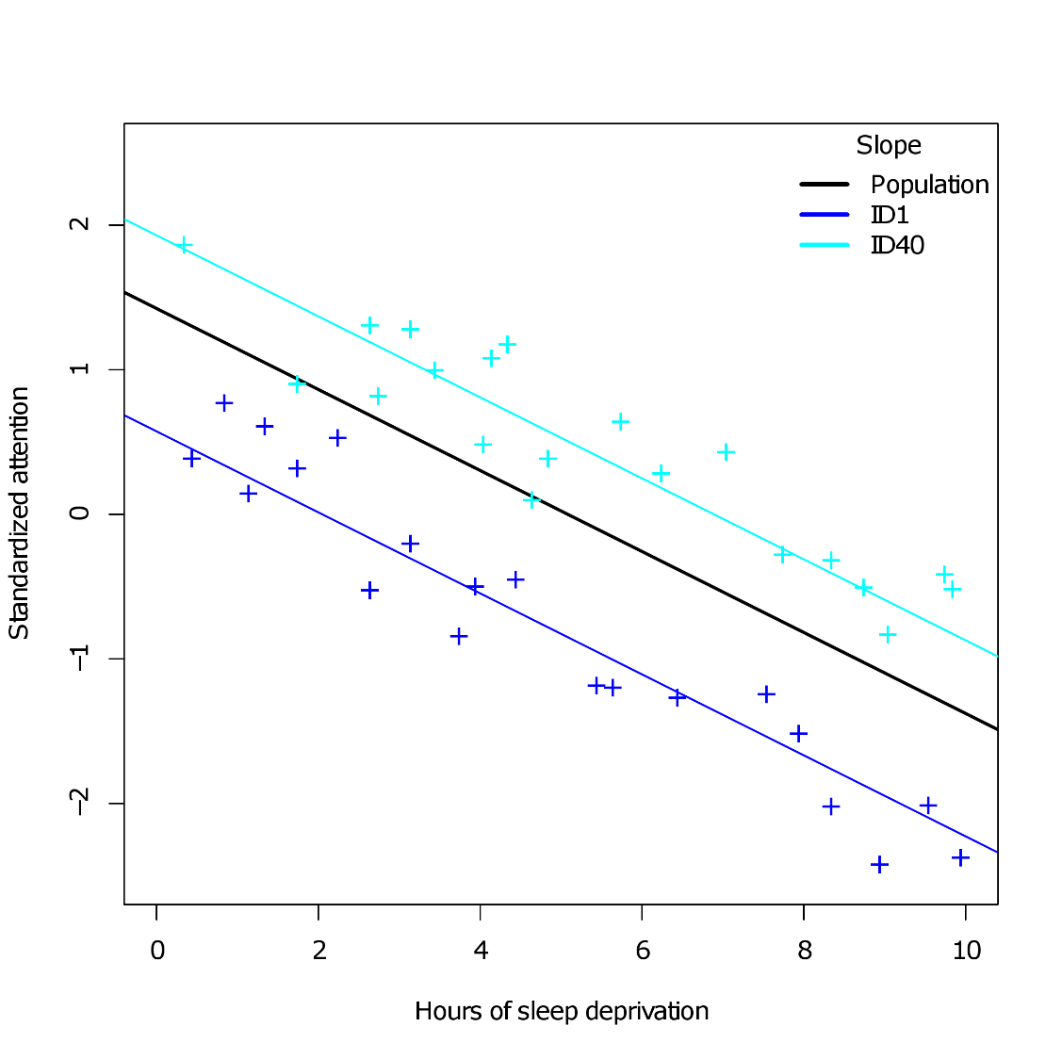
6.6 Sleep deprivation example
The random intercept HLM allows subjects to deviate from the population slope by a constant term:

Slide 25
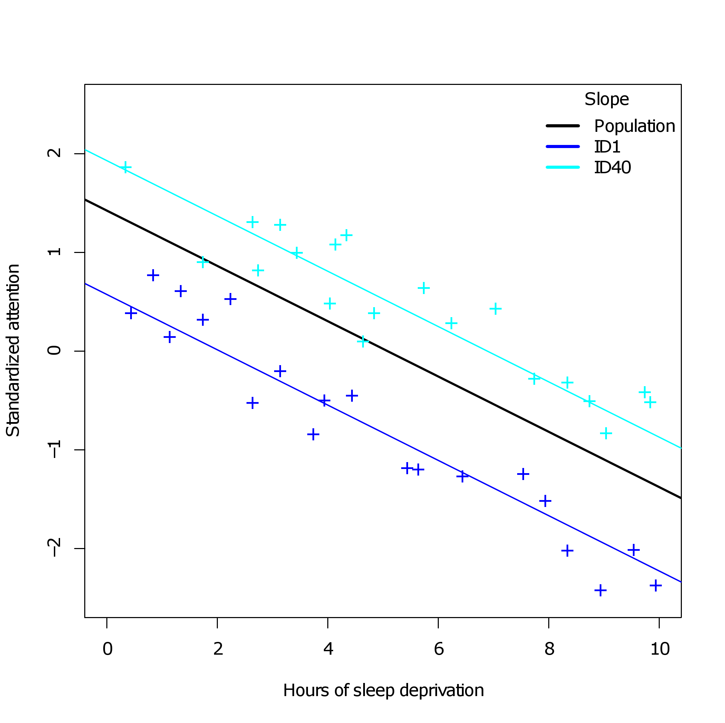


6.6 Sleep deprivation example
Error variance around the population slope is decomposed into two distinct components:
Variance due to subjects: intercepts vary randomly around the population slope
Variance due to pure measurement error: error varies randomly around subject slopes
$σ_{}^{2}$
$σ_{b}^{2}$

Slide 26
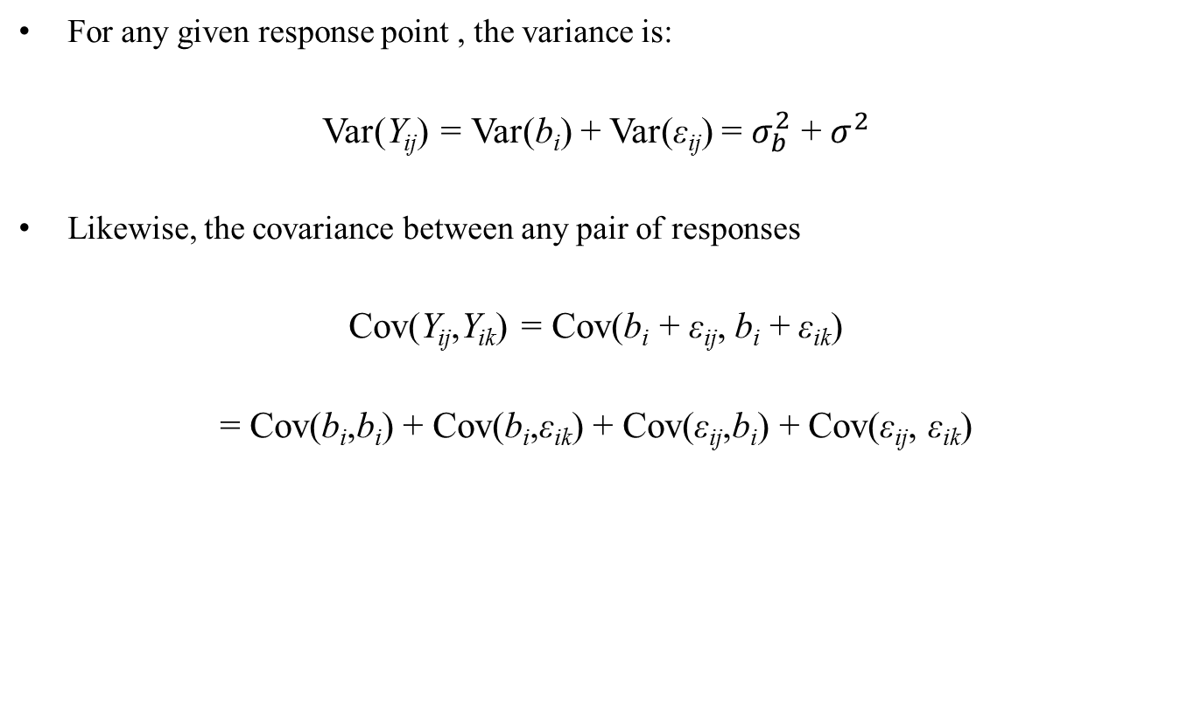
6.7 Marginal covariance

Slide 27
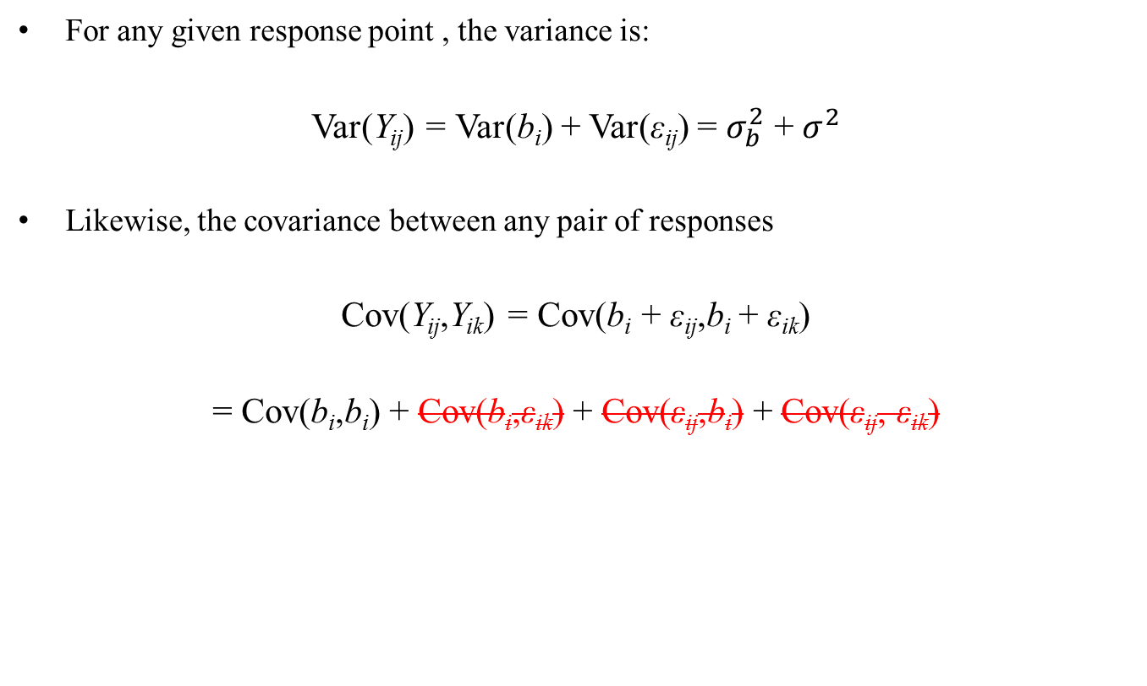
6.7 Marginal covariance
We have assumed that random intercepts and errors are uncorrelated. As per usual, we also assume that pairs of errors are uncorrelated.

Slide 28
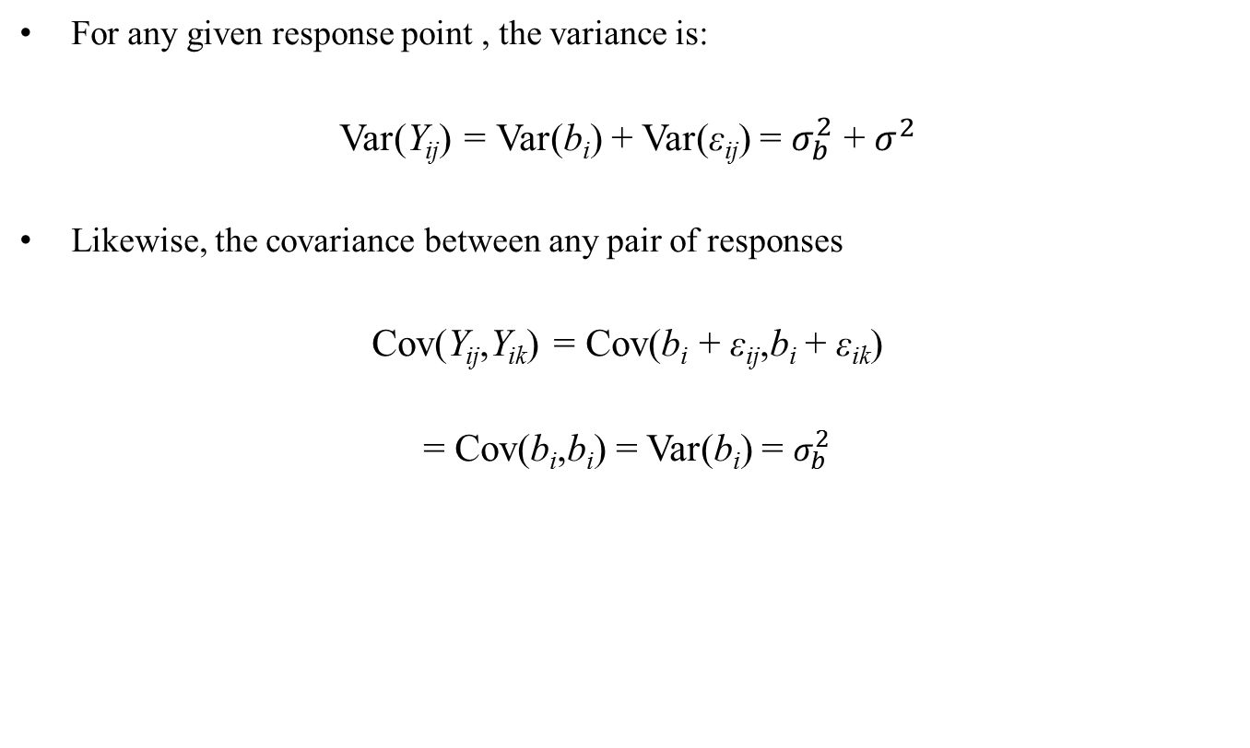
6.7 Marginal covariance

Slide 29
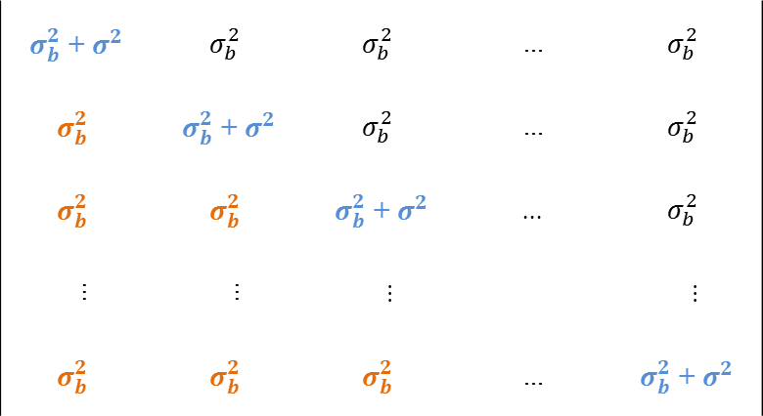
6.7 Marginal covariance
The random intercept model implies the following structure for the marginal covariance matrix of the repeated measurements:
Cov(Y_{i}) =
It turns out that the marginal covariance has a compound symmetry structure (i.e., vars equal, covs equal). We have encountered this structure before, for repeated measures ANOVA.
+ |  |  | ...
 | + |  | ...
 |  | + | ...
... | ... | ... |  | ...
 |  |  | ... | +
 |  |  | ...
 |  |  | ...
 |  |  | ...
... | ... | ... |  | ...
 |  |  | ...

Slide 30
6.8 Random intercept as a latent variable
The random intercept for subjects has an interesting interpretation as a latent variable.
Previously, I noted that covariance modeling would not be necessary if we had a covariate available that could perfectly explain the within-subjects correlation of the repeated measurements (e.g., the speed example). In practice, we usually don’t have such covariates available, and the sources for within-subject correlation can be multiple. In that sense, the true source is latent.
The random intercept approximates this latent source with a random individual difference variable. This is analogous to factor analysis, where multiple observed items are assumed to reflect an unobserved latent factor.
For this reason, HLM is sometimes treated as a special case of structural equation modelling (SEM). SEM is a general method for causal modelling among variables where the set of variables can include both observed and unobserved variables.

Slide 31
6.9 Fitting the model in R
We return to the sleep deprivation study. The data have been loaded into R and have been formatted in the required long format:
There are 50 subjects, measured at 20 sampling points of sleep deprivation. To fit an HLM, we load the packages "lme4" and "lmerTest"
Subject Attention Deprivation
1 ID1 -1.2826490 6.4
2 ID1 0.3678006 0.4
3 ID1 -2.3895953 9.9
4 ID1 -0.4654373 4.4
5 ID1 -0.5133250 3.9
6 ID1 0.5942014 1.3
7 ID1 0.5128525 2.2
8 ID1 -2.4365818 8.9
9 ID1 -1.5338506 7.9
10 ID1 -0.2181901 3.1
...
1000 ID50 -1.5361430 9.0

Slide 32
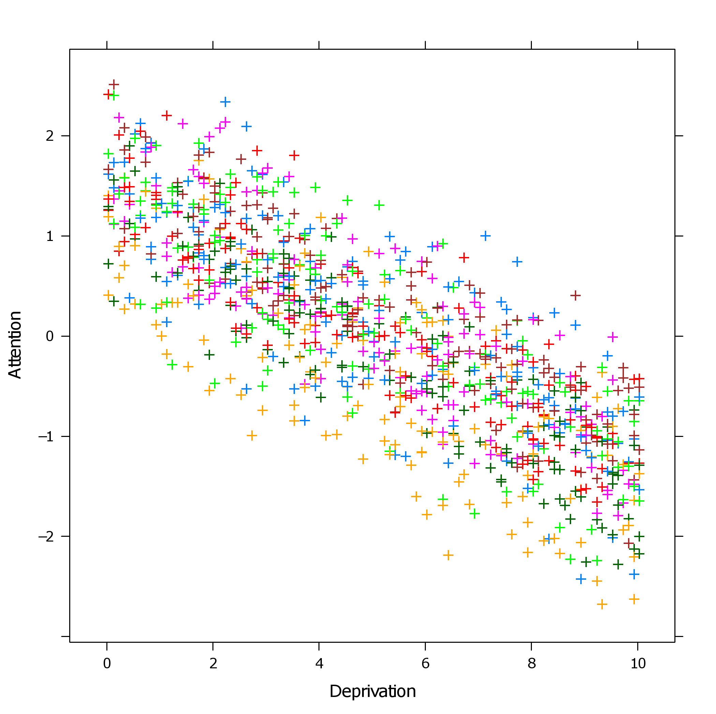
6.9 Fitting the model in R

Slide 33
6.9 Fitting the model in R
The main function for fitting HLMs in the "lme4" package is the "lmer" function. It uses a modified version of the typical linear model syntax in R:
rint <- lmer(Attention ~ 1 + Deprivation + (1|Subject),data=sleep)
Dependent variable
Random effects
Fixed independent effects

Slide 34
6.9 Fitting the model in R
The main function for fitting HLMs in the lme4 package is the "lmer" function. It uses a modified version of the typical linear model syntax in R:
rint <- lmer(Attention ~ 1 + Deprivation + (1|Subject),data=sleep)
The first part of the model specifies a model formula, where the response/dependent variable appears left of the tilde operator ( ~ ), and the fixed predictor/independent variables appear right of the tilde operator. Here we specify a (population) intercept, denoted by the 1, plus an effect for Deprivation.

Slide 35
6.9 Fitting the model in R
The main function for fitting HLMs in the lme4 package is the "lmer" function. It uses a modified version of the typical linear model syntax in R:
rint <- lmer(Attention ~ 1 + Deprivation + (1|Subject),data=sleep)
The first part of the model specifies a model formula, where the response/dependent variable appears left of the tilde operator ( ~ ), and the fixed predictor/independent variables appear right of the tilde operator. Here we specify a (population) intercept, denoted by the 1, plus an effect for Deprivation.
Following the fixed variables, a random effects part is specified, which is separated between brackets, and which can be recognized by the appearance of the vertical stroke operator ( | ). To the right of the vertical stroke, we specify a variable that contains repeated measurements (here Subject). To the left of the vertical stroke, we specifiy a random effects formula. If we only want a random intercept within subjects, we put the number 1, and nothing more.

Slide 36
6.9 Fitting the model in R
The "lmer" function fits the model for us, and we have asked for the model to be stored in the object "rint" (as specified by the assignment operator, <- ). Next we can request a model summary with the "summary" function.
rint <- lmer(Attention ~ 1 + Deprivation + (1|Subject),data=sleep)
summary(rint)
The summary output first displays information about the fitting process:
Linear mixed model fit by REML
Formula: Attention ~ 1 + Deprivation + (1 | Subject)
Data: sleep
REML criterion at convergence: 542.4
Some of these details are highly important! I return to these later…

Slide 37
6.9 Fitting the model in R
The output is divided into a random effects and fixed effects part:
Random effects:
Groups Name Variance Std.Dev.
Subject (Intercept) 0.25544 0.5054
Residual 0.08089 0.2844
Number of obs: 1000, groups: Subject, 50
Fixed effects:
Estimate Std.Error t-val
(Intercept) 1.42218 0.07379 19.27
Deprivation -0.28006 0.00315 -88.91

Slide 38
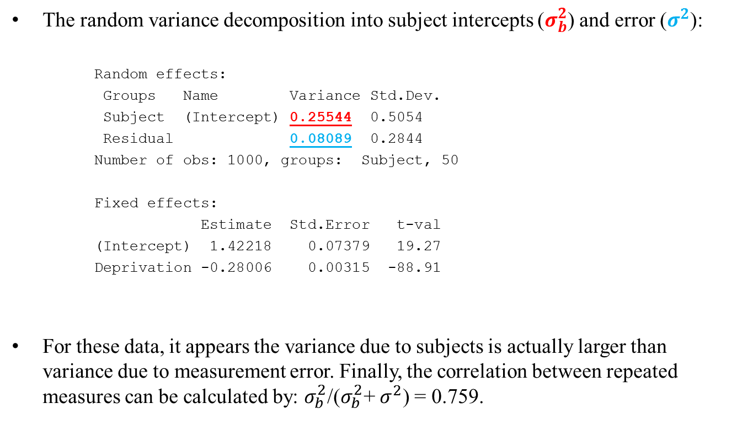
6.9 Fitting the model in R

Slide 39
6.9 Fitting the model in R
The "ranef" function returns the values for the random intercepts. These values denote the deviance of each subject from the population intercept!
ranef(rint)
$Subject
(Intercept)
ID1 -0.84966183
ID10 -0.25942567
ID11 -0.63440995
ID12 0.04833887
ID13 -0.85732489
ID14 0.57371996
...
ID6 -1.30205651
It appears that subject 6 is particularly outlying with respect to their deviance from the population intercept.

Slide 40
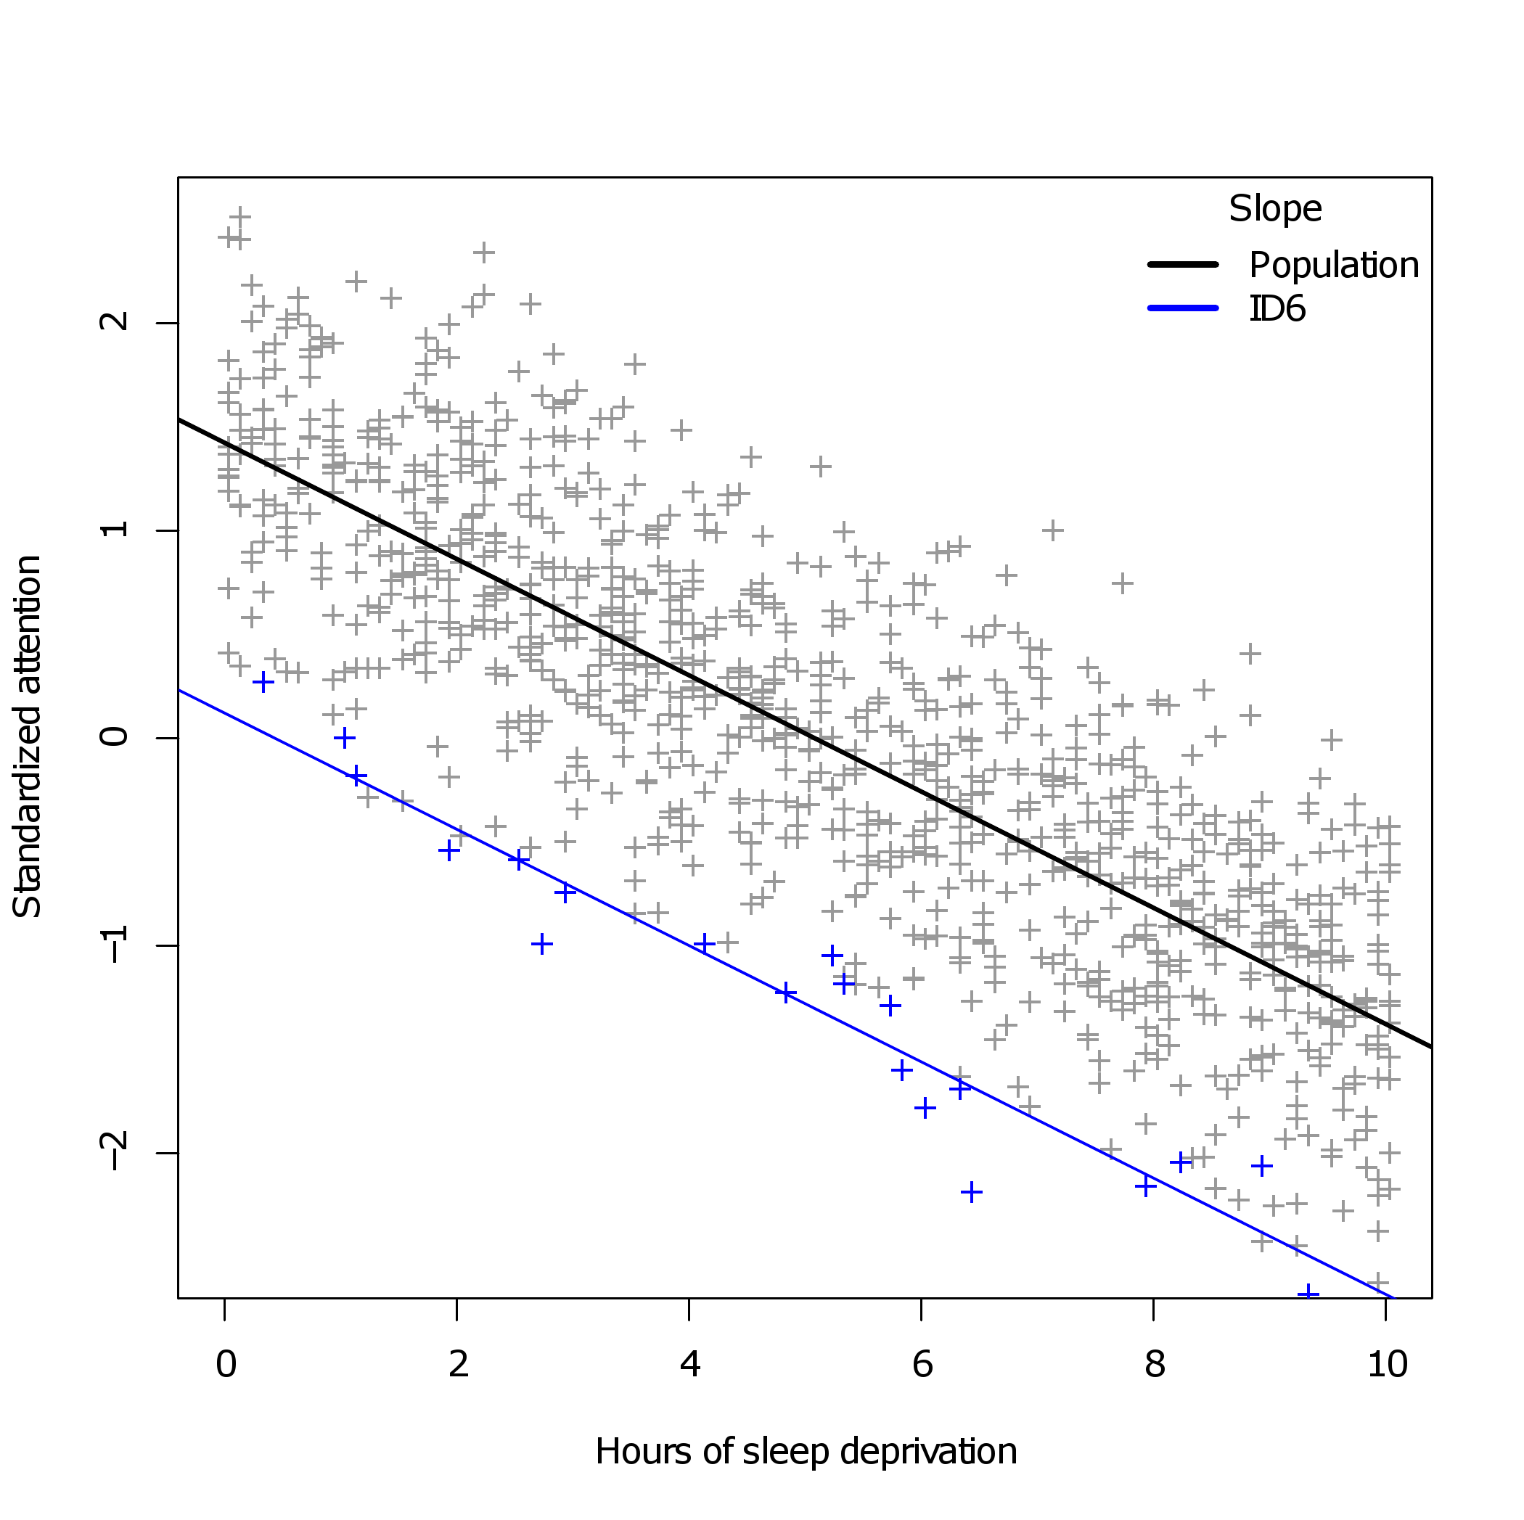
6.9 Fitting the model in R

Slide 41
6.9 Fitting the model in R
The fixed effects reveal a negative association between hours of sleep deprivation and degree of attention, as expected from the graphs we plotted.
Random effects:
Groups Name Variance Std.Dev.
Subject (Intercept) 0.25544 0.5054
Residual 0.08089 0.2844
Number of obs: 1000, groups: Subject, 50
Fixed effects:
Estimate Std.Error t-val
(Intercept) 1.42218 0.07379 19.27
Deprivation -0.28006 0.00315 -88.91

Slide 42
6.9 Fitting the model in R
Where is my p-value…?
Random effects:
Groups Name Variance Std.Dev.
Subject (Intercept) 0.25544 0.5054
Residual 0.08089 0.2844
Number of obs: 1000, groups: Subject, 50
Fixed effects:
Estimate Std.Error t-val
(Intercept) 1.42218 0.07379 19.27
Deprivation -0.28006 0.00315 -88.91
???

Slide 43
6.10 Inference on fixed effects for HLMs
For the standard linear model, tests of fixed effects depend on the Gauss-Markov assumptions, i.e., constant variance and uncorrelated errors. Degrees of freedom for such tests (t-tests and F-tests) are known exactly for the standard linear model.
For models where the variance is non-constant and the covariance possibly complex, degrees of freedom are not known exactly. It is not even certain that the distribution of the test statistic (under the null hypothesis) has a t- or F-distribution.
Different software/books/authors have attempted various solutions to this problem:
Theoretical approximation methods to the degrees of freedom (e.g., Satterthwaite, Kenward-Roger). Implemented in SAS, SPSS, and the R package "lmerTest".
Bayesian approaches that approximate the null distribution empirically. Implemented in the now defunct R package "languageR".
The R package "lme4" refuses to print inferential statistics altogether!

Slide 44
6.10 Inference on fixed effects for HLMs
Using the "lmerTest" package in R:
Linear mixed model fit by REML
t-tests use Satterthwaite approximations to degrees of freedom
Random effects:
Groups Name Variance Std.Dev.
Subject (Intercept) 0.25544 0.5054
Residual 0.08089 0.2844
Number of obs: 1000, groups: Subject, 50
Fixed effects:
Estimate Std.Error df t-val P-val
(Intercept) 1.42218 0.07379 53.90000 19.27 <2e-16 ***
Deprivation -0.28006 0.00315 950.10000 -88.91 <2e-16 ***
---
Signif. codes: 0 ‘***’ 0.001 ‘**’ 0.01 ‘*’ 0.05 ‘.’ 0.1 ‘ ’ 1
Note the fractional degrees of freedom, cfr. GG-corrected rm-ANOVA, or the Welch-corrected t-test.

Slide 45
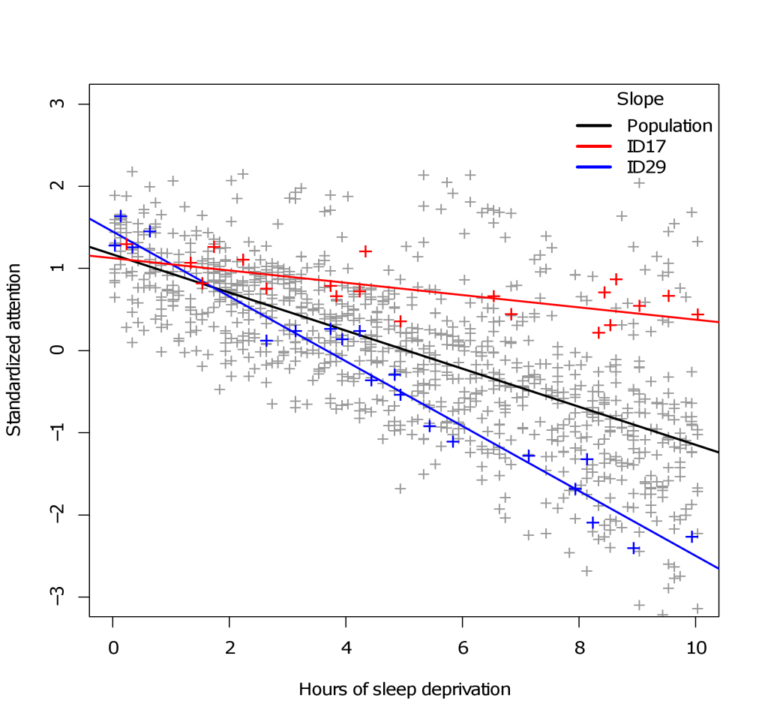
6.11 Random slopes
Sometimes/often, subjects not only differ with respect to their baseline deviation from the population trend, but differ with respect to the trend itself. For continuous within-variables, such differences would be called random slopes.

Slide 46
6.11 Random slopes model^{[for subjects]}
Let us now extend the random intercept model with additional random effects. Again, for simple one-way regression:
Y_{ij} = β₀ + β₁X_{ij} + b_{0i} + b_{1i}X_{ij} + ε_{ij}
β₀ The population intercept. The baseline response, across subjects, when X_{ij} = 0
β₁ The population slope. The rate of change between X and Y, across subjects
b_{0i} A between-subject intercept. A deviation of the population intercept
for the i^{th} subject
b_{1i} A within-subject slope. A deviation of the population slope for X_{ij}
for the i^{th} subject
ε_{ij} A within-subject error. A constant deviation of the population response
for the i^{th} subject for the j^{th} repeat

Slide 47
6.12 Fitting the model in R
In R, we keep the fixed effects part our model formula identical to the random intercept model. However, we extend the random effects specification:
rslope <- lmer(Attention~1+Deprivation+(1+Deprivation|Subject),data=sleep)
summary(rslope)
This time, we speficy that within subjects, there should be randomly varying intercepts (1), and randomly varying Deprivation slopes (+Deprivation).
The fixed effects formula and the random effects formula are now identical. This highlights that any predictor that was measured repeatedly within subjects can appear both in the fixed effects and the random effects of the model!

Slide 48
6.12 Fitting the model in R
Summary output of the random slopes model:
Random effects:
Groups Name Variance Std.Dev. Corr
Subject (Intercept) 2.507e-01 0.5006683
Deprivation 8.746e-07 0.0009352 1.00
Residual 8.089e-02 0.2844036
Number of obs: 1000, groups: Subject, 50
Fixed effects:
Estimate Std.Error df t-val P-val
(Intercept) 1.422305 0.073144 49.200000 19.45 <2e-16 ***
Deprivation -0.280077 0.003152 894.600000 -88.85 <2e-16 ***
---
Signif. codes: 0 ‘***’ 0.001 ‘**’ 0.01 ‘*’ 0.05 ‘.’ 0.1 ‘ ’ 1
Three sources of random variation now. Intercepts and Deprivation slopes for subjects, and error for measurements.

Slide 49
6.12 Fitting the model in R
Random effects values within subjects:
$Subject
(Intercept) Deprivation
ID1 -0.84276736 -1.574242e-03
ID10 -0.25625796 -4.786756e-04
ID11 -0.62784813 -1.172785e-03
ID12 0.04791784 8.950785e-05
ID13 -0.84839131 -1.584748e-03
ID14 0.56839192 1.061724e-03
ID15 -0.02916347 -5.447574e-05
...
The slope deviations all seem rather small. The summary output indicated that variation due to random slopes is equal to 0.0000008746, which is virtually negligible.
Do we really need the random slopes for these data?

Slide 50
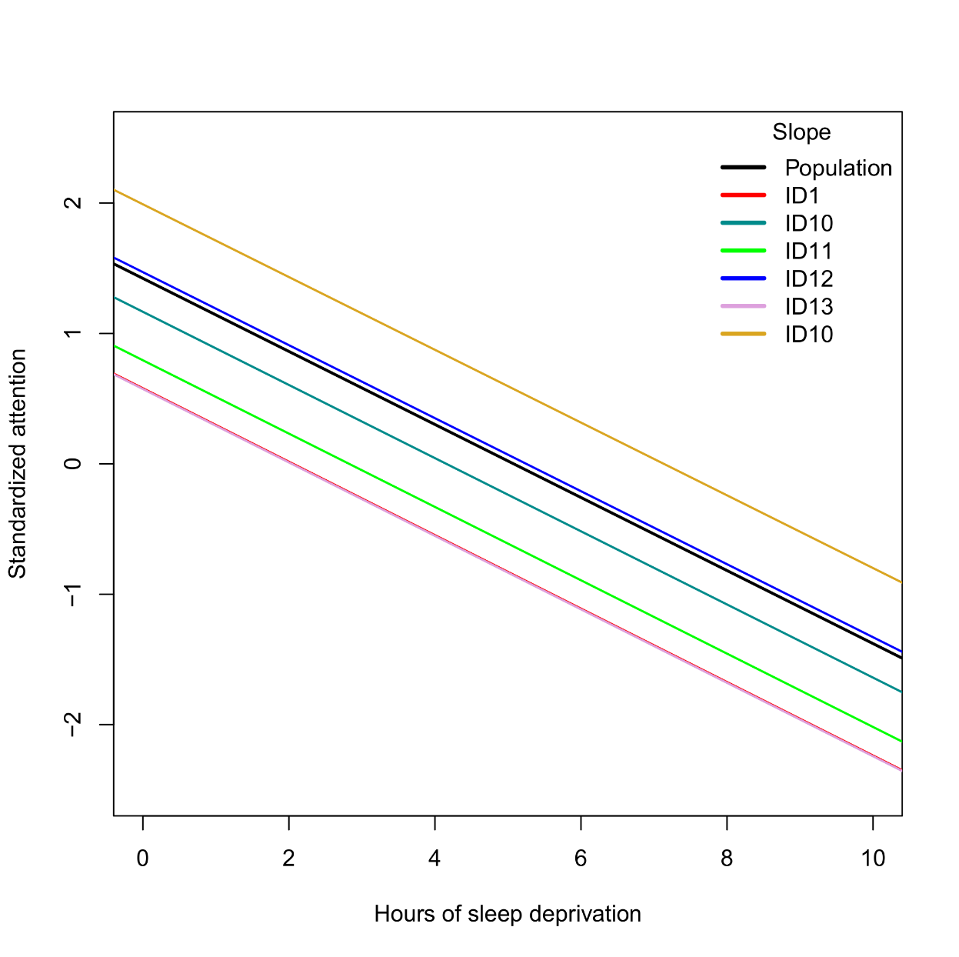
Do we need the random slopes…?
Predicted subject-specific deprivation slopes for the random slope model:

Slide 51
6.12 Inference on random effects in HLMs
Conventionally, models are compared with statistical tests, e.g., ANOVA F-tests or, more generally, Wald and likelihood ratio tests. Several software offer these tests for random effects parameters. However, such tests are problematic for three important reasons:
Boundary problem: testing whether a (co)variance parameter is non-zero is a test on the boundary of the parameter space. Unlike regression coefficients, which are theoretically unbounded, [–∞,+∞], a (co)variance parameter is bounded to [0,+∞]. Classical maximum likelihood theory (e.g., asymptotic normality) breaks down at these boundaries.
Non-nesting: traditional inferential model comparisons depend on models being nested. That is, the parameters of the reduced model should be a subset of the parameters of the full model. For comparisons between complex random effects structures, this is not always the case.
Hypotheses: unlike fixed effects, random effects are rarely the subject of scientific hypotheses. Conducting inferential tests on these parameters would unnecessarily inflate the multiple testing problem.

Slide 52
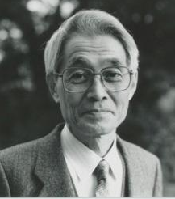
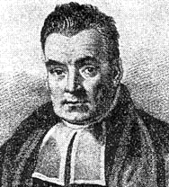
6.13 Information criteria
A general method for comparing (covariance) models is via information criteria. The most common criteria are Akaike Information Criterion (AIC) and Bayesian Information Criterion (BIC).
Given a dependent variable, and several competing parametric models for that dependent variable, information criteria will measure the relative index of fit, penalized by the number of parameters. It can be thought of as a measure of relative generalization.
The lower AIC/BIC---relative to competing models---the better the model fits the dependent data. Differences in AIC/BIC >2 are already considered meaningful!
BIC penalizes more heavily for extra parameters than AIC. It favors more parsimonious models.

Slide 53
6.13 Information criteria
Information criteria have many important advantages:
They penalize a model for extra parameters (unlike other fit measures, such as R-squared)
They can be used to compare non-nested models for the same dependent data (unlike conventional ANOVA F-tests)
They avoid classical inference with p-values
In my opinion, model selection using AIC/BIC is superior to hypothesis testing in many settings. It is particularly well-suited to the selection of random effects structures.
Let us re-examine the sleep data…

Slide 54
6.13 Information criteria
In R, it suffices to run the AIC or BIC functions on our model objects:
AIC(rint) ; BIC(rint)
AIC(rslope) ; BIC(rslope)
Which yields the following results. Minimal AIC/BIC for the random intercept model:
Random effects structure | AIC | BIC
Random intercept | 550.42 | 570.05
Random intercept and slope | 554.33 | 583.78
Random slope without intercept | 1090.64 | 1110.27
Uncorrelated random intercept/slope | 552.42 | 576.96

Slide 55
6.13 Information criteria
In R, it suffices to run the AIC or BIC functions on our model objects:
AIC(rint) ; BIC(rint)
AIC(rslope) ; BIC(rslope)
Which gives:
Random effects structure | AIC | BIC
Random intercept | 550.42 | 570.05
Random intercept and slope | 554.33 | 583.78
Random slope without intercept | 1090.64 | 1110.27
Uncorrelated random intercept/slope | 552.42 | 576.96
??
??

Slide 56
More random effects structures
The formula syntax in "lme4" allows a random effects structure that has a random slope but no random intercept. This is extremely unlikely to hold and would only make sense if all predictors/dependents had been centered around 0 within subjects (a.k.a., a regression through the origin).
lmer(Attention~1+Deprivation+(0+Deprivation|Subject),data=sleep)
By default, "lme4" sets the random intercept and the random slope to be correlated. This makes logical sense since higher intercepts typically imply steeper slopes. Turning this option off is possible with a double vertical stroke ( || ):
lmer(Attention~1+Deprivation+(1+Deprivation||Subject),data=sleep)

Slide 57

6.13 Extended sleep example
Let’s spice up the data a little…
Subject Gender Age Deprivation Bodytemp Attention
1 ID1 Male 23.5 6.4 36.193 -0.4386393
2 ID1 Male 23.5 0.4 36.897 1.3767838
3 ID1 Male 23.5 9.9 36.106 -1.6608681
4 ID1 Male 23.5 4.4 36.143 0.4722538
5 ID1 Male 23.5 3.9 36.159 0.4086486
6 ID1 Male 23.5 1.3 36.684 1.6514260
7 ID1 Male 23.5 2.2 36.290 1.5682040
8 ID1 Male 23.5 8.9 35.736 -1.7360241
9 ID1 Male 23.5 7.9 36.285 -0.7029214
10 ID1 Male 23.5 3.1 36.648 0.7418064
...
Between-subject varying: gender, age
Within-subject varying: deprivation, bodytemp, attention

Slide 58
6.14 Model selection strategy for HLMs
In the previous sleep data we had only one independent variable. Therefore we could focus entirely on the selection of the random effects for model selection. This time we have multiple independents, however. How should we proceed with model selection…?
Step 1: Random effects selection:
Use REML estimation!
Include all possible fixed effects under consideration, including potential interactions
While keeping these fixed effects constant, fit models with different random effects
Log AIC/BIC values for each random effects structure
Select as a final random effects structure the one that minimizes AIC and/or BIC
Step 2: Fixed effects selection:
Use ML estimation!
While keeping random effects (from step 1) constant, fit models with different fixed effects
Add/keep fixed effects based on significance tests or based on reduction in AIC/BIC
Select a final fixed effects structure

Slide 59
6.15 Variable scaling and coding
This time we are dealing with multiple independent variables, three continuous and one categorical. To ease interpretation, it is always a good idea to center and/or standardize the continuous variables, such that they have 0 mean and/or 1 sd. Often this also improves the stability of the "lmer" algorithms!
sleep2$Bodytemp <- scale(sleep2$Bodytemp)
sleep2$Age <- scale(sleep2$Age)
For categorical variables, we do not need to recode – the variable into a dummy manually. R will do this internally with 0/1 coding by default (as does most software). This type of coding is not the most useful, however. It may be wiser to use -1/1 coding instead. Here, we code female=1 and male=-1:
contrasts(sleep2$Gender) <- contr.sum(2)
contrasts(sleep2$Gender)

Slide 60
6.16 Extended sleep continued
This is the formula for the random intercept model:
rint <- lmer(Attention ~ 1
+ Gender + Age + Bodytemp + Deprivation
+ (1|Subject), data=sleep2)
More details about the formula syntax:
Technically, we do not need to include the "1" explicitly in the fixed effects part. R adds an intercept automatically to linear models. From here on, I will not write the "1" explicitly in model formulas.
For the random effects part, an explicit intercept cannot be omitted!
Variables that vary between-subjects should not (typically) appear in the random effects part
The dependent should always vary at the lowest level of the repeated measurements. It is not possible to model a between variable as dependent using within variables as independent

Slide 61
6.16 Extended sleep continued
What is the interpretation of the intercept in this model?
Random effects:
Groups Name Variance Std.Dev.
Subject (Intercept) 0.05708 0.2389
Residual 0.11353 0.3369
Number of obs: 1000, groups: Subject, 50
Fixed effects:
Estimate Std.Error df t-val P-val
(Intercept) -0.001207 0.035458 47.00 -0.034 0.97299
Gender1 0.030175 0.036409 47.00 0.829 0.41142
Age -0.106736 0.036394 47.00 -2.933 0.00518 **
Bodytemp 0.033197 0.015000 953.50 2.213 0.02712 *
Deprivation -0.876990 0.015089 956.00 -58.122 < 2e-16 ***
AIC: 819.6112 BIC: 853.9655

Slide 62
6.16 Extended sleep continued
What is the interpretation of the age effect?
Random effects:
Groups Name Variance Std.Dev.
Subject (Intercept) 0.05708 0.2389
Residual 0.11353 0.3369
Number of obs: 1000, groups: Subject, 50
Fixed effects:
Estimate Std.Error df t-val P-val
(Intercept) -0.001207 0.035458 47.00 -0.034 0.97299
Gender1 0.030175 0.036409 47.00 0.829 0.41142
Age -0.106736 0.036394 47.00 -2.933 0.00518 **
Bodytemp 0.033197 0.015000 953.50 2.213 0.02712 *
Deprivation -0.876990 0.015089 956.00 -58.122 < 2e-16 ***
AIC: 819.6112 BIC: 853.9655

Slide 63
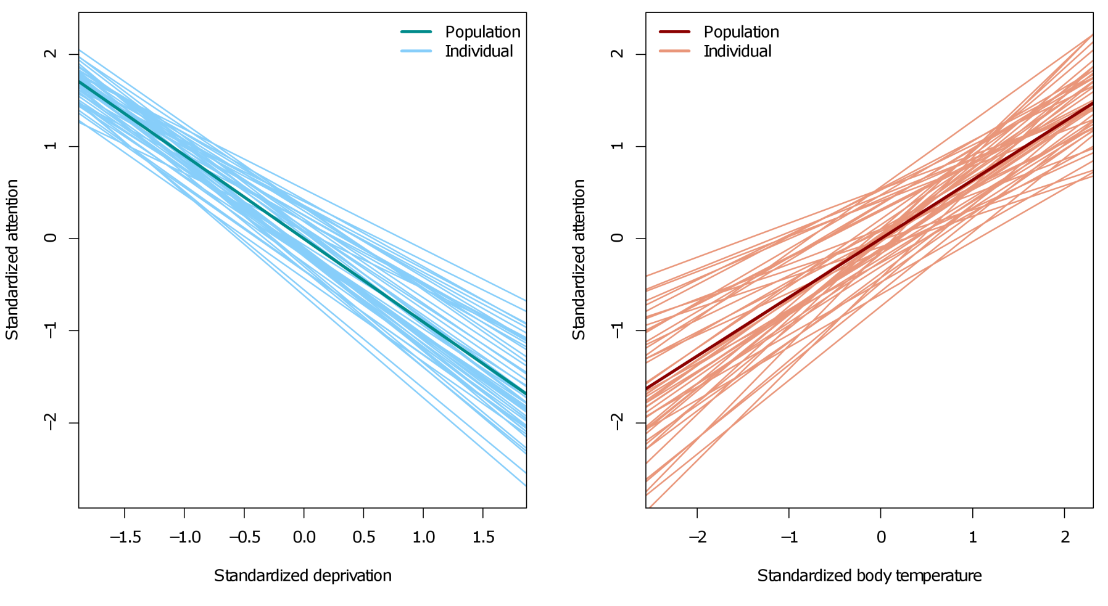
6.16 Extended sleep continued
What about random slopes for deprivation and/or body temperature? Let’s inspect the sample data first:

Slide 64
6.16 Extended sleep continued
We compare models with different random effects, without changing the fixed effects (!):
Both information criteria favor the model with random deprivation slopes and no random body temperature slopes.
Random effects model | R syntax | AIC | BIC
Intercept | (1|Subject) | 819.61 | 853.97
Intercept + Deprivation | (1+Deprivation|Subject) | 751.26 | 795.43
Intercept + Bodytemp | (1+Bodytemp|Subject) | 782.66 | 826.83
Intercept + Deprivation + Bodytemp | (1+Deprivation+Bodytemp|Subject) | 756.03 | 826.83

Slide 65
6.16 Extended sleep continued
Partial summary for the random slope model:
Random effects:
Groups Name Variance Std.Dev. Corr
Subject (Intercept) 0.06359 0.2522
Deprivation 0.01088 0.1043 0.95
Residual 0.10300 0.3209
Number of obs: 1000, groups: Subject, 50
Fixed effects:
Estimate Std.Error df t-val P-val
(Intercept) 7.233e-04 3.711e-02 42.80 0.019 0.9845
Gender1 9.527e-03 2.533e-02 45.90 0.376 0.7086
Age -2.553e-02 2.555e-02 47.90 -0.999 0.3227
Bodytemp 3.356e-02 1.436e-02 94.30 2.337 0.0197 *
Deprivation -8.732e-01 2.060e-02 80.30 -42.395 <2e-16 ***
---
Signif. codes: 0 ‘***’ 0.001 ‘**’ 0.01 ‘*’ 0.05 ‘.’ 0.1 ‘ ’ 1

Slide 66
6.16 Extended sleep continued
The age effect disappears in the random slope model:
Random effects:
Groups Name Variance Std.Dev. Corr
Subject (Intercept) 0.06359 0.2522
Deprivation 0.01088 0.1043 0.95
Residual 0.10300 0.3209
Number of obs: 1000, groups: Subject, 50
Fixed effects:
Estimate Std.Error df t-val P-val
(Intercept) 7.233e-04 3.711e-02 42.80 0.019 0.9845
Gender1 9.527e-03 2.533e-02 45.90 0.376 0.7086
Age -2.553e-02 2.555e-02 47.90 -0.999 0.3227
Bodytemp 3.356e-02 1.436e-02 94.30 2.337 0.0197 *
Deprivation -8.732e-01 2.060e-02 80.30 -42.395 <2e-16 ***
---
Signif. codes: 0 ‘***’ 0.001 ‘**’ 0.01 ‘*’ 0.05 ‘.’ 0.1 ‘ ’ 1

Slide 67
6.17 R-squared for HLMs
Just as in ordinary linear regression, it would be useful to quantify how well the HLM explains variation in the dependent variable. For ordinary regression, researchers often report R². Unlike AIC/BIC, R² has an absolute interpretation for goodness-of-fit.
For an HLM, calculating R² is complicated by the presence of the random effects, leading to two different types of R² :
Marginal R-squared: the proportion of variance in the dependent that is explained by the fixed effects, collapsed across all sources of random variation.
Conditional R-squared: the proportion of variance in the dependent that is explained by the fixed effects, conditioned on sources of random variation.
The addition of a fixed effect may increase marginal R² while paradoxically decreasing conditional R². These (and other) issues are a matter of ongoing research (Ronghui, 2003; Nakagawa & Schielzeth, 2013; Johnson, 2014). However, R scripts are available online with the most up-to-date formulas.

Slide 68
6.17 R-squared for HLMs
Loading and running the custom R² script:
source("C:/Myfolder/Subfolder/.../rsquaredlme.r")
r.squared(rslope)
Which gives:
Class Family Link Marginal Conditional AIC
1 merModLmerTest gaussian identity 0.8195546 0.8952632 721.6689
Due to the strong effect of deprivation, both R² values are very high. The conditional R² value is higher, however, due to the inclusion of the random effects structure.
Note that the AIC value that is reported in this output table differs from the one that we calculated earlier (751.26). This discrepancy is due to differences in so-called ML and REML estimation (see later).

Slide 69
6.17 R-squared for HLMs
In order to partial out R² across the different effects, e.g., the deprivation effect alone, one would be tempted to compare, for example:
mod1 <- lmer(Attention~Gender+Age+Bodytemp+Deprivation
+(1+Deprivation|Subject),data=sleep2)
mod2 <- lmer(Attention~Gender+Age+Bodytemp
+(1+Deprivation|Subject),data=sleep2)
r.squared(mod1)
r.squared(mod2)
This example is wrong for two reasons:
The first is that you should never compare different fixed effects structures between models that used REML estimation (see later)
The second is that it makes no sense to remove the fixed deprivation effect without removing the random deprivation effect

Slide 70
6.18 Final selection of fixed effects
Once a suitable random effects structure has been chosen, we could (optionally) select a final structure for the fixed effects. This selection could be based on AIC/BIC, R², or significance tests (or some other criterion).
Removing insignificant effects could improve the reliability with which the remaining effects are estimated, and increase power for statistical tests (less parameters = more df)
On the other hand, sometimes we want to keep certain variables in the model, even when they are insignificant, simply to control for certain covariates or to eliminate confounding
When comparing different fixed effects structures, always remember to use ML estimation, not REML!

Slide 71
7. Hierarchical linear model – Extensions

Slide 72
7.1 Estimation in HLMs – REML vs ML
In ordinary linear regression, the coefficients (=slopes) of the model are estimated with the so-called normal equations. These simple formulas are the solution to minimizing the sum of the squared residuals, which is called the least squares criterion.
This approach is equivalent to finding regression coefficients by the maximum likelihood (ML) criterion. If we assume that the dependent variable is normally distributed with mean indexed by the regression coefficients and constant variance, the best regression coefficients are those that maximize the likelihood of the observed data, given the assumed model.
For HLMs, regular least squares is replaced by a weighted least squares equation, where the weights are determined by the random effects. Fixed and random parameters have to be estimated in an alternating, iterative fashion, base on either the maximum likelihood (ML) criterion or the restricted maximum likelihood (REML) criterion.

Slide 73
7.1 Estimation in HLMs – REML vs ML
REML returns unbiased estimates for the (co)variance parameters of an HLM. It achieves this by applying a suitable transformation to the fixed effects part, prior to estimation.
However, different random effects structures will require different REML transformations for the fixed effects. Mathematically speaking, this makes fixed effects structures incomparable between different REML-estimated HLMs (even if they contain the same fixed effects, conceptually).
REML estimation is the default for fitting HLMs in most software, including the "lme4" package. It can be switched off as follows:
model <- lmer(Y~X+(1|Subject),data=example, REML=FALSE)

Slide 74
7.1 Estimation in HLMs – REML vs ML
For the extended sleep data, a model selection for the fixed effects part using AIC/BIC requires all models to be fitted using ML, e.g.:
mod1 <- lmer(Attention~Gender+Age+Bodytemp+Deprivation
+(1+Deprivation|Subject),data=sleep2,REML=FALSE)
mod2 <- lmer(Attention~Gender+Age+Deprivation
+(1+Deprivation|Subject),data=sleep2,REML=FALSE)
AIC(mod1) ; BIC(mod1)
AIC(mod2) ; BIC(mod2)
Which returns:
AIC: 721.6689, BIC: 765.8387
AIC: 725.0464, BIC: 764.3084

Slide 75


7.2 Hierarchical random effects
A consumer magazine wants to test the trustworthiness of star ratings for French restaurants. In five regions of France, six restaurants are sampled each: 2 two-star restaurants, 2 one-star restaurants, and 2 zero-star restaurants.
Each restaurant is visited and rated by 5 unique critics. Critics award points of quality from 0 to 100, on four different criteria: ambience, service, creativity, food.
The magazine primarily wants to find out if star-restaurants are indeed rated higher in quality by their food critics.

Slide 76
7.2 Hierarchical random effects
Sampling design of the study: Regions > Restaurants > Critics > Criteria
Regions
1
2
3
4
5
Restaurants
…
…
…
Critics
…
…
…
Criteria ratings
…
…
…
1 2 3 4

Slide 77
7.2 Hierarchical random effects
This time, we still have repeated measurements within subjects/critics (i.e., four quality ratings), but subjects are themselves repeats within restaurants, and restaurants are repeats within regions.
The magazine is not interested in specific regions or restaurants. It merely wants to investigate quality differences between levels of stars (0, 1, or 2). Toward that end, the chosen regions and restaurants represent a random sample from the population of regions and restaurants. Likewise, critics can be considered as a random sample from a population of critics (or restaurant-goers).
Thus, there are three nested sources of random variation to consider: regions, restaurants, and critics

Slide 78
7.2 Hierarchical random effects
A sample of 6 observations from the data:
> resto[sample(1:600,6),]
Region Restaurant Critic Stars Criterion Qual
Normandie Le Presse-purée d'Or ID69 0 Creativity 52
Alsace Champagne-Ard Le Renard Mariné ID24 2 Food 96
Île-de-France Brasserie les 6 Reines ID108 1 Service 89
Normandie Polytetrafluoroethylene ID63 0 Creativity 46
Centre Val de Loire Le Food ID31 0 Creativity 62
Provence-Alpes-Côte d' Déjeuner en Fuite ID143 2 Food 83
...
Visualizing the data gives an indication of what to expect. The lattice library has automated, formula-based functions for plotting, e.g.:
resto.star.means <- aggregate(Quality~Stars+Criterion,data=resto,FUN=mean)
barchart(Quality~I(as.factor(Stars)),groups=Criterion,data=resto.star.means)

Slide 79
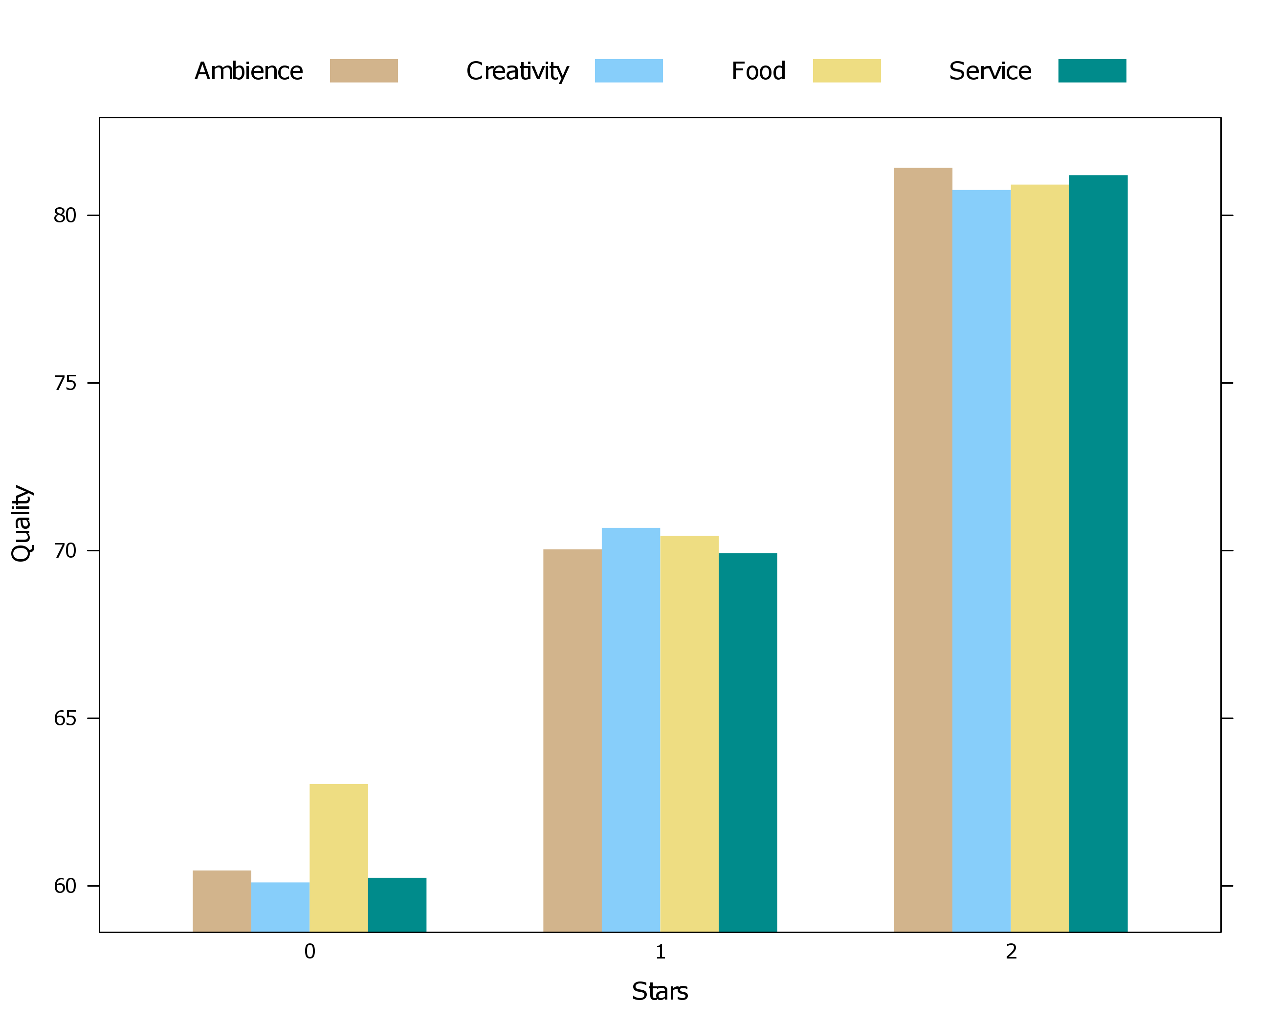
7.2 Hierarchical random effects

Slide 80
7.3 Fitting the model in R
As in the sleep deprivation example, we change the default contrast coding of the factors:
resto$Starcat <- as.factor(resto$Stars)
contrasts(resto$Starcat) <- contr.sum(3)
contrasts(resto$Criterion) <- contr.sum(4)
Which gives the following dummy codings:
Although stars could be treated as a continuous variable, I choose here to treat it as a categorical variable.
d1 d2 d3
Ambience 1 0 0
Creativity 0 1 0
Food 0 0 1
Service -1 -1 -1
d1 d2
0 stars 1 0
1 stars 0 1
2 stars -1 -1

Slide 81
7.3 Fitting the model in R
A three-level hierarchical model in R:
mod1 <- lmer(Quality~Starcat*Criterion
+(1|Region)+(1|Restaurant)+(1|Critic),data=resto)
This time we have three separate random effects formulas, one for each hierarchical level. The notation specifies that there should be random intercepts for regions, restaurants and critics, and that these sources of random variation are independent/uncorrelated.
In other words, individual regions, restaurants and critics are allowed to have a baseline of average quality score that differs from the overall population quality score.
In other other words, error variance for quality scores can be decomposed into an additive contribution of regions, restaurants, critics, and pure measurement error.

Slide 82
7.3 Fitting the model in R
A summary of random effects for the three-intercept model:
Random effects:
Groups Name Variance Std.Dev.
Critic (Intercept) 29.63861 5.4441
Restaurant (Intercept) 131.62709 11.4729
Region (Intercept) 0.02551 0.1597
Residual 4.87305 2.2075
Number of obs: 600, groups: Critic, 150; Restaurant, 30; Region, 5
It appears that most of the error variance in quality scores is due to within-critic correlation and within-restaurant correlation. Less important is variance due to regions and due to pure measurement error.
Can we drop the random intercept for regions altogether…?

Slide 83
7.4 Random effects selection
A summary of AIC/BIC comparisons:
Random effects model | AIC | BIC
(1|Region) | 4668 | 4729
(1|Restaurant) | 3887 | 3948
(1|Critic) | 3401 | 3462
(1|Region) + (1|Restaurant) | 3889 | 3954
(1|Region) + (1|Critic) | 3394 | 3460
(1|Restaurant) + (1|Critic) | 3252 | 3318
(1|Region) + (1|Restaurant) + (1|Critic) | 3254 | 3325

Slide 84
7.4 Random effects selection
What about more random effects within each level of hierarchy? A random effect for stars cannot be included at the restaurant or the critic level. Why?
You could try to add a random effect for rating criterion within the restaurant level. Check this for yourself. Does it improve the model fit?
As usual, we can ask for random effects estimates. First we refit the model to our final random effects structure:
mod2 <- lmer(Quality~Starcat*Criterion
+(1|Restaurant)+(1|Critic),data=resto)
ranef(mod2)
This time R will return two lists of random effects estimates, one for restaurants and one for critics. What do you conclude from these values?

Slide 85
7.5 Fixed effects selection
Now that we have chosen a suitable random effects structure. We can proceed to inspect main effects. We re-estimate the model with ML estimation, and ask for summary output:
mod3 <- lmer(Quality~Starcat*Criterion
+(1|Restaurant)+(1|Critic),data=resto,REML=FALSE)
summary(mod3)
Note that interactions between variables can be specified with the asterisk operator ( * ). Putting this between two variables includes both main effects and the interaction in the model. Equivalent notation:
mod3 <- lmer(Quality~Starcat+Criterion+Starcat:Criterion
+(1|Restaurant)+(1|Critic),data=resto,REML=FALSE)
summary(mod3)
Which separates the main effects from the interaction explicitly.

Slide 86
7.5 Fixed effects selection
Fixed effects:
Estimate Std.Error df t-val P-val
(Intercept) 70.7683 2.0334 30.00 34.803 < 2e-16 ***
Starcat1 -9.8083 2.8756 30.00 -3.411 0.00187 **
Starcat2 -0.4983 2.8756 30.00 -0.173 0.86358
Criterion1 -0.1283 0.1545 450.00 -0.831 0.40670
Criterion2 -0.2550 0.1545 450.00 -1.650 0.09960 .
Criterion3 0.6983 0.1545 450.00 4.519 7.94e-06 ***
Starcat1:Criterion1 -0.3717 0.2185 450.00 -1.701 0.08968 .
Starcat2:Criterion1 -0.1017 0.2185 450.00 -0.465 0.64199
Starcat1:Criterion2 -0.6050 0.2185 450.00 -2.768 0.00586 **
Starcat2:Criterion2 0.6650 0.2185 450.00 3.043 0.00248 **
Starcat1:Criterion3 1.3817 0.2185 450.00 6.323 6.21e-10 ***
Starcat2:Criterion3 -0.5283 0.2185 450.00 -2.418 0.01602 *
---
Signif. codes: 0 ‘***’ 0.001 ‘**’ 0.01 ‘*’ 0.05 ‘.’ 0.1 ‘ ’ 1
This is slightly difficult to interpret. Fortunately, the lmerTest package has a modified ANOVA function for conducting omnibus tests.

Slide 87
7.5 Fixed effects selection
The function can be run as follows:
anova(mod3)
Which returns:
Analysis of Variance Table of type III with Satterthwaite
approximation for degrees of freedom
Sum Sq Mean Sq NumDF DenDF F.value Pr(>F)
Starcat 78.033 39.016 2 30 8.1700 0.0014705 **
Criterion 100.258 33.419 3 450 6.9980 0.0001311 ***
Starcat:Criterion 222.977 37.163 6 450 7.7818 5.569e-08 ***
---
Signif. codes: 0 ‘***’ 0.001 ‘**’ 0.01 ‘*’ 0.05 ‘.’ 0.1 ‘ ’ 1
Evidence for an interaction between the number of stars a restaurant has and the criteria on which the restaurants were rated. But we already knew that...

Slide 88
7.5 Fixed effects selection

Slide 89
7.5 Fixed effects selection
It seems that, for restaurants with 0 stars, ambience, service and creativity are rated lower, on average, than food quality. For star-restaurants, this difference disappears.
A likely explanation is that restaurants without stars give priority to food quality, and less so to superficial aspects. Star-restaurants, on the other hand, need to maintain a consistent high quality on all aspects.
Testing the interaction hypothesis:
mod4 <- lmer(Quality~Starcat*Criterion
+(1|Restaurant)+(1|Critic),data=resto,
subset=Starcat!="0",REML=FALSE)
anova(mod4)

Slide 90
7.5 Fixed effects selection
Note the warning that states that the unused star level (=0) was dropped:
Warning messages:
1: contrasts dropped from factor Starcat due to missing levels
2: contrasts dropped from factor Starcat due to missing levels
Analysis of Variance Table of type III with Satterthwaite
approximation for degrees of freedom
Sum Sq Mean Sq NumDF DenDF F.value Pr(>F)
Starcat 14.9911 14.9911 1 20.003 4.6210 0.0440 *
Criterion 1.8275 0.6092 3 300.003 0.1878 0.9047
Starcat:Criterion 29.6875 9.8958 3 300.003 3.0504 0.0289 *
---
Signif. codes: 0 ‘***’ 0.001 ‘**’ 0.01 ‘*’ 0.05 ‘.’ 0.1 ‘ ’ 1
The ANOVA suggests that there is still an interaction between stars and rating criteria on quality scores, although it is much reduced, and the plot suggests it is unsubstantial.

Slide 91
7.5 Fixed effects selection
Since the fixed effects are nowhere part of the random effects structure, it is a bit safer to conduct a full R² analysis:
Fixed effects model ^{(ML estimated)} | Marginal R² | Conditional R² | AIC
1 | 0.000 | 0.975 | 3302
Starcat | 0.308 | 0.975 | 3293
Criterion | 0.000 | 0.976 | 3290
Starcat+Criterion | 0.308 | 0.976 | 3281
Starcat*Criterion | 0.309 | 0.978 | 3248

Slide 92
7.6 Meta-analysis as an HLM
A specific case of hierarchical nesting of measurements is that of subjects nested in studies/experiments.
For example, research on affective priming (see earlier) may include multiple studies where aspects of the design are systematically manipulated, while replicating the basic affective priming effect.
HLM represents an appealing context to conduct a sample-driven meta-analysis for the effect of interest, across all studies, e.g.:
meta <- lmer(RT~Prime*Target
+(1+Prime*Target|Study)+(1|Subject),data=alldata)
In this example, studies and subjects are assumed to contribute independent random variation to the data. Within studies, the affective priming effect is allowed to deviate from the population affective priming effect.

Slide 93
7.6 Meta-analysis as an HLM
There are many advantages to using random effects in a meta-analysis context:
Data can be pooled while controlling for differences between studies (e.g., different stimuli, extra manipulations, extra covariates).
All available data from studies can be used, not just summary effect sizes (as in conventional meta-analysis).
Different studies can have different designs (e.g., between or within). Within-subjects data can be handled with the inclusion of a random effect for subjects. This is not straightforward in conventional meta-analysis.
The major downside to this approach is that all sample data must be available to the researcher. For large-scale literature reviews, it may not be feasible to obtain all original datasets. Changes in data submission policies may change this, however...
As well, even for a set of extracted effect sizes, HLM could still be useful to pool both between- and within-subjects data!

Slide 94
7.7 More types of hierarchical data
The previous examples extend to other settings where data are nested:
Level 1 < | Level 2 < | Level 3 < | Level 4 <
Subjects | Dyads
Students | Classes | Schools
Patients | Doctors | Hospitals
Children | Families | Cities | Countries
Grapes | Vines | Vineyards
Fish | Species | Oceans
Tissue | Organs | Patients
Time series | Brain voxels | Subjects

Slide 95
7.8 Crossed random effects
Consider again the affective priming data. Typical trial-level data for a subject has the following structure:
Subject Trial Pword Tword Prime Target RT
1771 ID7 1 hate pain Negative Negative 503.3
1678 ID7 2 pain flower Negative Positive 541.9
1595 ID7 3 smile blood Positive Positive 484.6
1781 ID7 4 fear hell Negative Negative 503.8
1541 ID7 5 rainbow grave Positive Positive 537.7
1632 ID7 6 beach love Positive Negative 574.5
1598 ID7 7 puppy blood Positive Positive 513.9
1587 ID7 8 smile hell Positive Positive 516.5
1559 ID7 9 heaven hate Positive Positive 491.5
1707 ID7 10 hate puppy Negative Positive 519.9
...

Slide 96
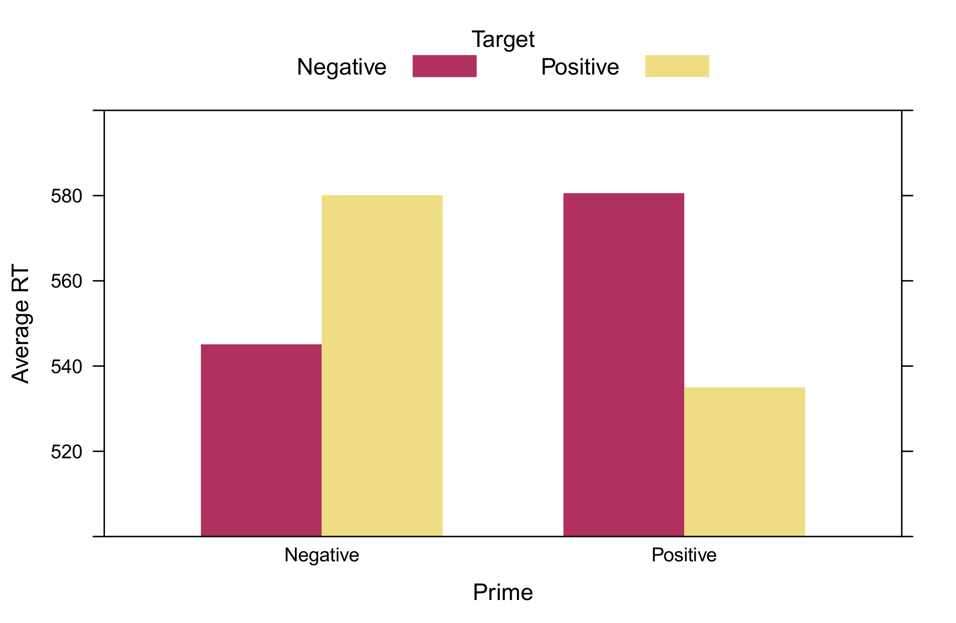
7.8 Crossed random effects
30 subjects performed the lexcial decision task (word or no word?) with affective priming. Target words (positive or negative) are preceded by prime words (positive or negative). Reaction times tend to be facilitated when these valences match.

Slide 97
7.8 Crossed random effects
The data contains two primary sources of random variation: subjects and words, which are both sampled from a population of subjects/words.
There were 8 positive and 8 negative words, which were presented in all possible combinations, representing 256 trials total.
Since each subject was presented with each word, one cannot say that words are nested in subjects. Instead, subjects and words are crossed random effects:
Subjects
1
2
3
…
30
Words

Slide 98
7.8 Crossed random effects
It turns out that "lme4" makes absolutely no distinction between hierarchical and crossed random effects in its formula syntax. The specification is exactly the same, e.g.:
model <- lmer(RT~Prime*Target
+(1|Subject)+(1|Pword)+(1|Tword),data=priming)
The estimates for the random effects variances are:
Random effects:
Groups Name Variance Std.Dev.
Subject (Intercept) 536.38 23.160
Pword (Intercept) 11.69 3.419
Tword (Intercept) 11.25 3.354
Residual 400.12 20.003
Number of obs: 7473, groups: Subject, 30; Pword, 16; Tword, 16

Slide 99
7.8 Crossed random effects
AIC/BIC for the model that includes random word intercepts is much lower (AIC=66238) than for a model that omits these intercepts (AIC=66525), suggesting strong evidence for within-word correlation of RTs.
This time we can also include random effects for the prime × target interaction within subjects:
model <- lmer(RT~Prime*Target
+(1+Prime*Target|Subject)+(1|Pword)+(1|Tword),
data=priming)
Including these random effects allows that individual subjects differ with respect to affective priming. Some may exhibit stronger effects, others none at all.
However, the AIC value indicates that this inclusion does not improve fit for these data, AIC=66246.

Slide 100
7.8 Crossed random effects
Finally, we have a look at the ANOVA table for the fixed effects of the affective priming model:
contrasts(priming$Prime) <- contr.sum(2)
contrasts(priming$Target) <- contr.sum(2)
model <- lmer(RT~Prime*Target+(1|Subject)+(1|Pword)+(1|Tword),
data=priming,REML=FALSE)
anova(model)
Which returns:
Analysis of Variance Table of type 3 with Satterthwaite
approximation for degrees of freedom
Sum Sq Mean Sq NumDF DenDF F.value Pr(>F)
Prime 2860 2860 1 14.0 7.15 0.01817 *
Target 50093 50093 1 7412.2 125.19 < 2.2e-16 ***
Prime:Target 215378 215378 1 14.0 538.28 1.423e-12 ***
---
Signif. codes: 0 ‘***’ 0.001 ‘**’ 0.01 ‘*’ 0.05 ‘.’ 0.1 ‘ ’ 1

Slide 101
(!) HLM as a data imputation model (!)
The priming data contained an additional complexity that I have not mentioned so far. Although every subject completed 256 trials, some trials were deleted from the final data, due to (a) wrong responses on the lexical decision task, (b) RTs that were too fast, or (c) RTs that were too slow. The final data were thus unbalanced at the trial level.
However, these missing values pose absolutely no problem to an HLM. Information that is missing from one subject will implicitly be imputed with information from the estimated covariance structure (i.e., the random effects), which is a pooled estimate from all available information.
The ability to implicitly impute missing information is what grants an HLM power to handle unbalanced data, partial-within designs (with systematic missingness), nested or crossed random effects, and continuous within-variables!

Slide 102


7.9 Longitudinal modeling with HLM
Toy retailer Dreamland is tracking the sales of its products. In particular, a new line of robot ponies is showing declining sales over the past month. The advertising department launches a new television campaign to promote the toys. Sales analysts want to test the effectiveness of the campaign.
Sales data from 30 Dreamland stores, for a 60 day period, 30 days before the advertising campaign, and 30 days afterwards. Every day, store employees log the number of robot ponies sold.

Slide 103
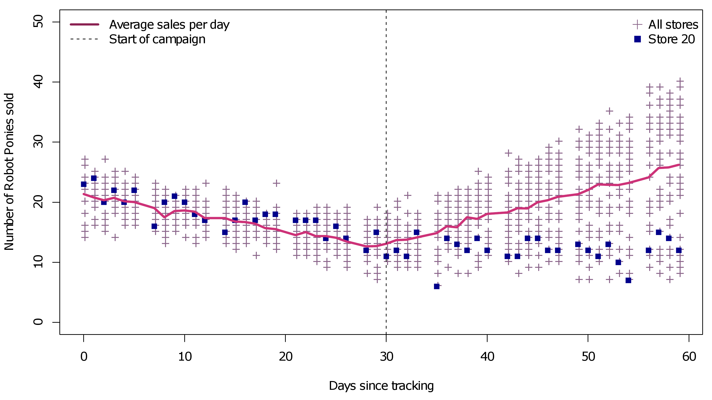
7.9 Longitudinal modeling with HLM
Inspection of the data:

Slide 104
7.9 Longitudinal modeling with HLM
Challenges in this dataset:
Systematic missingness on Sundays...
Different sales trends before and after the start of the advertising campaign...
No visual evidence for random time trends before advertising...
Visual evidence for random time trends after advertising...
Potential auto-correlation of time series...
The primary challenge for these data is how to model the sales trends over time. Clearly, a single regression slope is not adequate to capture the sales changes over time.
In general, most longitudinal data tend to exhibit non-linear trends. How can we take these dynamics into account in an HLM?

Slide 105
7.10 Polynomial regression
An obvious choice for these data would be the use of polynomials, that is, quadratic, cubic or even higher-order terms:
quadmod <- lmer(Sales~Time+I(Time^2)
+(1+Time+I(Time^2)|Store),data=ponies)
Two new operators appear in this formula, firstly the power operator ( ^ ), which transforms the time variable to the second power, and secondly the priority operator ( I ), which tells R explicitly that time must be squared before entering it into the model. Note that this will not work:
quadmod <- lmer(Sales~Time+Time^2
+(1+Time+Time^2|Store),data=ponies)
When entering the formula above, however, you may also receive a warning...

Slide 106
7.10 Polynomial regression
Warning messages:
1: Some predictor variables are on very different scales: consider rescaling
2: In checkConv(attr(opt, "derivs"), opt$par, ctrl = control$checkConv, :
Model failed to converge with max|grad| = 2.09415 (tol = 0.002, component 1)
3: In checkConv(attr(opt, "derivs"), opt$par, ctrl = control$checkConv, :
Model is nearly unidentifiable: very large eigenvalue
- Rescale variables?
The lmer function can experience numerical difficulties with very large values. This is especially problematic when polynomial terms appear. For this reason it would be wise to rescale the time variable.
ponies$Time.z <- scale(ponies$Time)
quadmod <- lmer(Sales~Time.z+I(Time.z^2)
+(1+Time.z+I(Time.z^2)|Store),data=ponies)
Which should run without trouble...

Slide 107
7.10 Polynomial regression
The random effects also include the quadratic term, which means that individual stores can have a trend that differs from the population trend. A comparison of AIC/BIC for this model (AIC=7100) with a model that omits the random quadratic term (AIC= 7532) confirms the importance of this effect.
Random effects:
Groups Name Variance Std.Dev. Corr
Store (Intercept) 1.772 1.331
Time.z 8.650 2.941 0.58
I(Time.z^2) 2.044 1.430 0.54 1.00
Residual 4.759 2.181
Number of obs: 1560, groups: Store, 30
Fixed effects:
Estimate Std. Error df t value Pr(>|t|)
(Intercept) 14.7842 0.2568 29.0850 57.573 < 2e-16 ***
Time.z 1.4273 0.5398 29.0000 2.644 0.0131 *
I(Time.z^2) 3.5180 0.2683 29.0580 13.112 9.88e-14 ***
---
Signif. codes: 0 ‘***’ 0.001 ‘**’ 0.01 ‘*’ 0.05 ‘.’ 0.1 ‘ ’ 1

Slide 108
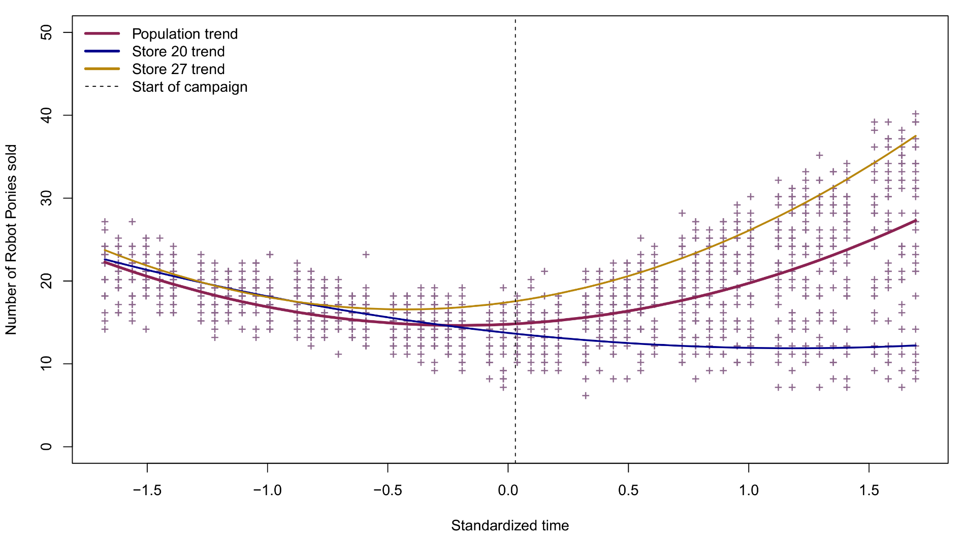
7.10 Polynomial regression
Predicted profiles for the population and two stores:

Slide 109
7.10 Polynomial regression
The results look nice but in reality polynomial regression is not easy to interpret.
We can clearly see that sales increased with the advertising campaign but the effect is hard to quantify. The model did not allow us to test two hypotheses:
Did advertising have a significant effect on the sales trend?
Are there random differences in stores with respect to the advertising effect?
Another problem with polynomial models are their behavior outside of the observed data. The quadratic curves on both sides would extrapolate to never-ending exponential sales.
Can we not find a model that solves these issues...?

Slide 110
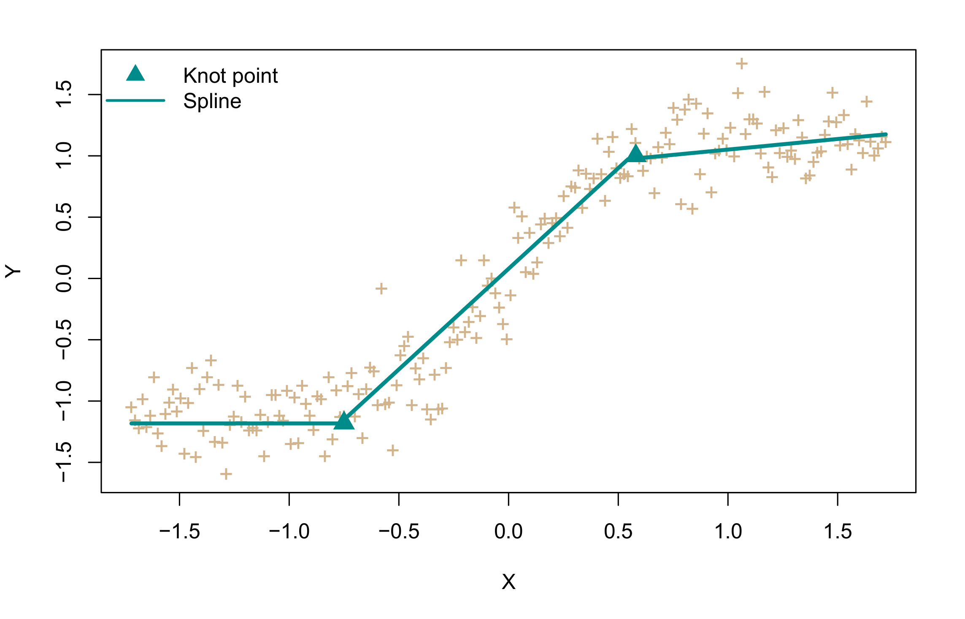
7.11 Piecewise regression with splines
An alternative approach to trend-modelling or curve-fitting with polynomials is to use piecewise linear regression. Instead of fitting one linear slope, we fit multiple linear slopes, joined by knot points. Such pieces are called splines.

Slide 111
7.11 Piecewise regression with splines
For the pony data, we can add a spline effect to our model by creating a new time variable, that is only ”switched-on” (non-zero) after the start of the advertising campaign. For the standardized time variable, this is done as follows:
ponies$Time.s <- ifelse(ponies$Time<0.03, 0, ponies$Time-0.03)
Next we enter it into an HLM:
splinemod <- lmer(Sales~Time.z+Time.s
+(1+Time.z+Time.s|Store),data=ponies)
However, it turns out that this model is not identifiable by R (=overparametrized) unless we restrict the random time and the random spline effect to be uncorrelated.
splinemod <- lmer(Sales~Time.z+Time.s
+(1+Time.z+Time.s||Store),data=ponies)

Slide 112
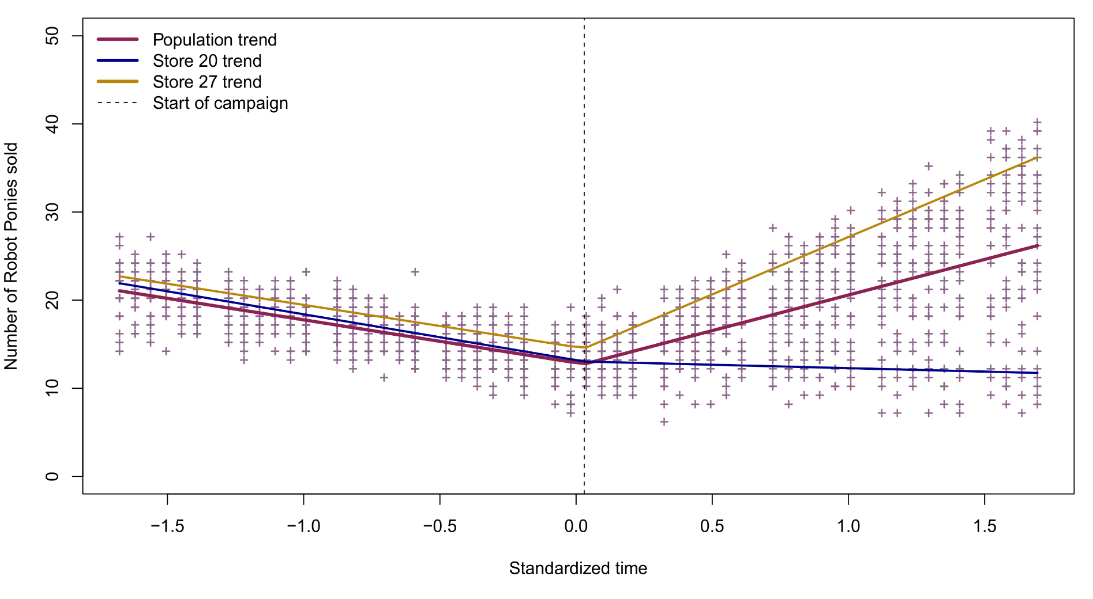
7.11 Piecewise regression with splines
Predicted profiles for the population and two stores:

Slide 113
7.11 Piecewise regression with splines
Testing the two hypotheses:
Random variation in store sales after advertising is supported by AIC/BIC, showing lower values for the model with a random spline effect (AIC=6827) than one without (AIC=7406).
Summary output indicates that there is a significant fixed spline effect. In other words, the linear trend of sales changes significantly after the start of the advertising campaign, -4.87 versus -4.87+12.95=8.08
Fixed effects:
Estimate Std.Error df t-val P-val
(Intercept) 12.8889 0.2203 34.2200 58.50 < 2e-16 ***
Time.z -4.8730 0.1329 34.5300 -36.66 < 2e-16 ***
Time.s 12.9516 1.0505 29.6500 12.33 3.38e-13 ***
---
Signif. codes: 0 ‘***’ 0.001 ‘**’ 0.01 ‘*’ 0.05 ‘.’ 0.1 ‘ ’ 1

