Slide 1
A practical introduction to random effects models for non-independent data
Part III
Ben Meuleman
Swiss Center for Affective Sciences
January 29, 2016, Geneva

Slide 2
Contents
Theory seminar
Standard linear model
Non-independent data
Classic repeated measures analysis
Marginal mixed model
Challenges to classic approaches
Hierarchical mixed model – Basics
Hierarchical mixed model – Extensions
Hierarchical mixed model – FAQ
Practical workshop

Slide 3
8. Hierarchical linear model – FAQ

Slide 4
FAQ topics
8.1 Between- versus within-subjects sample size
8.2 Sample size/power calculation for HLMs
8.3 Standardized effect sizes in an HLM
8.4 Checking statistical assumptions in an HLM
8.5 Significance of random effects values
8.6 Trial-aggregation of data (or not)
8.7 Non-normal dependent variables
8.8 Program errors in LME4

Slide 5
8.1 Sample size (between vs within)
For a study/experiment, is it better to have many subjects, or to have many repeated measurements within subjects?
In general, it is probably better to have many subjects rather than many repeats per subjects. Ultimately the goal of most analyses (i.e., statistical inference) is to generalize conclusions to the population of subjects. The more subjects, the more generalizable the conclusion.
If the goal is to generalize an effect within (a specific) subject, it is obviously more important to have many repeats within that subject.
There exists a misconception with some researchers that having many repeats per subject can compensate for not having many subjects in an experiment. This is typically not true, and depends on the degree to which the repeated measurements are correlated within a subject…

Slide 6
8.1 Sample size (between vs within)
Consider the example of flipping a coin. The result of a coinflip should not be influenced by whichever person is flipping it. That is, within a subject, coin flips should be uncorrelated. For this reason, there is no difference between having 1 person flip the coin 10 times, or having 10 persons flip the coin 1 time.
This example shows that repeated measurements within subjects will only afford extra power across subjects to the extent that they are uncorrelated. If the repeats are completely uncorrelated, having 10 repeats within a subject are no different than having 10 subjects as repeats.
As a consequence, it is true that repeated measures designs can have relatively more power with fewer subjects, but not necessarily so.
Of course, from a sampling perspective, it can be much easier/more efficient to measure the same subject repeatedly, than to measure many different subjects.

Slide 7
8.2 Setting sample size/power
How can I calculate a suitable power/sample size for an HLM analysis?
If you intend to run a study where the data will/must be analyzed in an HLM, you may wish to fix the sample size in advance (or because a journal requires it). This requires a prior specification of values for the following design parameters:
Power level
Significance level
Effect size
Number of intended repeats
Expected covariance/correlation among repeats
The most difficult values to specify in advance are the effect size and the expected covariance/correlation among repeated measures. In general, there is no straightforward extension from power/sample size calculation in the standard linear model to HLMs (except for some special cases).

Slide 8
8.2 Setting sample size/power
For HLMs the most practical strategy for sample size calculations is by simulation. That is, given some prior/earlier data and a selected random effects structure, you could simulate data from this model while systematically varying the fixed effect sizes.
A number of R packages have been developed that implement this approach for models fitted with lme4, including pamm, longpower, clusterPower, odprism, nlmeU

Slide 9
8.3 Standardized effect sizes in HLMs
I would like to report a (standardized) effect size for a fixed effect in an HLM. What should I report?
As mentioned, calculations of effect size in an HLM are complicated by the fact that one can calculate both a marginal effect size (≈at the population level) or a conditional effect size (taking into account the random effects structure).
At present, there is not a straightforward extension of statistics such as Cohen’s d, or (partial) eta/omega squared for HLMs. Software do not output these statistics by default. R-squared has been the subject of several papers and can be calculated according to recent formulas. However, this research is ongoing and the use of these formulas is therefore somewhat experimental.
If your dependent/predictor has a clear interpretation on its own measurement scale, then it may be more convenient to interpret directly the estimated mean differences (or regression coefficients) from the fixed effects output, possibly augmented with confidence intervals.

Slide 10
8.4 Checking statistical assumptions for an HLM
What are the statistical assumptions of an HLM and how should I check them for a fitted model?
An HLM shares many of the basic statistical assumptions of the standard linear model, such as normality of the residuals. Ideally, these should be verified for the final fitted model.
As with effect sizes, diagnostics on residuals require a choice of whether to look at the marginal residuals or to look at the conditional residuals. In chapter 9, Fitzmaurice, Laird and Ware (2004) discuss procedures to obtain transformed residuals and diagnose non-normality for HLMs.
Tests of (co)variance assumptions are typically subsumed by the procedure for random effects selection. That is, once a suitable structure for the random effects has been determined (e.g., by AIC/BIC selection), no further testing of variance assumptions is conducted.

Slide 11
8.4 Checking statistical assumptions for an HLM
Other important diagnostics for a model include whether or not there are outliers present, and whether or not there is multicollinearity between fixed effects.
Conventional statistics for diagnosing outliers (or influential cases) in a model have not been extended for HLMs, meaning that visual pre-screening should be the primary tool for this purpose. Ideally, this is conducted before fitting a model to your data.
Note that "outlyingness" for an HLM can occur at several levels of hierarchy, e.g., outlying observations, outlying subjects, outlying countries, etc. To some extent, an HLM can cope with outlyingness of the higher levels of hierarchy with the inclusion of random effects. Estimates for these effects can be inspected to detect deviating clusters of data.
For detecting multicollinearity (=problematically high correlation) among fixed effects there are scripts available online that report variance inflation factors for lmer-fitted models. These statistics can diagnose problems above a certain cutoff.

Slide 12
8.5 Significance of random effects values
I would like to know which subjects deviate significantly in their response(s) from the population trend. How can I test this?
Most software do not output this type of test by default, nor are there functions available that conduct the tests for you. The exception is SAS, which returns significance tests together with estimates for subject-specific random effects values.
In SAS, one could test whether a subject deviates significantly with respect to their intercept/slope from the population trends. This can be very informative. Unfortunately, SAS is licensed software (and expensive). Most universities do not have the license.
In R, several options suggest themselves…

Slide 13
8.5 Significance of random effects values
Options in R:
Descriptive approach: simply inspect values for the random effects and identify deviating subjects descriptively, e.g., by z-scoring the random effects values
Subsetting: if there are enough repeated measures per subject, one could test for all subjects separately whether they deviate significantly from the population effect (i.e., by first subtracting the population-level effect). Multiple testing is a problematic issue in this approach…
Bootstrapping: conduct a bootstrap test on the random effects values by resampling the data. Resampling schemes may have to be complex, however, due to the random effects structure.
Permutation: conduct a permutation test on the random effects values by permuting the data. This approach is better suited to statistical inference than bootstrapping. However, the permutation scheme can be equally complex.

Slide 14
8.6 Trial-averaging versus trial-level analyses
For repeated-trial data, is it better to average measurements across trials (e.g., per subject per condition), or to conduct a trial-level analysis with an HLM?
In principle, these two approaches could always be contrasted empirically, i.e., by running both and comparing the results. However, which approach is preferred depends on which effects you want to test and the degree to which you expect individual differences to influence those effects.
Trial-level analysis is recommended when:
You have trial-varying covariates (e.g., time), that influence the dependent
The explicit purpose is to estimate an effect (e.g., a priming effect) both within-subjects and between-subjects
You expect large individual differences with respect to a population effect (e.g., responsiveness to a treatment)

Slide 15
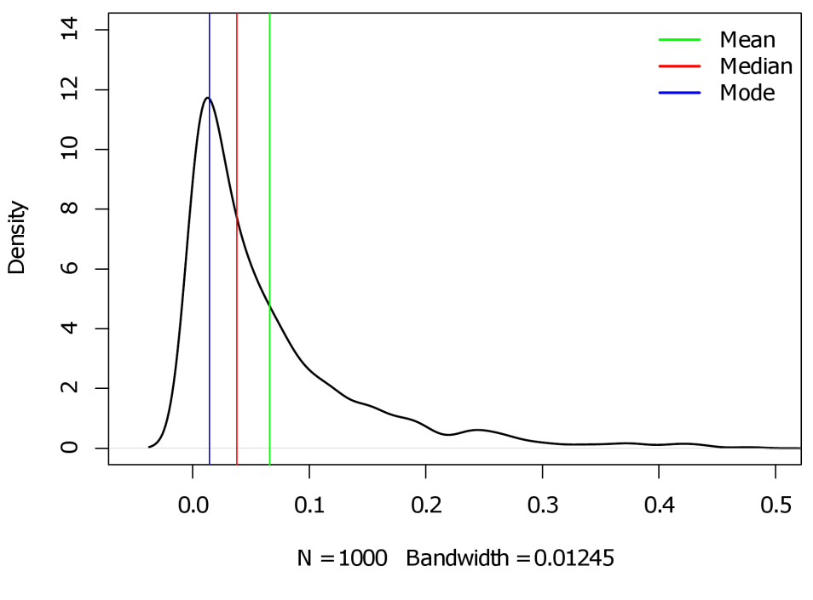
8.6 Trial-averaging versus trial-level analyses
In many cases trial-averaging of data, followed by a conventional repeated measures (M)ANOVA, is a perfectly acceptable approach.
For most experiments, the primary reason to present a subject with repeated trials is to acquire reliable estimates of the typical response for a condition (e.g., a reaction time in a certain condition).
An important question to ask yourself is whether the mean always captures typicality of repeated measures. Other measures of central tendency could be considered for trial-aggregation, such as the median, or even the mode (see graph).

Slide 16
8.7 Non-normal dependents
What about non-normal dependent variables?
The principle of HLM has been extended to non-normally distributed dependents, such as categorical (binomial) or count (Poisson) data.
Two distinct approaches have been developed for fitting such models, one using generalized estimating eqations (GEE), and one using random effects with generalized linear mixed models (GLMM).
Warning: Unlike the standard HLM (i.e., linear mixed model), the categorical extensions do not allow the user to conduct population- and subject-level inference simultaneously. GEE was developed for the former type of inference, GLMMs for the latter
Always inform yourself of which type you are using! GLMMs are not simple extensions of HLM to categorical dependents!

Slide 17
8.7 Non-normal dependents
Chapters 10 through 13 in Fitzmaurice, Laird and Ware (2004) contain an excellent introduction to these models and their complexities. Chapter 13 compares the GEE approach to the GLMM approach, and discusses the relative merits of each.
Numerous R packages offer functions to analyze non-normal dependents, including lme4, nlme, MCMCglmm, MASS, gee, geepack, and many custom scripts that can be found online.
My advice is to avoid these models unless you absolutely need them!

Slide 18
8.8 Program errors in lme4
When I run lmer() I get an error…?
There are several reasons why lmer() can return an error/warning:
Lmer experiences numerical difficulties with large data values. Normally a warning will be printed that recommends scaling of the variables.
The model that you are trying to fit is not identified. This means it is overparametrized, i.e., that the data lacks unique information to estimate one or more parameters.
There are not enough repeated measurements to estimate a particular effect (e.g., a within-subjects effect).
The specified random effects structure is too complex. The lmer function may not stop running (or take a very long time to terminate).
Lme4 usually prints informative warnings even when it terminates prematurely. These will help you to solve the problem. Often, warnings/errors point to a misspecification of the random effects structure.

