Slide 1
Introduction to the composite decomposition channel
what it is all about and why it exists

Slide 2
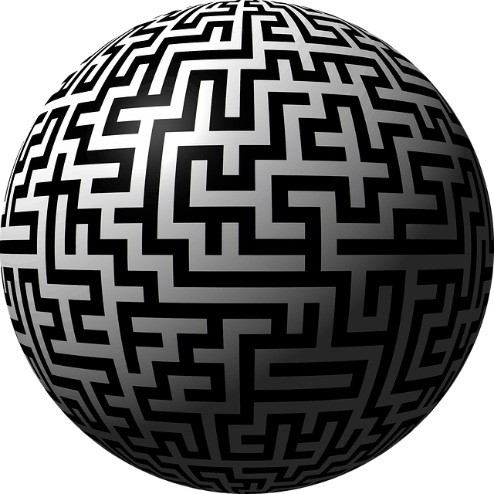

Why composite decomposition?
Source: Globe Labyrinth
Globe Cartography

Slide 3
Raison d'être of this channel
Discusses peculiar topics from various domains, like, software engineering, computer science and data science, not usually elaborated in books, journals, and blogs in self-contained manner.
This channel is not about repetition of what you can already find on the web without bringing in substantially different viewpoints about those themes.
This channel is about educational and practical material emanating from an extensive professional experience in the above mentioned domains!
This channel hosts videos that I share with my students.

Slide 4
Keeping up with videos

Slide 5
simple unawareness leads to not so simple consequences
Story about caches and memory leaks

Slide 6
abstract
In the old days of computing, for example, when I had worked on my Sinclair ZX Spectrum 48K in Z80 assembly, there was an intimate relationship between software and hardware. A software engineer had deep knowledge about the underlying mechanisms of a computer system. This has changed tremendously; just think about the shift toward serverless computing. Today most software people don’t even understand the memory layout of a computer let alone write programs in assembly language.
Modern programming languages try to make things simple by hiding details. IDEs autogenerate lots of boilerplate code reducing manual work and opportunity for bugs. Nevertheless, ignoring how things work in the background may lead to unwanted surprises and hard debugging sessions. This video is a story about why it is important to be knowledgeable about things happening under the hood.

Slide 7
Table of contents
Description of our use case
The need for caching and memoization
Differences between cold and warm (hot) caches
Built-in support for memoization exemplified in python 3.9
the importance of monitoring caching behavior

Slide 8
Problem description
We would like to compute the n-th fibonacci number and output both its value as well as number of steps taken to calculate it. Think of the latter as the number of times we’ve recalculated the same inner component. We will implement this task in python 3.9+.
The focus will be on demonstrating the dangers pertaining to uninformed usage of seemingly simple programming elements.

Slide 9


The need for memoization (form of caching)

Slide 10
Cold vs. warm cache

Slide 11
memoization in Python 3.9+

Slide 12
Monitoring caching behavior

Slide 13
conclusion
A Simple construct may bear a complex behavior.
You are fully accountable for all the code you deliver, be it explicitly or implicitly assumed.
Without knowing what is going on in the background you will not able to ship dependable solutions.

