Slide 1
Introduction to the composite decomposition channel
what it is all about and why it exists

Slide 2
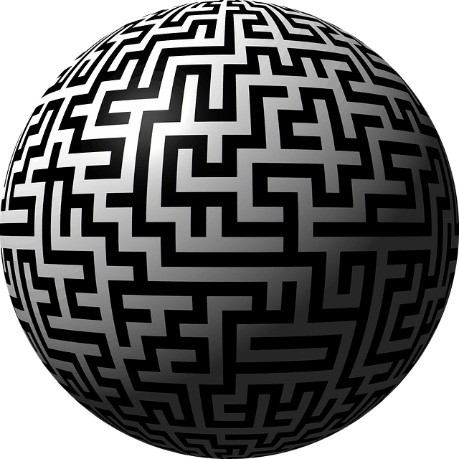
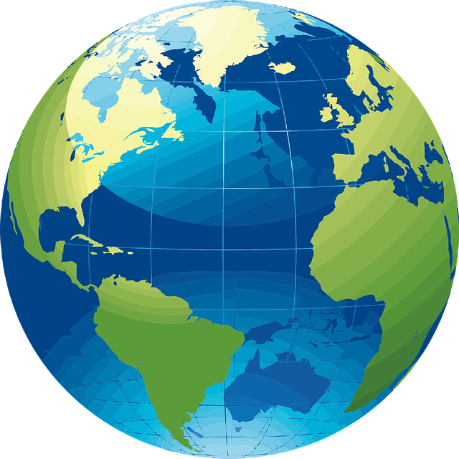
Why composite decomposition?
The aim of this channel is not to untangle you in one instance; the objective is to equip you with knowledge to untangle yourself anytime in the future!
Source: Globe Labyrinth
Globe Cartography

Slide 3
Raison d'être of this channel
Discusses peculiar topics from various domains, like, software engineering, computer science and data science, not usually elaborated in books, journals, and blogs in self-contained manner.
This channel is not about PURE repetition of what you can already find on the web!
This channel is about educational and practical material emanating from an extensive professional experience in the above mentioned domains!
This channel hosts videos that I share with my students.

Slide 4
Keeping up with videos

