Slide 1
Various Parallel Programming Systems
Parallel and Distributed Computing

Slide 2
Chapter 10
This presentation and source code is available at: https://github.com/evarga/parallel-computing-lectures.git

Slide 3


Key Terms
Fine-grained Data Parallelism
Vector Instructions
Vector Pipelining
GPUs
Loop-based Parallelism with OpenMP
Coarse-grained Data Parallelism
Shared Memory Parallelism
Distributed Memory Parallelism
Distributed Memory Programming
Task Scheduling

Slide 4
Conway’s Game Of Life
A 2D board with dimensions NxN is comprised of cells
Every cell is surrounded by 8 neighbors (looking in all directions)
A game unfolds in iterations
If a cell is alive and its count of live neighbors is in the range [2, 3], then it survives, otherwise it dies
If a cell is dead and its count of live neighbors is exactly 3, then it becomes alive, otherwise it stays dead

Slide 5
Versions of the Game
Conway Base (V1) - the basic sequential implementation
Conway V2 - the improved variant as described in exercise 2
Conway V3 - parallel version that uses Dask

Slide 6

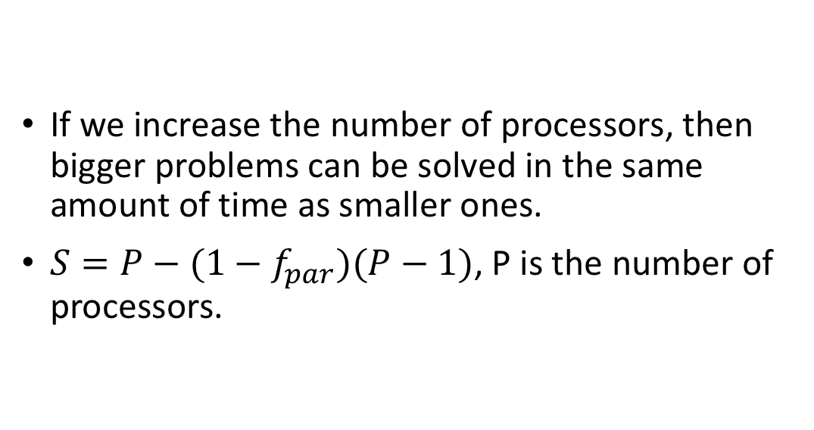
Gustafson’s Law
If we increase the number of processors, then bigger problems can be solved in the same amount of time as smaller ones.
$S=P−(1−f_{par})(P−1)$, P is the number of processors.

Slide 7
Vector Instructions (SIMD)

Slide 8
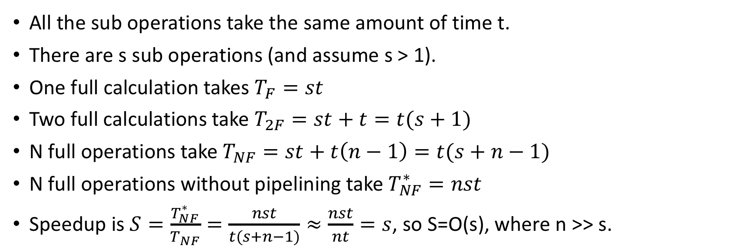
Vector Pipelining (Exercise 4)
All the sub operations take the same amount of time t.
There are s sub operations (and assume s > 1).
One full calculation takes $T_{F}=st$
Two full calculations take $T_{2F}=st+t=t(s+1)$
N full operations take $T_{NF}=st+t\left(n−1\right)=t(s+n−1)$
N full operations without pipelining take $T_{NF}^{∗}=nst$
Speedup is $S=\frac{T_{NF}^{∗}}{T_{NF}}=\frac{nst}{t(s+n−1)}≈\frac{nst}{nt}=s$, so S=O(s), where n >> s.

Slide 9
Distributed Memory Programming with MPI
Suppose there are 5 processors organized in a ring (processor 0 can communicate with processor 5, and vice versa). If every processor makes a blocking send request to its neighbor, then all them will be blocked; nobody can issue a receive request.
p = my_processor_number()
# send my data
my_line.MPI_Send(to=p-1,cells=N)
my_line.MPI_Send(to=p+1,cells=N)
# get data from neighbors
high_line = MPI_Receive(from=p-1,cells=N)
low_line = MPI_Receive(from=p+1,cells=N)
# do the local computation
tmp_line = my_line.copy()
my_line = life_line_update( high_line,tmp_line,low_line,N)
MPI_Isend( buffer1, to=neighbor1, result=request1 );
MPI_Isend( buffer2, to=neighbor2, result=request2 );
MPI_Irecv( buffer3, from=neighbor1, result=request3 );
MPI_Irecv( buffer4, from=neighbor2, result=request4 );
// maybe execute some other code
MPI_Wait( request1 ); MPI_Wait( request2 );
MPI_Wait( request3 ); MPI_Wait( request4 );
// make sure the operations are done
Suppose we have an even number of processors organized in a ring. The sending and receiving of messages would be done in stages as follows:
Even processors send to p-1. Odd processors receive from p+1.
Odd processors send to p-1. Even processors receive from p+1.
Even processors send to p+1. Odd processors receive from p-1.
Odd processors send to p+1. Even processors receive from p-1.

Slide 10
Task Scheduling and Loop Unrolling

Slide 11

Conclusion
Parallel programming requires professional software engineering practices, since ad-hoc approaches don’t work.
Parallel and distributed programming can be applied to boost efficiency, dependability, and clarity of design.
It is always best to reuse higher-level concurrency abstractions from mature frameworks.
For Game of Life you should use Golly (http://golly.sourceforge.net).

