Slide 1
Introduction to Parallelism in Python 3
Parallel and Distributed Computing

Slide 2
Chapter 3
This presentation and source code is available at: https://github.com/evarga/parallel-computing-lectures.git

Slide 3


Key Terms
Spawning processes
Locks and resource contention
Join
Simulation
Parallel merge sort

Slide 4


Cellular Automaton - Basic Python Features

Slide 5

Spawning Processes
Explicitly creating processes
Protecting the standard output (shared resource) via locking
Making evolvable procedures

Slide 6
Communicating via Queue and Manager
Digging Holes example using a queue
Waiting subprocesses to finish their work via join
Parallel “shared” data structures

Slide 7

Timing Processes
Using join to time a child process.
Calculate relative speedup $S=\frac{T_{1}}{T_{P}}$ and absolute speedup $S^{∗}=\frac{T_{1}^{∗}}{T_{P}}$. Parallelism is $\frac{T_{1}}{T_{∞}}$.
Amdahl’s law $S=\frac{1}{\frac{f_{par}}{P}+1−f_{par}}$, where f_{par} is the parallel fraction of the code and P is the number of processors.
Gustafson’s law S = P + (1 - P) * f_{ser}, where f_{ser} is the serial fraction of the code.

Slide 8
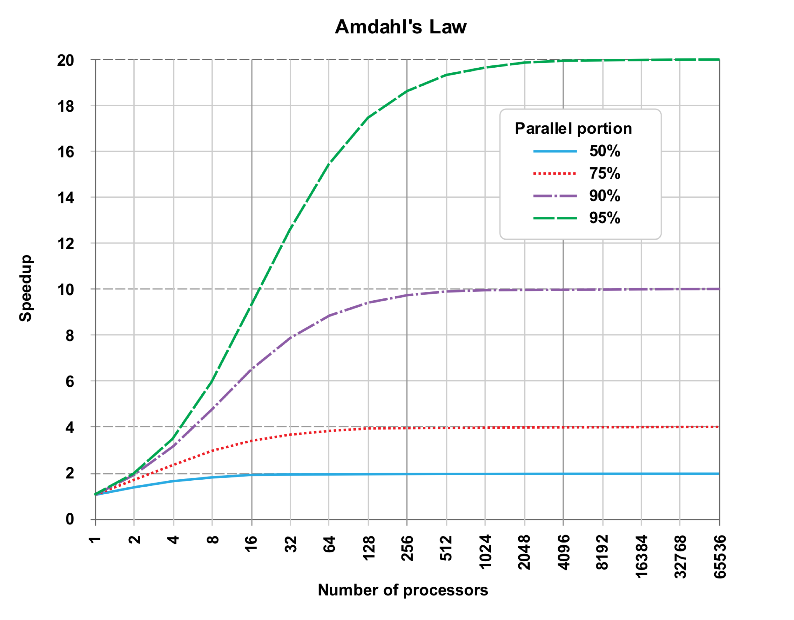
Parallel Scalability by Amdahl’s Law
Source: https://en.wikipedia.org/wiki/Amdahl%27s_law

Slide 9
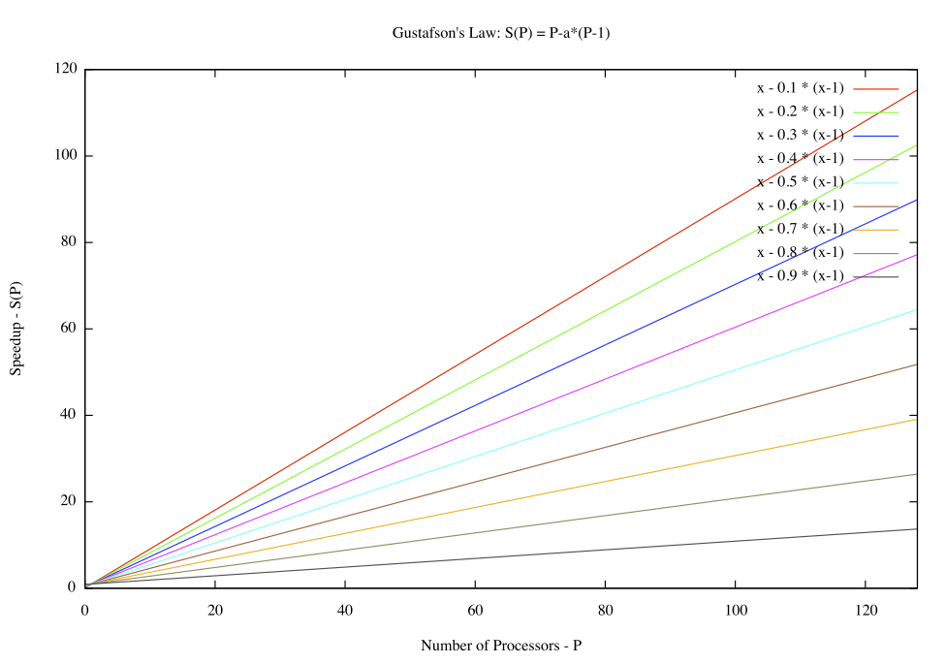
Parallel Scalability by Gustafson’s Law
Source: https://en.wikipedia.org/wiki/Gustafson%27s_law

Slide 10
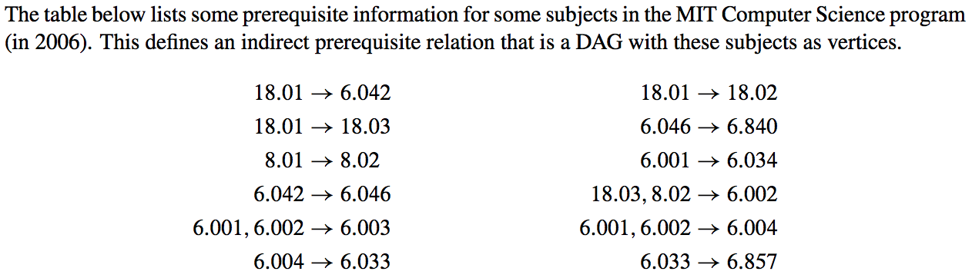
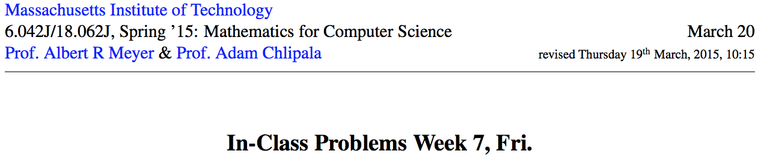
Parallel Scheduling
Problem Description
Source:

Slide 11
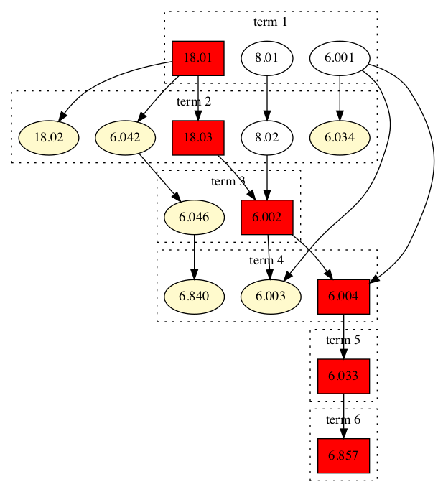
Class Schedule with Greedy Strategy
{18.02, 6.840, 6.003, 6.004, 6.034}
{18.02, 6.840, 6.003, 6.033, 6.034}
{18.02, 6.840, 6.003, 6.857, 6.034}
{18.02, 6.046, 6.003, 6.004, 6.034}
{18.02, 6.046, 6.003, 6.033, 6.034}
{18.02, 6.042, 6.003, 6.004, 6.034}

Slide 12
Class Schedule with 1 Subject per Term
18.01
8.01
6.001
18.02
18.03
6.042
8.02
6.034
6.002
6.046
6.003
6.004
6.840
6.033
6.857

Slide 13
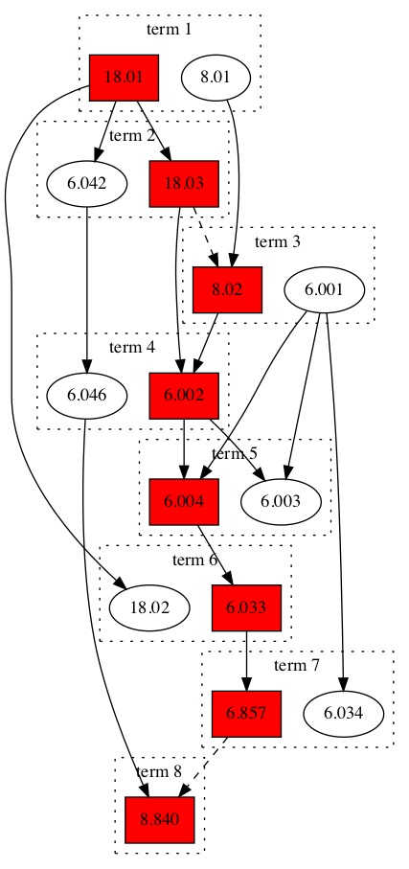
Class Schedule with 2 Subjects per Term

Slide 14
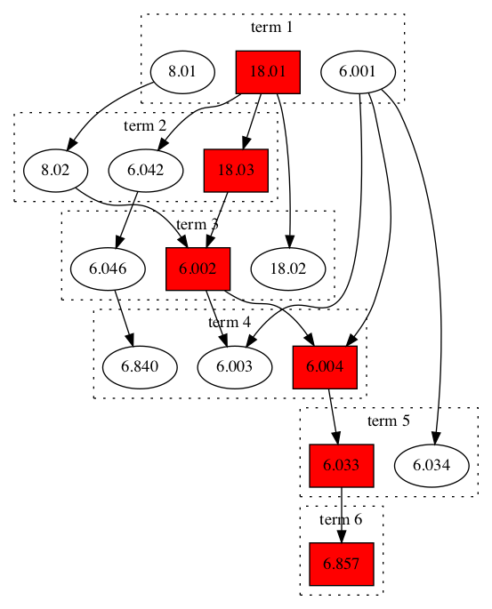
Class Schedule with 3 Subjects per Term

Slide 15
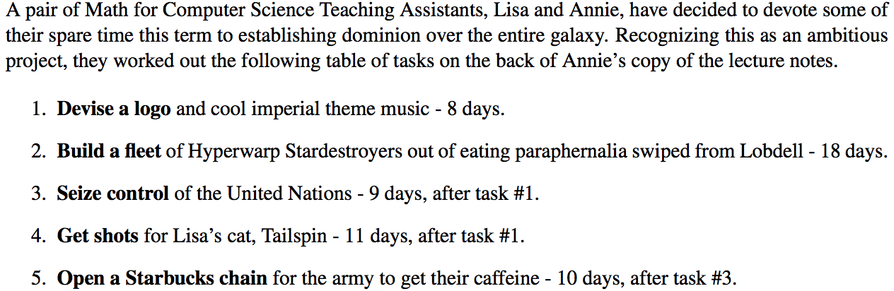
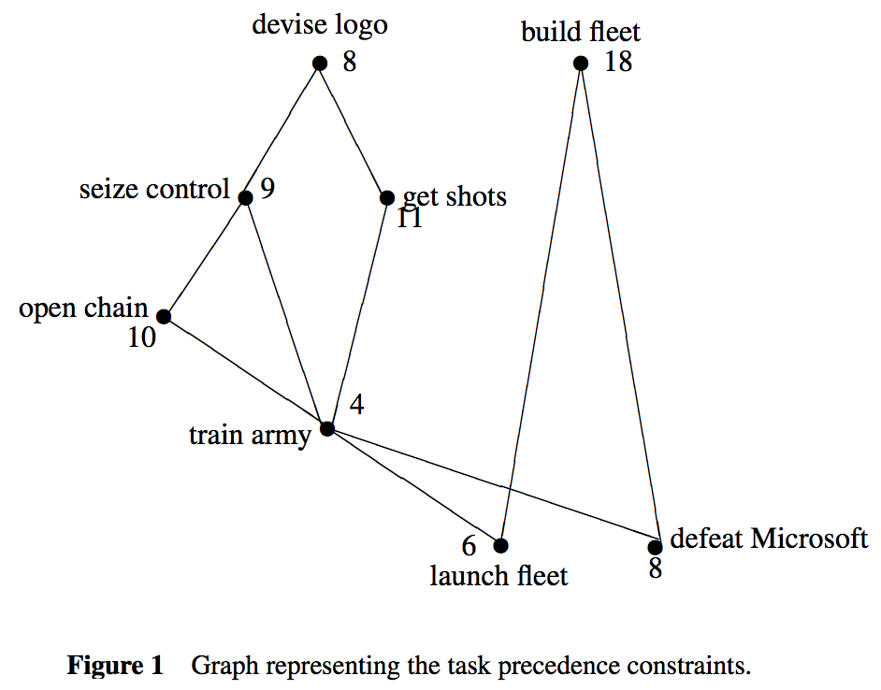
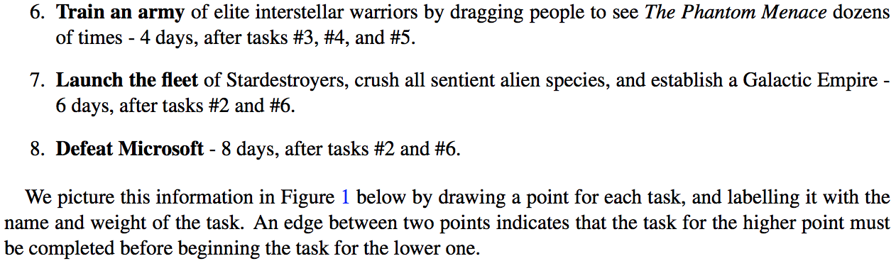
Weighted DAGs
Problem description
Source:

Slide 16
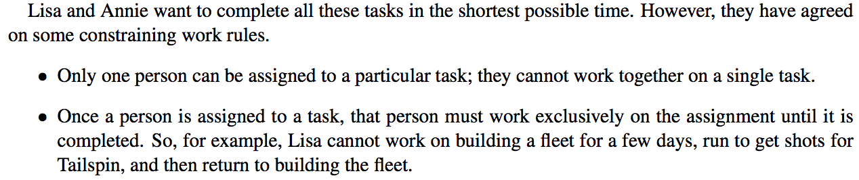
Scheduling Plans
Sequential execution requires 74 days. One possible order is: devise logo->seize control->get shots->build fleet->open chains-> train army->launch fleet->defeat Microsoft.
Estimation based on equal division of work is too optimistic and gives 37 days. This ideal parallelism cannot be achieved here due to interdependencies between tasks of different weights.
Estimation based on critical path is also too low and gives 39 days. It cannot be achieved, as blindly following the critical path would result in extra 2 days of idle time.
The minimum number of days to finish the project is 40 days.

Slide 17
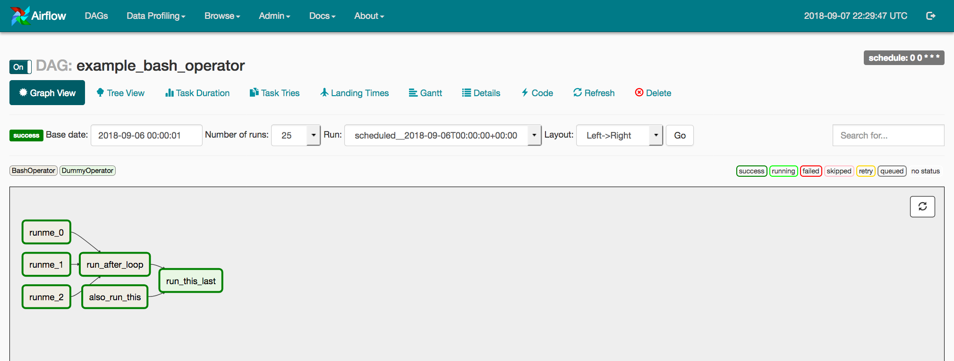
Apache Airflow

Slide 18
Pool/map paradigm
Monte Carlo estimation of 𝝅
Integration by Riemann sum
Parallel merge sort

Slide 19

Conclusion
Python is shipped with a powerful library called multiprocessing for working with processes.
Processes need to communicate and exchange data. Most often this can be accomplished via queues.
Pool/map paradigm is based upon the 3 steps general parallel problem solving procedure: distribute work, execute tasks in parallel, and combine partial results. Very reminiscent to the MapReduce paradigm.

