Slide 1
Introduction to Parallelism in Python 3
Parallel and Distributed Computing

Slide 2
Chapter 3
This presentation and source code is available at: https://github.com/evarga/parallel-computing-lectures.git

Slide 3


Key Terms
Spawning processes
Locks and resource contention
Join
Simulation
Parallel merge sort

Slide 4


Cellular Automaton - Basic Python Features

Slide 5

Spawning Processes
Explicitly creating processes
Protecting the standard output (shared resource) via locking
Making evolvable procedures

Slide 6
Communicating via Queue and Manager
Digging Holes example using a queue
Waiting subprocesses to finish their work via join
Parallel “shared” data structures

Slide 7

Timing Processes
Using join to time a child process.
Calculate relative speedup $S=\frac{T_{1}}{T_{P}}$ and absolute speedup $S^{∗}=\frac{T_{1}^{∗}}{T_{P}}$. Parallelism is $\frac{T_{1}}{T_{∞}}$.
Amdahl’s law $S=\frac{1}{\frac{f_{par}}{P}+1−f_{par}}$, where f_{par} is the parallel fraction of the code and P is the number of processors.
Gustafson’s law S = P + (1 - P) * f_{ser}, where f_{ser} is the serial fraction of the code.

Slide 8
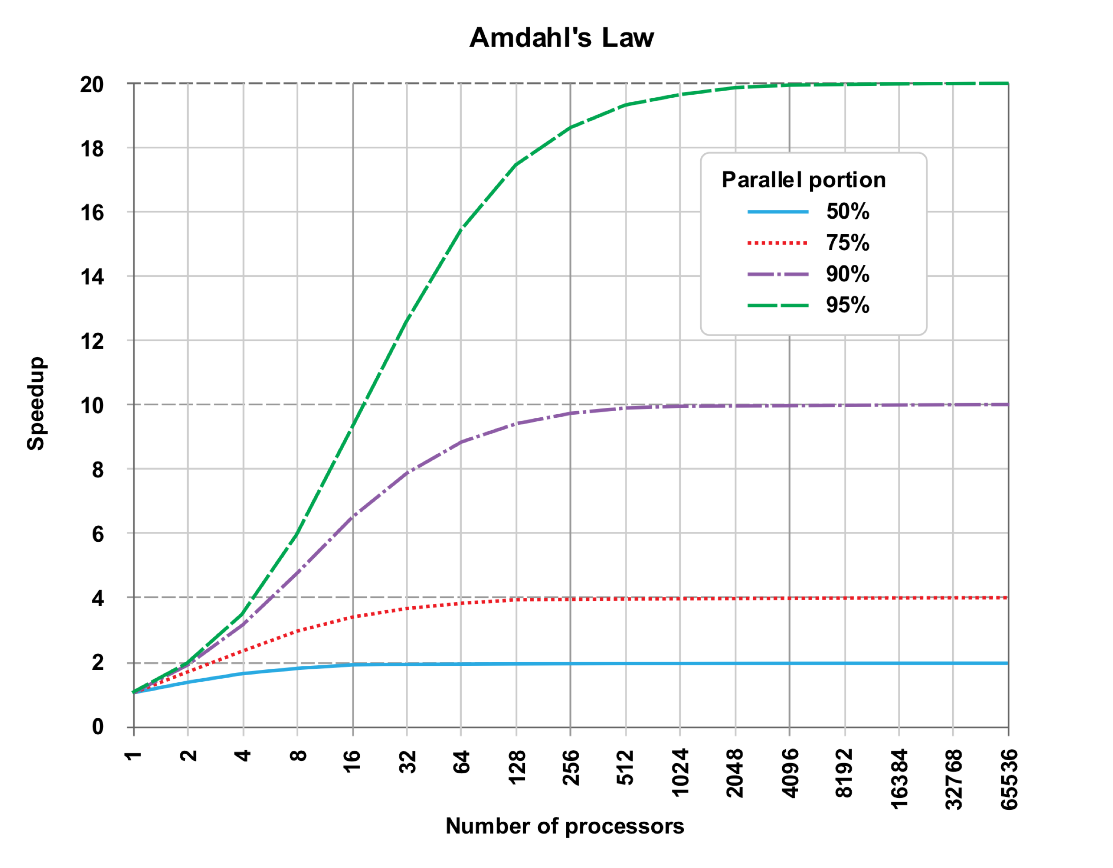
Parallel Scalability by Amdahl’s Law
Source: https://en.wikipedia.org/wiki/Amdahl%27s_law

Slide 9
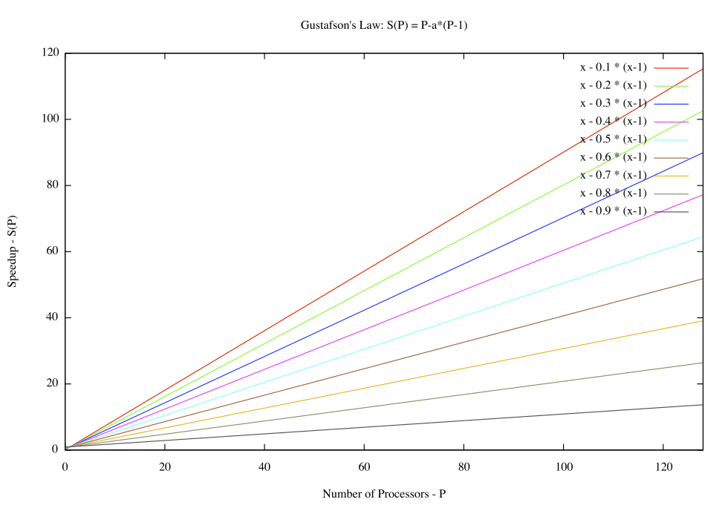
Parallel Scalability by Gustafson’s Law
Source: https://en.wikipedia.org/wiki/Gustafson%27s_law

Slide 10
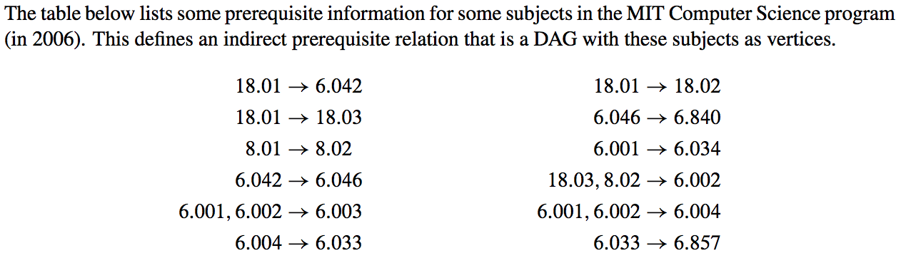
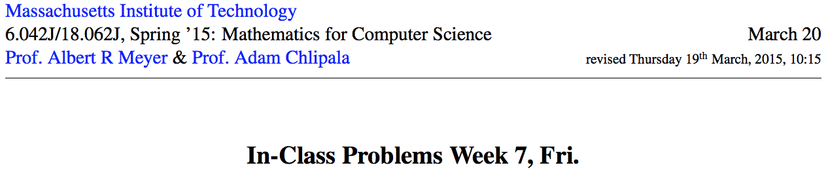
Parallel Scheduling
Problem Description
Source:

Slide 11
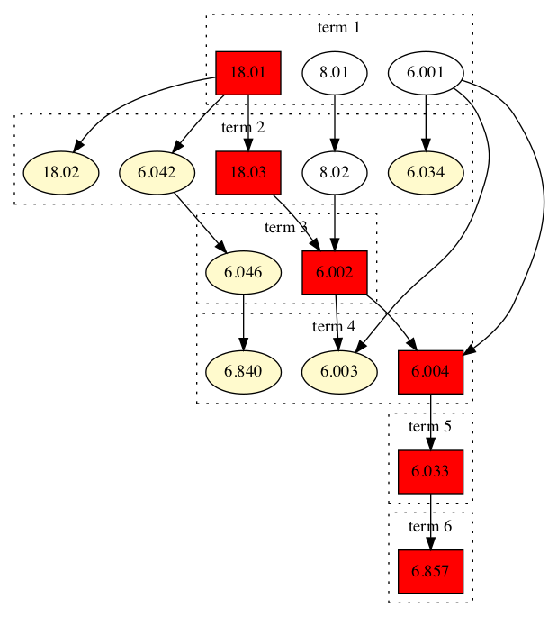
Class Schedule with Greedy Strategy
{18.02, 6.840, 6.003, 6.004, 6.034}
{18.02, 6.840, 6.003, 6.033, 6.034}
{18.02, 6.840, 6.003, 6.857, 6.034}
{18.02, 6.046, 6.003, 6.004, 6.034}
{18.02, 6.046, 6.003, 6.033, 6.034}
{18.02, 6.042, 6.003, 6.004, 6.034}

Slide 12
Class Schedule with 1 Subject per Term
18.01
8.01
6.001
18.02
18.03
6.042
8.02
6.034
6.002
6.046
6.003
6.004
6.840
6.033
6.857

Slide 13
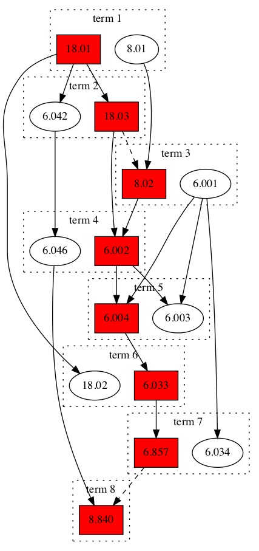
Class Schedule with 2 Subjects per Term

Slide 14
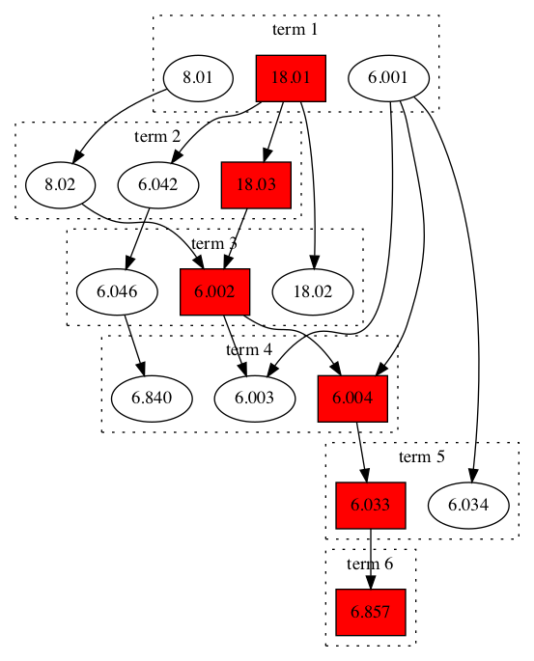
Class Schedule with 3 Subjects per Term

Slide 15
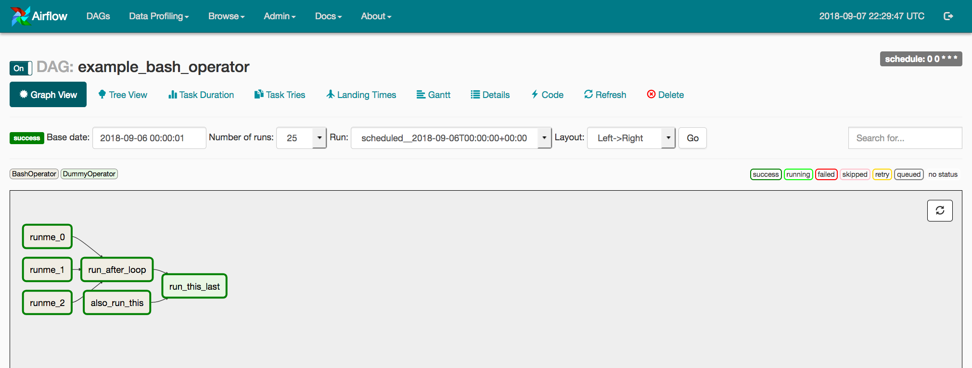
Apache Airflow

Slide 16
Pool/map paradigm
Monte Carlo estimation of 𝝅
Integration by Riemann sum
Parallel merge sort

Slide 17

Conclusion
Python is shipped with a powerful library called multiprocessing for working with processes.
Processes need to communicate and exchange data. Most often this can be accomplished via queues.
Pool/map paradigm is based upon the 3 steps general parallel problem solving procedure: distribute work, execute tasks in parallel, and combine partial results. Very reminiscent to the MapReduce paradigm.

