Slide 1
Basic concepts
Parallel and Distributed Computing

Slide 2
Chapter 2
This presentation and source code is available at: https://github.com/evarga/parallel-computing-lectures.git

Slide 3


Key Terms
Parallelism
Concurrency
Inter-process communication
Blocking
Shared variables
Race condition

Slide 4
Dribbling the Ball - Scratch Program
Version 1 - Synchronization of concurrent programs based on experimental setup
Version 2 - Synchronization of concurrent programs based on message exchange

Slide 5

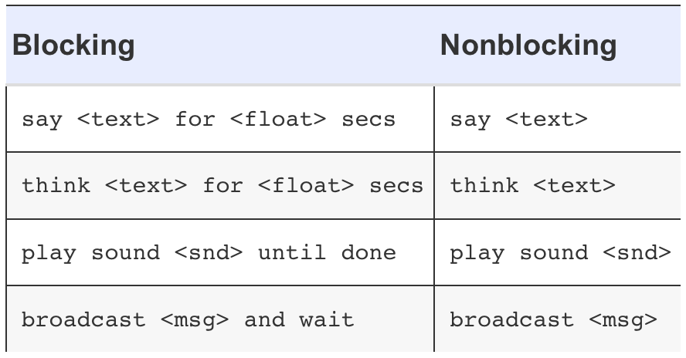
Pong Game - Scratch Program
Version 1 - Race condition present in the program
Version 2 - Race condition eliminated via explicit timing
Version 3 - race condition reestablished by introducing a new blocking command
Version 4 - Race condition avoided again by switching to a non-blocking command

Slide 6
Message Distribution - Scratch Program
Version 1 - Blocking message exchange
Version 2 - Non-blocking message exchange

Slide 7
Whack a Mole Game - Scratch Program
Showcases the difference between private and shared variables

Slide 8

Conclusion
Parallel and distributed computing is a norm rather than an exception
Scratch can be an efficient medium to express key notions in parallel and distributed computing
You have witnessed what parallelism, concurrency, race condition, shared variables, inter-process communication, and blocking mean.

