Slide 1

Case Study:
How does a bike-share navigate
speedy success?
2024-11-07

Slide 2

Summary
The Goal
The source of data
Result of the case study
Reccomendations
Advices to improve strategy
Question time

Slide 3

The Goal
The subject of this case study
How do annual members and occasional cyclists use Cyclistic bikes differently?

Slide 4
The sources of the dataset
To answer the question , we have used the following datasets
file name | dimension | righe
202310-tripdata-20241029.csv | 105.3 Mb | 537113
202311-tripdata-20241029.csv | 71.3 Mb | 362518
202312-tripdata-20241029.csv | 43.9 Mb | 224073
202401-tripdata-20241029.csv | 28.7 Mb | 144873
202402-tripdata-20241029.csv | 44.7 Mb | 223164
202403-tripdata-20241029.csv | 59.3 Mb | 301687
202404-tripdata-20241029.csv | 80.1 Mb | 415025
202405-tripdata-20241029.csv | 117.7 Mb | 609493
202406-tripdata-20241029.csv | 141.3 Mb | 710721
202407-tripdata-20241029.csv | 149.9 Mb | 748962
202408-tripdata-20241029.csv | 150.9 Mb | 755639
202409-tripdata-20241029.csv | 161.0 Mb | 821276
Pubblished on https://divvy-tripdata.s3.amazonaws.com/index.html
Opendata
The license allows to analyze them freely
The period analyzed is between 2023-10 until 2024-09
Composed by 5.854.544 samples
Imported on BigQuery and analyzed thanks to Google sheet

Slide 5
The sources of the dataset
The dataset scheme and data validation
Name | type | description | # NULL value | # Outlayer
ride_id | [string] | unique identifier of the ride on bike | 0 | 0
rideable_type | [category] | electric_bike, electric_scooter, classic_bike | 0 | 0
started_at | [datetime] | start data and time of the ride | 0 | 0
ended_at | [datetime] | end data and time of the ride | 0 | 135832 (2%)
member_casual | [category] | Member, Casual | 0 | 0
start_station_name | [string] | start station name | 1056535 (25%) | 0
start_station_id | [string] | start station identification code | 1056535 (25%) | 0
end_station_name | [string] | end station name | 1091792 (32%) | 0
end_station_id | [string] | end station identification code | 1091792 (32%) | 0
start_lat | [float] | position of start latitude | 1091792 (32%) | 0
start_lng | [float] | position of start longitude | 1091792 (32%) | 0
end_lat | [float] | position of end latitude | 1091792 (32%) | 16 (0%)
end_lng | [float] | position of end longitude | 1091792 (32%) | 42 (0%)

Slide 6
The sources of the dataset
Selection of the most significant columns.
Excluded columns relating to station positions and name due to incomplete data and data errors.
Removed rows where the end date was equal or minor of start date
Added columns calculated: month, day of the week, duration of each trip.
Name | type | description
ride_id | [string] | unique identifier of the ride on bike
rideable_type | [category] | electric_bike, electric_scooter, classic_bike
member_casual | [category] | Member, Casual
month | [1-12] | from the Started_at
dayofweek | [1-7] | from the Started_at
ride_length | [integer] | by difference of End_at end Started_at in minutes

Slide 7
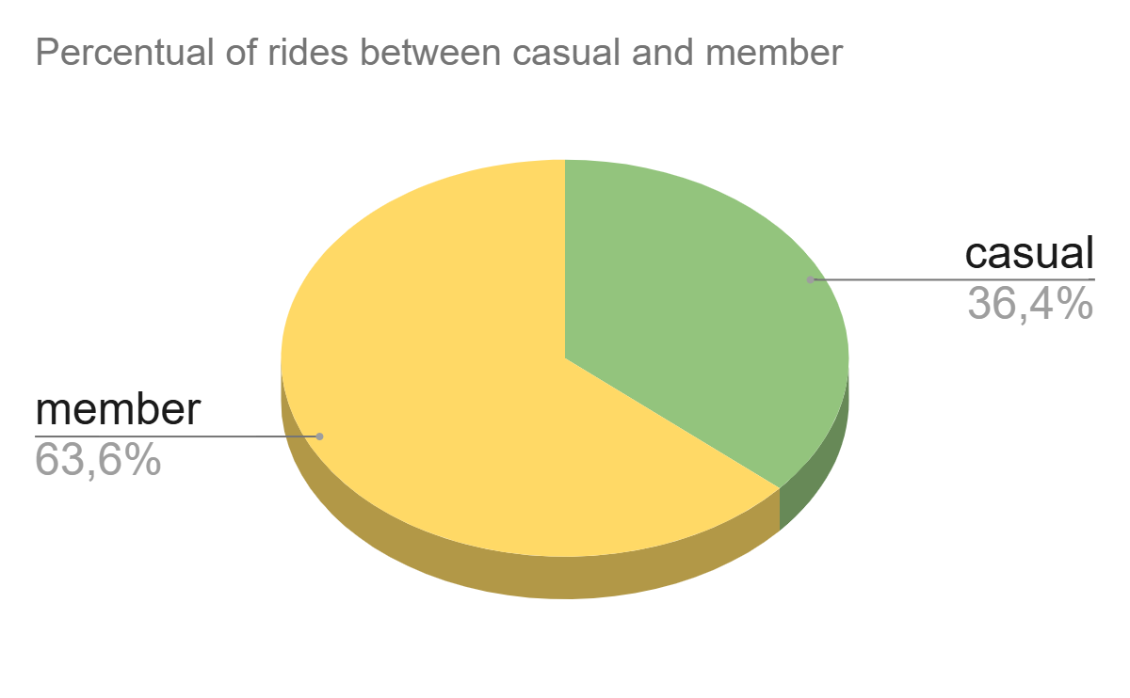
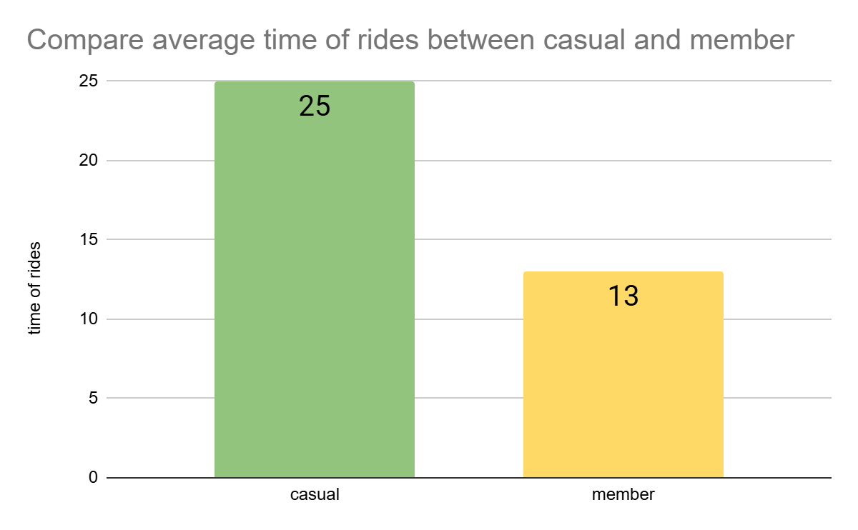
Analysis member vs casual
Analysis full dataset
Count of rides of members is double then casuals
Average time of rides of casual greater than member sometime is the double

Slide 8
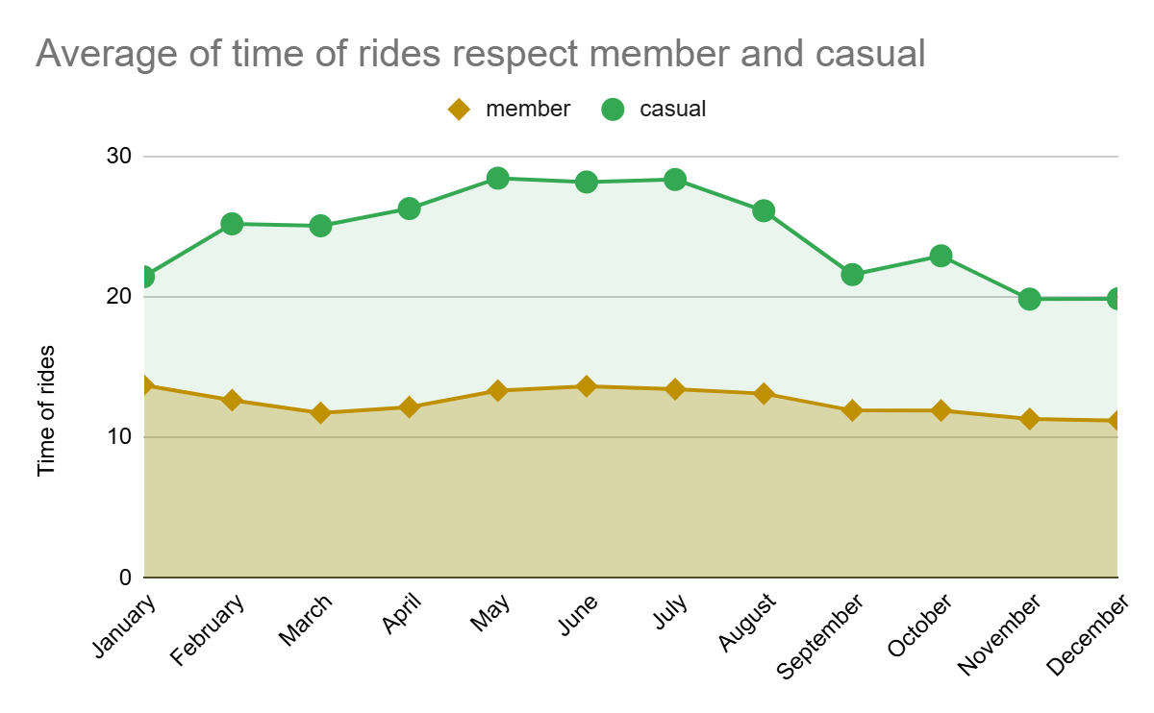
Analysis member vs casual
The trend of the average time of rides by months
 | Member | Casual
mean | 12,5 | 24,4
variance | 0,8 | 10,4
The average travel time of casuals is longer than members, especially in the spring and summer months.
Casuals have higher variance than members.
the Member variance is almost 0 to indicate that they always spend the same amount of time each month.
Notes:
average time of rides of casual greater than member sometime is the double
trend of use of bike in the year of casuals and members are the same
trend increase in summer month and decrease during winter month for both

Slide 9
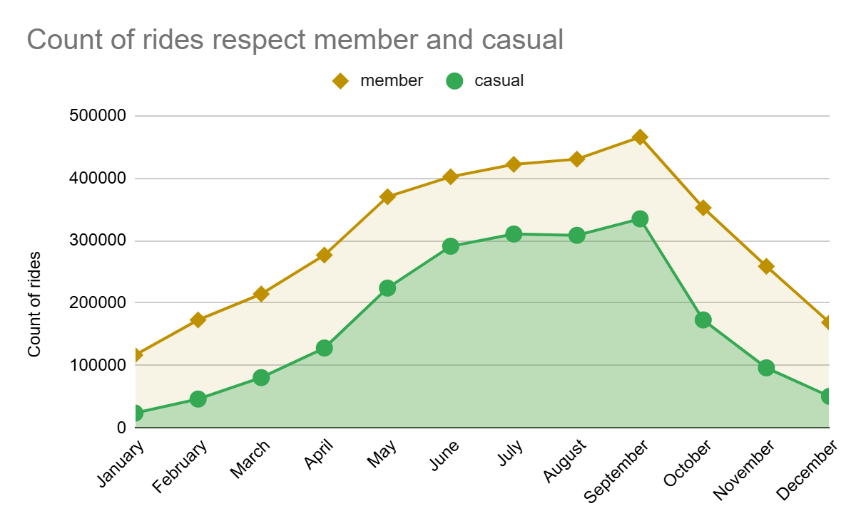
Analysis member vs casual
The trend of count of rides by months
The count’s trend of rides in the year is the same for both members and casuals.
The count of rides for both increase during spring and summer months
Notes:
average time of rides of casual greater than member sometime is the double
trend of use of bike in the year of casuals and members are the same
trend increase in summer month and decrease during winter month for both

Slide 10
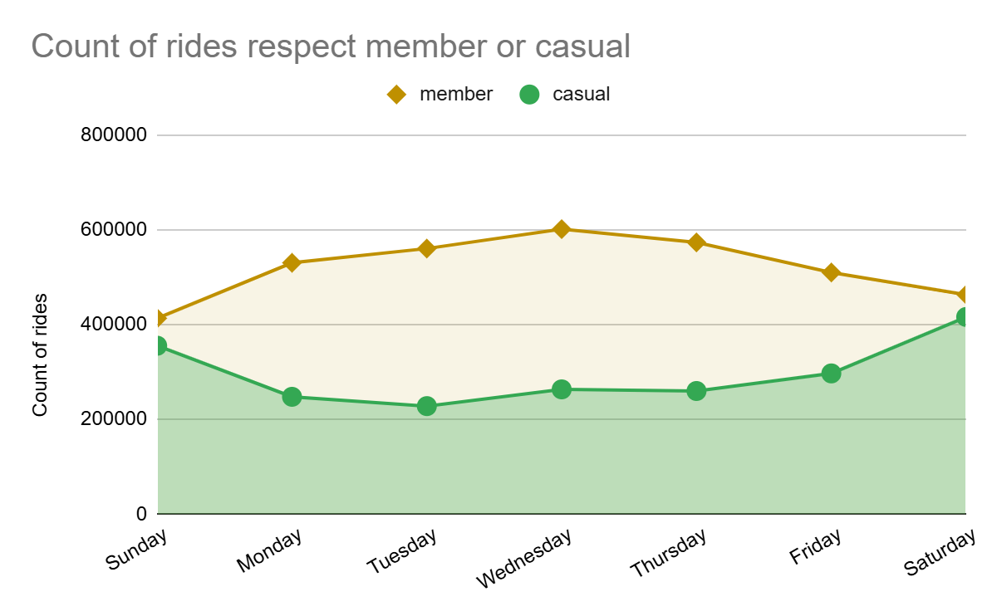
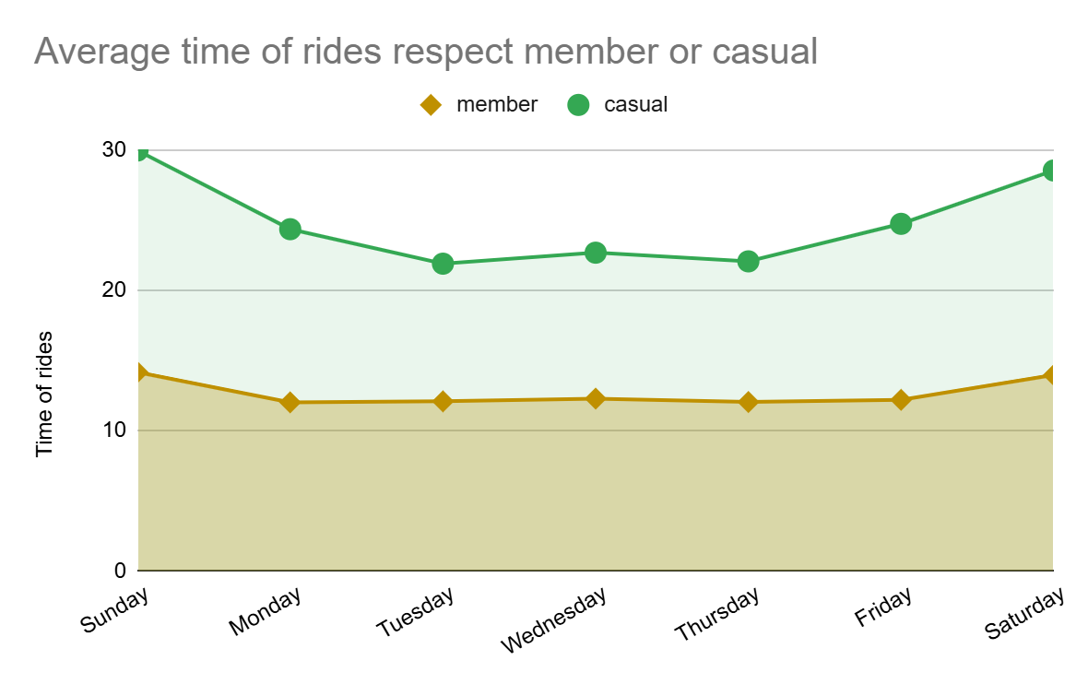
Analysis member vs casual
The trend of the average time and count of rides by day of week
member: the trend increase in work day
casual: the trend became greater in weekend
member: the trend is lower and constant
casual: the trend is greater during the weekend (max 30 sundsy and saturdsy, min 22 tuesday, wednesday, thursday)
Notes:
Opposite trend between casual and meber
the same during saturday and sunday
average time of casual with great variance with top during weekend,
average time of member constant around the mean of 13,
average time of member inferior then casual near the half

Slide 11
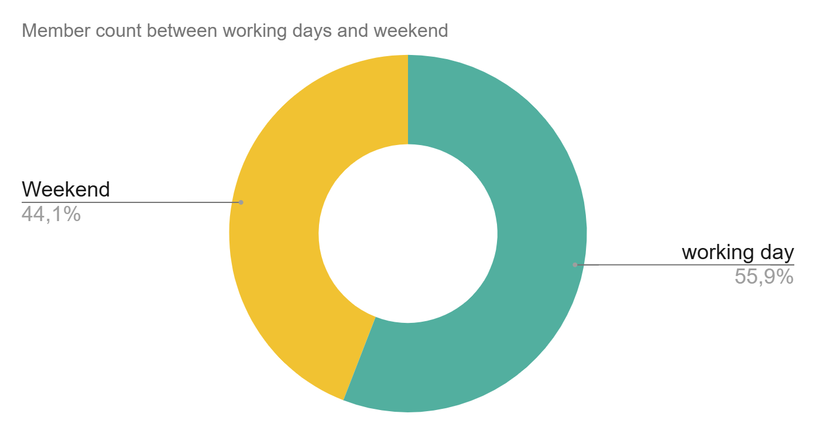
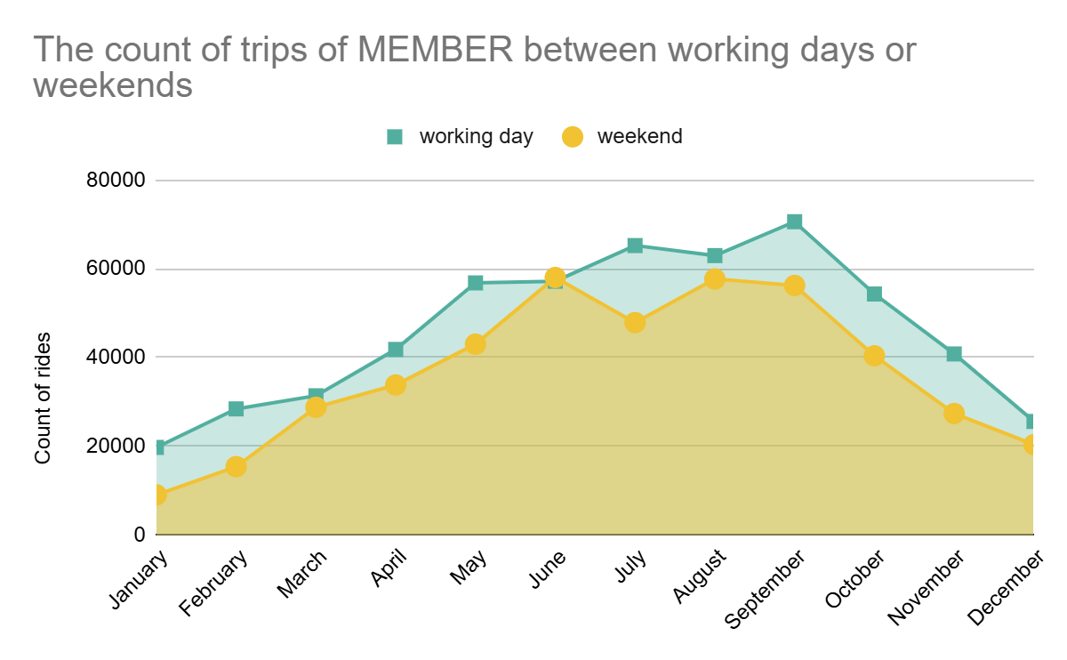
Analysis member vs casual
Compare the rides count of the member in the year during weekend or working days
The service is used by Members more frequent in working day than weekend (55.9% - 44.1%), this trend is similar in every months

Slide 12
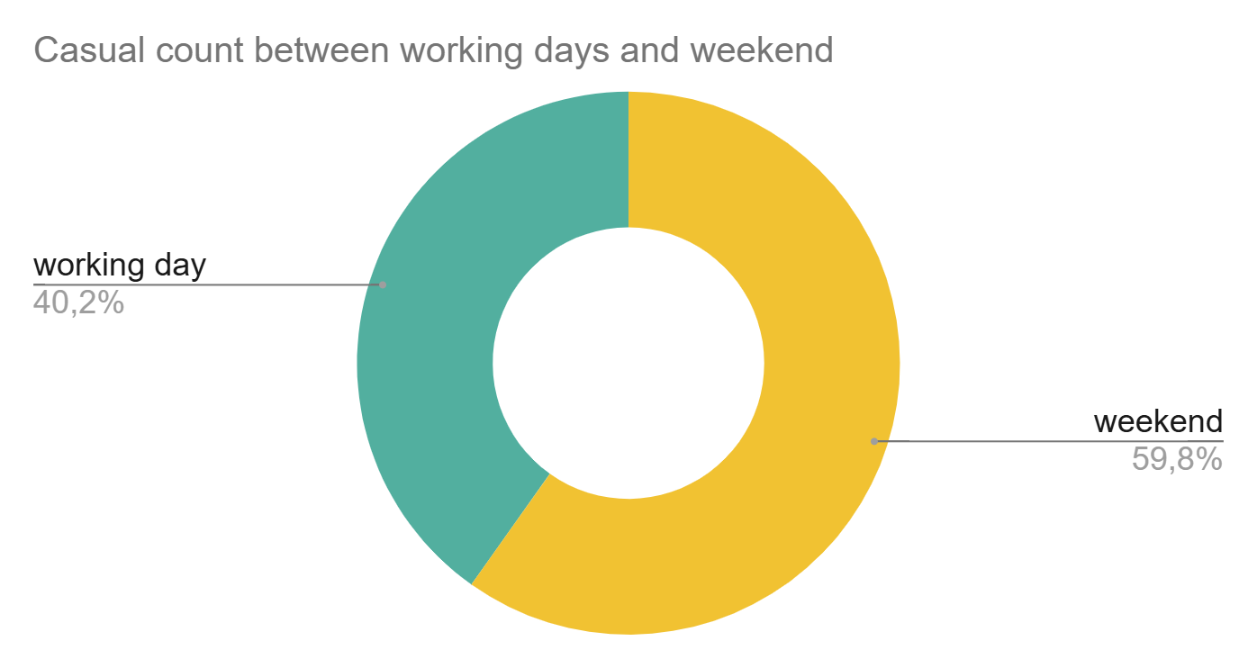
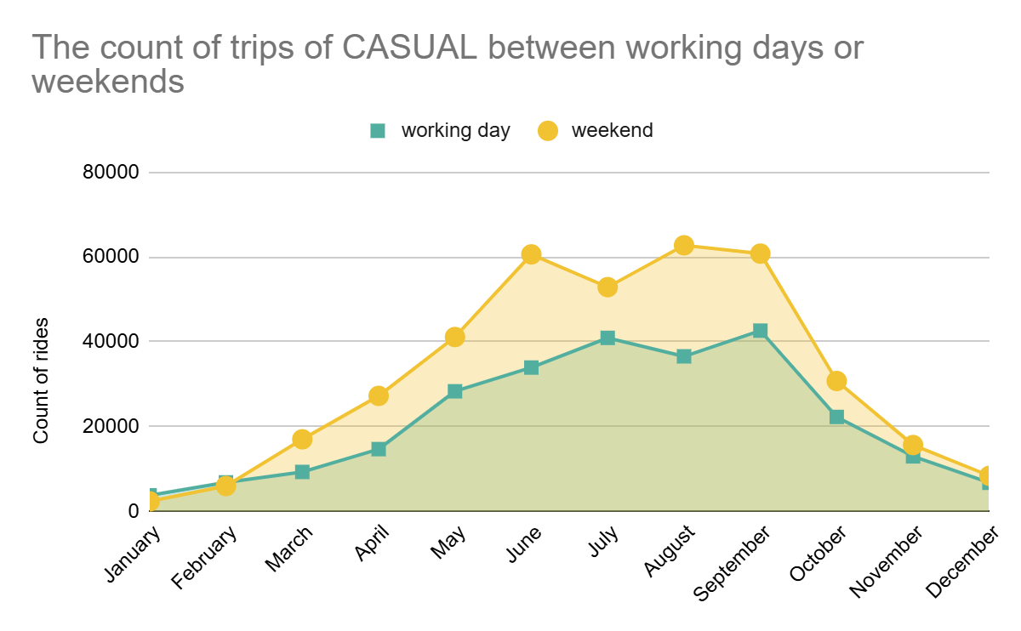
Analysis member vs casual
Compare the rides count of the casual in the year during weekend or working days
the service is used by Casuals more frequent during the weekend (59.8% - 40.2%)
that casuals in weekend increase the use during the spring and summer

Slide 13
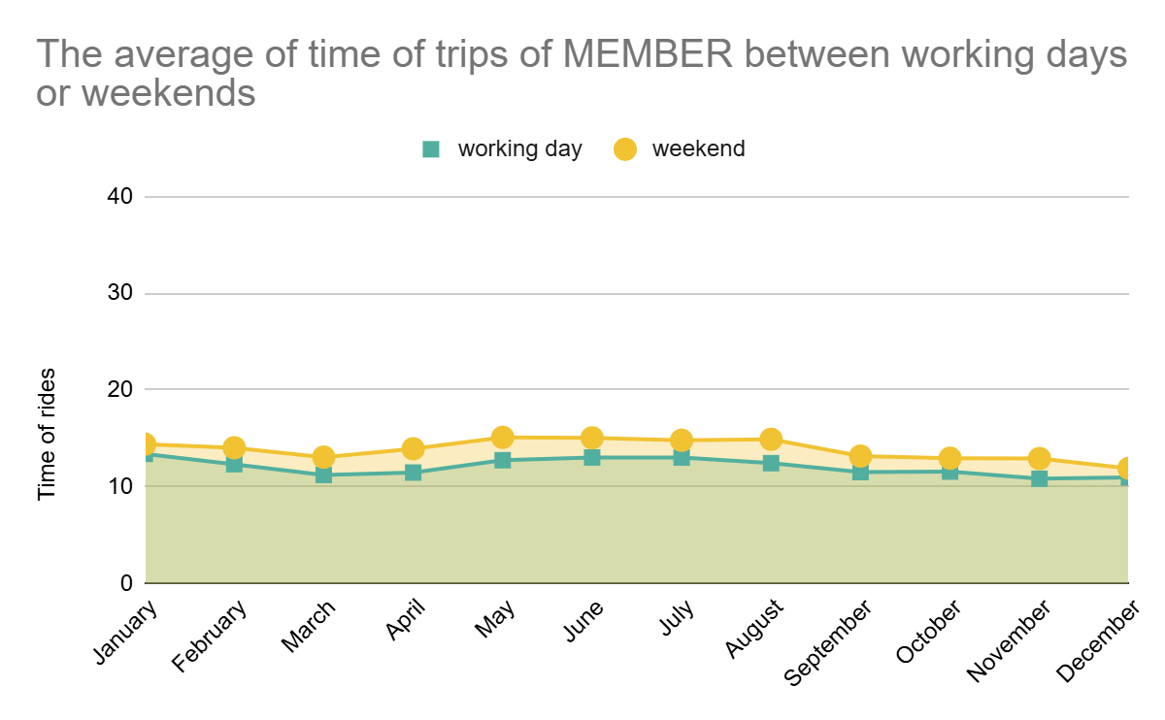
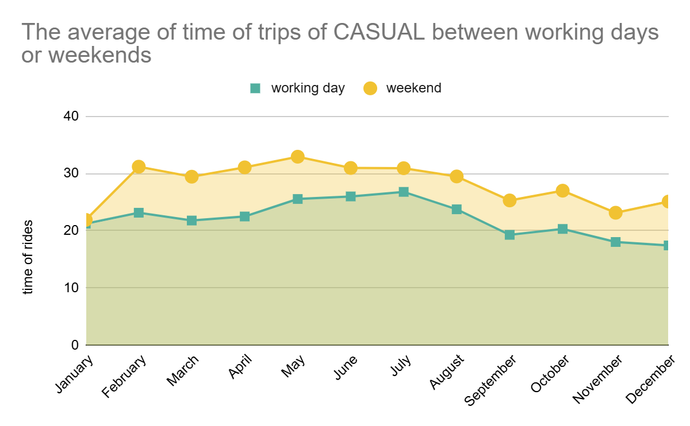
Analysis member vs casual
Compare Time of rides in the year between weekend or working days
member: trend in every months of year is similar in all days
casual: the service in every months of year is use smore in week end than working days
Notes:
In general there isn’t difference how much the service is used in workday or weekend
But in the weekend the time of use is greater the other days

Slide 14
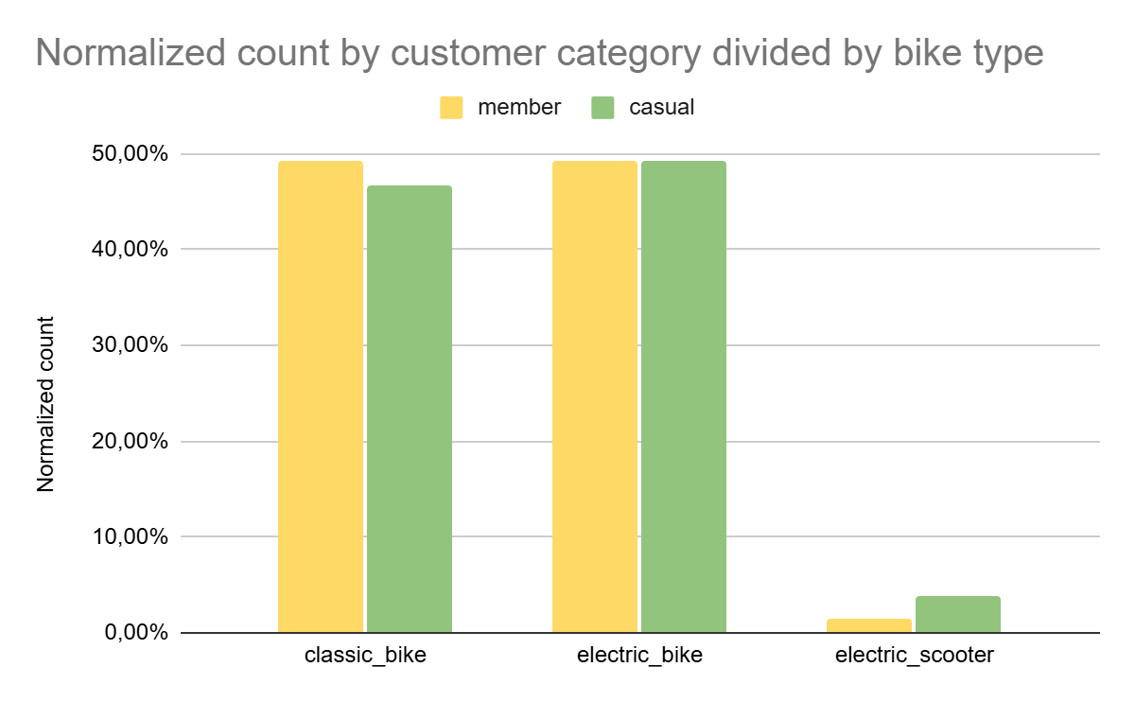
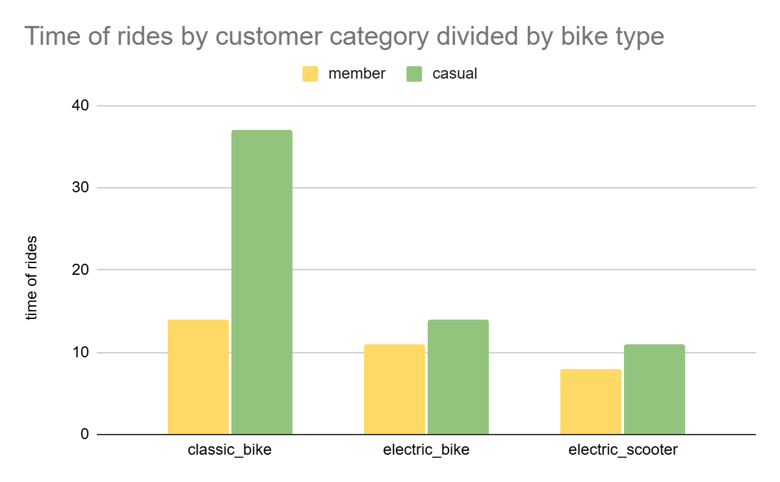
Analysis member vs casual
Comparing between type of bikes
member casual
member casual
member casual
member casual
member casual
member casual
All kind of customer use the same genre of bike in the same percentual
casual when use classic_bike tends to do longer rides then member

Slide 15

Result of the case study
Summary
Casuals rides are 28% less than members.
The duration of the casuals' races is longer than that of the members (25 minutes casuals vs 13 members)
Casuals increase their use of the service in the spring and summer more than members
Casuals prefer to use the service on weekends (average 30 minutes)
The rides count of members always has the same trend throughout the months on both working days and weekends
Casuals users prefer the classic bikes for traveling for a long periods, more than members (45 minutes versus 12 minutes)
Members use the service with a constant duration (low variance 0,8) as if the use depended on a scheduled event, vice versa the duration of the Casuals has a high variance to indicate that the use does not follow a scheduled need.

Slide 16

Reccomendations
Casuals use the service for pleasure, in fact they prefer spring and summer weekends and use the service for a long time
Members use the service to cycle for usual services such as going to work or other repetitive activity, to reach easily a destination.
The result of this study : To evaluate subscription strategies that favor those who use the service for:
longer periods
spring and summer months
using classic bike especially on weekends

Slide 17
Advices to improve strategy
Connecting the trips for the same user to the dataset would allow us to better understand the service's habits of use. Thus, we could identify homogeneous groups to which specific strategies can be dedicated through clustering.

Slide 18

Question time

