Slide 1

CASE STUDY 1:
Recommending Location to new Businesses
YELP DATA
Group 13

Slide 2
Problem Statement
While starting a new business, location plays a vital role for the business to prosper
Setting up a business at an improper location where others have a competitive edge could result in unfavorable outcomes
Hence, it is important to choose the right location to start a business
Our algorithm recommends areas in which it would be feasible to set up new business

Slide 3
Motivation
Around 60 percent of new businesses fail within the first year. And nearly 80 percent shutter before their fifth anniversary. Often, the No. 1 reason is simply location — and the general lack of self-awareness that you have no business actually being in that location.
https://www.cnbc.com/2016/01/20/heres-the-real-reason-why-most-restaurants-fail.html
Source : CNBC
Placing your business in a part of town that reflects your brand away from your competitors can impact the success of your establishing.
Source : The Arizona Republic

Slide 4
Our Approach and Methodology
The main aim is to show favourable places to start a new business
These places are either without many businesses of the same category or businesses without a good rating in an area
It is not easy for a new business to grow in a place with well-established competitors

Slide 5
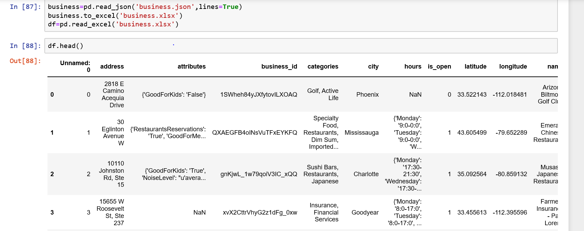
Importing The Dataset

Slide 6
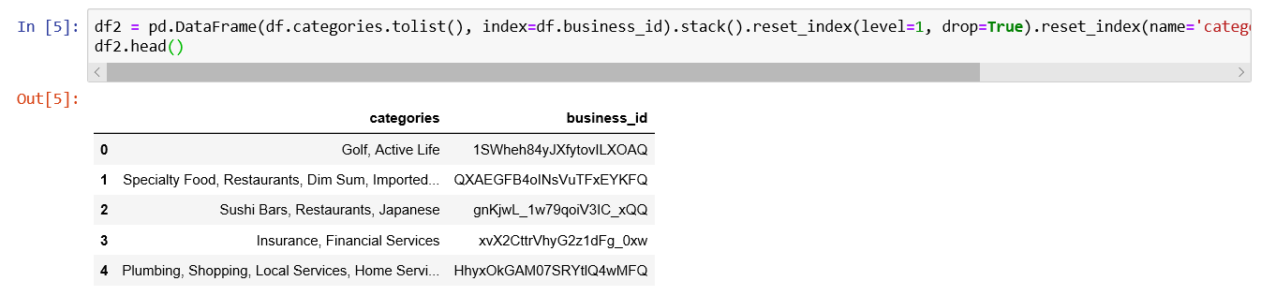
Extract ‘categories’ and ‘business_id’ into a new dataframe

Slide 7
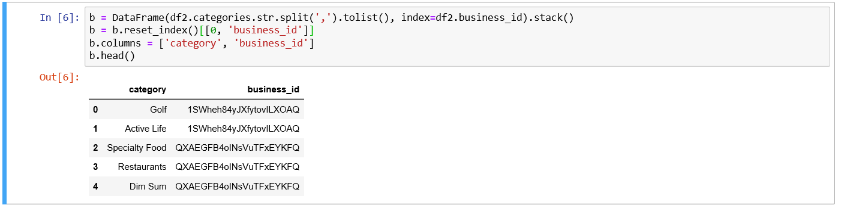
Splitting the list of categories as a single entry

Slide 8
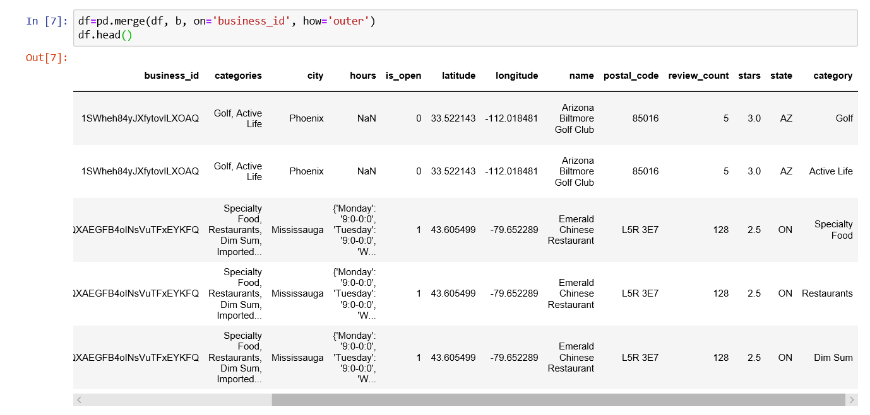
Merging Dataframes on business_id

Slide 9
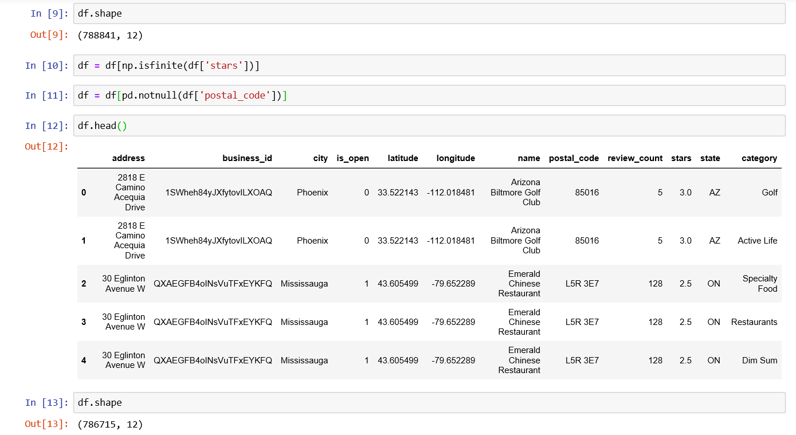
Data Cleaning

Slide 10
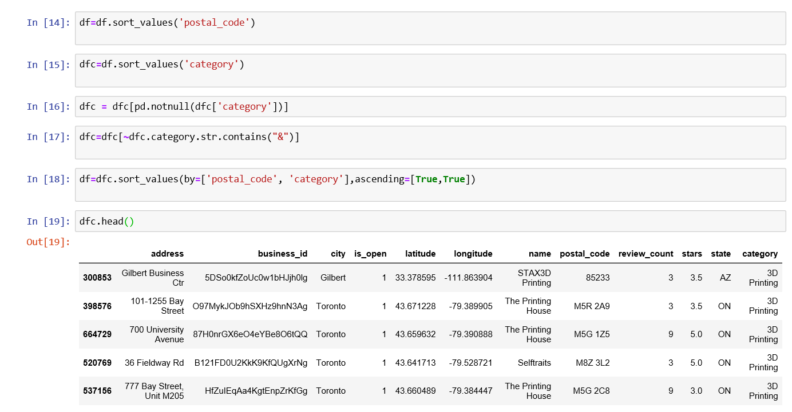
Sorting data by category and postal code

Slide 11
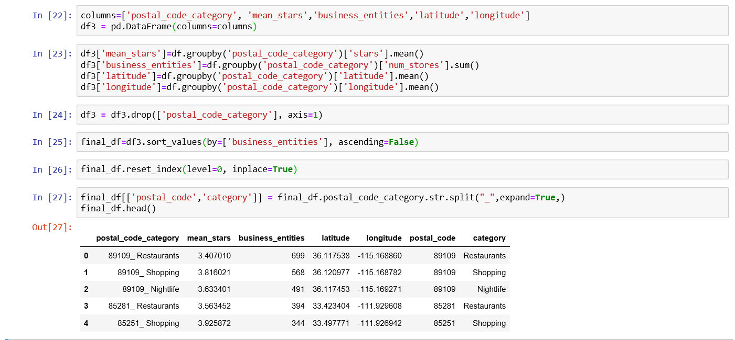
Calculating the average rating and number of business entities for a category for a postal code

Slide 12
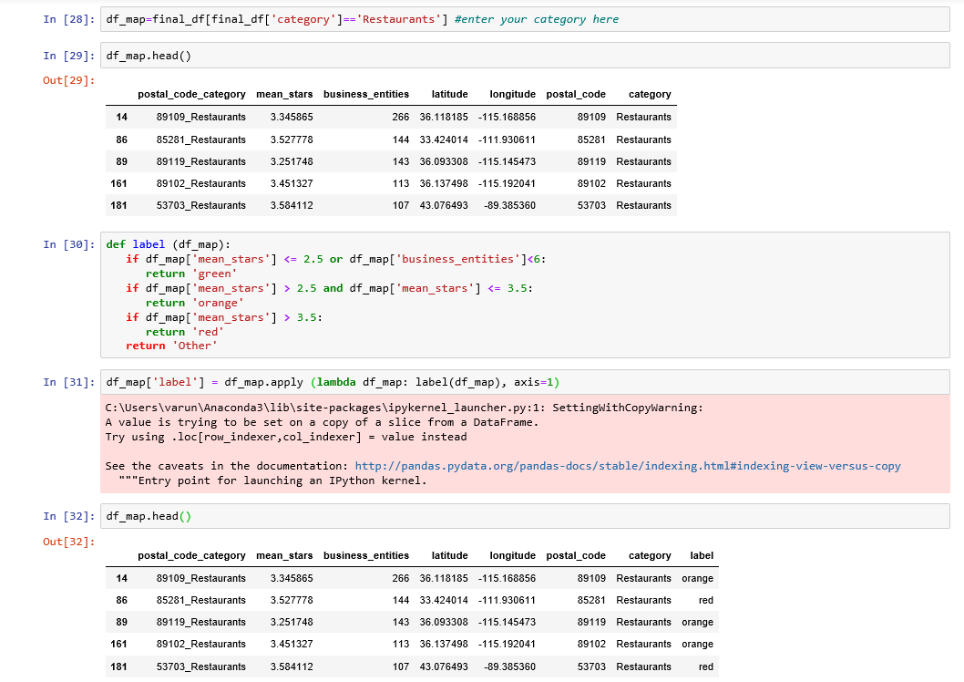
Calculating favorable locations to set up a business for a category

Slide 13
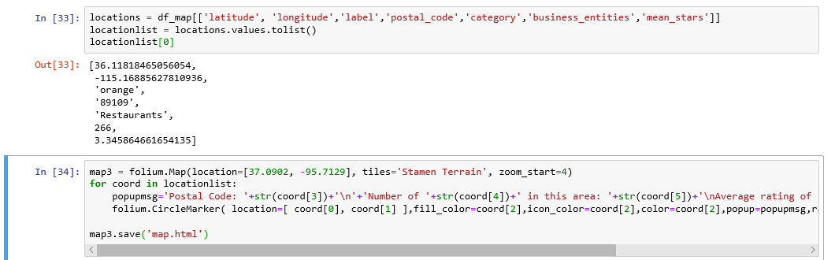
Plotting results on map

Slide 14
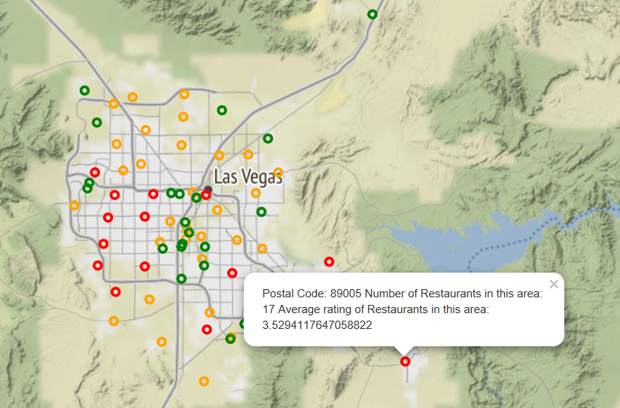
Sample Output
Green – Highly recommended
Orange – Average Rating
Red – Not Recommended

Slide 15
Thank You

