Slide 1
Telecom Customer Churn Prediction
Group 13 – Priyanka Phadnis, Varun Eranki, Vishaal Prabhakar, Lyzanne dsouza

Slide 2

Problem Statement
This case study aims to predict if and when a customer could probably churn based on the company’s data from the previous month, so as to offer those customers better services.

Slide 3

Definition of churn
Churn rate (sometimes called attrition rate), in its broadest sense, is a measure of the number of individuals or items moving out of a collective group over a specific period.
In simple terms it means the customer chooses to end services with its current provider and goes to another provider.

Slide 4
Reasons for Customer Churn:
Poor Onboarding Experience
Ineffective Customer Service
Weak Relationships
Better schemes by other providers(Functionality/Price)
Needs change

Slide 5

Motivation
Predicting which users could possibly switch can help telecom companies devise a new plan for those specific customers so as to prevent them from leaving the network.

Slide 6

Data Exploration
IBM Watson Telecom customer churn Dataset
https://www.ibm.com/communities/analytics/watson-analytics-blog/guide-to-sample-datasets/

Slide 7
INFORMATION VALUE AND WEIGHT OF EVIDENCE
Popular method of establishing relationship between the target variable and the individual predictors.
Useful at finding the impact of predictors on the final outcome.

Slide 8
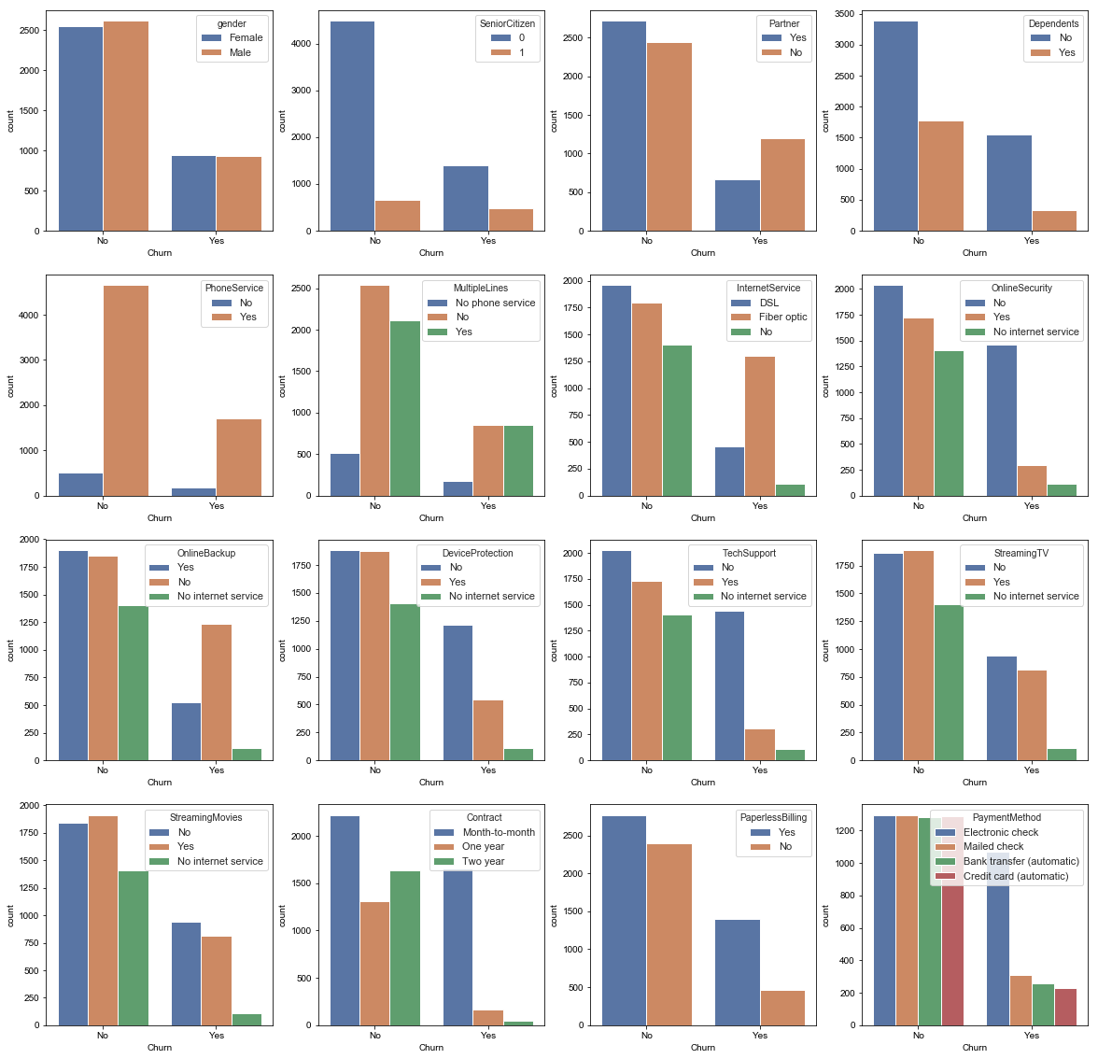

Slide 9
ALGORITHMS AND TECHNIQUES
LOGISTIC REGRESSION – BENCHMARK MODEL
XGBOOST
ARTIFICIAL NEURAL NETWORKS

Slide 10
MODEL EVALUATION RESULTS
Grid Search CV and k-fold validation was used to test the model.
The final parameters for XGBOOST were chosen because they gave the best accuracy, of around 80.5 percent. This was obtained by tuning each of the parameters and using grid search for each of the parameters.

Slide 11
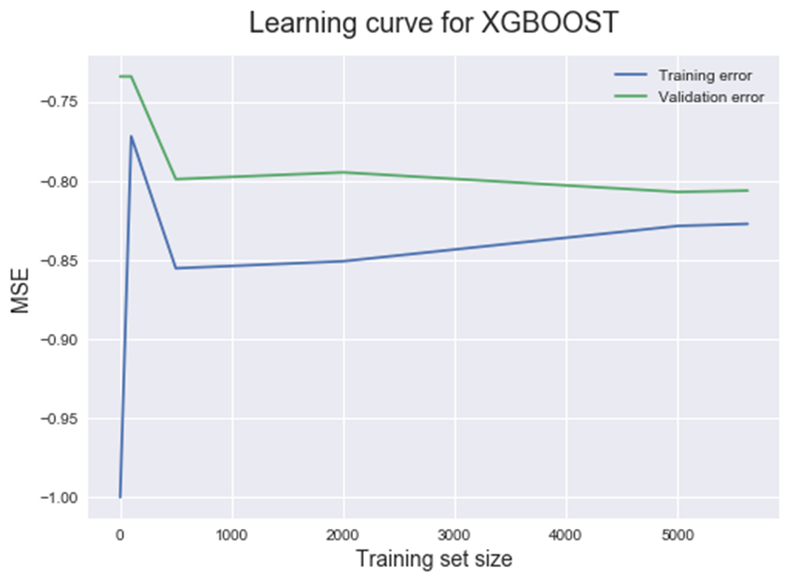
XGBOOST LEARNING CURVE

Slide 12
PERFORMANCE METRIC SCORES
MODEL | ACCURACY
LOGISTIC REGRESSION | 78.6%
XGBOOST | 80.5%
ARTIFICIAL NEURAL NETWORKS | 79.3%

Slide 13
WHY ACCURACY AS A COMPARISON PARAMETER?
The dataset is balanced. In case of imbalanced datasets, it is more likely to predict in favour of the target variable which is present in large proportion in the training dataset. Thus, accuracy can be considered as a good performance comparison metric for this dataset.

Slide 14
THANK YOU

