Slide 1
Workflow I - preprocessing & filtering
Input
Script B, Script C
Results
Reads
Script A
Filtering/Identification
HQ reads
Left,right
Trinity
phiX
Assembly
Quality control
Adapter
Ns
Q30
L50
chloroplast
Seperate reads
Left,right
mitochondrion
HQ reads
pairs,single
Repeat elements
Mips, species annotation
Mapping
RDNA
Merged pairs
HQ Reads
Scripts:
Preprocessing_combined.pl
Map_reads_to_gnome.pl
Remve_reads_fastq.pl

Slide 2

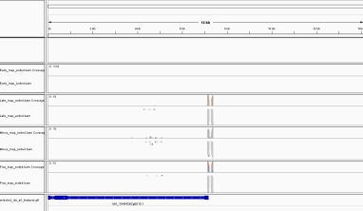
Workflow II - mapping reads to assembly and filter
Mapping
Mapping sam
Input
Results
Reads seperated
(pairs,single)
fasta
readsupport
Selected sam
Samtools
view –S -b
Selected bam
Assembly
fasta
Samtools sort
fasta
min5reads
Samtools
index
bam
bai
Genome browser
Script:
D) map_reads_and_filter.pl

Slide 3
Workflow III - selecting regions and visualization
Resources
Annotation gff - gene
Annotation gff
fasta
Mapping sam
Input
Selected sam
Gene ids
Script G
Samtools
view –S -b
Script E
Selected bam
Script E
Script H
Script F
Samtools sort
Results
1kb-region indication (bed)
Samtools
index
gff
Genome fasta
bam
bai
Scripts:
E) select_gff_entries_for_ids_in_col.pl
F) select_fa_entries_for_bed.pl
G) select_sam_entries_for_fasta.pl
H) add_bps_to_bed.pl

