Slide 1
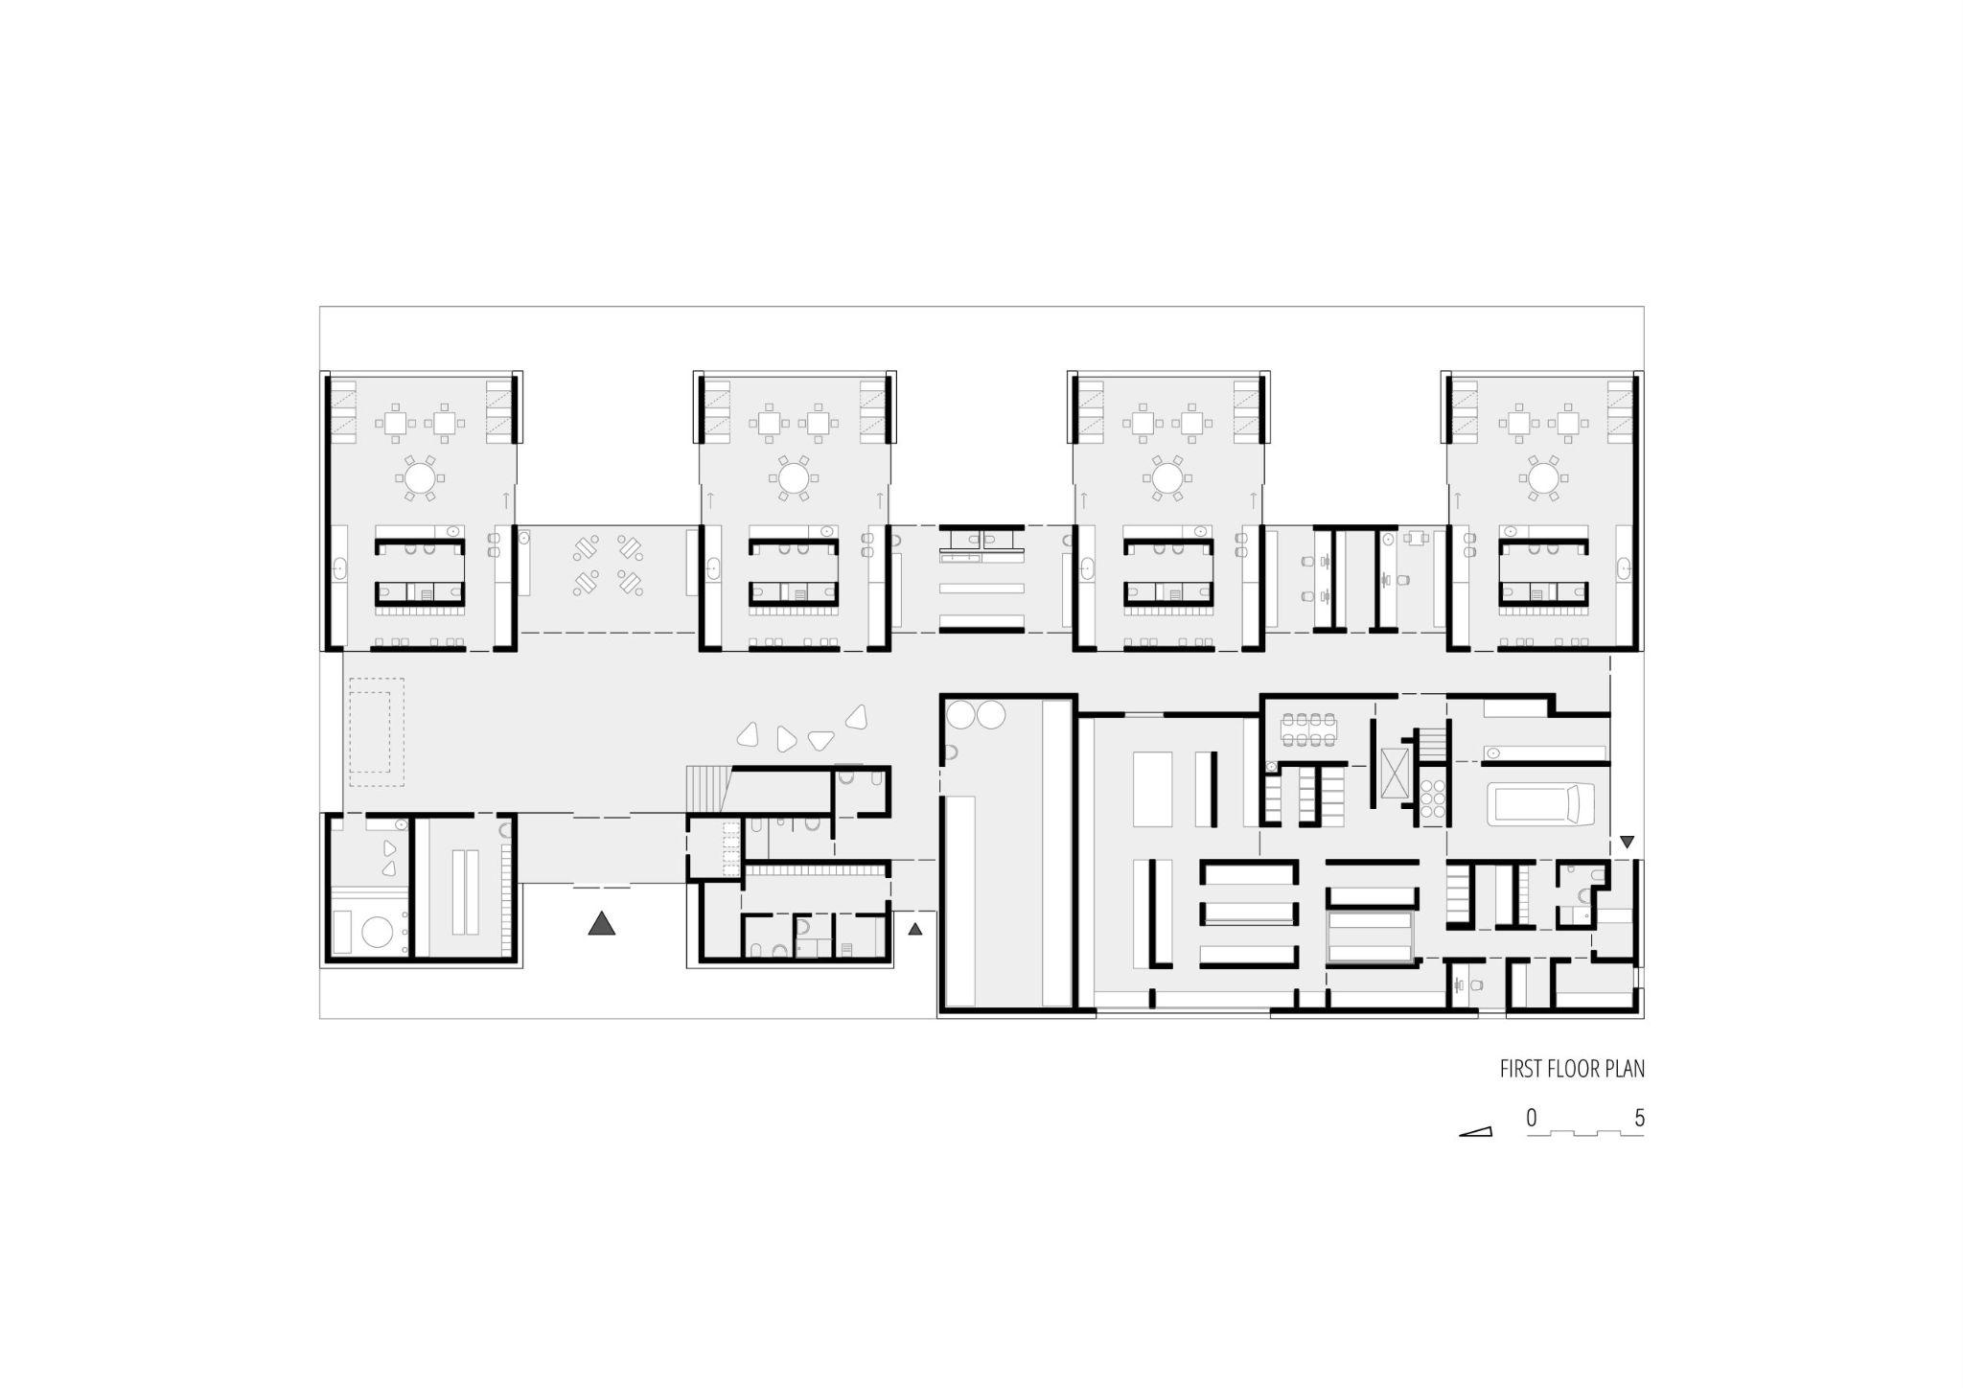
IDEA: A graph-based comparison of spatial connectivity and natural light in a kindergarten layout. Closeness and betweenness centrality are overlaid with a daylight factor analysis from Honeybee. The aim is to test whether the most most spatially integrated (closeness centrality) or most-traversed (betweenness centrality) are also the best-lit, and to surface mismatches as design feedback.
ŽALEC KINDERGARTEN By Efekt architecture 2024, Žalec,Slovenija

Slide 2
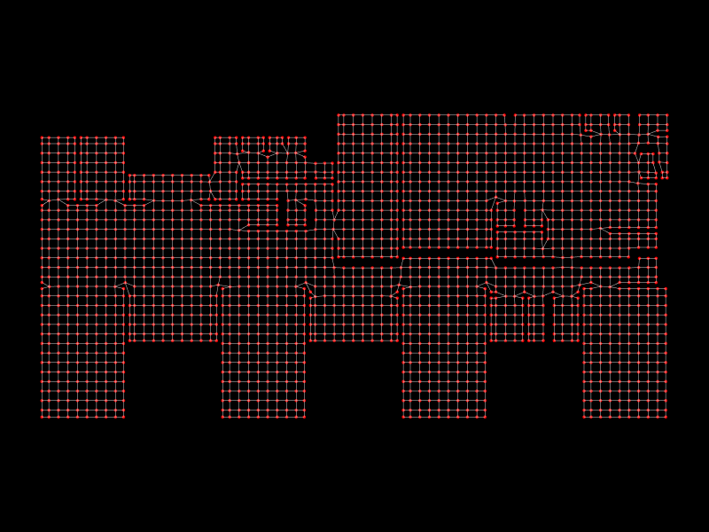
The analysis graph

Slide 3
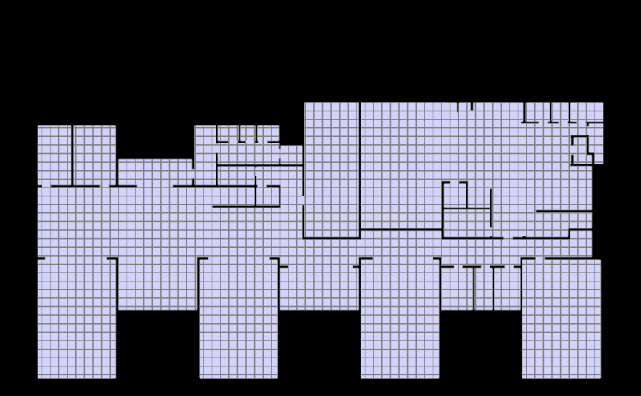
Overlay plan+grid, grid size 100 x 100

Slide 4
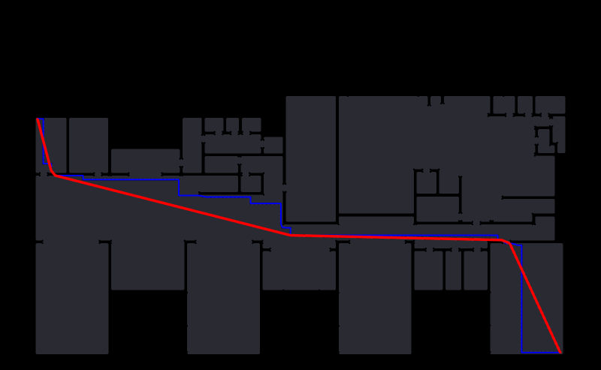
Shortest path

Slide 5

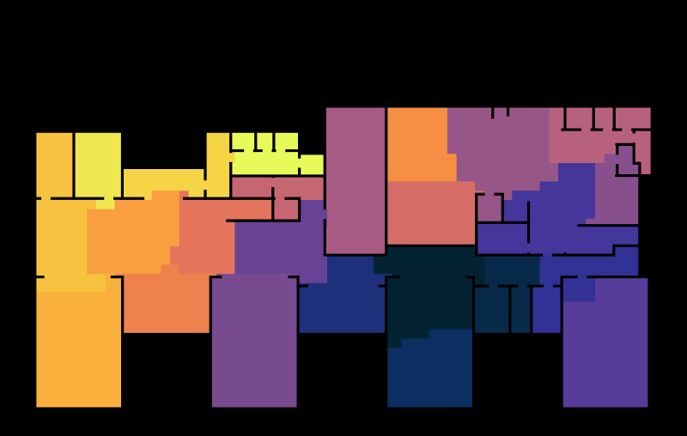
Overlay community detection and building layout
Curtain features of the layout were missed when running the community detection, like the inner service rooms of the classrooms and the communal space/hallway linking the classrooms

Slide 6
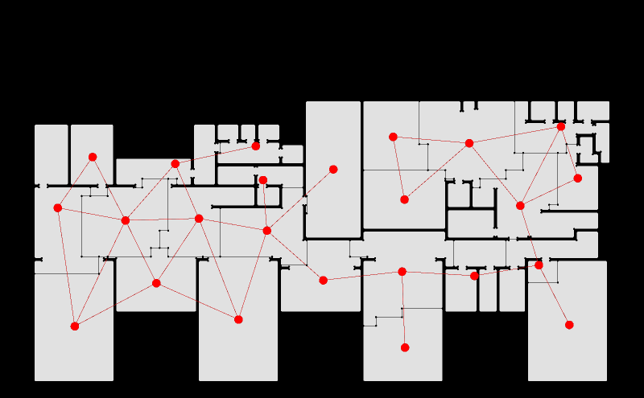
Adjacency graph from derived from the community detection

Slide 7
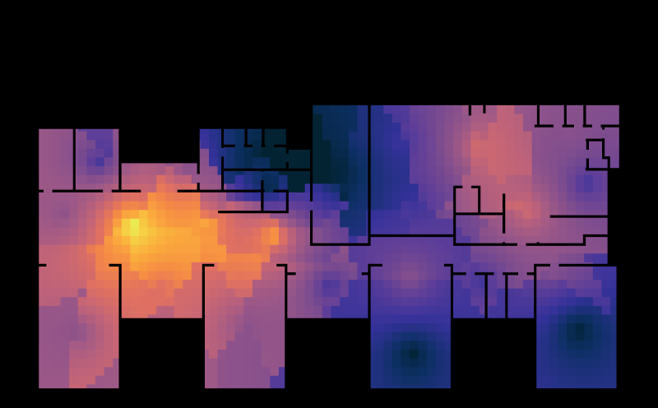
Degree centrality
The entry lobby is easier to access - good design Staff offices are harder to access (all the classrooms are having the same level of connection to the entrance lobby since they are only one edge away but because the community detection is misleading the heatmap is presenting the classrooms on the right as harder to access)

Slide 8
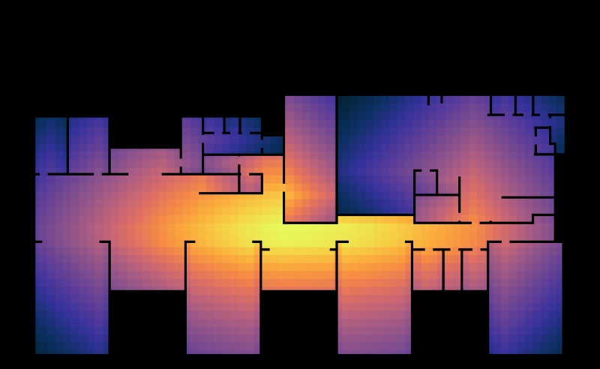
Closeness centrality
The easiest place to access, the best integrated place is the center of the hallway, when the community space gets into a hallway, on its narrower point - Not the best design idea. The most isolated are the offices and the kitchen - logical spatial distribution

Slide 9
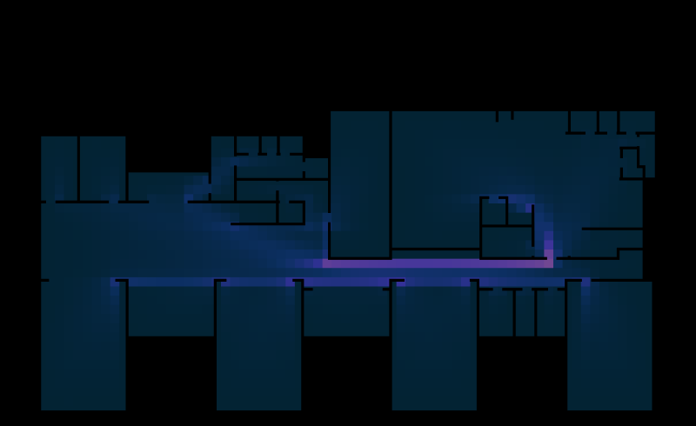
Betweenness centrality
The most traveled path is the centar hallway - typical for this types of layouts but it can mean congestion since the hallway is in its narrower point

Slide 10
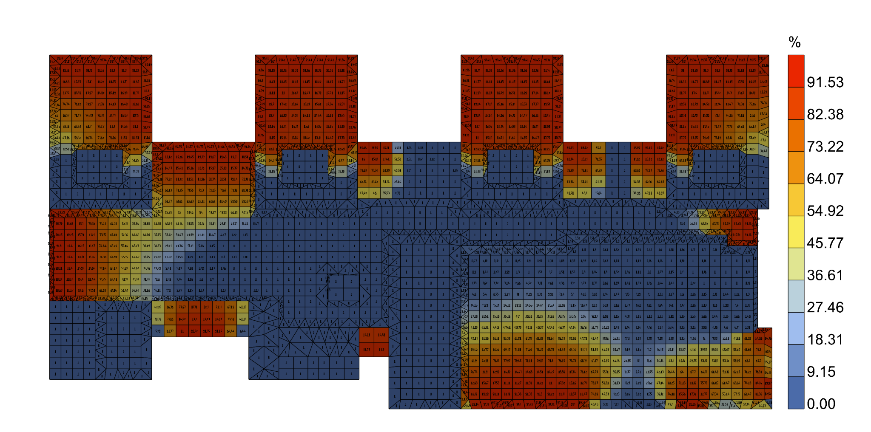
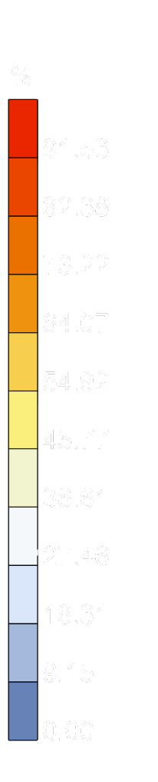
Daylight factor
The classrooms are receiving a lot of daylight and the entrance lobby as well, but the most integrated space of the hallway has no direct sunlight

