Slide 1


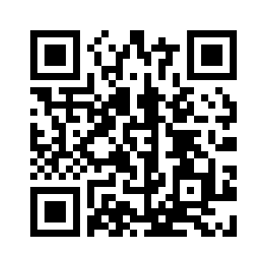






Datathon
&
Pitch your best ML/AI skills!
Jobfair
Find your data-science internship/job!
FEB 2023
FEB 14
Datathon data sets release
Quadrivium, Heverlee
FEB 16
Datathon kick-off event and workshops
FEB 23
Datathon pitches, closing event & Jobfair
For Bachelor, Master and PhD students from
Info
&
Registration

