Slide 1

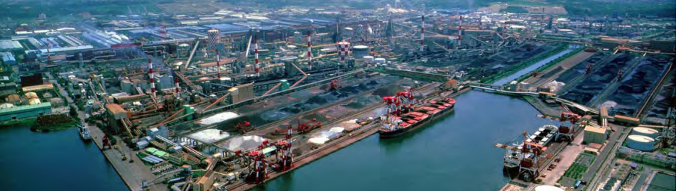
CHINA STEEL CORPORATION
November 2026
Strengthening Our
Partnership in Europe
European Customer Business Update & Strategic Partnership
Notes:
MAIN PRESENTATION
Suggested time: 0:24
SPEAKING POINTS
Thank you for meeting with us again. Today we would like to give you a concise business update, then spend time on your plans for 2027. We will cover our supply capabilities, European business and developments in recycled-content steel. Above all, we want to understand where CSC can support your next orders and projects.
DATA SCOPE AND CHECKS
Original cover photo and design retained from the unique 6 November master. User-supplied CSC material; image date unspecified.
SOURCES
User-provided CSC master and attachments as described in data scope. No individual customer or order identifiers shown.
Information cutoff: 6 November 2026. Main presentation total: 12 minutes 51 seconds, including the CBAM team slot and discussion introduction. Extended customer conversation follows.

Slide 2
CHINA STEEL CORPORATION
CSC Group connects diverse industrial capabilities
CSC Group: An Integrated Industrial Ecosystem
Engineering
Industrial Materials
Plant and equipment engineering
Resource recovery and materials
Steel Business
Steelmaking and processing
CSC · Dragon Steel · Chung Hung
Logistics & Investment
Green Energy
Shipping, trade and investment
Power and low-carbon energy
Cross-industry capabilities support long-term customer cooperation
01

Slide 3
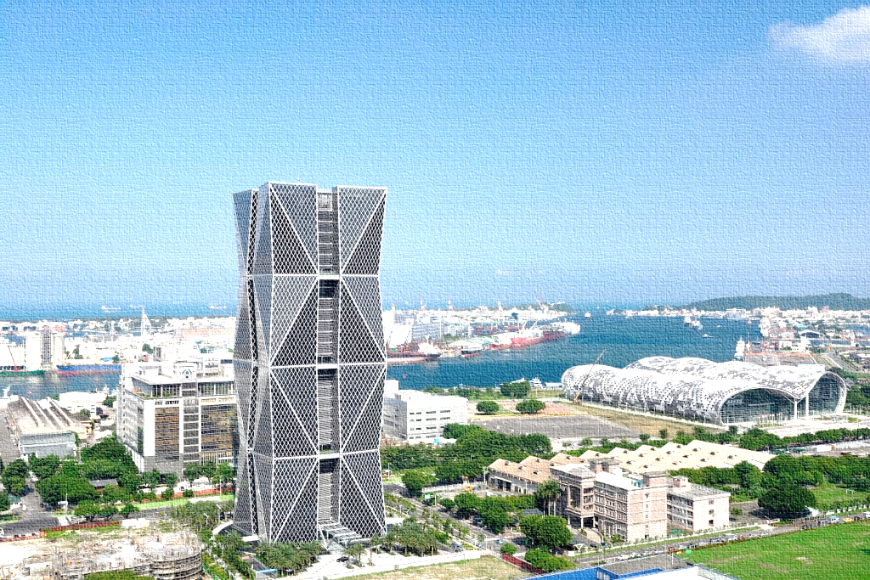
CHINA STEEL CORPORATION
CSC has the scale to support your steel requirements
CSC Company Snapshot
3 Dec 1971
20%
CSC established
Government Shareholder
~16m MT
9,249
Group steelmaking capacity
CSC parent employees
CSC Group Headquarters
11.25m MT
NT$317.155bn
2025 steel sales volume
2025 revenue
02
Notes:
MAIN PRESENTATION
Suggested time: 0:48
SPEAKING POINTS
These figures bring together the scale of the Group and selected facts about CSC itself. Group steelmaking capacity is approximately sixteen million metric tonnes a year. In 2025, consolidated steel sales were eleven point two five million tonnes, and consolidated revenue was just over three hundred and seventeen billion Taiwan dollars. Those figures refer to the Group, rather than the parent company. The establishment date and employee figure relate to CSC as the parent company. This distinction also matters when we move to the separate order-intake statistics.
DATA SCOPE AND CHECKS
2025 consolidated steel sales are 11.25 million metric tonnes and consolidated operating revenue is NT$317,155 million = NT$317.155 billion (Annual Report p.6). These are CSC Group consolidated figures. Parent-company-only 2025 revenue is NT$167,025 million; its rounded steel sales are 7.38 million tonnes (p.7). Do not mix these with the OLAP order-year totals. Group crude steel capacity is approximately 16 million tonnes/year; published CSC capacity is 9.9m and Dragon Steel around 6m (IR p.31). CSC was established on 3 December 1971. Employees 9,249 refer to the CSC parent at 28 February 2026 (Annual Report p.160); 2025 parent headcount was 9,263 and Group headcount was 26,715 at 28 February 2026. Original capital NT$157.7bn and government shareholding 20% are omitted from the visual KPIs; the shareholding figure had no dated scope in the supplied slide and should be checked if reused. Original USD equivalents are omitted to avoid an unstated conversion basis. Original headquarters photo retained unchanged, at 88 Chenggong 2nd Road, Qianzhen, Kaohsiung. All sales and revenue KPIs are full-year 2025 actuals, not order intake.
SOURCES
CSC 2025 Annual Report, 2026 AGM edition, printed pp.6–7 and 160. The exact public release date is not displayed. https://www.csc.com.tw/csc_e/ss/bd/pdf/stock115_03.pdf
CSC Investor Presentation, 23 September 2026, printed pp.31–32. https://www.csc.com.tw/csc_e/ss/pst/pdf/2026Sep23.pdf
Main presentation speaking allocations total 12 minutes 51 seconds (12:51), including CBAM and closing introduction. Extended customer conversation follows.

Slide 4
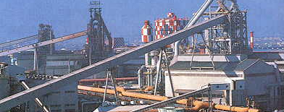
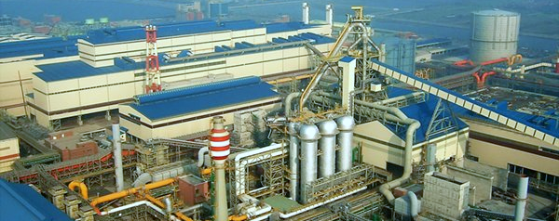
CHINA STEEL CORPORATION
Two Taiwan works anchor our supply capability
CSC Kaohsiung and Dragon Steel, Taichung
CSC Kaohsiung
Dragon Steel
Kaohsiung, Taiwan
Taichung, Taiwan
4 blast furnaces
2 blast furnaces + 1 electric arc furnace
10.0 million MT / year
5 + 1 million MT / year
Established in 1971
Dragon Steel name adopted in 2004
03
Notes:
MAIN PRESENTATION
Suggested time: 1:06
SPEAKING POINTS
Our two principal Taiwan works give us a substantial manufacturing base. CSC in Kaohsiung has four blast furnaces and approximately ten million metric tonnes of annual steelmaking capacity. Dragon Steel in Taichung combines two blast furnaces and an electric arc furnace, with approximately five million tonnes from the integrated route and one million from the electric furnace route. The original plant photographs are shown here. These are rounded nameplate capacities, rather than current output or available sales volume. CSC was established in 1971, while Dragon Steel adopted its present name in 2004. For your requirements, the discussion is the product, grade, qualification and delivery window that we should plan around.
DATA SCOPE AND CHECKS
Original CSC Kaohsiung and Dragon Steel photographs, crop and placement are retained. Original 10.0m and 5+1m MT/year values are rounded source nameplate figures. The current official IR uses CSC 9.9m and Dragon Steel approximately 6m. The apparent 0.1m difference is rounding, not an added production claim. Dragon Steel was established in 1993 and adopted its present name in 2004. BF/EAF icons and location cues are visual aids. No actual production, utilization, available allocation or delivery commitment is implied.
SOURCES
CSC 2025 Annual Report, 2026 AGM edition, printed pp.6–7 and 160. The exact public release date is not displayed. https://www.csc.com.tw/csc_e/ss/bd/pdf/stock115_03.pdf
CSC Investor Presentation, 23 September 2026, printed pp.31–32. https://www.csc.com.tw/csc_e/ss/pst/pdf/2026Sep23.pdf
Main presentation speaking allocations total 12 minutes 51 seconds (12:51), including CBAM and closing introduction. Extended customer conversation follows.

Slide 5
CHINA STEEL CORPORATION
Taiwan capacity supports a broad product range
CSC Group Production Capacity in Taiwan, annual nameplate capacity
Group Steelmaking
Hot Rolling+ PO
Cold Rolling
~16m
10+1m
4m
3 HSM+2POL
3 PLCM
MT / year
MT / year
MT / year
Galvanizing
Electrogalvanizing
Electrical Steel
1m
0.3m
0.45m
3 CGL
1 EGL
3 ACL
MT / year
MT / year
MT / year
04
Notes:
MAIN PRESENTATION
Suggested time: 1:06
SPEAKING POINTS
This simplified flow shows selected flat-steel routes, from steelmaking through hot and cold rolling to different finishing processes. The Group has approximately sixteen million tonnes of annual steelmaking capacity. The source capacity table reports ten million tonnes of hot rolling and four million tonnes of cold rolling. Galvanizing, electrogalvanizing and electrical-steel capacities are shown as separate finishing routes. Pickling, annealing and other intermediate operations have been left out of this overview. Some products leave the route earlier, and product-specific routes can differ. These are capacities at successive or parallel stages. They must not be added together and do not represent committed saleable volume. The complete equipment table remains in the notes.
DATA SCOPE AND CHECKS
Facilities / product | Lines | MT/year
Blast furnaces including Dragon Steel | 6 | 15,000,000
Electric arc furnace Dragon Steel | 1 | 1,000,000
HSM hot-rolled | 3 | 10,000,000
POL pickled and oiled | 2 | 1,000,000
PLCM cold-rolled | 3 | 4,000,000
CAL annealing | 2 | 2,000,000
CGL galvanizing | 3 | 1,000,000
EGL electrogalvanizing | 1 | 300,000
ACL silicon steel | 3 | 450,000
The displayed six values follow the supplied table. This is an overview of selected flat-steel routes. Hot-rolled material can be sold before cold rolling; cold-rolled and electrical-steel routes involve additional product-specific processing, including pickling and annealing, omitted for clarity. Finishing routes are parallel. Product capacities describe successive processing stages and cannot be summed with steelmaking capacity. Line census dates and current availability are not stated in the original capacity table. Source: supplied Eddy CSC 2026 Feb and the capacity table in this unique master; Group scale cross-checked against IR p.31.
SOURCES
CSC 2025 Annual Report, 2026 AGM edition, printed pp.6–7 and 160. The exact public release date is not displayed. https://www.csc.com.tw/csc_e/ss/bd/pdf/stock115_03.pdf
CSC Investor Presentation, 23 September 2026, printed pp.31–32. https://www.csc.com.tw/csc_e/ss/pst/pdf/2026Sep23.pdf
Main presentation speaking allocations total 12 minutes 51 seconds (12:51), including CBAM and closing introduction. Extended customer conversation follows.

Slide 6
CHINA STEEL CORPORATION
CSC's Overseas Manufacturing Footprint
Regional manufacturing and processing experience across Asia
ASIA
Malaysia
CSC 46%
CSC Steel Sdn. Bhd.
CR / PO 240,000 · GI 170,000 MT/year
India
Vietnam
CSC 56%
China Steel and Nippon Steel Vietnam
Joint Stock Company
Vietnam
CR 500,000 · GA / GI 300,000 MT/year
Malaysia
India
CSC 100%
CSCI Steel Corporation India Pvt. Ltd.
Electrical steel 200,000 MT/year
05
Notes:
MAIN PRESENTATION
Suggested time: 0:42
SPEAKING POINTS
The three locations show our regional manufacturing and processing experience. Malaysia focuses on cold-rolled and coated steel. Vietnam adds a broader flat-steel product range, while India focuses on electrical steel. The ownership figures have different legal scopes: the Malaysian percentage is the stake in its listed parent, while Vietnam and India relate to the operating companies shown. Only selected product-line capacities appear here. The full list is in the notes. These local processing capacities are separate from the Taiwan export-order statistics.
DATA SCOPE AND CHECKS
Malaysia: CSC Steel Sdn. Bhd.; CSC owns 46% of listed parent CSC Steel Holdings Berhad, not a direct 46% operating-company interest. CR/PO 240,000, GI 170,000 and PPGI 70,000 MT/year. Vietnam: China Steel and Nippon Steel Vietnam Joint Stock Company; CSC owns 56%; CR 500,000, GA/GI 300,000, ES 200,000 and PO 200,000 MT/year. India: CSCI Steel Corporation India Pvt. Ltd.; CSC owns 100%; electrical steel 200,000 MT/year. All are published processing/product-line reference capacities; stages can overlap and must not be added to Taiwan exports. Selected figures are emphasized without deleting the complete source list from Notes. Map uses Natural Earth 110m country polygons and approximate regional plant coordinates solely as location indicators. Map polygons and markers are native editable PowerPoint shapes. Map does not determine customs origin or trade eligibility. https://www.naturalearthdata.com/about/terms-of-use/
SOURCES
CSC 2025 Annual Report, 2026 AGM edition, printed pp.6–7 and 160. The exact public release date is not displayed. https://www.csc.com.tw/csc_e/ss/bd/pdf/stock115_03.pdf
CSC Investor Presentation, 23 September 2026, printed pp.31–32. https://www.csc.com.tw/csc_e/ss/pst/pdf/2026Sep23.pdf
Main presentation speaking allocations total 12 minutes 51 seconds (12:51), including CBAM and closing introduction. Extended customer conversation follows.

Slide 7
CHINA STEEL CORPORATION
Domestic demand anchors our global business
CSC domestic and export order intake
2025
Total 9,514,893 MT
Domestic 5,432,179 MT
Export 4,082,714 MT
2026
Total 10,095,143 MT
Domestic 5,713,701 MT
Export 4,381,442 MT
Source: CSC OLAP, updated 3 Nov 2026. Order intake by order-year field. 2026 is an open-year snapshot, not full-year sales.
06
Notes:
MAIN PRESENTATION
Suggested time: 0:54
SPEAKING POINTS
The order records show a strong domestic base alongside substantial export business. In the 2025 order-year field, domestic orders were five point four three million tonnes and exports four point zero eight million, representing fifty-seven point one and forty-two point nine percent. The 2026 snapshot contains five point seven one million tonnes of domestic orders and four point three eight million of exports, at fifty-six point six and forty-three point four percent. The bars use the same percentage scale. The actual volumes sit below them for clarity. The 2026 field remains open, so these figures describe order mix rather than completed full-year sales.
DATA SCOPE AND CHECKS
{
"2025": {
"domestic": 5432178.589000002,
"total": 9514892.706999999,
"export": 4082714.118,
"domestic_share": 0.5709132784023523,
"export_share": 0.429086721597648
},
"2026": {
"domestic": 5713700.758000002,
"total": 10095143.024,
"export": 4381442.266,
"domestic_share": 0.5659851221935498,
"export_share": 0.43401487780645037
}
}
Source: OLAP-德英(3).xlsx, worksheet 中鋼訂單量, updated 3 November 2026. Production and stock orders are selected. The year field is an order-year field; finalisation and legal-entity coverage are not fully documented. Raw values are preserved here; display volumes round to whole MT. Native bars use domestic/export fractions calculated from these raw totals at Excel-compatible 15-significant-digit precision, with equal 100% scales. Original MT values remain recorded here. 2026 is an open order-year snapshot, not full-year actual sales, shipment volume, a comparable YTD series or a forecast. No year-on-year full-year growth rate is computed.
SOURCES
User-provided OLAP workbook and unique Final master.
Main presentation speaking allocations total 12 minutes 51 seconds (12:51), including CBAM and closing introduction. Extended customer conversation follows.

Slide 8
CHINA STEEL CORPORATION
Our export reach spans major steel markets
2026 export orders on record: 4,381,442 MT
Europe: 357,204 MT · 8.2% of export orders
07
Notes:
MAIN PRESENTATION
Suggested time: 0:42
SPEAKING POINTS
The six largest original regions are shown separately, with five smaller regions grouped as Others. Southeast Asia remains the largest export-order region, followed by North America and Japan. Europe accounts for three hundred and fifty-seven thousand tonnes, or eight point two percent of export orders on record. Europe here is broader than the EU and includes the UK and other countries. The figures are an open-year snapshot, rather than a full-year result. For this visit, our interest is the products and delivery periods where we can develop further cooperation.
DATA SCOPE AND CHECKS
All original 2026 regions, MT and share of total exports (unrounded denominator 4381442.266 MT):
Middle East | 127350.000 MT | 2.9066%
Central & South America | 86461.000 MT | 1.9733%
Japan | 662438.218 MT | 15.1192%
North America | 712480.379 MT | 16.2613%
Southeast Asia | 1786610.193 MT | 40.7768%
Africa | 280.000 MT | 0.0064%
South Asia | 236430.835 MT | 5.3962%
Australia & New Zealand | 21802.404 MT | 0.4976%
China / Hong Kong | 192123.692 MT | 4.3849%
Europe | 357204.245 MT | 8.1527%
Korea | 198261.300 MT | 4.5250%
Top six original regions remain separate. Others = China / Hong Kong + Middle East + Central & South America + Australia & New Zealand + Africa = 428,017.096 MT, 9.7689%. Others is an aggregate and is placed last, rather than ranked as an original region. Raw regions reconcile exactly to 4,381,442.266 MT. Seven rounded displayed values total 4,381,441 MT, 1 MT below the rounded overall total; the displayed one-decimal shares total 100.1%. Europe is the original broader region including the EU, UK, Turkey and other European destinations; it is not Germany or EU-only. The complete 11-region classification is retained here. Source: OLAP-德英(3).xlsx / 中鋼訂單量, updated 3 November 2026. This open-year order snapshot does not establish full-year growth.
SOURCES
User-provided OLAP workbook and unique Final master.
Main presentation speaking allocations total 12 minutes 51 seconds (12:51), including CBAM and closing introduction. Extended customer conversation follows.

Slide 9
CHINA STEEL CORPORATION
Different Product Needs Across the EU, Germany and UK
Order intake by order year and 2026 product mix (MT)
Order volume (MT)
2026 product mix (MT)
Year | EU* | Germany | UK
2024 | 807,089 | 52,200 | 24,237
2025 | 493,998 | 59,323 | 96,388
2026 | 282,335 | 9,350 | 74,549
Product | EU* | Germany | UK
Plate | — | — | 2,104
Hot-rolled | 166,238 | 6,000 | 20,875
Cold-rolled | 31,025 | — | 30,460
Hot-dip galvanized | 33,860 | 3,000 | 21,110
Electrogalvanized | 870 | 350 | —
Electrical steel | 50,302 | — | —
Wire rod | 40
Total | 282,335 | 9,350 | 74,549
Germany: HR-led product mix, complemented by coated steel.
UK: Diversified demand across HR, CR and coated products.
Next Step: Explore new grades and sourcing opportunities.
08
Notes:
MAIN PRESENTATION
Suggested time: 1:21
SPEAKING POINTS
The product picture is different across these markets. The EU source grouping has a larger hot-rolled and electrical-steel component. UK orders have a greater cold-rolled and coated-steel emphasis. Germany is included within the EU grouping, and we show it separately to make our discussion more relevant. The 2026 German summary contains six thousand tons of hot-rolled steel, three thousand of hot-dip galvanized steel and 350 tons of electrogalvanized steel. Rather than extrapolating these snapshots, we would like to understand which grades and delivery windows will matter most to you in 2027.
DATA SCOPE AND CHECKS
EU/UK product summaries carry an update label of 3 November 2026. EU totals for 2024/25/26 are 807,089.065 / 493,997.535 / 282,335.365 MT. UK totals are 24,237 / 96,388 / 74,548.880 MT. The Germany screenshot supplied 6 November shows CR 18,190 / 26,185 / 0; EG 250 / 0 / 350; HR 18,495 / 17,718 / 6,000; HDGI 15,265 / 15,420 / 3,000. Each year reconciles to 52,200 / 59,323 / 9,350 MT. The screenshot has no independent cutoff timestamp, but totals match the country pivot. Germany is a subset of EU, not an additional region. HR/CR include automotive grades. The six classes omit 40 MT of EU bar/wire rod, stated on slide. Dash means no volume in the supplied summary. The EU source grouping excludes Turkey, Norway and the UK but includes Ukraine (40 MT), so it is not verified EU27. The country pivot total exceeds the product total by 875 MT. Different refresh timestamps and incomplete country-filter metadata prevent a proven reconciliation; see A1.
SOURCES
User-provided CSC master and attachments as described in data scope. No individual customer or order identifiers shown.
Information cutoff: 6 November 2026. Main presentation total: 12 minutes 51 seconds, including the CBAM team slot and discussion introduction. Extended customer conversation follows.

Slide 10
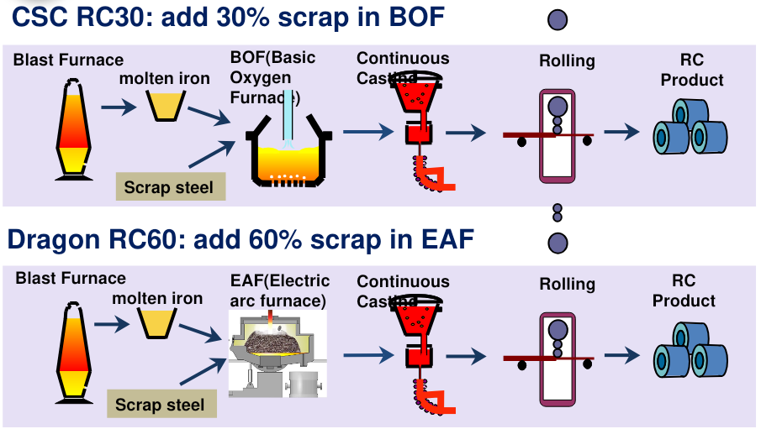
CHINA STEEL CORPORATION
RC steel is already a commercial offering
Validated recycled content, with established commercial applications
CSC RC30 (≥30% recycled content)
~74,000 MT
RC order intake
Jan–Aug 2026
~50% YoY
Dragon RC60 (≥60% recycled content)
UL 2809 validated products
IF automotive RC30
Electrical-steel and IT uses
CR / galvanized RC90
Grade and certificate scope vary
10
Notes:
MAIN PRESENTATION
Suggested time: 1:12
SPEAKING POINTS
Recycled-content steel is already part of CSC's commercial offering. The diagrams show two different routes. CSC RC30 uses a basic oxygen furnace route with increased scrap input, while Dragon RC60 uses an electric arc furnace route combining scrap and hot metal. The public portfolio includes products for automotive, IT and electrical applications, with validation covering specified products and recycled-content levels. Publicly announced company-wide orders were nearly 74 thousand tons in January to August 2026. For any potential order, we should confirm the grade, required recycled content and certificate scope. Recycled content and carbon-emissions performance are different measures.
DATA SCOPE AND CHECKS
Original RC30 and RC60 process images retained. RC30 means at least 30% recycled content and RC60 at least 60%, not equivalent carbon reductions. RC30 uses the BOF route; Dragon RC60 uses EAF with scrap and hot metal. Annual Report and Sustainability Report describe product-specific UL 2809 validations across HR, CR, galvanized, electrical and long products. IF automotive RC30 and CR/galvanized RC90 are public examples; grade and certificate scope require confirmation for any order. The public announcement reports nearly 74,000 MT of company-wide orders in January-August 2026 and about 50% YoY growth. This is not Europe-only. Internal January-October figures are excluded pending external disclosure clearance. No CBAM verification or product-emission factor is claimed.
SOURCES
[CSC-RC] CSC announcement: recycled-content steel for automotive applications. 2026; publicly available by September; exact day not displayed. https://www.csc.com.tw/csc/nc/newsMain1.asp?newsid=2798
[CSC-AR] CSC 2025 Annual Report. 2026 AGM edition; precise public release date not shown in PDF. https://www.csc.com.tw/csc_e/ss/bd/pdf/stock115_03.pdf
[CSC-ESG] CSC 2025 Sustainability Report. August 2026. https://www.csc.com.tw/csc/esg/pdf/esg-2025.pdf
Information cutoff: 6 November 2026. Main presentation total: 12 minutes 52 seconds, including the CBAM team slot and discussion introduction. Extended customer conversation follows.

Slide 11
CHINA STEEL CORPORATION
CSC's CBAM Readiness and Progress
[Pending Input from CSC CBAM Team]
Workstream | Confirmed update from CSC CBAM Team
Emissions Data | [Add product scope, reporting period and data coverage]
Calculation Methodology | [Add applicable methodology and calculation boundaries]
Verification | [Add verification status, scope and supporting evidence]
Customer Documentation Support | [Add document workflow, contacts and response timetable]
Next Steps | [Add approved milestones, owners and target dates]
10
Notes:
MAIN PRESENTATION
Suggested time: 1:00
SPEAKING POINTS
I will now invite our CBAM colleague to provide the confirmed update. The discussion will cover emissions data, calculation methodology, verification, customer documentation and the next steps. Our aim is to understand the information your importing entity needs and the timetable for providing it. The company-specific content on this page remains pending the CSC CBAM team's input.
DATA SCOPE AND CHECKS
[Pending Input from CSC CBAM Team]. One minute is reserved in the 12:51 main presentation. The team should add approved data scope, methodology, verification status, document workflow, owners and dated milestones. No placeholder implies completed work. If the update is not available before the visit, present this as a discussion framework. No emission factors, verifier approvals or delivery commitments have been invented.
SOURCES
[EU-CBAM] European Commission: CBAM definitive regime. 2026 implementation page; accessed 6 November 2026. https://taxation-customs.ec.europa.eu/carbon-border-adjustment-mechanism/cbam-definitive-regime_en
[UK-CBAM] HMRC Carbon Border Adjustment Mechanism: policy summary. Updated 2 November 2026; starts 1 January 2027. https://www.gov.uk/government/publications/carbon-border-adjustment-mechanism-cbam-policy-summary/carbon-border-adjustment-mechanism-cbam-policy-summary
Information cutoff: 6 November 2026. Main presentation total: 12 minutes 51 seconds, including the CBAM team slot and discussion introduction. Extended customer conversation follows.

Slide 12
CHINA STEEL CORPORATION
Challenges Persist, but New Opportunities Are Emerging
Global Steel Market | Challenges, Opportunities & Outlook
2027 Global Steel Demand
2028 Global Excess Capacity
1,752 Mt
745 Mt
+1.7% YoY
Source: worldsteel, Short Range Outlook, Oct 2026
Source: OECD Steel Outlook 2026, Jun 2026
CHALLENGES
OPPORTUNITIES
OUTLOOK
Trade Barriers
Selective Openings
Short Term
EU TRQs, CBAM and more AD measures
Opportunities where competing origins face restrictions
Uneven recovery and continued competition
Oversupply
AI-Related Demand
Medium Term
SEA expansion and China export pressure
Data centers, IT equipment and power infrastructure
Modest growth with higher-value opportunities
Closer demand planning, product development and flexible sourcing will be key to future cooperation.
Mt = million metric tonnes
09
Notes:
MAIN PRESENTATION
Suggested time: 1:10 (approximately 60–80 seconds at a natural delivery pace)
SPEAKING SCRIPT
The steel market still faces tougher market-access rules and structural oversupply. Capacity expansion in Southeast Asia and sustained Chinese export pressure continue to shape competition.
At the same time, restrictions on competing origins may open alternative sourcing opportunities, subject to local anti-dumping, quota and import rules. Investment in AI, data centres and energy infrastructure could also create demand for relevant steel grades. These are potential opportunities, rather than confirmed orders.
Worldsteel forecasts 2027 global steel demand at 1,752 million tonnes, up 1.7 percent. OECD projects excess capacity of 745 million tonnes in 2028. So the recovery may be modest and uneven, with continued competition. The numbers are institutional forecasts, and our short- and medium-term periods are analytical horizons.
For CSC and our customers, closer planning will be essential. We would welcome a discussion of the grades, indicative volumes and delivery windows you anticipate for 2027, and where joint product development or flexible sourcing could help.
DATA SCOPE AND INTERPRETATION
Slide abbreviations: SEA = Southeast Asia; EU = European Union; TRQ = tariff-rate quota; AD = anti-dumping; CBAM = Carbon Border Adjustment Mechanism; AI = artificial intelligence; IT = information technology. Short Term refers to 2026 Q4–2027 H1 and Medium Term to 2027–2028. These analytical horizons remain in the notes to keep the slide concise.
Information cutoff: 6 November 2026. Mt means million metric tonnes.
The 1,752 Mt demand level and +1.7% YoY are worldsteel's 2027 forecast, released on 12 October 2026. The 745 Mt excess-capacity figure is OECD's projection for 2028, released on 4 June 2026. These are distinct institutional metrics and should not be subtracted from, or compared as equivalent to, one another. Neither is a CSC official forecast.
Short Term (2026 Q4–2027 H1) and Medium Term (2027–2028) are the presentation's analytical horizons. The institutions did not issue the exact half-year projections displayed here.
Trade-barrier and oversupply descriptions summarize the market context. Selective supplier substitution, higher-value steel and AI-linked applications are potential commercial opportunities and analytical inferences, not established CSC demand, secured orders, supply commitments or guaranteed market access. Check product scope, exporter-specific AD status, origin, quotas and applicable import/carbon rules before quoting.
Potential AI-linked applications for discussion include server enclosures, galvanized steel and power-equipment materials, subject to customer specifications, grade qualification and project timing. Do not imply AI investment automatically produces CSC orders.
OFFICIAL REFERENCES
World Steel Association (worldsteel), Short Range Outlook October 2026, 12 October 2026. This publication supports the 2027 demand forecast, the uneven recovery and potential support from AI-related, data-centre and energy investment. Its outlook uses data available as of early September 2026.
https://worldsteel.org/media/press-releases/2026/worldsteel-short-range-outlook-october-2026/
OECD, OECD Steel Outlook 2026, 4 June 2026, Executive summary and Chapter 3. This report supports the excess-capacity projection, Southeast Asian capacity expansion and Chinese export pressure.
https://www.oecd.org/en/publications/2026/06/oecd-steel-outlook-2026_a79fb861.html
https://doi.org/10.1787/99ab9b0c-en
Trade context: European Commission, Steel and Metals Action Plan, COM(2025)125 final, 19 March 2025. Used only for qualitative context, not to establish current rates or quotas. The dedicated EU/UK trade slide and appendices retain their separate official references.
https://eur-lex.europa.eu/legal-content/EN/TXT/?uri=CELEX:52025DC0125
DEMAND DISCUSSION HANDOFF
Invite customers to share Product / Grade / Specification, Indicative Volume (MT), Delivery Window, Target Market, Qualification Requirements, CBAM / RC Documentation Needs and the Next Follow-up Action. Record indications as customer input, not commitments.
MAIN PRESENTATION TIMING
12 minutes 52 seconds, including the CBAM placeholder slot and the discussion introduction; appendices are on request and untimed.

Slide 13
CHINA STEEL CORPORATION
How CSC Can Support Your Business
Practical solutions for your 2027 steel requirements
Need a New Steel Grade?
Need Recycled-Content Steel?
Grade selection · Trials · Qualification
RC options · Product documentation
Steel tailored to your applications
Support for sustainable sourcing
Facing Processing Issues?
Planning Your 2027 Orders?
Forming · Surface quality · Troubleshooting
Volumes · Lead times · Delivery planning
Technical problem-solving support
Better visibility for future sourcing
Whatever your steel needs, let's explore how CSC can help.
13
Notes:
MAIN PRESENTATION
Suggested time: 0:54 (approximately 45–60 seconds)
SPEAKING SCRIPT
Looking ahead to 2027, there are four practical ways we can support your business.
If you need a new grade, we can work through material selection, trials and qualification for your application. For recycled-content steel, we can discuss suitable options and the product documentation that applies.
If you face forming, surface or processing issues, our technical teams can help investigate the problem and review possible solutions. And for future orders, earlier visibility on grades, expected volumes and delivery windows will help us plan together.
We would welcome the opportunity to review your upcoming requirements and new projects. With that in mind, let us hear which priorities matter most to your business.
TECHNICAL DETAILS FOR CUSTOMER DISCUSSION
New grade and application development: Discuss hot-rolled, cold-rolled, coated and electrical-steel families as relevant. Ask for the application, grade or performance targets, dimensions, forming conditions and qualification route. Material selection, trials and qualification require case-specific technical review. "Steel tailored to your applications" describes that review process and does not imply that every requested grade is already available or qualified. CSC's technical service team coordinates with in-plant professionals and R&D specialists to support product applications and development.
Recycled-content steel: RC means recycled content. Discuss the applicable RC product families and confirm grade, product, site and certificate scope before providing product documents. CSC publishes selected UL 2809 recycled-content validations. Recycled-content percentage is distinct from carbon-emissions reduction. Recycled-content validation does not establish CBAM emissions verification or blanket carbon-footprint certification. Provide only product documentation approved for the relevant product and scope.
Processing and quality: Obtain the grade, processing conditions, forming or surface observations and relevant samples or test evidence. Technical specialists can help investigate application and processing issues and review trials or possible corrective measures. Agree the support scope, contacts and next steps for each case.
2027 supply planning: Review indicative volumes, grades, dimensions, required lead times, delivery windows, target market and documentation needs. Joint planning improves visibility. Specific quantities, lead times, delivery commitments, trade eligibility and terms require confirmation. No unapproved supply allocation, price or guarantee is implied.
HANDOFF TO CUSTOMER DISCUSSION
Invite Product / Grade / Specification, Indicative Volume (MT), Delivery Window, Target Market, Qualification Requirements, CBAM / RC Documentation Needs and Next Follow-up Action. Distinguish indicative demand from firm orders. The next slide opens the four discussion directions.
OFFICIAL REFERENCES
CSC, Customer Technical Services, Technical Service Management. Undated webpage, reviewed 8 November 2026. Supports material application problem-solving and coordination among technical professionals and R&D specialists.
https://www.csc.com.tw/csc_e/esg/soc/soc5.html
CSC, Quality Control, Product Certification. Undated webpage, reviewed 8 November 2026. Supports selected UL 2809 recycled-content validations and their product families.
https://www.csc.com.tw/csc_e/esg/cg/cg4.html
CSC, Production / Product Introduction. Undated webpage, reviewed 8 November 2026. Supports the public steel product portfolio.
https://www.csc.com.tw/csc_e/pd/pd.html
CSC, China Steel Global Trading Corporation profile. Undated public company profile. Reference for export agency and coordination through overseas sales channels; the meeting is an invitation to joint review, not a supply commitment.
https://www.csc.com.tw/csc_e/gc/gro_Log_p2.html
CONTENT BASIS
Concise customer-facing wording follows the user's instructions. Detailed product, certificate and service explanations remain in Notes. No new company performance figures, regulatory rates or customer commitments are introduced.

Slide 14
CHINA STEEL CORPORATION
Let’s Shape Our Future Partnership
Understanding your sourcing priorities, market outlook and future opportunities
01
Sourcing Strategy
02
2027 Market Outlook
What is your domestic vs. import sourcing mix?
How do you see steel demand and prices evolving in 2027?
What factors matter most in supplier selection?
Which sectors or products offer the best growth potential?
03
Your Feedback on CSC
04
Future Opportunities
How do you assess CSC’s products and services?
What new grades, applications or projects should we prepare for?
Where can we better support your business needs?
How can we strengthen our cooperation in 2027 and beyond?
Let's Explore New Opportunities Together.
12
Notes:
MAIN PRESENTATION
Suggested time: 0:50 (approximately 45–60 seconds)
SPEAKING SCRIPT
Before we finish, we would really value your perspective in four areas.
First, how you balance domestic and imported steel, and what matters most when choosing suppliers. Second, your view of demand and prices in 2027, including the sectors and products where you see potential.
We would also welcome your feedback on working with CSC, both our products and the support you receive. Finally, let us look at new grades, applications and projects where we could work together.
Our aim is to understand your priorities more clearly and identify practical opportunities for 2027 and beyond. Where we see a good fit, we can agree the next steps together.
DISCUSSION GUIDANCE
Use these four areas as invitations to an open conversation. Follow the customer's priorities instead of reading all eight questions. Keep domestic/import sourcing mix commercially general and invite voluntary feedback. Customer views on future prices and demand are perspectives, not CSC forecasts.
For concrete opportunities, confirm Product / Grade / Specification, Indicative Volume (MT), Delivery Window, Target Market, Qualification Requirements, CBAM / RC Documentation Needs and Next Follow-up Action. Agree an owner and a follow-up date where appropriate. Indications of demand are not firm orders or commitments.
Germany: follow up on EU market-access requirements, carbon documentation, RC qualification and future demand as relevant. UK: follow up on UK market-access conditions, authorised-use eligibility, carbon documentation and product requirements as relevant. Confirm current official requirements before giving case-specific advice.
TIMING AND HANDOFF
Allow approximately 50 seconds for the speaking script. Formal speaking allocations total 12:51. Extended customer discussion follows.
SOURCES
Discussion themes and questions: user instructions, 8 November 2026. This page contains no new company performance claims, market forecasts or regulatory rates. Earlier source dates and content on other slides remain unchanged.

