Slide 1

Time Series Forecasting
Tesla Stock Price Analysis and Forecast
Team #02
Chris Fake, Jazz Ling, Nick Miller, Eva Wang
Notes:
Nick

Slide 2
Agenda
Overview & Objectives
Data & Analysis
Conclusions
Notes:
Nick

Slide 3

Company Overview
Produces electric vehicles, energy storage units, and solar panels
Deliveries (FY22): 1.3mn
Revenue (FY22): $81.5bn
EPS (FY22): $3.62
Notes:
Nick

Slide 4
Objectives
#1
Explore the impact of COVID-19 and the global chip shortage on Tesla stock prices.
#2
Train forecasting models to predict Tesla’s stock price for the next 12 weeks and 3 months of 2023.
Notes:
Nick

Slide 5
Objective #1
Explore the impact of COVID-19 and the global chip shortage on Tesla stock prices.
Notes:
Nick

Slide 6
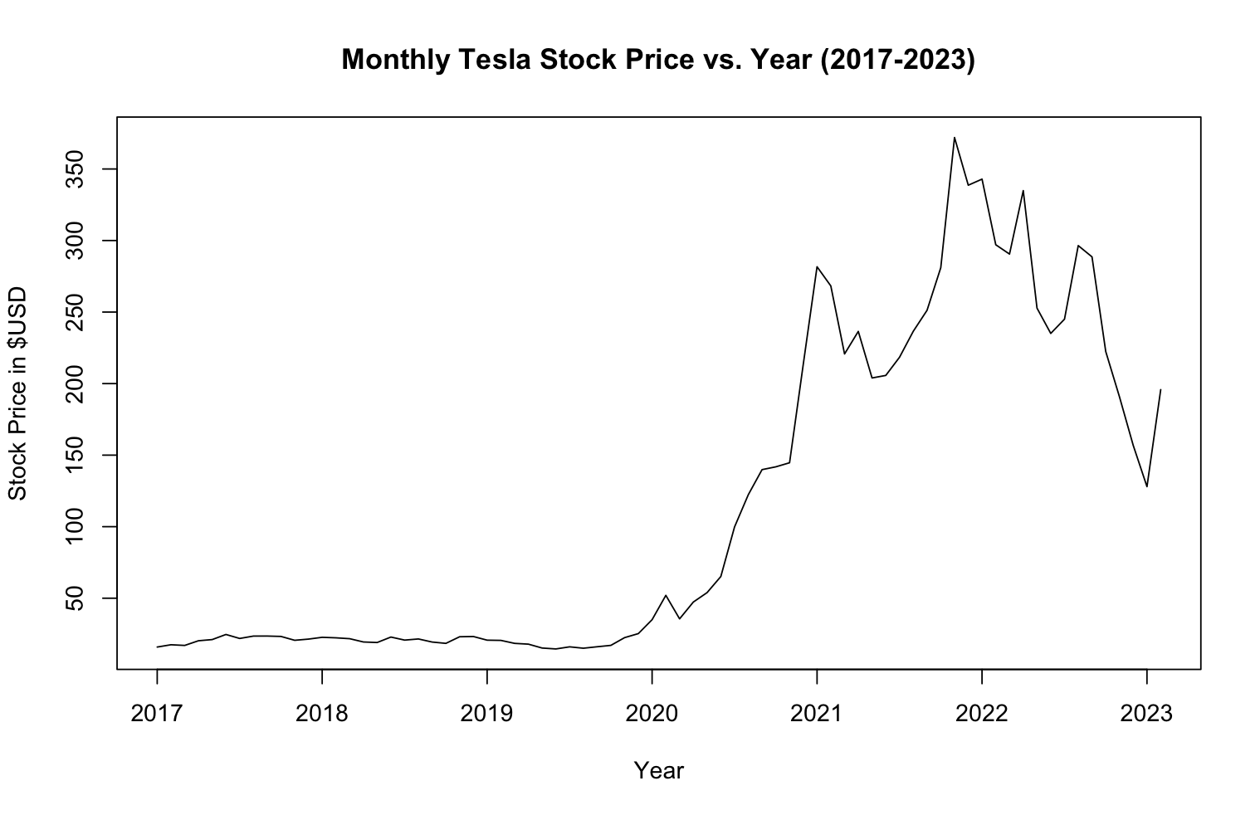
Tesla Stock Prices Over the Years
Start of COVID-19 and
Chip Shortage
Last Stimulus Check (March 2021)
Notes:
Nick
We can consider those who collected unemployment checks during COVID-19. The accumulation of checks can potentially explain why the increase in Tesla Stock prices occurred in 2022 and not during COVID-19.

Slide 7
Objective #2
Train forecasting models to predict Tesla’s stock price for the next 12 weeks and 3 months of 2023.
Notes:
Chris

Slide 8
Forecast Methods
Regression Based Model
Smoothing Methods
ARIMA Model
Neural Networks
Notes:
Chris

Slide 9
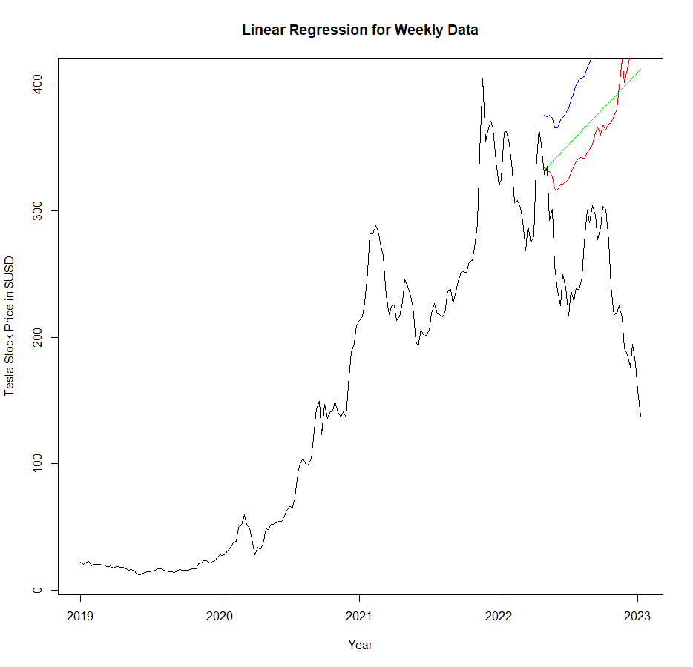
Regression Based Model - Weekly
Weekly Linear Model MAPE:
Trend = 58.8
Trend + Season = 55.7
Exp. Trend + Season = 85.9
Green = Trend
Red = Trend + Season
Blue = Exp. Trend + Season
Notes:
Chris

Slide 10
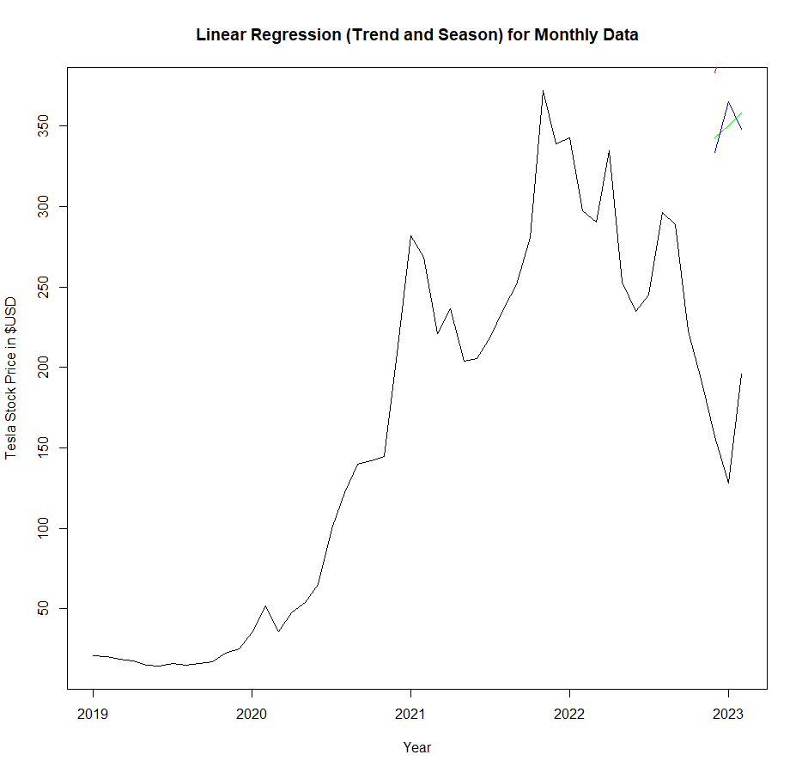
Regression Based Model - Monthly
Weekly Linear Model MAPE:
Trend = 124.9
Trend + Season = 155.6
Exp. Trend + Season = 125.2
Green = Trend
Red = Trend + Season
Blue = Exp. Trend + Season
Notes:
Chris

Slide 11
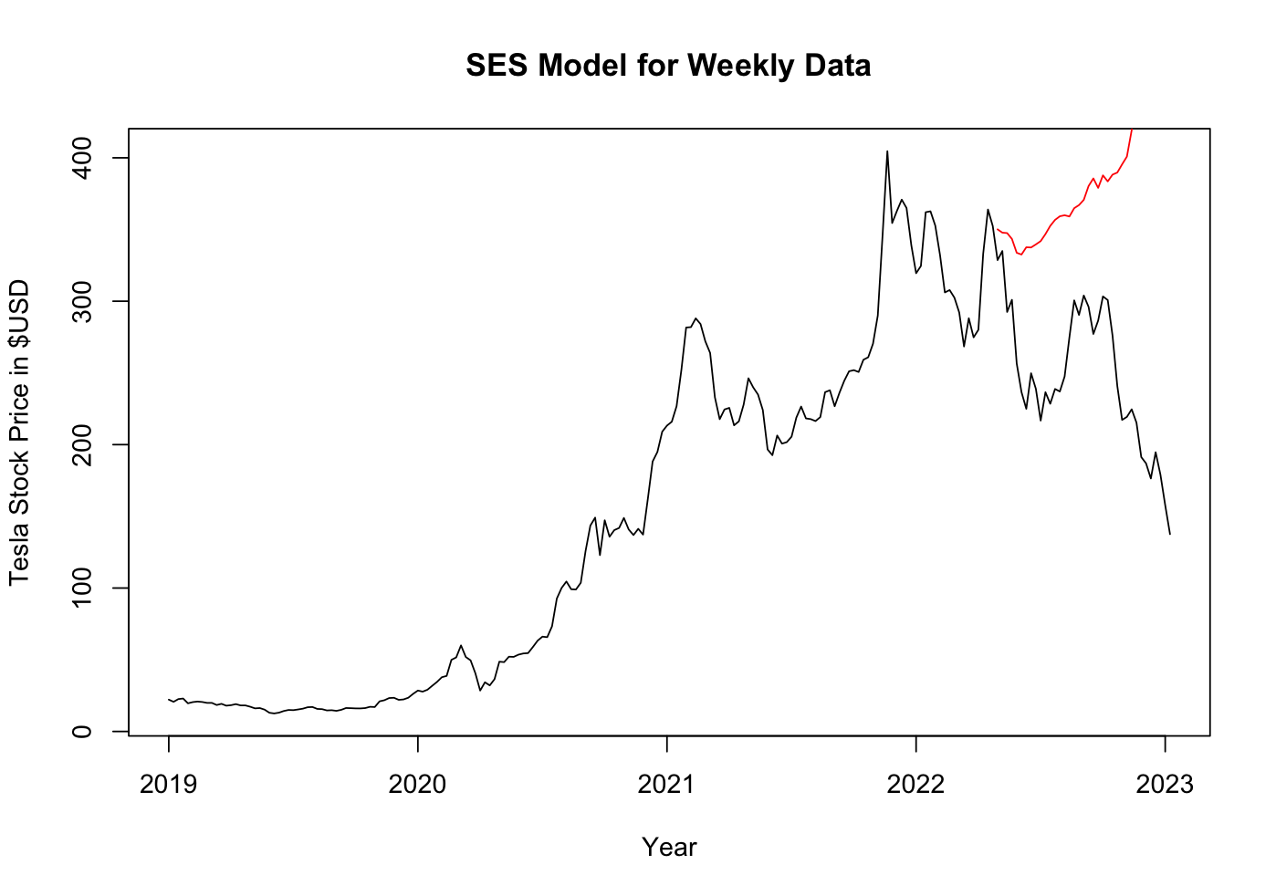
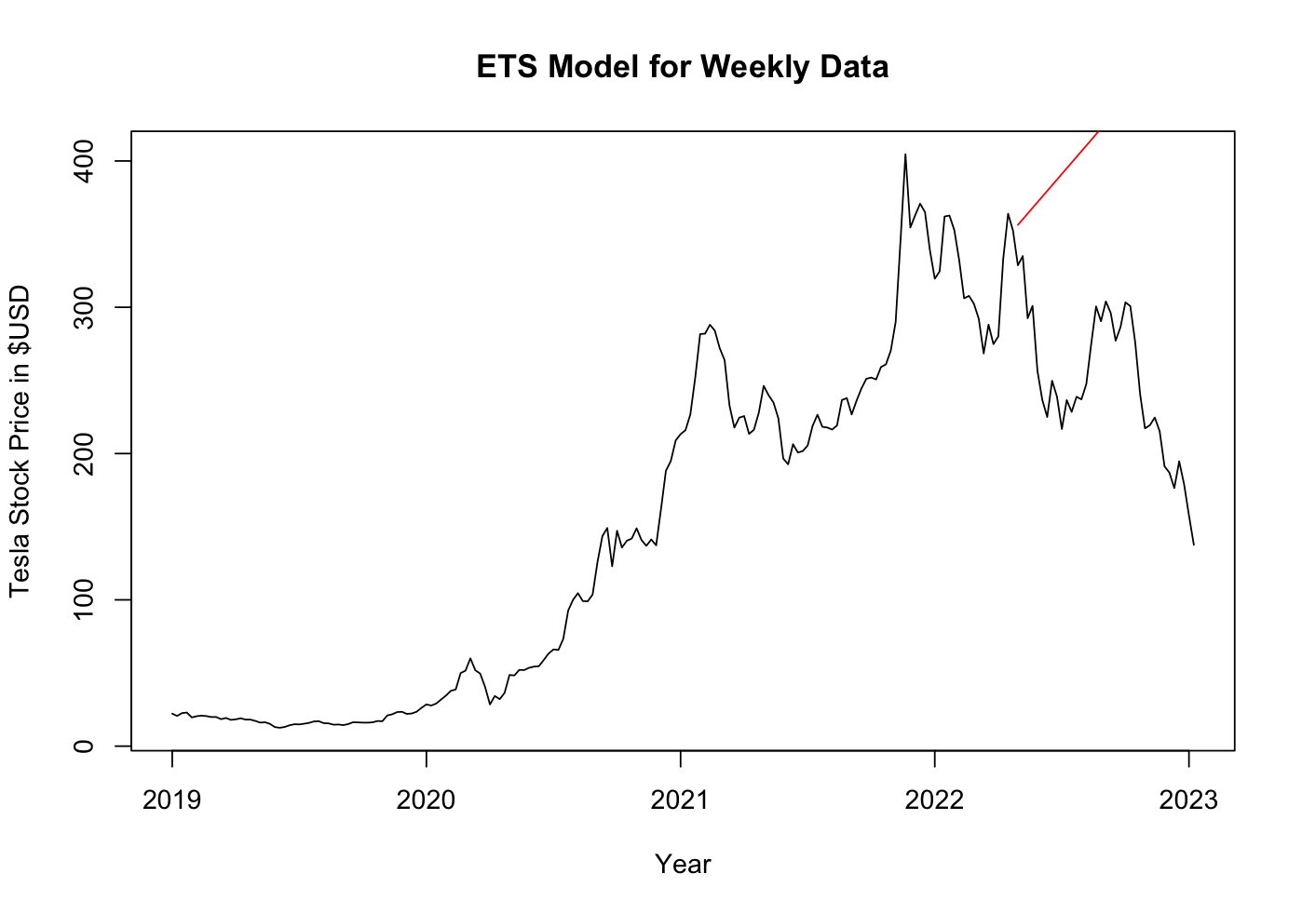
Smoothing Methods - SES vs. ETS - Weekly
SES Weekly:
MAE: 133.7566
MAPE: 63.23887
ETS “MAN” Weekly:
MAE: 179.5398
MAPE: 82.86146
Notes:
Jazz
As Chris has mentioned, the data did not seem to have any apparent trends or seasonality so we chose to use a SES model on both the weekly and monthly data. We wanted to also use the ETS function which automatically generates an alpha value and compare the SES to the ETS model. The ETS model produced a MAN model which is multiplicative errors, additive trend and no season which makes sense. We found that the SES model outperformed the ETS model and had a smaller MAPE by almost 20%.

Slide 12
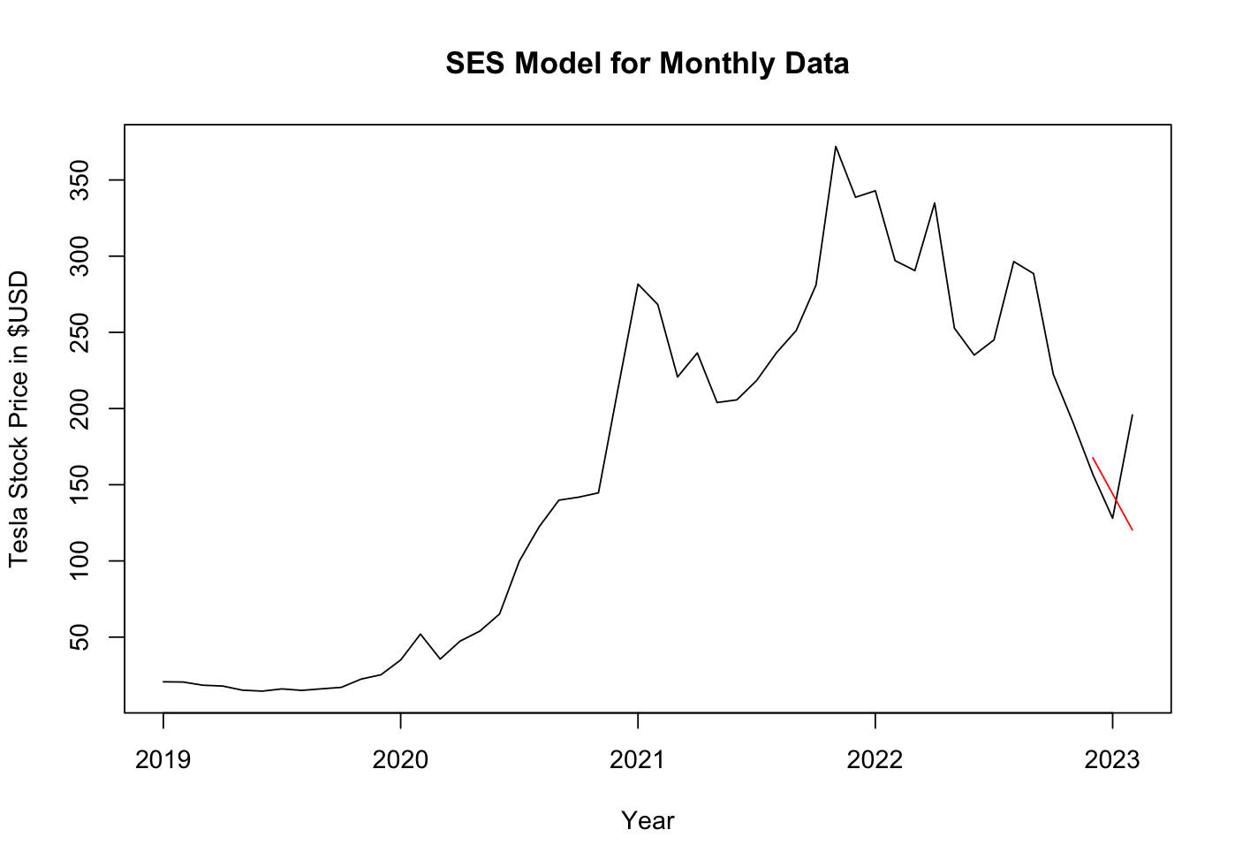
Smoothing Methods - SES vs. ETS - Monthly
SES Monthly:
MAE: 34.1464
MAPE: 19.34789
ETS “MAN” Monthly:
MAE: 34.1464
MAPE: 19.34789
Notes:
Jazz
For the monthly data, the ETS model generated a MAN model that was the exact same as the SES model. The MAPE was 19.35%

Slide 13
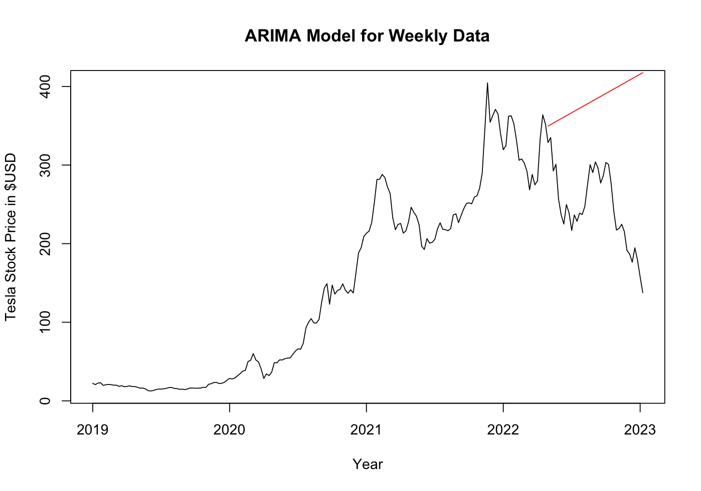
ARIMA Model - Weekly
ARIMA Weekly:
ARIMA(0,1,1)
MAE: 137.1278
MAPE: 63.60255
Notes:
Jazz
We also wanted to use an ARIMA model due to the volatility of the stock market. The lack of seasonality also makes the data a good candidate for the ARIMA model. We applied the ARIMA model on both the weekly and monthly data. These are the results it produced. Just like all the previous models we have went over so far, these models were not able to predict the sudden downward trend in the 2022. This makes sense however because the training data has a strong overall upwards trend.

Slide 14
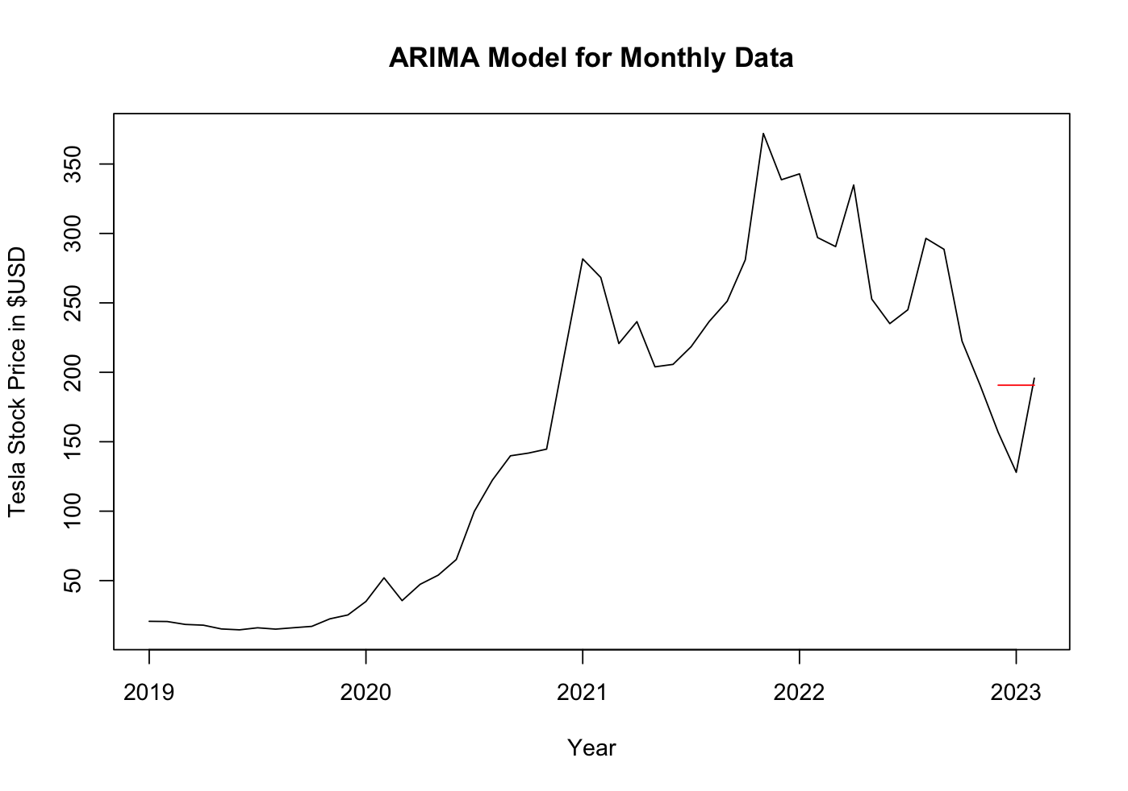
ARIMA Model - Monthly
ARIMA Monthly:
ARIMA(0,1,0)
MAE: 33.91
MAPE: 24.41626
Notes:
Jazz

Slide 15
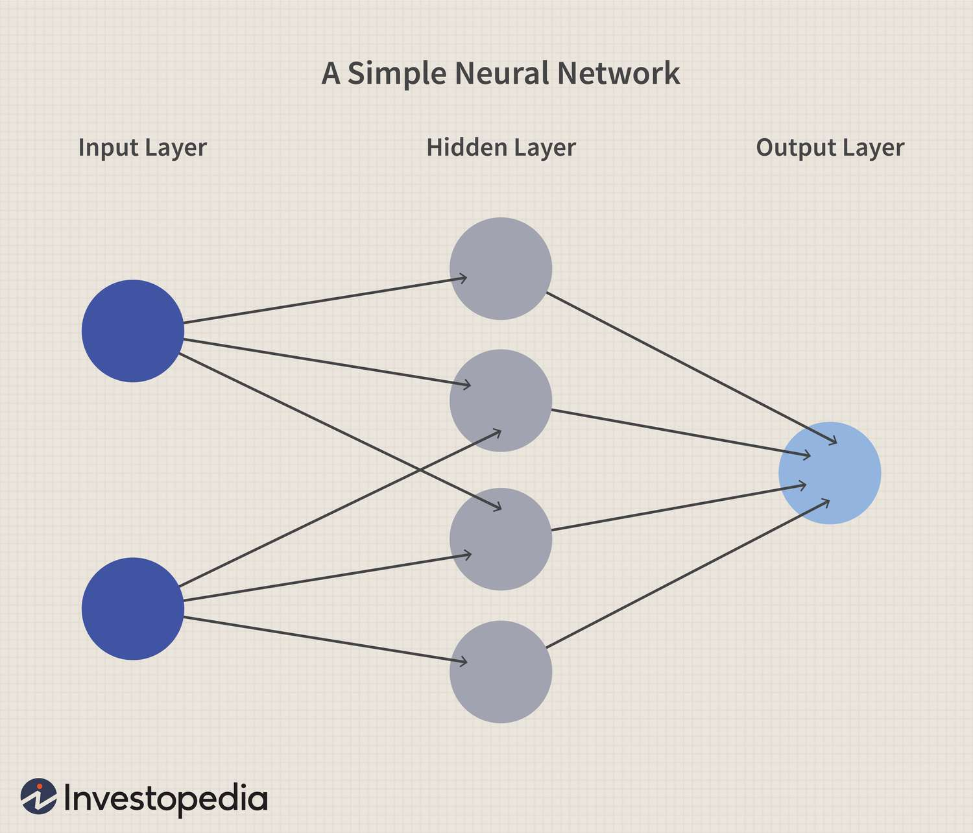
Neural Networks
Complex nature of stock price →
Neural Networks + Time Series
nnetar: Feed-forward neural networks with a single hidden layer and lagged inputs for forecasting univariate time series.
Notes:
Eva

Slide 16
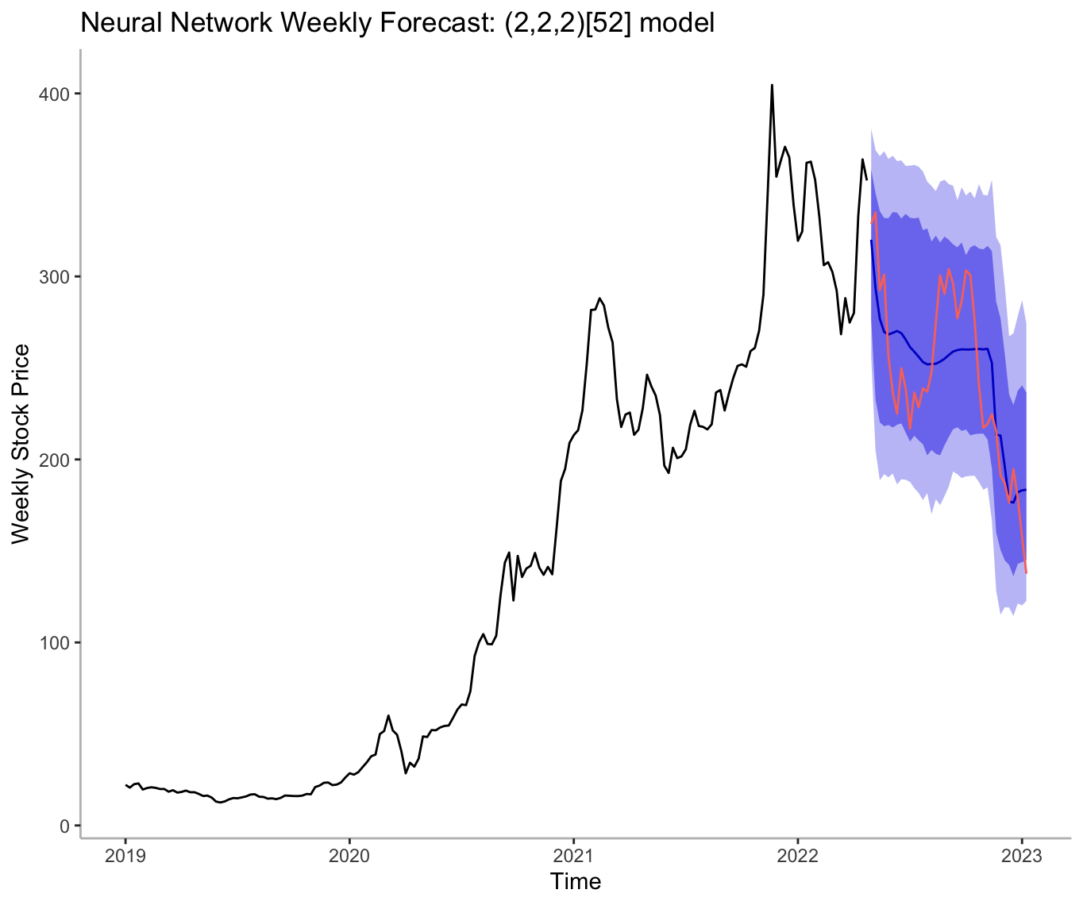
Neural Networks — Weekly
Weekly:
Seed at 80
2 periods of seasonal lag and lambda at 1
NNAR(2,2,2)[52] model
MAE: 25.70614
MAPE: 10.66192
Notes:
Eva

Slide 17
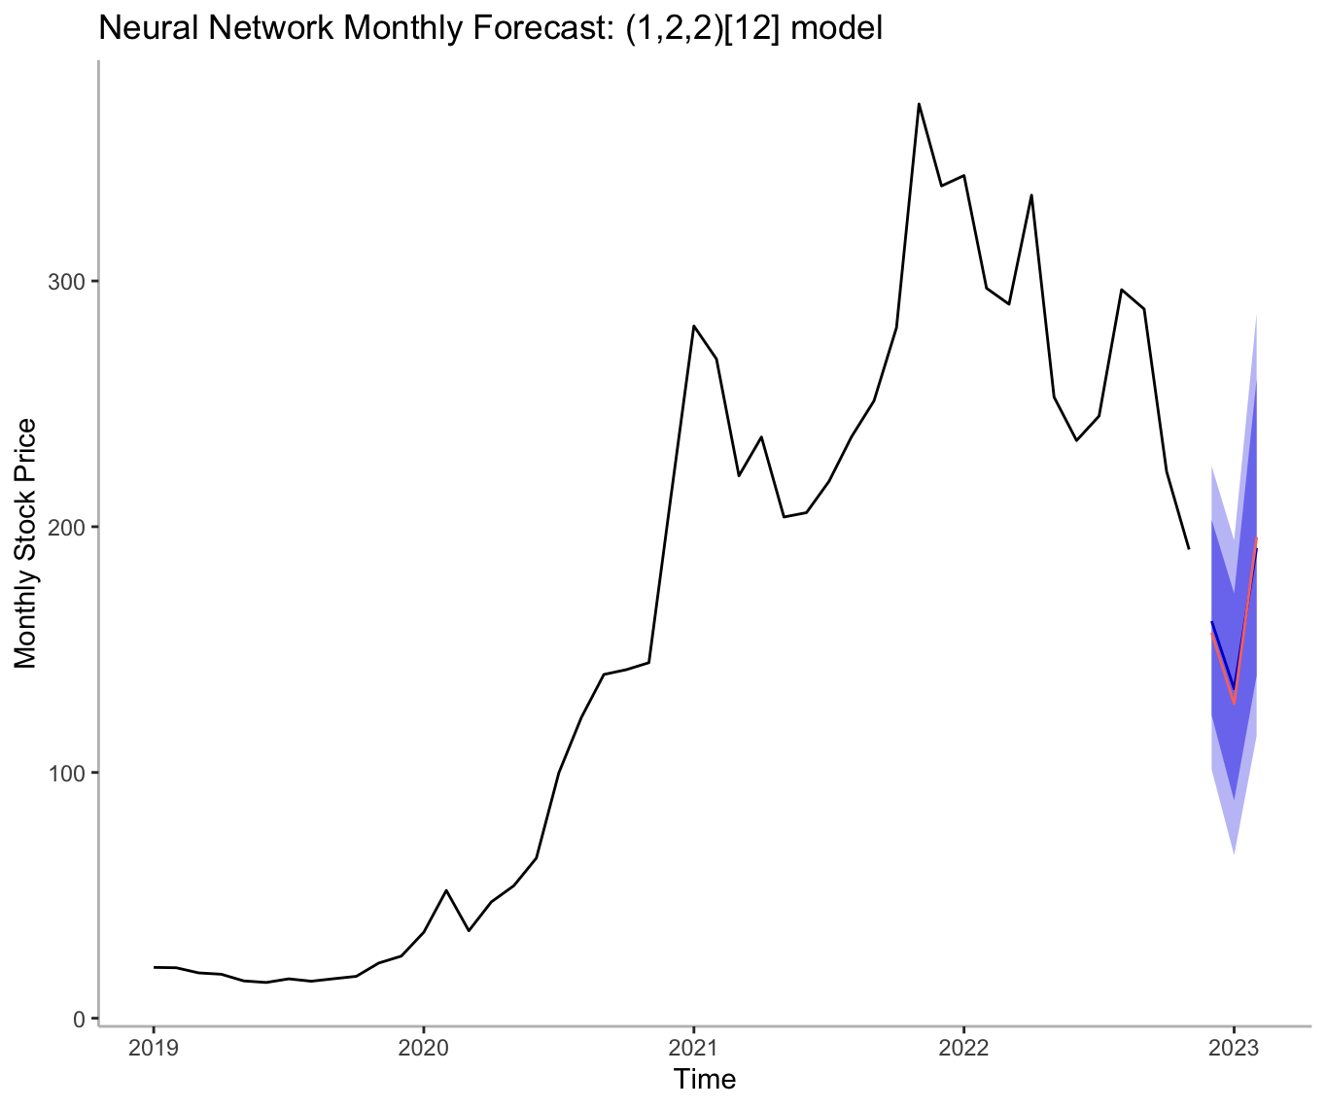
Neural Networks — Monthly
Monthly:
Seed at 2678
2 periods of seasonal lag and lambda at 1
NNAR(1,2,2)[12] model
MAE: 5.09701
MAPE: 3.35368
Notes:
Eva

Slide 18
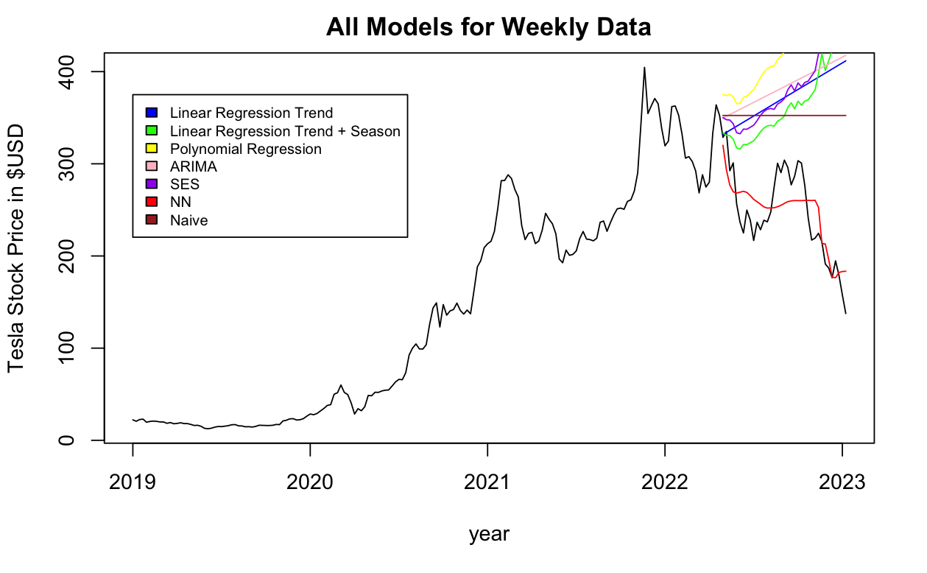
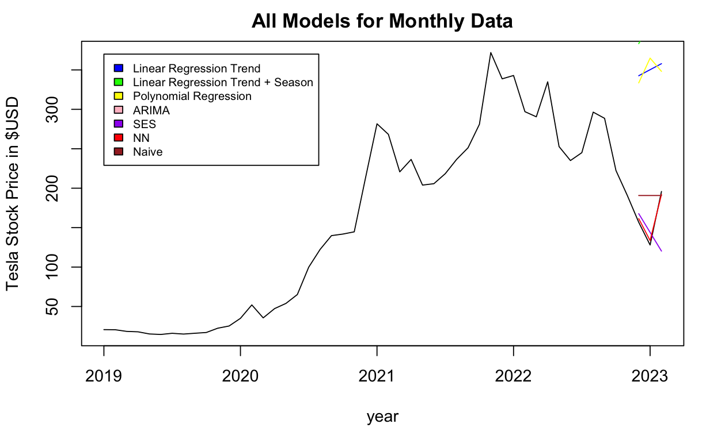
Neural Networks
Model Selection
Neural Networks model is the best performing.
Notes:
Eva

Slide 19
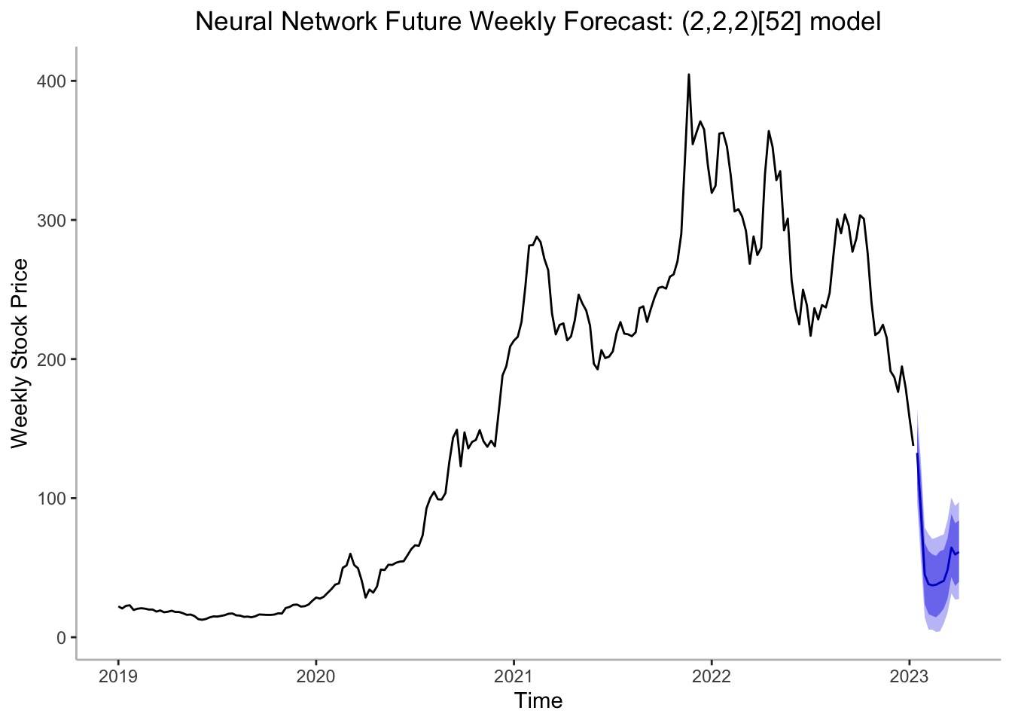
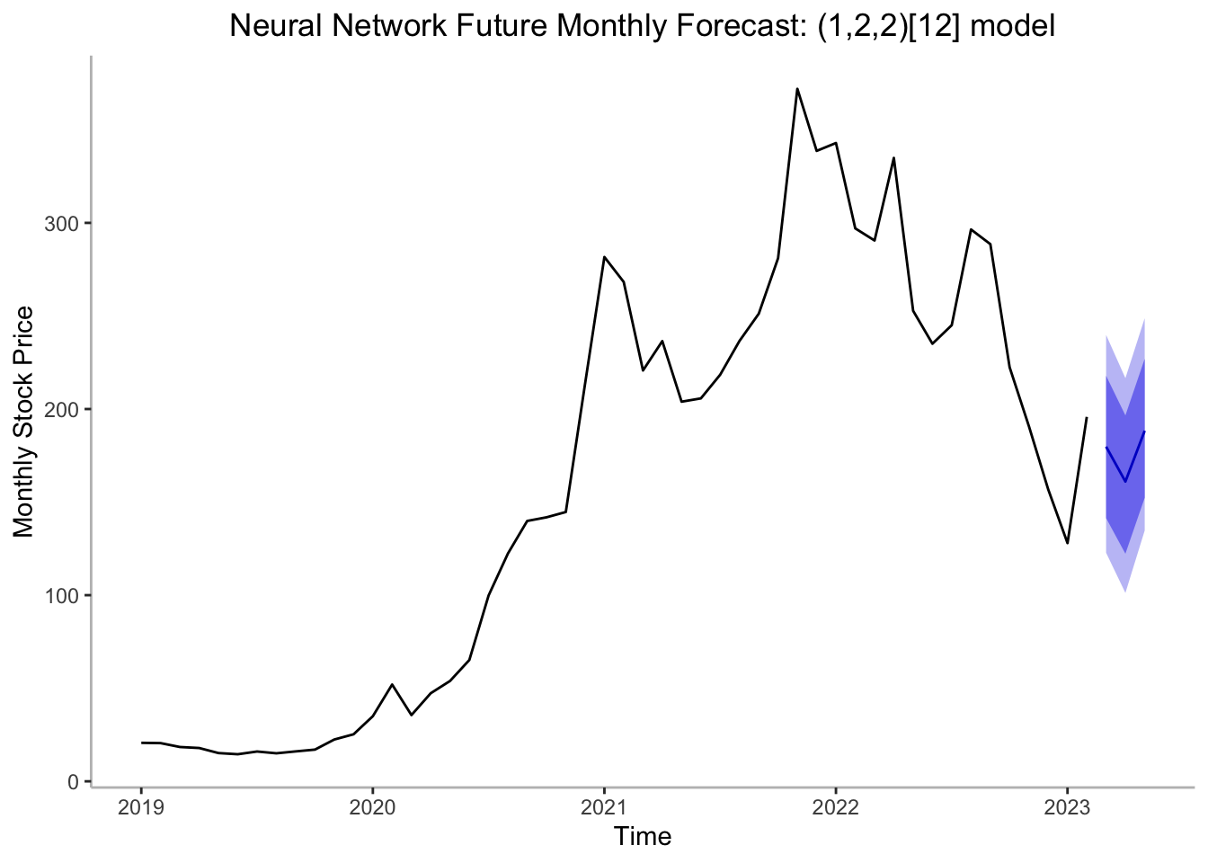
Model Implementation on Full Data + Forecast
Forecast the real future for 3 months and 12 weeks
2 mos after
2/14/2023 at $161.04
3 weeks after
2/14/2023 at $37.33
Notes:
Eva

Slide 20
Conclusion
Neural Networks have highest predictive power
As per our previous model, investors should buy in at 3 weeks to 2 months from now
Notes:
Eva

