Slide 1
Pixel Pet
Ryan Austin, Mariafernanda Hernandez, Jessica Martinez Marquez, Eva Zhou

Slide 2
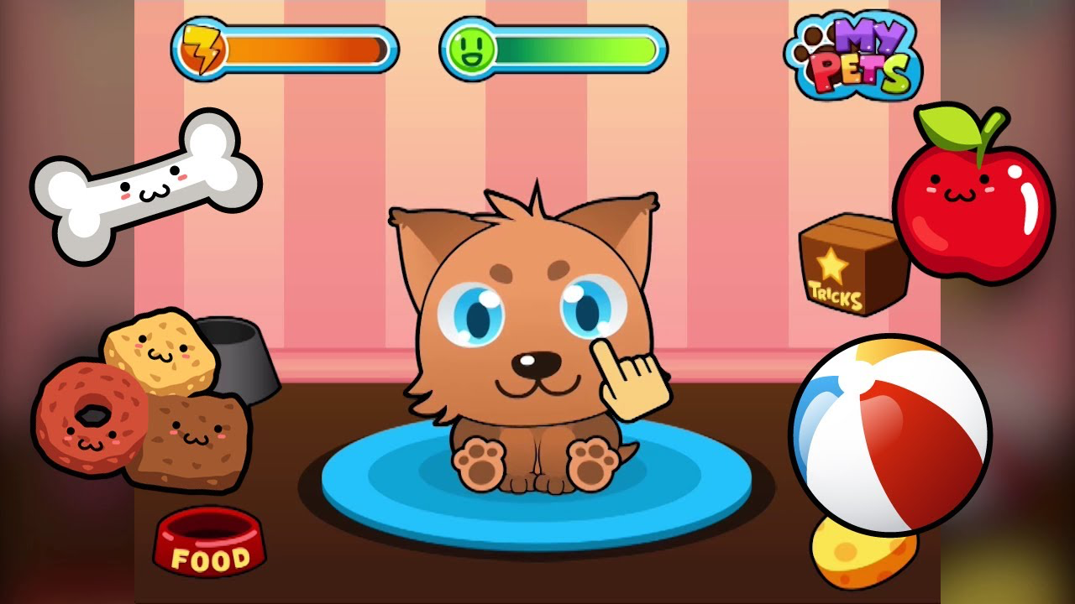
Project Background
> Inspired the Tamagotchi digital pet game. Where the user can feed and take care of their pets. They can even watch them grow over time!
> Aims to help child users learn about caring for pets if they get one in the future.

Slide 3
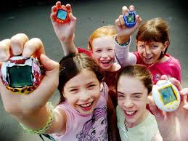
Target audience
> Kids around 6-10 year old who love animals and games
> Adults who enjoy raising pets but don’t have a real pet.
> Anyone who wants to reminisce about the old style Tamagotchi games

Slide 4
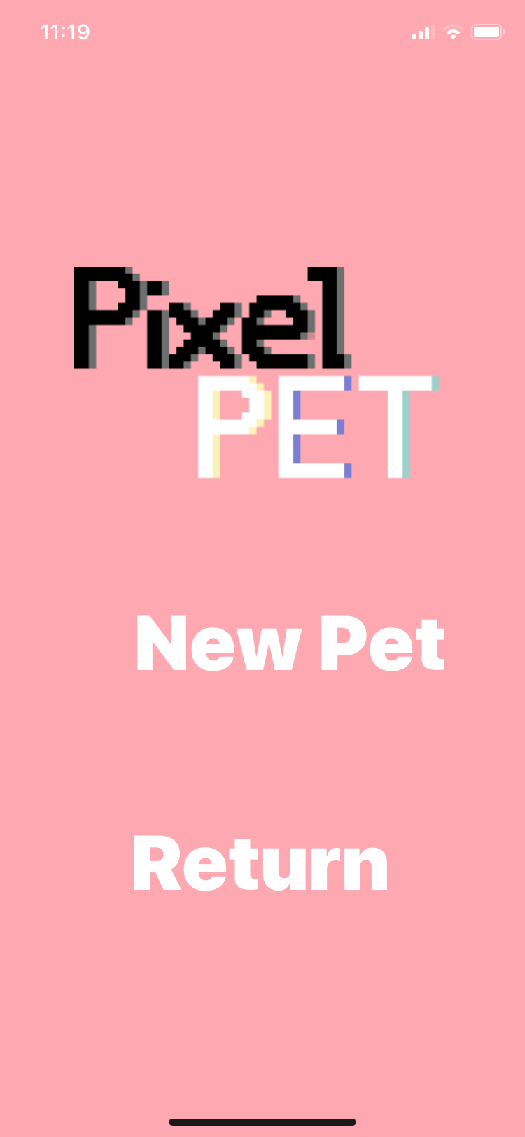
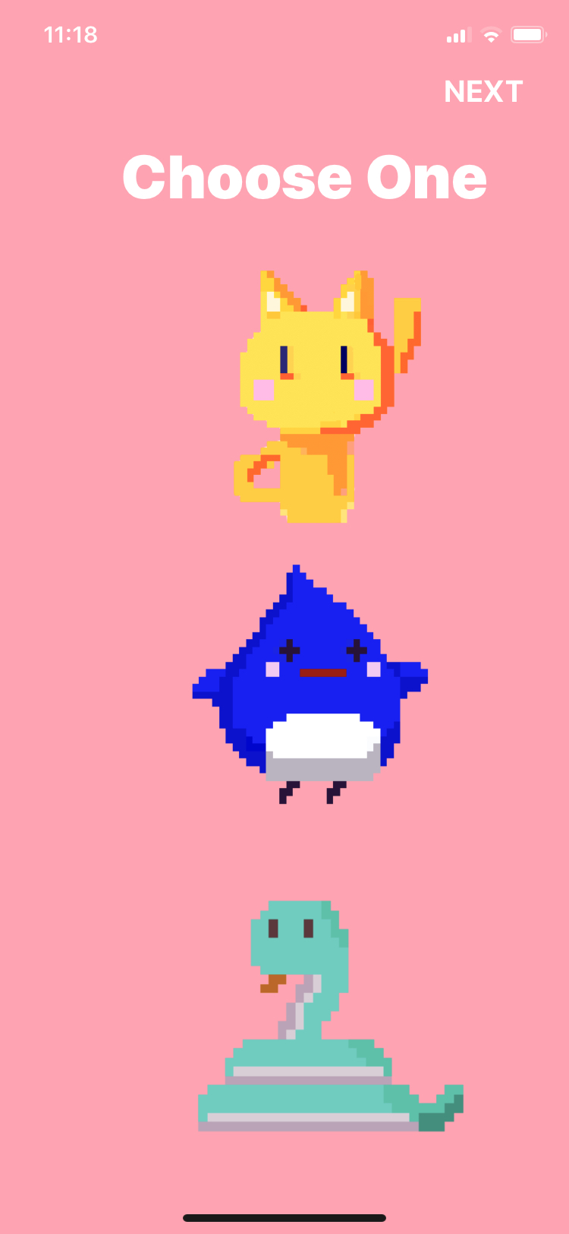
Opening Screens
When the app launches, the user has the option to return to their current pet, or to add a new pet to their Pixel Pet family. (left picture)
If they want to get a new pet, there will be three new animals to choose from. (right screen)

Slide 5
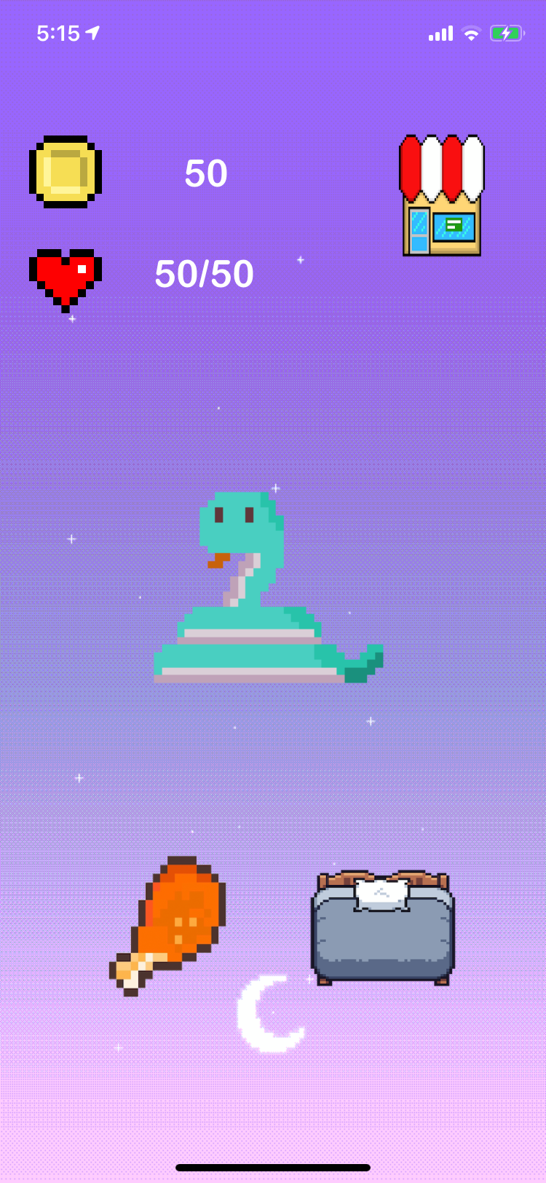
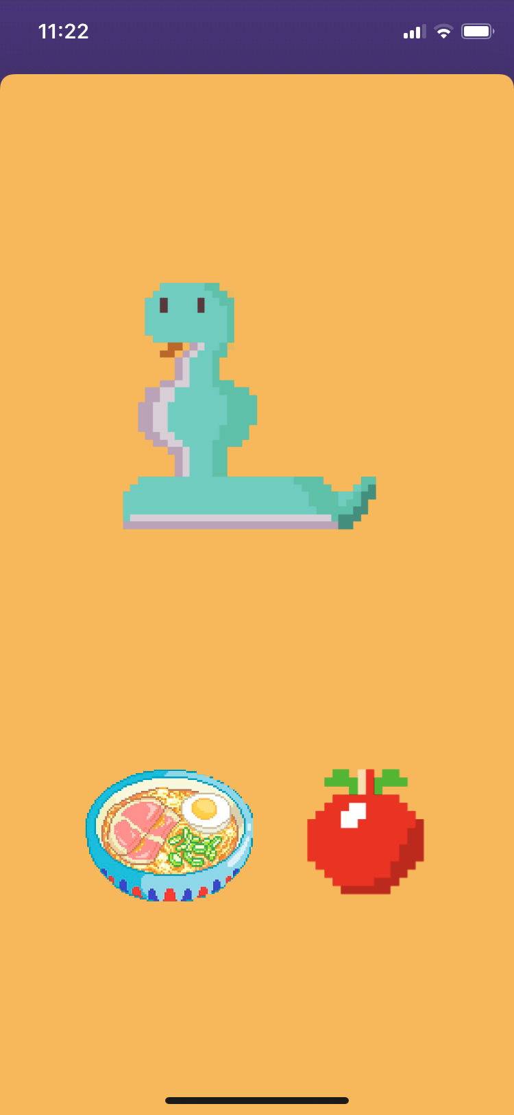
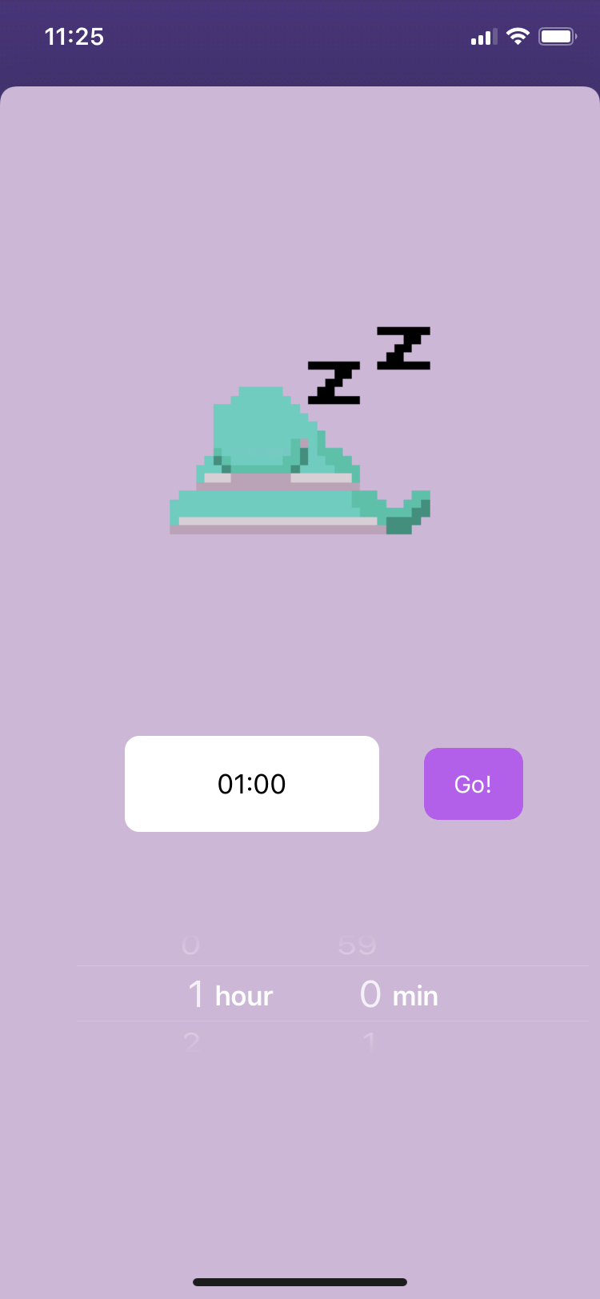
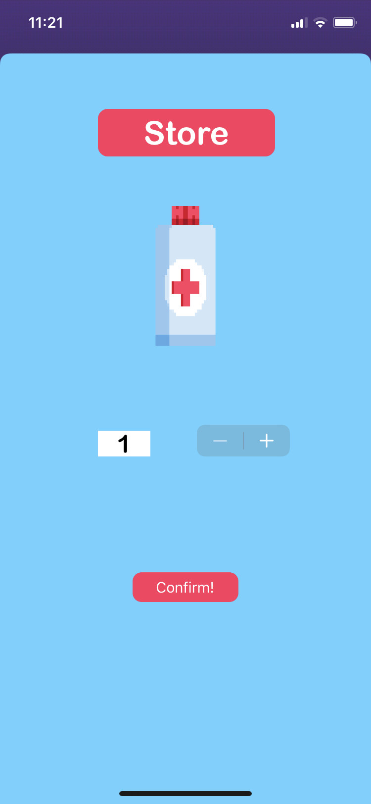
Main Screens Used in Gameplay
Link to store screen
Link to sleep screen
Link to eat screen
Eat Screen: select meal or snack
Sleep Screen: how long the user has slept
Store Screen: buy medicine to recover health
Main Screen

Slide 6
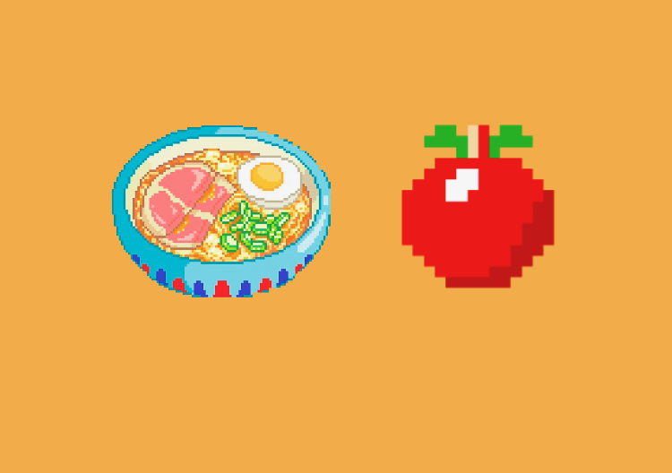
Gameplay Functions
MONITOR MONEY / HEALTH: At all times, the user can see how much money/health they have
EAT: When feeding the pet the user has the option to give a meal or a snack. A meal will give better rewards than a snack
SLEEP: The user can select the duration of time that they have slept. The pet needs at least 7.5 hours of sleep each day to be healthy
STORE: The user has the option to use money earned by pet to buy medicine
Meal Snack

Slide 7
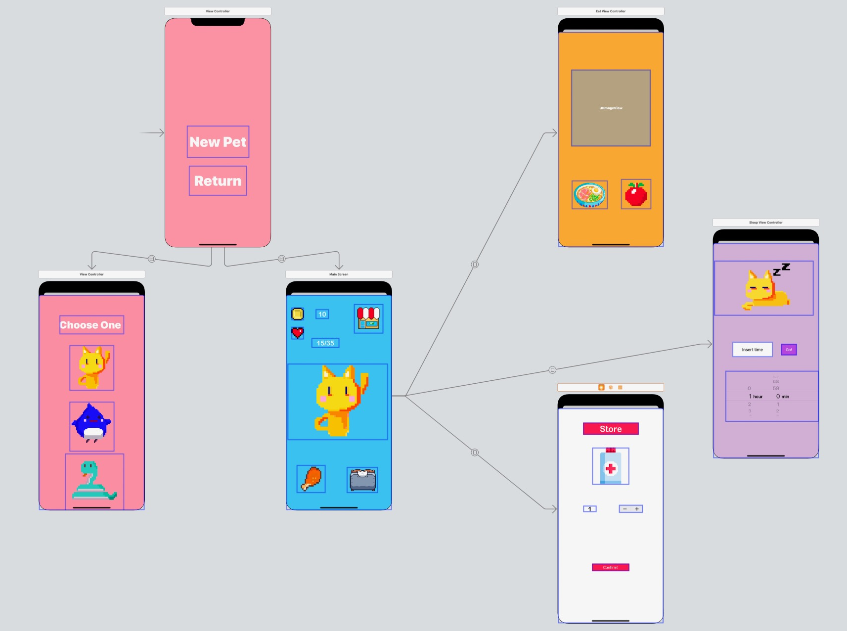
Overall Project Architecture

Slide 8
Thank You!

