Slide 1
MERJ
Ryan Austin, Mariafernanda Hernandez, Jessica Martinez Marquez, Eva Zhou

Slide 2
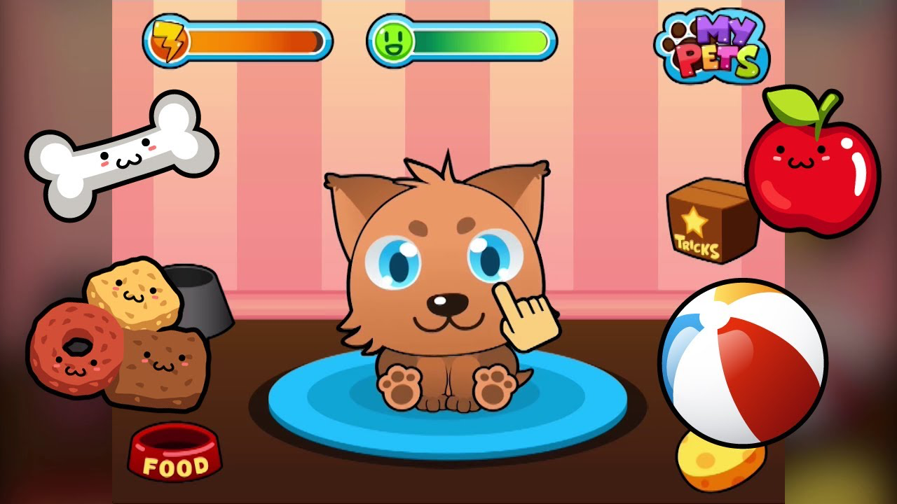
Background
> Inspired by games where a pet would be cared for by the user
> Also aims to make the user more mindful of sleeping habits

Slide 3
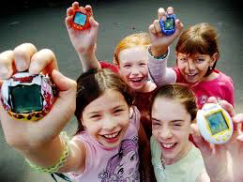
Target audience
> Kids around 6-10 year old who love cartoons and games
> Adults who enjoy raising pets but don’t have real ones and a way to remind them of old style Tamagotchi games

Slide 4
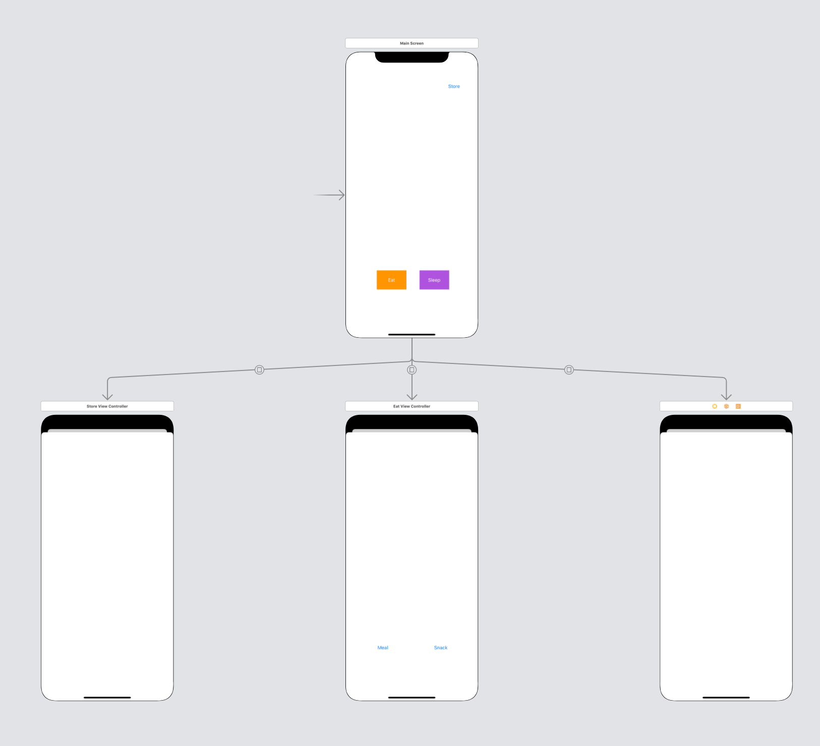
Screens
> Top screen is the
> center bottom is the potential eating prompt screen
> right screen is the potential sleeping prompt screen
> left screen is the potential shop screen
The code shows the aesthetic traits not shown here

Slide 5
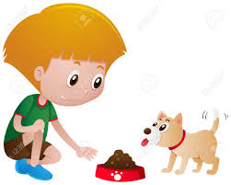
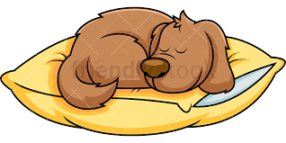
Main Functions (eat, sleep, store, etc.)
EAT: When feeding the pet the user has the option to give a meal or a snack. A meal will keep the pet full for longer than a snack
SLEEP: The user can select the duration of time that the pet will sleep
STORE: The user has the option to use money earned by adult pets to buy items such as food and medicine

Slide 6
Thank You!

