Slide 1
Azure deep dive: Bicep in the real world

Slide 2

Who am I?
Erwin van den Bogaard
Worked at Virtual Vaults for 3,5 years
Started at VV with Bicep 0.2.x

Slide 3
Infrastructure as code
“Infrastructure as code (IaC) uses DevOps methodology and versioning with a descriptive model to define and deploy infrastructure, such as networks, virtual machines, load balancers, and connection topologies. Just as the same source code always generates the same binary, an IaC model generates the same environment every time it deploys.” –Microsoft learn
Describe how our environment should be in code
Idempotent
Human readable
Automates the entire process
Security
Configuration drift
Revert

Slide 4
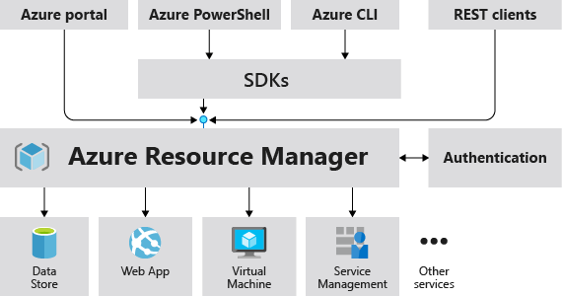
Azure Resource Manager
Management layer to create, update, and delete resources
Requests from SDKs, tools, portal, etc. all go to the Resource Manager
Control plane and data plane
New functionality is first released in REST API and later through updates added in SDKs and Portal
https://resources.azure.com

Slide 5
ARM templates
Declarative approach
JSON file
Idempotent
Deployment modes
Complete
Incremental
Template converts into separate REST API operations

Slide 6
Bicep
Gets transpiled into ARM template
Simpler syntax
Domain-specific language
Provided by MS team that owns the APIs it runs against
Supports everything ARM templates support

Slide 7
Tooling
Bicep VS Code extension
Intellisense
Code navigation
Refactoring
Commands
Bicep config file
Linter rules
Authentication
Experimental features
Aliases
Visualizer
Preview changes

Slide 8
Sharing Bicep across an organization
We had a lot of APIs in different repositories
Reduce code duplication
Increase quality
Source control
Versioning
Template specs
Private registries

Slide 9
Template specs
Designed to be deployed as a complete template
It’s an Azure resource
Provides access control
Provides versioning
Can be deployed through Portal, CLI, PowerShell, Bicep

Slide 10
Bicep registry
Intended to be combined into a larger template
Hosted on Azure Container Registry
Future plans to support other registries (i.e Docker Hub)
Provides access control
Provides versioning
Reference directly in a template
br:{registry}/{module_path}:{tag}

Slide 11
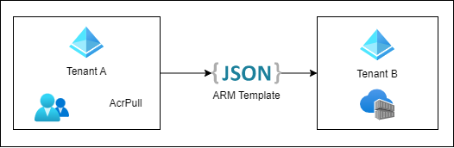
Cross tenant sharing
Organization has multiple subscriptions and tenants
When running code locally we needed Azure CLI to point to our dev environment
Don’t want to switch between subscriptions all the time
Azure lighthouse
Gives principals from a tenant permissions on another tenant
User / Group / Service principal
Role based access control

Slide 12
Deployment scripts
ARM cannot do everything
Resource type Microsoft.Resources/deploymentScripts
Requires two supporting resources
Azure Container instance
Storage account
Allows to run a Bash or PowerShell script as part of your deployment
Has two types of principals
Deployment principal
Deployment script principal
Can produce outputs and use them in the deployment

Slide 13
Questions?

Slide 14
Nice resources
Bicep playground (https://bicepdemo.z22.web.core.windows.net/)
https://learn.microsoft.com/en-us/azure/templates/
https://learn.microsoft.com/en-us/rest/api/azure/
https://github.com/Azure/azure-quickstart-templates
https://azure.github.io/bicep-registry-modules/

