Slide 1
Smart Waste Complaint and Collection Management System
MCA Project Presentation | Lovely Professional University | 2026
Laiba Naushad (324101314)

Slide 2
Problem Statement
- Citizens report overflowing bins, missed pickups, and illegal dumping through informal channels.
- Manual complaint handling makes accountability, location tracking, and status visibility difficult.
- Administrators need a unified view of complaints, workers, and high-priority cases.
- Sanitation workers need assigned task lists and proof-based closure.

Slide 3
Aim and Objectives
- Digitize the full complaint lifecycle from citizen submission to worker resolution.
- Provide role-based portals for citizens, administrators, and workers.
- Capture geo-tagged complaint locations using an interactive Leaflet map.
- Support photo upload for complaint evidence and resolution proof.
- Generate analytics for status, category distribution, and recent trends.
- Escalate unresolved complaints after a configurable SLA window.

Slide 4
Research Gap and Proposed Solution
Research Gap
Proposed Solution
- IoT systems focus mainly on sensors and bins.
- Traditional grievance systems often lack map pins and worker-level closure.
- Address-based search fails when citizens leave address fields incomplete.
- Three-role MERN web application.
- Map pin and photo-driven complaint submission.
- Admin dashboard with maps, filters, assignment, and analytics.
- Distance search using the Haversine formula.
- Audit logs and email notifications.

Slide 5
Technology Stack
Frontend
React 18, Vite, Tailwind CSS, React Router, Recharts, Leaflet
Backend
Node.js, Express.js, REST APIs, JWT, bcrypt, Multer
Database
MongoDB with Mongoose models
Integrations
Cloudinary, Gmail API, node-cron SLA job
Tools
VS Code, npm, Nodemon

Slide 6
System Architecture
Citizen Portal
MongoDB
Admin Portal
React SPA
Route Guards + API Client
Express API
Controllers + Middleware
Cloudinary
Worker Portal
Gmail API
PLACEHOLDER: Replace with architecture diagram from report, if required.

Slide 7
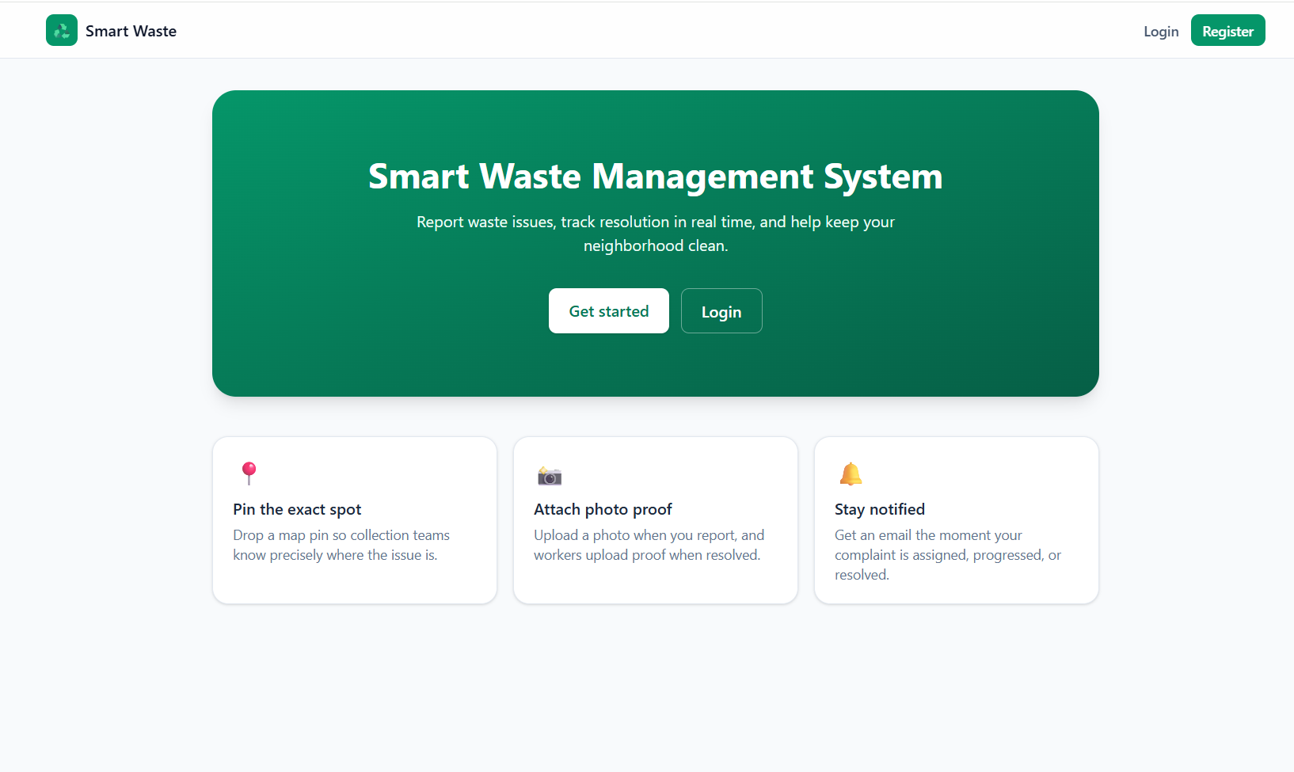
Home Screen

Slide 8
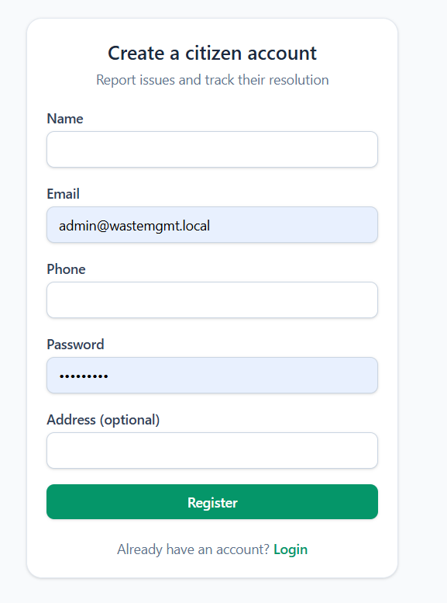
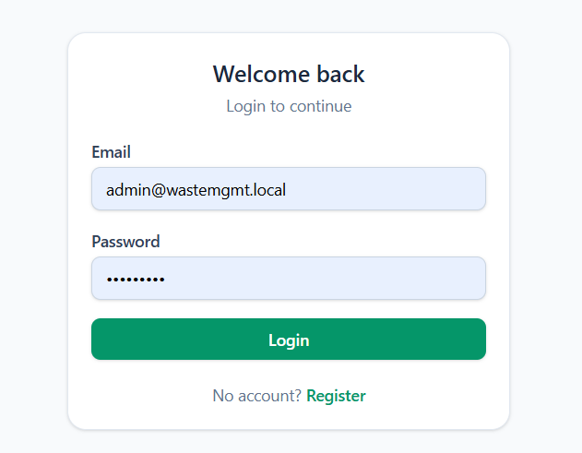
Authentication Screen

Slide 9
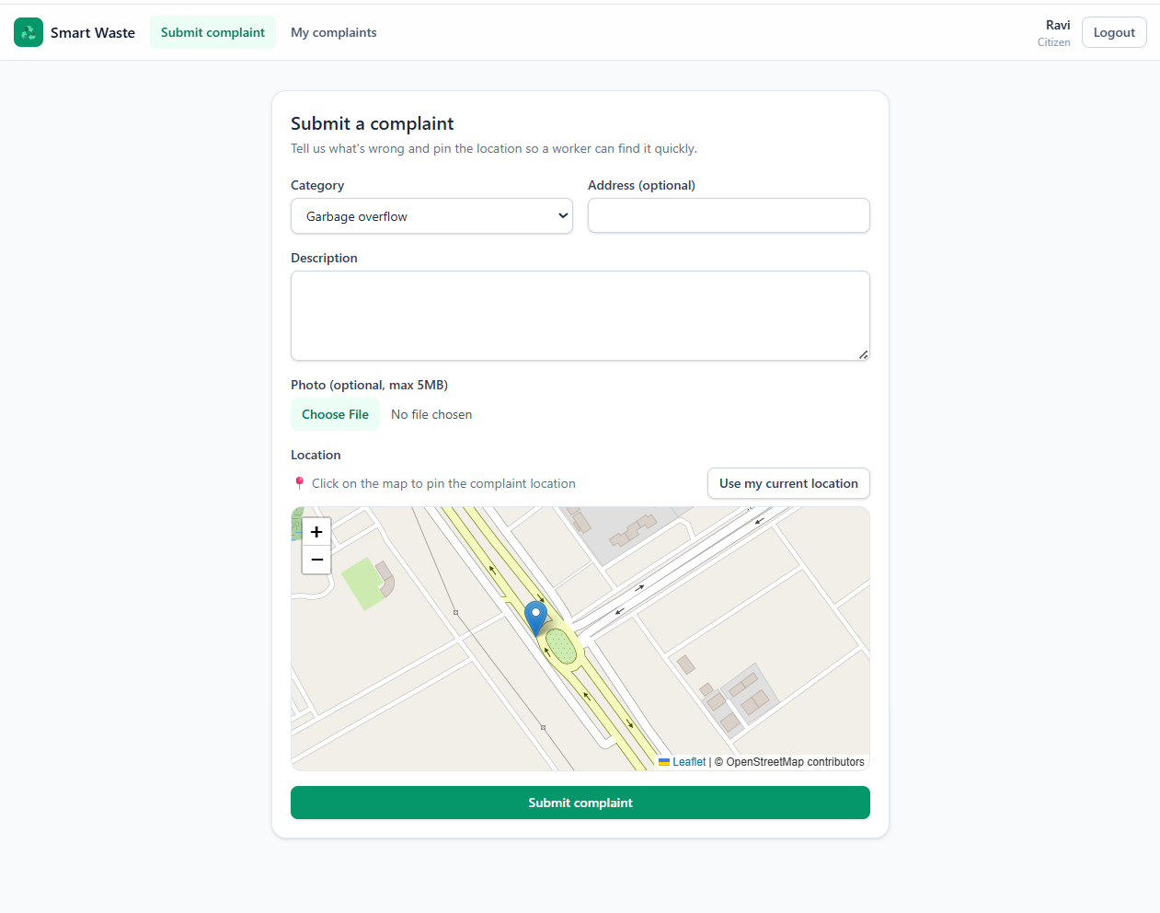
Citizen Complaint Submission
- Select waste complaint category.
- Add description and optional photo.
- Mark exact location on map.
- Submit complaint for admin review.

Slide 10
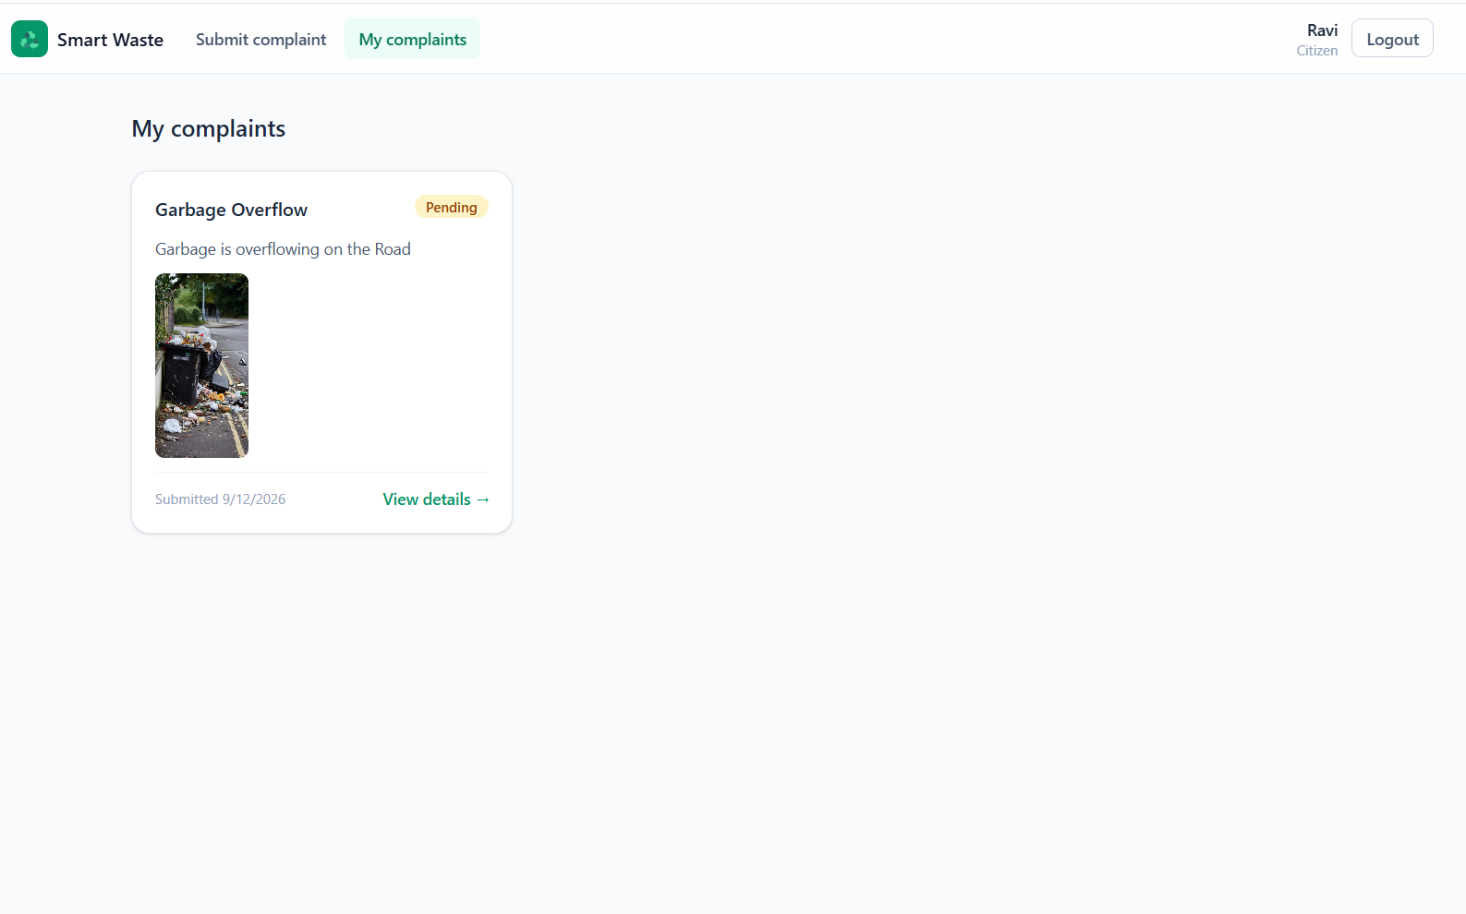
Citizen Tracking – List of Complaints
- Citizen can view all submitted complaints.
- Each complaint shows category, photo, date, and current status.
- “View details” opens the complete complaint timeline.

Slide 11
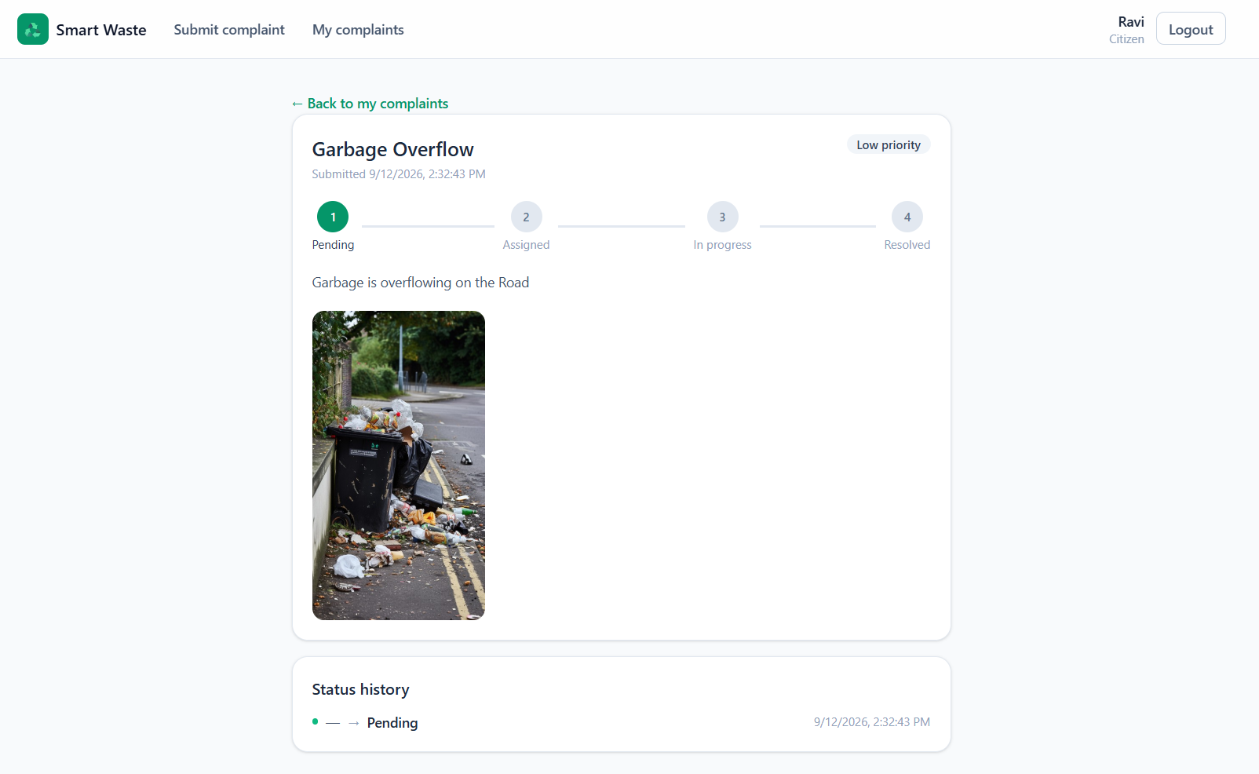
Citizen Tracking – Complaint Detail
- Shows complete complaint information in one place.
- Status tracker displays progress from Pending to Resolved.
- Status history keeps an audit trail of every update.
- Citizen can verify transparency without contacting admin manually.

Slide 12
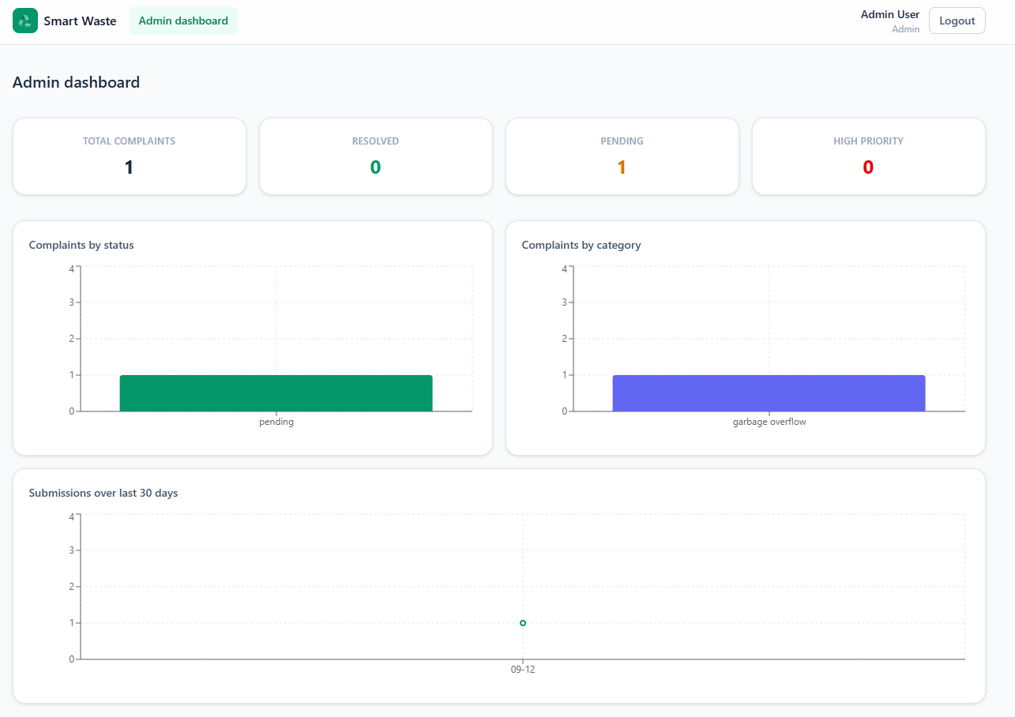
Admin Dashboard Overview
- Dashboard shows total, resolved, pending, and high-priority complaints.
- Charts summarize complaints by status, category, and date.
- Admin can quickly identify workload and complaint trends.
- Helps in monitoring overall system performance.

Slide 13
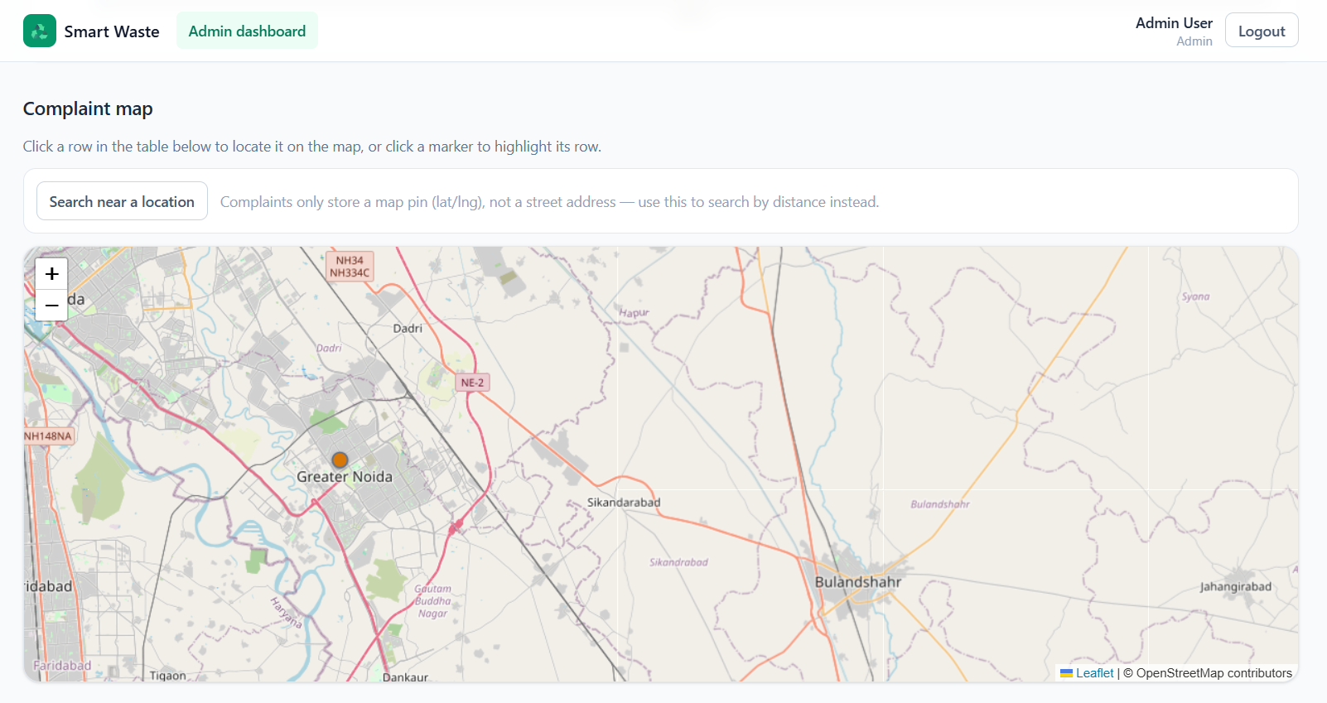
Admin Map and Geo Search
- Map shows where each complaint was reported.
- Admin can click markers to locate complaints quickly.
- Nearby complaints can be searched using radius filter.
- This helps assign workers based on location.

Slide 14
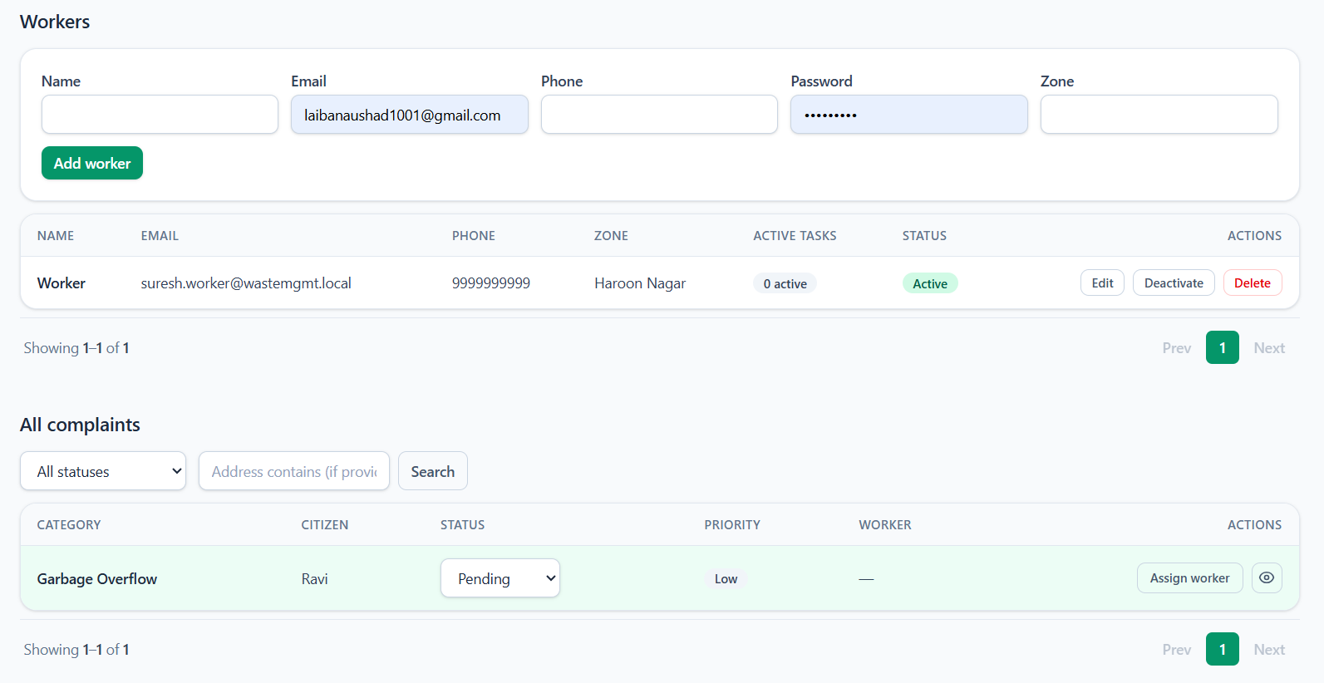
Worker Management
- Admin can add sanitation workers with contact and zone details.
- Worker accounts are linked with login access.
- Active/inactive status controls task assignment.
- Worker table shows task load and available actions.

Slide 15
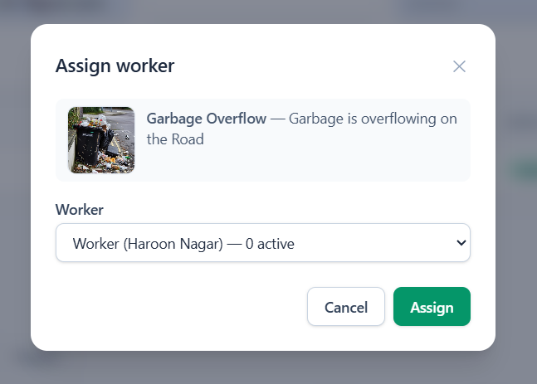
Complaint List And Worker Assignment
- Admin views all complaints in a centralized table.
- Complaints can be filtered by status or location/address.
- Pending complaints can be assigned to active workers.
- Assignment changes the complaint status to Assigned.

Slide 16
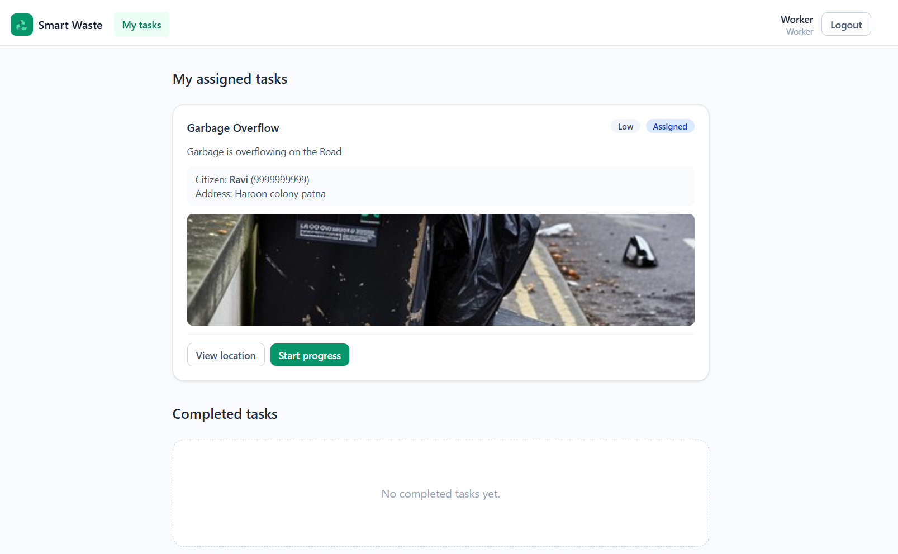
Worker Tasks List
- Worker can view complaints assigned by the admin.
- Each task shows complaint details, citizen contact, address, priority, and status.
- “View location” opens the complaint location for navigation.
- “Start progress” updates the task status to In Progress.

Slide 17
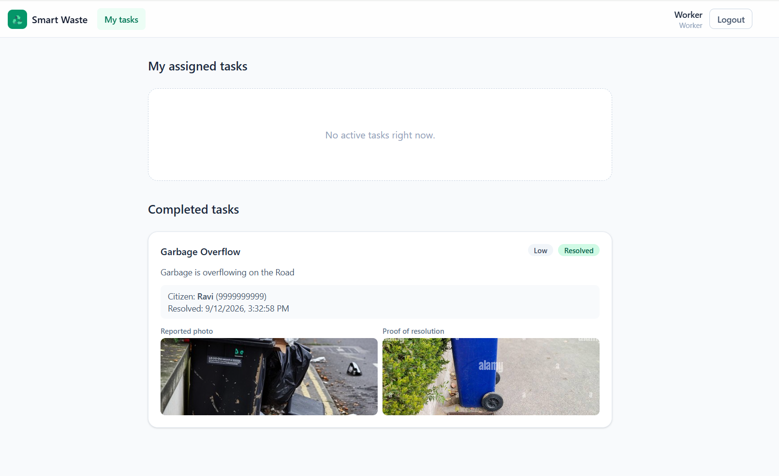
Worker Task Flow
- Once work starts, the task moves from Assigned to In Progress.
- After completing cleanup, worker uploads proof of resolution.
- Resolved task moves to the Completed Tasks section.
- Citizen and admin can see the updated status and proof.

Slide 18
Complaint Lifecycle
1. Pending
2. Assigned
3. In Progress
4. Resolved
- Pending: Complaint is submitted by the citizen and awaits admin review.
- Assigned: Admin assigns the complaint to an available worker.
- In Progress: Worker starts resolving the assigned complaint.
- Resolved: Worker completes the task and uploads proof of resolution.

Slide 19
Database and API Design
Database Models
API Groups
- User: name, email, phone, password hash, role.
- Complaint: category, photo, location, status, priority, assigned worker.
- Worker: linked user account, zone, active status, task count.
- StatusLog: old status, new status, updated by, timestamp.
- Authentication: register, login, current user.
- Complaints: create complaint, view own complaints, view details.
- Admin: manage complaints, assign workers, update status, view analytics.
- Worker: view assigned tasks, start work, upload resolution proof.

Slide 20
Security, Reliability and Notifications
- JWT authentication secures protected routes and APIs.
- Role-based access separates citizen, admin, and worker features.
- Passwords are stored securely using bcrypt hashing.
- Middleware handles validation, authorization, and errors.
- Logs help track requests and debug issues.
- Email notifications update users about complaint progress.
- SLA escalation highlights unresolved complaints automatically.

Slide 21
Results and Discussion
Testing Performed
Result
- Verified login flows for all three roles.
- Tested complaint submission with map coordinates and image upload.
- Checked admin assignment, filtering, analytics, and worker management.
- Verified worker progress and proof upload.
- End-to-end complaint reporting works.
- Admin can assign, monitor, and analyze complaints.
- Worker can close tasks with proof.
- Citizen can track progress transparently.

Slide 22
Limitations and Future Scope
- Add password reset and stronger account recovery.
- Add automated Jest/API test coverage.
- Add push or SMS notifications.

Slide 23
Project Highlights
- Full-stack MERN implementation with role-based access.
- Geo-tagged complaint reporting using map integration.
- Admin dashboard for assignment, tracking, and analytics.
- Worker task flow with proof-of-resolution upload.
- Status history improves transparency and accountability.

Slide 24
References
- React documentation: https://react.dev
- Node.js documentation: https://nodejs.org/docs
- Express.js documentation: https://expressjs.com
- MongoDB and Mongoose documentation: https://www.mongodb.com/docs and https://mongoosejs.com
- Leaflet documentation for interactive maps: https://leafletjs.com
- Cloudinary and Gmail API documentation for image storage and email notification concepts.

Slide 25
Thank You
Questions?
Project: Smart Waste Complaint and Collection Management System
Laiba Naushad (324101314)

