Slide 1
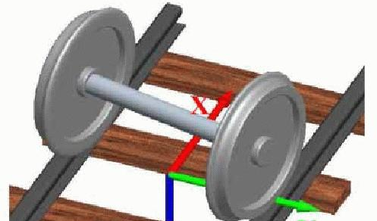
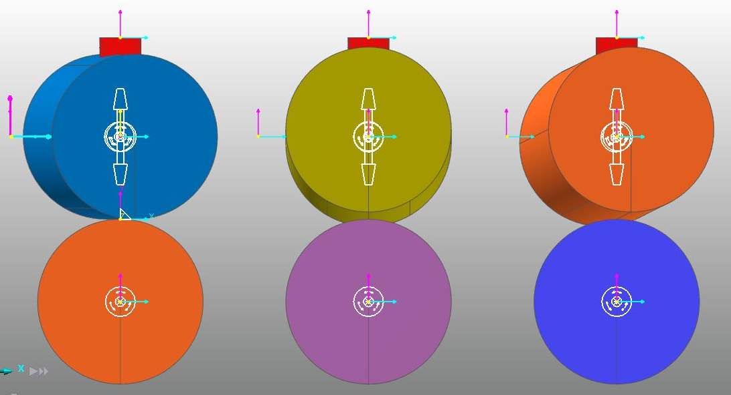

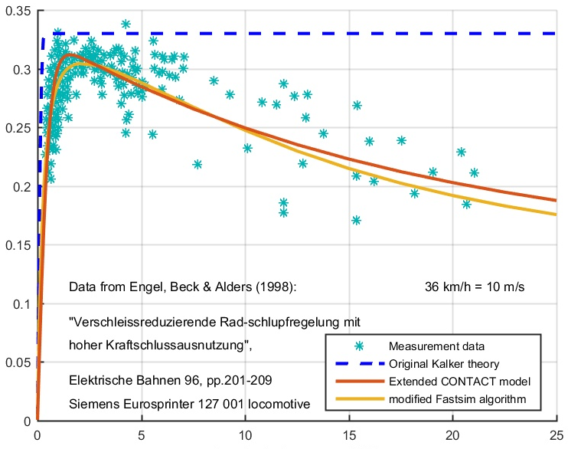
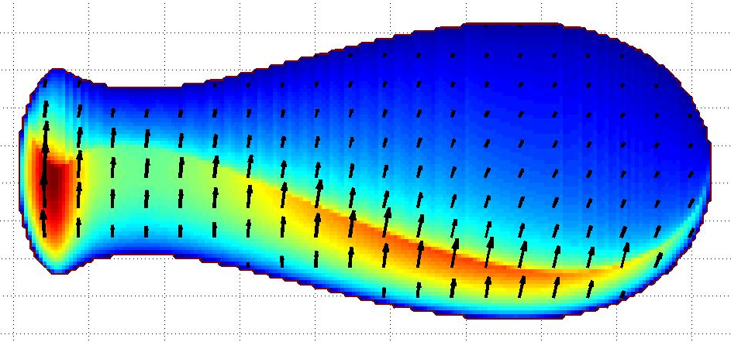
.inp .prr, …
Stand-alone CONTACT program
module 1 W/R CONTACT
module 2 roller CONTACT (n.y.a.)
module 3
basic CONTACT
CONTACT solvers
victorinox
.out .mat .subs
MATLAB program
CONTACT plotting routines

Slide 2
CONTACT library
wrapper routines for Fortran/C, Matlab or Python
module 1 W/R CONTACT
module 2 roller CONTACT (n.y.a.)
module 3
basic CONTACT
CONTACT solvers
victorinox
wrapper routines for Fortran/C, Matlab or Python

Slide 3
Module 1: m_wrprof, data, profiles, initcp, undefdist, rigslip, solvecp, in/output
CONTACT library: c_addon, caddon_data
Module 2: m_crdyn_globals, crdyn_rollers
Driver routines: contact, m_nonhz, m_scontc, m_sdis
In/output: m_input, m_soutpt, m_readline?
Physics modules: m_hertz, m_temperature, m_subsurf, m_visc
Hierarchical data-structure: m_hierarch_data
Generic grids: m_markers, m_grids, m_gridfunc, m_interp, m_profile?
Solvers: m_snorm, m_solvpn, m_stang, m_solvpt, m_leadedge
General facilities: m_print_output, m_timers, m_licensing, m_blas, makefiles
Influence coeff.: m_inflcf, m_aijpj, FFTs
Friction object: m_friclaw

Slide 4
contact, m_nonhz
Contact_addon, m_caddon_data
contact, m_wrprof
Input: m_wr_input, m_wr_output
Solvers: m_brentmeth, m_wr_solvecp
Physics: m_wr_locatecp, m_wr_undefdist, m_wr_rigslip
m_wrprof_data
Input: m_sinput, m_soutpt
Drivers: m_scontc, m_sdis
Solvers: m_snorm, m_stang, m_solvpn, m_solvpt
Physics: m_hertz m_temperature, m_visc, m_subsurf
m_hierarch_data
m_friclaw
m_inflcf
m_aijpj
m_profile
m_markers
m_grids
m_gridfunc
m_interp, m_smooth
m_timers, m_timings
m_readline
m_licensing
m_blas
m_print_output
makefiles
SoftwareKey: PLUS5 SDK
Intel MKL: FFTs, LAPACK

